Slide 1

Project Title - Seasonal Agriculture Performance Analysis
Student Name – Harshit Suryawanshi
College Name – Yeshwantrao Chavan College Of Engineering
AICTE STU ID : STU69e24463826811776436323

Slide 2

PROBLEM STATEMENT
Agricultural activities are influenced by seasonal variations in environmental conditions, farming practices, resource availability and market conditions. As a result, agricultural performance may differ from one season to another. However, raw agricultural data does not clearly explain how agricultural performance changes across seasons or what patterns can be observed in different seasonal conditions. The problem is to analyze the given agricultural dataset and investigate seasonal differences in agricultural performance by identifying meaningful patterns, trends, relationships and variations within the available data.

Slide 3
Project Description -:
This project provides a data-driven investigation into seasonal variations in agricultural performance using advanced data analytics techniques. Agricultural outcomes are heavily influenced by environmental conditions, resource inputs, and farming practices, leading to distinct performance fluctuations across seasons like Kharif, Rabi, and Zaid. The raw dataset was processed cleaned, and analyzed to evaluate key metrics including yield, revenue, net profit, water efficiency, and pest/disease risk. Through exploratory data analysis and statistical visualization, the project highlights critical seasonal trends, identifies loss-making patterns during dry months, and delivers actionable, evidence-based recommendations for crop planning and resource management

Slide 4

WHO ARE THE END USERS?
Agricultural Planners & Policy Makers: Use seasonal trends and efficiency data to allocate resources, manage subsidies, and design regional farming policies.
Farmers & Agricultural Advisors: Rely on yield predictions, disease risk alerts, and irrigation efficiency metrics to optimize crop selection and timing.
Agri-Business & Supply Chain Managers: Leverage seasonal production patterns to forecast market supply, optimize pricing, and streamline distribution logistics.
Data Scientists & Researchers: Utilize the foundational dataset, cleaning pipelines, and exploratory findings for further modeling and climate impact research.

Slide 5

Technology Used
Programming Language: Python (3.x)
Data Manipulation & Processing: Pandas, NumPy
Data Visualization: Seaborn, Matplotlib
Execution Environment: Google Colab / Jupyter Notebook

Slide 6
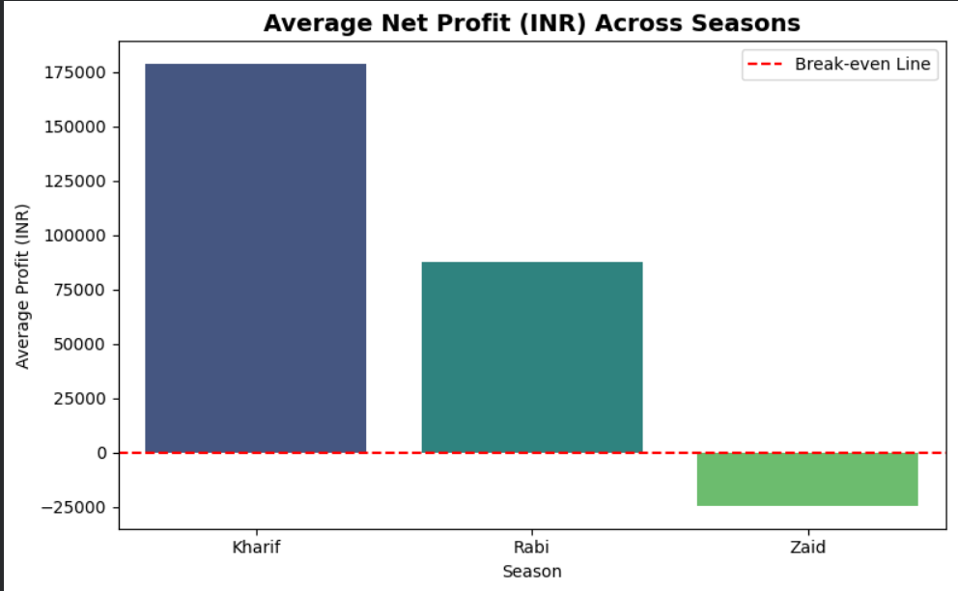
RESULTS
This Compares net financial returns across seasons, revealing strong profits in Kharif and Rabi alongside distinct losses during Zaid.

Slide 7
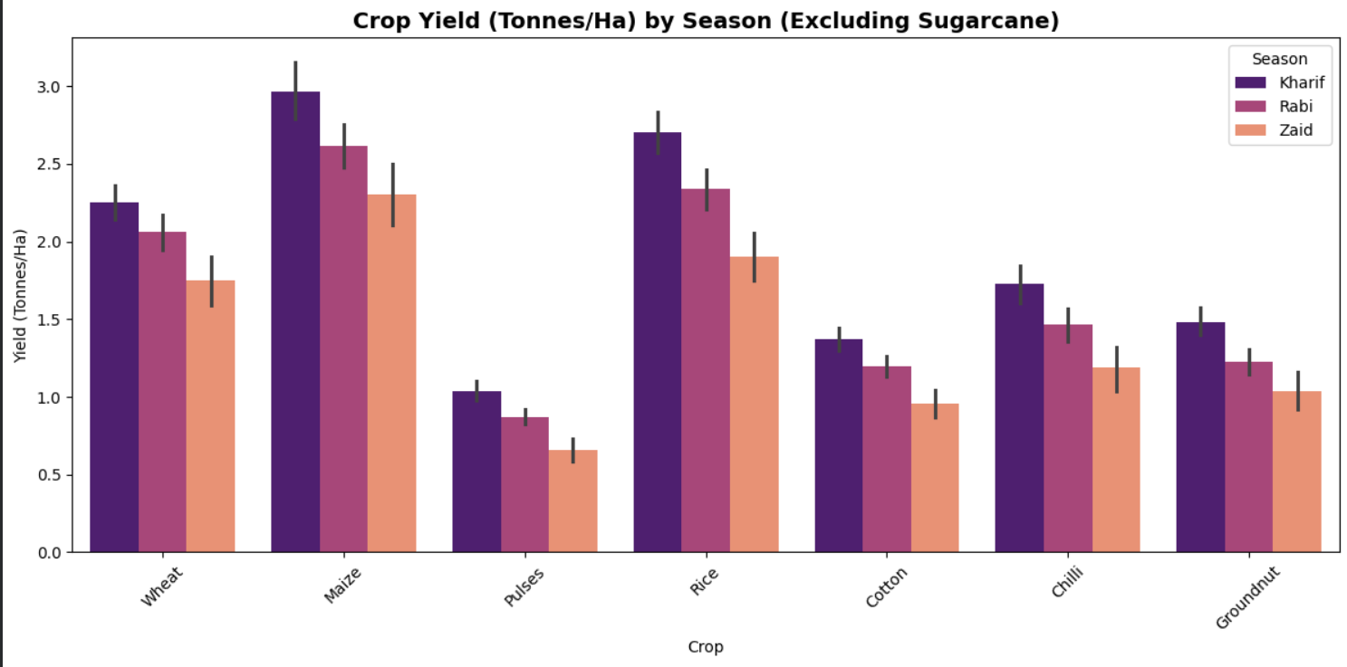
RESULTS
This screenshot Evaluates individual crop productivity across seasons, showing how Kharif weather conditions consistently maximize crop yields

Slide 8
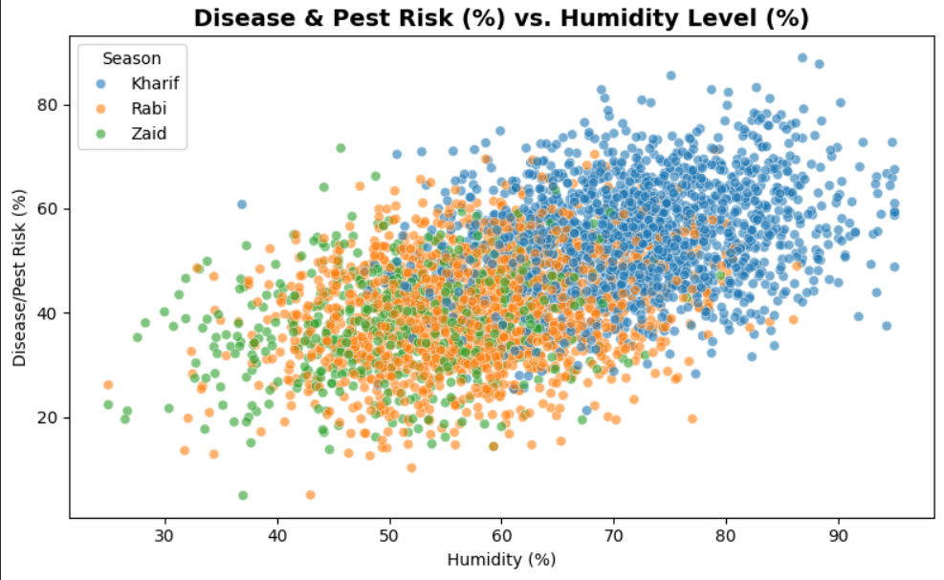
RESULTS
Below screenshot Demonstrates the direct positive link between rising atmospheric humidity and increased crop vulnerability to pests and diseases

Slide 9
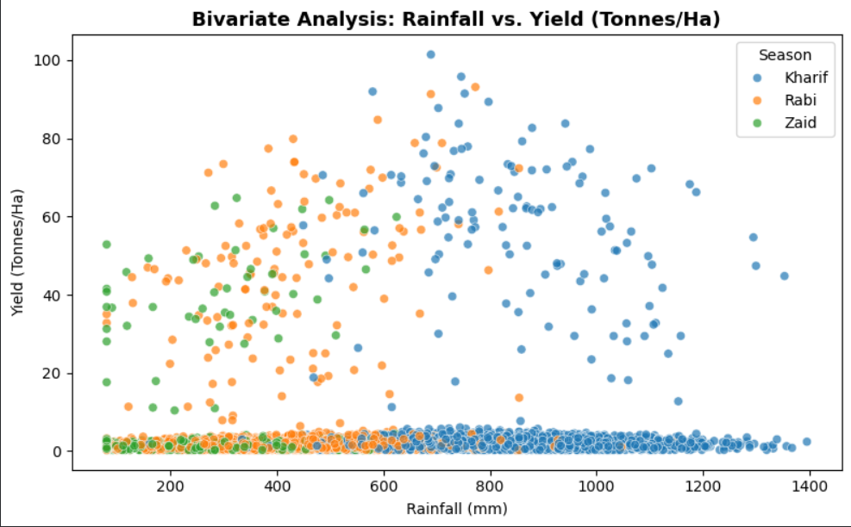
RESULTS
This Demonstrates how higher rainfall directly boosts crop yield up to an optimal threshold across different seasons

Slide 10
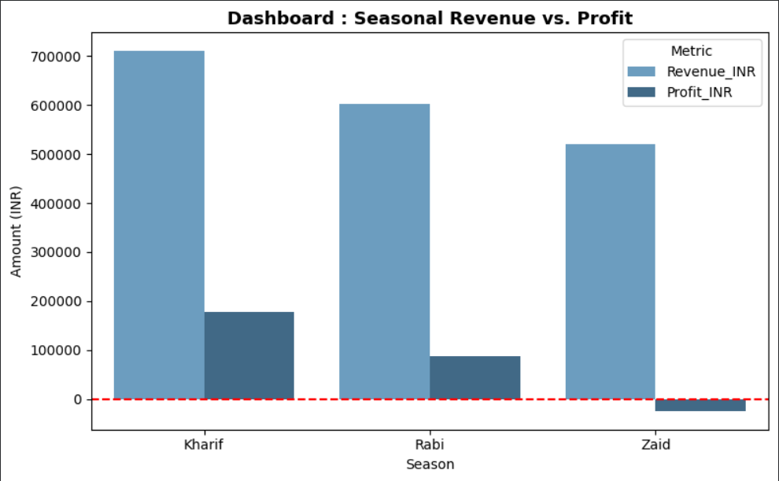
RESULTS
Illustrates total financial returns per season, revealing severe margin drops during the dry Zaid period.

Slide 11
Future scope
Predictive Modeling: Implement machine learning algorithms (e.g., Random Forest, XGBoost) to predict crop yields and financial returns based on real-time weather inputs.
Interactive Dashboard: Build an interactive web application using Streamlit or Dash to allow non-technical stakeholders to dynamically filter and visualize seasonal trends.
Geographic & Soil Mapping: Incorporate geospatial analytics (GIS) to map soil quality and regional yield variances across states and districts.

Slide 12
GitHub Link
https://github.com/Harshit07-ux-dev/-Seasonal-Agriculture-Performance-Analysis

Slide 13
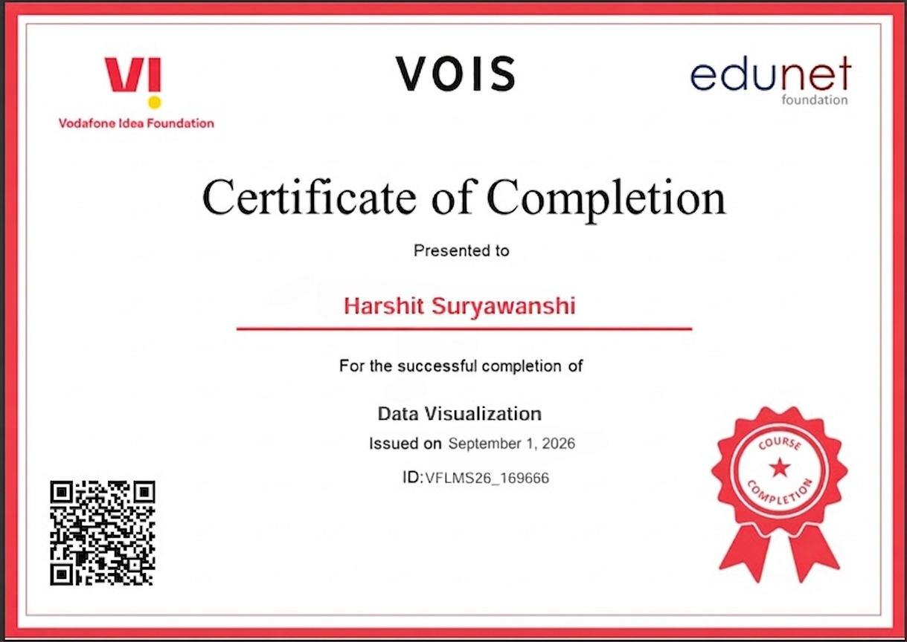
VOIS Course completion certificate -
Course name- Data Visualization

Slide 14
Thank you
.
.

