Slide 1
MTP Phase I Presentation
Data-Driven Control of Intelligent Hand Exoskeleton
By
Harshit Paramhans
234103420
Under the guidance of
Dr. Shyamanta M. Hazarika
Leveraging EMG Signals and Machine Learning for
Hand Gesture Classification
Department of Mechanical Engineering
Indian Institute of Technology Guwahati
Guwahati, Assam-India
November 2024

Slide 2
Outline
Introduction
Literature Review
Research Gap
Objectives
Methodology
Results
Observations
Conclusion
Future work
References

Slide 3
Introduction

Slide 4
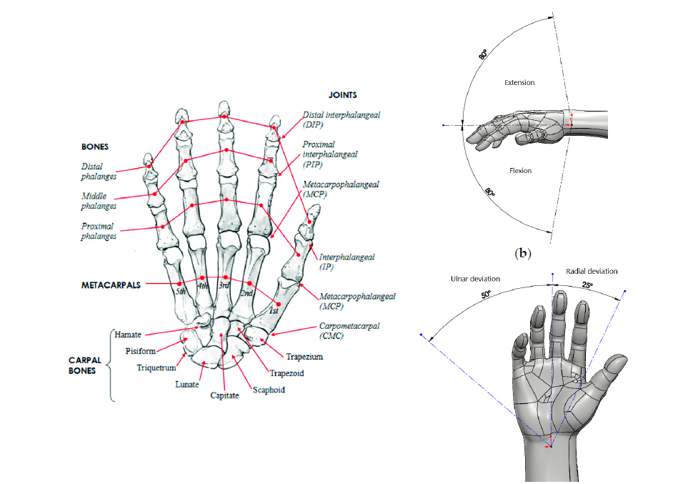
Motivation
Hand impairments due to injuries, neurological disorders, or aging significantly affect daily life.
Hand exoskeletons offer a promising solution by aiding in rehabilitation and restoring motor functions.
A key challenge: creating intuitive and responsive control mechanisms for hand exoskeletons.
Electromyography (EMG) signals provide a direct interface for controlling these devices by capturing muscle activity.
Fig 1: The internal bone structure of the hand as well as the wrist movements.[3]

Slide 5
Background
Complexity of Hand Movements:
The human hand performs intricate movements driven by neuromuscular signals.
Understanding these signals is vital for replicating natural hand motions.
Role of EMG Signals:
EMG captures electrical activity during muscle contractions, enabling gesture classification.
Offers potential for intuitive, user-driven control in assistive devices.
Importance of Machine Learning:
Machine learning facilitates classification of EMG signals into distinct gestures.

Slide 6
Literature Review

Slide 7
Rehabilitation and Hand Exoskeletons
Authors | Title | Results/Conclusions/Remarks
Du Plessis et al. | A Review of Active Hand Exoskeletons for Rehabilitation and Assistance. | Conducted a comprehensive review of advancements in active hand exoskeleton technologies over the past decade, categorizing their applications into rehabilitation, assistance, augmentation, and haptics The emphasis on rehabilitation and assistive technologies further aligns with the focus on developing data-driven control for an intelligent hand exoskeleton.
Noronha et al. | Exoskeletal Devices for Hand Assistance and Rehabilitation: A Comprehensive Analysis of State-of-the-Art Technologies. | Analyzed 97 active hand exoskeletons, and revealed a preference for underactuated devices due to their simplicity and robustness, alongside a growing adoption of soft robotics technologies for improved flexibility. The paper highlights the importance of lightweight and portable designs, which is relevant when considering the integration of EMG-based control for efficient and comfortable gesture detection.

Slide 8
EMG-Driven Control Systems for Hand Exoskeletons
Authors | Title | Results/Conclusions/Remarks
Leonardis et al. | An EMG-controlled robotic hand exoskeleton for bilateral rehabilitation. | Introduced a bilateral EMG-driven hand exoskeleton for stroke rehabilitation, emphasizing its free-palm and free-fingertip design, which preserved residual sensory perception. The need to develop accurate control systems (such as EMG-based detection) that ensure precise task performance and sensory feedback in exoskeleton-assisted gestures is emphasized.
Reaz et al. | Techniques of EMG signal analysis: detection, processing, classification and applications. | Reviewed various EMG signal analysis techniques, including decomposition, classification, and feature extraction, focusing on their applications in prosthetic control and human-computer interaction.
Phinyomark et al. | Feature reduction and selection for EMG signal classification. | Evaluated 37 time-domain and frequency-domain features, identifying the most effective ones for classification tasks. This paper’s identification of the most effective time-domain and frequency-domain features (MAV, WL, etc.) for EMG signal classification is directly relevant to the project work, where similar features are used.

Slide 9
ML Approaches for EMG Signal Classification
Authors | Title | Results/Conclusions/Remarks
Seyidbayli et al. | Comparison of machine learning algorithms for EMG signal classification. | Demonstrated the effectiveness of ensemble models, particularly Bagged Trees, in classifying hand gestures and achieved an impressive accuracy of 98.55%, highlighting the potential of ensemble methods to handle the variability and non-linearity of EMG signals. Random Forest (RF) algorithms have also gained prominence in EMG signal analysis.
Jaiswal et al. | Application of random forest algorithm on feature subset selection and classification and regression. | Showcased the utility of RF in feature selection, classification, and regression, particularly for datasets with numerous variables.
Chaudhary et al. | An improved random forest classifier for multi-class classification. | Developed an improved RF classifier that incorporated attribute evaluation and instance filtering, achieving superior performance in multi-class classification tasks.
Khushaba et al. | Electromyogram (EMG) feature reduction using mutual components analysis for multifunction prosthetic fingers control. | The paper proposes the Mutual Components Analysis (MCA) algorithm, which combines feature selection and projection, achieving over 95% classification accuracy for 15 finger movement classes using only four EMG channels.

Slide 10
Research Gap
EMG-driven systems face challenges like signal variability, noise, and electrode placement sensitivity. Despite advancements in machine learning and signal processing, there is a need for adaptive algorithms that can address these limitations in real-time, ensuring robust and user-friendly control mechanisms for dynamic environments.

Slide 11
Objectives
To design and validate a feature-based machine learning approach for accurately classifying hand gestures from EMG signals.
To explore future directions that enhance the practical utility of the framework, such as dimensionality reduction and real-time adaptability using reinforcement learning, thereby contributing to the development of intelligent, user-centric hand exoskeletons

Slide 12
Methodology

Slide 13
Flowchart
Acquiring and Organizing Data
Extracting Features from EMG Signals
Creating Feature Matrix
Classification of Hand Gestures

Slide 14
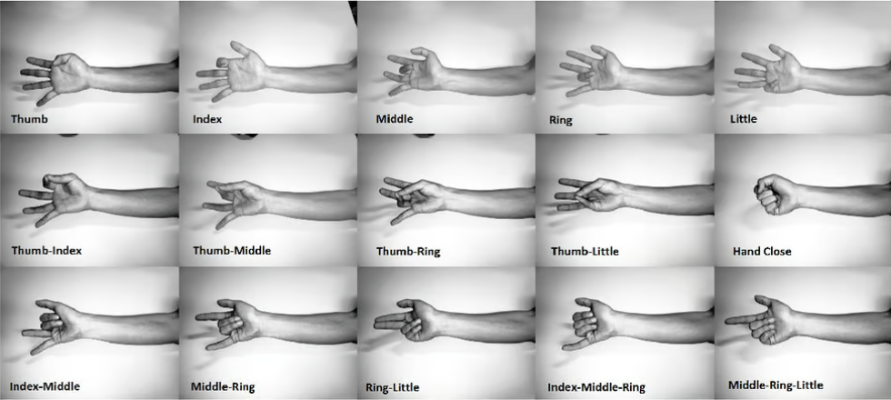
Acquiring and Organizing Data
Dataset Description: EMG data was sourced from the online repository by Dr. Rami N. Khushaba. It includes data from 8 participants performing 15 hand gestures across 3 trials. Eight EMG channels recorded signals at 4000 Hz, bandpass filtered between 20-450 Hz, with a notch filter to remove 50 Hz line interference.
Data Preparation: Only the first 10 seconds of each 20-second trial were used, yielding 360 trials in total.
Fig 1: Different classes of individual and combined fingers movement [20]

Slide 15
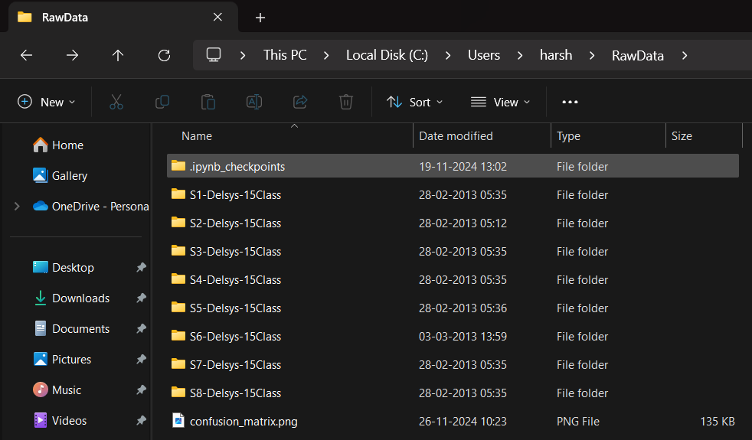

Raw EMG Signal Data

Slide 16
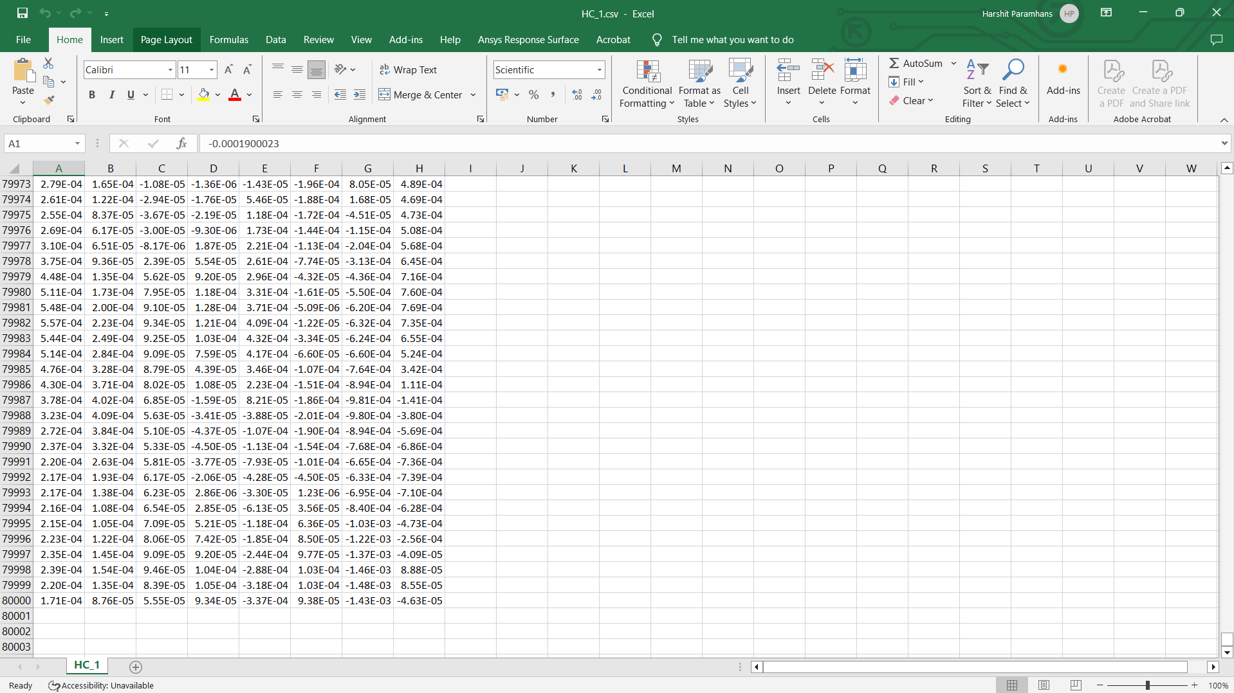

Slide 17
Extracting Features from EMG Signals
Time-Domain Features: RMS, MAV, WL were calculated to capture amplitude and variability.
Frequency-Domain Features: PSD, MNF, and MDF were derived to provide insights into energy and fatigue.
Statistical Features: Skewness and Kurtosis quantified distributional properties and peak sharpness.
Implementation Tools: Python libraries (NumPy, pandas, SciPy) were used for extracting these features from raw EMG signals.

Slide 18
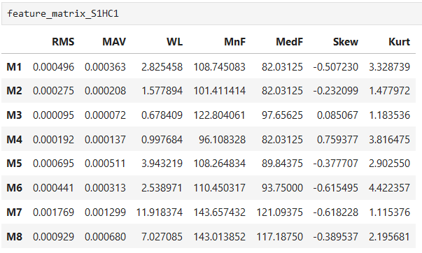
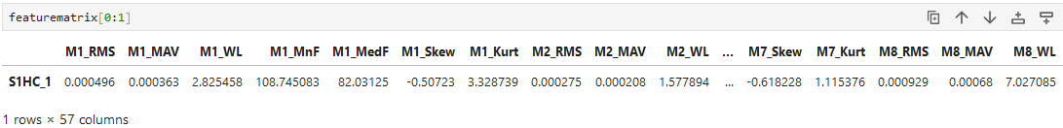
Creating Feature Matrix
Feature Matrix Construction: Seven features (RMS, MAV, WL, MNF, MDF, Skewness, Kurtosis) for 8 muscles created an 8×7 matrix per gesture.
Vectorization: The 8×7 matrix was flattened into a 56-dimensional vector for machine learning compatibility.
Final Dataset: Labels were added for each gesture, creating a feature matrix of 360 rows and 56 feature columns for classification. The 57th column represents the labels for each gesture.
Fig 2: Features of subject 1 for hand closed gesture (1st Trial)
Fig 3: Flattened features of subject 1 for hand closed gesture (1st Trial)

Slide 19
Classification of Hand Gestures
Classifier Used: Random Forest with 100 decision trees, implemented using Scikit-learn.
Data Preprocessing: Stratified train-test split (70% training, 30% testing) and feature standardization with StandardScaler.
Model Performance: The classifier achieved 81.48% accuracy on the test set, with results validated using a confusion matrix and classification report.

Slide 20
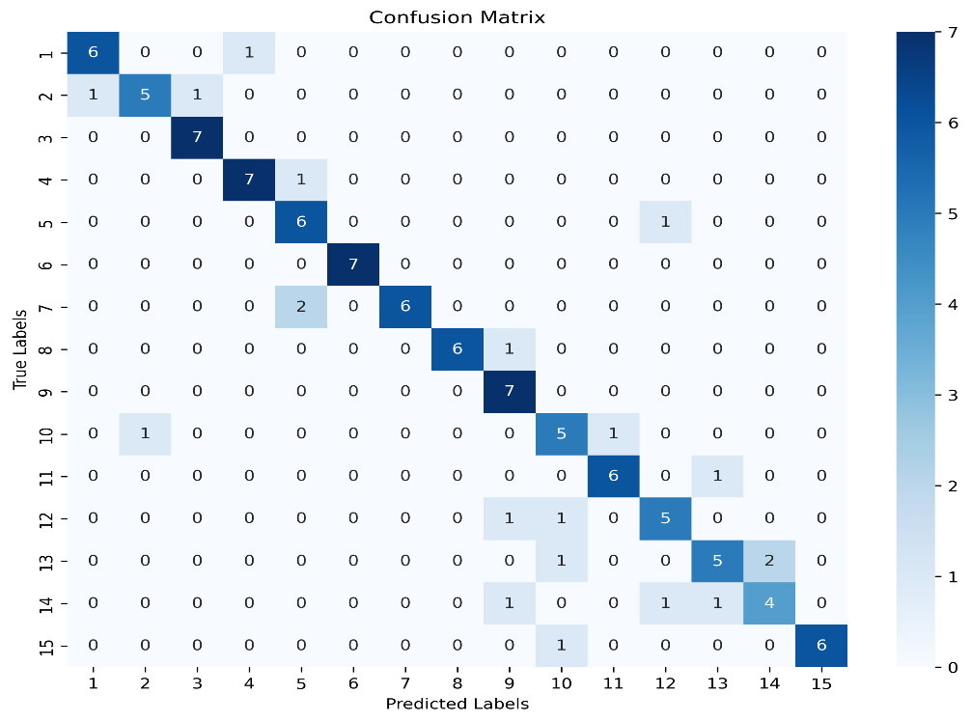
Results
Classification Report
Confusion Matrix
Label | Precision | Recall | f1-score | support
1 | 0.85714 | 0.85714 | 0.85714 | 7
2 | 0.83333 | 0.71429 | 0.76923 | 7
3 | 0.87500 | 1.00000 | 0.93333 | 7
4 | 0.87500 | 0.87500 | 0.87500 | 8
5 | 0.66667 | 0.85714 | 0.75000 | 7
6 | 1.00000 | 1.00000 | 1.00000 | 7
7 | 1.00000 | 0.75000 | 0.85714 | 8
8 | 1.00000 | 0.85714 | 0.92308 | 7
9 | 0.70000 | 1.00000 | 0.82353 | 7
10 | 0.62500 | 0.71429 | 0.66667 | 7
11 | 0.85714 | 0.85714 | 0.85714 | 7
12 | 0.71429 | 0.71429 | 0.71429 | 7
13 | 0.71429 | 0.62500 | 0.66667 | 8
14 | 0.66667 | 0.57143 | 0.61538 | 7
15 | 1.00000 | 0.85714 | 0.92308 | 7
Accuracy | 0.81481 | 0.81481 | 0.81481 | 0.81481
macro average | 0.82563 | 0.81667 | 0.81545 | 108
weighted average | 0.82668 | 0.81481 | 0.81501 | 108

Slide 21
Observations
The macro average precision, recall, and F1-score are 0.82563, 0.81667, and 0.81545, respectively, suggesting a balanced performance across all labels
Labels 6 achieved F1-score of 1.0. Labels 3, 8 and 15 have a F1- score above 0.9 indicating the model's ability to accurately predict instances of these gestures. Labels 1, 4, 7, and 11 also performed well with F1-scores above 0.85
Labels 10, 13 and 14 showed relatively low F1-scores (0.66667, 0.66667 and 0.61538) due to reduced recall values (0.62500 and 0.57143, respectively), suggesting the model struggles to capture all instances of these gestures.
Fig 4: F1-scores for the labels

Slide 22
Conclusions
Established a methodology for hand gesture recognition using EMG signals.
Demonstrated the Random Forest classifier's ability to achieve high classification accuracy on the extracted EMG feature set.
Validated its robustness and potential using the classification report and confusion matrix.

Slide 23
Future Work
The objectives of the future work to be done are:
Understanding and Implementing NMF:
Gain proficiency in applying NMF to Khushaba's dataset to extract meaningful muscle synergies.
Interpret the synergies to assess their utility for controlling a hand exoskeleton.
Controller Design Using Synergies:
Develop a control strategy driven by the identified muscle synergies.
Incorporating Reinforcement Learning:
Apply RL algorithms to optimize the control strategy, ensuring adaptive and efficient performance in real-time applications
Task\Month | Dec 2024 | Jan 2025 | Feb 2025 | March 2025 | April 2025
Learning NMF
Implementing Synergies
Learning RL
Simulation and Testing
Finalization and Documentation
Fig 5: Proposed timeline for future work

Slide 24
References
[1] Mitchell, T. M., & Mitchell, T. M. (1997). Machine learning (Vol. 1, No. 9). New York: McGraw-hill.
[2] Sen, P. C., Hajra, M., & Ghosh, M. (2020). Supervised classification algorithms in machine learning: A survey and review. In Emerging Technology in Modelling and Graphics: Proceedings of IEM Graph 2018 (pp. 99-111). Springer Singapore.
[3] Du Plessis, T., Djouani, K., & Oosthuizen, C. (2021). A review of active hand exoskeletons for rehabilitation and assistance. Robotics, 10(1), 40.
[4] Noronha, B., & Accoto, D. (2021). Exoskeletal devices for hand assistance and rehabilitation: A comprehensive analysis of state-of-the-art technologies. IEEE Transactions on Medical Robotics and Bionics, 3(2), 525-538.
[5] Leonardis, D., Barsotti, M., Loconsole, C., Solazzi, M., Troncossi, M., Mazzotti, C., ... & Frisoli, A. (2015). An EMG-controlled robotic hand exoskeleton for bilateral rehabilitation. IEEE transactions on haptics, 8(2), 140-151.d
[6] Wege, A., & Zimmermann, A. (2007, December). Electromyography sensor based control for a hand exoskeleton. In 2007 IEEE international conference on robotics and biomimetics (ROBIO) (pp. 1470-1475). IEEE.
[7] Reaz, M. B. I., Hussain, M. S., & Mohd-Yasin, F. (2006). Techniques of EMG signal analysis: detection, processing, classification and applications. Biological procedures online, 8, 11-35.

Slide 25
References
[8] Artemiadis, P. K., & Kyriakopoulos, K. J. (2010). An EMG-based robot control scheme robust to time-varying EMG signal features. IEEE Transactions on Information Technology in Biomedicine, 14(3), 582-588.
[9] Yousefi, J., & Hamilton-Wright, A. (2014). Characterizing EMG data using machine-learning tools. Computers in biology and medicine, 51, 1-13.
[10] Phinyomark, A., Phukpattaranont, P., & Limsakul, C. (2012). Feature reduction and selection for EMG signal classification. Expert systems with applications, 39(8), 7420-7431.
[11] Sharma, S., Kumar, G., Kumar, S., & Mohapatra, D. (2012). Techniques for feature extraction from EMG signal. International Journal of Advanced Research in Computer Science and Software Engineering, 2(1).
[12] Seyidbayli, C., Salhi, F., & Akdogan, E. (2020). Comparison of machine learning algorithms for EMG signal classification. Periodicals of Engineering and Natural Sciences, 8(2), 1165-1176.
[13] Jaiswal, J. K., & Samikannu, R. (2017, February). Application of random forest algorithm on feature subset selection and classification and regression. In 2017 world congress on computing and communication technologies (WCCCT) (pp. 65-68). Ieee.
[14] Gajowniczek, K., Grzegorczyk, I., Ząbkowski, T., & Bajaj, C. (2020). Weighted random forests to improve arrhythmia classification. Electronics, 9(1), 99.

Slide 26
References
[15] Chaudhary, A., Kolhe, S., & Kamal, R. (2016). An improved random forest classifier for multi-class classification. Information Processing in Agriculture, 3(4), 215-222.
[16] Ren, Y., Zhang, L., & Suganthan, P. N. (2016). Ensemble classification and regression-recent developments, applications and future directions. IEEE Computational intelligence magazine, 11(1), 41-53.
[17] Lee, D. D., & Seung, H. S. (1999). Learning the parts of objects by non-negative matrix factorization. nature, 401(6755), 788-791.
[18] Ajiboye, A. B., & Weir, R. F. (2009). Muscle synergies as a predictive framework for the EMG patterns of new hand postures. Journal of neural engineering, 6(3), 036004.
[19] Tresch, M. C., Cheung, V. C., & d'Avella, A. (2006). Matrix factorization algorithms for the identification of muscle synergies: evaluation on simulated and experimental data sets. Journal of neurophysiology, 95(4), 2199-2212.
[20] Khushaba, R. N., & Kodagoda, S. (2012, December). Electromyogram (EMG) feature reduction using mutual components analysis for multifunction prosthetic fingers control. In 2012 12th International Conference on Control Automation Robotics & Vision (ICARCV) (pp. 1534-1539). IEEE.

Slide 27
Thank You!

