Slide 1

Engineering a Smoother Ride:
Vibration Reduction in Driver Seat
Pavan Prudhvi - 234103427
Harshith - 234103420
Anjeet - 234103407

Slide 2
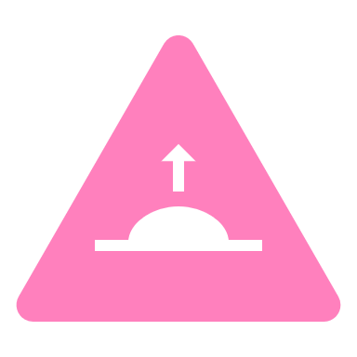
Problem Statement:
Excessive vibration of a driver's seat in a vehicle can have several effects on the driver, potentially leading to discomfort, fatigue, and even health issues over time.
To improve the driver’s ride quality, the suspension systems of the vehicle were optimized and controlled. However, the structure of the semi-active or active suspension systems was very complicated and expensive. Thus, it was limited in application on all vehicles and the driver's ride quality was also limited.

Slide 3
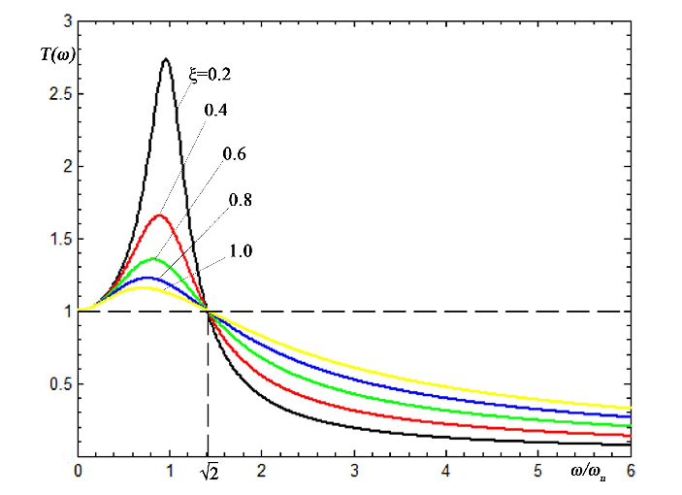


Problem :
$$\frac{ω}{ω_{n}}>√2$$
$$ω_{n}=√(\frac{k}{m})$$
We can reduce natural frequency by reducing the stiffness.
Reducing stiffness will leads to reduction in load bearing capacity of the system.

Slide 4
Moving Towards the Solution:
To enhance the driver's ride quality .
The seat suspension with negative stiffness structure was added to reduce the vibrations of the driver’s seat.

Slide 5
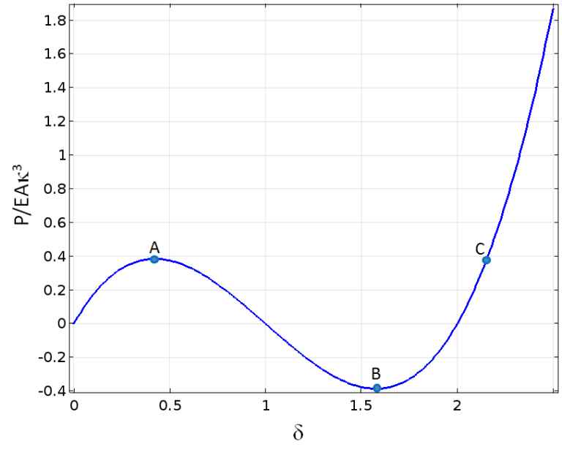
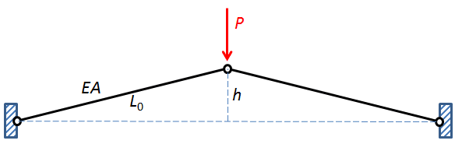
Negative Stiffness Mechanism
In a typical structure, an increase in force causes an increase in displacement.
Negative-stiffness mechanisms are those that can, exhibit increasing displacement with decreasing force during some region of their force-displacement relationship.
It is a passive approach for achieving low vibration environments and isolation against low frequency vibrations
Negative Stiffness Mechanism(NSM) reduces effective stiffness of the system without reducing the weight bearing capacity and leads to High-Static Low-Dynamic stiffness
Two-bar structure under compression
Between points A and B, displacement is increasing while force is decreasing. Thus, the structure’s stiffness is negative in that region.
Force (P/EAκ3) vs Displacement (δ) of a two-bar structure under compression.

Slide 6
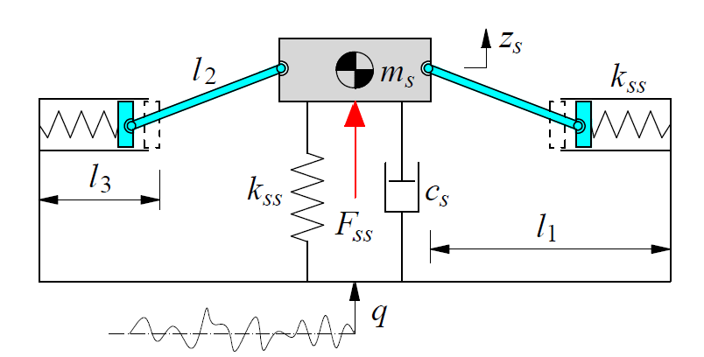


Negative Stiffness Structure(NSS) system:
Z = $z_{s}$- q
$$m_{s}\ddot{z}+c_{s}\dot{z}+ k_{s}z+2k_{ss}pz=m_{s}(ω^{2}Ysin\left(ωt\right))$$
$$Where, p=\frac{l_{3}−l_{1}}{\sqrt{\left(l_{2}−z^{2}\right)}}+1$$

Slide 7

Calculation
The isolation efficiency of the suspension system was evaluated via its root mean square displacement ($z_{ws}$).
${z_{ws}}^{2}$ = $T^{−1 }∗\int_{0}^{T}{z^{2}}$ dt
In order to evaluate the isolation efficiency of the seat’s NSS and SS system, the smaller values of the $z_{ws}$ are chosen as the objective functions.
Root Mean Square Displacement (RMSD)-SS: 0.024531
Root Mean Square Displacement (RMSD)-SS: 0.024531

Slide 8
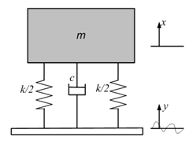
SS system
We can first assume the seat and suspension to consist of a simple mass, spring and damper system.
Equation of motion:
$$m\ddot{z}+c\dot{z}+kz=m (ω^{2}Ysin\left(ωt\right)) |$$
Z = x - y

Slide 9
MATLAB code – ode45
% Solve the first differential equation: mz'' + cz' + k1z + 2k2pz = m(ω^2)Ysin(ωt)
function dzdt1 = myODE3(t, z)
% Define the parameters for the first equation
m1 = 85; % Mass
c1 = 250; % Damping coefficient
k1 = 25000; % Spring constant
k2 = 13600; % Another spring constant
omega1 = 3.14; % Frequency
Y1 = 1; % Amplitude
l1 = 0.23; % Constant
l2 = 0.17; % Constant
l3 = 0.14; % Constant
% Calculate p
p = (l3- l1) / sqrt(l2^2 - z(1)^2) + 1;
% Define the first differential equation
dzdt1 = [z(2); (m1 * (omega1^2) * Y1 * sin(omega1 * t) - c1 * z(2) - k1 * z(1) - 2 * k2 * p * z(1)) / m1];
end
% Solve the second differential equation: mz'' + cz' + k1z = m(ω^2)Ysin(ωt)
function dzdt2 = myODE4(t, z)
% Define the parameters for the second equation
m2 = 85; % Mass
c2 = 250; % Damping coefficient
k2 = 25000; % Spring constant
omega2 = 3.14; % Frequency
Y2 = 1; % Amplitude
% Define the second differential equation
dzdt2 = [z(2); (m2 * (omega2^2) * Y2 * sin(omega2 * t) - c2 * z(2) - k2 * z(1)) / m2];
end
% Define the parameters for the first equation
m1 = 85; % Mass
c1 = 250; % Damping coefficient
k1 = 25000; % Spring constant
k2 = 13600; % Another spring constant
omega1 = 3.14; % Frequency
Y1 = 1; % Amplitude
l1 = 0.23; % Constant
l2 = 0.17; % Constant
l3 = 0.14; % Constant

Slide 10
MATLAB code – ode45
% Solve the first ODE using ode45
[t1, Z1] = ode45(@myODE3, tspan, z0);
% Solve the second ODE using ode45
[t2, Z2] = ode45(@myODE4, tspan, z0);
% Extract z values for both equations
z_values1 = Z1(:, 1);
z_values2 = Z2(:, 1);
% Create a single graph to compare the results of both equations
figure;
plot(t1, z_values1, 'b', 'LineWidth', 2);
hold on;
plot(t2, z_values2, 'r', 'LineWidth', 2);
xlabel('Time (t)');
ylabel('z(t)');
title('Comparison of Two Differential Equations');
legend('Equation 1', 'Equation 2');

Slide 11
MATLAB code – RK4 method
function [t, z] = R2(myODE, tspan, initial_conditions, h)
t_initial = tspan(1);
t_final = tspan(2);
% Number of steps
num_steps = round((t_final - t_initial) / h);
% Initialize arrays to store results
t = zeros(num_steps, 1);
z = zeros(num_steps, length(initial_conditions));

Slide 12
t(1) = t_initial;
z(1, :) = initial_conditions;
for i = 1:num_steps
% Current time
ti = t(i);
% Current state
zi = z(i, :);
k1 = h * myODE(ti, zi)';
k2 = h * myODE(ti + h/2, zi + k1/2)';
k3 = h * myODE(ti + h/2, zi + k2/2)';
k4 = h * myODE(ti + h, zi + k3)';
% Update time and state
t(i + 1) = ti + h;
z(i + 1, :) = zi + (k1 + 2*k2 + 2*k3 + k4)/6;
end
end

Slide 13
function dzdt1 = myODE3(t, z)
m1 = 85; % Mass
c1 = 250; % Damping coefficient
k1 = 25000; % Spring constat
k2 = 13600; % Another spring constant
omega1 = 3.14; % Frequency
Y1 = 1; % Amplitude
l1 = 0.23; % Constant
l2 = 0.17; % Constant
l3 = 0.14; % Constant
p = (l3- l1) / sqrt(l2^2 - z(1)^2) + 1;
% Define the first differential equation
dzdt1 = [z(2); (m1 * (omega1^2) * Y1 * sin(omega1 * t) - c1 * z(2) - k1 * z(1) - 2 * k2 * p * z(1)) / m1];
end

Slide 14
function [t, z] = R3(myODE, tspan, initial_conditions, h)
t_initial = tspan(1);
t_final = tspan(2);
% Number of steps
num_steps = round((t_final - t_initial) / h);
% Initialize arrays to store results
t = zeros(num_steps, 1);
z = zeros(num_steps, length(initial_conditions));
% Set initial conditions
t(1) = t_initial;
z(1, :) = initial_conditions;

Slide 15
% Runge-Kutta integration
for i = 1:num_steps
% Current time
ti = t(i);
% Current state
zi = z(i, :);
% Runge-Kutta coefficients
k1 = h * myODE(ti, zi)';
k2 = h * myODE(ti + h/2, zi + k1/2)';
k3 = h * myODE(ti + h/2, zi + k2/2)';
k4 = h * myODE(ti + h, zi + k3)';
% Update time and state
t(i + 1) = ti + h;
z(i + 1, :) = zi + (k1 + 2*k2 + 2*k3 + k4)/6;
end
end

Slide 16
% Solve the second differential equation: mz'' + cz' + k1z = m(ω^2)Ysin(ωt)
function dzdt2 = myODE4(t, z)
% Define the parameters for the second equation
m2 = 85; % Mass
c2 = 250; % Damping coefficient
k2 = 25000; % Spring constant
omega2 = 3.14; % Frequency
Y2 = 1; % Amplitude
% Define the second differential equation
dzdt2 = [z(2); (m2 * (omega2^2) * Y2 * sin(omega2 * t) - c2 * z(2) - k2 * z(1)) / m2];
end

Slide 17
% Define time span and initial conditions
tspan = [0, 10];
initial_conditions = [0, 0]; % [z_initial, z'_initial]
h = 0.01; % Step size
% Call the Runge-Kutta function for the first ODE
[t1, z1] = R2(@myODE3, tspan, initial_conditions, h);
% Call the Runge-Kutta function for the second ODE
[t2, z2] = R3(@myODE4, tspan, initial_conditions, h);
% Plot the results for both ODEs in one plot
figure;
plot(t1, z1(:, 1), 'b-', 'LineWidth', 2);
hold on;
plot(t2, z2(:, 1), 'r-', 'LineWidth', 2);
hold off;
xlabel('Time');
ylabel('Displacement');
title('Comparison of Two ODEs using Runge-Kutta 4th Order Method');
legend('show');
grid on;
% Calculate root mean square displacement (RMSD)
T = t(end); % Total time span
rmsd = sqrt(trapz(t, z(:, 1).^2) / T);
% Display the calculated RMSD
disp(['Root Mean Square Displacement (RMSD): ', num2str(rmsd)]);

Slide 18
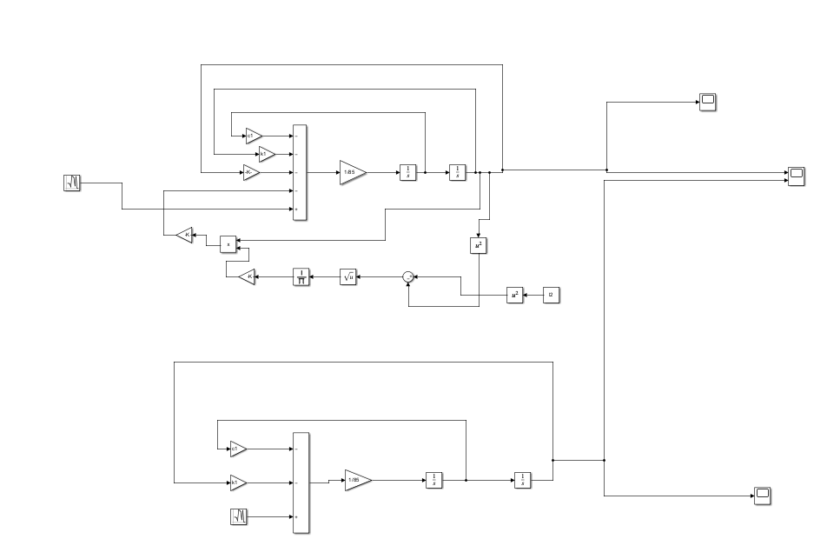
Simulink Model:

Slide 19
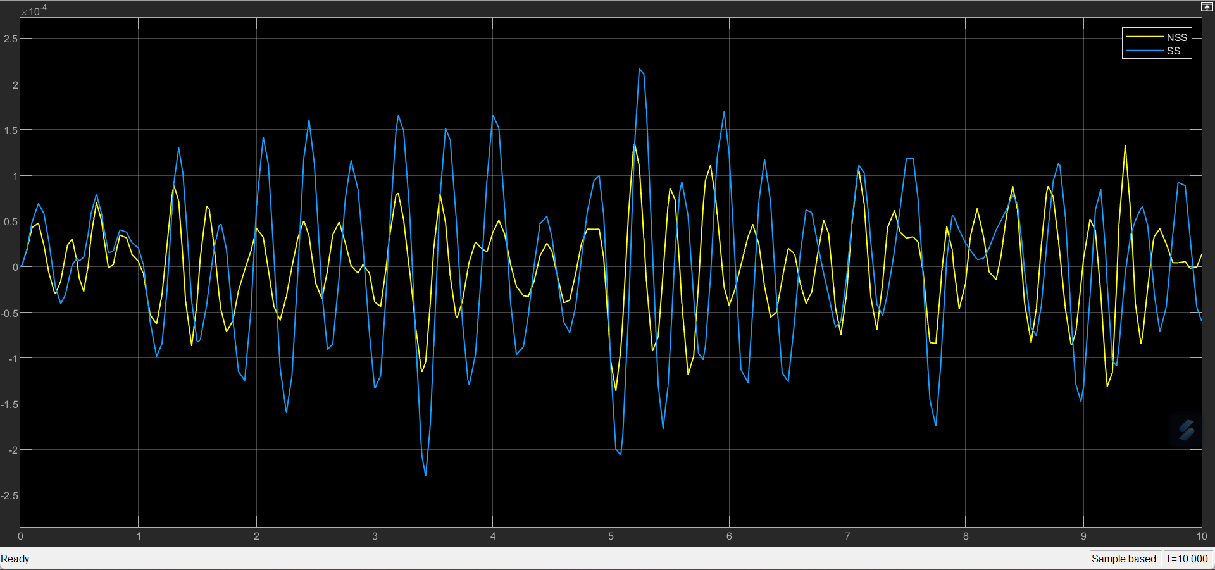
Results:
Random Excitation for both NSS an SS using Simulink

Slide 20
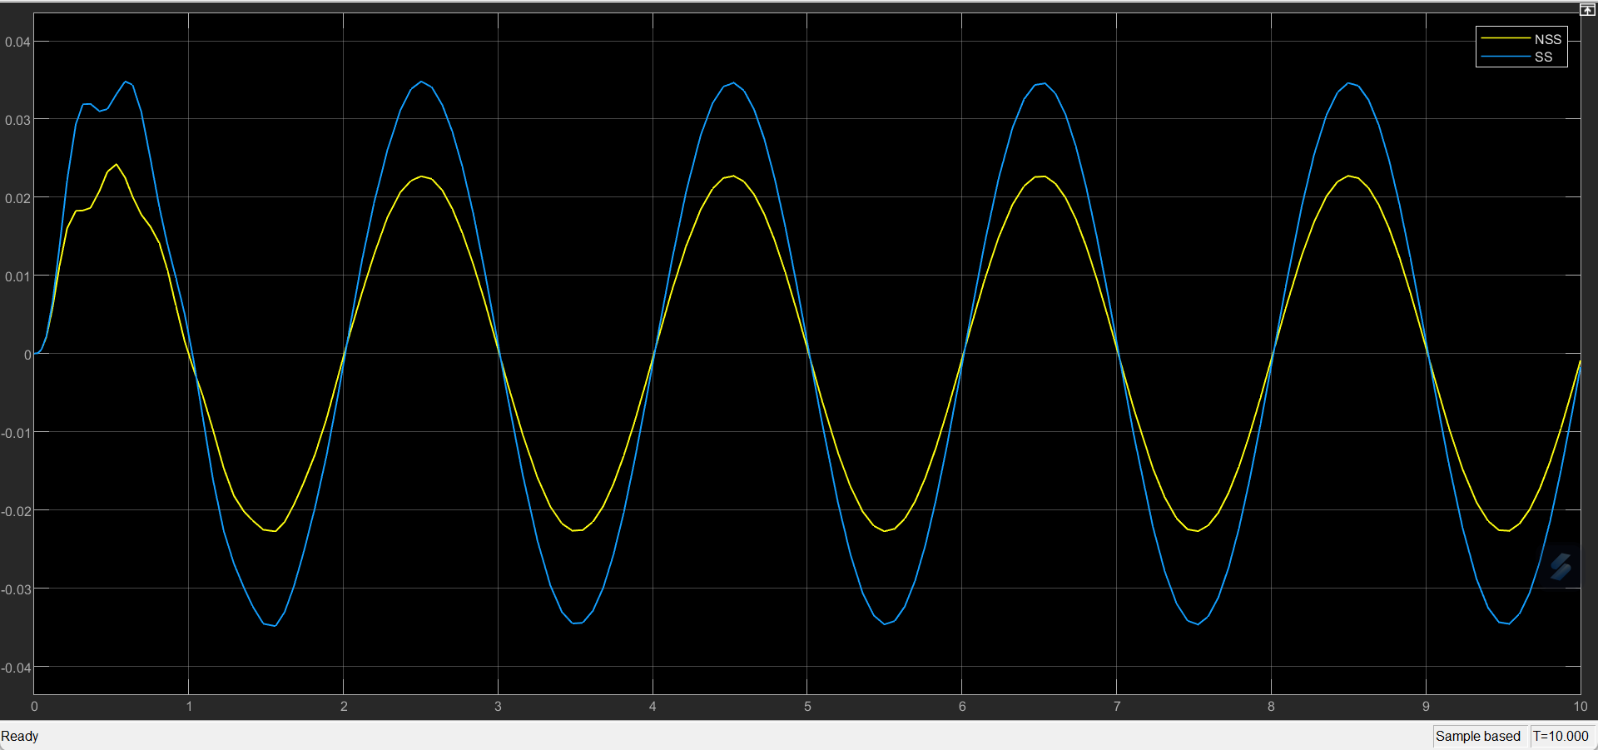
Results:
Sinusoidal input for both NSS and SS system

Slide 21
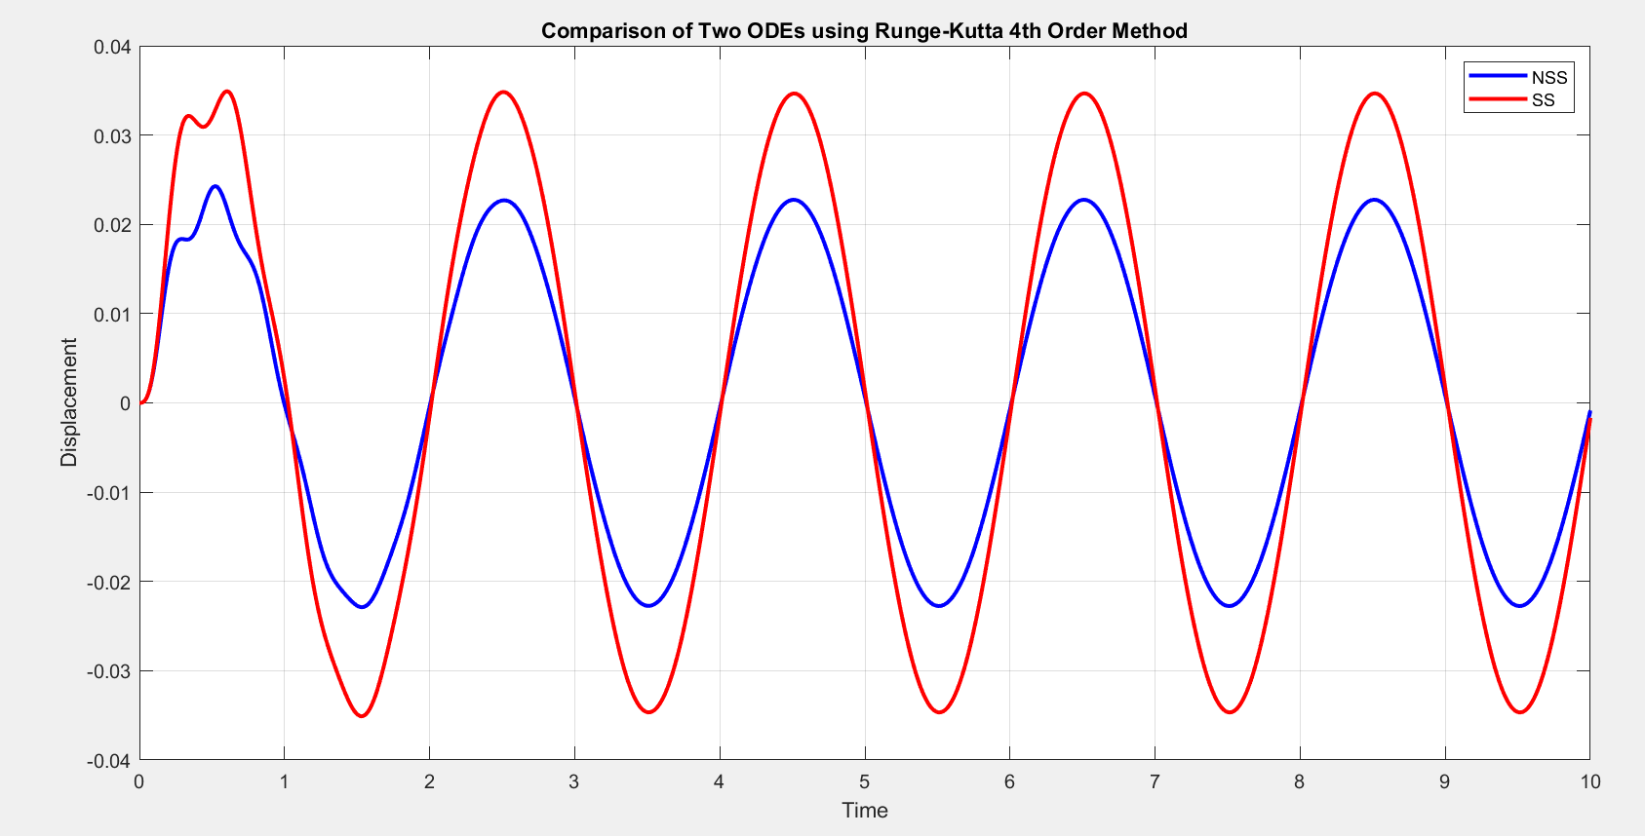
Results:
Using MATLAB code and sinusoidal excitation as input

Slide 22
Conclusion
Root Mean Square Displacement (RMSD)-NSS: 0.016081
Root Mean Square Displacement (RMSD)-SS: 0.024531
The calculation results of the (Zws) shows that by using NSS there is reduction of 52.546% comparing to the SS system.
The results show that the driver's seat ride comfort and isolation efficiency of the seat’s NSS are better than that of SS

Slide 23
References
ISO 2631-1. Mechanical vibration and shock – evaluation of human exposure to whole body vibration– Part 1: General requirements,” Geneve, Switzerland, 1997. Workers exposed to whole-body vibration (WBV) can be at increased risk for musculoskeletal disorders including low back problems, neck problems, and muscle fatigue. The ISO 2631-1 (1997) is a widely accepted standard for WBV assessment and provides guidelines on how to properly measure and interpret WBV exposure in relation to human health and comfort
A new design of seat suspension using different models of negative stiffness structure
Negative stiffness devices for vibration isolation applications: A review Huan Li, Yancheng Li, and Jianchun Li

Slide 24

Thank you!

