Slide 1



ML Meets the Web:
ML Model Deployment using FastAPI
Model
FastAPI
Client
Harshit Kumawat

Slide 2





What is Model Deployment?
Model Evaluation
Model Deployment
Model-to-production
Real-world ML integration
Easy access of model
Predict with simple input
Deployment Methods: API, cloud, docker, etc.
Data Collection
Fine Tuning
Data Preprocessing
Model Selection & Training
End User

Slide 3
What is FastAPI & Why Use It?
FastAPI is a modern, fast (high-performance), web framework for building APIs with Python based on standard Python type hints.
Key Features:
Automatic documentation
Pydantic-based data validation
Asynchronous support
Fast to code
Fewer bugs
Easy, short, robust
Drawbacks:
Async complexity
Fewer built-in tools
Smaller ecosystem
Debugging difficulty

Slide 4
Installation & Key Concepts of FastAPI
Installation: pip install fastapi, uvicorn, pydantic
Key Concepts:
API Endpoints: GET, POST, PUT, PATCH, DELETE
Response Structure: JSON responses
Request Validation: Done using Pydantic models
ASGI Server: Run using Uvicorn

Slide 5
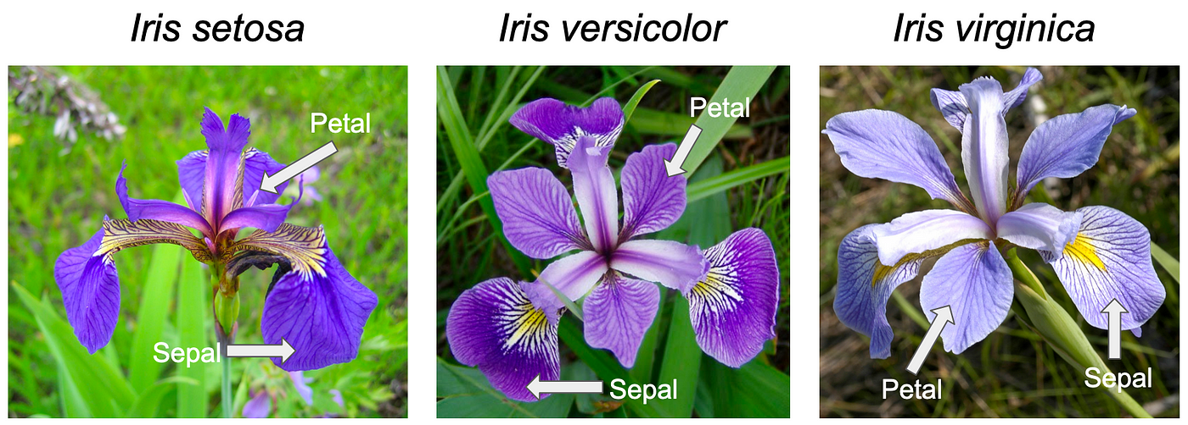

Iris Dataset
Images of 3 iris species (classes)
0: Setosa
1: Versicolor
2: Virginica
150 instances (50 per class)
4 features

Slide 6
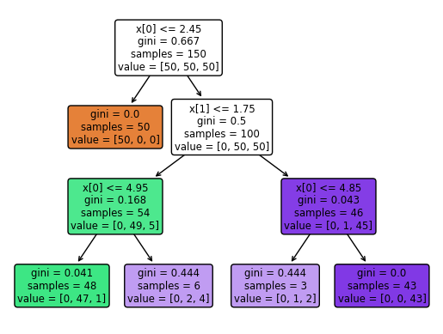
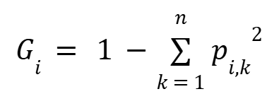
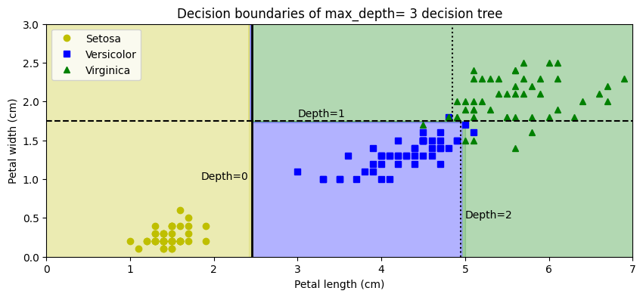
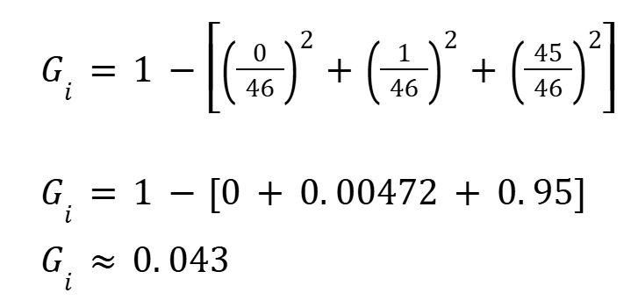
Decision Tree
Root Node
Condition on feature
Gini Impurity
No. of training instances
No. of instances in separate class
Gini Impurity (of i^{th} node):
Leaf Node
Split Node
Where, P_{i, k} is probability of k^{th} class in i^{th} node, n is no. of classes
For example,

Slide 7
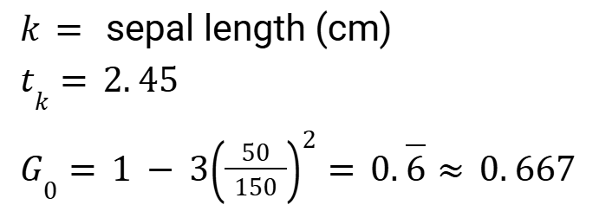

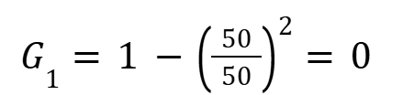
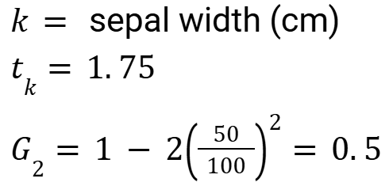

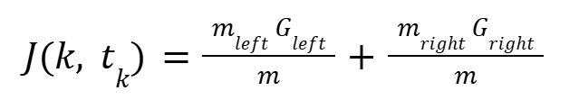

CART Algorithm
Classification And Regression Tree Algorithm
Used to train decision tree
Time Complexity:
Training:
Inference:
Cost function (for classification)

Slide 8


Pydantic Validation
POST /predict
Request Sent
Request Received
Error: 422
{
"sepal_length": 5.1,
"sepal_width": 3.9,
"petal_length": 1.2,
"petal_width": 0.2
}
Error: 400
Model Loaded?
Error: 500
JSON into 2D list
Return Prediction
Error?
Predict Class & Probabilities
Map index to class
{
“prediction”: “Setosa”,
“probas”: [1, 0, 0]
}
FastAPI-Based Model Prediction Flow

Slide 9
THANK YOU
Thank you for your time and consideration. I hope this walkthrough clearly explained the model deployment process using FastAPI.
Acknowledgements
Attributions
Contact
Internship Assignment by:
TheProductWorks.in
Learning Resources:
FastAPI Documentation
GeeksForGeeks
FastAPI Deployment Tutorials Playlist - Krish Naik
Python FastAPI Tutorial: Build a REST API in 15 Minutes - pixegami
Python, FastAPI and other icons for the diagrams are taken from Icons8.
Dataset: UCI Machine Learning Repository - Iris Dataset
Name: Harshit Kumawat
Email:harshitkumawat849@gmail.com
LinkedIn:https://www.linkedin.com/in/harshit-kumawat-8778ba259/
Project Repository

