Slide 2
Mid-Sem Presentation Title: Implementing compression algorithm and secure data transmission over UDP protocol
Team member : Harsh Narain Mathur R100218020
Harshit Chauhan R100218021
Pranay Mahajan R100218037
Mentor : Mr. Ankit Vishnoi

Slide 3
Problem Statement
This project presents a proposal to make a connection between client and server using socket programming and compress the large size text file into small size without any loss of data.

Slide 4
Methodology
The Methodology which we are using is Agile Development. This methodology provides an iterative and incremental approach to complete the project in which the various functions are treated as a sub tasks and each task is considered as a small project to fulfill every objective of the project

Slide 5

Client Server Architecture(CSA)
Client/server architecture is a computing model in which multiple components work in strictly defined roles to communicate. The server hosts, delivers and manages most of the resources and services to be consumed by the client
Client/server architecture works when the client computer sends
a resource or process request to the server over the network
connection, which is then processed and delivered to the client.

Slide 6
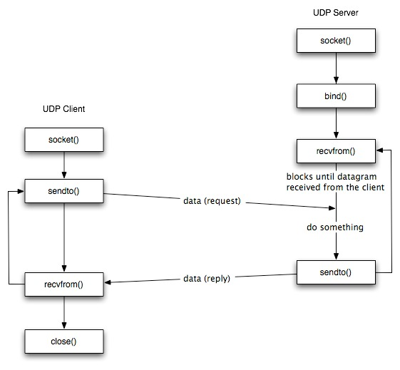
Socket Programming
A socket programming is a way to establish a connection between a client and a server.
It is a way of connecting two nodes on a network to communicate
with each other.
One socket (node) listens on a particular port at an IP,
while other socket reaches out to the other in order to form a
connection.

Slide 7
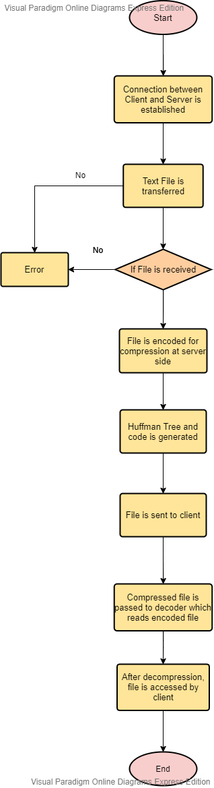
FLOWCHART:

Slide 8
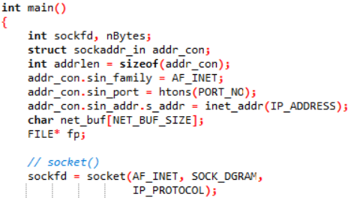
Implemented Code
1. #include<arpa/inet.h> = definitions for internet operations.
The <arpa/inet.h> header makes available the type in_port_t and the type in_addr_t.
The <arpa/inet.h> header makes available the in_addr structure
2. #include<netinet/in.h> = Internet address family.
The <netinet/in.h> header shall define the sockaddr_in structure that includes at least the following members:
sa_family_t sin_family AF_INET.
in_port_t sin_port Port number.
struct in_addr sin_addr IP address.

Slide 9
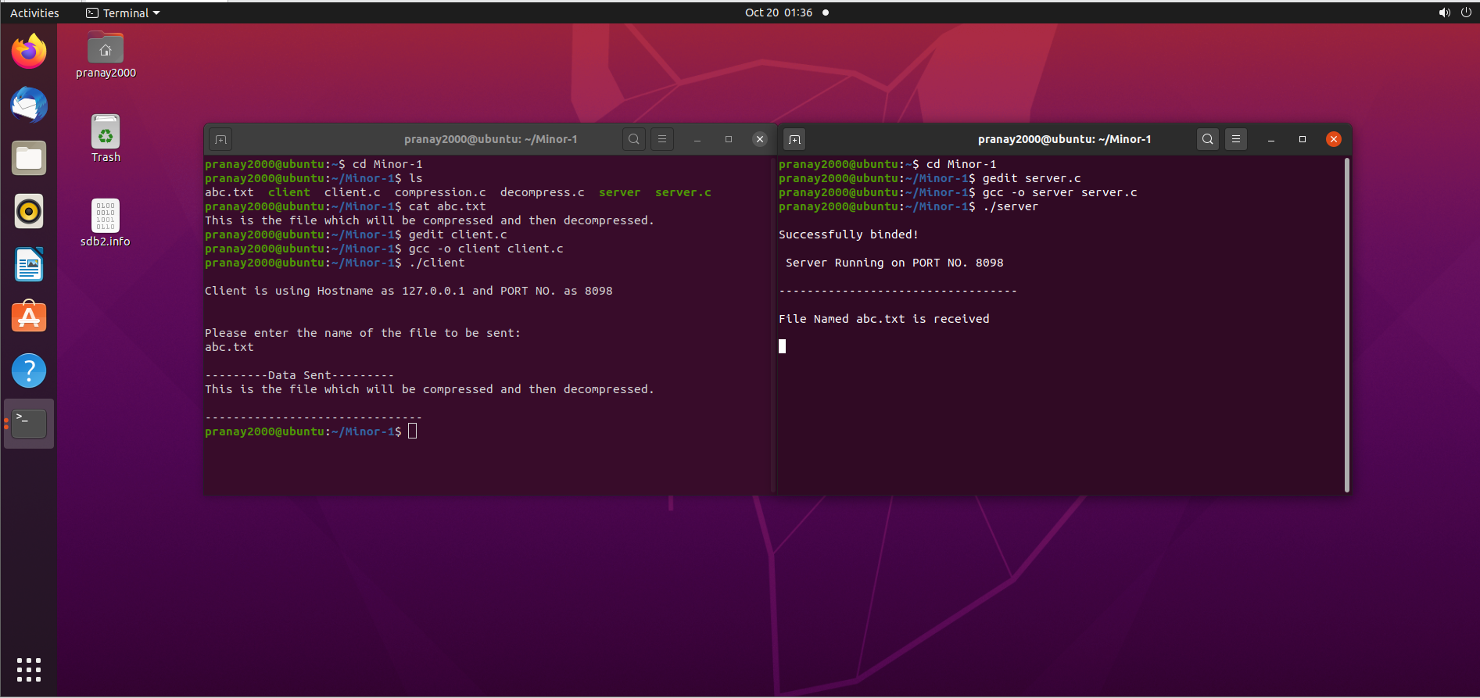
RESULT

Slide 10
Objective Achieved:
Implementation of Client-Server Architecture using UDP Protocol.
Pending Objective:
Implementation of Huffman Algorithm for Compression and Decompression.

Slide 11
Scope:
Over the years, there has been a tremendous increase in the amount of digital data produced and transmitted, representing text, images, video, sound, computer programs, etc. With this trend expected to continue, it makes sense to pursue research on compression algorithms.
Compression algorithms reduce the repetition of data without actual loss of data.
With its fast-compressed feature, Word Based Compression Algorithm is a great solution to compress text files for better storage, transmission of data that is large and reduce input/output load.
It helps in reduction of both compression ratio that is defined as the ratio between the uncompressed size and compressed size and transmission time of data over a channel.
Role of each Member:
Harsh Narain Mathur gathered the necessary requirements and did the analysis of the project.
Harshit Chauhan worked on the development of the algorithm.
Pranay Mahajan worked on the designing of the pseudocode and UML diagram of the project.

