Slide 2
Title: Implementing compression algorithm and secure data transmission over UDP protocol
Team member : Harsh Narain Mathur R100218020
Harshit Chauhan R100218021
Pranay Mahajan R100218037
Mentor : Mr. Ankit Vishnoi

Slide 3
Problem Statement
This project presents a proposal to make a connection between client and server using socket programming and compress the large size text file into small size without any loss of data.

Slide 4
Introduction
With the advancement of technology, the amount of data produced has been enormously increasing but the storage being provided is not sufficient to meet the increasing demands.
Data compression is a technique by which the same amount of data is transmitted by using a smaller number of bits. It is the process of modifying, encoding or converting the bits structure of data in such a way that it consumes less space on disk. The compression works in the following way first the message is compressed using encoding algorithm and then it is decompressed using decoding algorithms to get the desired data
One of the most important algorithm to implement compression is that of huffman encoding and it is used for lossless compression of data. In this it uses variable length encoding where length codes are assigned on the basis of frequency of characters.

Slide 5
Contents
1.Client Server Architecture
2. Socket Programming
3.Data Compression
4. Huffman Coding

Slide 6

Client Server Architecture(CSA)
Client/server architecture is a computing model in which multiple components work in strictly defined roles to communicate. The server hosts, delivers and manages most of the resources and services to be consumed by the client
Client/server architecture works when the client computer sends
a resource or process request to the server over the network
connection, which is then processed and delivered to the client.

Slide 7
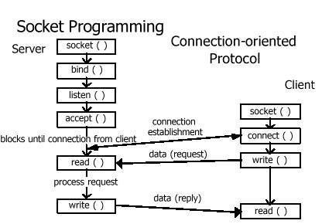
Socket Programming
A socket programming is a way to establish a connection between a client and a server.
It is a way of connecting two nodes on a network to communicate
with each other.
One socket (node) listens on a particular port at an IP,
while other socket reaches out to the other in order to form a
connection.

Slide 8
Data Compression and De-compression
Data Compression : Data compression is the process of modifying, encoding or converting the bits structure of data in such a way that it consumes less space on disk.
It enables reducing the storage size of one or more data instances or elements.
Data Decompression: Decompression is the process of restoring compressed data to its original form. Data decompression is required in almost all cases of compressed data, including lossy and lossless compression.

Slide 9
Huffman Coding
Huffman encoding is used for lossless compression of data. Huffman, uses variable length encoding where length codes are assigned to characters on the basis of frequency of occurrence of character. The character which has the maximum frequency is allotted with smallest bit code and character which has least occurrence gets the highest bit code.
Input - A string with different characters, say “ACCEBFFFFAAXXBLKE”
Output − Code for different characters:
Data: K, Frequency: 1, Code: 0000
Data: L, Frequency: 1, Code: 0001
Data: E, Frequency: 2, Code: 001
Data: F, Frequency: 4, Code: 01
Data: B, Frequency: 2, Code: 100
Data: C, Frequency: 2, Code: 101
Data: X, Frequency: 2, Code: 110
Data: A, Frequency: 3, Code: 111

Slide 10
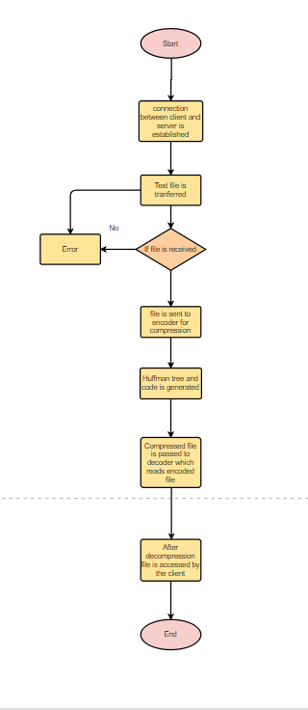
Flow chart

