Slide 1

Title: “Analysis and Forecasting of Carbon Emission in SAARC Countries using Attention-based LSTM” (paper ID: S22202)
An International Workshop on Big Data Analytics
for Climate Change in conjunction with IEEE BigData 2023
Presenter:
Anil Verma, PhD Scholar
Indian Institute of Engineering, Patna
Authors:
Anil Verma
Harshit Dhankhar
Prof Rajiv Misra
Prof T.N. Singh
Om Prakash Dhakal

Slide 2

Abstract
Climate change is urgent
CO2 emissions from industrial and transportation fossil fuels require immediate action.
Our research uses an advanced A-LSTM model to predict CO2 emissions and shows a 57% improvement over baseline LSTM models.
Highlights the need for global awareness and action to address this critical environmental issue.

Slide 3
Introduction
Coordinated global efforts are essential for addressing climate change challenges in South Asian nations.
Accurate CO2 emission predictions are crucial for policy-making, international commitments, economic development, and public awareness.
Developing countries, including SAARC members, have significant carbon reduction potential but require financial and technical support. Economic factors such as foreign investment, population growth, and energy consumption contribute to carbon emissions.
This paper evaluates CO2 emissions and their correlations with various factors for SAARC nations, utilizing machine learning for precise forecasting."

Slide 4
Research Gaps
Existing research on CO2 emissions has explored various aspects, including causal linkages with determinants.
However, gaps persist, prompting further investigation.
This study addresses limitations in dataset scale, overlooks pivotal determinants, and focuses on the understudied SAARC nations.
Conventional machine learning models face challenges like overfitting due to limited data points in this domain.

Slide 5
Research Contributions
Shedding light on the low level of environmental awareness regarding CO2 emissions in SAARC countries.
While similar indicators have been explored in previous studies, minimal attention has been devoted to analyzing SAARC data using machine learning techniques. This research endeavors to enrich the literature by applying deep learning methodologies to forecast CO2 emissions, particularly within the unique context of SAARC nations.
Significantly, this research emphasizes the importance of forecasting CO2 emissions using A-LSTM, demonstrating its practical advantages in terms of enhanced accuracy compared to traditional LSTM models

Slide 6
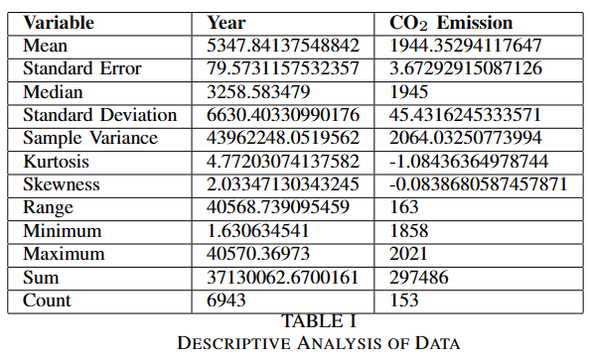
Methodology Data and variables
The research uses data from 1858 to 2021 sourced from Our World in Data and World Bank Indicators
Major carbon monitor categories include Power (Oil, Coal, Gas) and Industry (Oil and Gas combustion for Manufacturing, Coal combustion for Manufacturing, Cement, and others) along with GDP per capita and population.
Cumulative CO2 emission data is obtained from Kaggle.

Slide 7
Methodology Preprocessing
Datasets encompass 26 factors: GDP, population, CO2 emissions from cement, gas production, land use changes, and per-capita CO2 production trends.
Data cleaning involved removing values with over 50% missing data, particularly those before 1950.
Interpolation and next-value fill methods from the pandas library were applied for the remaining missing data.
To enhance LSTM training, data was upsampled and converted into monthly data using the 'M' keyword in the pandas resample() library.
Prediction of next year’s per capita CO2 production involved using data from the preceding three years, converted into training samples.
Data was partitioned by country, introducing a separation between adjacent data elements.

Slide 8
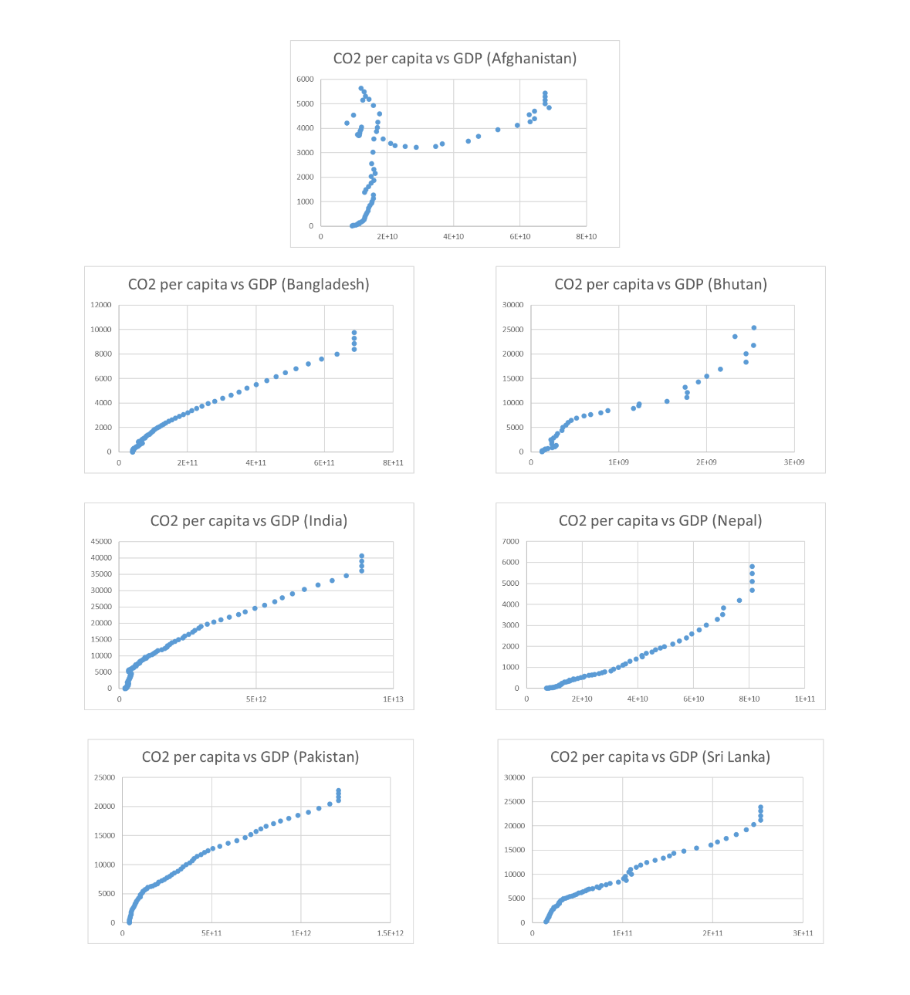
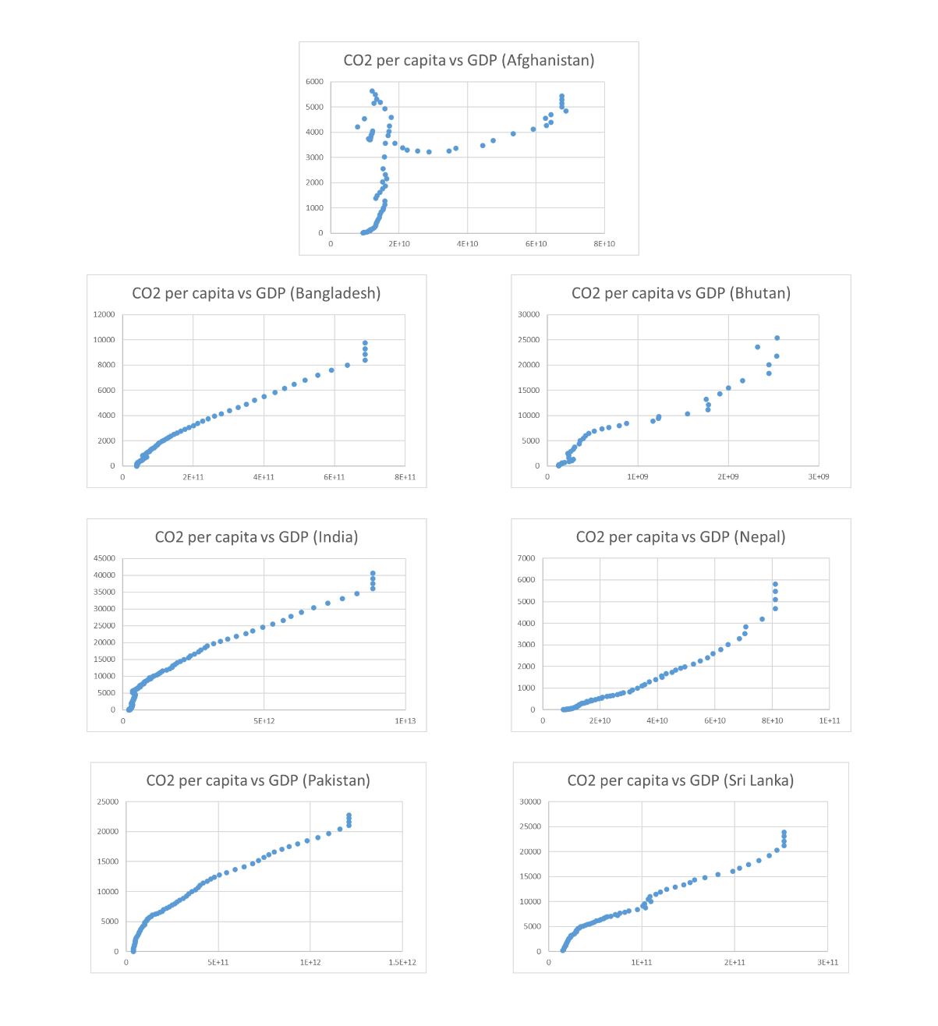
Fig1: Country wise GDP vs CO2 emission per capita
Fig2: Country wise Population vs CO2 emission per capita

Slide 9
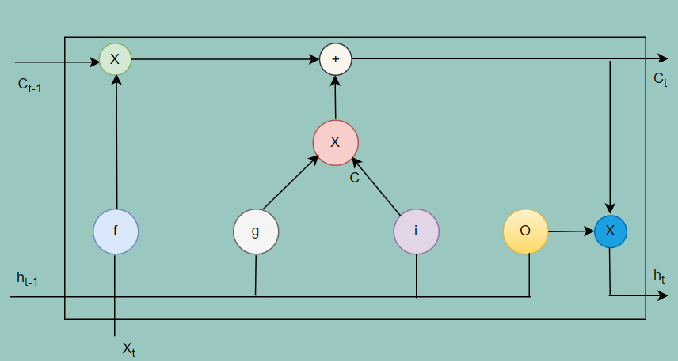
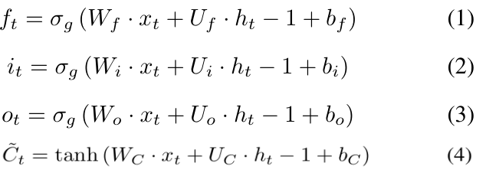

Methodology LSTM
The fundamental architectural arrangement of an LSTM. Within
the LSTM cell, it receives inputs: the current variable xt, the
preceding output ht − 1, and the prior cell state Ct − 1. The
components, namely the input gate (it), forget gate (ft), output
gate (ot), and memory cell (Ct)
Fig. 3. LSTM architecture
The gate activation function denoted as σg, is specifically a sigmoid function, and the function tanh() refers to the hyperbolic tangent function

Slide 10
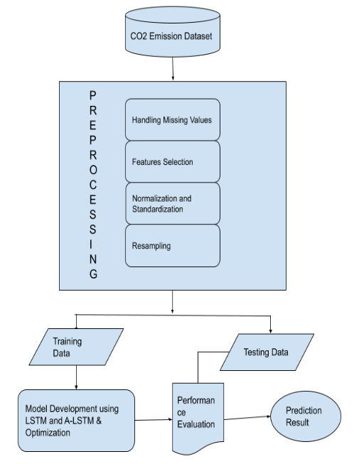
Methodology framework
Data Preparation:
Handling missing values
Selecting relevant features
Normalizing data
Resampling techniques
Dataset Splitting:
Partitioning the dataset into an 80:20 split for training and testing purposes.
Model Development:
Utilizing LSTM and Attention-based LSTM architectures
Performance Evaluation:
Meticulous assessment of model performance using various evaluation metrics.
Fig. 4. Framework for CO2 emission forecasting

Slide 11
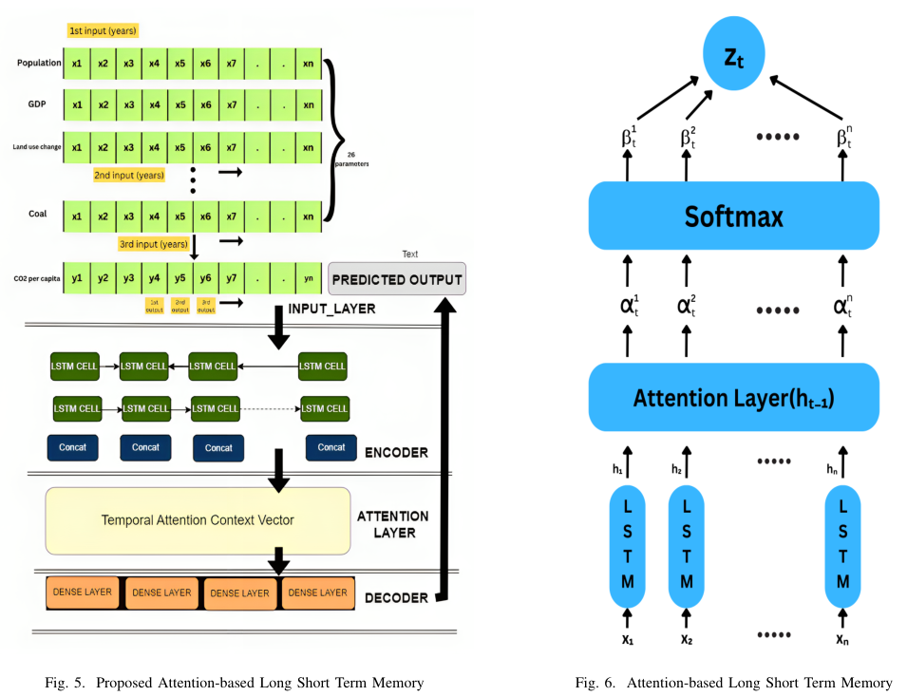
Methodology proposed model
Proposed: An Attention Mechanism based Long Short-Term Memory model as a predictive tool capable of synthesizing and utilizing valuable information from multiple temporal contexts to inform decision-making

Slide 12
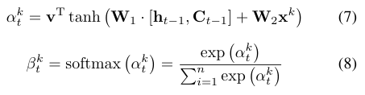
Methodology proposed model
In the initial step, we establish a mapping from xt to ft as: ht = f1(ft−1, xt) Here, ft represents a non-linear activation function, and ht ∈ Rs denotes the hidden state at time t, where ’s’ signifies the size of the hidden state.
In this context, we employ LSTM as the function f1 to mitigate the long-term dependence issue often encountered in time series prediction.
Subsequently, we construct an attention mechanism utilizing a deterministic attention model. For a given feature sequence xk = (xk1, xk2, . . . , xkm)^{T} ∈ R^{m},
We define the input feature sequence using equation 7, while the attention weight is established in equation 8 by referencing the preceding hidden state ht−1 and cell state Ct−1 within the LSTM unit.
The vector v and the matrices W1 and W2 are adjustable parameters within the model. The vector αk consists of ’m’ elements, where each ’i’-th element quantifies the significance

Slide 13

Methodology proposed model
The vector v and the matrices W1 and W2 are adjustable parameters within the model.
The vector αk consists of ’m’ elements, where each ’i’-th element quantifies the significance of the ’k’-th input feature sequence at time ’t’.
These values are normalized using softmax .
Additionally, βk serves as an attention weight, encapsulating a score that determines the degree of attention directed towards the ’k’-th feature sequence.
Equation 9 provides the expression for the weighted input feature sequence zt, at time ’t,’ which represents the output of the attention model.
Hence xt is replaced by the newly computed zt to update the attention model and finally raw time series is converted into attention-based time series.

Slide 14
Implementation Architecture
Experimental Environment:
Jupyter Notebook with Python 3.7.13
Open-source libraries: Pandas 2.1.1, Numpy 1.19.3, Keras, and Tensorflow 2.0+
Hardware Setup:
Ryzen 7 5800-H processor
16 GB RAM
64-bit Windows 11 Operating system
Experimental Models:
Time series forecasting of CO2 emissions dataset
Two deep learning models were used: LSTM and LSTM with Attention (A-LSTM)
Optimization:
Optimum results are considered from each model's ten unique runs.

Slide 15
Implementation Architecture
LSTM Model Architecture:
Relies on LSTM units for sequence modeling.
Two fully connected layers with 64 neurons each, followed by a dense layer.
Activation Function:
ReLU activation function is applied to each layer.
Optimization:
ADAM optimizer with a learning rate of 1e-4 and a decay of 1e6.
Training Parameters:
Mean Absolute Error (MAE) loss metric is used for training.
20% validation split during training.
Dropout rate of 0.1 is applied after the second fully connected layer to combat overfitting.
Batch Size:
Optimal batch size of 32 for performance and robustness.

Slide 16
Implementation Architecture
A-LSTM Model:
Introduces a 64-unit attention layer between the LSTM and dense layers.
Architecture: 64-neuron LSTM layer → Attention layer → Dense layer.
Model Parameters:
Learning rate, loss metric, optimizer, decay rate, and batch size are consistent with LSTM for a comparative study.
Parameter Calibration:
Due to its intricate structure, special attention is given to calibrating parameters for the LSTM forecasting model.
Manual adjustment of hyperparameters through trial and error to optimize hidden layers and neurons for both models.
Optimal Learning Rate:
A learning rate of 0.0001 consistently yields higher accuracy across all models.
Preventing Overfitting:
An early stopping strategy was implemented to prevent overfitting and enhance model efficiency.

Slide 17
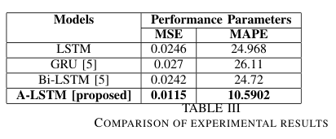
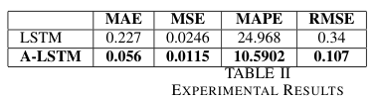
Performance Analysis
Experimental Results (Table II):
Outcomes from both LSTM and A-LSTM models are presented.
Clear indication of substantial enhancements in the proposed A-LSTM model compared to the baseline LSTM.
Comparison with Previous Study (Table III):
A-LSTM compared with LSTM, GRU, and Bi-LSTM.
Results show A-LSTM surpasses in both Mean Squared Error (MSE) and Mean Absolute Percentage Error (MAPE).
Notable improvement compared to the findings in [5].

Slide 18
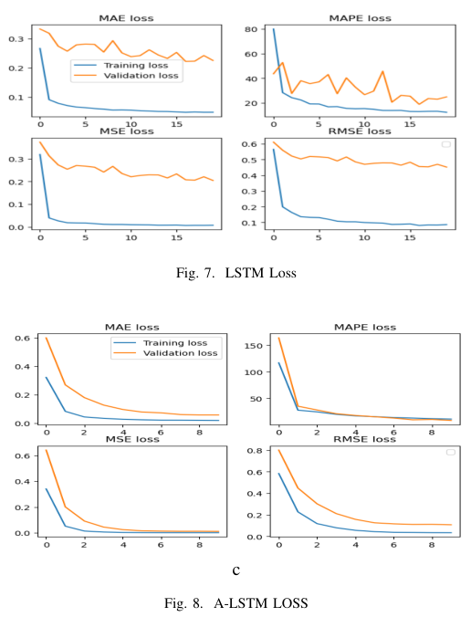
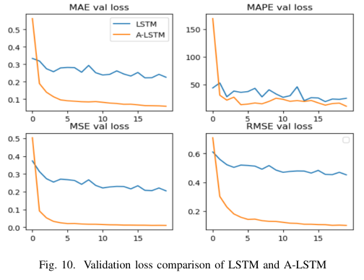
A-LSTM Model Performance:
Superior performance is evident in Figure 8 and 9.
A comprehensive comparison of training and testing loss is depicted in Figure 9 and 10 to assess overall performance.

Slide 19
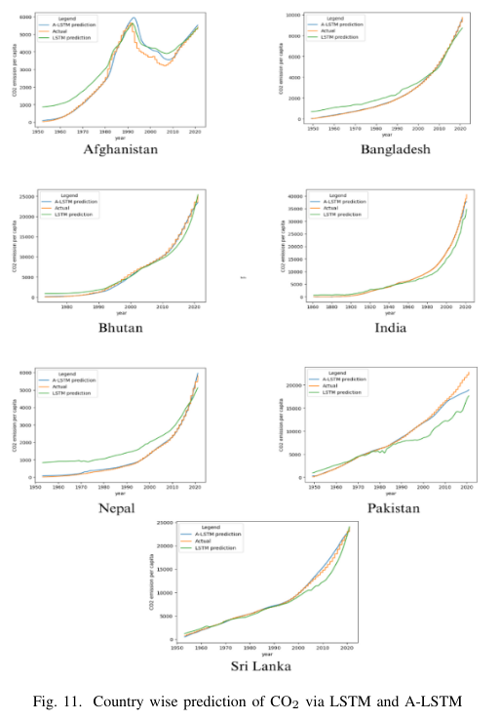
Final predicted CO2 emission outcomes for each of the seven SAARC nations illustrated in Figure 11.

Slide 20
CONCLUSION AND FUTURE RESEARCH DIRECTIONS
Conclusion:
Addressed the critical task of forecasting CO2 emissions to combat climate change.
Introduced an innovative A-LSTM model leveraging attention mechanisms for efficient computational resource allocation.
A-LSTM outperformed baseline LSTM across various metrics, demonstrating a 57% improvement in MAPE loss.
Notable enhancement in predictive accuracy compared to existing models (LSTM, GRU, Bi-LSTM from [5]).
Implications and insights are valuable for diverse predictive modeling applications, especially in forecasting CO2 emissions for sustainable development.

Slide 21
CONCLUSION AND FUTURE RESEARCH DIRECTIONS
Global Implications:
Although our study focuses on SAARC countries, its findings have broader implications.
The discoveries can serve as a blueprint for reshaping global energy consumption practices, aiming to reduce CO2 emissions worldwide.
Future potential for expansion: Exploring benefits and practical applications of quantum-enhanced LSTM and A-LSTM models for multivariate time series prediction.

Slide 22
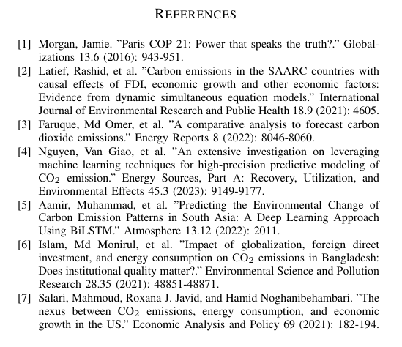
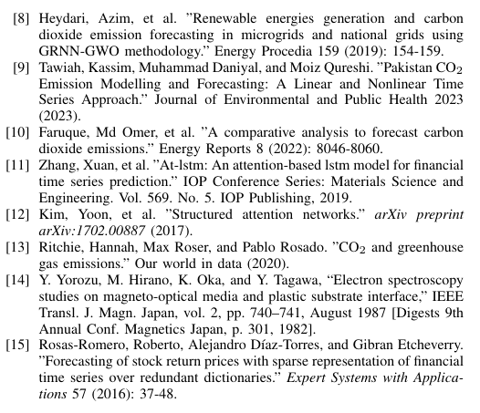

Slide 23


