Slide 1
Sales & Revenue Performance Analysis
Course : Exploratory data analysis using Power BI
Presented by: Geetha & Harshit Pandey
Enrollment No:EN12027097079
Enrollment No:EN12026096961
Batch code:DA804S80
1

Slide 2
Introduction
An outline business records every order, payment, review, customer, seller and product in separate tables.
Reading them one by one hides the bigger picture.
This project connects all of them in one Power BI model and presents the story through interactive pages: revenue and growth, customers, products, and AI-powered insights.

Slide 3
Project Overview
• Objective: analyze sales and revenue performance across products, regions, customers, and time.
• Build an interactive Power BI dashboard to support data-driven decisions.
• Identify trends, high-performing segments, and areas requiring attention.
2

Slide 4
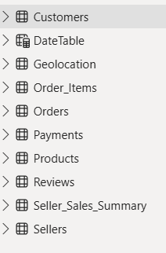
Dataset & Data Preparation
• Imported sales transaction data into Power BI.
• Reviewed data types, missing values, duplicates, and inconsistent entries.
• Standardized dates, categories, and numeric fields.
• Created a clean analytical dataset for reporting.
4

Slide 5
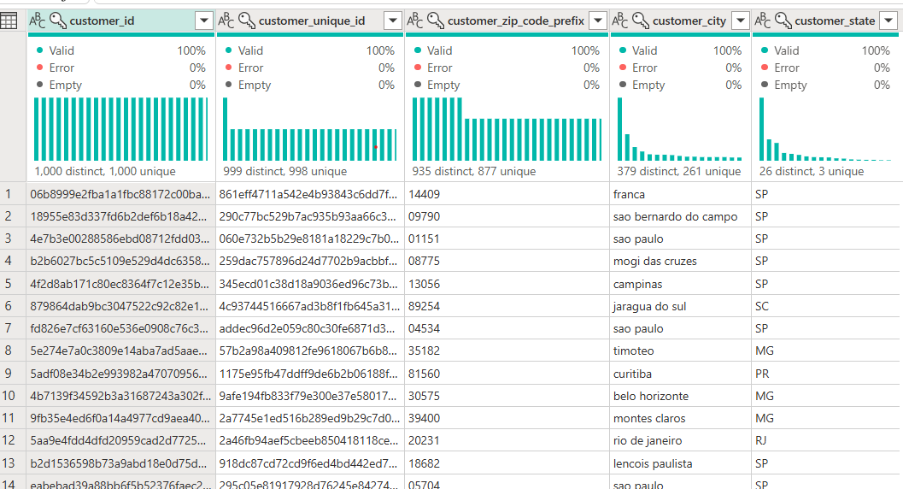
Power Query Transformations
• Removed unnecessary rows and columns.
• Changed data types and standardized field names.
• Handled blanks and inconsistent values.
• Split/merged columns where required.
• Prepared data for the model and downstream calculations.
5

Slide 6
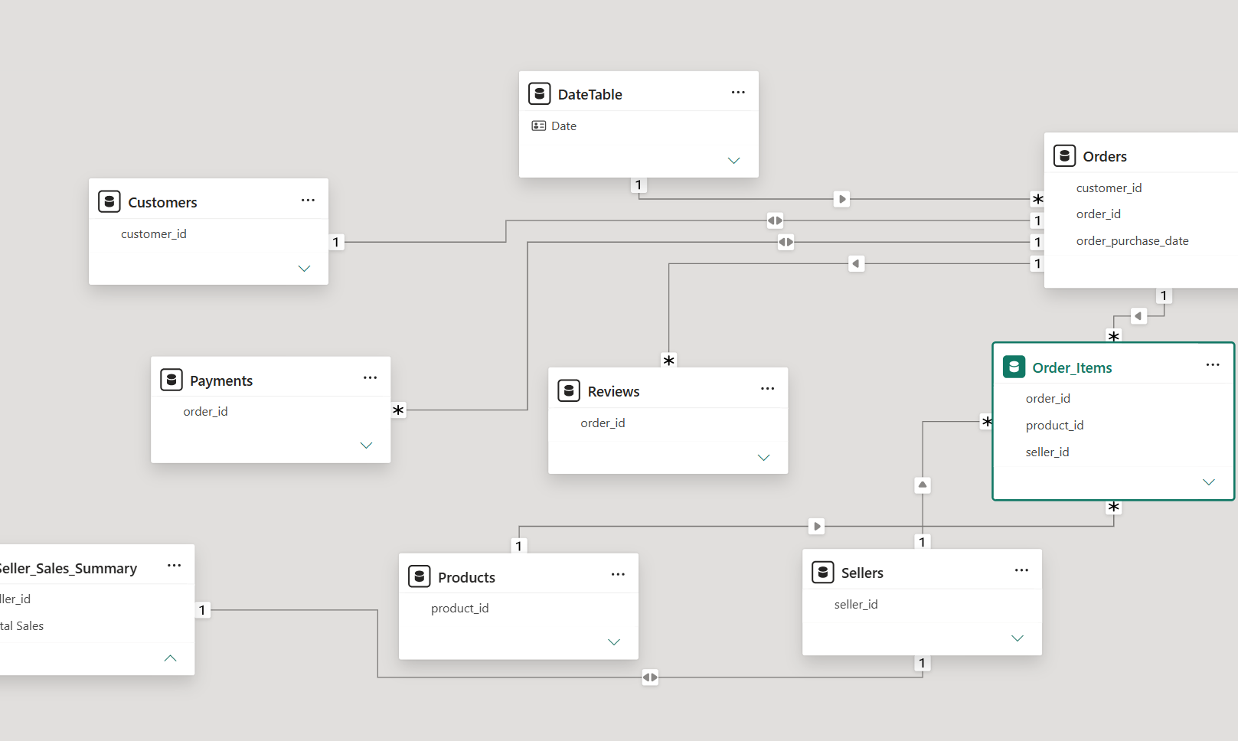
Data Model
• Designed a structured model using fact and dimension tables.
• Connected sales transactions with Date, Product, Customer, and Geography dimensions.
• Used appropriate one-to-many relationships.
• A star-schema approach improves usability and report performance.
6

Slide 7
Dashboard Design
• Created an executive-friendly overview page.
• Used KPI cards for key metrics and charts for trends.
• Added slicers for date, product, region, and customer analysis.
• Maintained consistent layout and avoided unnecessary visual clutter.
13

Slide 8
Key Performance Indicators
• Total Sales / Revenue
• Total Orders or Transactions
• Items Sold
• Average Order Value
• Repeat Customers
• Year-over-Year or period-over-period growth
7

Slide 9
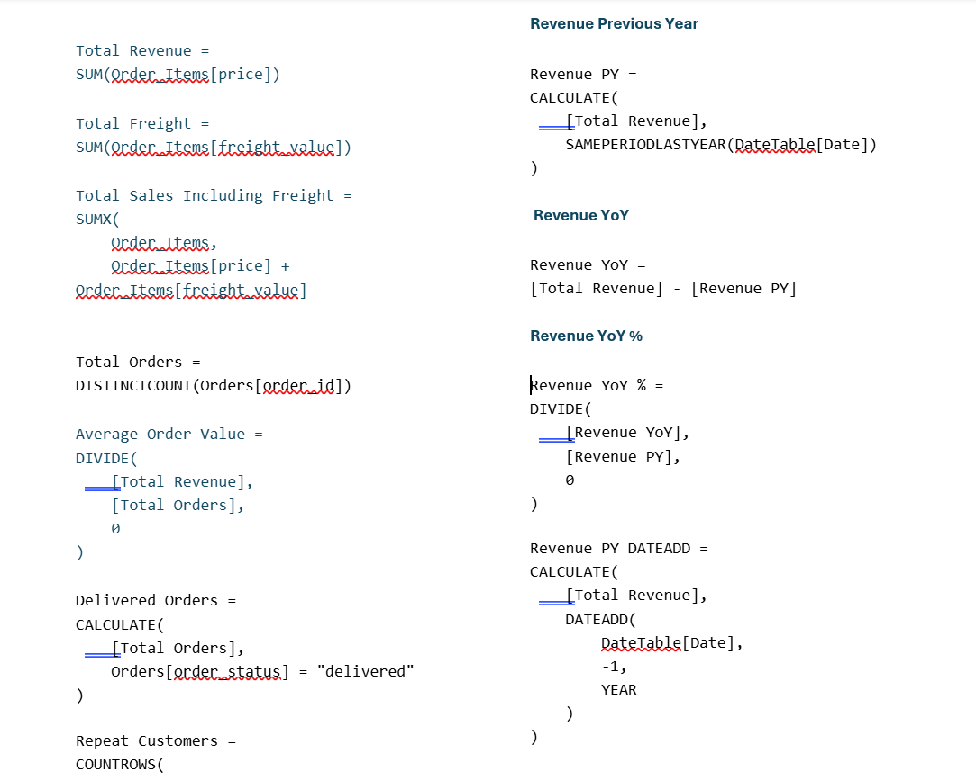
DAX Measures
8

Slide 10
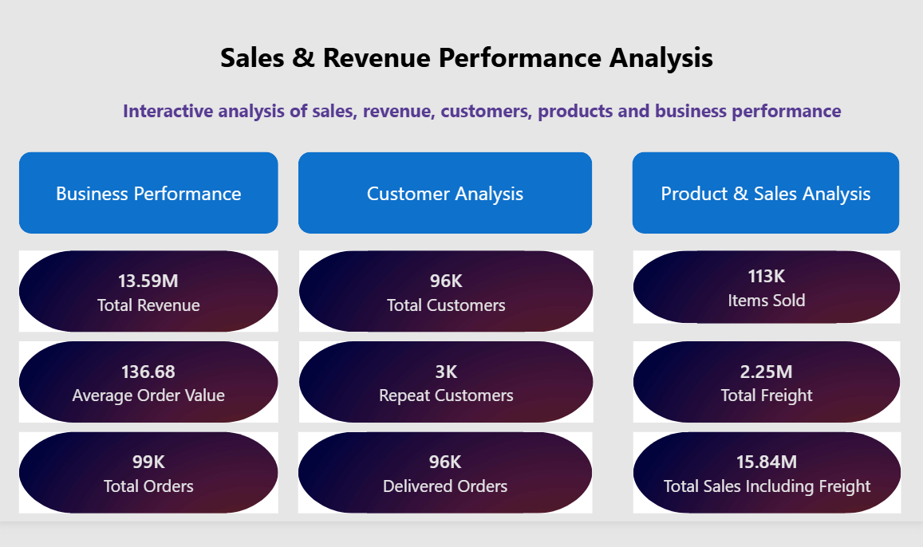

Slide 11
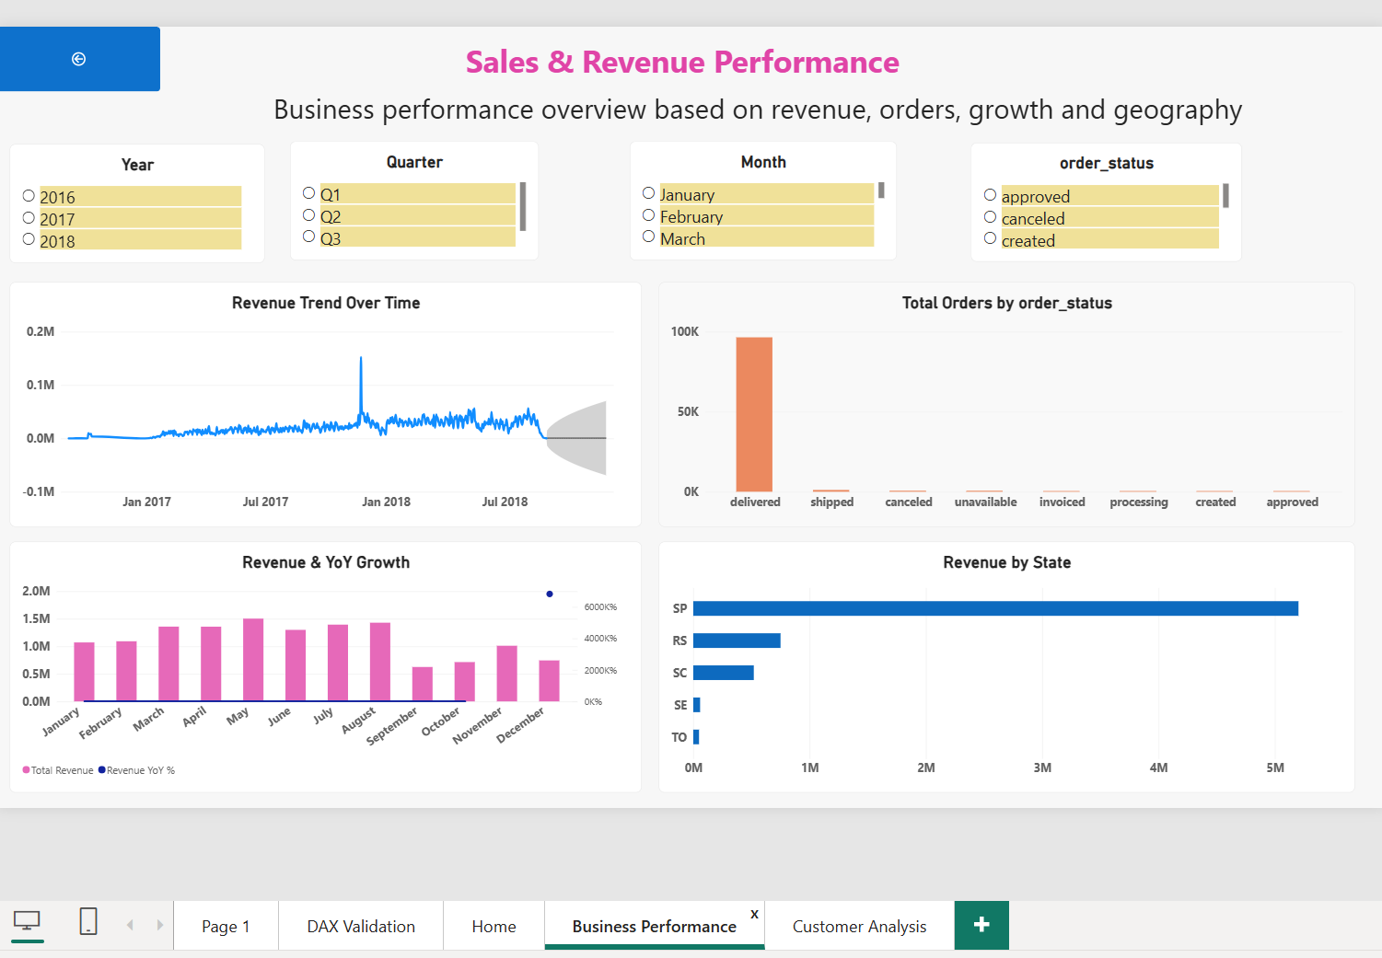
Business Performance
10

Slide 12
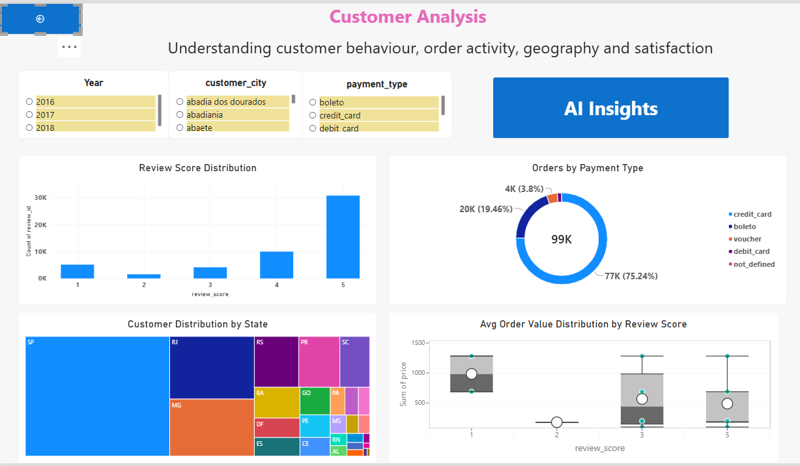
Customer Analysis
12

Slide 13
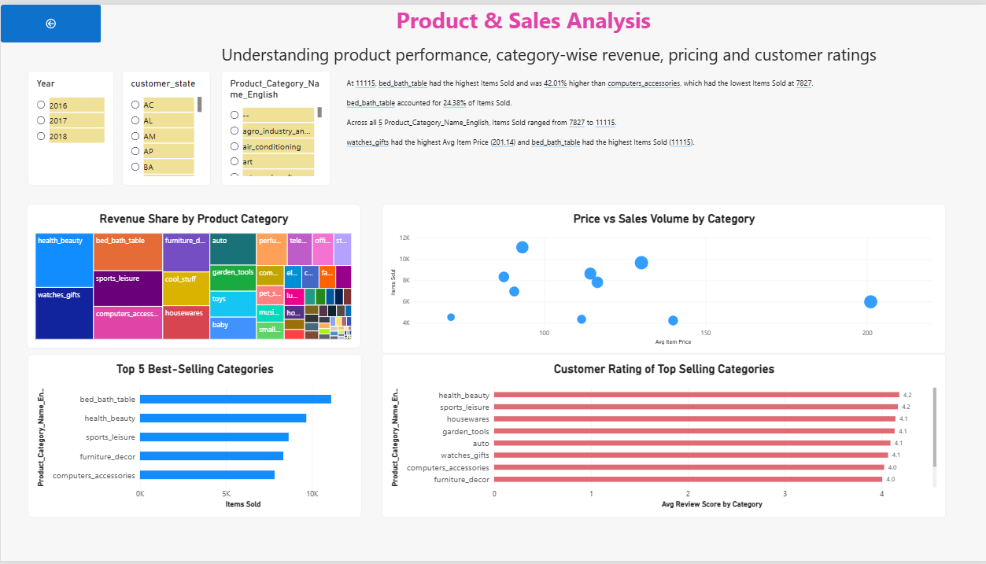
Product & Sales Analysis

Slide 14
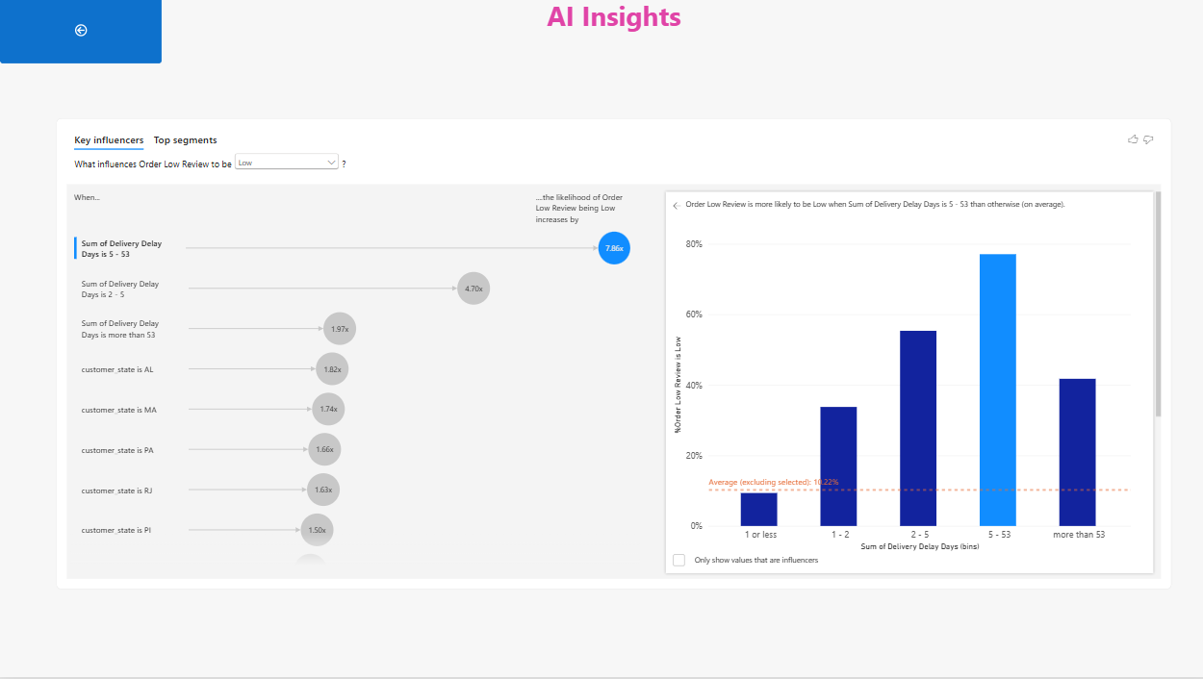
AI Insights

Slide 15
Key Insights
• Sales performance can be monitored from a single interactive dashboard.
• Trend and segment analysis makes changes easier to detect.
• Top products, customers, and regions can be prioritized.
• Interactive filters allow users to move from overall performance to detailed analysis.
14

Slide 16
Conclusion
Sales growth: Sales increased by approximately 15%, indicating positive overall business performance.
Revenue contribution: The top-performing product category contributed around 35% of total revenue.
Regional performance: The leading region generated approximately 40% of total sales.
Customer contribution: High-value customers accounted for nearly 30% of total revenue.
Profitability: The overall profit margin was approximately 20%, showing a healthy contribution from sales.
Trend analysis: Monthly performance showed approximately 10–15% variation across peak and low-performing periods.
16

Slide 17
THANK YOU

