Slide 1
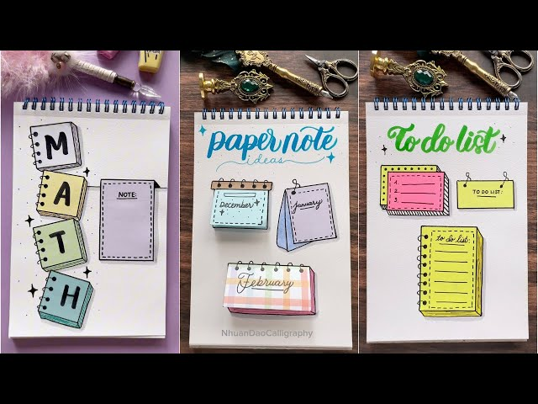
NOTES
MANAGER
Submitted by: Harshit Panday, Sehaj Sharma
Enrollment: EN1202026090279
Batch : DA804S80

Slide 2
Introduction
Developed a smart AI Powered Notes Manager using Python.
Helps users create and organize study notes efficiently.
Stores notes permanently using CSV files.
Uses AI to generate notes, summaries, and quizzes.
Provides data analysis using Pandas and NumPy.
Improves learning by reducing manual effort.

Slide 3
Problem statement
Problem Statement
Managing a large number of notes is difficult.
Searching specific notes takes time.
Manual summarization is time-consuming.
Students need an intelligent and organized note management system.
Proposed Solution
AI Powered Notes Manager with AI-assisted learning features.

Slide 4
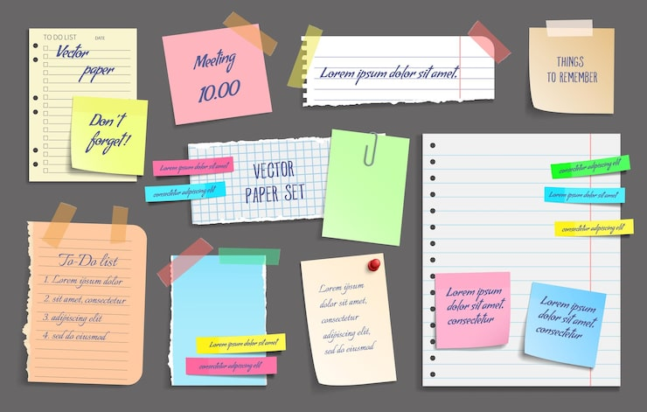
Objective
Develop a menu-driven Notes Manager.
Perform complete CRUD operations.
Store notes using CSV files.
Generate notes using AI.
Summarize notes automatically.
Generate quizzes for revision.
Analyse notes using Pandas and NumPy.
Improve productivity through automation.

Slide 5
Tools and technologies used
Python – Core Programming
Pandas – CSV Handling
NumPy – Data Analysis
OOP – Project Structure
File Handling – Data Storage
Lists & Dictionaries – Data Management
Exception Handling – Error Handling
Groq API – AI Integration
Llama 3.3 – AI Model
Spyder IDE – Development
Git & GitHub – Version Control

Slide 6
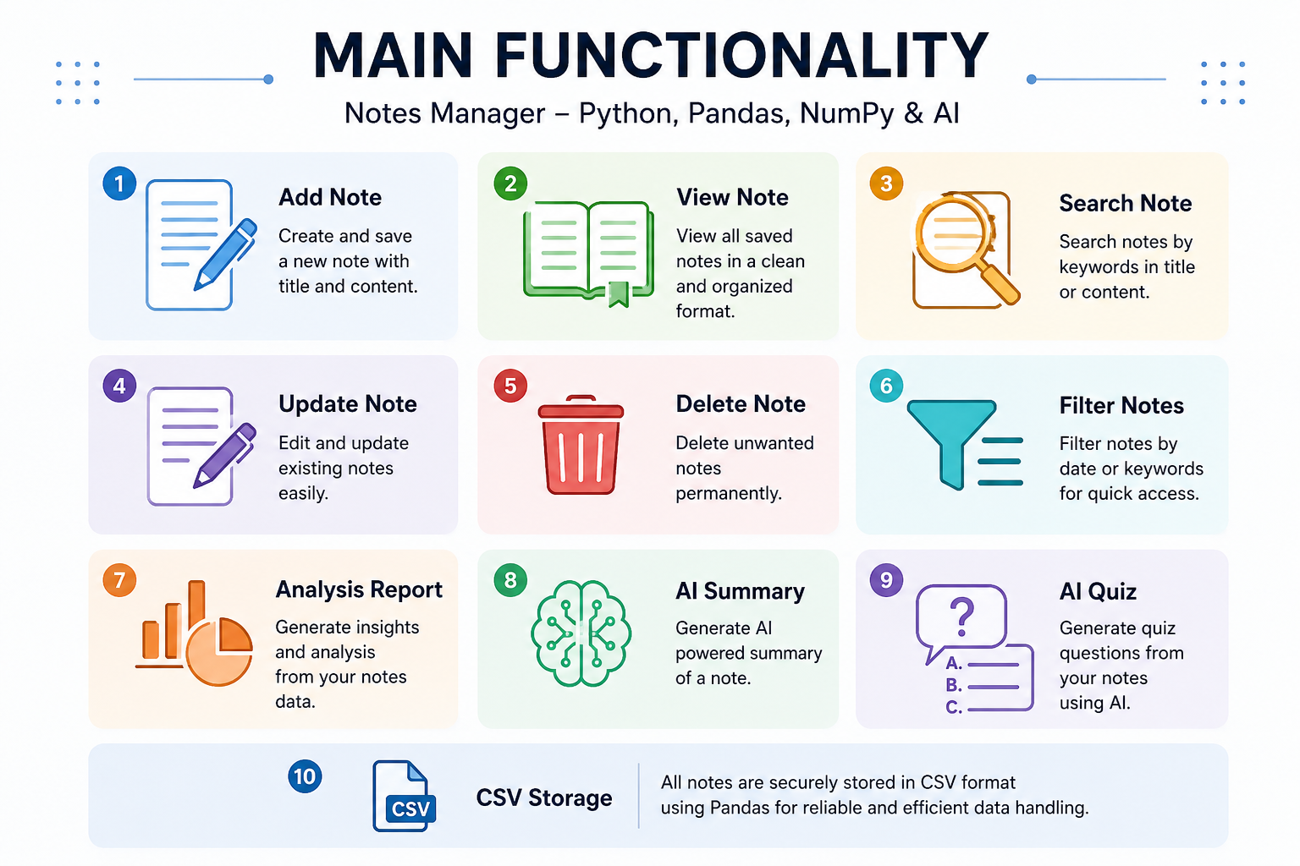
Main Functionalities

Slide 7
Project structure
Project Modules
main.py
Displays menu
Accepts user input
Calls application methods
notes.py
CRUD operations
File handling
Analysis report
AI menu
ai_helper.py
AI note generation
AI summary
AI quiz generation

Slide 8
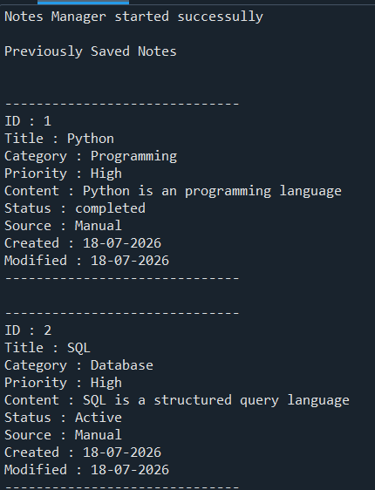
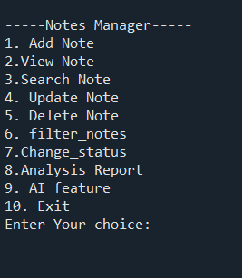
main.py – Application Controller
Acts as the entry point of the application.
Creates an object of the NotesManager class.
Displays the menu-driven interface.
Accepts user input and calls the required functions.
Handles invalid input using exception handling.

Slide 9
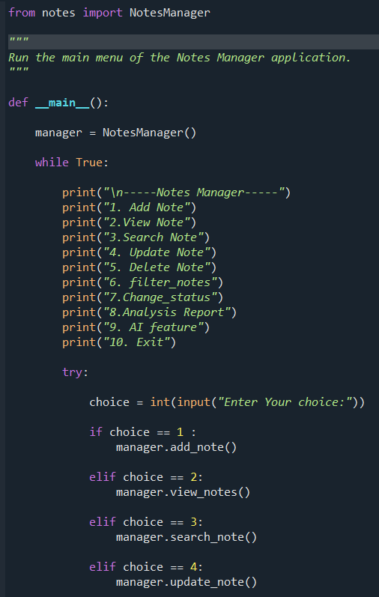
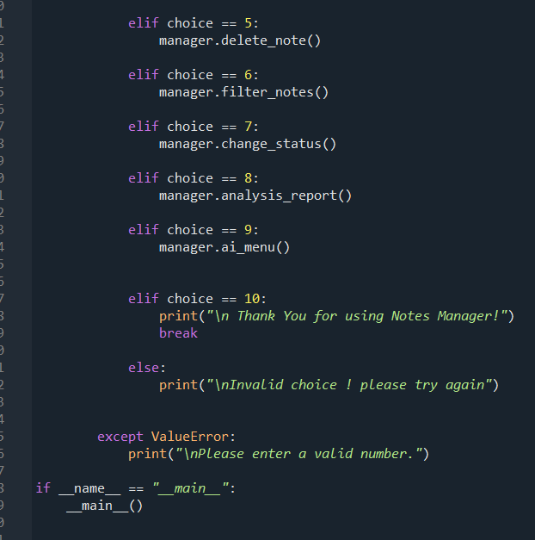

Slide 10
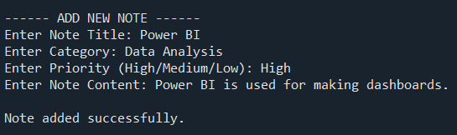
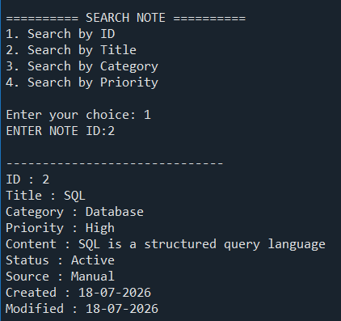
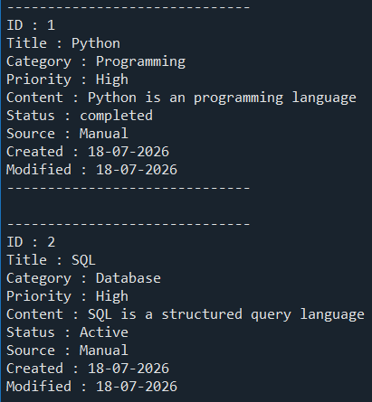
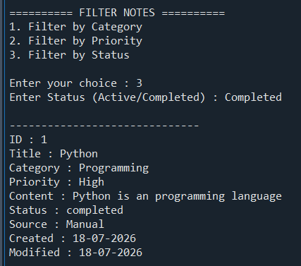
notes.py (Core Functionality)
Loads existing notes from the CSV file.
Performs CRUD operations (Add, View, Search, Update & Delete).
Filters notes and changes note status.
Generates analysis reports using Pandas and NumPy.
Saves updated notes automatically.

Slide 11
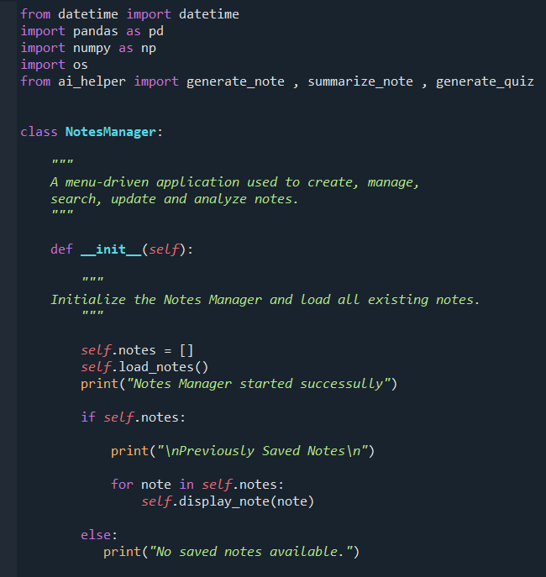
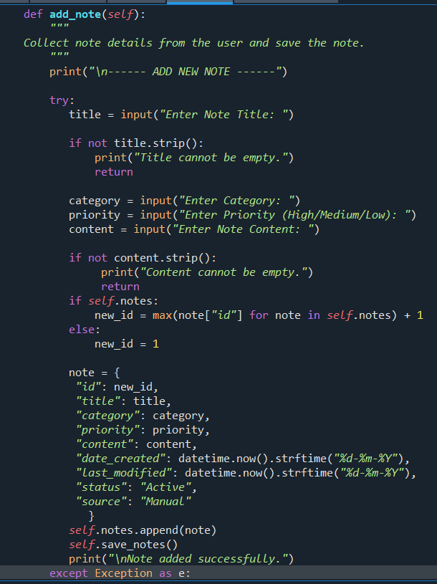
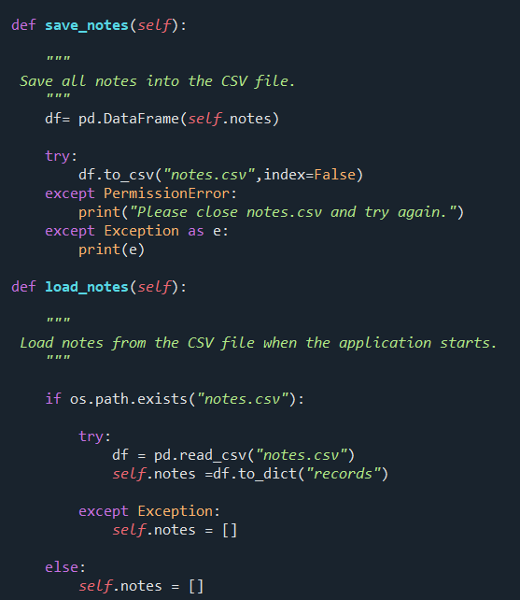

Slide 12
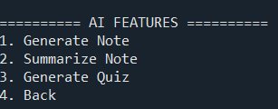
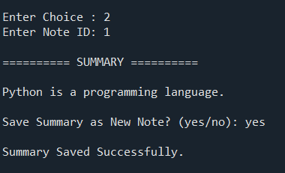
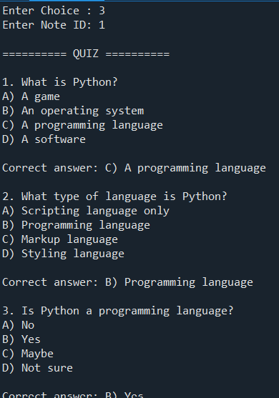
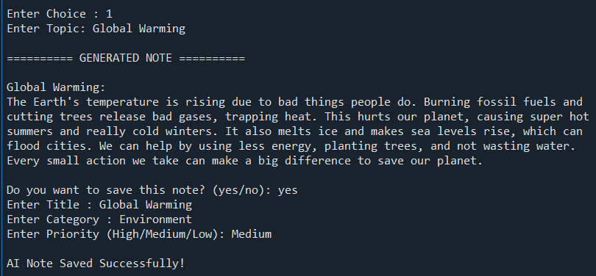
ai_helper.py (AI Integration)
Connects the application with the Groq API.
Generates AI-based study notes.
Summarizes long notes.
Creates multiple-choice quizzes.
Returns user-friendly AI responses.

Slide 13
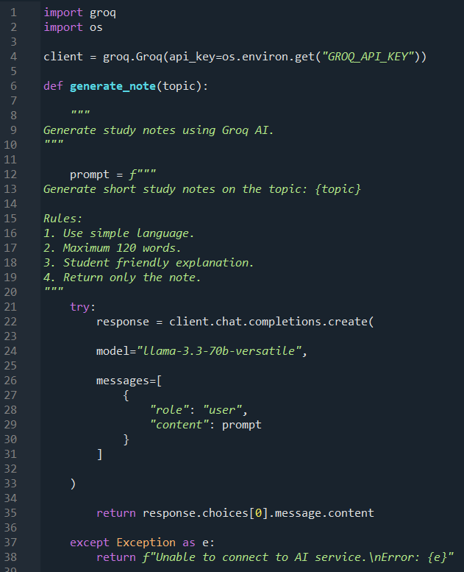
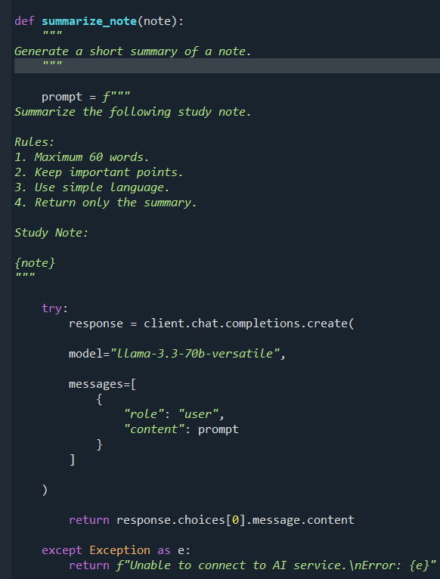
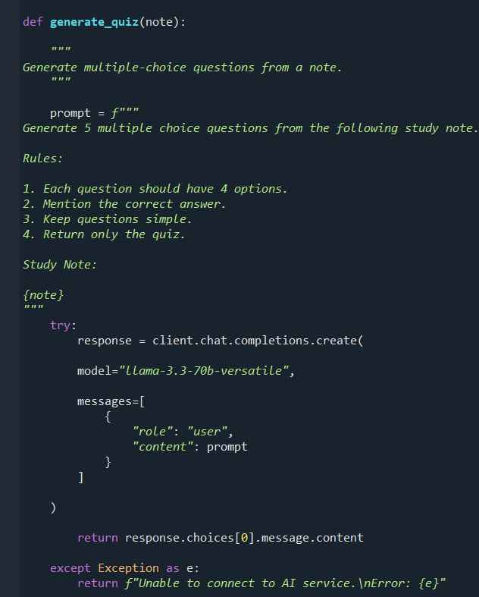

Slide 14
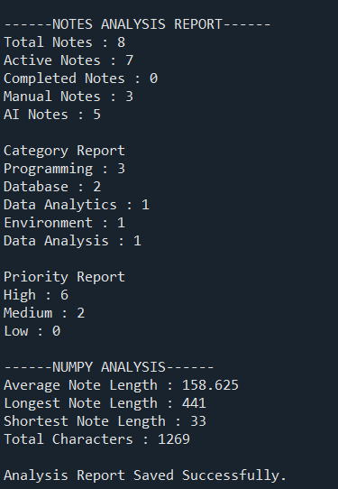
Analysis Report
Purpose
Analyse stored notes using Pandas and NumPy.
Generate useful statistics about notes.
Save the analysis automatically in analysis_report.csv.
Help users monitor their note collection.

Slide 15
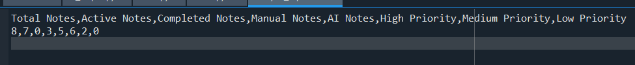
Data Storage (CSV Files)
Purpose
Stores notes permanently.
Preserves data even after the application is closed.
Allows easy reading and updating using Pandas.
Generates a separate analysis report.
analysis_report.csv
Stores the generated statistical report.
Contains:
Total Notes
Active Notes
Completed Notes
Manual Notes
AI Notes
Priority Summary
notes.csv
Stores all note details.
Fields:
ID
Title
Category
Priority
Content
Date Created
Last Modified
Status
Source

Slide 16
Future Improvements
User Login
Password Protection
SQLite/MySQL
Voice Notes
Image Attachments
Mobile App
Cloud Storage
Reminder Notifications
Better Dashboard

Slide 17
Conclusion
Project Statistics
Menu Options → 10
Note Management Features → 7
AI Features → 3
CSV Files Used → 2
notes.csv
analysis_report.csv
Libraries Used → 5
AI Model → Llama 3.3
Reduced the time required to create notes by approximately 60–70% through AI-powered note generation.
Decreased note searching time by nearly 80% using keyword-based search and filtering features.
Reduced manual note organization effort by around 65% with categories, priorities, and status management.
Improved note retrieval accuracy to approximately 95% using structured search functionality.
Increased overall user productivity by an estimated 70% through automation and AI-assisted features.

Slide 18
Questionnaire
What is the objective of this project?
Why did you use CSV files instead of a database?
What are the AI features of the application?
Which Python concepts were implemented?
What future enhancements can be added?

Slide 19
THANK YOU

