Slide 1
RL-BASED DYNAMIC BATTERY THERMAL MANAGEMENT
Reinforcement Learning for Adaptive EV Battery Cooling in Software Defined Vehicles
Rebuilt implementation and results
B.Tech Major Project, Session 2026-27
Rishuraj Singh (2410030738) • Nihaal Sansanwal (2410031372) • Harshit Parmar (2410031422) • Chaitanya Sharma (2410031341)
Under the guidance of Dr. Pranav Srivastava
School of Computer Science and Engineering • IILM University, Greater Noida
Notes:
Source: cover pages of the supplied Phase2_Report_RL_Battery_Thermal_Management (1).docx and MidTerm_Evaluation_Report_RL_Battery_Thermal_Management.docx.

Slide 2
PROJECT OVERVIEW
Adaptive cooling for an EV battery
A software simulation will model battery temperature under driving and charging demand. An RL agent will learn how much cooling to apply from the current battery and operating conditions.
Temperature
Aim to keep the battery within a defined operating band
Cooling energy
Research objective
Test whether an RL controller can reduce auxiliary cooling energy compared with a PID baseline while keeping temperature within the chosen limits. Any improvement must be established through evaluation.
Measure the energy used by the cooling system
SDV scope
Study software deployment feasibility after simulation
2
Notes:
Source: Phase-II report, Introduction and Sections 1.1, 1.6–1.7, 3.3. RL means reinforcement learning. PID means proportional-integral-derivative control. SDV means software-defined vehicle. The energy benefit is a research objective.

Slide 3
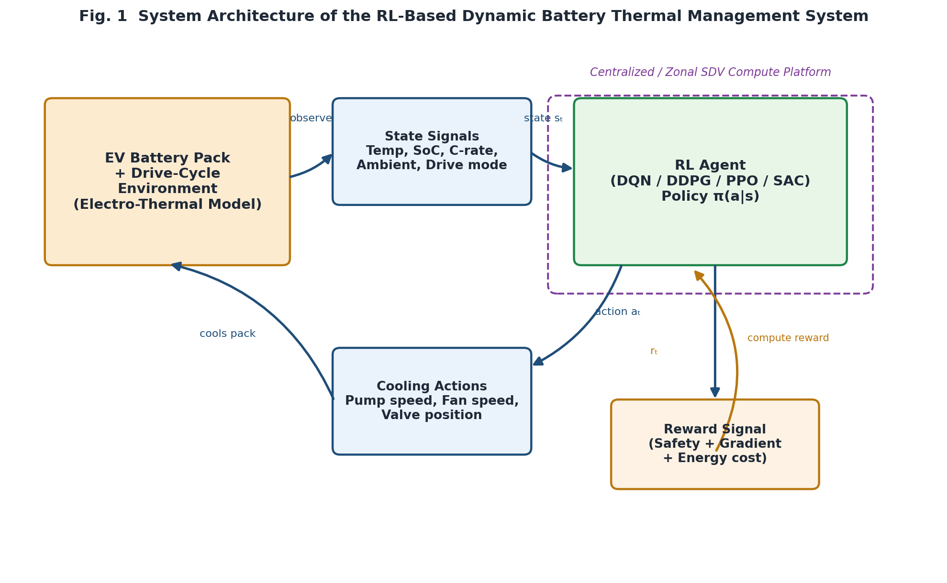
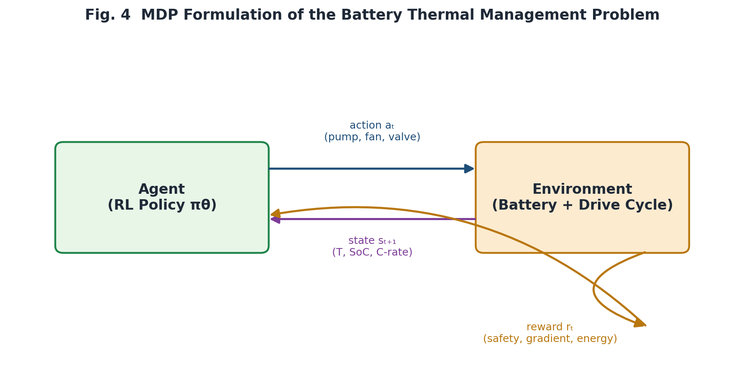
SYSTEM DESIGN
Closed-loop architecture and RL interaction
Fig. 4 — MDP loop (state, action, reward)
At each step, the agent observes the battery state and selects cooling effort. The model returns the next state and a reward. The reward updates the policy during training. SDV deployment remains a feasibility study.
Fig. 1 — System architecture
3
Notes:
Source: Phase-II report, Sections 3.1–3.4 and Figures 1 and 4. Original architecture and MDP images retained from the supplied PPT. The depicted SDV platform is conceptual. MDP means Markov decision process.

Slide 4
Rebuilt plant and simulation environment
01 Model the pack
Use an equivalent-circuit electrical model and four thermal nodes to simulate state of charge, heat and true spatial temperature difference.
02 Check model behaviour
A PyBaMM SPMe cross-check supports electrical lookup values. Thermal conductances remain engineering assumptions.
03 Build the environment
The Gymnasium environment uses independent continuous pump, fan and chiller commands with a supervisory shield.
04 Prepare driving inputs
Real UDDS, HWFET, US06, ECE and EUDC traces are loaded with source URLs and hashes.
4
Notes:
Source: Phase-II report, Sections 1.2–1.3, 2.5 and 4.2. Mid-term report, Section 2.2, identifies synthetic drive-cycle inputs as a current limitation.

Slide 5
Rebuilt state action and reward
State
Action
Four pack-node temperatures, state of charge, C-rate, ambient, operating mode and demand preview.
Independent continuous pump, fan and chiller commands coordinate coolant flow, radiator heat rejection and chiller cooling.
Reward
Penalise temperature-band violation, true spatial delta T, auxiliary energy and relative aging exposure.
A supervisory shield provides measured intervention; reward penalties alone do not guarantee safety.
5
Notes:
Source: Phase-II report, Section 1.4. Mid-term report, Section 1, specifies five discrete cooling levels and identifies reward re-tuning. Its viva section describes a weighted penalty rather than a hard constraint. C-rate expresses charge/discharge current relative to battery capacity.

Slide 6
Training and fixed evaluation
Training completed
Fixed controller comparison
PPO, SAC and TD3 trained for 20,000 environment steps each across five seeds on the mixed scenario.
The same eight held-out episodes compare learned policies with tuned PID, bang-bang, null and sampling MPC, with and without the shield.
Metrics
Report time outside band, true spatial delta T, auxiliary energy, aging exposure and shield firing rate. The temporal rate proxy is retired.
6
Notes:
Source: Phase-II report, Sections 1.5–1.7 and 2.5. Metric distinction follows the quantities in Phase-II Section 1.7 and Mid-term Section 3.1: inter-cell temperature difference is not dT/dt. MPC means model predictive control.

Slide 7
REBUILT RESULTS
What the evidence supports
1
Rebuilt environment
2
Deep RL completed
The rebuilt study uses four thermal nodes, three continuous actuators, real traces and a null-controller hardness gate.
PPO, SAC and TD3 trained across five seeds. The tuned PID has lower shielded mean cost than the learned policies at this budget.
3
Safety result
4
Deployment result
Without the shield, learned policies violate the band for more than 41% of evaluated time. With it, violations are zero but interventions occur in about 20% of steps.
ONNX SAC measured 0.017 ms median on the laptop CPU; sampling MPC measured 228.949 ms. These values do not certify an automotive ECU.
7
Notes:
Source: Mid-term report, Sections 1, 2.1 and 2.2. These are the implementation statuses reported in that document. SDV feasibility scope: Phase-II Section 3.3.

Slide 8
WORK REMAINING
Evidence-led next steps
01
02
03
Measured pack validation
Longer training
Safety verification
Validate thermal conductances and pack thermal mass against measured hardware data.
Increase training budgets and seeds before drawing a policy-quality conclusion.
Test shield coverage and intervention limits on broader simulated disturbance cases.
04
05
06
Broader evaluation
Target ECU
Result traceability
Evaluate across vehicle parameters, climates and a larger held-out scenario set.
Benchmark the exported policy on a representative automotive compute target.
Keep every report and slide number linked to a file under report/results.
8
Notes:
Source: original PPT slide 8, Phase-II Sections 2.5, 3.3 and 4.2, and Mid-term Sections 2.2 and 3.1. MPC remains conditional on feasibility.

Slide 9
Thank You
Questions & Discussion
RL-Based Dynamic Battery Thermal Management for Software Defined Electric Vehicles
Rishuraj Singh • Nihaal Sansanwal • Harshit Parmar • Chaitanya Sharma
Guide: Dr. Pranav Srivastava — IILM University, Greater Noida
Notes:
Source: supplied reports, title pages.

