Slide 1
Hibernate_cache

Slide 2
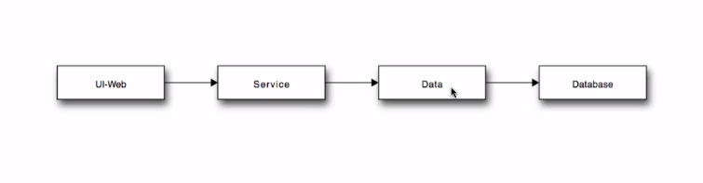

Slide 3
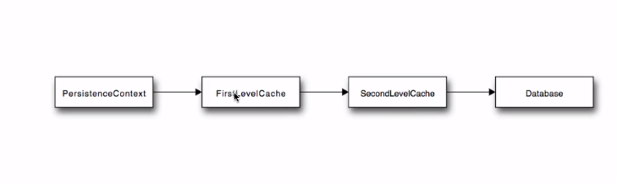

Slide 4
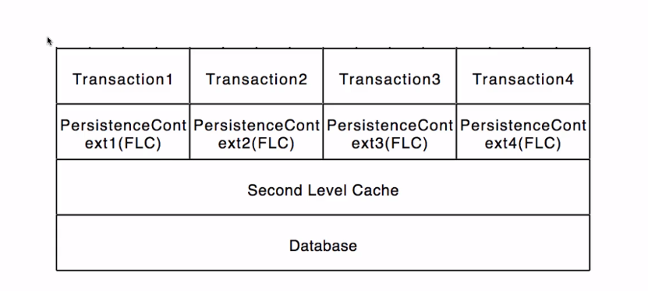

Slide 5
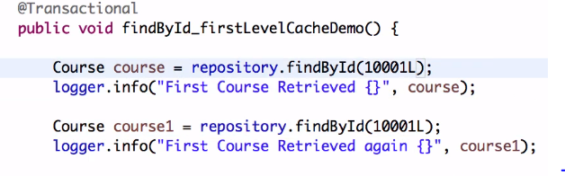
this annotation will add data fetched from query to first level cache
without this same query will be executed multiple times

Slide 6
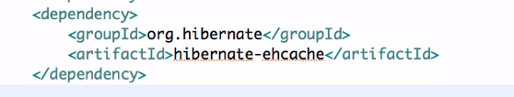
Second level cache

Slide 7
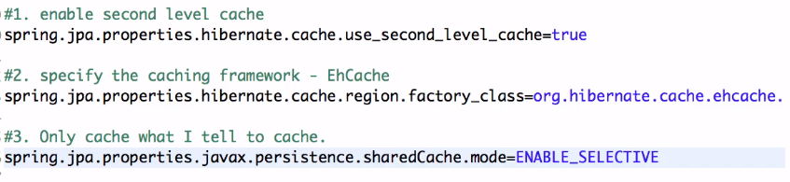
application.properties file

Slide 8
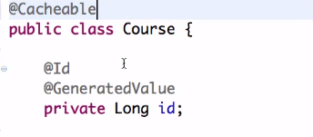

Slide 9
Caching
Caching is facility provided by ORM frameworks which help users to get fast running web application, while help framework itself to reduce the number of queries made to the database in a single transaction.
Hibernate also provide this caching functionality at first level and second level.

Slide 10
Hibernate caching improves the performance of the application by pooling the object in the cache.
It is useful when we have to fetch the same data multiple times.

Slide 11
There are mainly two types of caching:
first level cache
second level cache.

Slide 12
First Level Cache
Session object holds the first level cache data. It is enabled by default.
The first level cache data will not be available to entire application.
An application can use many session object.

Slide 13
First-level cache :
It represents the default cache used by Hibernate Session object while interacting with the database.
It is also called as session cache and caches objects within the current session.
All requests from the Session object to the database must pass through the first-level cache or session cache.
One must note that the first-level cache is available with the session object until the Session object is live.

Slide 14
Second Level Cache
SessionFactory object holds the second level cache data.
The data stored in the second level cache will be available to entire application.
One of the common second-level cache providers is EhCache.

Slide 15
Hibernate.cfg.xml
<property name="hibernate.cache.use_second_level_cache">true</property>
<property name="hibernate.cache.region.factory_class">org.hibernate.cache.ehcache.EhCacheRegionFactory</property>

Slide 16
Hibernate Second Level Cache
Hibernate second level cache uses a common cache for all the session object of a session factory.
It is useful if you have multiple session objects from a session factory.

Slide 17
SessionFactory holds the second level cache data. It is global for all the session objects and not enabled by default.

Slide 18
Example
@Entity
@Cacheable
@Cache(usage = CacheConcurrencyStrategy.READ_WRITE, region="myEntityCache")
public class MyEntity {
// ...
}

Slide 19
In java
Query query = session.createQuery("from MyEntity where name=:name");
query.setParameter("name", "John");
query.setCacheable(true);
query.setCacheRegion("myQueryCache");

