Slide 1
Anti-Aliasing Filter Design

Slide 2
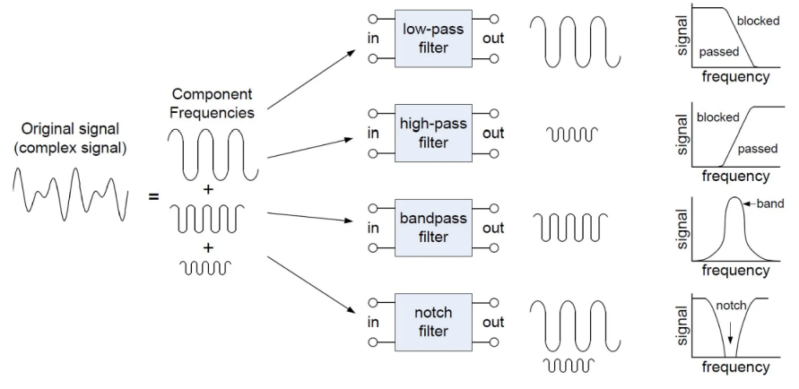
What is Filter?
- Its a electronic block which allows only specific frequency to pass and reduce the other frequencies.
- The LPF which allows only lower frequency to pass and higher frequency get removed; The HPF allows higher frequency to pass and lower frequency get blocked; The BPF allows only specific range of frequency to pass other get blocked.
Frequency response and Transfer function
- The behavior of filter accross the different frequencies is known as frequency response of the filter.
- The frequency where the output drop by -3dB (starts to attenuation) reduction in signal strength.
- TF describe the behavior of input and output of the filter.
Order of Filter
- Number of energy storing element present into the design of filter determines the order of the filter.
- Order = number of poles.
- Poles = mathematical points that create filter’s behavior.
Difference between Butterworth, Chebyshev, and Elliptic filters
- Butterworth: Smooth response, no ripple.
- Chebyshev: Ripple in passband or stopband, sharper cutoff.
- Elliptic: Ripple in both, sharpest cutoff.

Slide 3
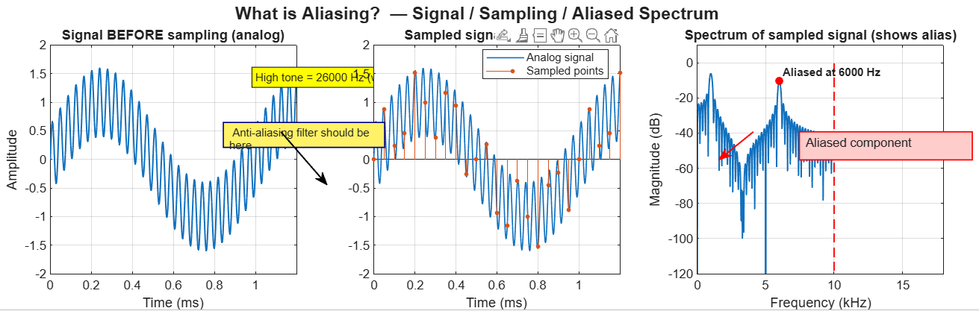
What is Aliasing?
- Its a distortion that occurs when the ADC samples a signal frequencies which is higher than half the sampling rate of the ADC.
- These higher frequencies flows into the lower frequency band and appear as false signals.
Why Does It Occur?
-Aliasing happens when you sample slower than twice the highest signal frequency (violating Nyquist rule).
- According to the Nyquist theorem, a signal must be band-limited to fs/2 before sampling.
- Real-world signals are not perfectly band-limited → they contain noise, harmonics, and unwanted high-frequency components.
-When these are sampled, they overlap with the real signal spectrum → causing irreversible distortion.
Aliasing happens because sampling cannot distinguish high-frequency signals from lower ones—so it misinterprets them.

Slide 4

Nyquist Sampling Theorem
- The sampling frequency must be at least twice the highest frequency present in the input signal.
- This ensures the ADC can correctly reconstruct the signal without overlap in frequency domain.
$fs=2 ∗Sampling Frequency$
In real world applications signals doesn’t have perfect bandwidth and aliasing is always possible.
Why anti-aliasing filter?
- Anti-aliasing filter is an analog low-pass filter used before the ADC to remove high-frequency signals that can cause aliasing.
- It’s purpose it to remove/stop the frequencies which is above the Nyquist rate, preventing the low frequency signals to appears into the digital signals.
Why use LPF as Anti-Aliasing Filter?
- Low-pass filters remove high frequencies that cause aliasing. High-pass filters cannot prevent aliasing.

Slide 5
Types of filters
RC low pass Filter
- Uses only R and C for designing, which help to reduce frequency signals.
Active low pass Filter
- Uses op-amp + RC filter to create different orders of filter.
Sallen-Key Low-Pass Filter
- It’s a popular 2nd order filter topology for active low pass filter.
Multiple pole Filter
- It’s made by cascading 2nd order filters together to achieve higher order.
LC Filter
- Low pass filter by using L and C components.
Butterworth Filter
- It’s a maximally-flat magnitude filter. No ripples in the passband. Smooth response. (Commonly used for AAF)
Chebychev Filter
- It’s a filter with ripples but very sharp cutoff slope.
Bessel Filter
- It is designed for linear phase it preserve waveform.

Slide 6
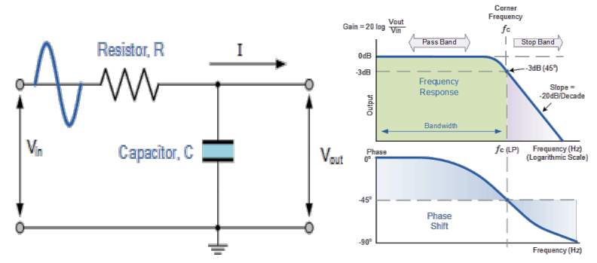
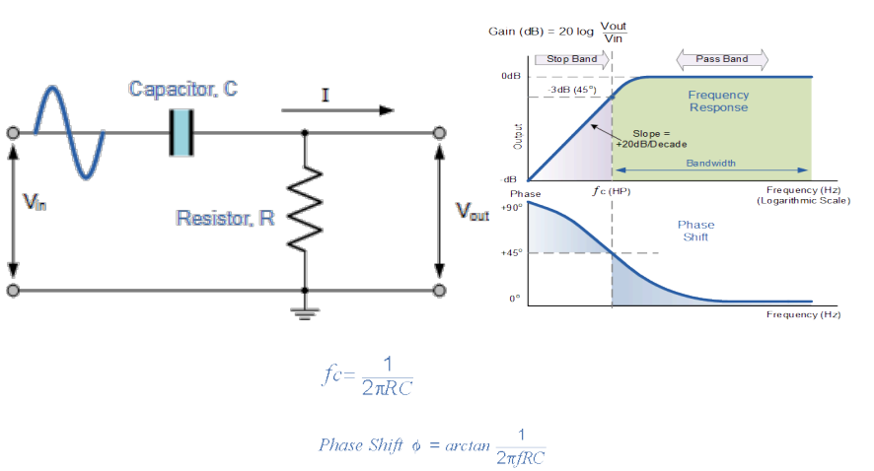
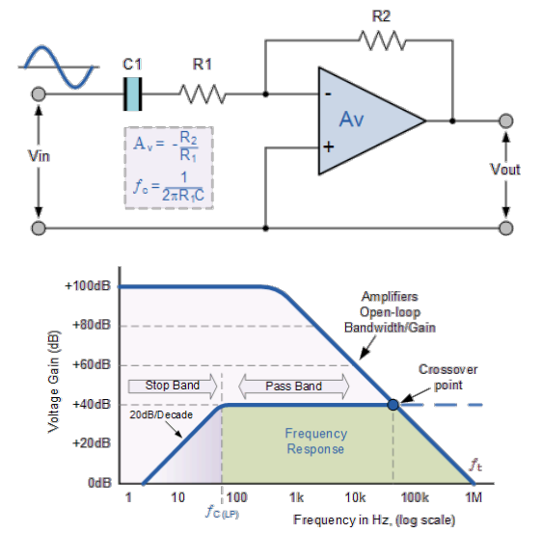
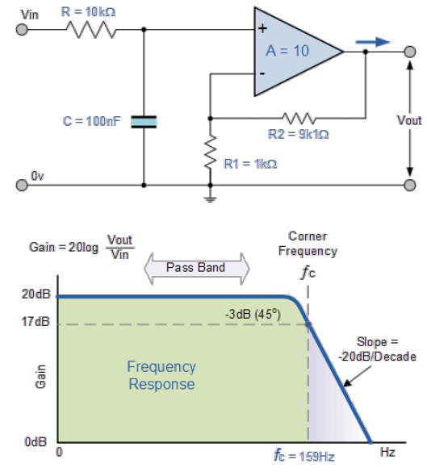
Low Pass Filter (LPF)
- Passes low-frequency signals and attenuates high-frequency signals.
Passive LPF
Active LPF
High Pass Filter (HPF)
- Passes high-frequency signals and attenuates low-frequency signals.
Passive HPF
Active HPF

Slide 7
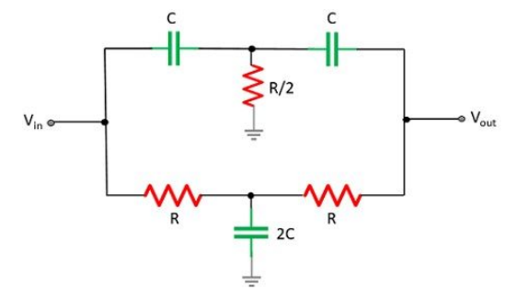
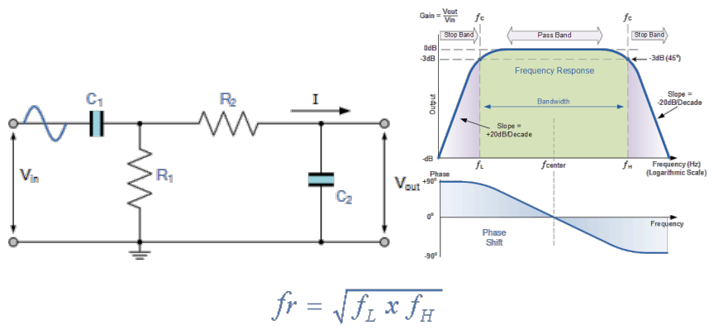
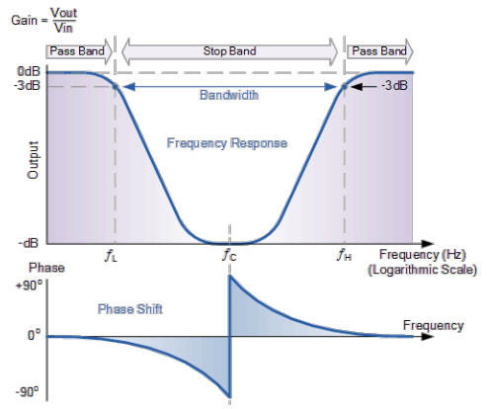
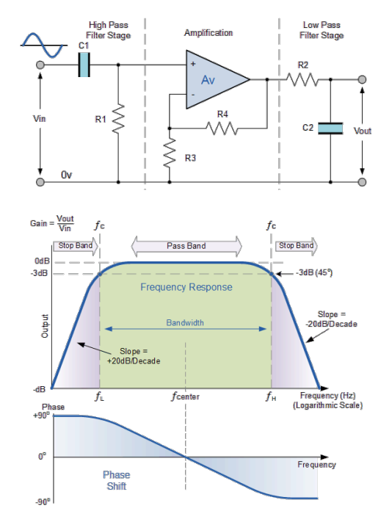
Band Pass Filter (BPF)
- Passes signals within a specific frequency range and attenuates signals outside that range.
Passive BPF
Active LPF
Band-Stop (Notch) Filter
- Attenuates signals within a specific frequency range and passes signals outside that range.

Slide 8
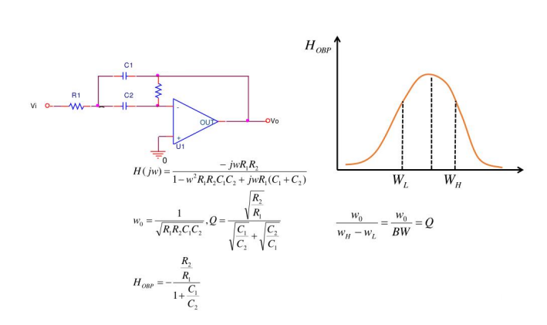
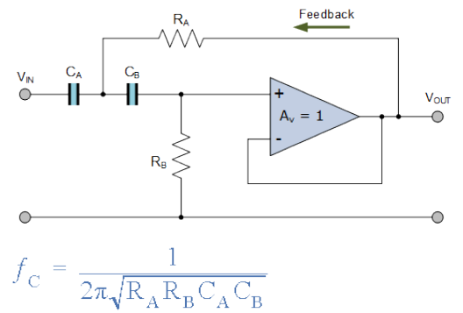
Filter Topology
Passive Filter
- Use only passive components (resistors, capacitors, and inductors). They are simple to implement but have limitations in terms of gain and impedance matching.
Active Filter
- Use active components (op-amps) in combination with passive components. They offer greater flexibility and can provide gain, impedance matching, and isolation. Common topologies include:
Sallen-Key 2. Multiple Feedback

Slide 9
Filter Design Consideration
Filter Order
- Determines the steepness of the filters roll-off. Higher-order filters have steeper roll-offs but are more complex to design and implement.
Passband Ripple
- The maximum amount of variation in the filter's gain within the passband.
Stopband Attenuation
- The minimum amount of attenuation provided by the filter in the stopband.
Quality Factor
- A measure of a filter's selectivity. A high Q filter has a narrow bandwidth and a high peak gain.
Realizability
- The ability to physically implement a filter using practical components such as resistors, capacitors, and inductors.

Slide 10
Higher Order Filter Comparison
Order | Components | Delay | Pros | Cons | When to use
1 | Very simple: 1 R + 1 C | Minimal phase distortion | Very cheap, smallest area | Poor stopband rejection | Low-precision systems
2 | Moderate: Sallen-Key or multiple feedback | Moderate phase shift | Steeper roll-off with modest complexity | Needs op-amp with GBW margin | When you need clearer stopband than 1st order but limited parts
4 | Higher: two 2nd-order stages | Larger phase shift & group delay | Practical for many ADC front-ends | More components, higher layout sensitivity | Good default for precision ADCs
5 | Higher: mix of 2nd + 3rd or cascaded stages | Significant phase/group delay | Strong stopband rejection with cascaded | More design effort, sensitive to tolerances | Use when tight anti-aliasing required
6+ | Complex: many stages or higher-order topologies | Large phase distortion | Very steep roll-off, strong rejection | Large area, high cost | Very high-performance systems

Slide 11
Filter Designing Requirements
- ADC resolution: 16-bit
- Sampling: 1.0 Vp-p, Single-ended
- Sampling rate: 1Msps
- Required Filter: 5-pole
- SNR: ~98dB
AAF Design Workflow
- Define ADC sampling rate
- Determine the Nyquist frequency
- Choose cutoff < 0.8 x Nyquist
- Select topology
- Simulate frequency response
Why 5-Pole Filter
- 1st/2nd order: Insufficient stopband attenuation
- 5th order: much steeper roll-off
- Provides required attenuation near 0.5-1MHz region

Slide 12
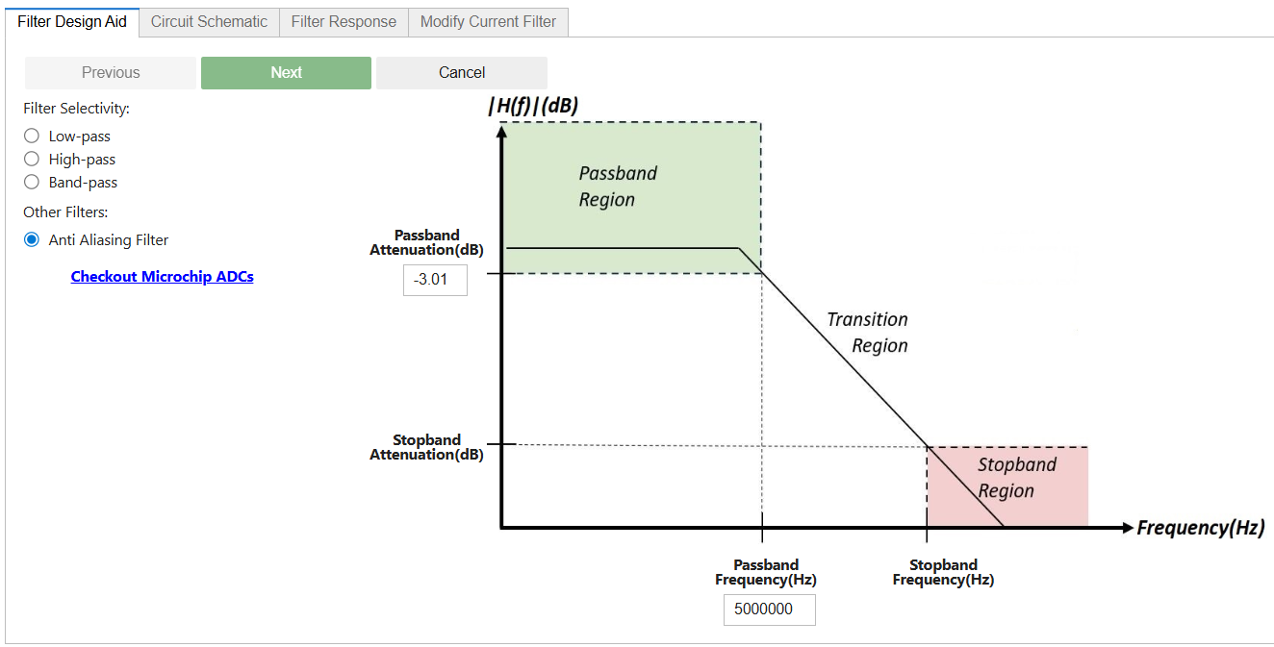
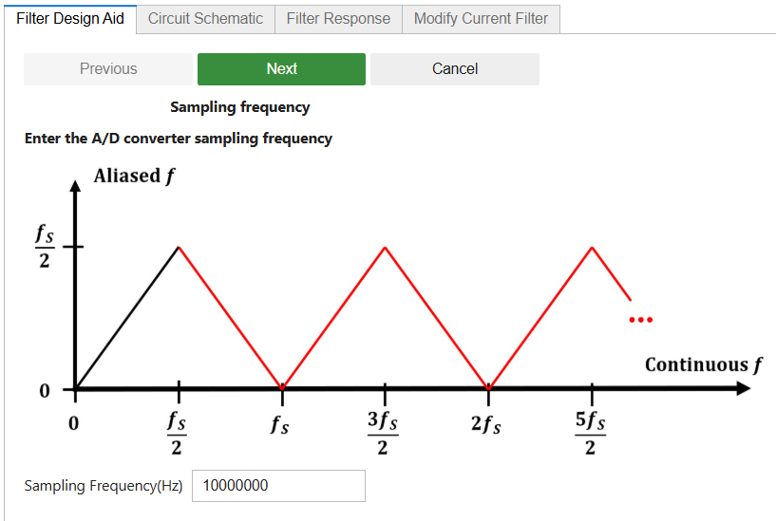
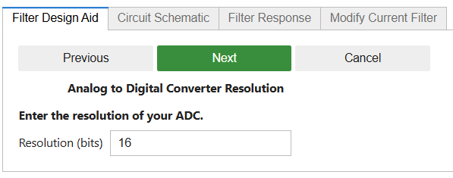
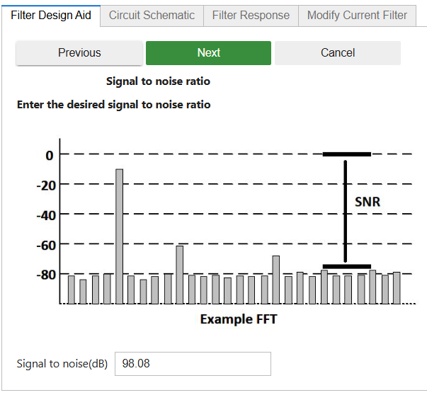
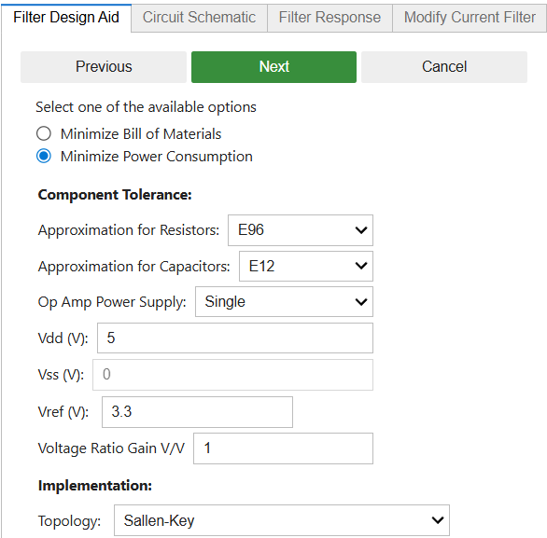
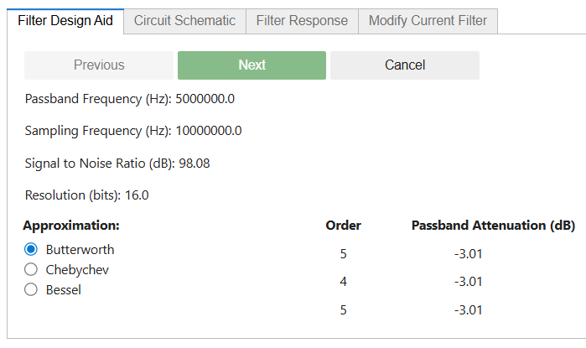
Filter Designing Using Microchip Filter designer (Active Filter)

Slide 13
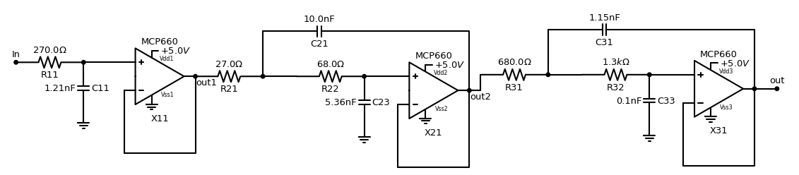
Filter Designing Using Microchip Filter designer (Active) - Depending the Inputs provided we can get the circuit for the AAF
ADC input is single-ended, unipolar, 1.0 Vp-p.
Use a 5-pole Active Anti-Aliasing Filter with 0.5 MHz nominal cutoff.
Cutoff frequency must be programmable.

