Slide 1
HTML , CSS

Slide 2
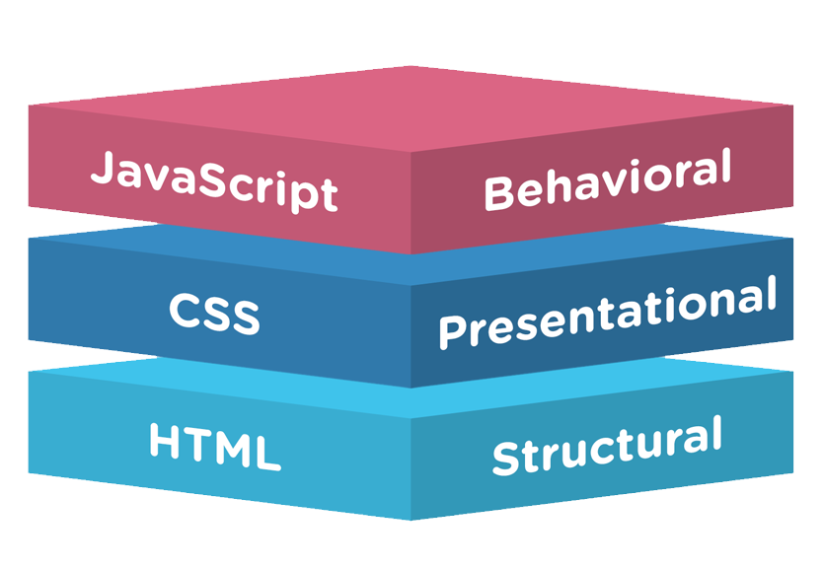
HTML vs CSS vs JAVASCRIPT
Overview

Slide 3
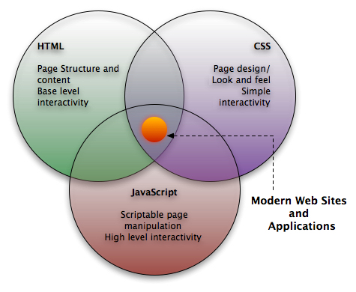
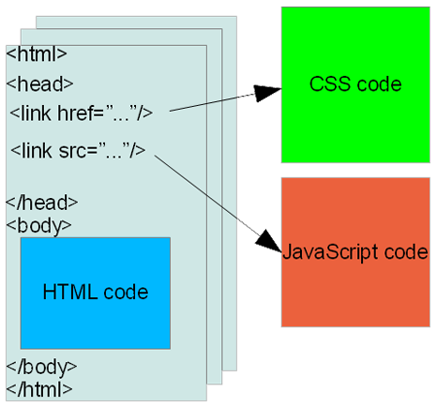
HTML vs CSS vs JAVASCRIPT
Overview

Slide 4
What is HTML?
Tim Berners-Lee was the author of html, with his team at CERN.
The HTML that Tim invented was strongly based on SGML (Standard Generalized Mark-up Language).
Hypertext Markup Language (First Version of HTML) was formally published on June 1993.
Platform independent.
HTML is a format that tells a computer how to display a web page.
The documents themselves are plain text files (ASCII) with special "tags" or codes that a web browser knows how to interpret and display on your screen.

Slide 5
HTML Versions
HTML 2.0
HTML 2.0 was developed by the Internet Engineering Task Force HTML Working Group in 1996.
HTML 3.2
HTML 4.0
HTML 4.01
HTML 4.01 was released as a W3C Recommendation 24. December 1999.
HTML 4.01 is a minor update of corrections and bug fixes in HTML 4.0.
W3C will not continue to develop HTML. Future W3C work will be focusing on XHTML.
Notes:
HTML 2.0 is an outdated version of HTML. All browsers available on the market today, rely on newer versions of HTML. For a Web developer there is no need to study the HTML 2.0 standard.
HTML 3.2 was released as a W3C Recommendation 14. January 1997. HTML 3.2 added widely-deployed (Netscape) features such as fonts, tables, applets, text-flow around images, superscripts and subscripts, to the existing HTML 2.0 Standard.
One of the elements that was added to the 1997 HTML 3.2 standard - the <font> tag - have introduced unnecessary complexity to the important task of separating HTML content (text) from its presentation (style). The <font> tag is expected to be removed from future versions of HTML.
HTML 4.0 was released as a W3C Recommendation 18. December 1997. A second release was issued on 24. April 1998 with only some editorial corrections.The most important feature of HTML 4.0 is the introduction of style sheets (CSS).

Slide 6
XHTML 1.0
XHTML 1.0 reformulates HTML 4.01 in XML.
XHTML 1.0 was released as a W3C Recommendation 20. January 2000.
HTML5
Web Hypertext Application Technology Working Group(WHATWG) and W3C came up with this in 2007
HTML 5 is a combination of HTML 4.01 and XHTML 1.0.
Many browsers are going to start supporting this in the future.
HTML 5 is backwards compatible.

Slide 7
You can write your HTML code in almost any available text editor, including notepad.
Open source text editor
Brackets http://brackets.io/ Notepad++ https://notepad-plus-plus.org/
or
We’ll use Eclipse which has built-in HTML Editor.
HTML Document will always be saved in .html extension or an .htm extension.

Slide 8
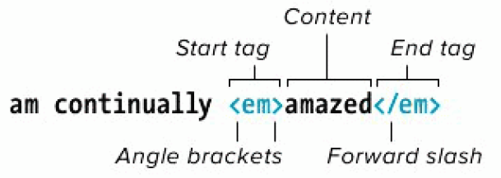
HTML Tags and Elements
Tags are enclosed in angle brackets < >
For Eg.: <html> Opening Tag, </html> Closing Tag.
Element is the combination of (opening & closing Tags and the content between them).
For Eg.:
<p>Part of this text is <b>bold</b>. </p> is a PARAGRAPH element that contains a BOLD element
An HTML document is a collection of elements (text/media with context).

Slide 9
Empty tags vs Container tags
Some elements which does not requires closing tags, are known as Empty Tags or Elements.
For Eg.:
<img src=“peoplestrategists_logo.jpg” alt=“People Strategists Logo” />
<br > begining of new line. BR stands for BReak.
<hr > puts a line across the page. HR stands for Horizontal Rule.
The elements which requires opening and closing tags, are known as Container Tags or Elements.
For Eg.:
<h1> This is a heading </h1>
<p> This is a paragraph </p>

Slide 10
HTML Attributes and Values
HTML elements can have attributes which provides additional information about an element.
Always specified in the opening tag and should contained value.
For Eg.:
<!DOCTYPE html>
<html>
<head>
<title>Align Attribute Example</title>
</head>
<body>
<p align="left">This is left aligned</p>
<p align="center">This is center aligned</p>
<p align="right">This is right aligned</p>
</body>
</html>
This is left aligned This is center aligned This is right aligned

Slide 11
Some Important Attributes
Attribute | Options | Function
title | User Defined | "Pop-up" title of the elements.
href | User Defined | The link address is specified in the href attribute opens.
class | User Defined | Classifies an element for use with Cascading Style Sheets.
id | User Defined | Names an element for use with Cascading Style Sheets.
bgcolor | numeric, hexidecimal, RGB values | Places a background color behind an element
background | URL | Places a background image behind an element
align | right, left, center | Horizontally aligns tags
valign | top, middle, bottom | Vertically aligns tags within an HTML element.
width | Numeric Value | Specifies the width of tables, images, or table cells.
height | Numeric Value | Specifies the height of tables, images, or table cells.

Slide 12
Structural Elements
A standard HTML document has two main structural elements
head contains setup information for the browser & the Web page
For E.g., the title for the browser window, style definitions, JavaScript code, …
body contains the actual content to be displayed in the Web page
<html lang=“en”>
<head>
<meta charset=“UTF-8” />
<title>My first HTML document</title>
</head>
<body>
<p> Hello world! </p>
</body>
</html>

Slide 13
Comments and doctype
HTML has a mechanism for embedding comments that are not displayed when the page is rendered in a browser.
Eg.: <!-- This is comment text -->
Besides tags, text content, and entities, an HTML document must contain a doctype declaration as the first line. For
Eg.:
<!DOCTYPE html>
<html lang=“en”>
<head>
<meta charset=“UTF-8” />
<title>My first HTML document</title>
</head>
<body>
<p> Hello world! </p>
</body>
</html>
Current version of HTML is 5 and it makes use
of the following declaration: <!DOCTYPE html>
Notes:
Note : The doctype declaration is not an HTML tag, but tells the browser which version of HTML the page is written in.

Slide 14
doctype
DOCTYPE tells the consuming user agent (web browsers, web crawlers, validation tools) what type of document the file is. Using it ensures that the consumer correctly parses the HTML as you intended it.
HTML 4.01 Strict
This DTD contains all HTML elements and attributes, but does NOT INCLUDE presentational or deprecated elements (like font).
<!DOCTYPE HTML PUBLIC "-//W3C//DTD HTML 4.01//EN" "http://www.w3.org/TR/html4/strict.dtd">
HTML 4.01 Transitional
This DTD contains all HTML elements and attributes, INCLUDING presentational and deprecated elements (like font).
<!DOCTYPE HTML PUBLIC "-//W3C//DTD HTML 4.01 Transitional//EN“ "http://www.w3.org/TR/html4/loose.dtd">

Slide 15
doctype
HTML 4.01 Frameset
This DTD is equal to HTML 4.01 Transitional, but allows the use of frameset content.
<!DOCTYPE HTML PUBLIC "-//W3C//DTD HTML 4.01 Frameset//EN" "http://www.w3.org/TR/html4/frameset.dtd">
HTML 5
<!DOCTYPE html>

Slide 16
<head> and <body> Elements
The <head> element is where you include a <title> element (that appears in the title bar of the browser).
You can also include lots of other type of information in the <head> element.
Cascading Style sheet information, or a link to an external style sheet (or several).
“Meta” data, such as who authored the page, the type of content, and clues that search engines may (or may not) use to help categorize your page.
JavaScript code.
The <body> element contains the main bulk of the material to be displayed on the webpage.
Paragraphs.
Tables and lists.
Images.
JavaScript code.
PHP code can be included here too (if passed through a PHP parser before being served to the client’s browser).
Other embedded objects (videos, etc).

Slide 17
<head> Elements
Meta tags
The <meta> tag provides metadata about the HTML document.
Meta elements are typically used to specify page description, keywords, author of the document, last modified, and other metadata.
Some examples –
Example 1 - Define keywords for search engines:
<meta name="keywords, description " content="HTML, CSS, XML, XHTML, JavaScript">
Example 3 - Define the author of a page:
<meta name="author" content="Hege Refsnes">
Example 4 - Refresh document every 30 seconds:
<meta http-equiv="refresh" content="30">

Slide 18
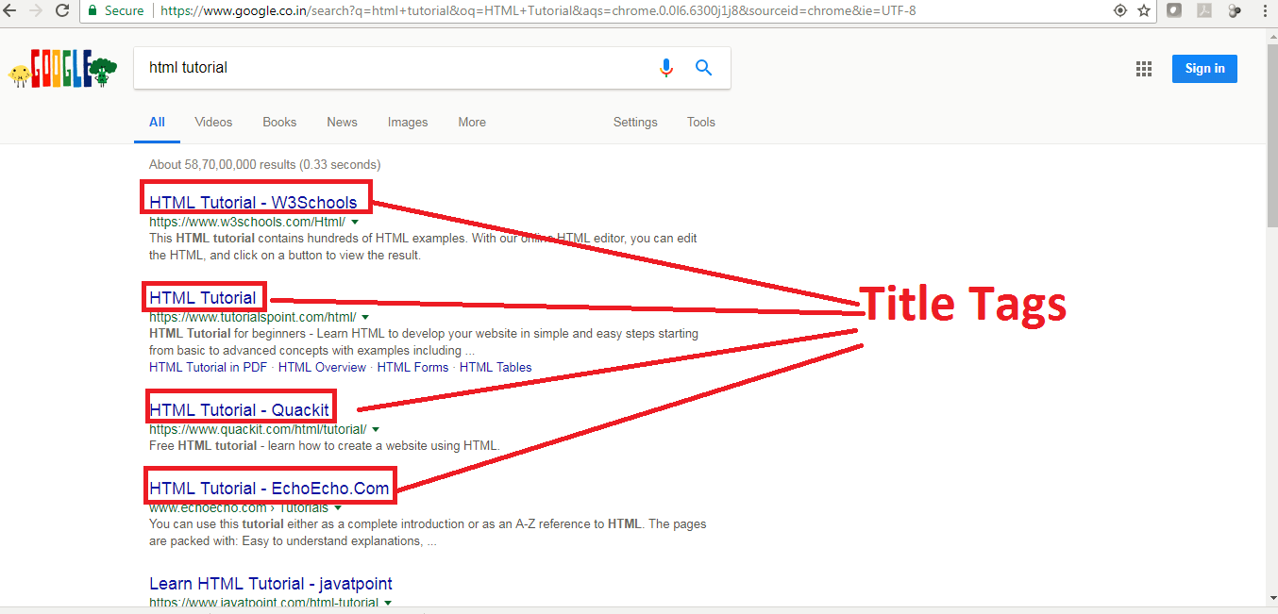
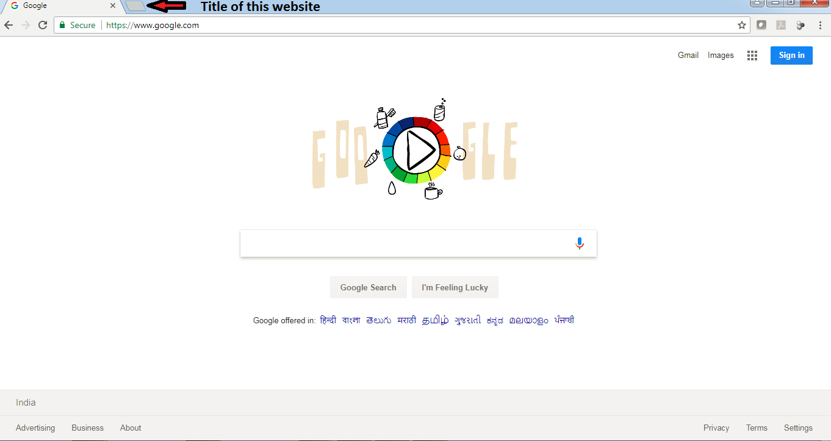
<head> Elements (Cont.)
Title Tag
The <title> tag is required in all HTML documents and it defines the title of the document.
The <title> element: Defines a title in the browser toolbar.
Provides a title for the page when it is added to favorites.
Displays a title for the page in search-engine results.
Eg.:

Slide 19
<head> Elements (Cont.)
Link Tag
The <link> tag defines a link between a document and an external resource.
In HTML the <link> tag has no end tag.
Some Imp. Attributes – charset, - To know browser, which character encoding is used. href, - hyperlink. rel, - Relation between linked document. target. – It specifies where to open the linked document.
Example –
<head>
<link rel="stylesheet" type="text/css" href="theme.css">
</head>
Notes:
Note : The <link> tag is used to link to external style sheets.
The <link> element is an empty element, it contains attributes only.

Slide 20
<head> Elements (Cont.)
Script Tags
The <script> tag is used to define a client-side script, such as a JavaScript.
The <script> element either contains scripting statements, or it points to an external script file through the src attribute.
Example -
<html>
<head>
<title>Align Attribute Example</title>
</head>
<body>
<p id="demo"></p>
<script>document.getElementById("demo").innerHTML = "Hello JavaScript!"; </script>
</body>
</html>
Hello JavaScript!
Notes:
Note: Script can be used in both head and body section. In accordance with logic of script it can be used in either of the section.
Mostly it is used in the head section.

Slide 21
<head> Elements (Cont.)
Style Tag
The <style> tag is used to define style information for an HTML document.
Inside the <style> element you specify how HTML elements should render in a browser.
Example-
<html>
<head>
h1 {color:red;} p {color:blue;}
</head>
<body>
<h1>A heading</h1> <p>A paragraph.</p>
</body>
</html>
This is a heading This is a paragraph.
Notes:
Note: Each HTML document can contain multiple <style> tags.
Style can also be used externally using link tag. We’ll discuss this more deeply in CSS.

Slide 22
Elements for the BODY section
Block-level elements
The BODY of a document consists of multiple block elements. If plain text is found inside the body, it is assumed to be inside a paragraph P. See the syntax rules for an explanation of the syntax used in the overview.
Headings
H1 - Level 1 header
H2 - Level 2 header
H3 - Level 3 header
H4 - Level 4 header
H5 - Level 5 header
H6 - Level 6 header
Text containers
P - Paragraph
PRE - Preformatted text
BLOCKQUOTE - Large quotation
ADDRESS - Address information
Text Level Elements
Logical Markups
Physical Markups
Special Markups
Lists
UL - Unordered list
OL - Ordered list
DIR - Directory list
MENU - Menu item list
LI - List item
DL - Definition list
DT - Definition term
DD- Definition
Others
DIV - Logical division
CENTER - Centered division
FORM - Input form
HR - Horizontal rule
TABLE - Tables

Slide 23
Elements for the BODY section
Headings
There are 6 types of heading tags.
Eg.: –
<html>
<body>
<h1>This is heading 1</h1>
<h2>This is heading 2</h2>
<h3>This is heading 3</h3>
<h4>This is heading 4</h4>
<h5>This is heading 5</h5>
<h6>This is heading 6</h6>
<p><b>Tip:</b> Use h1 to h6 elements only for headings. Do not use them just to make text bold or big. Use other tags for that.</p>
</body>
</html>
This is heading 1 This is heading 2 This is heading 3 This is heading 4 This is heading 5 This is heading 6 Tip: Use h1 to h6 elements only for headings. Do not use them just to make text bold or big. Use other tags for that.

Slide 24
Elements for the BODY section (Cont.)
<p> - Paragraph Tag and <pre> - Preformatted Tag
<p> Tag - Another way to structure your text in paragraph forms.
<Pre> Tag - is used to apply structural exactness.
Eg.:
<html>
<body>
<p>This is a paragraph of text.</p>
<p>This is a second paragraph of text.</p>
<pre>This is preformatted text with exact space,
line and breaks.</pre>
</body>
</html>
This is a paragraph of text. This is a second paragraph of text. This is preformatted text with exact space, line and breaks.

Slide 25
Elements for the BODY section (Cont.)
<blockquote> Tag and <address> Tag
Blockquote Tag - Indicates that the enclosed text is an extended quotation.
Address Tag - Address Information of the Author/Owner.
Eg.:
<html>
<body>
<blockquote cite="http://www.sujatabatra.com/">
<p>This is a quotation taken from the Sujata Batra.</p>
</blockquote>
<address>
Written by
<a href="mailto:sujatabatra@hotmail.com">Sujata Batra</a>.<br>
Visit us at:<br>
www.SujataBatra.com<br>
S1, TowerX, Some Business Bay,<br>
Outer Ring Road, Delhi.
</address>
</body>
</html>
This is a quotation taken from the Sujata Batra. Written by Sujata Batra. Visit us at: www.SujataBatra.com S1, TowerX, Some Business Bay, Outer ring road, Delhi.

Slide 26
Elements for the BODY section (Cont.)
Text Formatting Elements
Physical markup
TT - Teletype
I - Italics
B - Bold
U - Underline
STRIKE - Strikeout
BIG - Larger text
SMALL - Smaller text
SUB - Subscript
SUP - Superscript
Logical markup
EM - Emphasized text
STRONG - Strongly emphasized
DFN - Definition of a term
CODE - Code fragment
SAMP - Sample text
KBD - Keyboard input
VAR - Variable
CITE - Short citation
Special markup
A - Anchor
IMG - Image
BASEFONT - Default font size
APPLET - Java applet
PARAM - Parameters for Java applet
FONT - Font modification
BR - Line break
MAP - Client-side imagemap
AREA - Hotzone in imagemap

Slide 27
Elements for the BODY section (Cont.)
Text Formatting Elements (Physical Markup)
Tag Description
<b>….</b> - bold.
<i>……</i> - italic.
<u>….</u> - underline.
<strike>…</strike> - strikethrough.
<sub>….</sub> - subscript.
<sup>….</sup> - superscript.
<big>….</big> - bigger font (one font size bigger).
<small>….</small> - small font (one font size smaller).
<tt>….</tt> - typewriter (monospaced).

Slide 28
Elements for the BODY section (Cont.)
Text Formatting Elements (Physical Markup)
<html>
<body>
<b> Sujata Training. </b> <br>
<i> Java Training. </i> <br>
<u> Powered by – Sujata Batra. </u> <br>
<strike> Text. </strike> <br>
<small> Copyright &copy Sujata Batra Pvt.Ltd. </small>
<sub> Subscipt. </sub>
<sup> Superscript. </sup>
</body>
</html>
Sujata Training. Java Training. Powered by – Sujata Batra. Text. Copyright © Sujata Batra Pvt.Ltd. _{Subscipt.} ^{Superscript.}

Slide 29
Elements for the BODY section (Cont.)
Text Formatting Elements (Logical Markup)
Tag Description
<em> - Emphasized
<strong> - Strongly emphasized
<dfn> - A definition
<code> - Represents computer code
<kbd> - keyboard characters
<var> - Program variable
<cite> - A citation
Notes:
Logical tags allow the browser to render that information in the manner most appropriate for that browser. Text that should be emphasized (<EM>) may be best emphasized in Windows with italics, and bold in Unix.
Logical tags help you, the author, keep track of what you are saying, without the distraction of presentation. If you need to indicate someone's address, use <ADDRESS>, knowing it will be presented in an appropriate manner.

Slide 30
Elements for the BODY section (Cont.)
Text Formatting Elements (Logical Markup)
<html>
<body>
<em> Sujata Training. </em> <br>
<strong> Java Training. </strong > <br>
<dfn> Powered by - SujataBatra. </dfn > <br>
<code> Text. </code> <br>
<kbd> Subscipt. </kbd>
<var> Superscript. </var>
<cite> Superscript. </cite>
</body>
</html>
Sujata Training. Java Training. Powered by - SujataBatra. Text. Subscipt. Superscript. Superscript.

Slide 31
Elements for the BODY section (Cont.)
Text Formatting Elements (Special markup)
Links and Navigation
Anchor Element-
An anchor can be used to create a link to another document (with the href attribute).
Types –
External : <a href=“https://www.google.com”>Our Best Friend</a>
Internal : <a href=“\contact.htm”>contact</a>
Image Tag-
The syntax for the tag to insert image into the webpage is- <img src=“url” alt=“alternate text”>
Eg.: <img src=“\images\SomeImage.jpg” alt=“Some Image”>
Notes:
Linking the pages
A link is a unidirectional pointer from a source document that contains the link to the some destination. Links help the user to navigate across pages as well as within a page. The text or an image that provides such link(s) is called hypertext or hyperlink.
Hyperlinks can be created by using a <A> tag, which stands for anchor and has the following attributes.
HREF - Hypertext Reference: This attribute points the link to a bookmark, another file, either within the same webs site or elsewhere on the internet.
NAME - Name: The name of the bookmark. This attribute lets you “bookmark” a location on the web page. An HREF anchor can point a link to that area on the page.
TITLE - Displays balloon help in IE
TARGET - With the target attribute, you can define where the linked document will be opened.
You can use HREF to point to a URL and allow the reader to view the page from the beginning. Or, you can use HREF to point to a specific area of that page, indicated by a NAME bookmark, so that the user goes straight to that section of the document.
Formatting the Link
The following attributes of <BODY> tag is used to provide color for the link.
LINK - Specifies the link color.
VLINK - Specifies the visited link color
ALINK - Specifies the active link color.
Inseting Image
“SRC” Attribute: used to mention the path where the image file is stored and the image file name.
“ALT” Attribute: used to display an alternate text in case the image file could not be loaded.

Slide 32
Elements for the BODY section (Cont.)
Unordered List and Odered Lists
Unordered Lists - <ul> tag. Item lists in <li> tag. The list items will be marked with bullets.
Ordered Lists - <ol> tag. Item lists in <li> tag. . The list items will be marked with numbers.
Eg.:
<html>
<body>
<h2>Unordered List </h2>
<ul>
<li>Java</li>
<li>Python</li>
<li>Ruby</li>
</ul>
<h2>Ordered List </h2>
<ol>
<li>Java</li>
<li>Python</li>
<li>Ruby</li>
</ol>
</body>
</html>
Unordered List Java Python Ruby Ordered List Java Python Ruby

Slide 33
Elements for the BODY section (Cont.)
Div Tag
<div> tag – Used to defines a division or a section in an HTML document. And to group block-elements to format them with CSS.
Eg.:
<html>
<body>
<div style="color:#00FF00">
<h2>Sujata Academy</h2>
<p>Welcome to Java Training</p>
</div>
</body>
</html>
Sujata Academy Welcome to Java Training.

Slide 34
Elements for the BODY section (Cont.)
Table Element
<table> Tag : <tr> Table Row - Defines a new row, <td> Table Data - Defines a single cell, <th> Table Headings - Defines header cell.
<html>
<body>
<style> table, th, td { border: 1px solid black; }
</style>
<table>
<tr>
<th>Day</th> <th>Session</th>
</tr>
<tr>
<td>Thursday</td> <td>HTML</td>
</tr>
<tr>
<td>Friday</td> <td>CSS</td>
</tr>
</table>
</body>
</html>
Day | Session
Thursday | HTML
Friday | CSS
Notes:
Tables can be used not only to display tabular data but also to position the contents of the page in a
more structured manner. The page layout can be controlled very effectively with tables. Tables are
defined with the <table> tag.
Note: Tables are used on websites for two major purposes.
1) The primary purpose of arranging information in a table
2) The more widely used purpose of creating a page layout with the use of hidden tables. (border attribute values set to “0”).
The Attributes and it values
ALIGN - Align the table in a web page. (LEFT | RIGHT | CENTER).
BORDER - Specifies the thickness of the border
BGCOLOR - The background color for the table.
CELLPADDING - Specifies the space between the cell wall and contents .
CELLSPACING - Specifies the space between cell.
WIDTH - Specifies the width of the table
The WIDTH attribute value can be in percent (or) pixels. Pixels can be thought of as the smallest
logical unit for display. Pixel resolution can vary from PC to PC. Tables built with percents will
occupy that percentage of the browser’s visible area or the container area.

Slide 35
Tables
Display data in a tabular format.
Helps in positioning the contents of the page in a more structured way.
<TABLE> ….. </TABLE> : define a table.
Some attributes
ALIGN = LEFT | RIGHT | CENTER
BORDER = n (Number of Pixels )
BGCOLOR = “color” | “#rrggbb”
CELLSPACING = n (Number of Pixels )
CELLPADDING = n (Number of Pixels )
WIDTH= % Of Parent | n (pixels)
Notes:
Tables can be used not only to display tabular data but also to position the contents of the page in a
more structured manner. The page layout can be controlled very effectively with tables. Tables are
defined with the <table> tag.
Note: Tables are used on websites for two major purposes.
1) The primary purpose of arranging information in a table
2) The more widely used purpose of creating a page layout with the use of hidden tables. (border attribute values set to “0”).
The Attributes and it values
ALIGN - Align the table in a web page. (LEFT | RIGHT | CENTER).
BORDER - Specifies the thickness of the border
BGCOLOR - The background color for the table.
CELLPADDING - Specifies the space between the cell wall and contents .
CELLSPACING - Specifies the space between cell.
WIDTH - Specifies the width of the table
The WIDTH attribute value can be in percent (or) pixels. Pixels can be thought of as the smallest
logical unit for display. Pixel resolution can vary from PC to PC. Tables built with percents will
occupy that percentage of the browser’s visible area or the container area.

Slide 36
Table structure
<TABLE BORDER=1> <!-- start of table definition -->
<CAPTION> caption contents </CAPTION> <!--caption definition -->
<TR> <!-- start of header row definition --> <TH> first header cell contents </TH> <TH> last header cell contents </TH>
</TR> <!-- end of header row definition -->
<TR> <!-- start of first row definition --> <TD> first row, first cell contents </TD> <TD> first row, last cell contents </TD>
</TR> <!-- end of first row definition -->
<TR> <!-- start of last row definition --> <TD> last row, first cell contents </TD> <TD> last row, last cell contents </TD>
</TR> <!-- end of last row definition –>
</TABLE> <!-- end of table definition -->
Notes:
Table structure
Tables are defined with the <TABLE> tag.
A table is divided into rows (with the <TR> tag), and each row is divided into data cells (with the <TD> tag).
The letters TD stands for “Table Data", which is the content of a data cell. A data cell can contain text, images, lists, paragraphs, forms, horizontal rules, tables, etc
<TH> specifies the table header cell. It should occur within a<TR> tag. Some browsers will emphasize the text enclosed by this tag.
<CAPTION> tag is used to give heading to the table. By default caption is placed above the table.
<CAPTION ALIGN =“bottom” > will place the caption below the table.

Slide 37
Creating tables
Simple sample table :
Heading1 | Heading2
Cell 1 | Cell 2
Cell 3 | Cell 4
<TABLE BORDER=1 CELLSPACING=1 CELLPADDING=1 WIDTH=30%>
<CAPTION> Simple sample table </CAPTION>
<TR>
<TH>Heading1</TH> <TH>Heading2</TH> </TR> <TR> <TD>Cell 1</TD> <TD>Cell 2</TD> </TR> <TR> <TD>Cell 4</TD> <TD>Cell 5</TD> </TR>
</TABLE>
Notes:
The <TD> Attributes.
ALIGN - Defines the horizontal alignment in cells and values can be left, right, center, justify.
BGCOLOR - Specifies the background color of the table cell.
VALIGN - Specifies the vertical alignment of cell content and values can be top, iddle, bottom, baseline
WIDTH - Specifies the width of the table cell.( % (or) pixels)
COLSPAN - Indicates the number of columns this cell should span
ROWSPAN - Indicates the number of rows this cell should span

Slide 38
Creating tables
<TABLE WIDTH="100%" BORDER=1 BGCOLOR=gray> <TR ALIGN=CENTER > <TD COLSPAN=2>This cell spans 2 columns!</TD> <TD> Cell </TD></TR> <TR ALIGN=CENTER > <TD ROWSPAN=3>This cell spans 3 rows!!</TD> <TD> Cell </TD> <TD> Cell </TD></TR> <TR ALIGN=CENTER > <TD> Cell </TD> <TD> Cell </TD></TR> <TR ALIGN=CENTER > <TD> Cell </TD> <TD> Cell </TD> </TR>
</TABLE>
This cell spans 2 columns! |  | Cell
This cell spans 3 rows!! | Cell | Cell
 | Cell | Cell
 | Cell | Cell
Notes:
The rowspan and colspan attributes.
By adding the rowspan and colspan attributes to the table elements, it is possible to create data cells
that span a given number of rows or columns.
To set a cell to span three rows use <td rowspan=“3”> and to set a heading to span two columns,
use <th colspan=“2”>.
Setting the value of colspan and rowspan to more than the number of columns or rows in the table
Should not extend the size of the table.

Slide 39
Elements for the BODY section (Cont.)
Form Elements
<form> - It is a method of accepting inputs from user. A form is an area that can contain form elements.
Eg.:
<form name=“form1” action="abc.asp" method=get>
<!- form elements -->
</forms>
Name- is used for future manipulation of data by scripting language.
Action- indicates a program on the server that will be executed when this form is submitted. Mostly it will be an ASP or a CGI script.
Method- indicates the way the form is submitted to the server - popular options are GET/POST.
Notes:
Note : Form data can be manipulated by client side scripts like Javascript and VBScript.
GET method.
The GET method is the default method for browsers to submit information.
GET is easy to deal and fast.
All the information form the form is appended onto the end of the URL.
It is not secure because the data input appears in the URL.
Most browsers limit a URL to several thousand characters.
POST method.
Used to pass large amount of information to the server.
Contents are sent with HTTP request body not with URL.

Slide 40
Elements for the BODY section (Cont.)
Form Elements
Form Elements | Description
Text Field | Can create a Text Field by using Input Element with Type Attribute.
Pass Word Field | When text is entered in Pass Word Field it shows **** Symbol
Combo Box | It can have multiple values and it allows user to select one value at a time
List Box | It can have multiple values and allows user to select more than one value at a time
Radio Button | Can create a Radio Button by using Input Element with Value and Name Attribute
Check Box | Can create Check box by Using Input Element
Command Button | This is useful for submitting any data that is helpful in transferring data across different interfaces

Slide 41
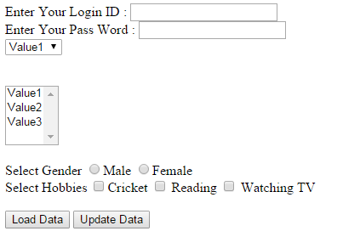
Elements for the BODY section (Cont.)
Form Elements
<html>
<body>
<form name=“frm”>
Enter Your Login ID : <input type=textsize=20><br>
Enter Your Pass Word : <input type=Password maxlength=8 size=20><br>
<select name=combo1>
<option>Value1</option>
<option>Value2</option>
<option>Value3</option>
</select> <br><br><br>
<select name=combo1 multiple>
<option>Value1</option>
<option>Value2</option>
<option>Value3</option>
</select><br><br>
Select Gender
<input type=Radio value=Male name=Checked>Male
<input type=Radio value=Female name=Checked>Female <br>
Select Hobbies
<input type= Checkbox >Cricket
<input type= Checkbox > Reading
<input type= Checkbox > Watching TV<br><br>
<input type=submit value="Load Data">
<input type=button value="Update Data">
</form>
</body>
</html>
Notes:
Note : Form data can be manipulated by client side scripts like Javascript and VBScript.
GET method.
The GET method is the default method for browsers to submit information.
GET is easy to deal and fast.
All the information form the form is appended onto the end of the URL.
It is not secure because the data input appears in the URL.
Most browsers limit a URL to several thousand characters.
POST method.
Used to pass large amount of information to the server.
Contents are sent with HTTP request body not with URL.

Slide 42
Elements for the BODY section (Cont.)
Character Entities
Some characters like the < character, have a special meaning in HTML, and therefore cannot be used in the text. The most common character entities:
Result | Description | Entity Name
< > & “ ‘ | non-breaking space less than greater than ampersand quotation mark apostrophe | &nbsp; &lt; &gt; &amp; &quot; &apos;
Some Other Commonly Used Character Entities
© ® £ ¥ | copyright registered trademark pound yen | &copy; &reg; &pound; &yen;

Slide 43


Slide 44
Overview
Advance version of HTML.
In 2008, the first HTML5 public draft was released
HTML5 W3C Final Recommendation was released 28. October 2014.
New elements, attributes, and behaviors were introduced.
It helps to create more powerful website and interactive web applications.
HTML5 comes with XML syntax.
HTML5 is to compete with Flash and Silverlight.
Empowering Mobile devices.

Slide 45
Technical Advantages Over Previous Version.
Audio and Videos are integral part of HTML5 specifications e.g. <audio> and<video> tags.
Vector graphics is integral part of HTML5 e.g. SVG and canvas.
JS GeoLocation API in HTML5 helps identify location of user browsing any website (provided user allows it).
Full duplex communication channels can be established with Server using Web Sockets.
Allows JavaScript to run in background. This is possible due to JS Web worker API in HTML5.
Application Cache, Web SQL database and Web storage is available as client side storage.
Retain Backward Compatibility with previous versions of HTML5.

Slide 46
HTML5 Technology Functions
Semantics: allowing you to describe more precisely what your content is.
Connectivity: allowing you to communicate with the server in new and innovative ways.
Offline & Storage: allowing webpages to store data on the client-side locally and operate offline more efficiently.
Multimedia: making video and audio first-class citizens in the Open Web.
2D/3D Graphics & Effects: allowing a much more diverse range of presentation options.
Performance & Integration: providing greater speed optimization and better usage of computer hardware.
Device Access: allowing for the usage of various input and output devices.
Styling: letting authors write more sophisticated themes.

Slide 47
HTML5 New Tags and Elements
HTML5 Indroduces 28 New Elements, Some of them are mentioned here.
Navigation:
<article>
<aside>
<header>
<hgroup>
<footer>
<figure>
<figcaption>
<nav>
<section>
Multimedia/Interactivity:
<audio>
<canvas>
<embed>
<source>
<track>
<video>
New <input> types:
color
date
datetime
datetime-local
email
month
number
range
search
tel
time
url
week
Miscellaneous:
<bdi>
<command>
<datalist>
<details>
<keygen>
<mark>
<meter>
<output>
<progress>
<summary>
<rp>
<rt>
<ruby>
<time>
<wbr>

Slide 48
Elements removed in HTML5
Element | Use instead
<acronym> | <abbr>
<applet> | <object>
<basefont> | CSS
<big> | CSS
<center> | CSS
<dir> | <ul>
<font> | CSS
<frame>
<frameset>
<noframes>
<strike> | CSS
<tt> | CSS

Slide 49
Migration from HTML4 to HTML5
HTML4 | HTML5
<div id="header"> | <header>
<div id="menu"> | <nav>
<div id="content"> | <section>
<div id="post"> | <article>
<div id="footer"> | <footer>

Slide 50
Defining HTML5 Documents
Remember the DOCTYPE declaration-
<!DOCTYPE html>
Again, HTML5 simplifies this line:
<html lang="en">
The default character encoding (charset) declaration
<meta charset="UTF-8">
Notes:
Program –
<!doctype html>
<html lang="en">
<head>
<meta charset="utf-8">
<title>Welcome to Snapdeal Academy</title>
</head>
<body>
</body>
</html>

Slide 51
Semantic Elements
A semantic element clearly describes its meaning to both the browser and the developer.
Eg. of non-semantic elements: <div> and <span> - Tells nothing about its content.
Eg. of semantic elements: <form>, <table>, and <img> - Clearly defines its content.
Many web sites contain HTML code like: <div id="nav"> <div class="header"> <div id="footer"> to indicate navigation, header, and footer.
HTML5 offers new semantic elements to define different parts of a web page:
<article>
<aside>
<details>
<figcaption>
<figure>
<footer>
<header>
<main>
<mark>
<nav>
<section>
<summary>
<time>

Slide 52
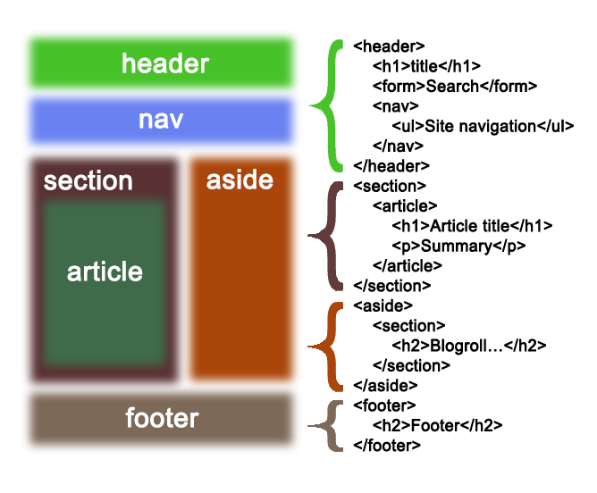
Semantic Elements

Slide 53
Graphics API
(Canvas and SVG)
Previously possible with Flash, VML, Silverlight.
Very complex to do in JavaScript without plugins (for example, rounded corners or diagonal lines).
Provide native drawing functionality on the Web.
Completely integrated into HTML5 documents (Part of DOM).
Can be styled with CSS.
Can be controlled with JavaScript.

Slide 54
(Canvas and SVG)
Both have their own unique features and can be used combined.
Canvas | SVG
Low level | High Level
Immediate mode | Retained mode
Fixed size | Scalable
Best for keyboard-based apps | Best for mouse-based apps
Animation (no object storage) | Medium animation
Pixels | XML object model
No interaction | User interaction (hit detection, events on the tree)

Slide 55
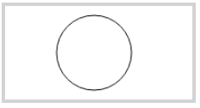
Canvas
<canvas> element as “a resolution-dependent bitmap canvas which can be used for rendering graphs, game graphics, or other visual images on the fly.” A canvas is a rectangle in your page where you can use JavaScript to draw anything you want and CSS for styling. In 2D context and 3D context (Web GL).
Eg.:
<canvas id="myCanvas" width="200" height="100" style="border:4px solid #d3d3d3;"> Your browser does not support the HTML5 canvas tag.</canvas> <script> var c = document.getElementById("myCanvas"); var ctx = c.getContext("2d"); ctx.beginPath(); ctx.arc(95,50,40,0,2*Math.PI); ctx.stroke(); </script>

Slide 56


SVG – Scalable Vector Graphics
<svg> element Modularized, XML-based language for describing 2D vector and mixed vector/raster graphics. You can zoom SVG graphics to any level.
Eg.:
<svg width="100" height="100"> <circle cx="50" cy="50" r="40" stroke="blue" stroke-width="4" fill="orange" /> Sorry, your browser does not support inline SVG. </svg> <br> <svg width="300" height="200"> <polygon points="100,10 40,198 190,78 10,78 160,198" style="fill:red;stroke:black;stroke-width:5;fill-rule:evenodd;" /> Sorry, your browser does not support inline SVG. </svg>

Slide 57
HTML5 Media Elements - Audio and Video
<audio> and <video>- are two new HTML5 media elements can be controlled using Audio/Video API, have native support in the browser (Embedded Codecs).
AV Containers and Codecs
Audio and Video containers H264 and Ogg.
Audio and Video codecs (algorithm used to encode and decode an audio or video stream) Audio – AAC, MP3, Vorbis. Video – H264, MP4, Theora.
You can add multiple formats per (Audio/Video).
Notes:
HTML <video> Element
<video width="320" height="240" controls>
<source src="movie.mp4" type="video/mp4">
<source src="movie.ogg" type="video/ogg">
Your browser does not support the video tag.
</video>
HTML <audio> Element
<audio controls> <source src="horse.ogg" type="audio/ogg"> <source src="horse.mp3" type="audio/mpeg"> Your browser does not support the audio element. </audio>

Slide 58
Example
HTML <video> Element <video width="320" height="240" controls> <source src="movie.mp4" type="video/mp4"> <source src="movie.ogg" type="video/ogg"> Your browser does not support the video tag. </video>
HTML <audio> Element <audio controls> <source src="horse.ogg" type="audio/ogg"> <source src="horse.mp3" type="audio/mpeg"> Your browser does not support the audio element. </audio>

Slide 59
HTML5 Plug-ins
To extend the functionality of the HTML browser. Plug-ins are also known as Helper Applications. Popular example of plug-ins are Java applets. Plug-ins can be added to web pages with the <object> tag or the <embed> tag.
<object> Element – It is used to embed plug-ins (like Java applets, PDF readers, Flash Players) in web pages.
Eg.: <object width=“200" height=“60" data=“SujataTraining.swf"></object>
<embed> Element – Used to embed object within an HTML document. It does not have closing tag.
Eg.: <embed width=“200" height=“60" src=“SujataTraining.swf">

Slide 60
HTML5 IDEs and Tools
C
1. Currently limited HTML5 IDE support
-SEEdit (Text Editor)
2. HTML5 simplicity reduces work.
3. Advanced browser development tools allow for “semi-rapid” development and live coding.
-Chrome Developer Console.
-Safari Web Inspector.
-Firefox Firebug Add-on and Opera Firefly.
4. More IDE support as specification solidifies.

Slide 61
CSS

Slide 62
What is CSS ?
CSS stands for “Cascading Style Sheets”
Cascading: refers to the procedure that determines which style will apply to a certain section, if you have more than one style rule.
Style: how you want a certain part of your page to look. You can set things like color, margins, font, etc for things like tables, paragraphs, and headings.
Sheets: the “sheets” are like templates, or a set of rules, for determining how the webpage will look.
CSS is a stylesheet language used to describe the presentation of a document written in HTML or XML.

Slide 63
CSS
History
CSS1 was the first edition introduced in 1996.
CSS2 was published in 1998 and provides enhancement over CSS1.
CSS2.1 was the last 2nd generation edition of CSS.
CSS 3 is the latest edition. Several new functionalities have been provided through CSS3.
Functions like rounded corners, backgroubnd decoration, box shadows, which are demonstrated in the subsequesnt sections, are introduced in this version.

Slide 64
CSS
Advantages
A web application will contains hundreds of web pages, which are created using HTML.
Formatting these HTML pages will be a laborious process, as formatting elements need to be applied to each and every page.
CSS saves lots of work as we can change the appearance and layout of all the web pages by editing just one single CSS file.

Slide 65
CSS Syntax Rules
Rule have two parts - Selector and declaration.
Selector: The HTML element you want to add style to.
<p> <h1> <table> etc
Declaration: The statement of style for that element. Made up of property and value.
Rules
Declaration
Selector
p {font-family:Arial;}
Property
Value
Declaration
Notes:
A CSS declaration must always end with semi colon.
There can be multiple declarations represented by multiple property value pairs.
You can also have declarations on separate lines for easy readability like –
P {
font-family:Arial; }
4. CSS is a Case-Senstive.

Slide 66
CSS Style Example
Selector - I want the text color of my paragraph to be red and the background color to be black.
<html>
<head>
<style> p {font-family:Arial; color: red; background-color:black;} </style>
</head>
<body>
<p> <b> Welcome to Snapdeal Academy </b> </p>
</body>
</html>
Welcome to Snapdeal Academy

Slide 67
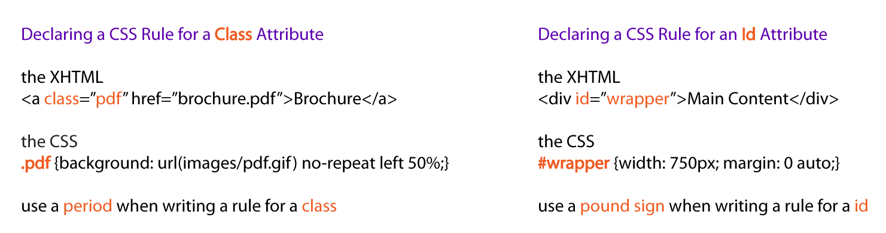
CSS Selectors
CSS selectors allow you to select and manipulate HTML elements based on their id, class, type, attribute, and more.
Examples –

Slide 68
CSS Selectors (Cont.)
Declaring a CSS Rule for a Elements Attribute
It will style all the content of that element which you are selecting.
Example-
The HTML
<p> Welcome to the Sujata Academy </p>
<p> <b><i> Powered by – Sujata Batra </i></b></p>
The CSS
p {text-align: center; color: blue;}

Slide 69
CSS Selectors (Cont.)
Grouping Selectors
You can group all the selectors of same style to minimize the code. The selectors should be separated with comma.
Example-
h2 {text-align: center; color: red; } p {text-align: center; color: red;}
Grouped Selectors-
h2, p {text-align: center; color: red; }

Slide 70
Inserting a StyleSheet
You can do in three different ways-
External Style Sheet
Styles are specified in an external CSS file. you can change the looks of entire website by using single external style sheet.
Eg.: <head> <link rel="stylesheet" type="text/css" href=“ex1.css” /> </head>
Internal Style Sheet
To Appy specific styles to a single HTML file inside the head section of an HTML page.
Eg.: <style> p { text-align:left; font-size:24px; } </style>
Inline Styles
Styles are specified inside an HTML tag/element.
Eg.: <p style="font-family:Algerian; font-size:28px;"> Demo of Inline Style </p>

Slide 71
Inserting a StyleSheet
Multiple Style Sheets – It can be referenced inside an HTML document.
The questions is, what styles will be applicable when there is more than one style specified?
All styles cascade into a new virtual style sheet by applying the following rules, where the higher number has the greater priority:
Browser default.
External Stylesheet.
Internal Stylesheet (styles defined in head section).
Inline Style (styles defined in an HTML element).
Notes:
As you can observe, Inline Style has the highest priority. This means that the inline style defined in an HTML element will override a style defined within the head section, which in turn may override the style defined within an external style sheet.
If the link to the external style sheet is placed below the internal style sheet in HTML <head>, the external style sheet will override the internal style sheet!

Slide 72
Formatting with CSS Properties
CSS Background
We can use CSS Background properties to define the background effects of an element.
The following properties can be used for background effects :
background-color
The background-color property is used to specify the background color of the element.
background-image
The background-image property is used to set an image as a background of an element.
background-repeat
background-attachment
used to specify if the background image is fixed or scroll with the rest of the page in browser window.
background-position
used to define the initial position of the background image.
By default, the background image is placed on the top-left of the webpage.

Slide 73
Formatting with CSS Properties
CSS Background Image
You can use an image as the background for an element using background-image property.
Example-
body{ background-image:url(‘java.png’); }
By default, the image is repeated, both horizontally and vertically, so as to cover the entire
body (or the element on which it is applied).

Slide 74
Formatting with CSS Properties
CSS Background Color
The background-color property is used to specify the background color of an element.
Example-
body {
background-color:darkblue;
}
Similarly, we can specify the background for any element (wherever applicable).
p { background-color:orange; }

Slide 75
Formatting with CSS Properties
CSS Background Position
If the background image disturbs the text, i.e. if the text cannot be read clearly due to
the image in the background, we can set the position of the background image.
Example-
body {
background-image:url(“SomeImage.jpg");
background-repeat:no-repeat;
background-position:right top;
}

Slide 76
Formatting with CSS Properties
CSS Background Shorthand
You can also specify all the properties in a single property. This property is known as shorthand property.
For specifying shorthand property, you just need to use background.
Example-
body {
background:cyan url(‘SomeImage.jpg') no-repeat right top;
}

Slide 77
Formatting with CSS Properties
Text Formatting
The following properties can be used for formatting text :
Text Color
Text Alignment
Text Decoration
Text Transformation
Text Indentation

Slide 78
Formatting with CSS Properties
Text Alignment
We can either align the text to the left, right, center or we can make it justified.
Example-
p { text-align:left;}
h1{text-align:center;}
Text Color
The color property is used to set the color of text.
Example-
body { color:blue;}
p1 {color:magenta;}

Slide 79
Formatting with CSS Properties
Text Decoration
You can use text-decoration property to set or remove decorations from text.
Example-
p {text-decoration:overline;}
p {text-decoration:line-through;}
p {text-decoration:underline;}
Text Transformation
You can use text-transform property to specify uppercase and lowercase letters of any text.
Example-
h1 {text-transform:uppercase;}
h2 {text-transform:lowercase;}
p {text-transform:capitalize;}

Slide 80
Formatting with CSS Properties
CSS Font
CSS font properties are used to define the font family, size, style and boldness of the text. In CSS, there are two types of font family names:
generic family - a group of font families with a similar look (like "Serif" or "Monospace").
font family - a specific font family (like "Times New Roman" or "Arial").
Comments in CSS
/* comment */ - This is comment used in CSS.

Slide 81
Formatting with CSS Properties
CSS Font Family
The font-family property should hold several font names as a "fallback" system. If the browser does not support the first font, it tries the next font.
Example :
p { font-family:”Arial”, Times, “Sans-serif”;}
CSS Font Style
You can use the property font-style to specify mostly italic text. It has three values – Normal, Italic, Oblique (similar to italic).

Slide 82
Formatting with CSS Properties
CSS Font Size
You can use the font-size property to set the size of text. The font-size value can be
absolute or it can be relative.
Example- h1 {
font-size: 30px;
}
p {
font-size: 14px;
}

Slide 83
Formatting with CSS Properties
CSS Font Size with em (Relative Size)
You may face resizing problems, when you use older versions of browsers.
To avoid such problems, you can use set font size using em, instead of pixels.
The em size unit is a W3C recommendation.1 em is equal to the current font size. The default text size is 16 px. So, the default size of 1 em is 16 px.
Example
h2 {
font-size: 1.875em; /* 30px/16=1.875em */
}
p {
font-size: 0.875em; /* 14px/16=0.875em */
}

Slide 84
CSS Units
CSS has several different units for expressing a length.
Many CSS properties take "length" values, such as width, margin, padding, font-size, border-width, etc.
Length is a number followed by a length unit, such as 10px, 2em, etc.
A whitespace cannot appear between the number and the unit. However, if the value is 0, the unit can be omitted.
There are two types of length units:
absolute
relative.

Slide 85
Absolute Lengths
The absolute length units are fixed and a length expressed in any of these will appear as exactly that size.
Pixels (px) are relative to the viewing device. For low-dpi devices, 1px is one device pixel (dot) of the display. For printers and high resolution screens 1px implies multiple device pixels.
Unit | Description
cm | centimeters
mm | millimeters
in | inches (1in = 96px = 2.54cm)
px * | pixels (1px = 1/96th of 1in)
pt | points (1pt = 1/72 of 1in)
pc | picas (1pc = 12 pt)

Slide 86
Relative Lengths
Relative length units specify a length relative to another length property. Relative length units scales better between different rendering mediums.
Viewport = the browser window size. If the viewport is 50cm wide, 1vw = 0.5cm.
Unit | Description
em | Relative to the font-size of the element (2em means 2 times the size of the current font)
ex | Relative to the x-height of the current font (rarely used)
ch | Relative to width of the "0" (zero)
rem | Relative to font-size of the root element
vw | Relative to 1% of the width of the viewport*
vh | Relative to 1% of the height of the viewport*
vmin | Relative to 1% of viewport's* smaller dimension
vmax | Relative to 1% of viewport's* larger dimension
% | Relative to the parent element

Slide 87
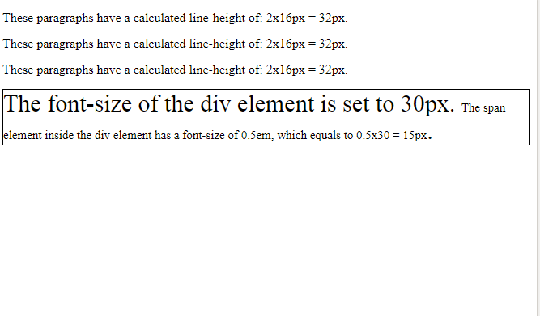
Example
<!DOCTYPE html>
<html>
<head>
<style>
p {
font-size: 16px;
line-height: 1em;
}
div {
font-size: 30px;
border: 1px solid black;
}
span {
font-size: 0.5em;
}
</style>
</head>
<body>
<p>These paragraphs have a calculated line-height of: 2x16px = 32px.</p>
<p>These paragraphs have a calculated line-height of: 2x16px = 32px.</p>
<p>These paragraphs have a calculated line-height of: 2x16px = 32px.</p>
<div>The font-size of the div element is set to 30px. <span>The span element inside the div element has a font-size of 0.5em, which equals to 0.5x30 = 15px</span>.</div>

Slide 88
Formatting with CSS Properties
CSS Links
You can use CSS styles to style any link. Links can be styled in different ways by using any CSS property like color, font-family etc.
Links can be in one of the following states :
a: link – Unvisited link
a: visited – A link that the user has visited
a: hover – A link over which the mouse pointer is moving
a: active – A link, which has been just clicked
Links can be styled according to their states.

Slide 89
Formatting with CSS Properties
Styling Links
CSS Links
a {
font-weight: bold;
}
a:link {
color: black;
}
a:visited {
color: gray;
}
a:hover {
text-decoration: none;
color: white;
background-color: navy;
}
a:active {
color: aqua;
background-color: navy;
}
link - before a visit
visited - after it has been visited
hover - when your mouse is over it but you have not clicked
active - you have clicked it and you have not yet seen the new page

Slide 90
Formatting with CSS Properties
CSS List
You can use CSS list properties for
Setting different list item markers for ordered lists
Setting different list item markers for unordered lists
Set an image as the list item marker
Values-
list-style-type
list-style-image

Slide 91
Formatting with CSS Properties
Box Model : Introduction
Box model is useful for designing the layout of an HTML Page. CSS Box model describes a box that wraps around HTML elements.
Using this model, we can define the margins, borders, padding and the actual content. We can place border around elements and space elements in relation to each other.
Margin
Border
Padding
Box Model : Illustration
You can set the height and width of an element using the height and width properties.
Content

Slide 92
Formatting with CSS Properties
CSS Padding
You can use the CSS padding properties to define the space between the element border and the element content. It is possible to change the top, right, bottom and left padding independently using separate properties.
In shorthand; specify one, two, three, or four space-separated values:
[value] [top, right, bottom, and left] 10px
[value] [value] [top and bottom] [left and right] 10px 20px
[value] [value] [value] [top] [right and left] [bottom] 10px 20px 30px
[value] [value] [value] [value] [top] [right] [bottom] [left] 10px 20px 30px 40px
Note: padding: 10px 20px 30px 40px; is same as padding-top: 10px; padding-right: 20px; padding-bottom: 30px; padding-left: 40px;

Slide 93
Formatting with CSS Properties
CSS Border
You can use the CSS Border properties to specify the style and color of an element’s border.
border-style
To make a border around an element.
Values: solid, dotted, dashed, double, groove, ridge, inset and outset.
border-width
sets the width of the border
There are also properties for border-top-width, border-right-width, border-bottom-width and border-left-width.
border-color
sets the color.

Slide 94
Border-width
In shorthand; specify one, two, three, or four space-separated values:
[value] [top, right, bottom, and left] 10px
[value] [value] [top and bottom] [left and right] 10px 20px
[value] [value] [value] [top] [right and left] [bottom] 10px 20px 30px
[value] [value] [value] [value] [top] [right] [bottom] [left] 10px 20px 30px 40px
Note : border-width: 10px 20px 30px 40px; is same as border-top-width: 10px; border-right-width: 20px; border-bottom-width: 30px; border-left-width: 40px;

Slide 95
Formatting with CSS Properties
CSS Margin
Using CSS Margin properties you can specify the space around elements.
One, two, three, or four space-separated values:
[value] [top, right, bottom, and left] 10px
[value] [value] [top and bottom] [left and right] 10px 20px
[value] [value] [value] [top] [right and left] [bottom] 10px 20px 30px
[value] [value] [value] [value] [top] [right] [bottom] [left] 10px 20px 30px 40px
Note : margin: 10px 20px 30px 40px; is same as margin-top: 10px; margin-right: 20px; margin-bottom: 30px; margin-left: 40px;, for example.

Slide 96
Formatting with CSS Properties
Pseudo-Class
A pseudo-class is used to define a special state of an element.
Style an element when a user mouses over it.
Style visited and unvisited links differently.
/* unvisited link */ a:link { color: #FF0000; } /* visited link */ a:visited { color: #00FF00; } /* mouse over link */ a:hover { color: #FF00FF; } /* selected link */ a:active { color: #0000FF; }

Slide 97
Formatting with CSS Properties
Pseudo-Elements
A CSS pseudo-element is used to style specified parts of an element.
Style the first letter, or line, of an element
Insert content before, or after, the content of an element
The ::first-line pseudo-element is used to add a special style to the first line of a text. All Pseudo Elements-
Selector | Example | Example description
::after | p::after | Insert content after every <p> element
::before | p::before | Insert content before every <p> element
::first-letter | p::first-letter | Selects the first letter of every <p> element
::first-line | p::first-line | Selects the first line of every <p> element
::selection | p::selection | Selects the portion of an element that is selected by a user
Notes:
Note: ::selection always starts with double colons (::).

Slide 98
Formatting with CSS Properties
Media Types
The @media rule makes it possible to define different style rules for different media types in the same stylesheet.
Example-
@media screen {
p { font-family: verdana, sans-serif;
font-size: 20px;
} }
@media print {
p { font-family: georgia, serif;
font-size: 15px;
color: blue;
} }
Notes:
Note: ::selection always starts with double colons (::).

Slide 99
CSS float
The CSS float property is a positioning property.
Used to push an element to the left or right, allowing other element to wrap around it.
Generally used with images and layouts.

Slide 100
How it works
A floated element may be moved as far to the left or the right as possible. Simply, it means that a floated element can display at extreme left or extreme right.
The elements after the floating element will flow around it.
The elements before the floating element will not be affected.
If the image floated to the right, the texts flow around it, to the left and if the image floated to the left, the text flows around it, to the right.

Slide 101
CSS float Properties
Property | Description | Values
clear | The clear property is used to avoid elements after the floating elements which flow around it. | left, right, both, none, inherit
float | It specifies whether the box should float or not. | left, right, none, inherit

Slide 102
CSS Float Property Values
Value | Description
none | It specifies that the element is not floated, and will be displayed just where it occurs in the text. this is a default value.
left | It is used to float the element to the left.
right | It is used to float the element to the right.
initial | It sets the property to its initial value.
inherit | It is used to inherit this property from its parent element.

Slide 103
Final Example
<!DOCTYPE html>
<html>
<head>
<style>
.header{margin:-8px -8px 0px;background-color:red;color:white;text-align:center;padding:10px;}
.container{width:100%}
.left{width:15%px;float:left;}
.body{width:65%;float:left;background-color:pink;padding:5px;}
.right{width:15%;float:left;}
.footer{margin:-8px;clear:both;background-color:green;color:white;text-align:center;padding:10px;}
</style>
</head>

Slide 104
<body>
<div class="header"><h2>Sujata Training</h2></div>
<div class="container">
<div class="left">
<p>Left Page</p>
</div>
<div class="body">
<h1>Body Page</h1>
<p>Page Content goes here</p><p>Page Content goes here</p><p>Page Content goes here</p>
<p>Page Content goes here</p><p>Page Content goes here</p><p>Page Content goes here</p>
<p>Page Content goes here</p><p>Page Content goes here</p><p>Page Content goes here</p>
<p>Page Content goes here</p><p>Page Content goes here</p><p>Page Content goes here</p>
<p>Page Content goes here</p>
</div>
<div class="right">
<p>Right Page</p>
</div>
</div>
<div class="footer">
<p>Footer</p>
</div>
</body>
</html>

Slide 105
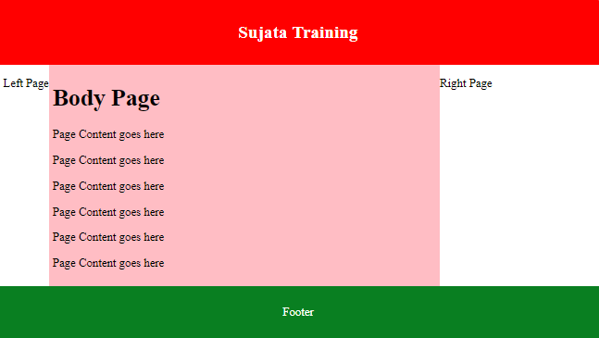

Slide 106
Writing for Web Audience
Punch up headlines.
Web visitors scan first for headlines, so make every heading word meaningful.
Emphasize key concepts.
Help readers scan for key concepts by emphasizing important information.
Harness the power of lists.
Lists slow the reader down and bring attention to important information
Create meaningful captions.
Web users focus on text over graphics, make sure to caption all graphics clearly.
Simplify for understanding.
Reading from the screen is slower than reading from print, so make your users happy by giving them less to read.

Slide 107
Writing for Web Audience
Invert the pyramid.
The inverted pyramid style is bottom-up. To write this way, start by stating the conclusion. Then build upon the conclusion by summarizing the most interesting and important supportive information. Next provide detail about each important point. Then close with background information.
Write one idea per paragraph.
Make sure each paragraph contains one idea only, and summarize that idea in the first sentence.
Make each page stand alone.
Don't expect that users will enter your Web site at the home page and work their way through the site in an organized manner. Thanks to the power of search engines and offsite links, visitors may enter your site on any page at all. Because of this, each page needs to stand alone, and your prose must not assume that they have already read any other page. Provide context to help users understand where the page fits within your Web site.

Slide 108
Writing for Web Audience
Be current, accurate, and credible.
Capture the trust of your readers by offering information that is up-to-date and accurate .
A simple way to improve credibility: Skip the marketing hype. Replace it with well-written, interesting, and useful information.
Give credit where credit is due. If your site has multiple authors, give each one credit with a byline. Bylines are personal touches that add credibility to a Web site. And don't just quote information from a study or survey; you'll gain credibility by providing a direct link to the source.

