Slide 1
Teammates:
L Shailender Goud
Mehak Makol
Aashi Bhansali
Harshit Chebolu
Tanushree Mishra
PM101 · INTERACTION DESIGN · CANCELLATION EXPERIENCE
Staymint
Own the clarity of cancellation.
Mobile wireframes for cancelling an existing hotel booking, designed around Agoda's cancellation APIs.
PROTOTYPE
DELIVERABLE
DEMO DATA
Interactive synthetic demo:
7 wireframe screens in 12 selected views,
Deterministic and synthetic:
7 screens, 9 reviewer scenarios
with design, developer, business notes
Azure Palms Resort & Spa
ASSUMPTIONS
Android app. A booking created in Staymint is created with Agoda at once. Support is an internal booking-linked channel, not an Agoda call.
The Agoda pages referenced for this flow do not publish HTTP verbs, endpoint paths,
reference expiry, or the exact check-in cutoff time; stated as assumptions
where used.
October 2026
Notes:
Staymint is a hotel booking app built on Agoda's inventory, and this project designs one use case: cancelling an existing booking. The thesis is on the cover: own the clarity of cancellation. Everything shown runs on synthetic data, and assumptions are stated wherever the referenced Agoda pages are silent. The prototype is an interactive synthetic demo with seven screens and nine reviewer scenarios; the deck walks seven wireframe screens in twelve selected views, each with design, developer and business notes.

Slide 2
PM101 · PRODUCT NOTE · 1 OF 2
Product Note - the problem and the goal
What Staymint is fixing, for whom, and how big the problem is.
WHAT IT IS - PROJECT AND GOAL
Project: Staymint - the cancellation experience for our multi-hotel booking
app, built on Agoda's inventory.
Goal: cancel one existing booking knowing the refund before you commit,
and the true status after.
PROBLEM - WHAT AND FOR WHOM
FOR WHOM - THE CUSTOMER
WHAT GOES WRONG TODAY
A Staymint customer with one existing hotel booking
The refund consequence is unclear before they commit;
who needs to cancel it - plans changed, zero-refund,
an uncertain outcome can look like success; support
amount moved at commit, unclear outcome, or support.
restarts without the booking context.
HOW BIG IS THE PROBLEM?
India: the National Consumer Helpline recovered over Rs 10 crore in Travel & Tourism refunds, 25 Apr 2025-31 Jul 2026 [1].
That is money recovered through grievances, not total customer loss, and covers all travel, not only hotels.
For hotels, a room-night is perishable: once the night passes, it cannot be sold [2], so late cancellations leave less time to resell it.
Staymint targets the customer's uncertainty (refund amount, true status), not penalties or hotel occupancy.
2
Notes:
Page one of the product note: the project is Staymint's cancellation experience, built on Agoda's inventory, for a customer cancelling one existing booking. The problems are an unclear refund consequence before the customer commits, an uncertain outcome that can look like success, and support that restarts without the booking context. The size of the problem is honestly not yet measured - the demo uses synthetic data and there is no production baseline - so the slide lists the metrics we would collect to size it. Problem size, India: the National Consumer Helpline recovered over Rs 10 crore in Travel & Tourism refunds between 25 Apr 2025 and 31 Jul 2026 (PIB, 9 Sep 2026, https://www.pib.gov.in/PressReleasePage.aspx?PRID=2308386&lang=1&reg=3). That is recovered money, not total loss, and covers all travel. A hotel room-night is perishable (https://peaqplus.com/learn-perishable-inventory.html). Not measured: how often hotel cancellations end in unclear refunds or status. Sources on slide 14.

Slide 3
PM101 · PRODUCT NOTE · EVIDENCE
Evidence behind the problem size
India refund grievances, what they show, and what stays unmeasured. Sources cited.
THE CUSTOMER'S PAIN
After cancelling, the customer needs two clear answers: "Is my booking cancelled?" and "How much money will I get back?" If the refund changes or confirmation fails, they may be unsure whether they are still booked or charged. That is the uncertainty our flow addresses.
Our reading, not tested with users: Agoda's cancel flow can cause this. The refund amount can move between preview and confirm (error 914), and a timeout leaves the status unknown [3].
THE COST, KEPT SEPARATE
Customer: a penalty the booking policy allows is a cost, not a failure. A delayed refund is money tied up, not lost. A wrong or wrongly denied refund is a loss.
India evidence: the National Consumer Helpline recovered over Rs 10 crore in Travel & Tourism refunds, 25 Apr 2025-31 Jul 2026 [1]. This is money recovered through grievances, not total customer loss, and it covers all travel, not only hotels.
Hotel: a room-night is perishable. Once the night passes, an unsold room's revenue is gone [2], so late cancellations leave less time to resell the room. Resale or penalties can offset the loss. We make rules, amounts and outcomes clearer; we claim no effect on occupancy.
SOURCES
[1] Press Information Bureau (PIB), "National Consumer Helpline facilitates refunds of over Rs 105 crore to consumers in 15 months", 9 Sep 2026. https://www.pib.gov.in/PressReleasePage.aspx?PRID=2308386&lang=1&reg=3
[2] Peaqplus, "What is Perishable Inventory in Hotels?" (vendor definition). https://peaqplus.com/learn-perishable-inventory.html
[3] Agoda Demand API documentation, "Cancel bookings". https://developer.agoda.com/demand/docs/cancel-bookings
14
Notes:
Evidence page. Sources: PIB 9 Sep 2026; Peaqplus perishable inventory definition; Agoda Demand API cancel bookings. No figure here measures Staymint's exact failures.

Slide 4
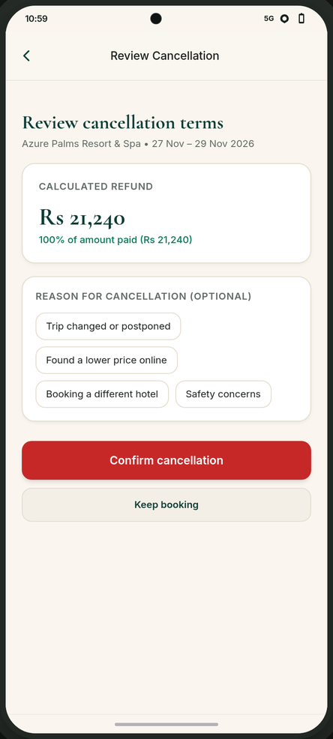
PM101 · PRODUCT NOTE · 2 OF 2
Product Note - how we answer it
Objectives, approach, proof, and what is still unknown.
OBJECTIVES - WHAT GOOD LOOKS LIKE
CONCEPT MOCK
1
2
3
Latest terms first
No fake certainty
Context into support
See the latest refund
An uncertain outcome is
Support picks up where
estimate before you
never shown as a
the customer left off -
confirm; if it moves,
success.
no starting over.
we ask again.
HOW WE ARE SOLVING IT
Two-step cancel on Agoda's APIs: Preview shows the refund and policy; Confirm
sends the same reference and amount with a reason. Amount moved (error 914):
re-preview, show old and new, take fresh consent. Timeout: no blind retry -
recheck status, then resolve, retry, or escalate. Support is internal and
carries the booking context. Scope: one existing booking only.
Trade-off accepted: extra checks over fewer taps - never friction to discourage
W3 Review cancellation - refund before commit.
cancelling.
Full set: Slides 8-12 · live demo: Slide 13.
SUCCESS METRICS - TO MEASURE, NOT CLAIMED RESULTS
OPEN QUESTIONS
Refund disputes per 100 cancellations.
Refund payout timing and method: not specified in the
'What is my status' contacts per cancellation.
referenced docs; the receipt confirms cancellation only.
Repeat-booking rate among customers who cancelled.
Exact check-in cutoff, reference expiry: not specified.
Resolution time for cancellation support tickets.
Fee-waiver wait: docs allow polling up to 72 h -
when should we escalate to support?
3
Notes:
Page two: the objectives are latest terms first, no fake certainty, and context into support. The approach is a two-step preview-then-confirm on Agoda's cancellation APIs, fresh consent when the amount moves, timeout reconciliation without blind retries, and internal support that carries the booking context - scope stays one existing booking. Success metrics are measurable definitions to track after launch, not claimed results. Open questions cover refund payout timing, the exact check-in cutoff and reference expiry, and how long to wait on a hotel fee waiver - the docs allow polling up to 72 hours - before escalating to support. A concept mock of the review screen is attached on the right.

Slide 5
PM101 · CUSTOMER JOURNEY · FLOW DIAGRAM
The cancellation journey, part 1: entry to review
From opening a booking to the cancel review, including the unhappy paths. The keep-or-confirm decision continues in Part 2 (Slide 5).
decision continues on Slide 5
PART 1 OF 2 · ENTRY TO REVIEW
CUSTOMER
Open My
Tap 'Review
Tap 'Contact
Retry, or
Keep or
bookings
cancellation'
support'
contact
confirm?
S1
S2
C
support?
D
S5
support
OUR APP
Unavailable -
Support request
retry
no
offer support
Preview failed
C
C
D
no
fails
Open booking,
Show details
Already
no
Before
yes
Request preview
Review + reason
Refund = 0?
refresh status
+ review entry
cancelled?
check-in?
S4
S5
(S5)
S1
S2
(S3)
(S3)
yes
yes
Cancelled -
'No refund. Cancel
refresh
no option
without refund?'
B
policy + refund
A
'Cancel without refund'
AGODA
Status + policy
Policy + refund
S1
S4
Diamond = decision · red = stop state · green = final state · dashed = return or recheck path
S1-S9 = journey step ids · A-D = exception branches · W1-W7 = wireframe screens (Slides 8-12)
4
Notes:
This is the first half of the journey as the customer experiences it: from My bookings, through review, up to the keep-or-confirm decision. Diamonds are decisions, red states stop the flow, green states are final, and dashed lines are return or recheck paths. Two things to notice: an already-cancelled or unavailable booking never shows a cancel action, and a zero-refund case still asks for explicit consent in different words. The decision itself continues on the next slide.

Slide 6
PM101 · CUSTOMER JOURNEY · FLOW DIAGRAM
The cancellation journey, part 2: decision to outcome
Continues from Slide 4: the confirm, the timeout reconciliation, and the changed-refund path that asks again.
from Slide 4
reliably not cancelled: offer retry
PART 2 OF 2 · DECISION TO OUTCOME
CUSTOMER
Sees 'We're
confirm again
Keep or
Keep
Booking kept
checking'
Review + confirm
confirm?
S5
S8
S9
S5
OUR APP
Confirm + reason
Send confirm
timeout / unclear
Timeout -
Recheck
if cancelled: show S7
S6
no blind retry
status
S8
S8
unresolved: escalate
Re-preview
Escalate via
'Booking cancelled'
Show updated
cancellation final
refund changed
S9
support
+ refund
refund
S8
S7
S9
AGODA
re-preview
Cancellation final
Refund
Updated refund
updated refund
S6
mismatch
S9
S9
confirmed
Diamond = decision · red = stop state · green = final state · dashed = return or recheck path
S1-S9 = journey step ids · A-D = exception branches · W1-W7 = wireframe screens (Slides 8-12)
5
Notes:
Part two begins at the keep-or-confirm decision and ends in one of three outcomes: kept, cancelled and confirmed, or escalated to support. If the answer times out or is unclear, we never blindly retry the confirm; we recheck the booking status first. And if the refund has changed, the customer sees the new amount and consents again before anything is executed.

Slide 7
PM101 · SYSTEM FLOW · TECHNICAL SHADOW
How the system keeps the promise, part 1: entry
The same journey as Slide 4, drawn as calls between the customer, the Android UI, our backend and the Agoda API. Part 2 (confirm, reconcile, outcomes) is on Slide 7.
CUSTOMER
decision continues on Slide 7
TECHNICAL SHADOW · PART 1 OF 2
Open My
Tap 'Review
Tap 'Contact
Retry, or
Keep or
bookings
cancellation'
support'
contact
confirm?
S1
S2
C
support?
S5
D
ANDROID UI
bookingId
Preview failed
no
Show details +
Cancelled -
Unavailable -
retry
D
Open booking
review entry
no option
offer support
S1
S2
B
C
Review: policy,
Refund = 0?
support
refund, reason
(S5)
S5
yes
display only
Loading state
'No refund. Cancel
bookingId
yes
no
S4
fails
without refund?'
yes
A
OUR BACKEND
Snapshot (Search):
Support ticket
bookingId
'Cancel without refund'
freeCancellation*,
- internal
cancellationPolicy*
C
Booking
- display only
Details call
Already
no
Before
Store reference
S1
Receive status
cancelled?
check-in?
Preview call
+ refund
S1
(S3)
(S3)
S4
S4
bookingIds: [long]
bookingId (long)
AGODA API
Policy, refundRate,
policy + refund
Status + policy
reference
S1
S4
6
Notes:
This is the same journey drawn as calls between the customer, the Android UI, our backend and the Agoda API. The booking-time snapshot from Search is display only; the authoritative status and policy always come from a fresh Booking Details call. The preview call is what makes the promise possible: it returns the policy, the refund amount and a reference before the customer commits to anything. The exact request and response fields for each call are in the developer notes on the wireframe pages, and the decision at the end continues on the next slide.

Slide 8
PM101 · SYSTEM FLOW · TECHNICAL SHADOW
How the system keeps the promise, part 2: outcomes
Continues from Slide 6: the confirm call, timeout reconciliation, and the changed-refund path (error 914).
from Slide 6
not cancelled: offer retry
TECHNICAL SHADOW · PART 2 OF 2
CUSTOMER
Keep, or
Sees 'We're
Review new amount,
confirm
checking'
confirm again
cancellation?
S8
S9
S5
ANDROID UI
Keep
'Booking cancelled'
+ refund
Booking kept
Show 'We're
S7
S5
checking'
cancelled + refund
confirm + cancelReason
S8
Show updated
if cancelled: show S7
refund
confirm again (NEW reference + refundRate)
display only
S9
OUR BACKEND
updated refund
Confirm call
timeout / unclear
Timeout -
Reconcile status
Record cancelled
S6
no blind retry
S8
+ refund
S8
S6
unresolved: escalate
error 914
Re-preview call
Recheck via
Escalate via
Replace reference
S9
Booking Details
support ticket
+ refund
S8
S8
S9
HTTP 200 (empty)
bookingIds: [long]
AGODA API
bookingId
new reference
HTTP 200 empty -
Error 914:
Booking Details:
Updated refundRate,
final
refund mismatch
status
new reference
S6
S9
S8
S9
7
Notes:
Part two covers the commit and everything that can go wrong after it. The confirm call sends the latest reference with the matching refund amount, and success is an HTTP 200 with an empty body, which is final. If the answer times out or is unclear, we never blindly retry the confirm; we recheck the booking status first, and Agoda recommends at least three attempts within fifteen minutes. If the refund changed, error 914 triggers a fresh preview, and the customer consents again to the new amount before anything is executed.

Slide 9
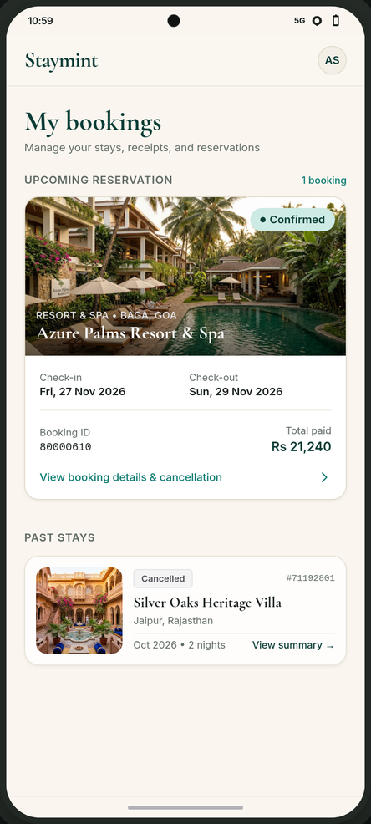
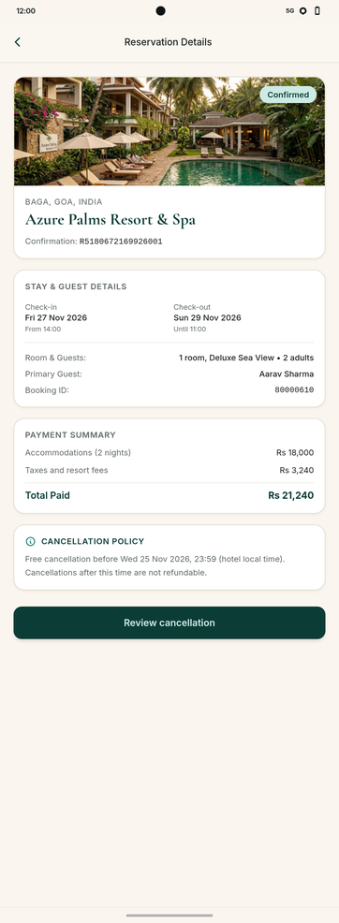
PM101 · WIREFRAMES · ENTRY
Wireframes 1-2: My bookings → Reservation details
Booking status is visible before anyone asks for it.
DESIGNER
W1
Visibility of system status - status chips
show state before anyone asks, so there is no digging.
W2
Shallow IA - review entry is one tap from details,
so the path to cancel involves no hunting.
DEVELOPER
W1
Booking Details call on open: bookingIds* (max 40) →
status*, checkIn*/checkOut*, cancellationPolicy*,
hotelComNumber.
W2
Preview is fetched only on entry to review: bookingId*
→ reference*, policyText*, refundRate{currency*,
inclusive*}, SLA 120 s.
BUSINESS
Both
Hypothesis to measure: self-serve state visibility
should cut 'what is my status' support volume.
W1
W2
My bookings - status at a glance
Details - cancel entry
Scenario data (synthetic): Azure Palms Resort & Spa · booking 80000610 · Rs 21,240
8
Notes:
Wireframes one and two are the entry. My bookings shows status chips up front, so the state is visible before anyone asks; the home screen cancelled chip variant is described here rather than pictured, since only an active booking is shown. The details screen refreshes the booking from Agoda on open and keeps Review cancellation one tap away. Not every state is pictured on any wireframe page; the intermediate loading caption variant is covered in these notes as well.

Slide 10
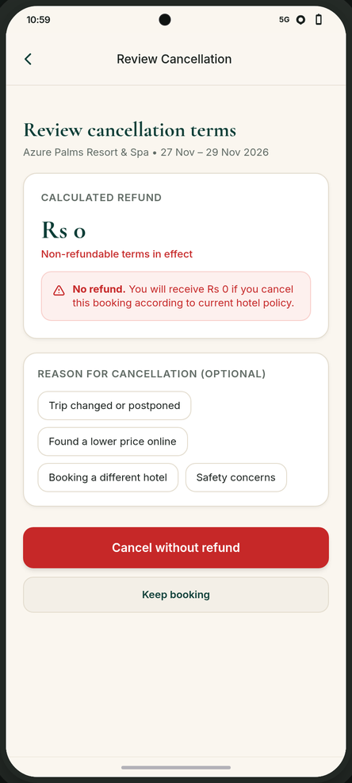
PM101 · WIREFRAMES · COMMITMENT
Wireframe 3: Review cancellation (standard / zero)
The customer confirms the number, not just the action.
DESIGNER
Std
Visual hierarchy - refund amount and policy
outrank decoration: the customer confirms the number.
Zero
Consent in plain words - the button itself
says 'Cancel without refund': zero is clear.
Both
Error prevention - 'Keep booking' stays easy to find.
DEVELOPER
Std
Preview within the 120 s SLA; refundRate is a money
object {currency*, inclusive*}, inclusive = amount
incl. taxes, not a percentage.
Both
Confirm sends bookingId*, the latest reference* and
the matching refundRate{currency*, inclusive*};
cancelReason* is required - the UI reason is optional,
documented 0 = None.
BUSINESS
W3
W3·0
Both
Hypothesis to measure: informed consent should reduce
Review - standard refund
Review - zero refund
refund disputes.
Scenario data (synthetic): Rs 21,240 standard · Rs 0 zero-refund
9
Notes:
Wireframe three is the review screen, shown in standard and zero-refund variants. The customer confirms the number, not just the action: the refund and the policy lead, and in the zero case the button itself says Cancel without refund. The reason chips are optional in the UI, while the API still requires a cancellation reason code, documented zero equals None. The business note is a hypothesis to measure, not a claimed result.

Slide 11
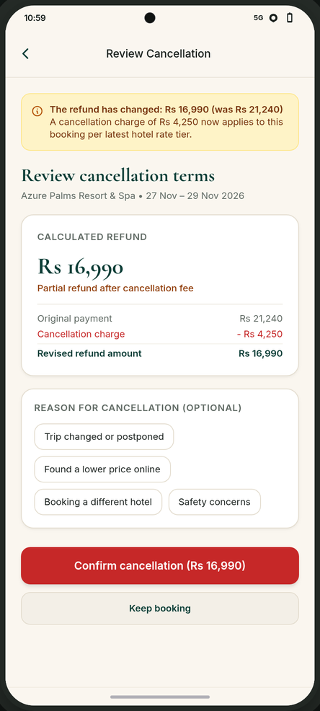
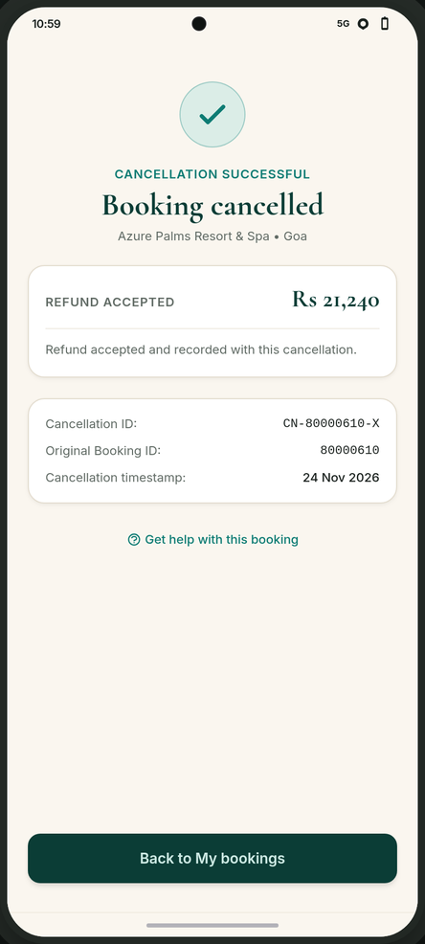
PM101 · WIREFRAMES · CHANGE
Wireframes 3b-5: Changed refund → fresh consent
If the amount moves, we ask again - and the receipt says exactly what happened.
DESIGNER
W3b
Error prevention via fresh consent - the banner
names old and new amounts, confirmed in the button.
W5
Honest feedback - the receipt confirms cancellation
without promising payout timing or method.
DEVELOPER
W3b
error 914 (refund mismatch) → re-preview →
re-confirm with the new reference*.
W5
Success is HTTP 200 with an empty body; the receipt
records reference* and timestamp.
BUSINESS
Both
Hypothesis to measure: re-consent keeps consent valid
when terms move, protecting dispute rates.
W3b
W5
Changed refund - re-consent
Cancellation receipt
Scenario data (synthetic): Rs 21,240 → Rs 16,990 · fee Rs 4,250
10
Notes:
This is the changed-refund path. If Agoda answers with error 914, the customer never learns the new amount from a failure message; they get a fresh preview and confirm again, because consent belongs to the amount, not to the session. The post-update receipt variant is not pictured; after re-confirmation the flow lands on the same confirmed screen as the standard path, carrying the new reference and amount.

Slide 12
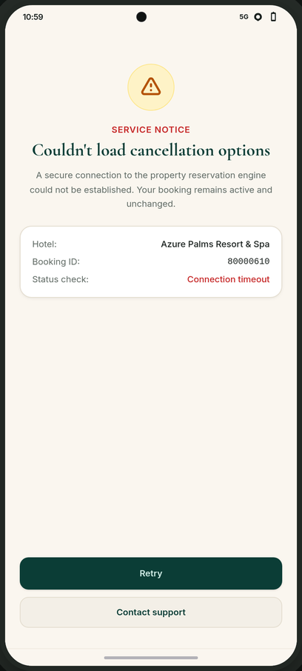
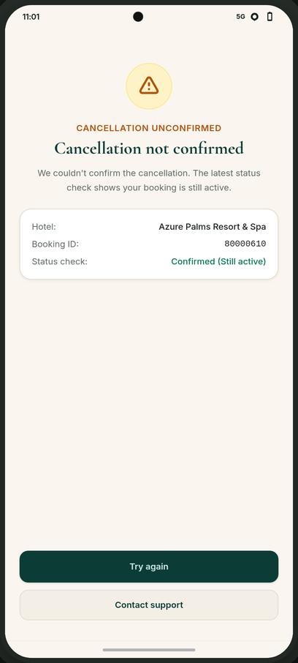
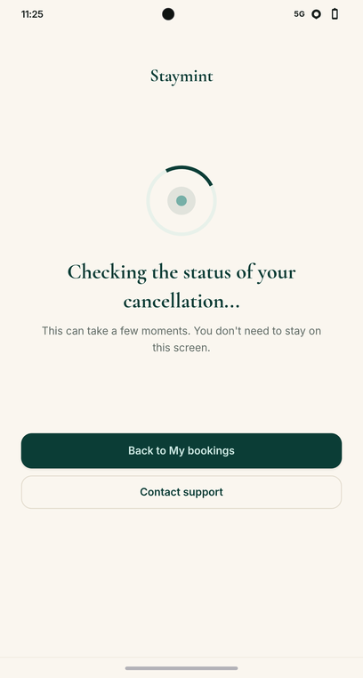
PM101 · WIREFRAMES · PROGRESS + FAILURE
Wireframes 4-6: Waiting, failure, and 'still active'
An uncertain cancellation is never presented as success.
DESIGNER
All
Visibility of system status -
each state is visually distinct.
W4
Preserved context - waiting keeps
the thread: leave and return.
DEVELOPER
W4
Confirm timeout → recheck via
Booking Details (>=3 tries / 15
min) before any claim.
W6a
A failed preview is separated from
an ineligible booking.
W6b
The latest status check shows the
booking is still active.
BUSINESS
All
Hypothesis to measure: honest
W4
W6a
W6b
states preserve rebooking
Checking latest status
Preview failed - unchanged
Still active - safe to retry
confidence.
Scenario data (synthetic): status checks are simulated
11
Notes:
These are the honest-waiting states. While the system cannot confirm, the screen says we are checking your booking, and it never presents an uncertain cancellation as done. If the timeout resolves, the flow continues to the same confirmed screen; if it stays unclear, the customer is offered support with the booking context already attached. The support-submitted confirmation variant is described here rather than pictured: after contacting support, the customer sees that the request is with the team, not that the booking is cancelled.

Slide 13
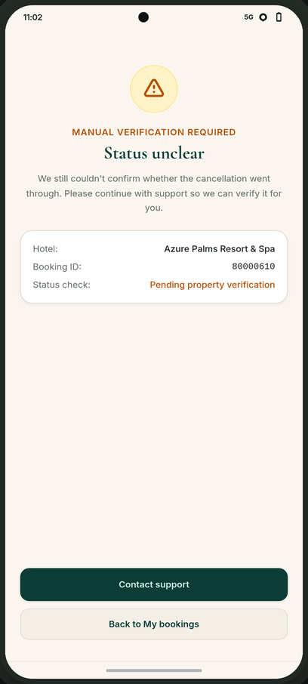
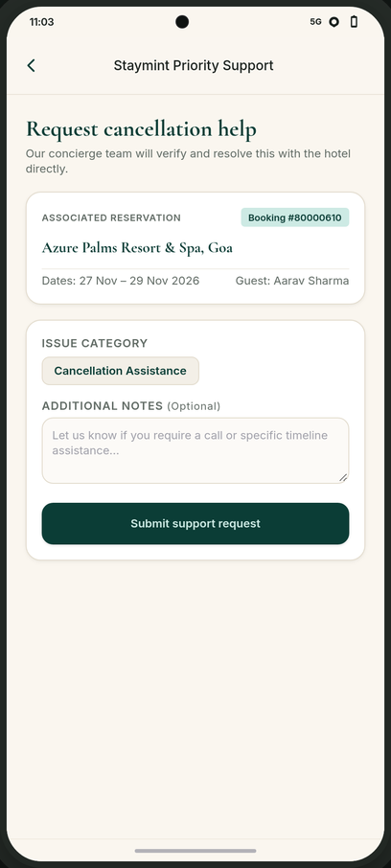
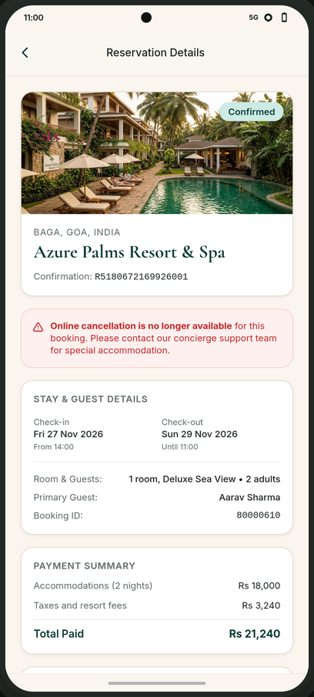
PM101 · WIREFRAMES · ASSISTED PATHS
Wireframes 6c-7: Support with context, and clear no's
When the app cannot resolve it, support starts where the customer left off.
DESIGNER
W7
Reduced repetition - booking
context is prefilled for support.
W2b
Clear terminal state - a clear
no, not a dead end or retry loop.
DEVELOPER
W7
Support request carries the booking
reference and a status snapshot;
is internal, not an Agoda call.
W2b
Unavailable is separated from
failure: no retry loop offered.
BUSINESS
Both
Hypothesis to measure:
context-carrying support should
resolve faster with less repeat
explanation.
W6c
W7
W2b
Status unclear - verify
Support request - prefilled
Cancellation unavailable
Scenario data (synthetic): support flow is simulated
12
Notes:
The assisted and closed states: preview failure, already cancelled, and cancellation unavailable. A failed preview is explained as a request problem with retry and support, never confused with an ineligible booking. The already-cancelled notice variant is covered in these notes rather than pictured: it tells the customer the booking is already cancelled and offers the receipt instead of any cancel action.

Slide 14
PM101 · PROTOTYPE
Run it live
Every screen in this deck is running code you can click through.
INTERACTIVE PROTOTYPE - SYNTHETIC DATA
staymint-prototype.vercel.app
Open in any modern browser - no sign-in, no backend.
HOW TO REVIEW
THE 9 REVIEWER SCENARIOS
1 · Open the link above.
1 Standard (Rs 21,240)
6 Timeout unresolved (W4C → W6c)
2 · Pick a reviewer scenario.
2 Zero refund (Rs 0)
7 Preview failure (W4A → W6a)
3 · Click through: every state in
3 Updated refund (Rs 16,990)
8 Already cancelled
Slides 8-12 is reachable.
4 Timeout resolved (W4C → W5)
9 Cancellation unavailable
5 Timeout active (W4C → W6b)
The flow is not just drawn - it runs.
Deterministic synthetic data: Azure Palms Resort & Spa · booking 80000610 · not connected to live Agoda systems.
13
Notes:
Everything in this deck is running code. The link opens a deterministic synthetic prototype with nine reviewer scenarios covering the standard path, zero refund, changed refund, the three timeout outcomes, preview failure, already cancelled and unavailable. Pick a scenario and click through; every state shown in the wireframes is reachable. The data is synthetic and the prototype is not connected to live Agoda systems.

