Slide 1
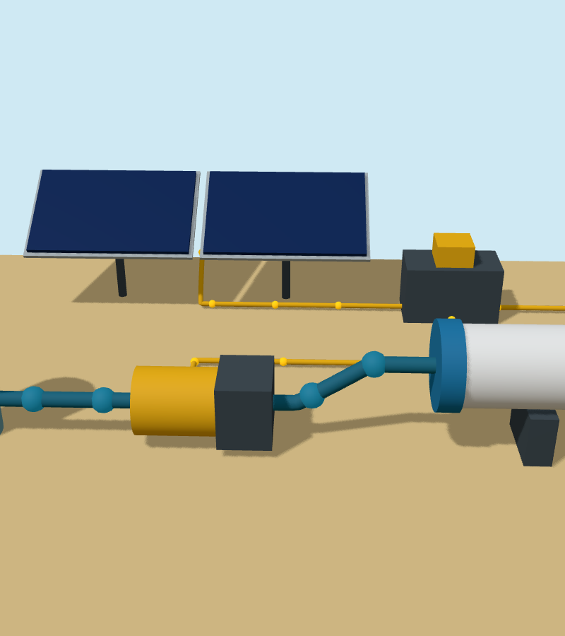
Fresh water from sea and sun
A solar-powered desalination plant that makes about 20 litres a day, for drinking and for crops
Notes:
Introduce the project in one sentence: this plant uses only sunlight to turn sea water into fresh water, and it serves two uses, drinking and growing food. Everything shown is a 3D design model, not a built plant.

Slide 2
Plenty of water, almost none to drink
96.5%
2.2 billion
35 g/L
of Earth's water is in the oceans
people lack safely managed drinking water
of salt in sea water. Good drinking water has under 0.6 g/L
Source: USGS Water Science School
Source: WHO/UNICEF JMP, 2022 data
Source: WHO taste guidance
Sea water has to lose more than 98% of its salt before people or crops can use it.
Notes:
Most of the water on Earth is in the oceans (USGS: about 96.5%). Meanwhile 2.2 billion people lack safely managed drinking water (WHO/UNICEF, 2022 data). Sea water carries about 35 grams of salt per litre; water tastes good to drink below about 0.6 grams per litre. So the plant must remove more than 98% of the salt.

Slide 3
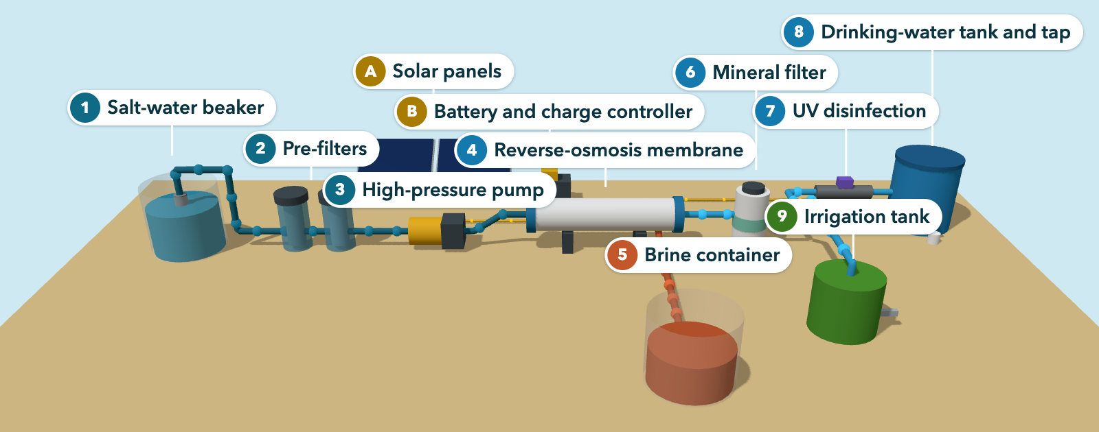
The whole plant at a glance
Salt water
Fresh water
Brine, the salty reject
Electricity
Notes:
Walk along the flow from left to right. Salt water (dark blue) starts in the beaker at 1, which stands in for the sea. It is filtered at 2, pressurised at 3 and split by the membrane at 4. Brine (orange) collects in its own container at 5. Fresh water (light blue) gets minerals at 6, then splits: 7 and 8 for drinking, 9 for irrigation. A and B are the solar power supply (yellow cables). The interactive model can be opened in a browser to show the water moving.

Slide 4
What each part does
A
Solar panels
5
Brine container
Turn sunlight into electricity
Collects the salty reject
B
Battery and charge controller
6
Mineral filter
Store energy for steady running
Adds calcium and magnesium
1
Salt-water beaker
7
UV disinfection
Stands in for the sea: 35 g/L of salt
Kills germs in drinking water
2
Pre-filters
8
Drinking-water tank and tap
Remove sand and silt
Closed, food-safe storage
3
High-pressure pump
9
Irrigation tank
Squeezes salt water to about 55 bar
Stores water for plants
4
Reverse-osmosis membrane
Lets water through, holds salt back
Notes:
This is the key to the labels on the model. A and B are the power supply. 1 to 5 handle salt water and brine. 6 to 9 handle the fresh water. The next four slides go through them stage by stage.

Slide 5
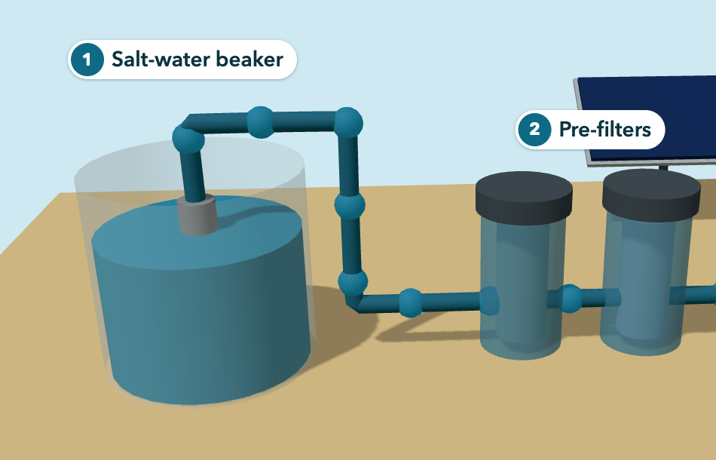
Stage 1: draw in salt water and clean it
1
Salt-water beaker
Stands in for the sea: 35 g of salt per litre. A strainer on the suction pipe keeps grit out.
2
Pre-filters
Two cartridge filters, coarse then fine, remove sand and silt that would clog the membrane.
Clean feed water protects the membrane, the most delicate part.
Notes:
In this model a beaker of salty water stands in for the sea. It holds 35 grams of salt per litre, the same as sea water. A strainer on the suction pipe keeps grit out. Making 20 litres of fresh water takes about 200 litres of salt water. Then two cartridge filters, a coarse one and a fine one, take out sand and silt. This matters because grit would clog and scratch the membrane, which is the most delicate and expensive part.

Slide 6
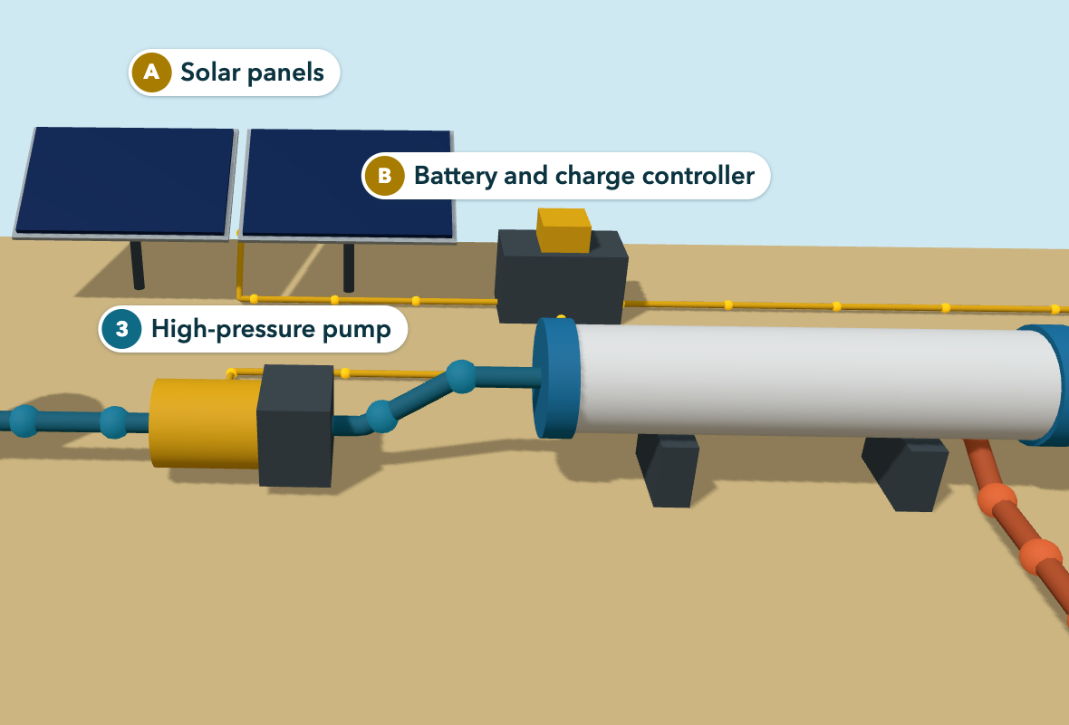
Stage 2: turn sunlight into pressure
A
Solar panels
About 100 W of panels: roughly 350 Wh on a sunny day (estimate).
B
Battery and controller
A 12 V battery keeps the pump steady when clouds pass.
3
High-pressure pump
Raises the salt water to about 55 bar, twice its 27 bar osmotic pressure.
No fuel and no mains electricity: the sun does all the work.
Notes:
Sea water naturally pulls fresh water towards it with an osmotic pressure of about 27 bar. To push water the other way, out of the sea water, the pump must beat that pressure, so it works at about 55 bar. The pump is the main energy user, and it runs entirely on the solar panels. The battery keeps the pressure steady when a cloud passes.

Slide 7
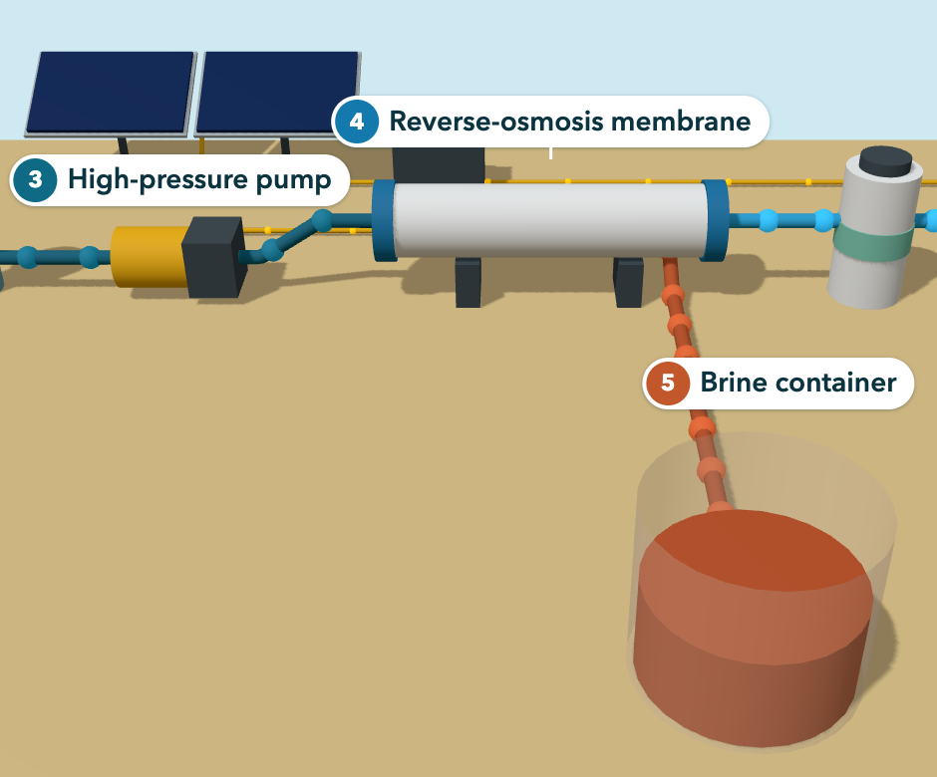
Stage 3: separate salt from water
4
Reverse-osmosis membrane
Water is pushed through; at least 99% of the salt stays behind.
5
Brine container
The salty reject collects here, apart from the beaker.
200 L
20 L
180 L
salt water in
fresh water
brine out
35 g/L salt
0.35 g/L salt
39 g/L salt
Notes:
This is the heart of the plant. Under pressure, water molecules pass through the membrane but salt cannot. Out of every 10 litres pumped in, about 1 litre comes out fresh and 9 litres leave as brine. Because so little water is removed, the brine is only about 11% saltier than the feed. In the model it collects in its own container, so the beaker does not get saltier. A real plant on the coast would return it to the sea, away from the intake. These figures are calculated design estimates.

Slide 8
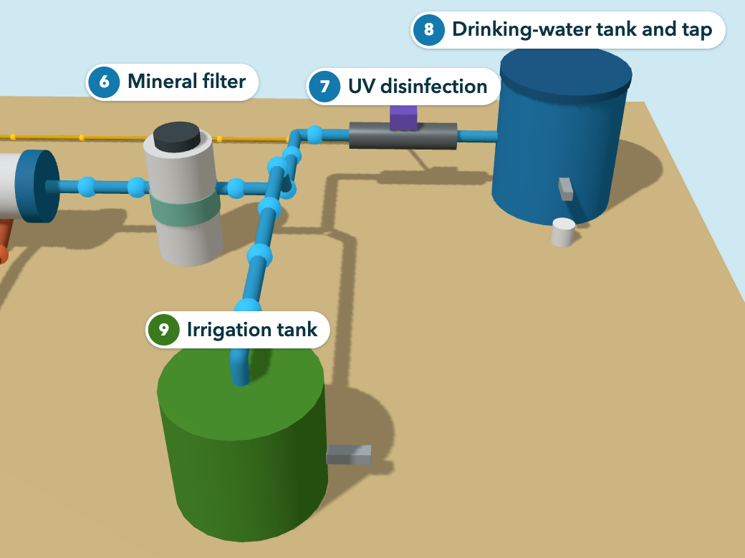
Stage 4: one water, two uses
7
8
Drinking: 12 L a day
UV light kills germs before storage
Closed, food-safe tank and tap
Target: under 600 mg/L of salts (WHO)
9
Irrigation: 8 L a day
No disinfection needed
Own tank and tap for watering plants
Target: under 450 mg/L salts, 0.7 mg/L boron (FAO)
6
Mineral filter: adds calcium and magnesium for both lines.
Notes:
Water straight from the membrane has almost no minerals, so first the mineral filter adds calcium and magnesium for both lines. Then the lines differ. Drinking water must be free of germs, so it passes a UV lamp and goes into a closed tank. Irrigation water does not need disinfecting, but crops are sensitive to salt and boron, and they need calcium and magnesium: a desalination plant in Israel that left magnesium out caused deficiency in crops (Yermiyahu et al., Science, 2007).

Slide 9
One sunny day in numbers
170 Wh
pump energy for 20 L, at 8.5 Wh per litre
350 Wh
from a 100 W panel on a sunny day
3.5 hours
of pumping, at about 5.7 L an hour
All figures are design estimates, not measurements.
Notes:
These are design estimates, not measurements. Water: 200 litres of salt water in gives 20 litres fresh, split 12 for drinking and 8 for irrigation, and 180 litres of brine. Energy: a small 12 volt desalination pump uses about 8.5 watt-hours per litre (Katadyn PowerSurvivor 40E datasheet), so 20 litres needs about 170 Wh and about 3.5 hours of pumping. A 100 W panel with 5 sun hours and 70% system efficiency gives about 350 Wh, so there is roughly twice the energy needed. The UV lamp adds a small extra load that is not counted.

Slide 10
What is simplified, and what is next
Simplified in this model
Next steps
A 3D concept: a beaker stands in for the sea, and every number is an estimate
Assumes 1 L fresh from every 10 L of salt water
Needs a membrane that holds back 99% of salt
Boron and membrane cleaning are not modelled
Build a bench prototype: 12 V pump, one membrane
Measure salt at each stage with a TDS meter
Lab-test the water before anyone drinks it
Scale up with more panels and membranes
The process is sound on paper. The next step is to prove it with measurements.
Notes:
Be open about the limits. This is a concept model, and a beaker stands in for the sea. The 1-in-10 recovery is an assumption that matches small units; large plants recover far more. The membrane must hold back at least 99% of salt: the small reference unit averages 98.4%, which gives about 560 mg/L, fine to drink but a little above the FAO level for unrestricted irrigation. Boron, which membranes remove less well than salt, has not been checked. Next steps: build a bench prototype, measure salt at each stage with a TDS meter, and have the water tested in a laboratory before anyone drinks it.

Slide 11
Sources and assumptions
Sourced figures
Assumptions (estimates)
Ocean share of water, 96.5%: USGS Water Science School, "How much water is there on Earth?"
2.2 billion without safely managed drinking water: WHO/UNICEF Joint Monitoring Programme, 2022 data
Drinking water tastes good under 600 mg/L of dissolved solids: WHO guidance, as quoted in the Australian Drinking Water Guidelines (NHMRC)
Irrigation limits, 450 mg/L salts and 0.7 mg/L boron: FAO Irrigation and Drainage Paper 29, Table 1 (Ayers and Westcot, 1985)
Crops need magnesium in desalinated water: Yermiyahu et al., Science 318 (2007)
Small 12 V unit, 4 A, about 5.7 L/h, 8.5 Wh per litre, 98.4% salt rejection: Katadyn PowerSurvivor 40E datasheet
Osmotic pressure about 27 bar, operating pressure 55 bar and up: Open University, "The reverse osmosis process"; IEEE reverse-osmosis topic page
Fresh water target: 20 L a day
Recovery: 1 L fresh per 10 L salt water
Membrane holds back 99% of salt
Sun: 5 peak hours, 70% system efficiency
Drinking: 4 people at 3 L each
Brine and fresh-water salt levels are calculated from these, not measured
Notes:
Backup slide. The left column lists where the sourced figures come from. The right column lists the assumptions behind the estimates; change any of them and the numbers change.

