Slide 1
UPGRAD
Course Project: Credit Risk Analyzer
      By- Harshit Gosain(GCP2)

Slide 2
Problem Statement-1
This case study aims to identify patterns which indicate if a client has difficulty paying their instalments which may be used for taking actions such as denying the loan, reducing the amount of the loan, lending (to risky applicants) at a higher interest rate, etc. This will ensure that the consumers capable of repaying the loan are not rejected. Identification of such applicants using EDA is the aim of this case study.
In other words, the company wants to understand the driving factors (or driver variables) behind loan default, i.e. the variables which are strong indicators of default. The company can utilise this knowledge for its portfolio and risk assessment.
To develop your understanding of the domain, you are advised to independently research a little about risk analytics - understanding the types of variables and their significance should be enough.

Slide 3
Problem Statement-2
Results Expected by Learners
Present the overall approach of the analysis in a presentation. Mention the problem statement and the analysis approach briefly.
Identify the missing data and use an appropriate method to deal with it. (Remove columns/or replace them with an appropriate value.)
Hint: Note that you must clearly state the approach to replace the missing value.
Identify if there are outliers in the dataset. Also, mention why do you think it is an outlier. Again, remember that for this exercise, it is not necessary to remove any data points.
Identify if there is a data imbalance. Find the ratio of data imbalance.
Hint: How will you analyse the data in case of data imbalance? You can plot more than one type of plot to analyse the different aspects due to data imbalance. For example, you can choose your own scale for the graphs, i.e. one can plot in terms of percentage or absolute value. Do this analysis for the ‘Target variable’ in the dataset ( clients with payment difficulties and all other cases). Use a mix of univariate and bivariate analysis etc.
Hint: Since there are a lot of columns, you can run your analysis in loops for the appropriate columns and find the insights.
Explain the results of univariate, segmented univariate, bivariate analysis, etc. in business terms.
Find the top 10 correlation for the Client with payment difficulties and all other cases (Target variable). Note that you have to find the top correlation by segmenting the data frame w.r.t to the target variable and then find the top correlation for each of the segmented data and find if any insight is there. Say, there are 5+1(target) variables in a dataset: Var1, Var2, Var3, Var4, Var5, Target. And if you have to find top 3 correlation, it can be: Var1 & Var2, Var2 & Var3, Var1 & Var3. Target variable will not feature in this correlation as it is a categorical variable and not a continuous variable which is increasing or decreasing.
Include visualisations and summarise the most important results in the presentation. You are free to choose the graphs which explain the numerical/categorical variables. Insights should explain why the variable is important for differentiating the clients with payment difficulties with all other cases.
You need to submit one/two Ipython notebook which clearly explains the thought process behind your analysis (either in comments of markdown text), code and relevant plots. The presentation file needs to be in PDF format and should contain the points discussed above with the necessary visualisations. Also, all the visualisations and plots must be done in Python(should be present in the Ipython notebook), though they may be recreated in Tableau for better aesthetics in the PPT file.

Slide 4
Approache and Methodology
After loading Data Set we have done data cleaning by removing null values and had given some values to NA. Like NA is replace to not valid or not provided.
After cleaning whole data sets we visualise the columns necessary to analyse data.
Also we find out the target inbalance in data(Target column).

Slide 5
Graphs and Visualisation with Insights
We have three types of graphs.
Univariate(one variable)
Bivariate(two variables)
Multivariate(two or more variables)

Slide 6
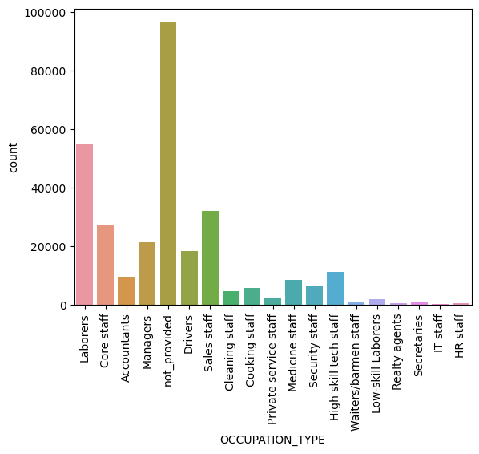
This is the countplot of occupation that shows how many application is came from which type of person doing which type of occupation.

Slide 7
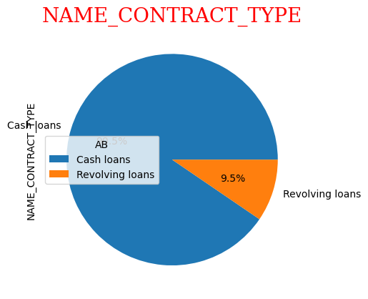
This is basically the pie chart shows type of loan taken by people is it revolving or cash loan.

Slide 8
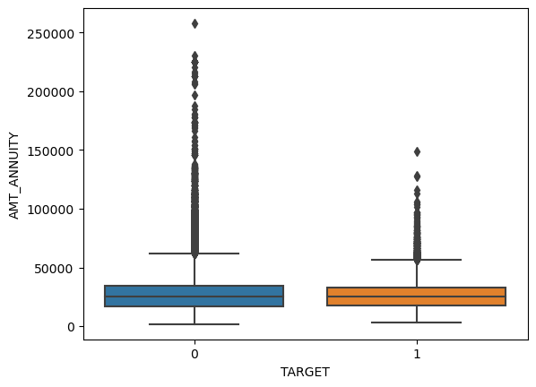
This is the box plot showin 0=good customer and 1=bad customer, that shows no. of good and default customers and the outliers.

Slide 9
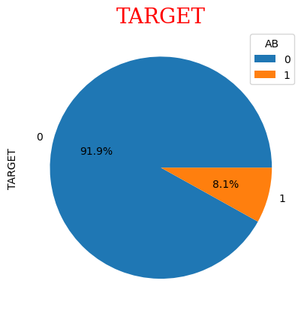
This is the pie chart shows the target inbalace of 91.9% of good customer and 8.1% of default customer.

Slide 10
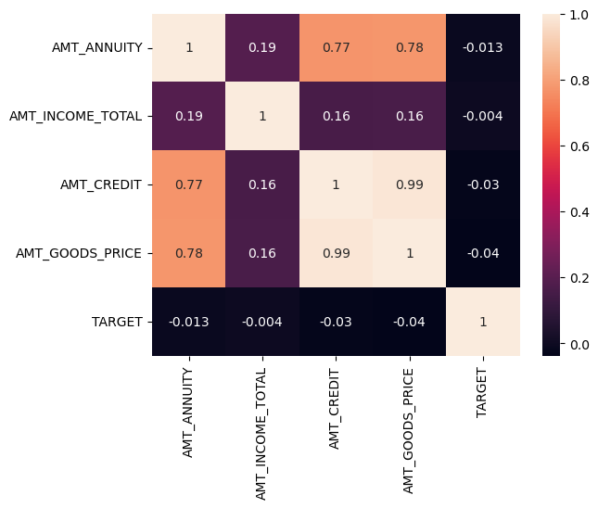
This is the heat map of all main columns of new application file showing relation.

Slide 11
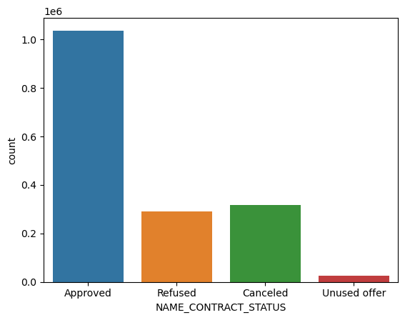
This shows no. of application approved or refused or canceled or unused previously.

Slide 12
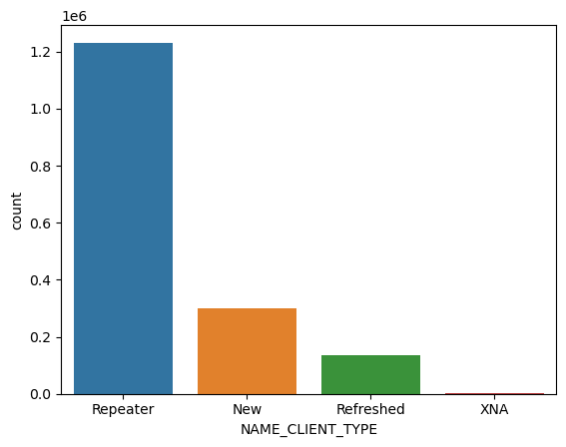
This count plot shows repeated or new or refreshed customer application.

Slide 13
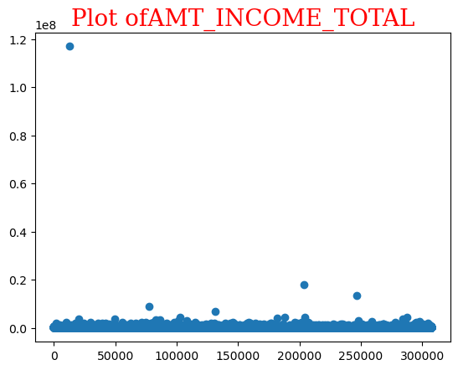
This is scatter plot showing the total income of people given application for loan.

Slide 14
Recommendation and conclusion
Firstly, I will conclude that every data has inbalance as good or defaulters are not equall.
Second ,customer repaying loan timely should given loan and customer not repaying it there application should rejected.
In last we conclude that loan shoude be given by observing all mandatory details like there income, expenses etc.

