Slide 1

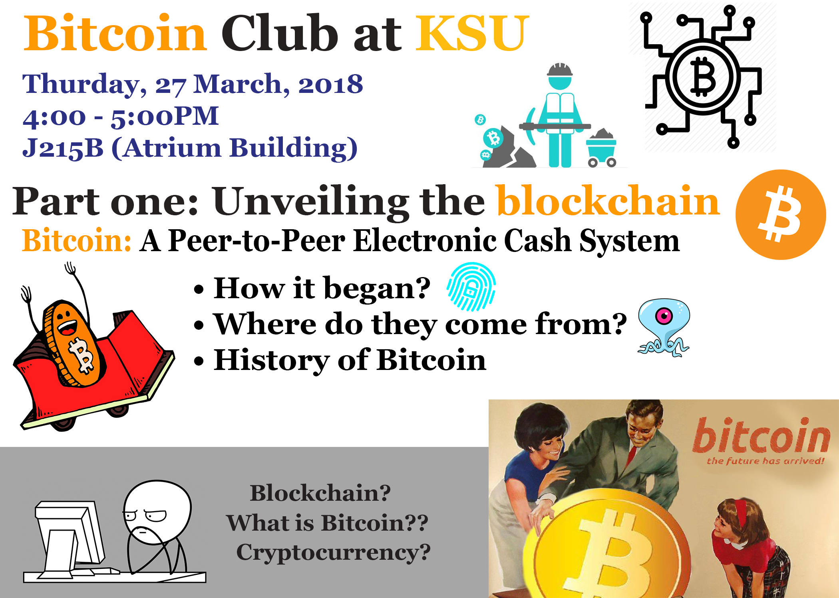
5 Credits (still missing)

Slide 2





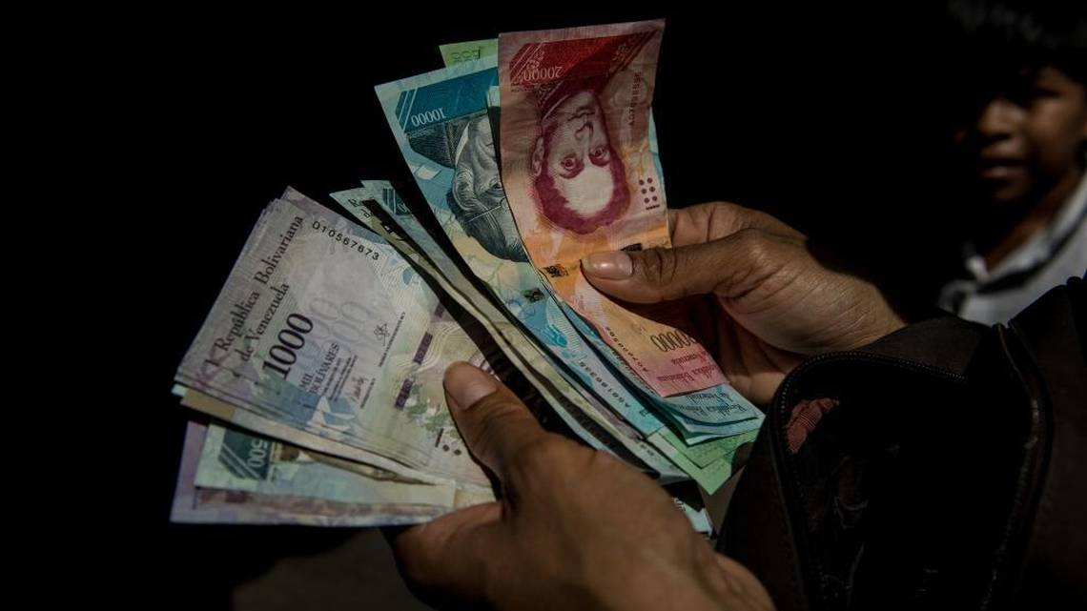



Motivation behind cryptocurrencies:
Key point motivations for me:
Banking for the under-banked
Security and Privacy
Decentralization
Venezuela/ Argentina tanking economies
You can't get $1 out of the bank in Venezuela.
Inflation is over 4000% (source: CNN Money)

Slide 3
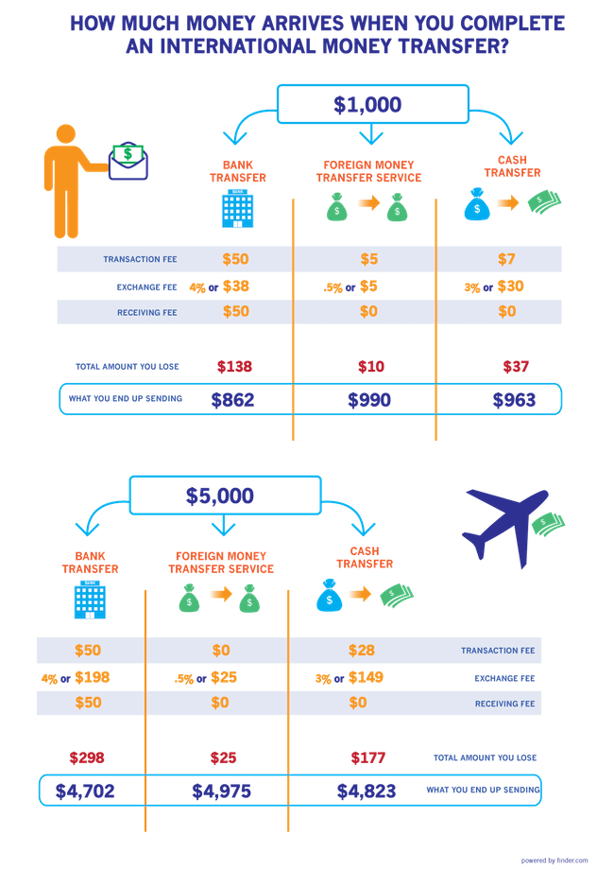
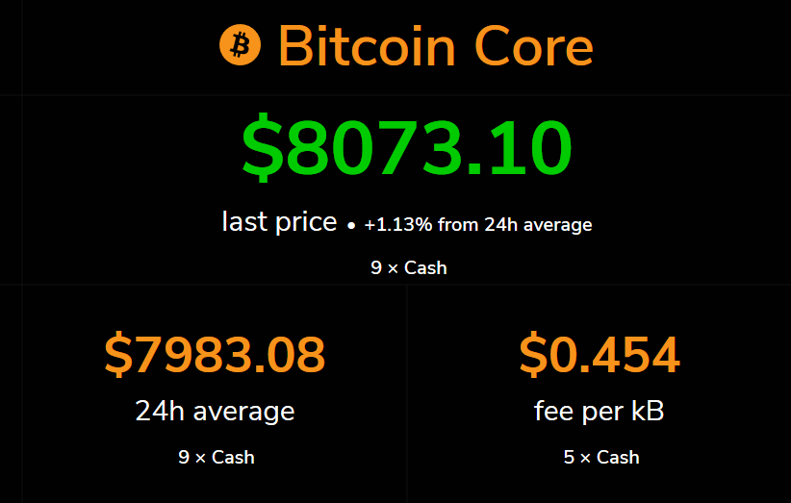
(As of today, March 27, 2018)
Have you ever imagined how do the magical plastic cards (Credit/Debit cards) help you buy resources with just a swipe? Crazy idea when you think about it, isn't it?

Slide 4
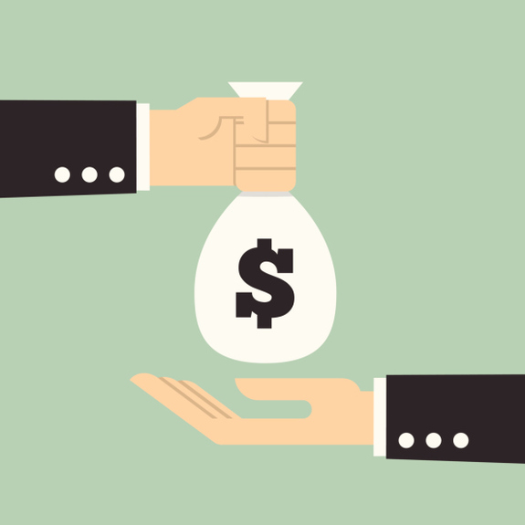
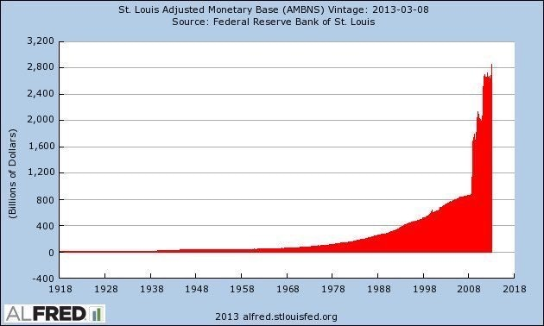
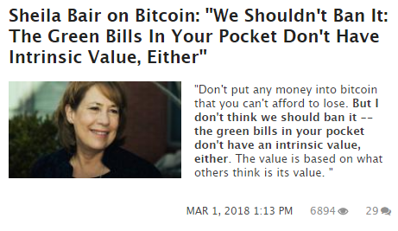
Is it worthy enough for you to consider this?
My question is, as an end-user do “you” care?
Key point I want to highlight today in this meetup today.
As long as you get the product/resource you seek, “you” don’t seem to be oblivious about how “you” get it
Is it the societal norm?
Trade and money

Slide 5
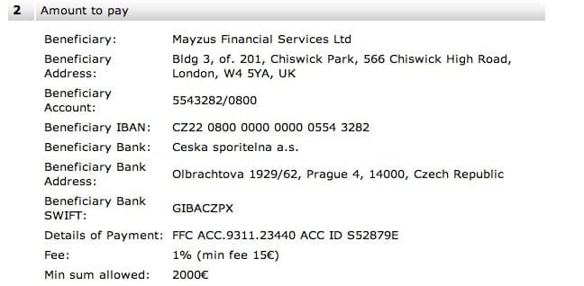
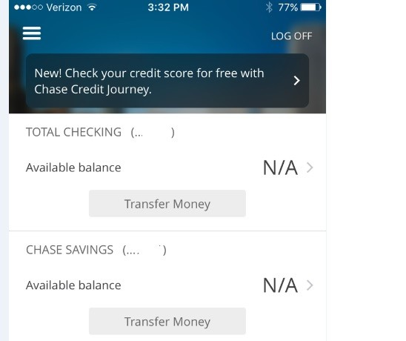
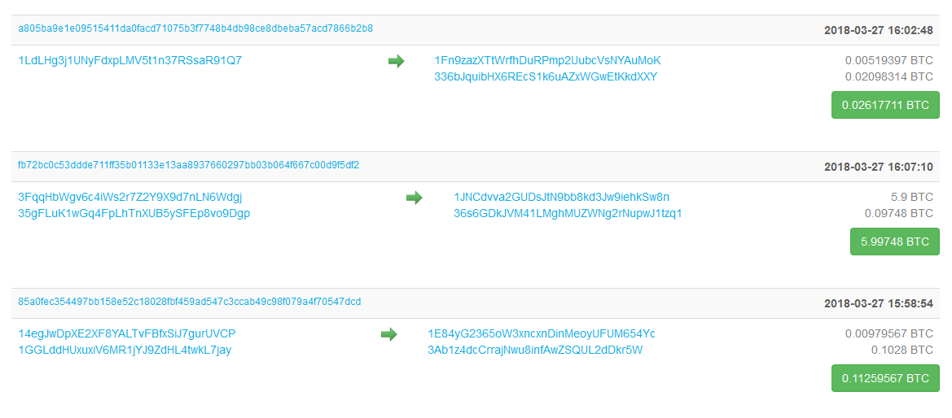
Banking vs Cryptocurrencies

Slide 6
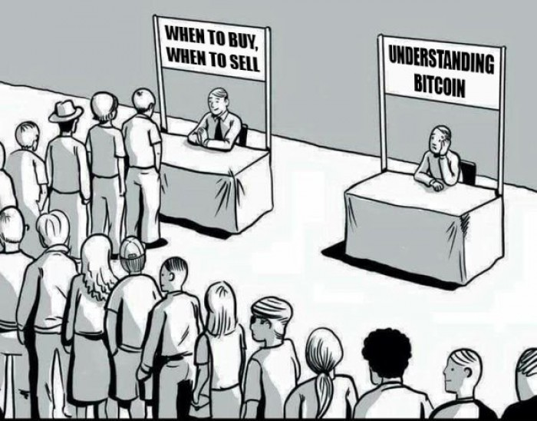
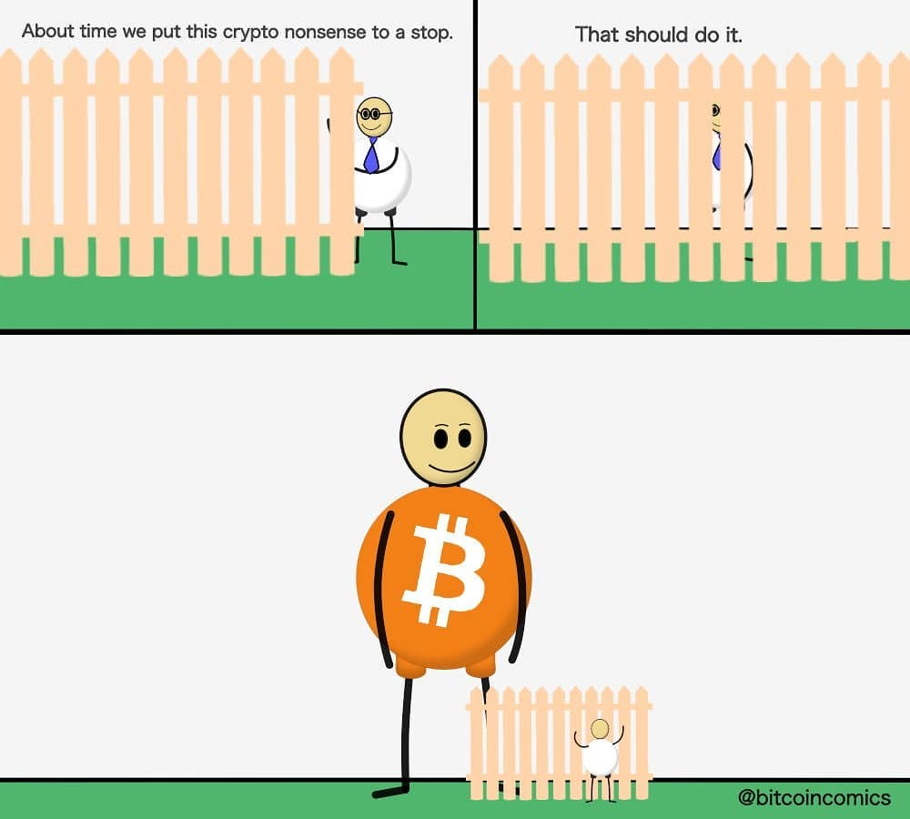
People trying to get into cryptocurrencies:
2 Phases as seen below:

Slide 7
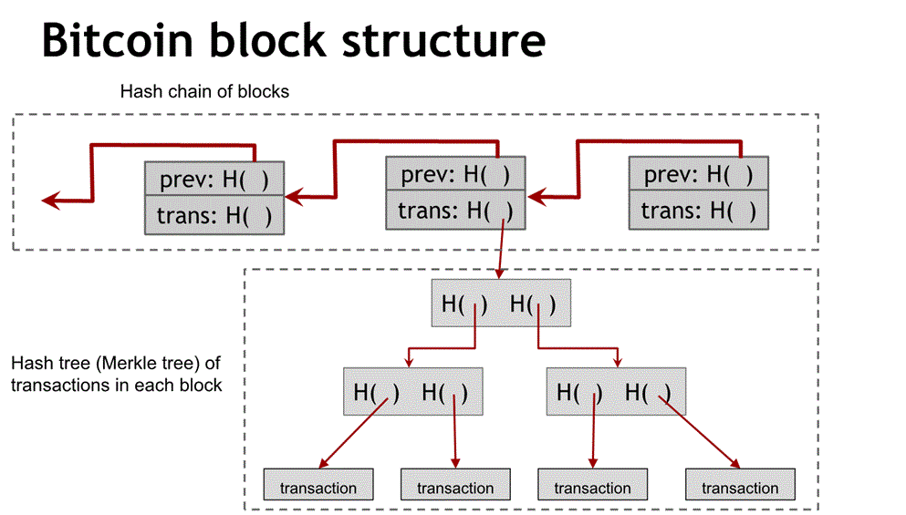
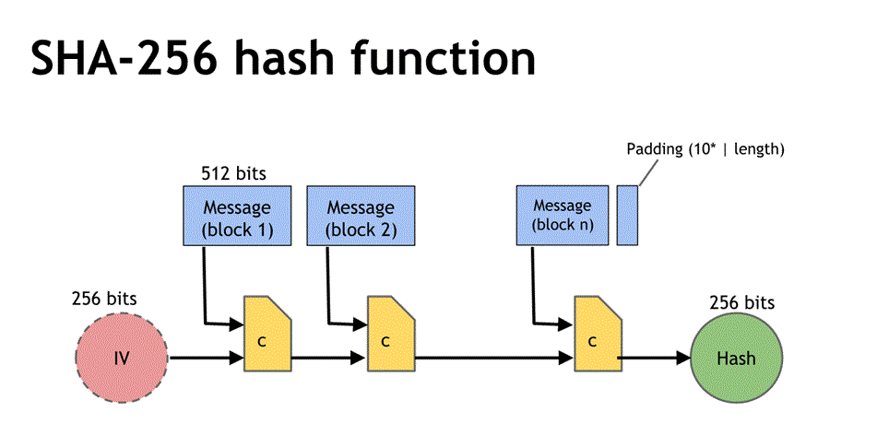
Setting up for the big picture:
Merkle tree
Hash functions
SHA-256
Script
Public Key Cryptography
Hash pointers
Proof of Work etc.
Further details coming up in next meetings.

Slide 8
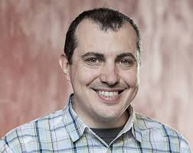
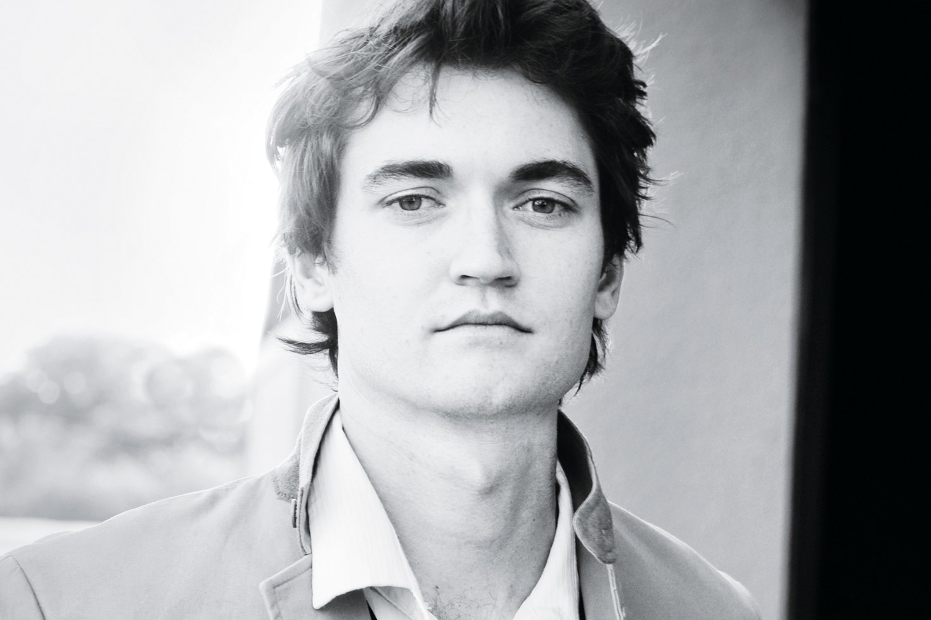
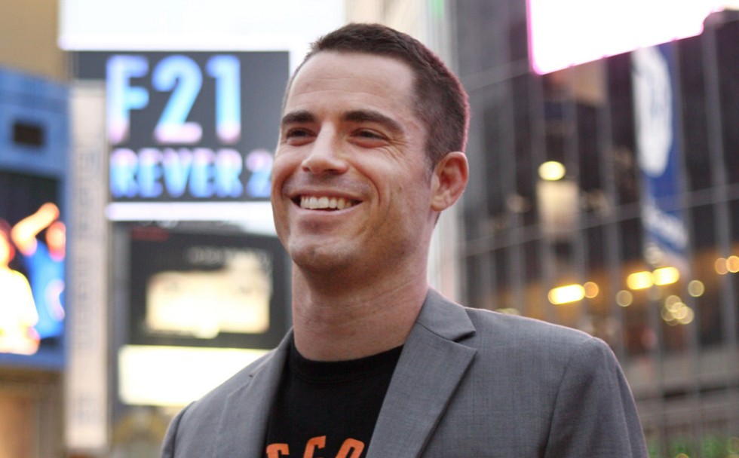
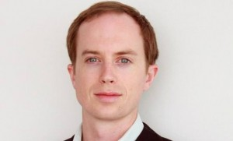

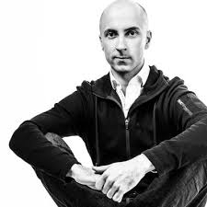
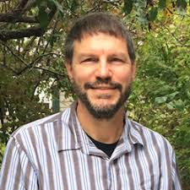
Know em’ all
2 credits each

Slide 9
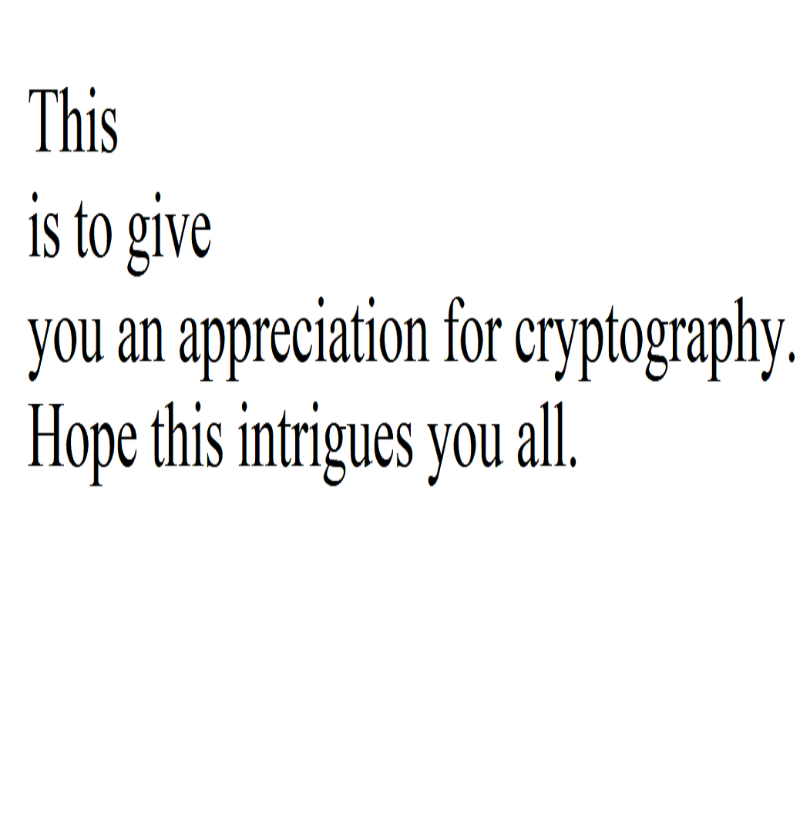
~Joshi
Solutions to the last puzzles:
Hello all, salutations, hashes & treasures hide everywhere. Lions eat nilgai, giraffe, tigers & hippopotamus.
Owl feathers, tiger hairs include spots. These example x's trivia. Hens are so hairy. The hens even validate
a law using equilibrium. With isotopes, tetra-chlorofluorocarbons hide multiplicative unification. Later, these
isotopes polymerize larger isotopic combinations and thus isomers obtain negative oxidization. Further,
gravity in very even numbered polymers revolves inside meta-states, expanding negative unique metamers
by existing resistance states.
~Joshi
Primes in the images:
1, 3, 5, and 5, which refer to the number of words on each line.
Also, the dimensions of the image itself: 1051x1061
"Hash the length of this text. Hash the value with multiplication of given prime numbers."
Length of the text: 577
(not to scale)
Stay tuned for more puzzles! (GitHub Repo)
Thomas Fuller: 8 credits

Slide 10
Questions? Ideas? Thoughts?
Wrap-up, “Give-away”
Puzzle(s) (5 credits each)
GitHub
Looking for more members, looking for committee members as well
Technical / Non-technical
Subject & Schedule for the next meeting
Swag etc.

Slide 11
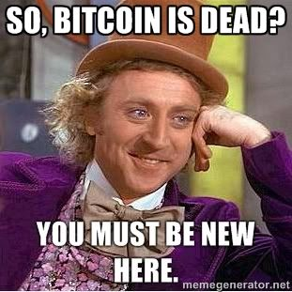
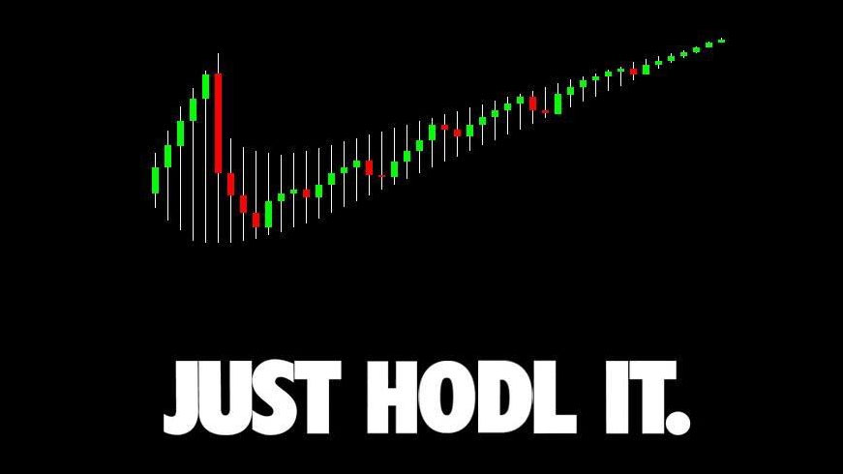
What am I trying to do with the club?
Resume Builder
Learn along with you guys
Cutting edge technology
Practical approach to applied cryptography
Get involved, contribute
Become rich (maybe)

Slide 12
Are we a registered organization? Yes, you can check Owl life for further information about this.
Do I know everything? Nope, still on the learning phase.
Do I want you to make financial decision based on my approach to crypto in general? Nope.
Are you responsible for you own money? Yes.
Am I here to learn from you guys? Yes.
Do I wish to learn together? Yes.
Am I being sponsored? A big fat NO.
Do I wish to be sponsored for the club? Yes (pizza etc. for future meetings)
Will KSU sponsor us? Time will tell.

Slide 13
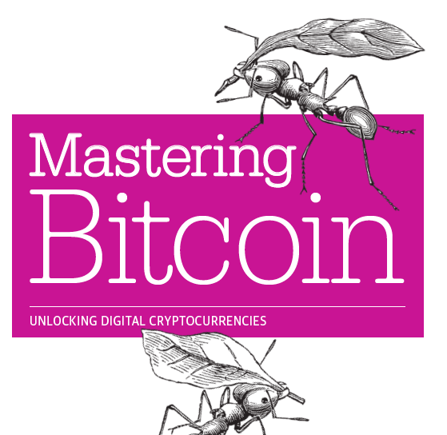
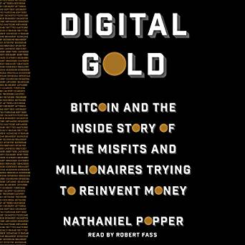

Cool places to start with-
Coinmarketcap
Bitcoin.org
Reddit (informative yet you have to be careful)
Cryptography (general)
Blockchain.info
Fin-tech
Books *I can recommend a few
Thanks to Jennifer for the awesome Christmas Gift!

Slide 14
Thank you for attending the meeting!

