Slide 1
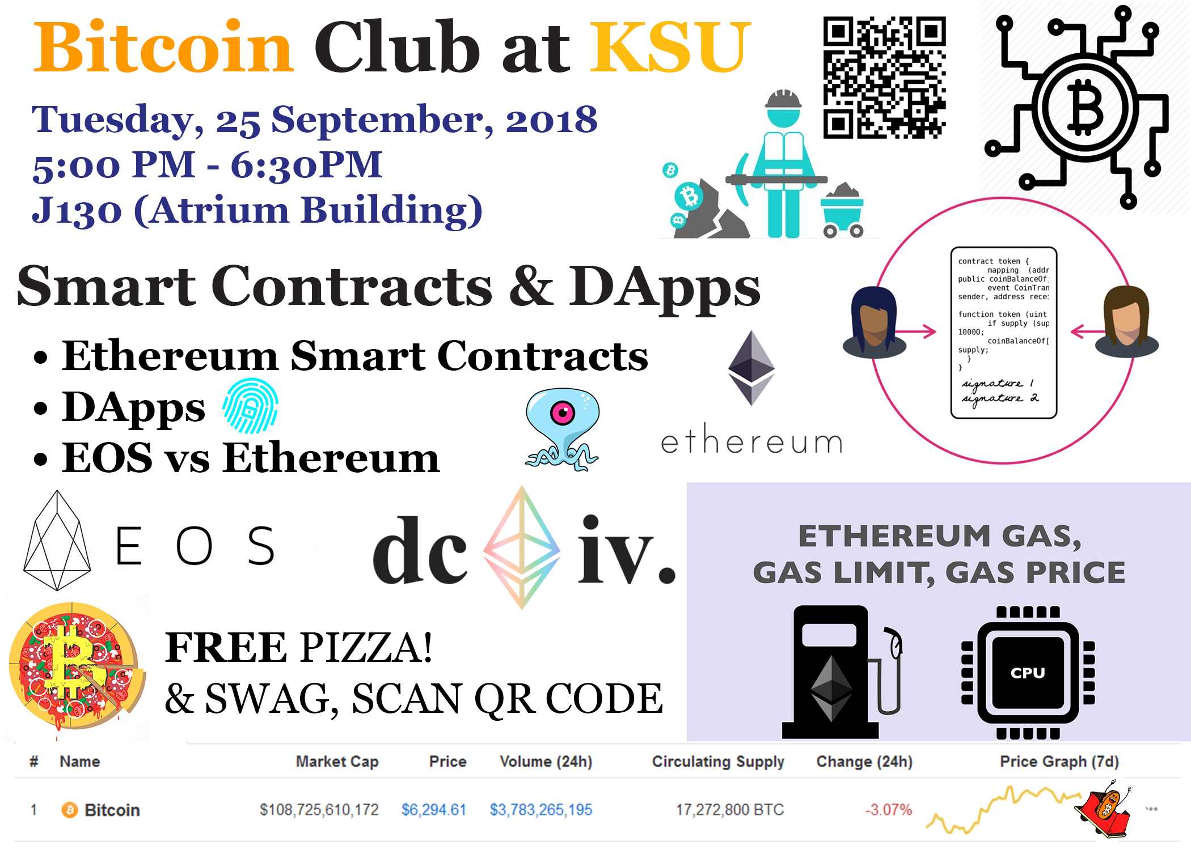

Slide 2

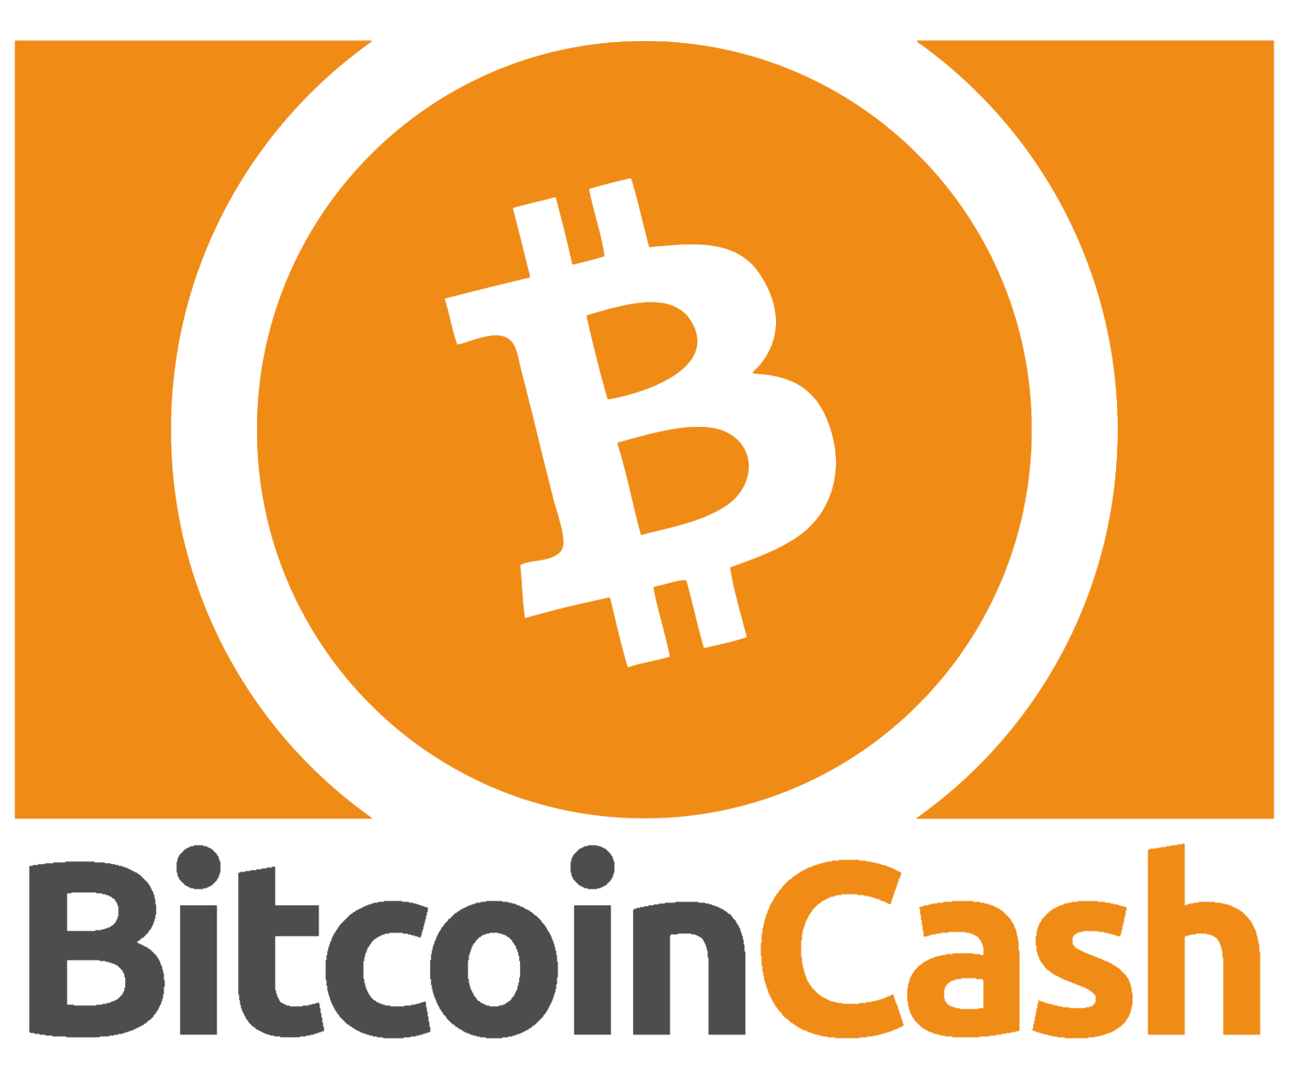

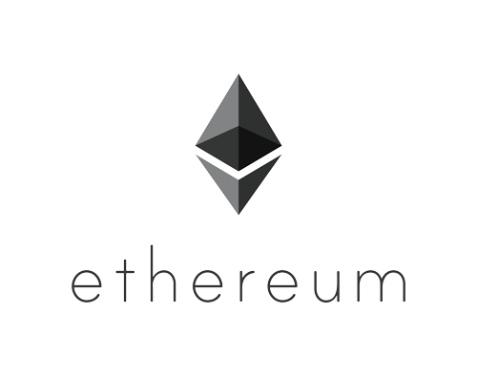


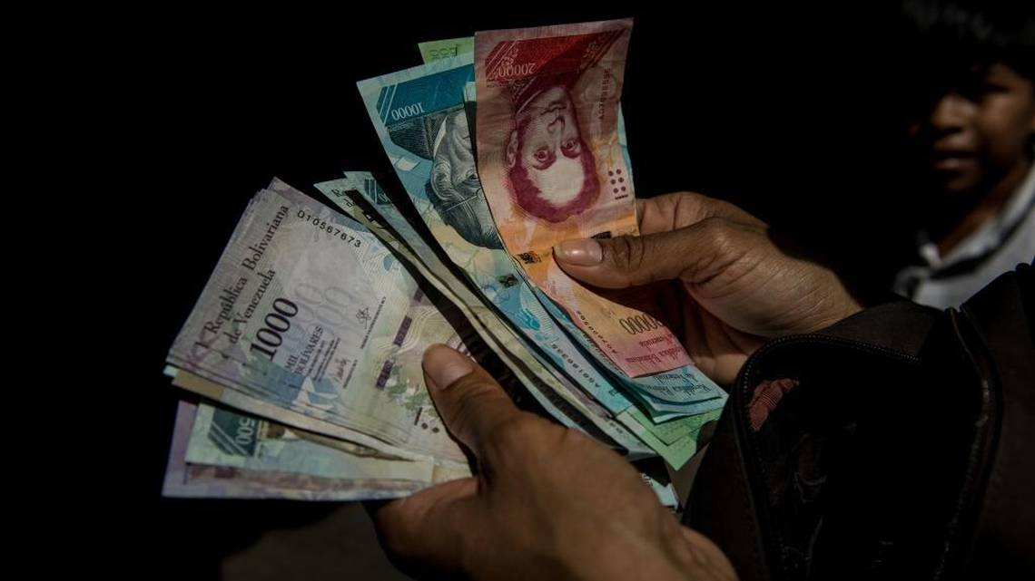


Motivation behind cryptocurrencies:
Key point motivations for me:
Banking for the underbanked
Security and Privacy
Decentralization
Venezuela/ Argentina tanking economies
You can't get $1 out of the bank in Venezuela.
Inflation is over 4000% (source: CNN Money)
(Quick refresher: Referring back from some old slides)

Slide 3
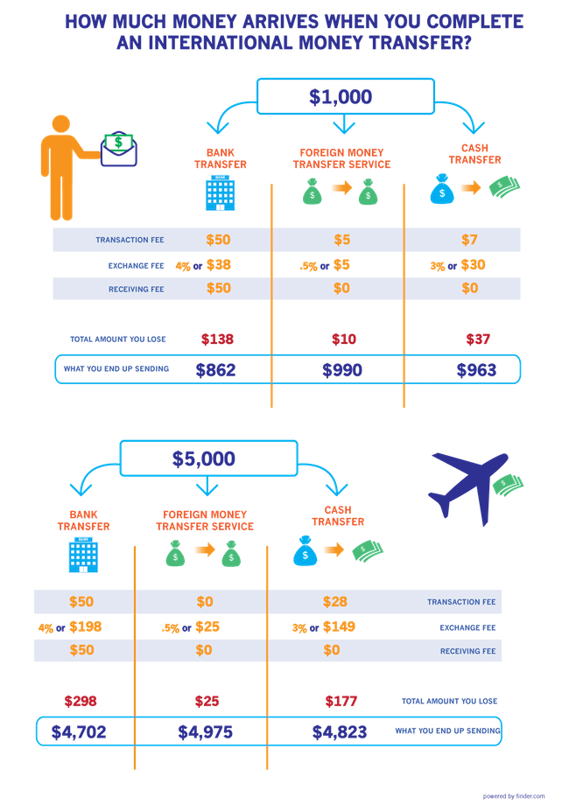
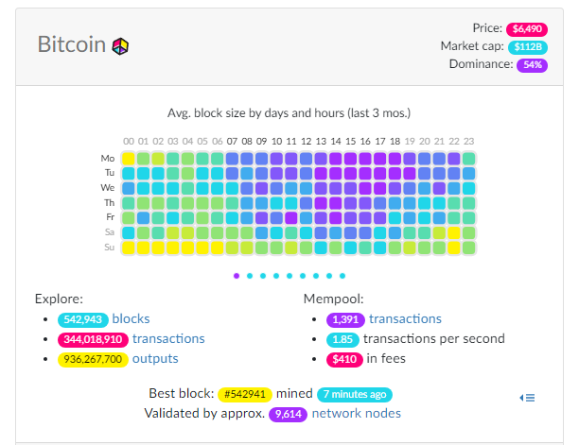
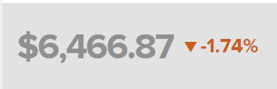
(As of today, September 24, 2018)
Have you ever imagined how do the magical plastic cards (Credit/Debit cards) help you buy resources with just a swipe? Crazy idea when you think about it, isn't it?
(Quick refresher: Referring back from some old slides)

Slide 4

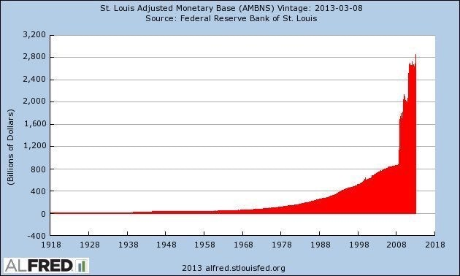
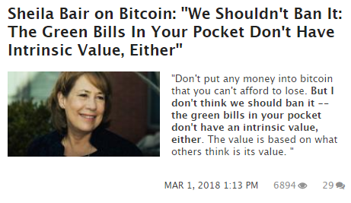
Is it worthy enough for you to consider this?
My question is, as an end-user do “you” care?
As long as you get the product/resource you seek, “you” don’t seem to be oblivious about how “you” get it
Is it the societal norm?
Trade and money
(Quick refresher: Referring back from some old slides)

Slide 5
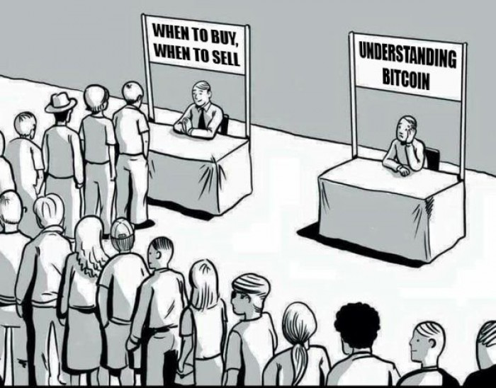
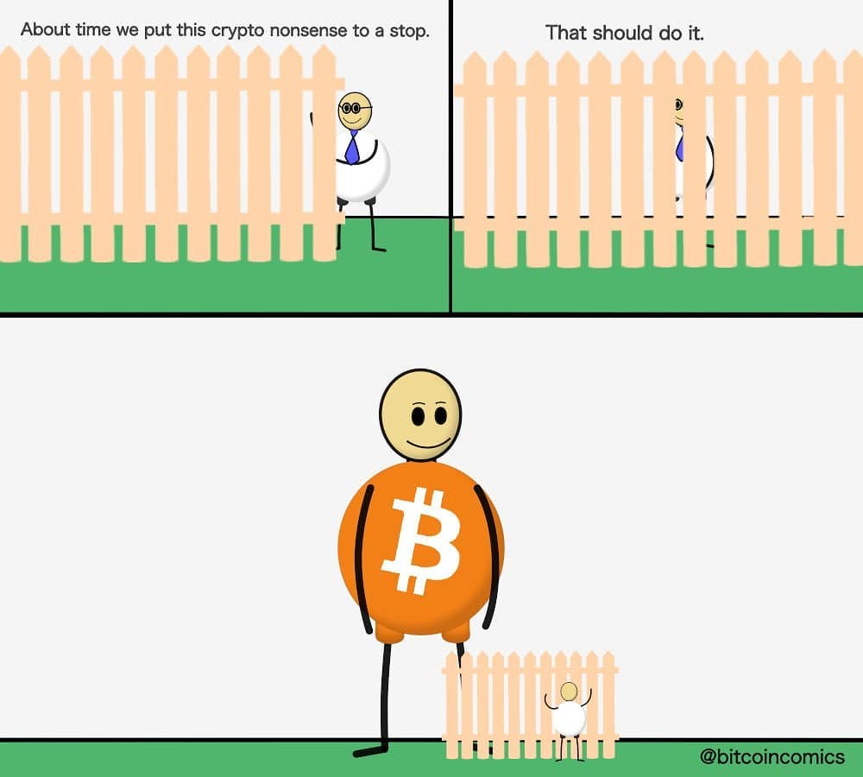
People trying to get into cryptocurrencies:
Two phases as seen below:

Slide 6
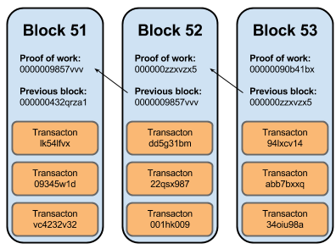
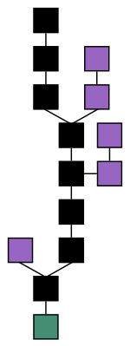
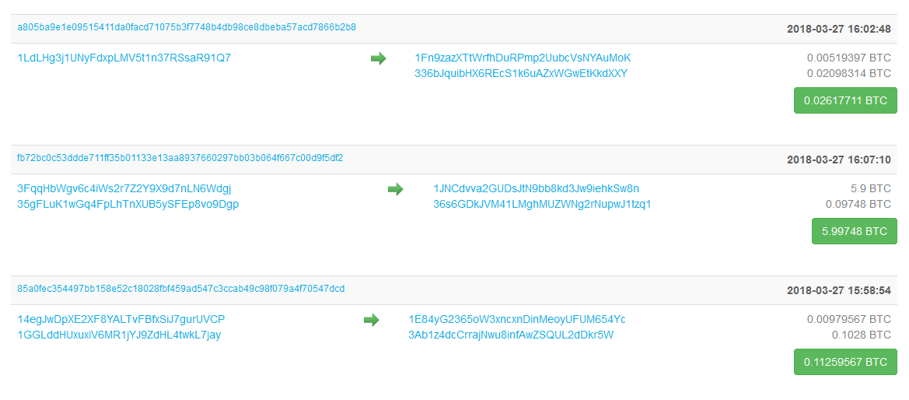
Blockchain
Computing power based - no one can be more powerful than everyone else
Majority consensus - everyone acting in self-interest means everyone must agree
Transactions and state - perfect for keeping track of money
Source: https://github.com/BCGatech/blockchainpresentation/blob/master/Token%20Presentation.pptx

Slide 7
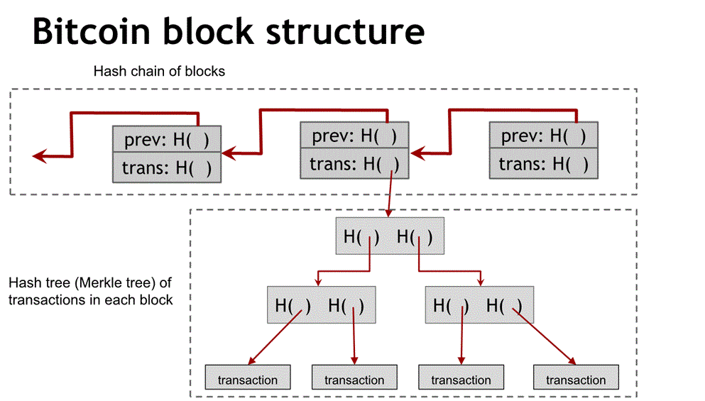
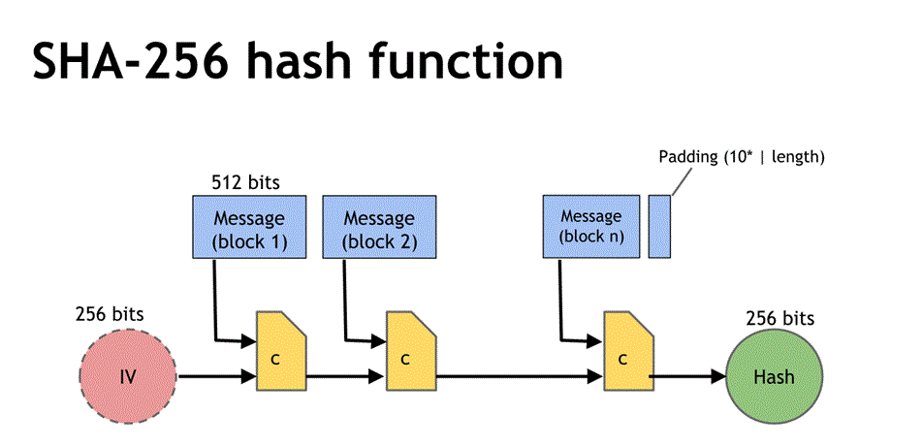
Setting up for the big picture:
Technical jargon (yawn!)
Merkle tree
Hash functions
SHA-256
Script** (worth noticing for today)
Public Key Cryptography
Hash pointers
Proof of Work etc.
(Quick refresher: Referring back from some old slides)

Slide 8
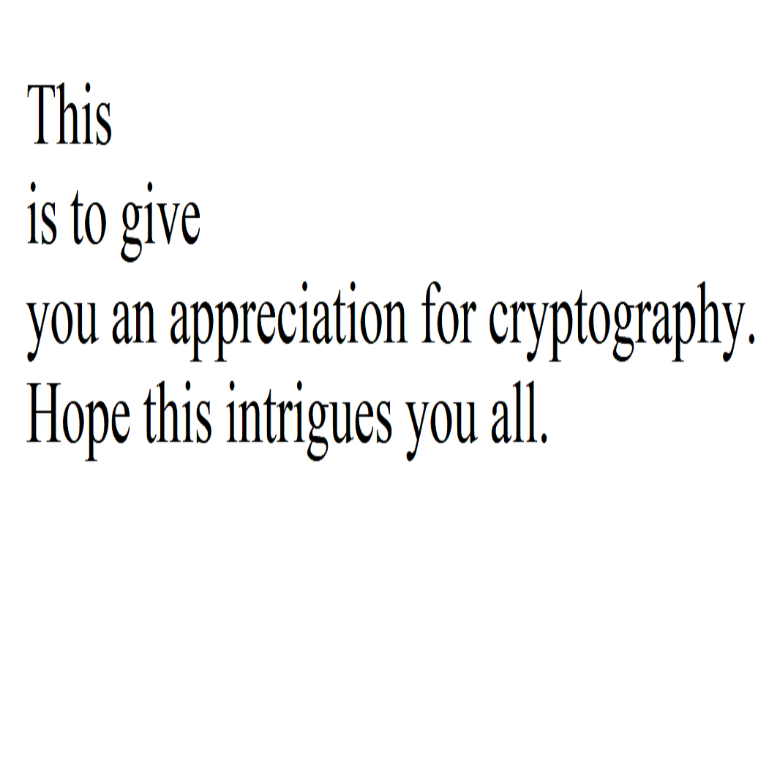
Solutions to the last puzzles:
~Joshi
Hello all, salutations, hashes & treasures hide everywhere. Lions eat nilgai, giraffe, tigers & hippopotamus.
Owl feathers, tiger hairs include spots. These example x's trivia. Hens are so hairy. The hens even validate
a law using equilibrium. With isotopes, tetra-chlorofluorocarbons hide multiplicative unification. Later, these
isotopes polymerize larger isotopic combinations and thus isomers obtain negative oxidization. Further,
gravity in very even numbered polymers revolves inside meta-states, expanding negative unique metamers
by existing resistance states.
~Joshi
Primes in the images:
1, 3, 5, and 5, which refer to the number of words on each line.
Also, the dimensions of the image itself: 1051x1061
"Hash the length of this text. Hash the value with multiplication of given prime numbers."
Length of the text: 577
(not to scale)
Stay tuned for more puzzles!
(GitHub: https://github.com/HarshitJoshi/BitcoinClub)
(Quick refresher: Referring back from some old slides)

Slide 9
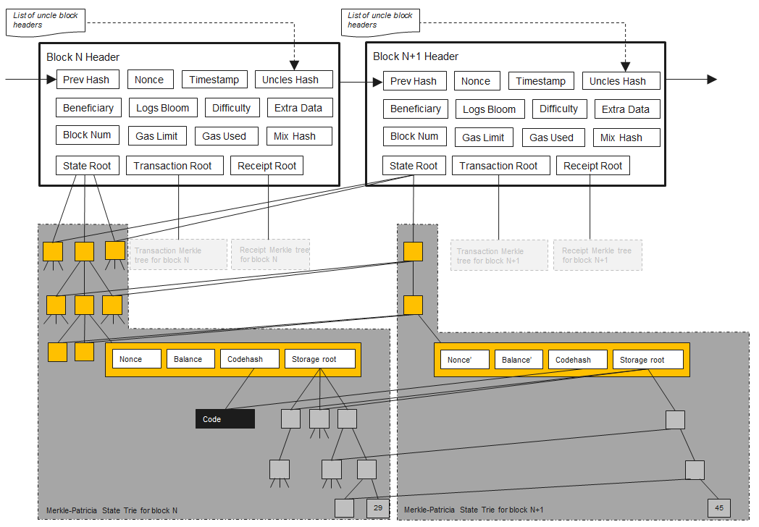
Ethereum
Proposed in late 2013 by Vitalik Buterin
Goal: Building decentralized applications
Argument against Bitcoin’s Script (non-turing complete)
Ether:
Fundamental cryptocurrency for Ethereum’s operation
Used to pay “gas” or “fuel”, a unit of computation used in transactions and other state transitions
Eighteen million ether, at most, are mined per year.
Technical jargon (yawn!)
Merkle Trees
EVM (Ethereum Virtual Machine)
KECCAK-256
State Transitions
Solidity, Serpent, LLL (vs Script)
Public Key Cryptography
Hash pointers
Proof of Work (may switch to POS)
“Ethereum would never be possible without bitcoin—both the technology and the currency“
Source: https://www.ethereum.org/, https://github.com/llSourcell/ethereum_demo/blob/master/Ethereum%20Explained.ipynb
Notes:
Turing complete is a computer science term that basically means it can run any program any other computer can run.

Slide 10
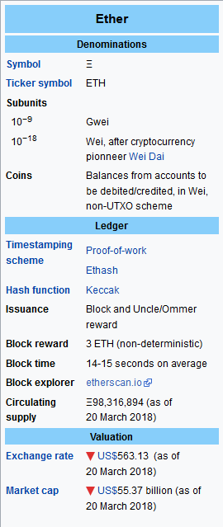
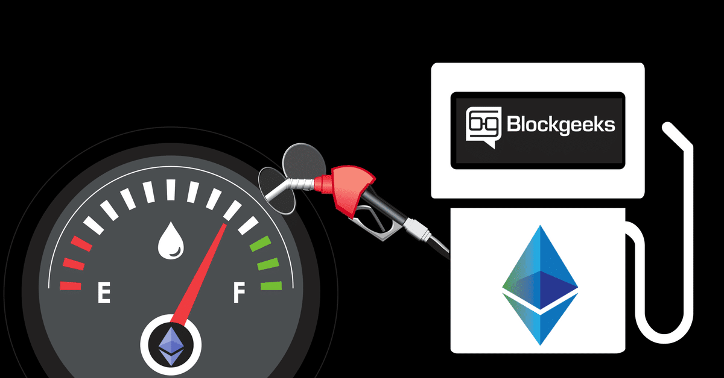
Ethereum Gas, Gas Price & Limit cont.
Each and every line of code in Solidity requires a certain amount of gas to be executed
Why Gas?
To incentivize the miners; more miners -> more hash rate -> more secure and fast system
Measured in units of gas (depends on how many EVM instructions need to be executed)
~ Ethereum Yellow Paper discusses this is detail
Source: https://blockgeeks.com/guides/ethereum-gas-step-by-step-guide/

Slide 11
Ethereum Gas, Gas Price & Limit
Ethereum Gas Limit:
Sender of the tx must specify a gas limit before submission to the network
The max amount of gas the sender is willing to pay for tx
Things to remember:
Different operations have different gas costs
Miner stop executing the moment gas runs out
Leftover gas is returned to the operation generator
https://kb.myetherwallet.com/gas/what-is-gas-ethereum.html
Source: https://blockgeeks.com/guides/ethereum-gas-step-by-step-guide/

Slide 12
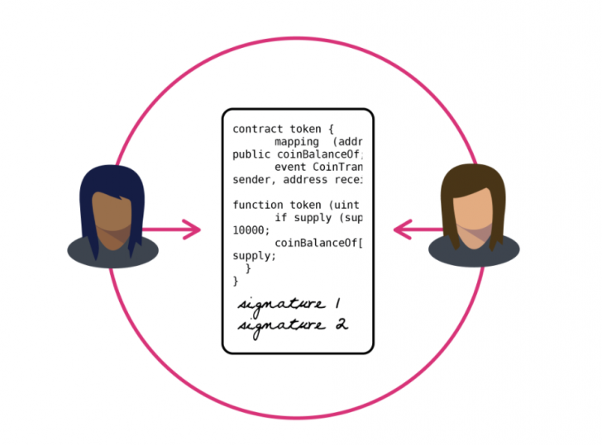
Key Point: Ethereum Smart Contracts
Smart Contract:
Code executing instructions transparently
On the block chain so results are immutable
Compare to use of force for traditional contract enforcement
Ex. timers, voting, financial agreements, etc.
Smart contracts can:
Function as 'multi-signature' accounts, so that funds are spent only when a required percentage of people agree
Manage agreements between users, say, if one buys insurance from the other
Provide utility to other contracts (similar to how a software library works)
Store information about an application, such as domain registration information or membership records
Ethereum Virtual Machine (EVM) is a Turing-Complete Architecture
Can execute arbitrary programs governing money + data on the chain
Source: https://github.com/BCGatech/blockchainpresentation/blob/master/Token%20Presentation.pptx

Slide 13
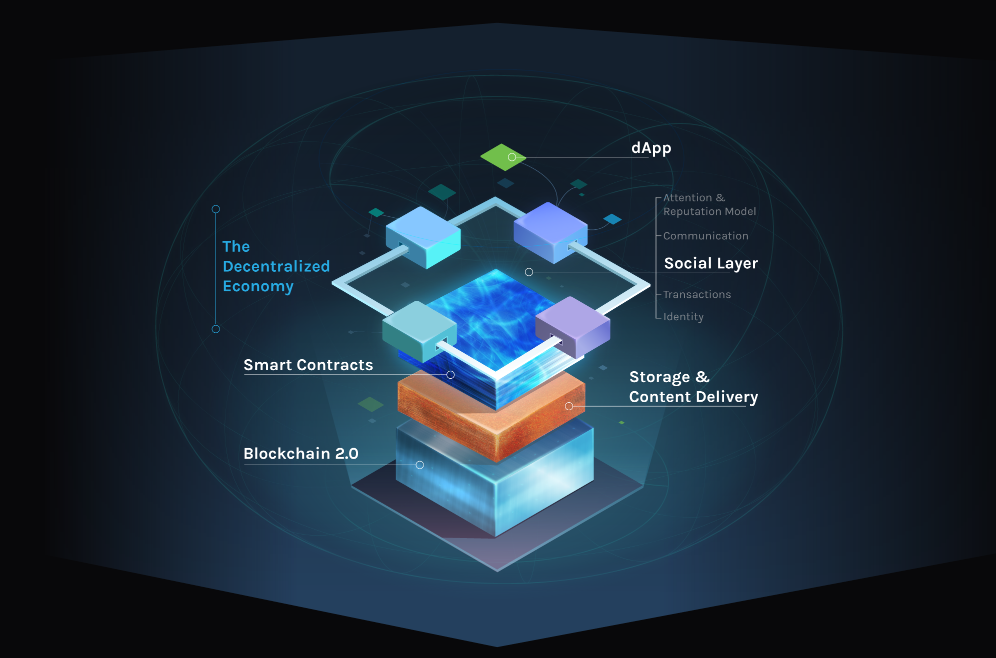
DApps Visualized

Slide 14

DApps
Doesn't depend on any specific party
Not for selling a specific party's service
Instead, a tool for people and organizations on different sides of an interaction used to come together without any centralized intermediary.
A "decentralized Appstore" where anyone can publish their unstoppable apps (DApps), which unlike today's apps (think Gmail or Uber) don't require a middleman to function or to manage a user's information.
Leads to DAO (Decentralized Autonomous Organizations)
Source: https://www.coindesk.com/information/what-is-a-decentralized-application-dapp/, https://github.com/llSourcell/ethereum_demo/blob/master/Ethereum%20Explained.ipynb

Slide 15
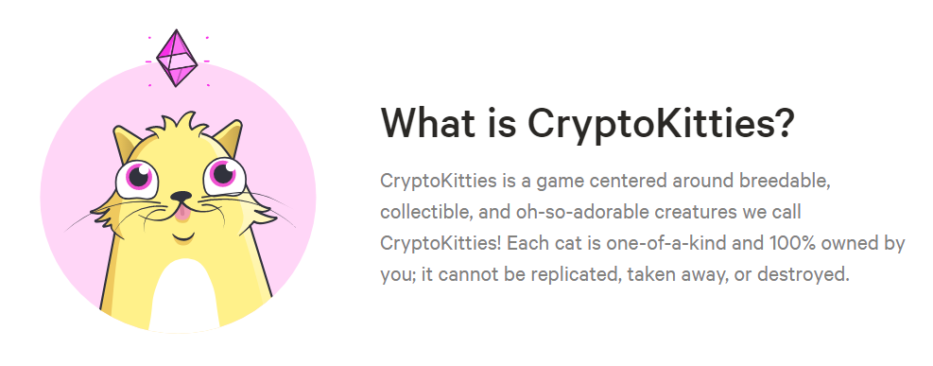
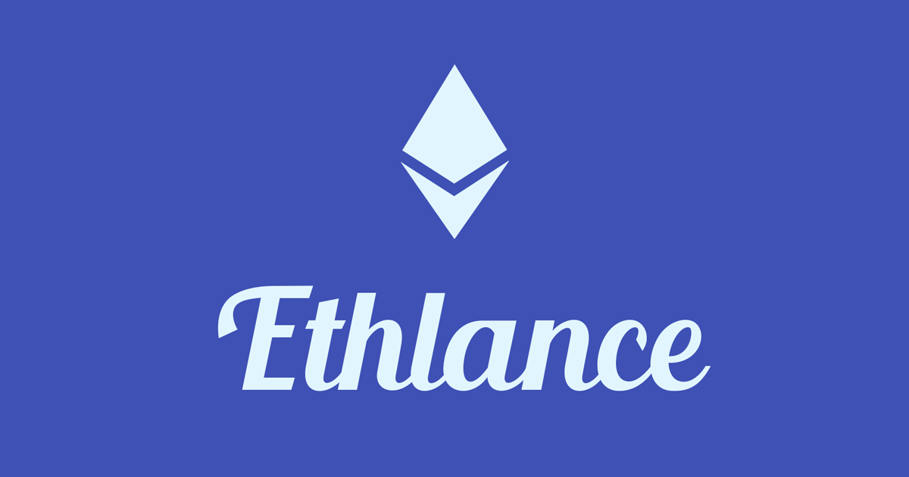



DApps Examples

Slide 16
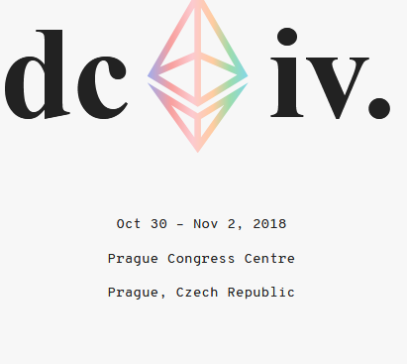
Final Thoughts
Block chain is not hard, it is still foreign concept
Takes time to digest-in
Smart contracts can be really useful
Good references for starting with Solidity and Smart Contracts:
Micah Riggan’s channel (Senior developer at BitPay)
https://www.youtube.com/channel/UC1xAylh1hRqaNYWmBdohtIg
https://remix.ethereum.org
https://metamask.io/
https://solidity.readthedocs.io/en/v0.4.24/introduction-to-smart-contracts.html
https://truffleframework.com/
And of course, Google!

Slide 17
Questions? Ideas? Thoughts?
Not a part of the club?
https://owllife.kennesaw.edu/organization/BitcoinClub
GitHub
Looking for more members, looking for committee members as well.
Technical / Non-technical
Subject & Schedule for the next meeting
Swag etc.

Slide 18
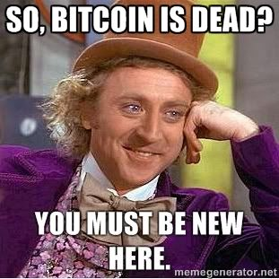
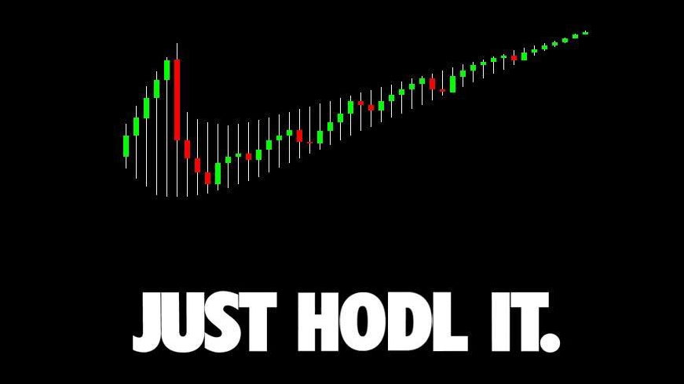
What am I trying to do with the club?
Resume Builder
Learn along with you guys
Cutting edge technology
Practical approach to applied cryptography
Get involved, contribute
Become rich (maybe)

Slide 19
Thank you for attending the meeting!

