Slide 1


5 Credits

Slide 2
Thank you everyone for coming to the Kick-off meeting of KSU Bitcoin Club.
I would like to extend my warmest and sincere thanks to Dr. Joseph Eyles (our Advisor) for getting us this location for the meeting. I would also like to thank all the committee members for helping me out with the club material and preparations.

Slide 3








What are Cryptocurrencies?
Pick yours –
Bubble? Ponzi Scheme? Hoax?
Get rich quick??
Future??
Heard about any of these before?
Name them all for 2 credits

Slide 4
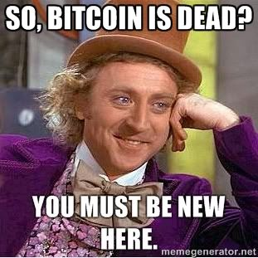
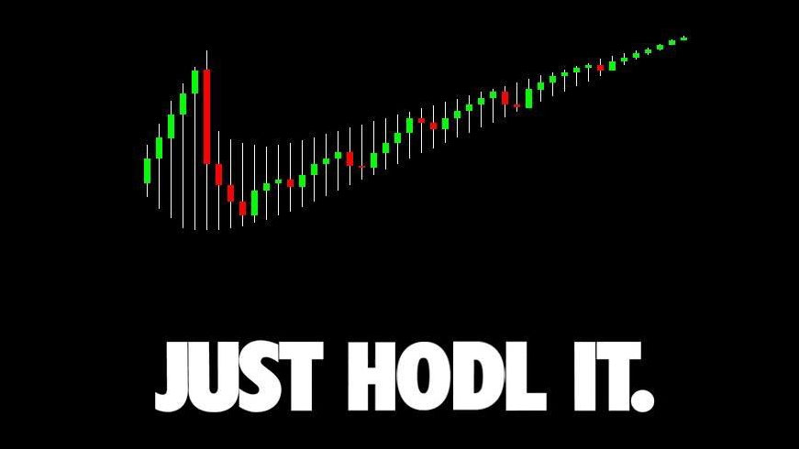
What am I trying to do with the club?
Resume Builder
Learn along with you guys
Cutting edge technology
Practical approach to applied cryptography
Get involved, contribute
Become rich (maybe)

Slide 5
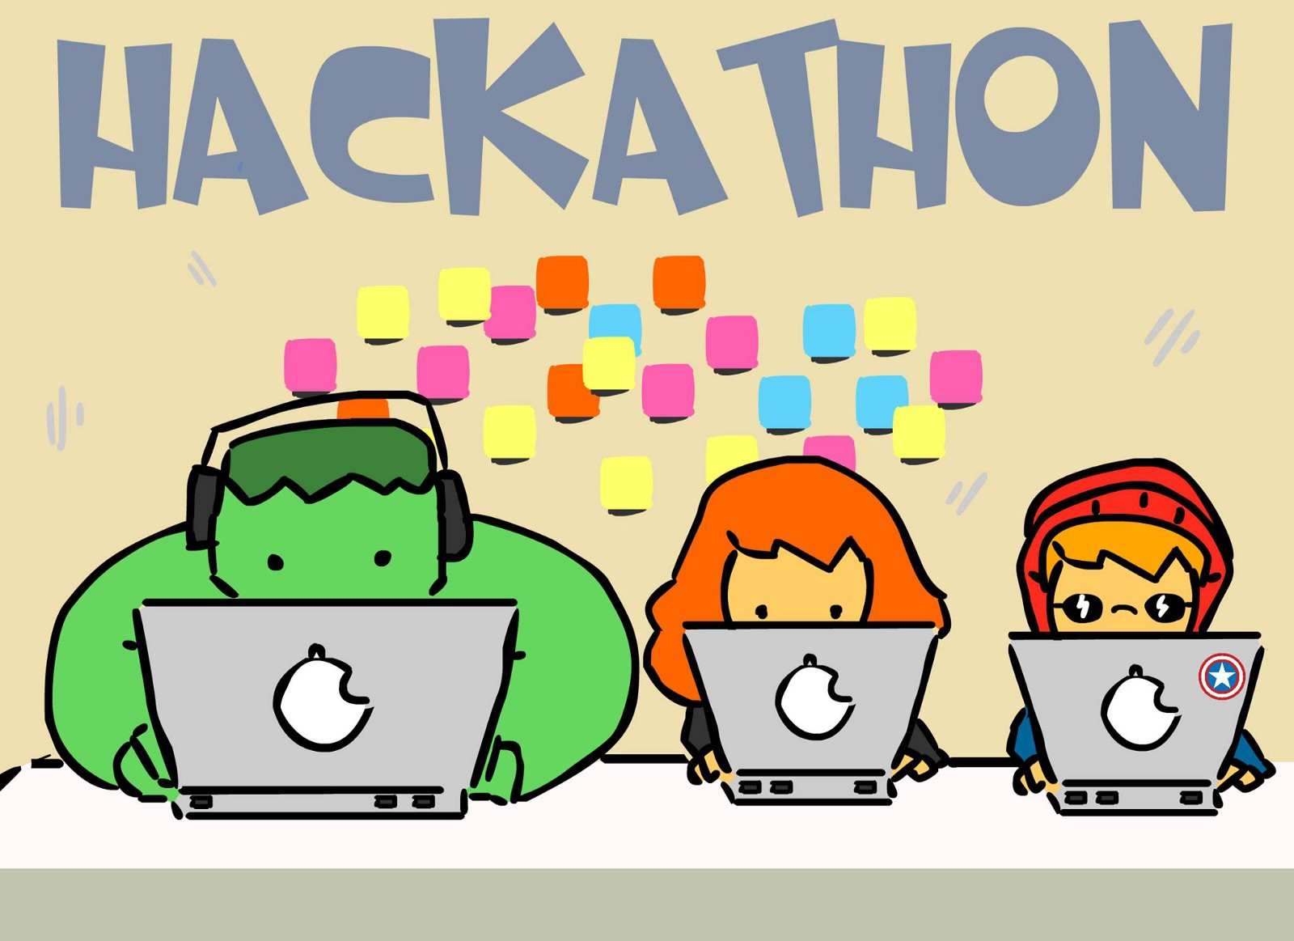

Some ideas I wanted to share:
Mini Hackathons
Group projects
Research topics
Guest Speakers
Community events

Slide 6
Are we a registered organization? Yes, you can check Owl life for further information about this.
Do I know everything? Nope, still on the learning phase.
Do I want you to make financial decision based on my approach to crypto in general? Nope.
Are you responsible for you own money? Yes.
Am I here to learn from you guys? Yes.
Do I wish to learn together? Yes.
Am I being sponsored? A big fat NO.
Do I wish to be sponsored for the club? Yes (pizza etc. for future meetings)
Will KSU sponsor us? Time will tell.

Slide 7
Why Crypto?
What is Blockchain?
Quick Overview of what’s happening using Bitcoin as an example
Merkle Tree
SHA256 (one way hash functions)
Should you care?

Slide 8
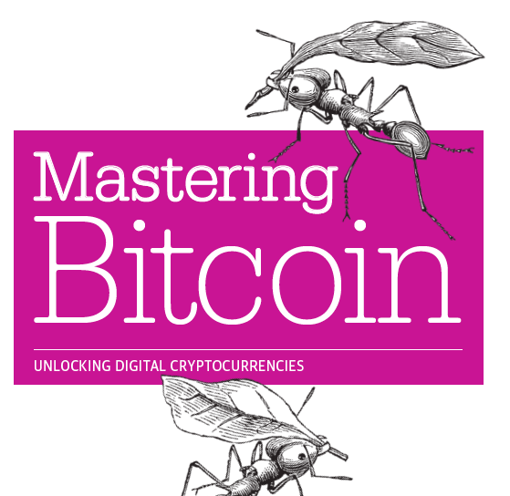
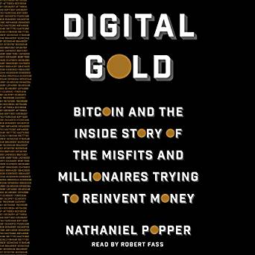

Cool places to start with-
Coinmarketcap
Bitcoin.org
Reddit (informative yet you have to be careful)
Cryptography (general)
Blockchain.info
Fin-tech
Books *I can recommend a few
Thanks to Jennifer for the awesome Christmas Gift!

Slide 9
Questions? Ideas? Thoughts?
Wrap-up, “Give-away”
Puzzle(s) (5 credits each)
GitHub
Looking for more members, looking for committee members as well.
Technical / Non-technical
Subject & Schedule for the next meeting
Swag etc.

Slide 10
Thank you for attending the meeting!

