Slide 1


Slide 2
AGENDA
What is Version Control?
Exploring Git and GitHub
Getting setup
Hands-on practice using terminal interface (Charlie Liu)
Hands-on practice using GitKraken GUI (Muhammad Ali)
Quick review of other tools around GitHub
Merkle trees in Git (if time permits)
Conclusion

Slide 3


Version Control
Record history
Facilitate team work
Expose source code
Branch/merge development paths
Two types:
Centralized VCS
Decentralized VCS
- “Undo up to a certain point”

Slide 4


About Git
Created by Linus Torvalds, creator of Linux, in 2005
Came out of Linux development community
Designed to do version control on Linux kernel
Goals of Git:
Speed
Support for non-linear development (thousands of parallel branches)
Fully distributed
Able to handle large projects efficiently
(A "git" is a cranky old man. Linus meant himself.)
“I'm an egotistical bastard, and I name all my projects after
myself. First Linux, now git.”

Slide 5
GitHub
GitHub is a site for online storage of Git repositories.
You can create a remote repo there and push code to it.
Many open source projects use it, such as the Linux kernel.
You can get free space for open source projects, even private repositories are free!
Question: Do I always have to use GitHub to use Git?
Answer: No! You can use Git locally for your own purposes.
Or you or someone else could set up a server to share files.
Or you could share a repo with users on the same file system, as long everyone has the needed file permissions).

Slide 6
Setup
Follow this link below or just google, “Download Git” https://git-scm.com/downloads
Creating an account at GitHub:
https://github.com
Follow installation steps along with me. Please raise your hand if you need help or something’s unclear while installing.

Slide 7
Initial Git configuration
Set the name and email for Git to use when you commit:
git config --global user.name "Bugs Bunny"
git config --global user.email bugs@gmail.com
– git config –list to verify these are set.
Set the editor that is used for writing commit messages:
git config --global core.editor nano

Slide 8
Creating a Git repo
Two common scenarios: (only do one of these)
To create a new local Git repo in your current directory:
git init
This will create a .git directory in your current directory.
Then you can commit files in that directory into the repo.
git add filename
git commit –m "commit message"
To clone a remote repo to your current directory:
git clone url localDirectoryName
This will create the given local directory, containing a working copy of the files from the repo, and a .git directory (used to hold the staging area and your actual local repo)

Slide 9
Git commands
command | description
git clone url [dir] | copy a Git repository so you can add to it
git add file | adds file contents to the staging area
git commit | records a snapshot of the staging area
git status | view the status of your files in the working directory and staging area
git diff | shows diff of what is staged and what is modified but unstaged
git help [command] | get help info about a particular command
git pull | fetch from a remote repo and try to merge into the current branch
git push | push your new branches and data to a remote repository
others: init, reset, branch, checkout, merge, log, tag

Slide 10
Add and commit a file
The first time we ask a file to be tracked, and every time before we commit a file, we must add it to the staging area:
git add Hello.java Goodbye.java
Takes a snapshot of these files, adds them to the staging area.
In older VCS, "add" means "start tracking this file." In Git, "add" means "add to staging area" so it will be part of the next commit.
To move staged changes into the repo, we commit:
git commit –m "fix bug #22"

Slide 11
Branching and merging
Git uses branching heavily to switch between multiple tasks.
To create a new local branch:
git branch name
To list all local branches: (* = current branch)
git branch
To switch to a given local branch:
git checkout branchname
To look at logs of commits:
git log
To merge changes from a branch into the local master:
git checkout master
git merge branchname

Slide 12
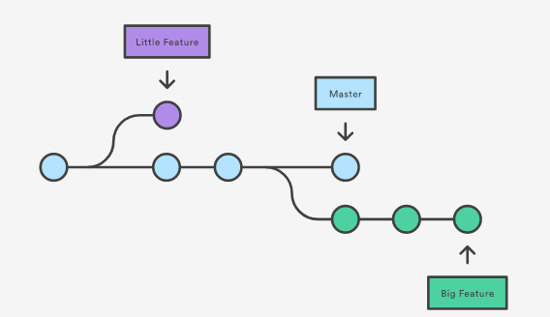
Branching and merging (cont.)

Slide 13
Interaction with remote repository
Push your local changes to the remote repo.
Pull from remote repo to get most recent changes.
– (fix conflicts if necessary, add/commit them to your local repo)
To fetch the most recent updates from the remote repo into your local repo, and put them into your working directory:
git pull origin master
To put your changes from your local repo in the remote repo:
git push origin master

Slide 14
Viewing/undoing changes
To view status of files in working directory and staging area:
git status or git status –s (short version)
To see what is modified but unstaged:
git diff
To see a list of staged changes:
git diff --cached
To see a log of all changes in your local repo:
git log or git log --oneline (shorter version)
1677b2d Edited first line of readme 258efa7 Added line to readme 0e52da7 Initial commit
git log -5 (to show only the 5 most recent updates), etc.

Slide 15
Happy Coding!

Slide 16
Let’s explore GitHub together!

Slide 17
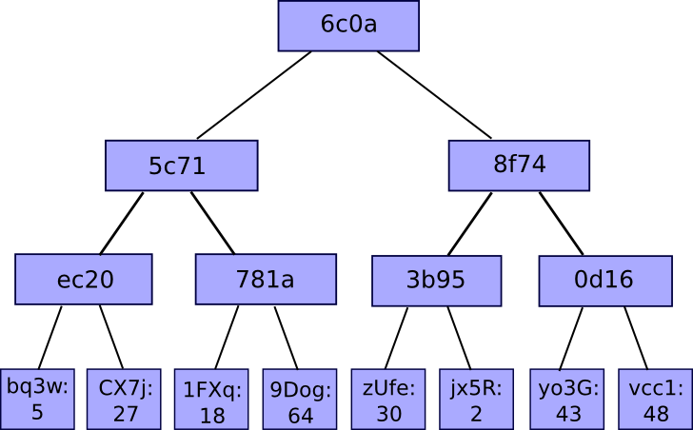
Merkle Tree
Won’t go in depth with the working
Tying back to Blockchain
Quick view at the internals of GitHub

Slide 18
Thank you for attending!
Questions?

