Slide 1

Waste Right
Household waste collection, starting at ₹10
Scan your waste.
Book a pickup.
Know what happens next.
Zenith Hackathon / 24 October 2026
Waste Right 01
Notes:
Project pitch. Cover is a generated product illustration, not a photograph of a deployed service. Current repository and business rules reviewed on 24 October 2026.

Slide 2
Problem statement
Everyday waste needs a simpler path from the home to the right processor.
How can a household identify mixed waste, arrange an affordable pickup and know what was actually collected?
Waste Right combines phone-camera assistance with a human-verified collection service.
Waste Right 02
Notes:
Adapted from the supplied waste-identification problem statement and the founder’s expanded collection-service model. Product problem framing, not a measured survey result.

Slide 3
Pain points for residents and helpers
The difficulty continues after someone identifies the waste.
For residents
For collection partners
Mixed packaging is confusing.
Collection takes too many steps.
Weight and final fees are unclear.
The outcome is hard to track.
Jobs and addresses are scattered.
Material and weight need checking.
Earnings and dues need clear records.
Disputes need a simple process.
Waste Right 03
Notes:
Product hypotheses from the supplied requirements and existing workflows. No interviews, market-size figures or field observations are claimed.

Slide 4
The solutions we provide
Each feature removes a specific step or uncertainty.
Less effort to start
Scan with a phone or describe the waste. Confirm the suggestions.
A clear collection flow
Reuse an address, choose a time and see automatic charges. The helper records weight.
A shared record
Residents review receipts. Helpers see earnings. Operations handles payments and issues.
Waste Right 04
Notes:
Implemented prototype features in camera, confirmation, booking, receipt, helper and Operations components. No time-saving percentage or service guarantee has been measured.

Slide 5
Complete Waste Right overview
One service connects residents, helpers, Operations and processing partners.
Resident
Scan → confirm items → schedule → accept the collection receipt.
Helper and Operations
Collect → weigh → verify → record earnings, payments and disputes.
Processing and benefits
Hand over accepted material → record actual recovery → apply earned credits and rewards.
AI suggests. People confirm. Every financial benefit needs a record.
Waste Right 05
Notes:
End-to-end operating model. Product workflows exist in the prototype; downstream contracts, government awards and public pilot outcomes are not asserted secured.

Slide 6
The resident journey
A short flow, from the camera to the collection receipt.
01 Scan and confirm
Use the phone camera or a description. Correct the suggested items.
02 Schedule
Choose the address, date and time. Check the automatic fee.
03 Review the receipt
The helper weighs the waste. Accept the receipt or report a problem.
Waste Right 06
Notes:
Implemented flow in dashboard.tsx, quick-pickup.tsx, confirmation-checklist.tsx and service API. Users can reuse details from their last pickup. Camera/device permissions remain required.

Slide 7
The user keeps the final say
A camera makes starting easier. Confirmation makes the record trustworthy.
What the app does
What the resident controls
Suggests items and materials.
Reads visible labels with OCR.
Asks for clarification when needed.
Removes a mistaken item.
Corrects mixed materials.
Confirms what will be collected.
Photographs do not establish weight or safe handling.
Waste Right 07

Slide 8
One mixed-waste example
Illustrative journey, not a recorded customer collection.
Camera view
Fruit scraps and a plastic food container appear together.
Resident review
The resident confirms both and keeps the materials separate if possible.
Helper handover
The helper checks the material, records scale readings and sends the receipt.
The app does not automatically treat the whole load as organic.
Waste Right 08

Slide 9
Where the collected waste goes
The pilot needs agreed handovers with local processing partners.
Organic waste
Suitable clean organics go to an approved composting or biogas partner. The processor confirms what it accepts.
Dry materials
Paper, plastic, glass and metal go to suitable recyclers after material checks.
Special waste
Batteries, hazardous items and unsuitable loads need a separate specialist arrangement.
Recovery income and programme benefits require actual acceptance and payment records.
Waste Right 09
Notes:
Proposed downstream operating model, not a claim of signed processing agreements. App supports household-material review and ordinary bookings, while special-handling waste cannot use ordinary instant booking. No compost output ratio, material selling price, processor capacity or emissions saving is assumed.

Slide 10
Plans for different collection needs
Current pilot prices. One-month passes have no automatic renewal.
 | Basic | Gold | Platinum
Price | ₹10 / pickup | ₹399 / month | ₹469 / month
Included pickups | 1 | 14 | 24
Per pickup limit | 2 kg | 8 kg | 10 kg
Monthly allowance | Pay per pickup | 112 kg | 240 kg
Segregation | ₹5/kg if mixed | Included | Included
Resident recovery share | 0% | 10% of net | 15% of net
Metal counts toward limits. Specialist or hazardous waste needs separate handling.
Waste Right 10
Notes:
Source: web-app/src/lib/catalog.ts and pickup-pricing.ts. Recovery share means positive accepted material-sale proceeds after agreed direct costs. Basic and reward credits have 2kg limits for all materials. No historical ₹599/₹699 pricing is used.

Slide 11
Clear charges before and after weighing
Residents never have to guess the weight.
Standard hours
7 am to before 2 pm. No collection from 2 pm to 5 pm.
Evening hours
5 pm to 7 pm. A ₹5–₹7 surcharge depends on time, weight and sorting.
Mixed Basic waste
₹5 per measured kg for segregation. Gold and Platinum include segregation.
Example: 2 kg of mixed Basic waste at 10 am = ₹10 pickup + ₹10 sorting = ₹20.
Waste Right 11
Notes:
Current pickup-time.ts and pickup-pricing.ts. Membership waives segregation-related evening component, while time/weight fees remain. Example assumes measured 2 kg and no other charge.

Slide 12
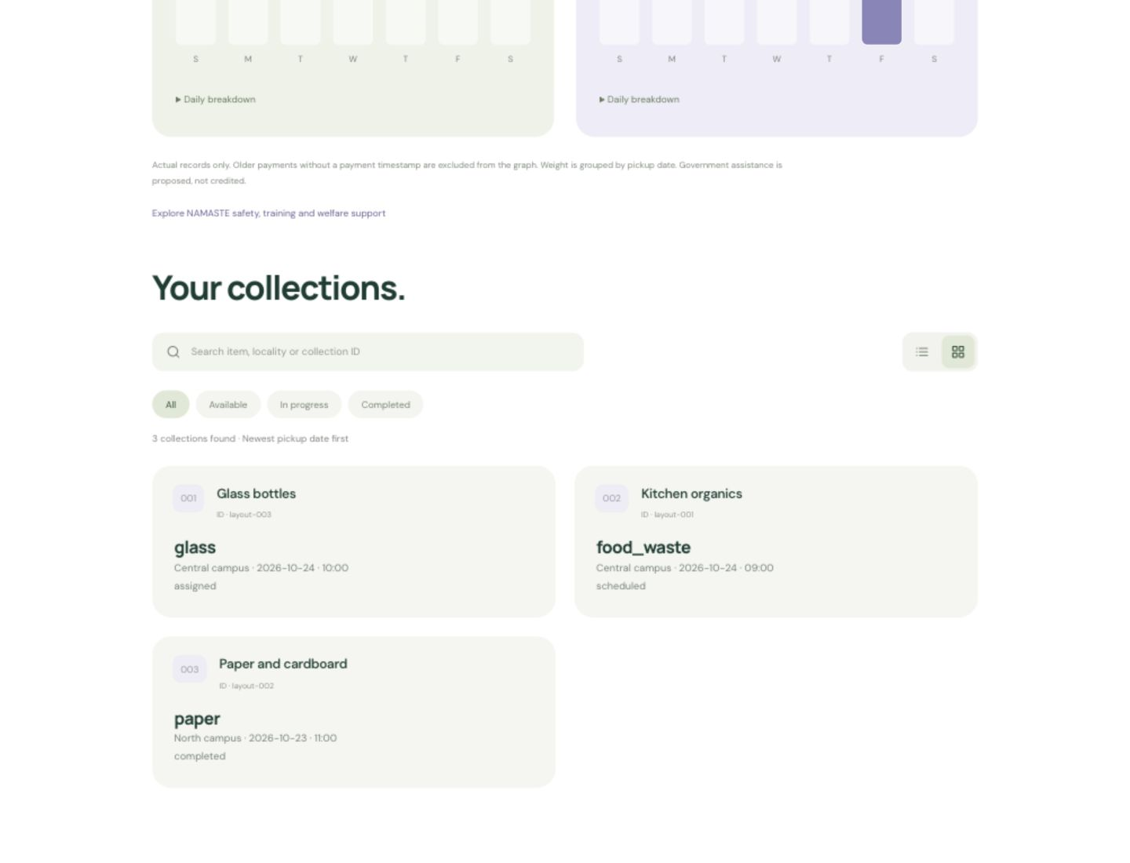
Helpers get a dedicated workspace
English and Hindi support the collection workflow.
Collections have their own page
Search by item, locality or ID.
Switch between grid and list.
Accept jobs and record weight.
Track receipts and status.
Synthetic layout example
Waste Right 12
Notes:
Actual component preview with explicitly synthetic jobs. Demonstrates layout only, not customer traction or live service activity. Helpers require Operations approval.

Slide 13
Helper earnings are visible
The pilot separates earned pay, recorded payments and outstanding amounts.
₹8
+ 50% of sorting service value
per completed pickup
+ 40% of net recovery
Earnings require a completed, accepted receipt. Operations records actual payments.
Waste Right 13
Notes:
Current helper-pay.ts pilot policy. Included membership sorting uses the recorded ₹5/kg comparison value, so the company must fund that service. Net recovery must deduct agreed direct costs once. A pay record does not initiate a bank transfer. Fair hourly pay still requires measured route-time and expense data.

Slide 14
Operations knows what to do next
A separate workspace for Collections, Payments, Helpers and Issues.
A collection queue
Search records and open one collection at a time.
Clear payment steps
See earned, paid and outstanding helper amounts. Record a completed transfer.
Separate sale records
Record actual recycler income and costs, then the resident’s recovery share.
Waste Right 14
Notes:
OperationsWorkspace replaces the simultaneous forms. Includes existing helper approval, dispute resolution, special collection review, handover weighing and activity history. No bank transfer service is represented as implemented.

Slide 15
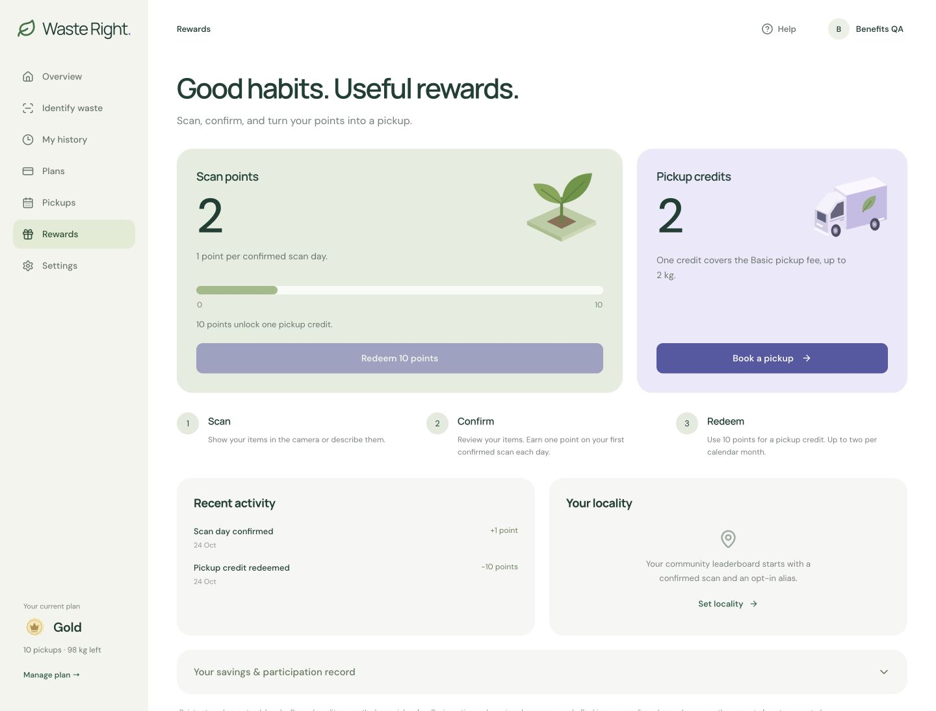
Rewards make the habit easier to keep
Earn one point on the first confirmed scan day.
10 points
unlock one pickup credit
Up to two credits per calendar month.
Each covers the Basic fee up to 2 kg.
Waste Right 15
Notes:
Actual dashboard screenshot using synthetic QA activity. Points are per confirmed India calendar day, not per repeated scan. Credits do not waive applicable sorting or evening charges. Local leaderboard uses opt-in aliases and confirmed scan days, not more waste generation.

Slide 16
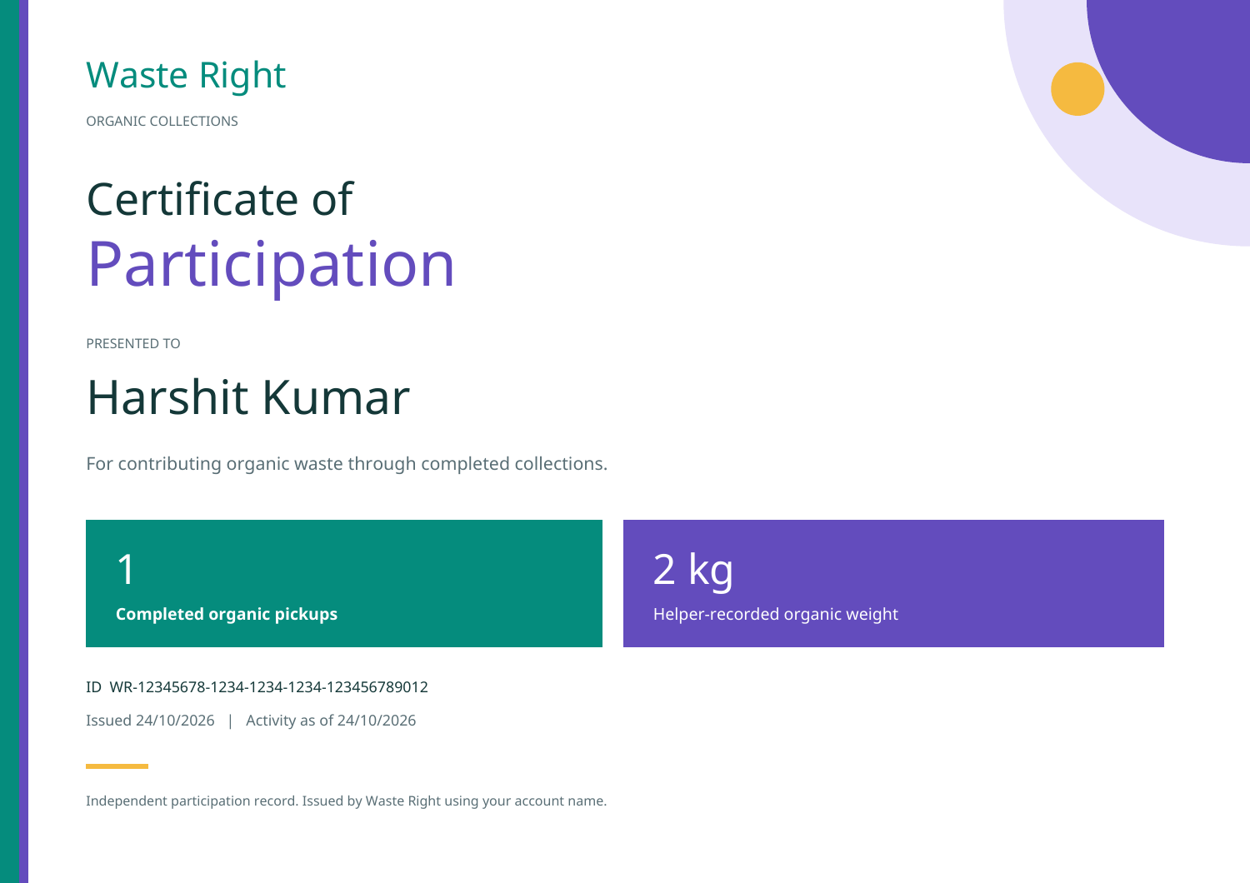
A useful record of participation
A completed organic pickup unlocks a downloadable Waste Right certificate.
Name and participation ID
Completed organic pickups
Helper-measured organic kg
Issue date and activity snapshot
Independent issuer: Waste Right
Illustrative certificate
Waste Right 16
Notes:
PDF render is a synthetic layout-verification sample. Real downloads authenticate the account owner and require completed accepted measured organic activity. Identity comes from the account profile. No government issuance, DigiLocker identity verification, Aadhaar linkage or cryptographic government signature.

Slide 17
How Waste Right earns revenue
Customer payments and verified material recovery fund the service.
Pickup fees
Basic collections generate a fee for each completed booking.
Monthly passes
Gold and Platinum generate revenue when residents buy or renew their pass.
Material recovery
Accepted recycler or processor proceeds contribute after direct costs and shares.
Government support adds income only after eligibility and actual receipt.
Waste Right 17
Notes:
Revenue model, not booked sales or traction. Passes do not automatically renew. No processor agreement, material price or guaranteed compost yield is assumed.

Slide 18
A ₹10 pickup leaves a narrow margin
Illustrative base-fee calculation before travel and other costs.
₹10
₹8
₹2
customer pickup fee
base helper pay
left before other costs
Dense routes, subscriptions and actual recovery must cover transport, sorting, payment fees and overhead.
Waste Right 18
Notes:
Arithmetic: ₹10 minus ₹8 = ₹2. This is not net profit. Gold full-use base helper pay is 14×₹8=₹112; Platinum is 24×₹8=₹192. Included sorting, recovery shares and other costs are additional. Unit economics require field validation.

Slide 19
GOBARdhan: the organic-processing route
A proposed role for Waste Right: collection and feedstock aggregation.
Programme
The integrated 2026–36 CBG framework supports production and market access.
Our proposed role
Deliver suitable organic waste to a contracted biogas or CBG processing partner.
What is still required
Partner acceptance terms, project eligibility and the relevant approvals. No Waste Right award is documented.
Waste Right 19
Notes:
Official source, checked 24 Oct 2026: https://www.pib.gov.in/PressReleaseIframePage.aspx?PRID=2317937&lang=2&reg=48 . MoPNG launch on 1 Oct 2026. Scheme participation opportunities include feedstock collection and aggregation. Plant support is not an automatic collection-app subsidy.

Slide 20
Urban partnerships and startup funding
Two distinct routes: municipal service agreements and competitive innovation support.
SBM–Urban 2.0
Swachhata Startup Challenge
Supports segregation, door-to-door collection and scientific processing.
Seek an urban local body pilot. Confirm current local approvals and procurement routes.
The 2022 competition offered ₹25 lakh each to ten selected projects.
That window is closed. No current call or Waste Right award is verified.
A PPP requires a signed public-authority agreement; scheme alignment alone is insufficient.
Waste Right 20
Notes:
Official sources: https://www.pib.gov.in/PressReleasePage.aspx?PRID=2220345&lang=1&reg=1 (SBM-U overview, original five-year mission from Oct 2021); https://www.pib.gov.in/Pressreleaseshare.aspx?PRID=1860635&lang=2&reg=48 (2022 challenge, applications closed 15 Apr 2022); https://www.pppinindia.gov.in/faqs (PPP contractual framework). Confirm continuation/local procurement after the published mission period. No grant included in revenue.

Slide 21
Fertiliser support and the resident benefit
Support is recorded only after eligibility and actual receipt.
Published MDA terms
Waste Right credit policy
₹1,500 per tonne of eligible fertiliser output from BG/CBG plants.
The March 2026 update said the scheme was concluding that year. Continuation needs confirmation.
50% of attributable support actually received is allocated to the resident as a recorded credit.
This is our policy, not a government-set entitlement.
Raw household waste weight cannot directly determine an MDA payment.
Waste Right 21
Notes:
Official source: https://www.pib.gov.in/PressReleasePage.aspx?PRID=2237444&lang=2&reg=48 (10 Mar 2026). FOM/LFOM/PROM are the eligible products described. Rate is not per kg of household input. Current applicable terms and continuation require confirmation. Operations records support and credit references; no automatic transfer or government approval is claimed.

Slide 22
Support for collection partners
Safe work and access to welfare matter alongside pay.
Our service responsibilities
Potential NAMASTE support
Clear pay records and dispute handling.
Review route time and travel costs.
Plan safety equipment and training.
Validated waste pickers may qualify for PPE, safety training and health coverage under scheme rules.
Waste Right signup alone does not establish government eligibility.
Waste Right 22
Notes:
Sources: https://socialjustice.gov.in/schemes/37-0 and https://www.pib.gov.in/PressReleasePage.aspx?PRID=2134303&lang=2&reg=48, reviewed 24 Oct 2026. Waste pickers joined NAMASTE component in 2024. Benefits depend on enumeration/validation and applicable rules. No automatic benefit award claimed.

Slide 23
AI assists the collection decision
The current app combines image understanding, OCR and resident review.
Image understanding
Suggests likely materials from camera frames or a description.
OCR
Reads visible packaging text to add context.
Human confirmation
The resident confirms the list. The helper establishes actual material and weight.
Waste Right 23
Notes:
Implementation sources: classify/route.ts, live-camera.tsx, confirmation-checklist.tsx. Configurable provider; avoid naming an unverified model version. This slide describes application architecture, not accuracy benchmarks or disposal-rule certification.

Slide 24
Our own organic-waste model
A trained research model separates organic regions from visible contaminants.
450
67
66.13%
labelled source images
held-out test images
foreground mean IoU
IoU measures overlap between predicted and labelled regions. It is not item-identification accuracy.
One household and one fixed camera. Phone-camera validation is still needed.
Waste Right 24
Notes:
Source: model/training/HOUSEHOLD_V2.md and household-v2-results.json. Dataset: Wolling and Pal https://doi.org/10.48436/27k90-dvw73, CC BY 4.0. DeepLabV3 MobileNetV3 Large, Colab Tesla T4. Split 315 train / 68 validation / 67 test, grouped by capture day and duplicate clusters. Organic IoU70.30%, contaminants61.97%, foreground mean66.13%. Capture-group-held-out within one household, not cross-household. Separate local inference API and image tester exist; model does not replace app identification flow.

Slide 25
A working app with a separate model service
Simple components keep the demo understandable and the model replaceable.
Web app
Next.js and React with role-based resident, helper and admin workspaces.
Application records
Local MongoDB stores accounts, bookings, receipts, benefits and payment records.
AI and payments
Configurable image AI and OCR. Razorpay checkout integration. Separate local Python inference API.
Waste Right 25
Notes:
Razorpay integration is implemented but live checkout/payment configuration and actual bank transfers are not asserted verified. Local inference uses FastAPI/PyTorch on localhost and processes images in memory. Production authentication, hosting and operations require deployment hardening.

Slide 26
What works today
A tested prototype, with clear limits before launch.
Built in the prototype
Before a public launch
Camera and description flow
Automatic fees and scheduling
Helper collections and earnings
Receipts, disputes and PDF certificates
Live payment and bank checks
Field tests on phones and routes
Approved processor agreements
Government eligibility and identity onboarding
31 tests passed, plus isolated API integration checks and a production build.
Waste Right 26
Notes:
Source: docs/edge-case-audit.md, 24 Oct 2026. Isolated integration tests cover auth/role isolation, competing claims, reward redemption, booking idempotency, receipt acceptance, settlement and signed webhook replay/tamper checks. No live provider charge. Browser control was disabled during final landing visual pass. Tests do not establish security certification or production reliability.

Slide 27
A focused first pilot
Proposed scope: one campus or housing cluster, with one processing partner.
Start small
Target 50 households and two approved helpers for a four-week pilot.
Measure the work
Track completed pickups, route minutes, kg accepted, repeat bookings and disputes.
Measure the money
Track helper hourly take-home and contribution after every direct cost.
Pilot gate: reliable collections, positive route contribution and acceptable helper earnings.
Waste Right 27
Notes:
These are proposed pilot targets, not current users, staff, partners or results. Profit/earnings thresholds must be agreed after measuring local wage/travel realities. No invented traction.

Slide 28
What we need next
A pilot location and a processing partner to test the complete service.
A campus or housing association
A local waste processor and collection partners
Support to measure real costs and improve the service
Waste Right 28
Notes:
Closing ask. No named organisation is presented as a confirmed partner. No funding amount or contract is invented.

Slide 29
Appendix: rewards and service rules
Useful details for reading the deck without a presenter.
Points and credits
One point per first confirmed scan day in India. Ten points per credit. Maximum two credits per calendar month.
Savings and history
Savings separate fee reductions, included segregation and recorded government credits. History stores scans, receipts and disputes.
Certificate and identity
Completed measured organic collections unlock the PDF. Waste Right issues it using the account name. DigiLocker and Aadhaar linking remain unconfigured.
Waste Right 29
Notes:
Sources: streak.ts, service.ts, benefits.ts, certificate.ts and docs/digilocker-identity-setup.md. Points survive a broken streak. Reward credit covers only Basic collection fee, up to 2kg; applicable sorting/evening charges remain. Opt-in locality leaderboard measures scan days, not waste generation.

Slide 30
Appendix: pricing and earnings examples
Illustrative calculations under the current pilot policy.
2 kg mixed Basic pickup
Customer pays ₹20 in standard hours. Helper earns ₹8 + ₹5 sorting share = ₹13 before any recovery share.
₹100 positive recovery pool
Helper recovery share is ₹40. Gold resident share is ₹10, or Platinum ₹15. Remaining ₹50 or ₹45 is before other business expenses.
₹100 attributable support received
Resident credit policy allocates ₹50 after completed processing, receipt and credit records. No projected grant appears as savings.
Waste Right 30
Notes:
Arithmetic follows pickup-pricing.ts, helper-pay.ts, catalog.ts and government-benefits API. Net pool is buyer proceeds minus agreed direct costs. Helper base/sorting compensation must be handled once in direct costs to avoid claiming the same money as free margin. Figures are examples, not real transactions. Gold/Platinum subscription costs and route overhead are separate.

Slide 31
Sources and evidence
The pitch uses project records and official scheme information.
Product and business rules
Model evidence
Current app catalog and pricing logic
Helper pay and benefit accounting
Certificate eligibility and edge-case audit
Household-v2 results and model card
TU Wien dataset, CC BY 4.0
doi.org/10.48436/27k90-dvw73
Government sources: PIB and the implementing departments. GOBARdhan, SBM–Urban 2.0, MDA, NAMASTE and the 2022 startup challenge.
Waste Right 31
Notes:
Primary sources: https://www.pib.gov.in/PressReleaseIframePage.aspx?PRID=2317937&lang=2&reg=48 ; https://www.pib.gov.in/PressReleasePage.aspx?PRID=2220345&lang=1&reg=1 ; https://www.pib.gov.in/Pressreleaseshare.aspx?PRID=1860635&lang=2&reg=48 ; https://www.pib.gov.in/PressReleasePage.aspx?PRID=2237444&lang=2&reg=48 ; https://socialjustice.gov.in/schemes/37-0 ; https://api.apisetu.gov.in/ ; https://doi.org/10.48436/27k90-dvw73 . Internal: web-app/src/lib/catalog.ts, pickup-pricing.ts, helper-pay.ts, benefits.ts, certificate.ts; docs/helper-pay-government-support.md; docs/edge-case-audit.md; model/training/HOUSEHOLD_V2.md and household-v2-results.json. All product screenshots show synthetic QA records. Cover is a generated illustration. No customer traction, government approval, bank payment or independent-household model accuracy is claimed.

