Slide 1
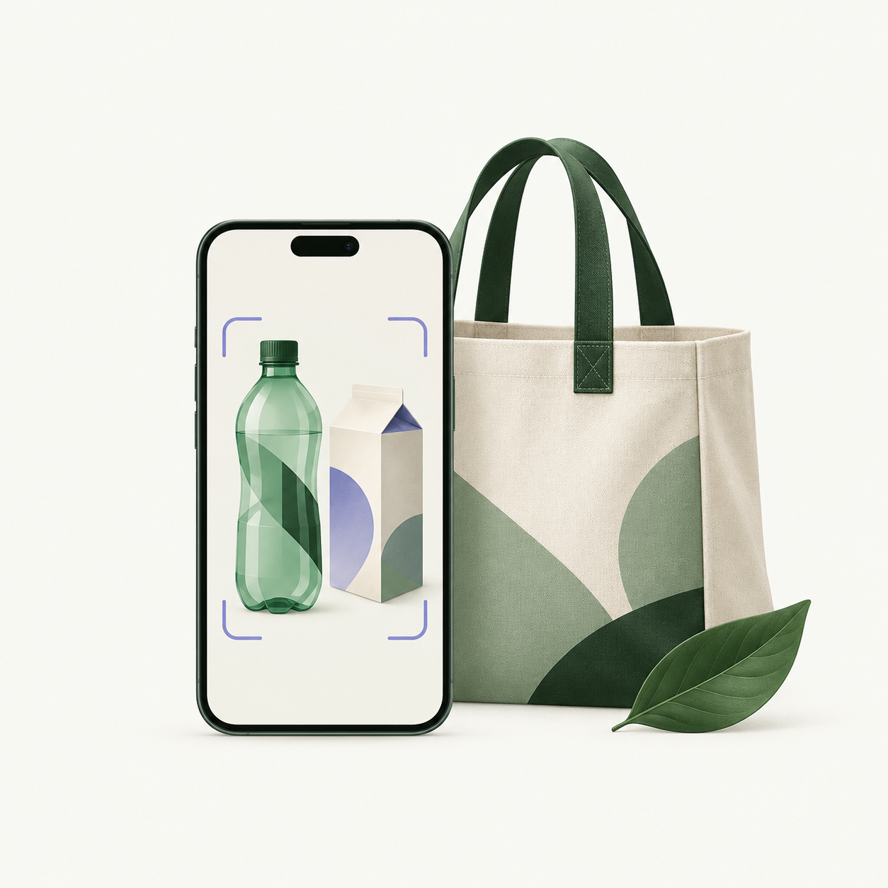
Waste Right
Everyday waste.
One simpler pickup.
Phone-camera identification and doorstep collection, with the resident in control.
Pickups from ₹15
Waste Right
01
Notes:
Sources: Waste Right product requirements supplied by the project owner in this conversation. Current implementation: web-app/src/lib/catalog.ts, pickup-pricing.ts, service.ts and application components, inspected 23 October 2026. Cover artwork is an AI-generated illustration, not a photograph or product screenshot.

Slide 2
Sorting and collection create separate hurdles
“What is this made of?”
“How do I get it collected?”
A bottle may look simple. A lined cup, dirty container or mixed wrapper needs a closer look.
The resident still needs a pickup time, a clear fee and someone to verify the handover.
Waste Right connects identification to a collection request in the same flow.
Waste Right
02
Notes:
Sources: Waste Right product requirements supplied by the project owner in this conversation. Current implementation: web-app/src/lib/catalog.ts, pickup-pricing.ts, service.ts and application components, inspected 23 October 2026. The supplied problem statement identifies uncertainty around mixed materials and disposal. These pain points describe the product problem, not measured survey findings.

Slide 3
The resident journey
01
02
03
04
Scan
Confirm
Schedule
Review receipt
Use the phone camera. A photo or text description also works.
Review the suggested items. Correct or remove anything inaccurate.
Choose a date and time. Check the fee and collection address.
The helper measures the waste. Approve or dispute the receipt.
Waste Right
03
Notes:
Sources: Waste Right product requirements supplied by the project owner in this conversation. Current implementation: web-app/src/lib/catalog.ts, pickup-pricing.ts, service.ts and application components, inspected 23 October 2026. The post-confirmation composer, helper weighing and resident approval flow are implemented. Collection remains subject to helper availability.

Slide 4
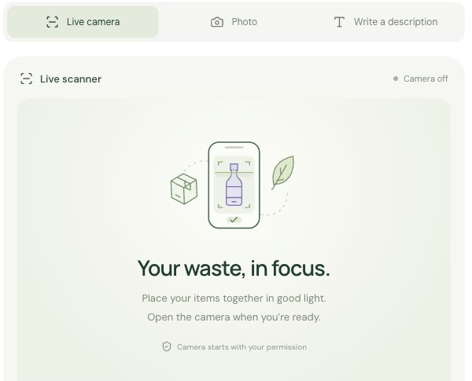
The phone camera is the starting point
Show several items together
AI suggests the visible materials. Text recognition reads English packaging labels to help identify the item.
Automatic mode waits 15 seconds after each analysis, with up to 8 scans per session.
Camera access requires permission. The app does not save the image frames.
Waste Right
04
Notes:
Sources: Waste Right product requirements supplied by the project owner in this conversation. Current implementation: web-app/src/lib/catalog.ts, pickup-pricing.ts, service.ts and application components, inspected 23 October 2026. Actual local product screenshot, camera off. Upstream AI processes submitted frames. The app does not retain image frames. Automatic scanning is bounded rather than continuous per-frame streaming. Physical phone-camera performance is not claimed as validated.

Slide 5
People resolve uncertain identification
Example: a takeaway cup
What the app asks
What the resident controls
Does it have a lining? Is there residue? Does it need special handling?
Keep or remove suggested items. Correct the material and condition before confirming.
Unclear or specialist waste does not enter ordinary instant pickup.
Waste Right
05
Notes:
Sources: Waste Right product requirements supplied by the project owner in this conversation. Current implementation: web-app/src/lib/catalog.ts, pickup-pricing.ts, service.ts and application components, inspected 23 October 2026. This is an illustrative uncertainty scenario, not a claim that a specific cup is recyclable. Local-guide controls are removed from the current resident interface. The app does not claim universal local disposal rules.

Slide 6
Scheduling starts immediately after confirmation
Less repeated entry
A time the resident chooses
The saved address, available plan and reward credits load into the pickup form. “Use last pickup” reuses regular items and preferences.
7 am to before 2 pm, or 5 pm through 7 pm, India time. The 2–5 pm break stays unavailable.
No scale needed at home
The helper records weight at collection. The resident never enters an estimate.
Waste Right
06
Notes:
Sources: Waste Right product requirements supplied by the project owner in this conversation. Current implementation: web-app/src/lib/catalog.ts, pickup-pricing.ts, service.ts and application components, inspected 23 October 2026. Use last pickup never copies the previous date, measured weight or charge. Location capture is optional and requires permission. Availability of a chosen time depends on a helper accepting the request.

Slide 7
Three ways to pay for collection
 | Basic | Gold | Platinum
Price | ₹15 / pickup | ₹599 / month | ₹699 / month
Pickups included | 1 | 14 | 24
Limit per pickup | 2 kg | 8 kg | 10 kg
Monthly allowance | Pay per pickup | 112 kg | 240 kg
Recovery share | None | 10% | 15%
Monthly passes renew manually. Weight limits include metal.
Recovery shares apply to positive net proceeds from accepted material, after documented direct costs.
Waste Right
07
Notes:
Sources: Waste Right product requirements supplied by the project owner in this conversation. Current implementation: web-app/src/lib/catalog.ts, pickup-pricing.ts, service.ts and application components, inspected 23 October 2026. Source: current catalog.ts. Prices/counts follow owner requirements. Basic cap and 10%/15% shares are current configurable pilot defaults. These are proposed service offers, not validated profitable prices.

Slide 8
A clear price before and after collection
Example: Basic pickup at 10 am
At booking
Pickup fee
₹15
At collection
Helper measures 2 kg of unsegregated waste
2 kg × ₹5 = ₹10
After approval
Resident approves the measured receipt
₹10 extra
Total for this example
₹15 pickup + ₹10 sorting
₹25
Separated waste has no sorting fee. Evening fees add ₹5–₹7. Plans and rewards cover only the base pickup fee.
Waste Right
08
Notes:
Sources: Waste Right product requirements supplied by the project owner in this conversation. Current implementation: web-app/src/lib/catalog.ts, pickup-pricing.ts, service.ts and application components, inspected 23 October 2026. Illustrative arithmetic using the implemented ₹15 base and ₹5/kg rate, not an actual customer bill. Evening: ₹5 + ₹1 for unsegregated waste + ₹1 if measured weight exceeds 2 kg, capped at ₹7. Extra charges follow receipt approval.

Slide 9
Helpers have their own workspace
Collection and verification
Work and earnings records
Approved helpers accept available jobs, verify the material and record gross and container weight.
Helpers track assigned jobs and recorded work payments in English or Hindi.
The resident approves the handover
Operations handles helper approval, disputes and settlement records. Payout entries record payment references.
Waste Right
09
Notes:
Sources: Waste Right product requirements supplied by the project owner in this conversation. Current implementation: web-app/src/lib/catalog.ts, pickup-pricing.ts, service.ts and application components, inspected 23 October 2026. Helper signup does not grant collector authority. Operations approval is required. Earnings and payout references are database records, not automatic bank transfers or guaranteed income. Address/location details are revealed to a helper only after assignment.

Slide 10
Downstream handling in the pilot
Organic waste
Paper, plastic and metal
Batteries and specialist waste
Separate collection for an agreed composting partner.
Material-specific handover to buyers or recyclers who accept the grade.
Separate inspection and an appropriate specialist channel. Ordinary pickup stays blocked.
Operations records accepted material, actual buyer proceeds and direct costs before any recovery payout.
Waste Right
10
Notes:
Proposed pilot operating model. Receiving partners and accepted material grades must be agreed before launch. The current prototype records collection weights and settlements, but does not prove downstream processing or environmental impact. Source: owner business-model requirements and current Operations implementation.

Slide 11
Daily scan points support a repeat habit
1 point
10 points
for the first new confirmed scan
on each India calendar day
redeem one Basic pickup credit
at any time in the month
Up to 2 redemptions per month. Sorting and evening charges still apply.
History supports repeat pickups. The optional locality leaderboard uses an alias.
Waste Right
11
Notes:
Sources: Waste Right product requirements supplied by the project owner in this conversation. Current implementation: web-app/src/lib/catalog.ts, pickup-pricing.ts, service.ts and application components, inspected 23 October 2026. Source: service.ts and activity/streak implementation. Multiple scans on one day do not earn extra points. A scan does not establish that recycling occurred and no environmental impact is claimed. Location leaderboard is opt-in.

Slide 12
How Waste Right earns revenue
Service income
Material recovery
Basic pickup fees and monthly passes fund collection. Sorting charges cover the additional work for unsegregated waste.
Accepted material can generate buyer proceeds. Recorded direct costs and the plan’s resident share determine what remains.
Profit depends on operating costs
Helper pay, transport, sorting, downstream handling, AI, payments and support all reduce service revenue.
Waste Right
12
Notes:
Sources: Waste Right product requirements supplied by the project owner in this conversation. Current implementation: web-app/src/lib/catalog.ts, pickup-pricing.ts, service.ts and application components, inspected 23 October 2026. Business-model description, not a forecast or financial guarantee. Processing/buyer contracts and local material prices remain to be validated. No fixed commodity price or the superseded 35/40/15/10 revenue split is claimed.

Slide 13
The pilot must validate the collection cost
Illustration: 20 Gold + 10 Platinum households
₹18,970
520
monthly subscription revenue
before any operating costs
included pickups if every household
uses its full monthly allowance
₹36.48 service revenue per included pickup at full use
Nearby collections on shared routes are the pilot operating approach. Actual costs will decide whether these prices can scale.
Waste Right
13
Notes:
Sources: Waste Right product requirements supplied by the project owner in this conversation. Current implementation: web-app/src/lib/catalog.ts, pickup-pricing.ts, service.ts and application components, inspected 23 October 2026. Planning illustration only, not traction or forecast. Arithmetic: 20×599 + 10×699 = 18,970. 20×14 + 10×24 = 520. 18,970/520 = 36.4808. Excludes sorting/surge/recovery income, taxes and every operating expense. Shared-route consolidation is a proposed operating practice, not a claim that automated route optimization exists.

Slide 14
A working app, with launch work clearly defined
Implemented in the prototype
Required before a public launch
Resident and helper accounts
Camera, photo, text and OCR inputs
Editable results and disposal history
Pickup scheduling and measured receipts
Plans, scan rewards and Operations records
Physical-device and field trials
A staffed collection area
Approved processing and buyer partners
Measured collection costs
Payment webhook delivery and full checkout tests
Next.js and MongoDB power the prototype. Razorpay uses test credentials. Public collection and live payment verification remain launch work.
Waste Right
14
Notes:
Sources: Waste Right product requirements supplied by the project owner in this conversation. Current implementation: web-app/src/lib/catalog.ts, pickup-pricing.ts, service.ts and application components, inspected 23 October 2026. Implementation status inspected in the repository. MongoDB persists accounts and service records. Local automated checks cover authorization, booking/receipt state and synthetic payment signature/replay handling. A provider credential read check succeeded. A completed real gateway transaction, public webhook delivery and physical phone-camera performance are not asserted. Custom-model training is deferred.

Slide 15
A focused first pilot
One housing society
30 households
30 days
The pilot will measure
Completed pickups and missed requests
Cost per collection and per kg
Material corrections and rejected loads
Repeat bookings and reward use
Receipt disputes and settlement time
A proposed pilot, with a dedicated collection team and confirmed downstream partners.
Expansion follows reliable service and positive contribution after direct costs.
Waste Right
15
Notes:
Sources: Waste Right product requirements supplied by the project owner in this conversation. Current implementation: web-app/src/lib/catalog.ts, pickup-pricing.ts, service.ts and application components, inspected 23 October 2026. Pilot proposal, not an active partnership or existing customer count. Proposed mix for the economics illustration is 20 Gold and 10 Platinum. No diversion, carbon savings, sales or adoption claim is made.

Slide 16
Waste Right
A phone scan becomes
a collection request
and a measured receipt.
Our next step: a 30-household pilot in one housing society.
Waste Right
16
Notes:
Sources: Waste Right product requirements supplied by the project owner in this conversation. Current implementation: web-app/src/lib/catalog.ts, pickup-pricing.ts, service.ts and application components, inspected 23 October 2026. Closing request is for a bounded operational pilot. The pitch describes a working local hackathon prototype and a proposed service model, with no invented traction or profitability claim.

