Slide 1

Indian Institute of Information Technology Una
Review - 1
Project Phase - III (CSL801)
Topic - PowerRef
Presented by:
Divyank Sharma Harshit Kumar Kanhaiya Gupta
21119 21121 21125
Under Supervision of - Ms. Nisha

Slide 2
Outline
01
INTRODUCTION
02
MOTIVATION
03
PROJECT OBJECTIVE
04
INNOVATION IN THE PROJECT
05
06
CURRENTLY AVAILABLE
SOLUTIONS
BLOCK SCHEMATIC
07
WORK PROGRESS

Slide 3
01
INTRODUCTION

Slide 4
1. INTRODUCTION
Android App to improve job application success with personalized referral suggestions.
Uses web scraping and algorithms to recommend the most effective referrals.
Focuses on strategic referrals, offering a unique approach.
Includes tools such as a resume builder, company search, and referral.
Interview Preparation via MCQs

Slide 5
02
MOTIVATION

Slide 6
2. MOTIVATION
Help job seekers stand out in a competitive job market.
Simplify the process of finding the most impactful referrals.
Increase the chances of getting noticed by recruiters.

Slide 7
03
PROJECT OBJECTIVE

Slide 8
3. PROJECT OBJECTIVE
Provide personalized referral suggestions .
Increase job success rates using recommendation algorithms.
Ensure secure management and storage of user data.
Enable LinkedIn sign-in to simplify user onboarding.
Offer a dashboard for managing referral activities.

Slide 9
04
INNOVATION IN THE PROJECT

Slide 10
4. INNOVATION IN THE PROJECT
Leverages web scraping to gather data for accurate referral suggestions.
Integrates LinkedIn sign-in for automatic data import.
Combines multiple job-seeking tools (referral manager, resume builder, company search, interview preparation) in one app.
Focuses specifically on strategic referrals, setting it apart from generic networking platforms.

Slide 11
05
CURRENTLY AVAILABLE SOLUTIONS

Slide 12
5. CURRENTLY AVAILABLE SOLUTIONS
S . NO. | Solution
Solution 1 | LinkedIn Referral
Solution 2 | Hired

Slide 13
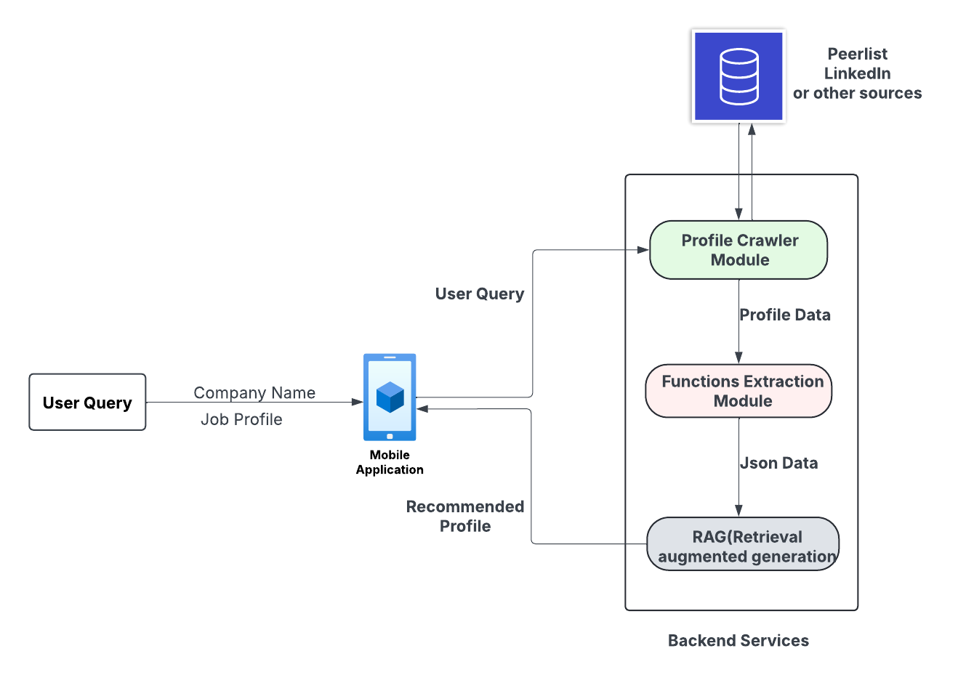
06
BLOCK SCHEMATIC

Slide 14
06
WORK PROGRESS

Slide 15
6. WORK PROGRESS
Frontend Development: 70% completed.
Backend Development: Initiated and currently in progress.
Data Scraping: Successfully completed from the Peerlist website.
Algorithm Optimization: Implementation of RAG for optimized referral recommendations has begun.

Slide 16
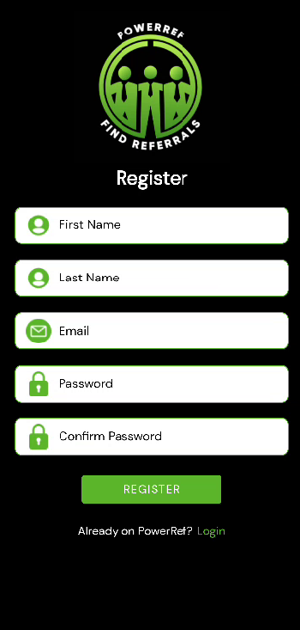
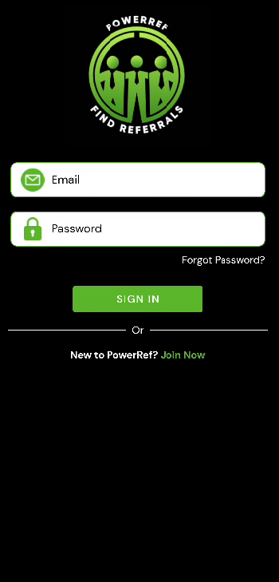
7. Demonstration

Slide 17
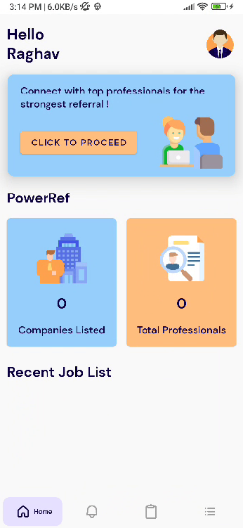
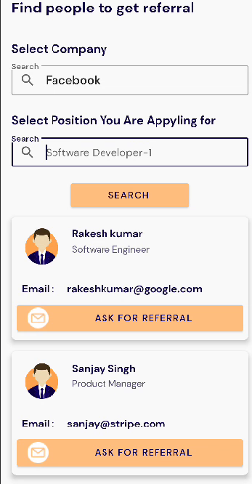
7. Demonstration

Slide 18
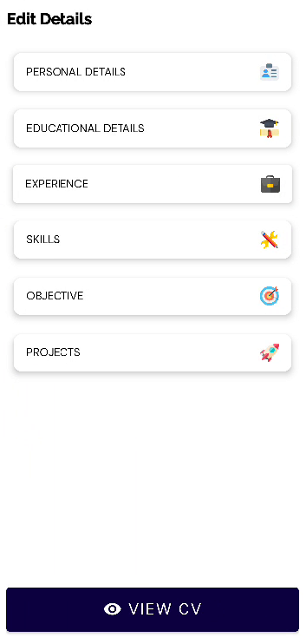
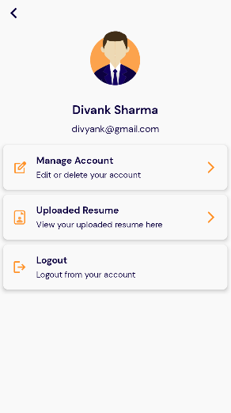
Demonstration

Slide 19
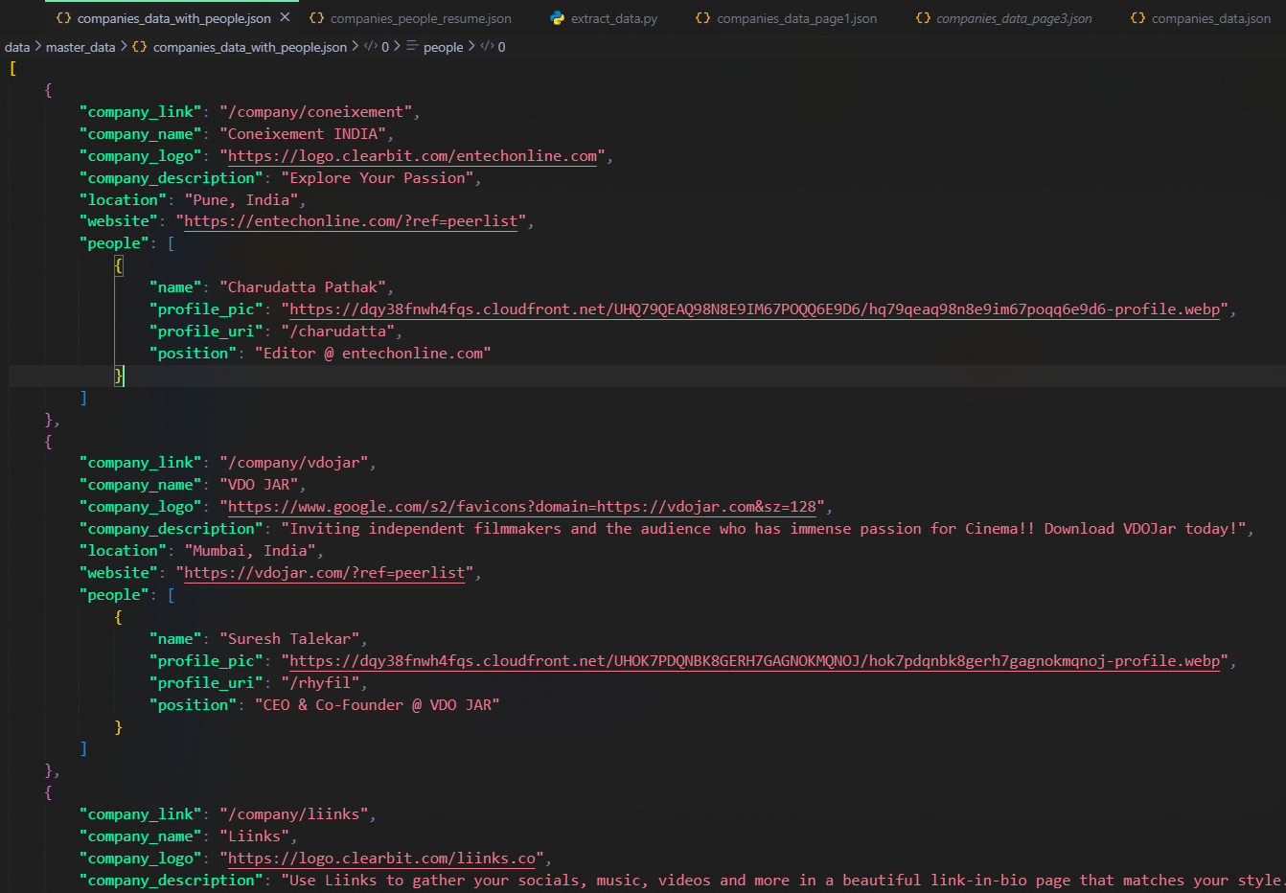
Demonstration

Slide 20
REFRENCES
Android Developer Documentation. URL: https://developer.android.com/
Node.js. URL: https://nodejs.org/
Stack Overflow. URL: https://stackoverflow.com/
Figma. URL: Figma

Slide 21
Thanks!

