Slide 1
NETFLIX
100M+
SVD
ORIGINAL PROJECT
Reimagining
Content Discovery
Movie Ratings
Prize-Winning Algorithm
Netflix Prize Dataset
Building a Scalable Personalized Recommendation Engine
Collaborative Filtering · Matrix Factorization · ALS · SVD
• Netflix Prize Dataset (100M+ ratings)
• Large-scale Collaborative Filtering
• Explainable Recommendation Pipeline
RMSE
TOP 10
0.98
Personalized Recs
AUTHOR
AUTHOR
Harshit Gupta
Ishant Bharti
Best Score
24113053
24115076

Slide 2
NETFLIX
02 / 08
Problem Statement
Why Recommendation Systems Are Challenging
KEY OBJECTIVE
Predict user preferences and recommend Top-10 movies efficiently.
01
02
03
04
100M+ Ratings
Extreme Sparsity
Prediction Accuracy
Memory Constraints
Over 100 million user-movie ratings across thousands of titles to process.
User-movie matrix is extremely sparse — most users rate <1% of movies.
Need accurate predictions at scale with minimal error (RMSE).
Must process large datasets on limited computational resources.
VISUAL: Sparse matrix illustration — user × movie grid with mostly empty cells

Slide 3
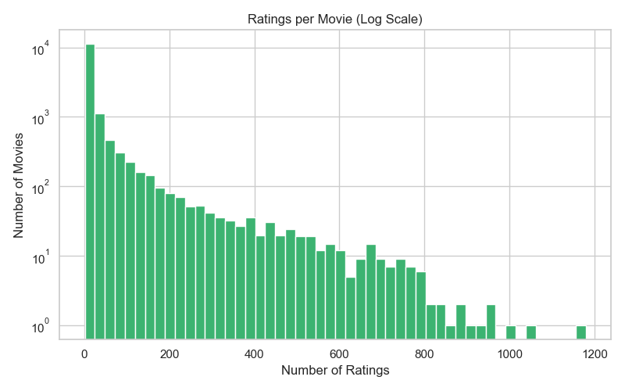
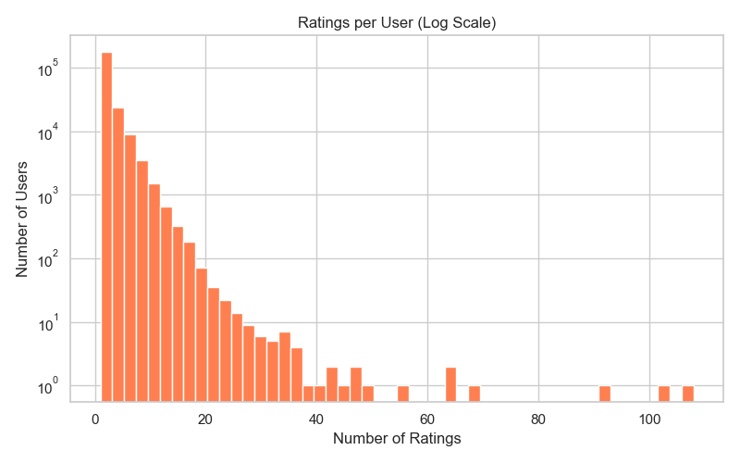
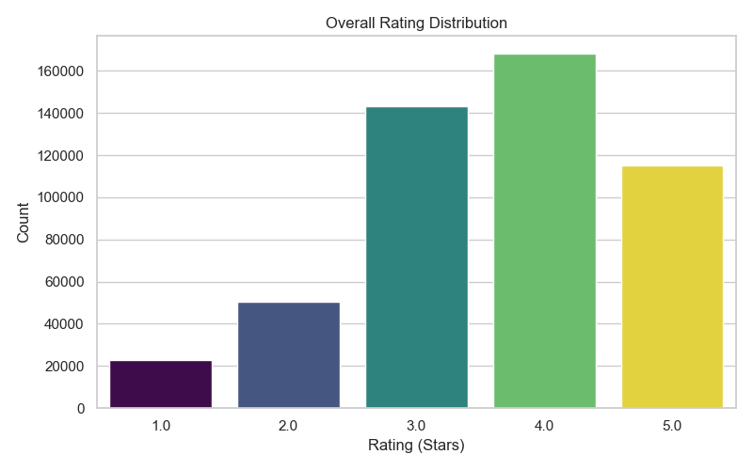
NETFLIX
03 / 08
Dataset Insights
Understanding User Behavior
POSITIVITY BIAS
Users prefer 3 to 5 stars
Ratings of 4 ★ dominate — strong optimistic skew in the dataset.
THE LONG TAIL
Few movies dominate interactions
Thousands of niche movies receive very little interaction — the long-tail effect.
TAKEAWAY: Recs must balance popularity and personalization

Slide 4
NETFLIX
04 / 08
Data Engineering Pipeline
Processing Large-Scale Data Efficiently
RAW DATA
PARQUET FORMAT
TEMPORAL SPLIT
SPARSE MATRIX
ML READY
100M+ ratings 2 GB text files
▶
10x compression Fast I/O reads
▶
80/20 train/test Date-ordered
▶
SciPy CSR format Memory efficient
▶
CF · ALS · SVD Pipeline done
TEMPORAL VALIDATION — No Data Leakage
MEMORY OPTIMIZATION — Scale on Any Hardware
• Ratings sorted chronologically by date
• Converted raw text to Parquet format
• 80% training / 20% test split
• SciPy sparse matrices (CSR) used
• Future data never leaks into training
• Memory footprint reduced significantly
• Mirrors real-world deployment constraints
• Runs on standard consumer hardware

Slide 5
NETFLIX
05 / 08
Recommendation Models
Algorithms Evaluated — Three Approaches, One Winner
Item-Based CF
ALS
SVD
Collaborative Filtering
Alternating Least Squares
Singular Value Decomposition
Recommends movies that are mathematically similar to ones the user already liked.
Purpose-built for sparse datasets. Iteratively solves user/item latent factors.
Learns hidden user and movie latent features — capturing deep preference patterns.
✓ Cosine similarity between item vectors
✓ Designed for sparse matrix data
✓ Discovers latent preference factors
✓ Intuitive & interpretable results
✓ Efficient matrix factorization
✓ Captures hidden content patterns
✓ No training needed — instant lookup
✓ Scalable and parallelizable
✓ Best overall prediction accuracy
⚠ Struggles with very sparse data
⚠ Requires iteration tuning
⚠ RMSE = 0.98 on test set
🏆 NETFLIX PRIZE WINNER

Slide 6
NETFLIX
06 / 08
Performance Evaluation
Benchmarking the Models — RMSE & MAP@10
RMSE — Root Mean Square Error
MAP@10 — Mean Average Precision @ 10
Measures rating prediction accuracy. Lower score = better prediction.
Measures relevance of top-10 recommendations against what user actually watched.
MODEL COMPARISON
MODEL
RMSE ↓
MAP@10 ↑
PERFORMANCE VERDICT
Item-Based CF
1.24
0.031
Baseline — interpretable but limited
ALS
1.08
0.047
Good — handles sparsity well
SVD ★ Winner
0.98
0.061
Best — Prize-winning algorithm
🏆 SVD — RMSE 0.98 | MAP@10 0.061 — Best Overall Performance
Successfully learned hidden user and movie latent features. The same algorithm that won the original Netflix Prize competition.

Slide 7
NETFLIX
07 / 08
Interactive Recommendation Dashboard
Explainable AI for Recommendations — Built with Streamlit
● ● ●
localhost:8501 — Netflix Recommender | Streamlit
🔍 Why was this recommended?
🎬 Recommender
🏆 Your Top 10 Recommendations
Extracts SVD latent factors to mathematically explain similarity. No black box.
› User ID
1
The Shawshank Redemption
★★★★★
› Algorithm
› Top-K
2
Schindler's List
★★★★★
📊 Latent Factor Explainability
› Explain
The Dark Knight
Visualizes the hidden genre/preference dimensions that drove each recommendation.
3
★★★★☆
4
Pulp Fiction
★★★★☆
💬 Example Explanation
5
Forrest Gump
★★★★☆
"Because you liked Movie A & B, Movie C shares similar latent features."

Slide 8
NETFLIX
FUTURE DIRECTIONS
ORIGINAL
The Road Ahead
Conclusions & Future Work
🔀 Hybrid Recommendation System
Combine collaborative filtering with content-based filtering for richer results.
PROJECT OUTCOMES
🧊 Cold-Start Solution
✓ Processed 100M+ ratings efficiently on standard hardware
Use genres, actors, and directors metadata to onboard new users with no history.
✓ Built a scalable end-to-end recommendation pipeline
✓ SVD achieved best-in-class RMSE of 0.98
📡 Real-Time Streaming Pipeline
✓ Generated explainable recommendations via Streamlit
Live recommendation updates as users watch — event-driven architecture.
✓ Full latent-factor transparency — no black box
FINAL TAKEAWAY
🌐 Context-Aware Recommendations
Scalable ML can transform content discovery through personalized recommendations.
Factor in time of day, device type, and viewing session patterns.

