Slide 1
Lec.6 OMT
Instructor : Prashant Mishra
BIAS Bhimtal

Slide 2
INTRODUCTION
Many methodologies are available to choose from for the system development. Each methodology is based on modeling the business problem and implementation in an object oriented fashion.
The Rumbaugh method has a strong method for producing object models.
Jacobson have a strong method for producing user-driven requirement and object oriented analysis model.
Booch has a strong method for producing detailed object oriented design models.

Slide 3
Purpose of Object Modeling Technique
To test physical entity before construction of them.
To make communication easier with the customers.
To present information in an alternative way i.e. visualization.
To reduce the complexity of software.
To solve the real world problems.

Slide 4
Rumbaugh’s Object Modeling Technique:
Describes the dynamic behavior of objects in a system using the OMT dynamic model.
Four phases.
Analysis – results are objects, dynamic and functional models.
System design – gives a structure of the basic architecture.
Object design – produces a design document.
Implementation – produces reusable code.

Slide 5
OMT separates modeling in to three different parts
• Object Model – presented by object model and the data dictionary.
• Dynamic model - presented by the state diagrams and event Flow diagrams.
• Functional Model – presented by data flow and constraints.

Slide 6
OBJECT MODEL
Object model describes the structure of objects in a system, their identity and relationships to other objects, attributes, and operations.
The object model is represented graphically with an object diagram.

Slide 7
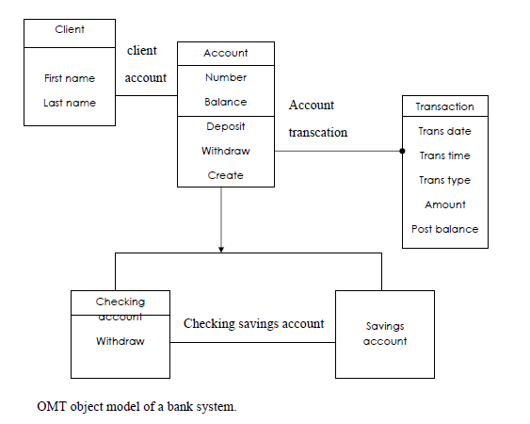

Slide 8
THE OMT DYNAMIC MODEL
OMT provides a detailed and comprehensive dynamic model.
The OMT state transition diagram is a network of states and events.
Each state receives one or more events, at which it makes the transition to the next state.
The next state depends on the current state as well as the events.

Slide 9
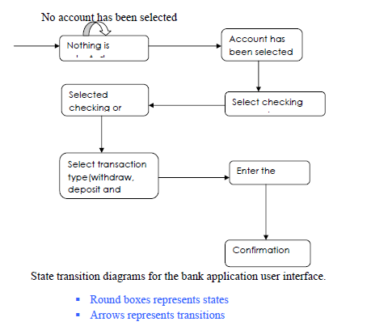

Slide 10
The OMT FUNCTIONAL MODEL
The OMT data flow diagram (DFD) shows the flow of data between different processing in a business.
Data Flow Diagrams use four primary symbols:
The process is any function being performed
The data flow shows the direction of data element movement
The data store is a location where data are stored.
An external entity is a source or destination of a data element.

Slide 11
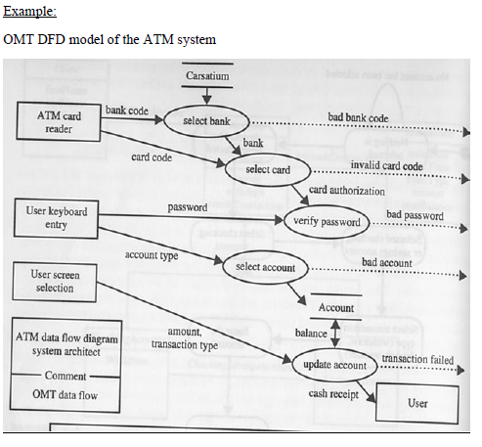

Slide 12
A fundamental assumption of OMT is that object-oriented thinking represents a more natural and intuitive way for people to reason about reality.
OMT is one of the precursors to the Unified Modeling Language (UML). There are three main diagrams in OMT: object, dynamic, and functional.
The OMT dynamic models resemble UML sequence and UML statechart diagrams. Also the notation of classes is the same as the class symbol that is used by UML.
The OMT object model illustrates the static relationship among classes and objects in a system. This diagram is similar to the UML object and class diagrams.

Slide 13
THE BOOCH METHODOLOGY :
•In software engineering the Booch method, that is published in 1991 by Grady Booch, is a widely used method in object-oriented analysis and design.
The Booch method has been superseded by UML, which features elements from the Booch method with OMT and OOSE.
The Booch method helps to design systems using the object paradigm. It covers the analysis- and design phases of an object-oriented system. The method defines different models to describe a system and it supports the iterative and incremental development of systems.
• Is criticized for his large set of symbols.
•It consists of the following diagrams:
_ Class diagrams.
_ Object diagrams.
_ State transition diagrams.
_ Module diagrams.
_ Process diagrams.
_ Interaction diagrams.

Slide 14
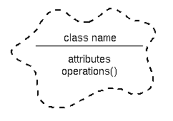
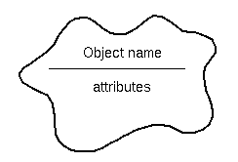
The Booch method notation
Figure 1. A class diagram notation.
Figure 2. A object diagram notation.

Slide 15
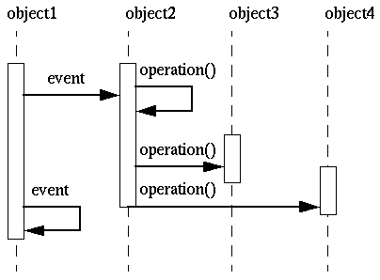
The dynamic nature of an application can be illustrated by state transition and interaction diagrams.
Figure 3. An interaction diagram
There are several Booch diagrams that are very similar to diagrams in UML. These Booch diagrams are state transition and interaction diagrams. The State transition diagram corresponds to UML's statechart diagram and the interaction diagram corresponds to UML's sequence diagram.

Slide 16
Macro development process
The Booch methodology prescribes a macro development process and a micro development process. Macro development process: It consists of following steps: 1. Design or create the system architecture. 2. Evolution or implementation. 3. Conceptualization 4. Maintenance. 5. Analysis and development of the model.

Slide 17
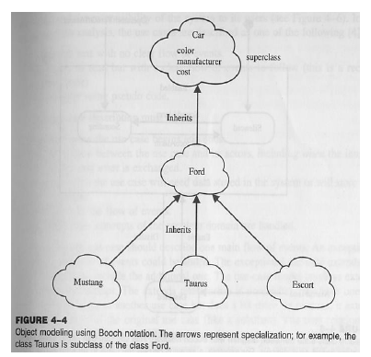

Slide 18
Micro development process
Micro development process:
It represents the daily activities of small or large group of software developers.
It describes the day-to-day activities.
The micro development process consists of the following steps. 1. Identify classes and objects. 2. Identify classes and object semantics. 3. Identify classes and object relationships. 4. Identify classes and object interfaces and
implementation.

Slide 19
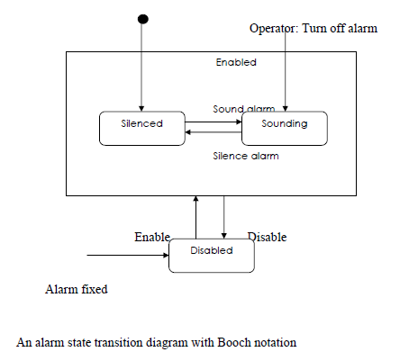

Slide 20
JACOBSON METHODOLOGY:
• Object-oriented business engineering (OOBE)
• Object-oriented software engineering (OOSE)
– It covers the entire life cycle
– Stress traceability(enables reuse of analysis and design work) both forward and backward

Slide 21
Object-Oriented Software Engineering (OOSE)
Object-Oriented Software Engineering (OOSE) is a software design technique that is used in software design in object-oriented programming.
OOSE is developed by Ivar Jacobson in 1992. OOSE is the first object-oriented design methodology that employs use cases in software design. OOSE is one of the precursors of the Unified Modeling Language (UML), such as Booch and OMT.
It includes a requirements, an analysis, a design, an implementation and a testing model.
Interaction diagrams are similar to UML's sequence diagrams. State transition diagrams are like UML statechart diagrams.

Slide 22
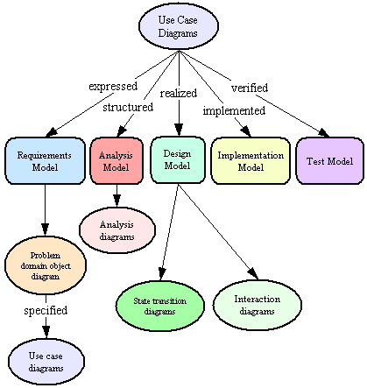
Object-Oriented Software Engineering.

Slide 23
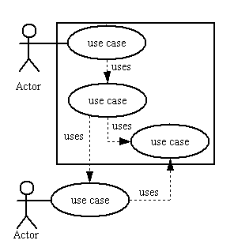
Figure 2. Jacobson’s Use Case diagram.

Slide 24
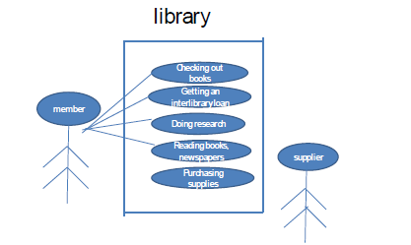
Object oriented software Engineering: Objectory
• OOSE is also called Objectory
• Development process is also called as use case driven development
• The system development method based on OOSE is a process for the industrialized development of the s/w

Slide 25
Object-oriented business engineering (OOBE)
Object-oriented business engineering (OOBE) is object modeling at enterprise level. Use cases are the important tool for modeling.
OOBE is a framework for architecture, business engineering, business process management and object-oriented development.
OOBE provides the framework that businesses use to articulate and communicate business process improvements, business definitions and rules. It provides the crucial link missing from traditional approaches to systems development and business process engineering: a clear path from business concepts to reusable information systems components.

Slide 26
Use cases
✓ Scenarios for understanding system requirements.
✓ Non formal text with no clear flow of events.
✓ Text easy to read.
✓ Formal style using pseudo code.
✓ Can be viewed as concrete or abstract (not initiated by actors).
– Understanding system requirements
– Interaction between user and system
– It captures the goal of the user and responsibility of the system to its users

Slide 27
The primary difference between OOBE and traditional business modeling and redesign approaches is that OOBE facilitates thinking about the business as though it were a series of modular components that can be reconfigured at-will as the business changes. OOBE encourages convergence of diverse thinking (through business patterns); while still very clearly capturing and respecting those differences that create profitable differentiation in the marketplace. OOBE harmonies information systems thinking with business thinking, driving systems from the business point of view, but not treating business and systems as incompatible. By providing a clean transition between business and systems thinking, OOBE makes possible the realization of a new breed of business operations where key processes, and even entire businesses, are implemented electronically.
The three phases involved in OOBE process are:
Analysis phase
Design and implementation phase
Testing phase

Slide 28
Booch Method | Rumbaugh Method | Jacobson Method
Approach: Phases Covered: Strength: Weakness: Uni-directional Relationship: Bi-directional Relationship: Diagrams used: | Object centered approach. Analysis, design and implementation phases. Strong method for producing detailed object oriented design models. Focus entirely on design and not on analysis. Uses. Associations. Class diagram, state transition diagram, object diagram, timing diagram, Module diagram, process diagram. | Object centered approach. Analysis, design and implementation phases. Strong method for producing object model static structure of the system. Cannot fully express the requirements. Directed Association. Uni-directed Associations. Data flow diagrams, state transmission diagram, class/object diagram. | User centered approach. All phases of life phase cycle. Strong method for producing user driven requirements and object oriented analysis model. Do not treat OOP to the same level as other methods. Acquaintance Relationships. Use case diagram.

Slide 29
SA/SD v/s JSD

Slide 30
SA/SD(Structure Analysis / Structure Design)
SA/SD(Structure Analysis / Structure Design)
Structure analysis / structure design (SA/SD) includes a variety of notations for formally specifying software.
In analysis phase, data flow diagrams, process specification, a data dictionary, state transition diagrams, and entity relationship diagrams are used to logically describe a system.
In design phase, details are added to the analysis model and the data flow diagrams are converted into structure chart descriptions of programming language code.

Slide 31
Data flow diagram- data flow diagram model the transformation of data as it flows through the system and are the focus of the Structure analysis / structure design. A data flow diagram consists of
processes
data flows
actors and
Data stores.
Structure analysis/ structure design recursively divide complex processes into sub diagrams until many small processes are left that are easy to implement. When the resulting processes are simple enough, the decomposition stops , and a process specification is written for each lowest level process .process specification may be expressed with decision tables ,pseudo code or other techniques.

Slide 32
Data dictionary: the data dictionary contains missing from data flow diagram. The data dictionary defines data flows and data stores and the meaning of various names.
Entity –relationship (ER) Diagrams: it highlights relationship between data stores that otherwise would only be seen in the process specification. Each ER data element corresponds to one data flow diagram.
Data store, the object modeling notation is an enhancement over ER diagram.
The above tools are used during the process of structure analysis. Structured design follows structured analysis and address low level details. Data flow diagram processes are converted into programming language functions and a structure chart is created showing the procedure call tree.

Slide 33
Jackson structured development (JSD)
Jackson structured development (JSD) is another mature methodology which has a different style than SA/SD or OMT. The JSD methodology was developed by Michel Jackson and is especially popular in Europe.JSD does not distinguish between analysis and design and instead lumps analysis and design as specification.
JSD divides system development into two stages
Specification
Implementation.
JSD first determines the “what” and then the “how”.
JSD is intended especially for application in which timing is important.
A JSD model begins with consideration of the real world, the purpose of the system is to provide functionality, but Jackson feels that one must first consider how this functionality fits in with real world.
JSD model describes the real world in terms of entities, actions or ordering of actions. Entities usually appear as noun in requirement statements and actions appear as verbs

Slide 34
JSD software development consists of six sequential steps:
Entity Structure Step
Entity Action Step
Initial Model Step
Function Step
System Timing Step
Implementation

Slide 35
Entity Structure Step
Entity Structure Step: Jackson presents several examples one of which is the design of elevator control system. The elevator control system controls two elevators which services six floors. Each floor has six inside buttons (one for each floor). Each floor has up and down buttons in the waiting area .Jackson identifies two entities for elevator control example: Button and elevator.

Slide 36
Entity Action Step
Entity Action Step: Action occurs in the real world and is not an artifact of the system. Action takes place at a point in time are atomic and not decomposable. The entity structure step partially orders the actions of each entity by time. The elevator control system illustrate the importance of ordering actions .it is permissible for an elevator to arrive at floor 3 leaving floor 3 , arrive at floor 2, leave floor 2 and so on. It does not make sense for two arrived actions to occur in succession; arrive and leave operations must be alternate.

Slide 37
Initial Model Step
Initial Model Step: The initial model step states how the real world connects to the abstract model. JSD supports state-vector and data stream connection. The elevator user does not want the control system to remember each button pressed and send an elevator fine to service request .the JSD model of the computer system is unaware of the number of presses and only communicates with the real world in the “up-flag”.

Slide 38
Function step
Function step: It uses pseudo code to state output of actions. At the end of this step the developer has a complete specification of the required system in the elevator example, turning the display panel lights on or off as an elevator arrives at each floor is a function that must be specified.

Slide 39
System timing step
System timing step: this step considers how much the model is permitted to lag the real world. For the most part, the result of the timing step is a set of informal notes on performance constraints. For example an elevator control system must detect when up and down buttons are pressed.

Slide 40
Implementation step
Implementation step: this focuses on the problems of process scheduling and allocates processors to processes. The number of processes may be different from the number of processors. Jackson’s elevator control model has 50 processes. The developer must decide whether to match each process to one or 50 CPU or how to get several processes to share the same CPU. After the six JSD steps comes writing of code and database design.

