Slide 1
An FPGA-Based Instrument for RRAM Characterization
EE 344 - Electronic Design Lab
Milestone 3
MON - 08
Debasish Panda [21d070021]
Deshpande Varad Shailesh [21d070024]
Grampurohit Shreyas Jayant [21d070029]
Harshit Raj [20d070033]

Slide 2
Progress in last milestone
Had completed the schematic in KiCAD for the final circuit.
Had completed the testing of the analog part of the scaled-down circuit.
VHDL driver for DAC was completed and ADC driver was being developed.
Modified the tentative work distribution plan and Gantt chart outlining individual tasks to be done before each of the project milestones.

Slide 3
Feedback received
Use recommended op-amp in front of DAC instead of the one we decided.
Make a common repository for all the documents and sheets associated with the project with version control.
Start making the interface between FPGA and laptop.
Update the Gantt Chart to include the time for making enclosure for PCB.

Slide 4
Addressal of feedback
We were on the verge of ordering the recommended opamp, but we decided to get the new DAC working first. The new DAC got damaged since it was ESD sensitive but those precautions were not taken while soldering. So we decided to stay with the old DAC.
We have created a common Github repository - https://github.com/HarshitRaj3007/EDL2024
The POC for interfacing of FPGA with laptop is ready.
Gantt Chart has been updated accordingly.
Videos@ https://drive.google.com/drive/folders/13kLhzrZny3STd89KioyVIFqhOgMc7KOY?usp=sharing

Slide 5
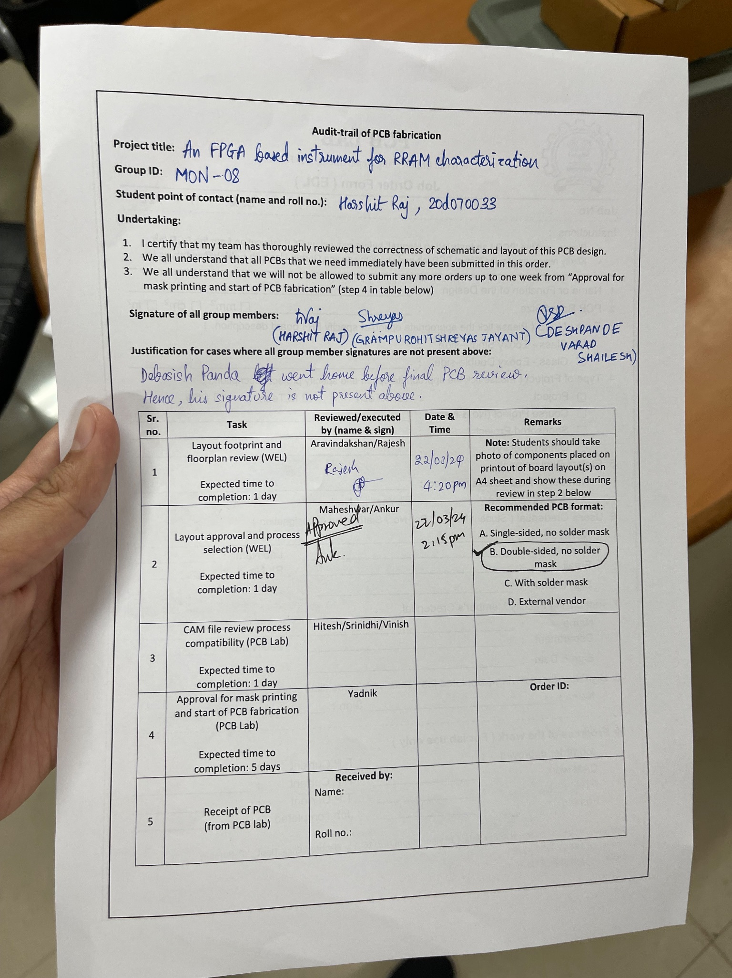
PCB Readiness
PCB layout for the scaled-down version of the circuit (which will be used as a backup option) has been submitted for printing.
PCB design of the final version is still in progress.
Note: The PCB form on the right only shows Stage 2 complete as the PCB Lab, after Stage 3 and Stage 4 verification, directly took the form when giving the order.

Slide 6
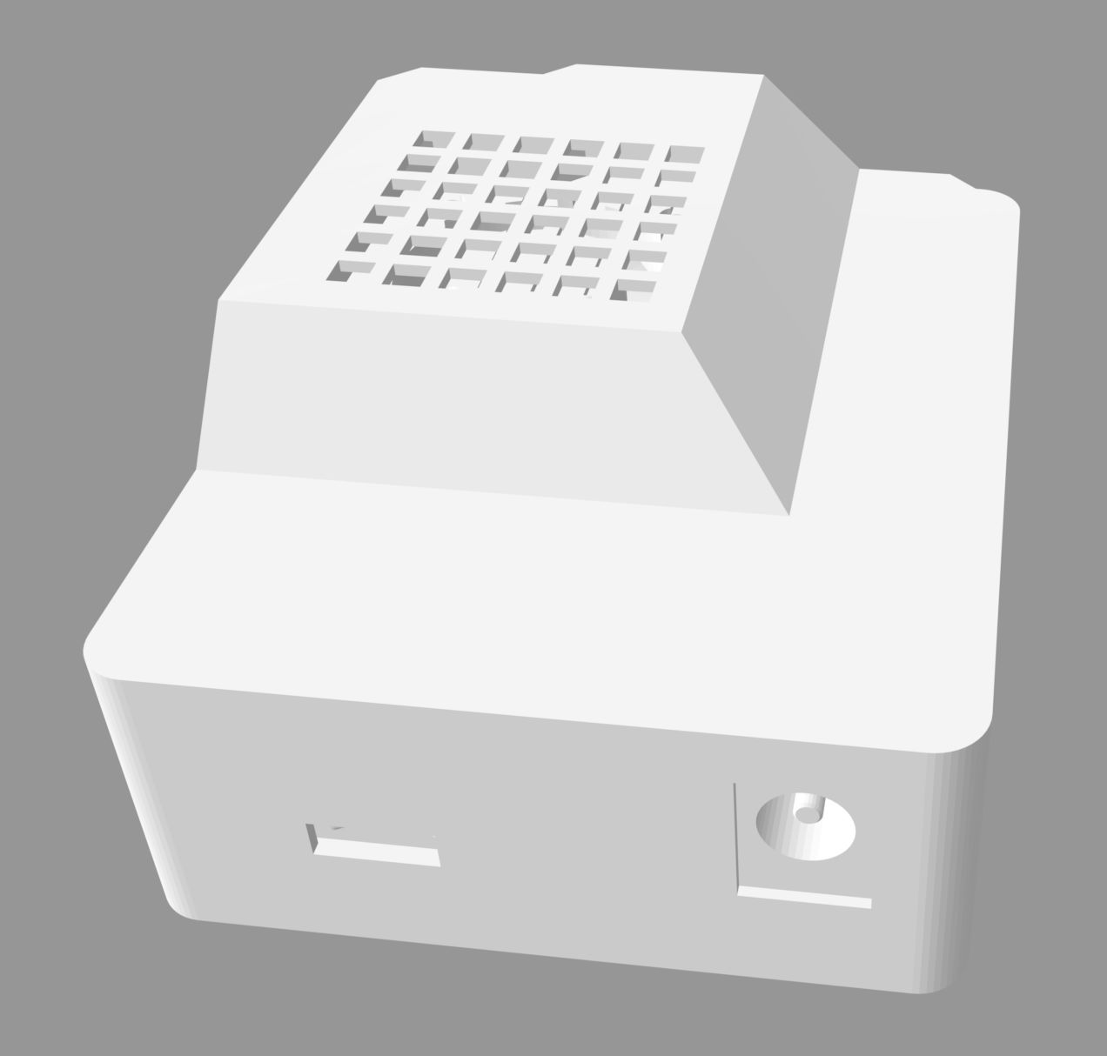
CAD Readiness
A preliminary design for the PCB enclosure has been completed on Fusion 360 whose geometric dimensions have not been finalised yet since we do not have the PCB layout of the final version. As soon as our PCB design is complete (will be done in 1-2 days), the CAD design will be updated accordingly.

Slide 7
Critical tasks in progress
PCB design for the power supply circuit is in progress
Final PCB design is in progress
CAD design for PCB enclosure is in progress

Slide 8
Key risks not yet addressed
We will receive our testing PCB on 1st April or later. If we find issues in that, we will have to shift our focus on identifying issues in the testing PCB and making it work.
We haven’t addressed over-current protection properly using analog circuitry, in case the RRAM has some error and becomes a dead short or gets low impedance (a coding solution has been thought of).

Slide 9
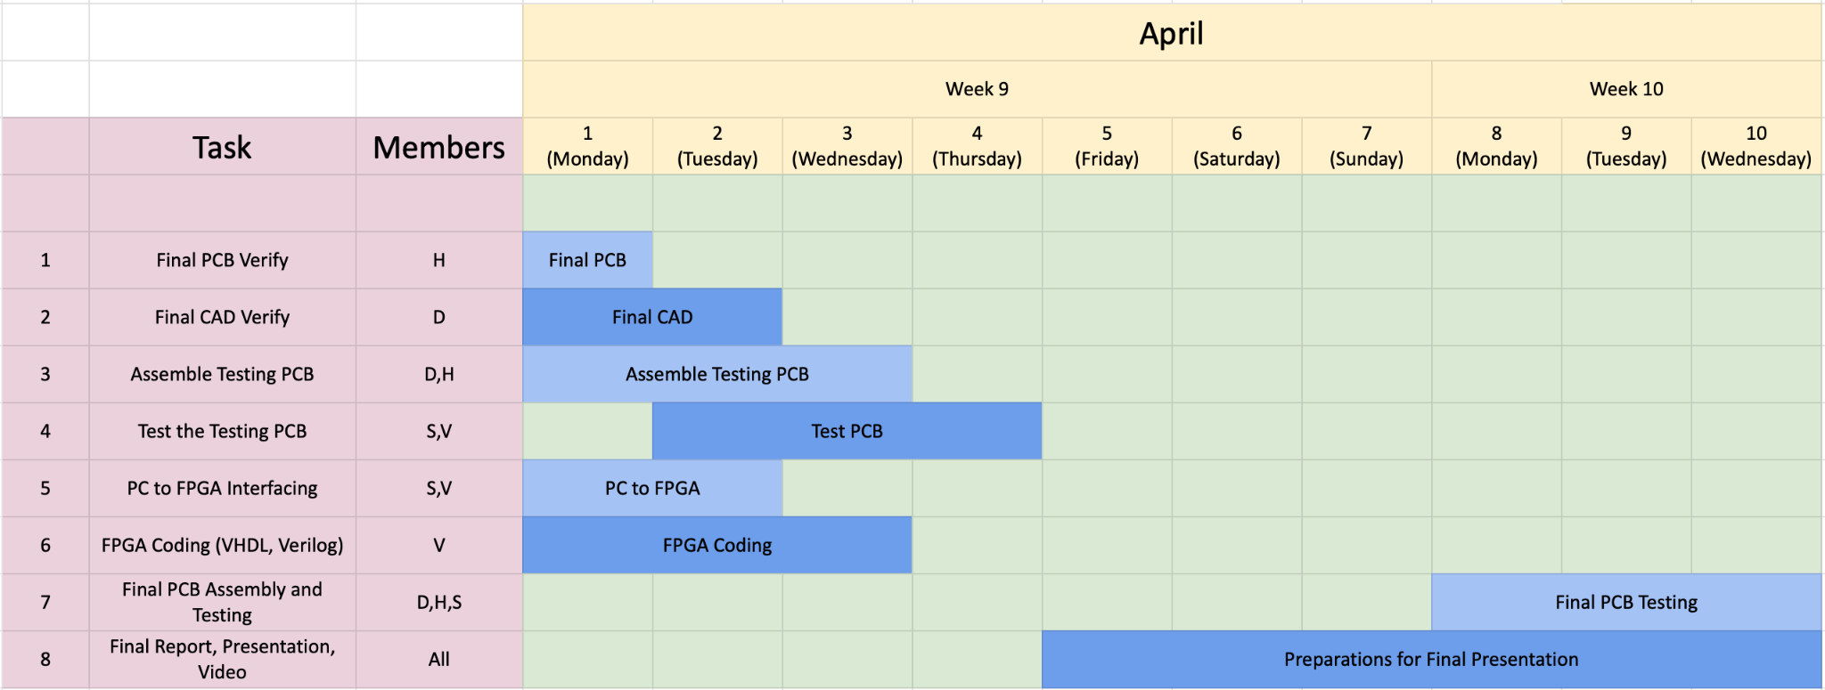
Updated Gantt chart for project planning

Slide 10
Reasons for deviation from Gantt chart
We had not considered that 10 days in between would be spent in midsem.
The previous Gantt chart was too demanding and so we had to postpone a few tasks to the coming week
The PCB printing for the simplified version is taking much longer than expected. Few decisions and work are based upon the working of this circuit on PCB.

Slide 11
Work distribution
Harshit: Ideal Circuit design, PCB design of Simplified Circuit, Final Circuit design, PCB design of Final Circuit.
Shreyas: Simplified Circuit design, Ideal Circuit design, testing of analog circuits in Simplified Circuit - breadboard, testing of analog circuits in Ideal Circuit design, design of Final Circuit, Graphical User Interface(Python).
Varad: Development of VHDL drivers for scaled down and powerful ADCs and DACs, development of Verilog driver to initiate UART through JTAG using Intel Avalon interface, control logic for driving the operations.
Debasish: Testing and verification of the procured ICs after soldering them to breakout boards for the same, CAD (PCB enclosure) design, PCB and circuit design of the Power Module.

Slide 12
Final demo plans
We tried interfacing the powerful ADC with FPGA, and while it worked initially, we realised it stopped functioning in testing(prior ESD damage possibility). Since the final PCB deadline is near, we decided not to fiddle with the spare (new) ADC, and rather stick to the ADC in the simplified version. So we have decided to refine the current design. Following are the additional features we plan to present:
Support for -5V
4 x 4 resistive crossbar array
We are actively working on the GUI as well.

Slide 13
Planned pipeline for the final demo
The user will see an interface on a PC to control the device. They can choose to read/write/reset the RRAM. They can provide the voltage and square pulse duration for writing, and choose the particular unit in the crossbar.
The set parameters go to the FPGA through UART-JTAG, the switches are set in the required orientation, and the pulse is sent out using the DAC.
The analog circuitry handles the pulse to the RRAM and the data comes back to the FPGA through the ADC.
The FPGA sends the data back to the PC.
The Python frontend on PC performs the required calculations and prints out the necessary information back to the user.

