Slide 1
An FPGA-Based Instrument for RRAM Characterization
EE 344 - Electronic Design Lab
Milestone 2
MON - 08
Debasish Panda [21d070021]
Deshpande Varad Shailesh [21d070024]
Grampurohit Shreyas Jayant [21d070029]
Harshit Raj [20d070033]

Slide 2
Progress in last milestone
Identified and understood the problem statement that we’re working on along with practically achievable target specs for our proposed implementation.
Identified suitable components for on-board implementation of the circuit after going through multiple datasheets and the prescribed research papers so as to ensure an economically viable project, while achieving satisfactory specifications.
Tentative work distribution plan and Gantt chart outlining individual tasks to be done before each of the project milestones.

Slide 3
Feedback received
The initial ideation was to power our implementation by a battery source, which was pointed out to be less favourable for extended running times, and we were asked to make provision for the board to be powered via A/C supply.
We were also asked to make a simpler, scaled-down version of the final implementation, using components available at WEL as a backup option.

Slide 4
Addressal of feedback
We scrapped the idea of using batteries as a power source, and decided instead to use an A/C adapter so as to power the board using domestic A/C supply, while enumerating all the power management considerations. These power management concerns have been taken into consideration in the schematic.
To achieve the scaled down implementation, we have three major subtasks:
Analog Design considerations
Elementary testing of the scaled-down version of the analog circuit has been completed. No sneak currents were observed and resistance values were obtained accurately, even for 5 𝜇s pulse. In some cases, there was propagation delay and slew rate issues, which are expected to reduce once the improved components arrive.
ADC and DAC interfacing
Except for some minor issues, we were able to read data from both ADC testing circuit. For DAC, we are able to send the expected SPI signal from FPGA but facing some issues with getting the output from DAC. Most importantly, the VHDL simulation of the code was as per our expectations.
Schematic and PCB
Schematic has been completed and we are currently working on the PCB layout.

Slide 5
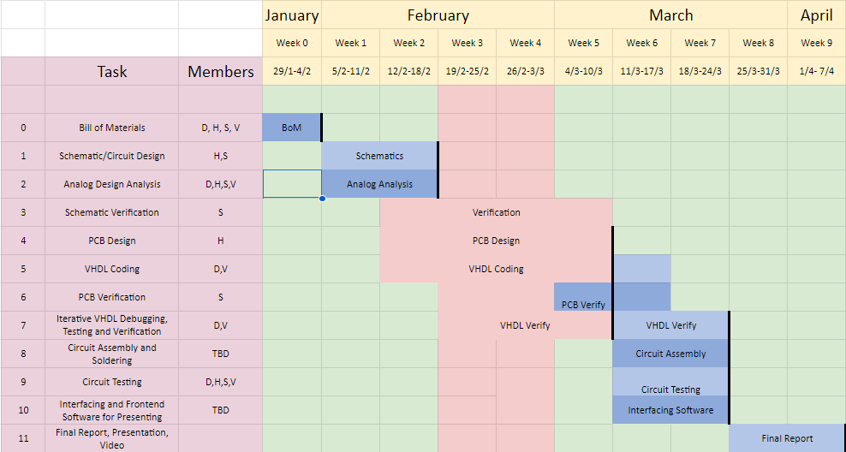
Updated Gantt chart for project planning
Weeks 3 and 4 are mid-semester weeks

Slide 6
Reasons for deviation from Gantt chart
When we initially made the chart, we did not realise that mid-semesters were scheduled from 24th Feb to 2nd March. This caused some tasks after Milestone 1 to be shifted towards the right side.

Slide 7
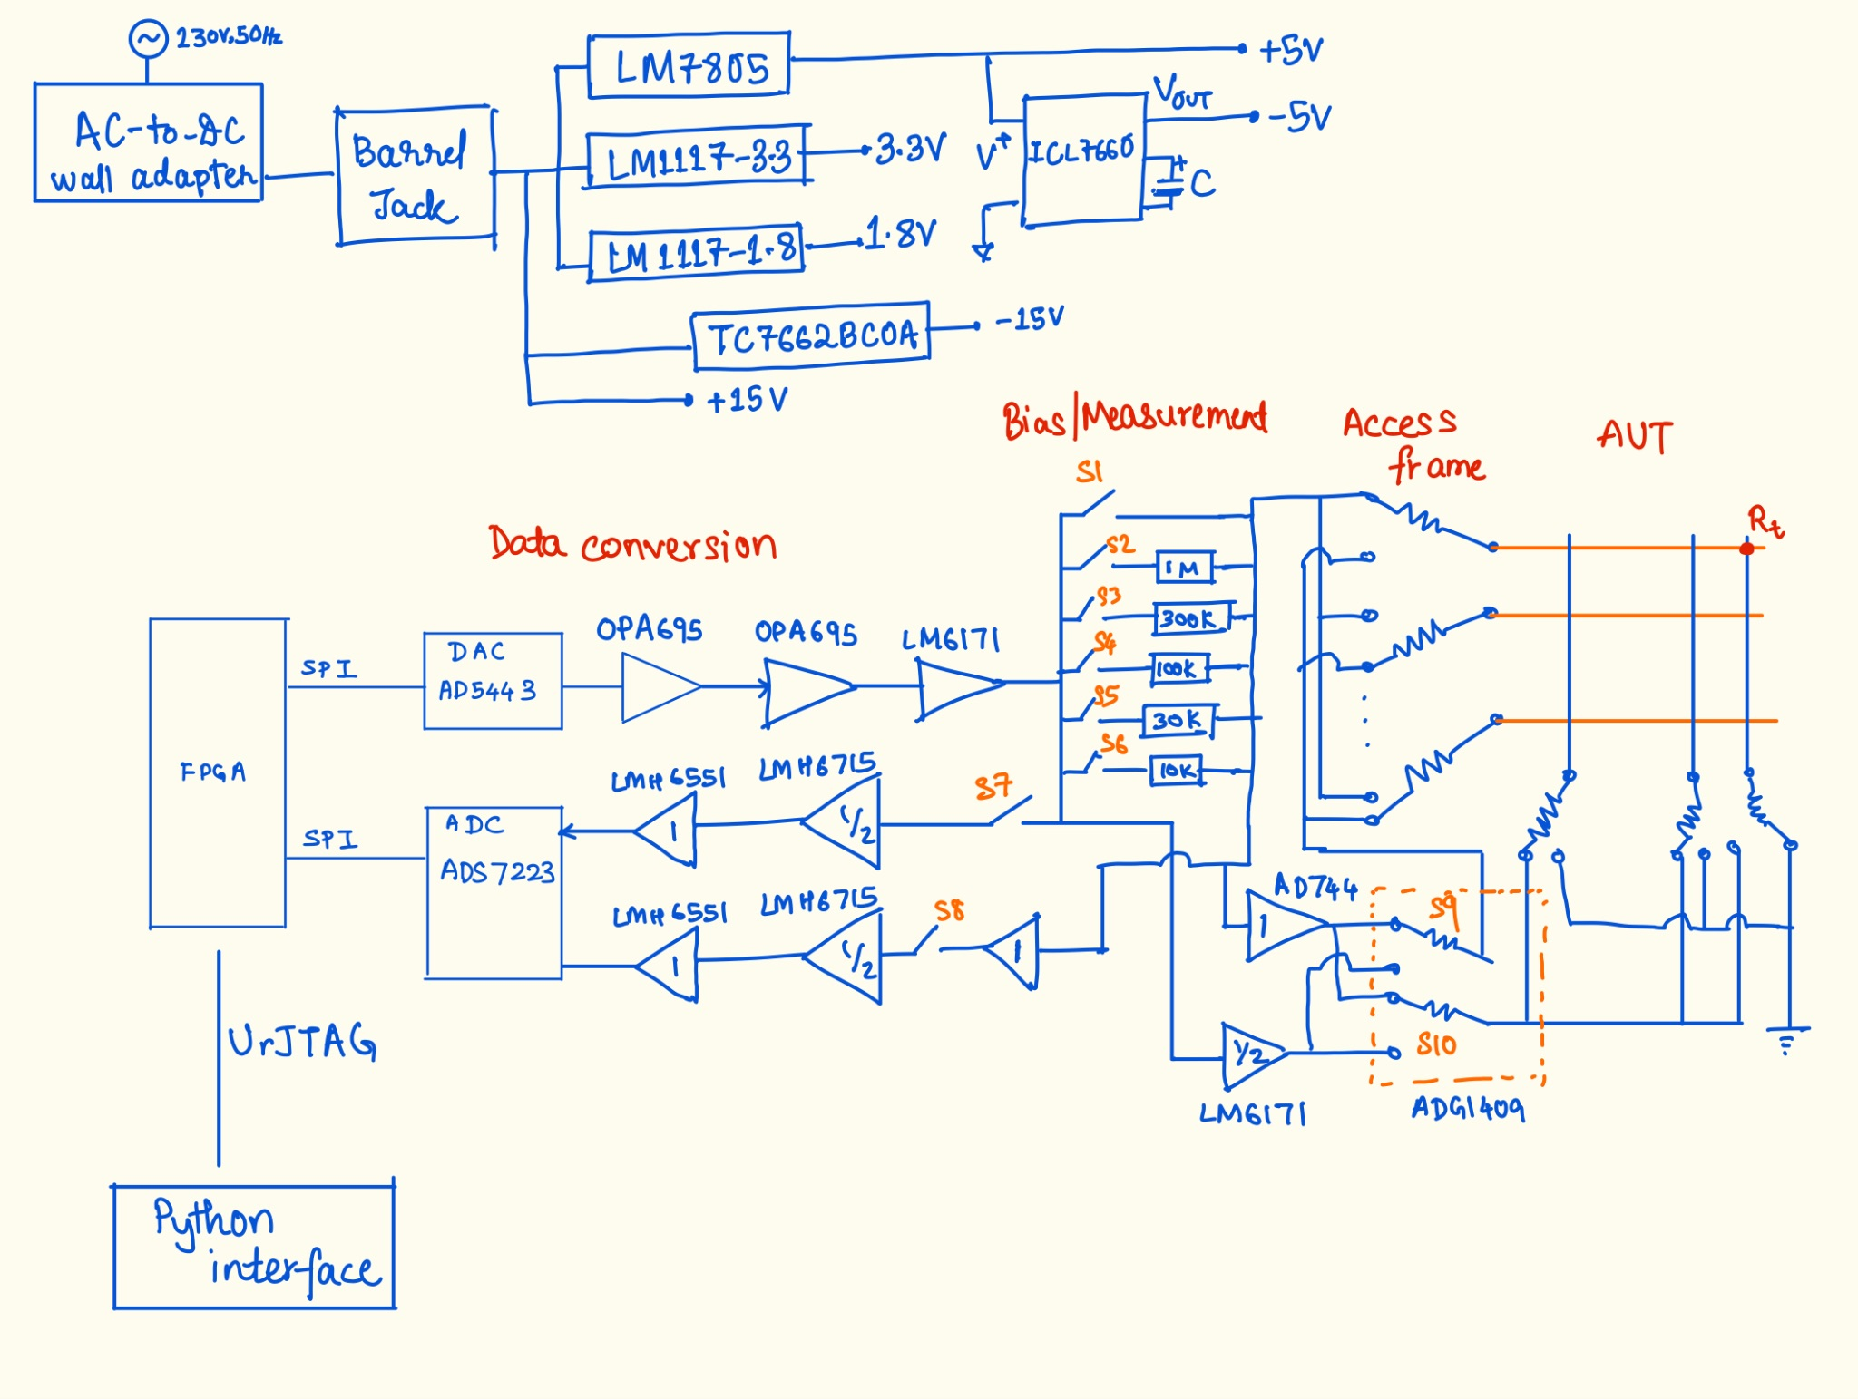
Block diagram

Slide 8
Calculations and analysis for block diagram
Power supply: These considerations are based on the various requirements of amplifiers, switches, ADC and DAC.
DAC Pathway:
OPA695s are CFAs. The output of OPA695 pair is from -4.2V to 4.2V. But at the output of LM6171 the output range is -5V to 5V. Hence the gain of LM6171 is set to 1.19.
ADC Pathway:
LMH6715 is set to a gain of 0.5 so that the input voltage at the ADC lies within the range of -2.5V to 2.5V.
Detailed calculations and reasoning for selection of particular resistance and capacitance values, along with the type of configuration of amplifiers, etc will be explained in a report.

Slide 9
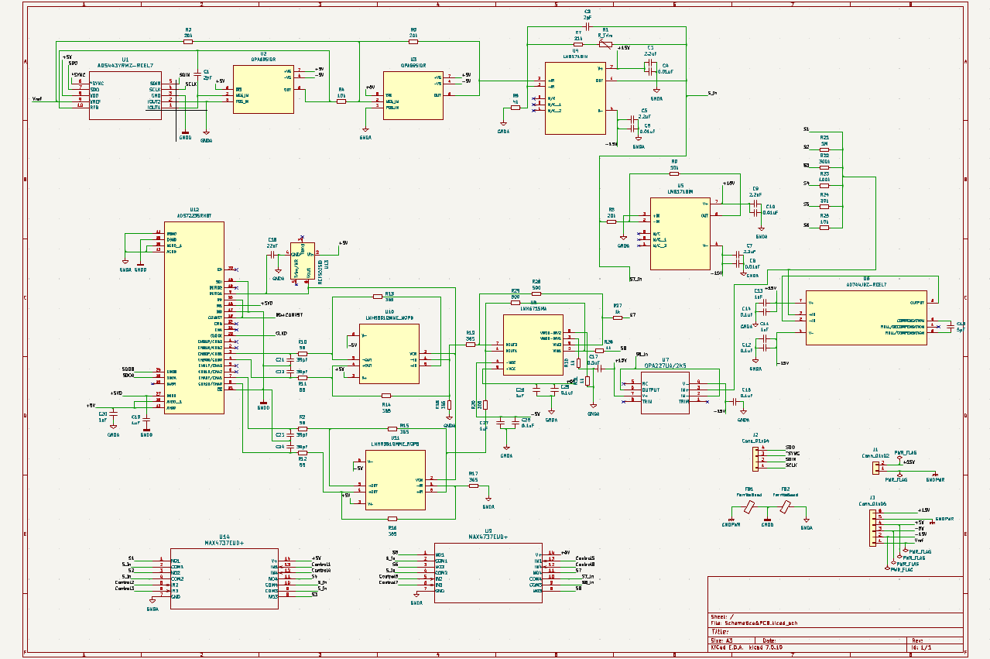
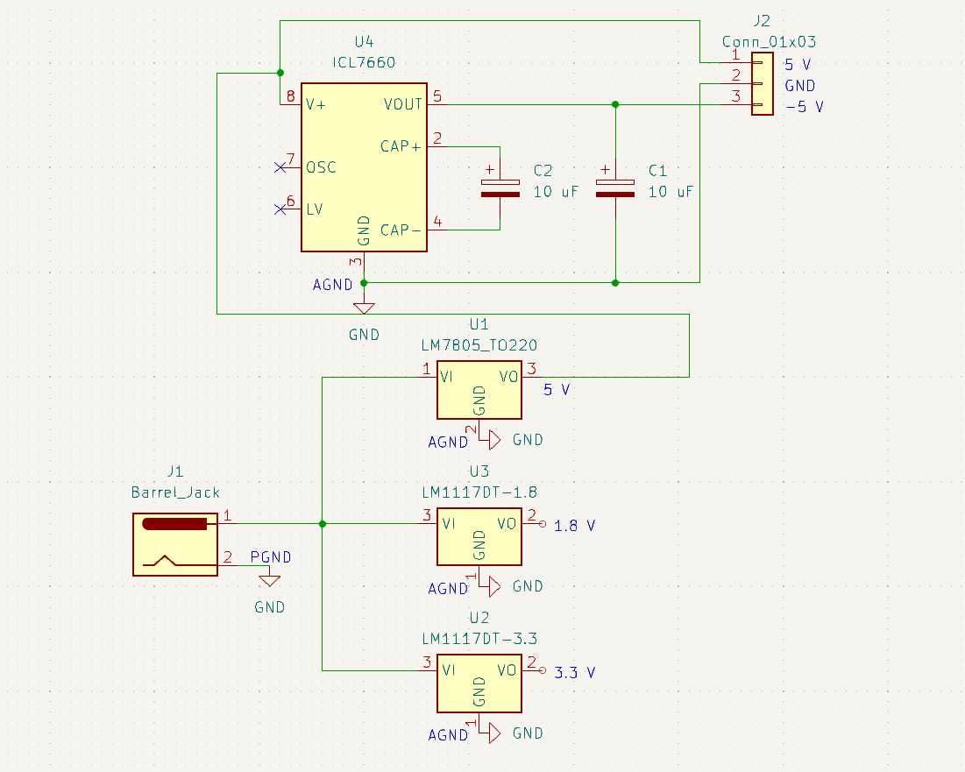
Circuit Schematic

Slide 10
Testing plan
Preliminary testing
Testing of analog circuits for the scaled-down version has been completed.
Testing of ADC-FPGA interface has been nearly completed, and the testing of the DAC-FPGA interface is in progress.
Intermediate testing
Next up, we’ll be testing the analog circuits using the actual components ordered for the project on breakout boards. Another significant change we aim to introduce in this phase is to power the chips using A/C supply as recommended to us.
Similarly, we’ll be testing the ADC and DAC interface with the new components and try to increase the extent of testing by actually interfacing the ADC and DAC with the verified analog circuits.
As soon as our ordered components arrive, we can test them on breakout boards (for VQFN-32, SOIC-8, MSOP-10 are available, we have checked the same with Maheshwar Sir).
Final testing
The final stage will involve verification of the PCB layout (packaged within an enclosure box) which will be tested while being powered by domestic A/C supply.

Slide 11
Results of preliminary testing
The resistance value inside the 2 x 2 array used for testing was estimated accurately up to the third decimal point.
No sneak currents were seen.
The resistance measurement was accurate even for a pulse of 5 𝜇s. This implies that the amplifiers selection in the testing circuit based on slew rate, bandwidth and other considerations was correct.
The ADC is able to correctly send data and as shown in the video, we have checked the waveforms on the DSO, there is a minor problem in displaying this onto the FPGA LEDs. For the DAC, we are able to generate the correct command sequence through SPI.

Slide 12
Additional Considerations
PCB printing
Our project needs VQFN-32, MSOP-10, SOIC-8 packages, which we have checked with Maheshwar Sir, and are workable with in our lab itself. We can order from PCB power if, in some unseen scenario, we need to outsource.
We have checked with the lab, and there are breakout boards available to test each of these.
User interface
Thought of a simple python-driven interface or a webpage that dumps data into a .txt file, and this will communicate with the FPGA via a urJTAG interface.

Slide 13
Additional Considerations (contd.)
3. PCB Holder/Enclosure
We are working on creating a mechanical holder/enclosure for the PCB. We have learnt the basics of CAD software and will soon start working on it once major tasks are accomplished.

