Slide 1
An FPGA-Based Instrument for RRAM Characterization
EE 344 - Electronic Design Lab
Milestone 4
MON - 08
Debasish Panda [21d070021]
Deshpande Varad Shailesh [21d070024]
Grampurohit Shreyas Jayant [21d070029]
Harshit Raj [20d070033]

Slide 2
Project Summary
We present a compact, FPGA-based implementation for characterizing RRAM (Resistive Random Access Memory) crossbar arrays which is intended to aid researchers in their study of RRAM.
Read capability
Write capability
Interface available at laptop through same USB cable

Slide 3
Demo Video
Link to the demo video - Demo

Slide 4
Methodology
PCB Design and print
Design simplified circuit
Breadboard, test
Graphical User Interface
Understand reference Analog Design
[jtag uart] FPGA & Laptop link
DAC, ADC drivers
Final Circuit Design
PCB Design and print
CAD
Breadboard, test
Design ideal circuit

Slide 5
Challenges faced and their solutions
Challenges | Solutions | Remarks
MAX4737 not dual supply | CD4066 | Successful
Only SPST switches but needed SPDT as well | Connected two in parallel and gave opposite control signals | Successful
DAC ESD issue | Use different DAC | Successful
ADC damage | ESD damage or excessive voltage sent during testing | Unsuccessful
100 kHz input on THT resistor lead to slewing output (like RC circuit) | Used SMD resistors to reduce capacitance, but it still had the issue | Unsuccessful
Negative voltage supply issue | External power bank | Successful
Designed a –1/2 gain instead of a +1/2 requirement in Simplified PCB | Changed the design in the Final PCB | Successful

Slide 6
Challenges faced and their solutions
LM6172 OpAmp IC overheating on Simplified PCB | Searched for shorting issues | Unsuccessful
Footprint of RRAM IC wasn’t known | Made the design modular by providing a header output | Successful
Short in a trace with the ground plane in printed Final PCB | Searched for it under a microscope and cut it | Successful
Two header pins of FPGA routed on PCB were read only | Shorted it with unassigned header pins | Successful
Xen10 real time communication issue and lack of header pins | Used DE0-Nano | Successful
DE0-Nano UART JTAG/array issue | Limited documentation, very few resource online | Successful

Slide 7
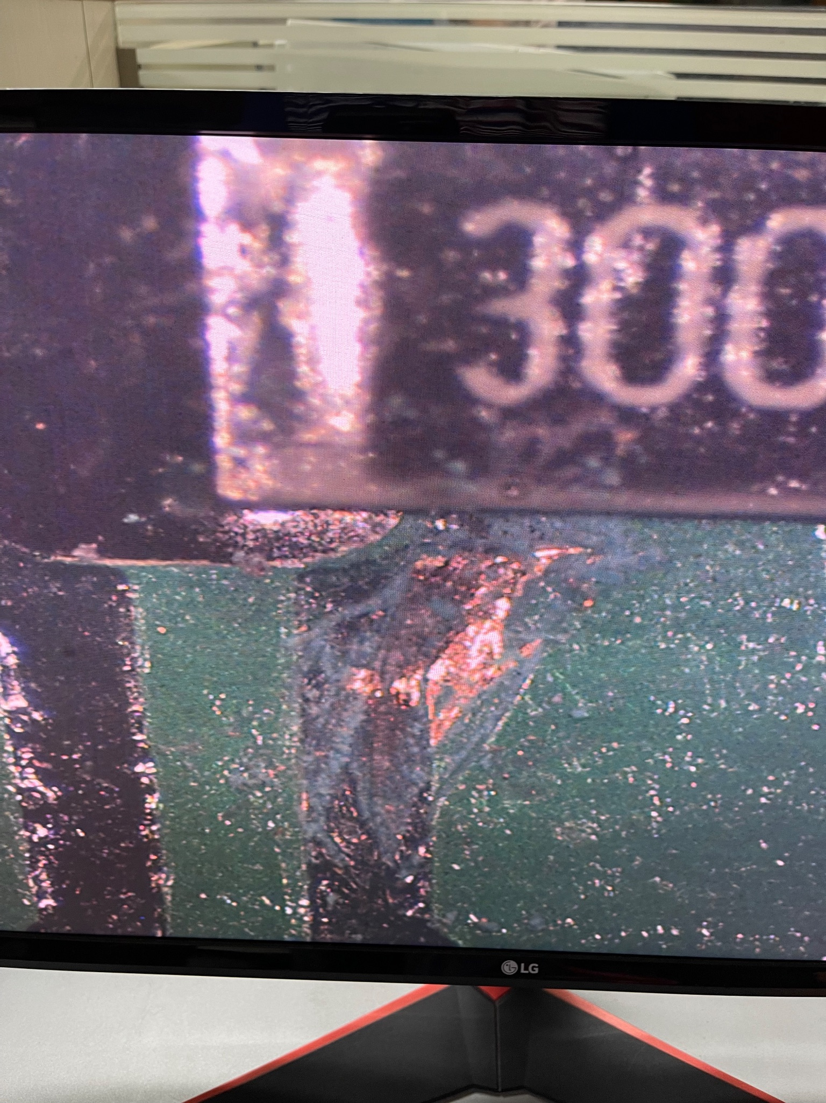
Examples of problems solved
PCB trace issue: While verifying if a soldered component was connected properly by doing a shorting test, we found out that an entire trace was shorted to the ground plane. We searched for this under a microscope and found the short (refer image). This short was then cut using a knife to resolve the issue.
Switch supplies: The switches used by us needed control signals with its Vss as reference, but our FPGA could only output between 0 and 3.3V. To ensure –5V passes through it due to device specifications and also have reliable switching, we had to power it using Vss = –5V and Vdd = +9V. This was ascertained through extensive experimentation.
jtag uart: Intel Avalon interface is complicated, therefore to understand the reverse-engineered method, fastest way is to experiment extensively.

Slide 8
Individual Contributions
Member | Contributions made over entire duration of project | Average hours spent on EDL per week in Jan and Feb ‘24 | Average hours spent on EDL per week in March and April ‘24
Shreyas | Analog Design, breadboard testing, soldering, PCB testing, GUI | 7 | 15
Harshit | PCB Design, Analog Design, breadboard testing, soldering, PCB testing | 5 | 15
Varad | FPGA: Drivers for ADC & DAC, jtag uart reverse-engineering, elementary Analog analysis | 7 | 25
Debasish | CAD, testing of procured ICs, soldering, power PCB design & testing | 4 | 12

Slide 9
Conclusion
Key functionalities demonstrated: Reading and Writing the RRAM. Resistor value has an error upto 5%. Any pulse width greater than 100 𝜇s can be sent.
Key lessons learnt:
Refer to ESD instructions in datasheet before handling an IC.
Read and understand the datasheets thoroughly before deciding components.
We underestimated the effort required to interface Laptop and FPGA effectively.
Key gaps to be addressed: Wall power supply, Easy resistor value selection
Acknowledgements: Thanks to Prof. Siddharth Tallur & Prof. Veeresh Deshpande, Maheshwar sir, Ankur sir, Mangesh sir for their guidance and help and the entire WEL staff & TAs for keeping the lab open at hours outside of the normal schedule.
Links to access the project files: Github, GDrive

