Slide 1
DISCRETE MATHEMATICAL STRUCTURES(18CS36)
3rd Semester
CSE department
Faculty: Anitha Sandeep
UNIT-1

Slide 2
Definition of Discrete Mathematics:
It is a study of discrete structures which are abstract mathematical models dealing with discrete objects such as sets, permutations, graphs, finite state automata etc and the relation between them.

Slide 3
Table of Contents
Fundamental Principles of Counting
The Rule of Sum and Product
Permutations
Combinations
The Binomial Theorem
Combinations with repetition
Mathematical Induction, Recursive Definitions, Recurrence Relations
Method of mathematical induction
Recursive definition
First order linear recurrence relation- Formulation problems and examples
Second order linear homogeneous recurrence relations with constant coefficients

Slide 4
Fundamental Principles of Counting
Rule of Sum: It is a basic counting approach in combinatorics.
A basic statement of the rule is that if there are m choices for one task and n choices for another task, and the two tasks cannot be done at the same time, then performing either task can be accomplished in m+n ways.
Ex:
1. A college has 40 books on sociology and 50 books on anthropology.
A student can select among 40+50=90 books.
2. Ravi goes to a pet shop and finds that the pet shop has 3 reptiles, 4 birds, 5 rabbits, and 6 fish. If Ravi can only pick one animal as a pet, how many choices does Ravi have for a pet?
Ans: 18

Slide 5
Rule of Product/Principle of Choice: If a procedure can be broken down into first and second stages, and if there are m possible outcomes for first stage and if for each of these outcomes, there are n possible outcomes for second stage, then the total procedure can be carried out in designated order in mn ways.
Ex:
1. There are 6 men and 8 women for auditioning in a drama club. In
how many ways couples can be selected?
Ans: 6x8=48 ways.

Slide 6
2. There are 2 letters followed by a 4 digits in name plates. In how many ways name plates possible
If no letter or digit is repeated?
Ans: 26x25x10x9x8x7 = 3276000
b) With repetition of letters and digits
Ans: 26x26x10x10x10x10 = 6760000
c) With repetitions, how many plates have only vowels and even digits
Ans: 5x5x5x5x5x5 = 5⁶

Slide 7
Rule of sum and product
Example:
There are 6 kinds of muffins, 8 kinds of sandwiches and 5 beverages(hot coffee, hot tea, ice tea, cola and orange juice). In how many ways either a muffin and a hot beverage or a sandwich and a cold beverage be selected?
Ans: 6x2+8x3 = 12 + 24 = 36 ways

Slide 8
Permutations
Permutations are counting linear arrangement of distinct objects.
Formula for choosing r objects from n objects = nPr = n!/(n-r)!
Ex:
There are 10 students. 5 are to be chosen and seated in a row for a picture. How many such linear arrangements are possible?
Ans: There are 10 students and 5 positions.
First position can be filled in 10 ways, second position in 9 ways, so on. So, ans is 10x9x8x7x6 = 30240 = 10!/(10-5)!

Slide 9
Definition:
Given a collection of n distinct objects, any(linear) arrangement of these objects is called a permutation of the collection.
If there are n distinct objects say a_{1,} a₂,a₃,….a_{n} and r is an integer, 1≤r≤n, then number of permutations of size r for n objects is
P(n,r)=nPr= n!/(n-r)!
Ex:
The number of permutations of letters in word COMPUTER is 8!
The number of arrangement of letters in BALL = 4!/2! = 12
The number of arrangement of letters in PEPPER = 6!/(3!2!) = 60

Slide 10
In general, if there are n objects with n₁ of first type, n₂ of second type,……. n_{r} of r^{th} type, where n₁+n₂+…..+n_{r} = n, then there are n!/(n₁! n₂! …. n_{r}!)
Ex:
Arrangement of letters in MASSASAUGA = 10!/(4! 3!)=25200
Arrangement of letters in MASSASAUGA such that all A’s appear together= 7!/3! = 840
No. of paths in xy plane from (2,1) to (7,4) where step to be either one unit to right or up is ----- 5 right and 3 up moves= 8!/(5! 3!) = 56

Slide 11
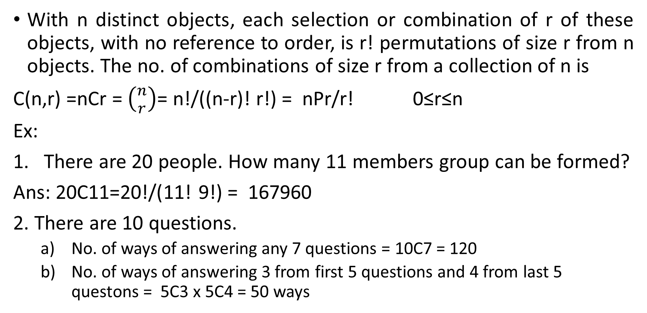
Combinations
With n distinct objects, each selection or combination of r of these objects, with no reference to order, is r! permutations of size r from n objects. The no. of combinations of size r from a collection of n is
C(n,r) =nCr = $\left({n \atop r}\right)$= n!/((n-r)! r!) = nPr/r! 0≤r≤n
Ex:
There are 20 people. How many 11 members group can be formed?
Ans: 20C11=20!/(11! 9!) = 167960
2. There are 10 questions.
No. of ways of answering any 7 questions = 10C7 = 120
No. of ways of answering 3 from first 5 questions and 4 from last 5 questons = 5C3 x 5C4 = 50 ways

Slide 12
c) No. of ways of answering 4 from first 5 questions and 3 from last 5 questions = 5C4 x 5C3 = 50 ways
d) No. of ways of answering 5 from first 5 questions and 2 from last 5 questions = 5C5 x 5C2 = 10 ways
e) No. of ways of answering 7 questions where each of selection includes at least 3 of first 5 questions = 50 + 50 + 10 = 110 ways
f) No. of ways of answering 7 questions where each of selection includes at most 3 of first 5 questions = 10+50=60ways
3. a) no. of arrangement of letters in TALLAHASSEE = 11!/(3! 2! 2! 2!)= 831600
b) no. of arragements with no adjacent A’s =
Without A’s there are 8 letters which can be arranged in 8!/(2! 2! 2!) = 5040
Three of these 9 locations can be selected in 9C3 = 84 ways
By product rule, ans is 5040 x 84 = 423360

Slide 13
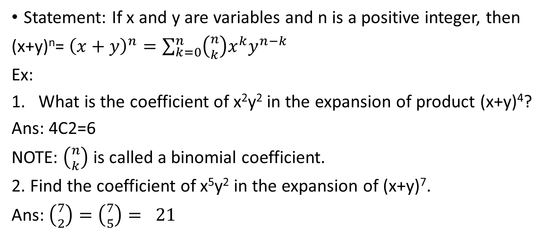
Binomial Theorem
Statement: If x and y are variables and n is a positive integer, then
(x+y)^{n}= ${\left(x+y\right)}^{n}=\sum_{k=0}^{n}{\left({n \atop k}\right)x^{k}y^{n−k}}$
Ex:
What is the coefficient of x²y² in the expansion of product (x+y)⁴?
Ans: 4C2=6
NOTE: $\left({n \atop k}\right)$ is called a binomial coefficient.
2. Find the coefficient of x⁵y² in the expansion of (x+y)⁷.
Ans: $\left({7 \atop 2}\right)=\left({7 \atop 5}\right)= 21$

Slide 14

3. Find the coefficient of a⁵b²in the expansion of (2a – 3b)⁷.
Ans: $Let x=2a, y=−3b$
coefficient of x⁵y² in (x+y)⁷ is $\left({7 \atop 2}\right)=\left({7 \atop 5}\right)= 21$
and $\left({7 \atop 5}\right)$x⁵y²= 21(2a)⁵ (-3b)² = 21 x 32 x 9 a⁵b² = 6048 a⁵b²
^{Therefore ans is 6048}

Slide 15
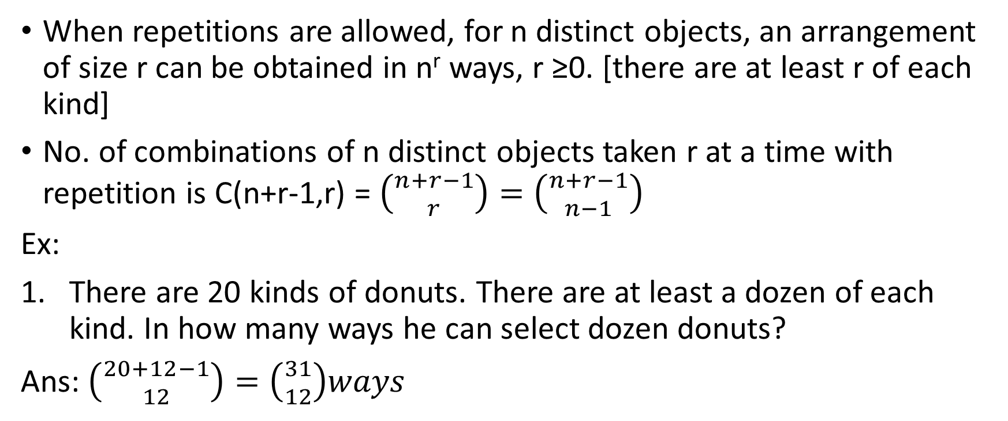
Combinations with repetitions
When repetitions are allowed, for n distinct objects, an arrangement of size r can be obtained in n^{r} ways, r ≥0. [there are at least r of each kind]
No. of combinations of n distinct objects taken r at a time with repetition is C(n+r-1,r) = $\left({n+r−1 \atop r}\right)=\left({n+r−1 \atop n−1}\right)$
Ex:
There are 20 kinds of donuts. There are at least a dozen of each kind. In how many ways he can select dozen donuts?
Ans: $\left({20+12−1 \atop 12}\right)=\left({31 \atop 12}\right)ways$

Slide 16
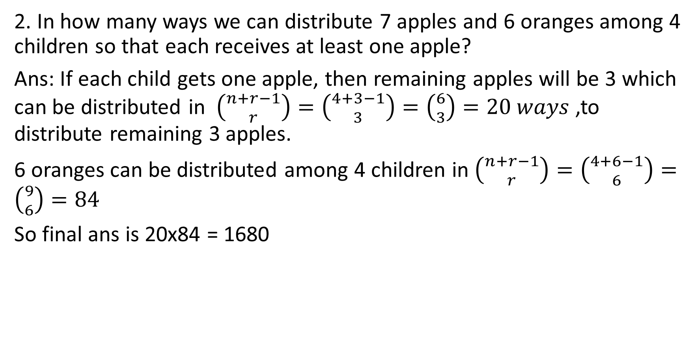
2. In how many ways we can distribute 7 apples and 6 oranges among 4 children so that each receives at least one apple?
Ans: If each child gets one apple, then remaining apples will be 3 which can be distributed in $\left({n+r−1 \atop r}\right)=\left({4+3−1 \atop 3}\right)=\left({6 \atop 3}\right)=20 ways$ ,to distribute remaining 3 apples.
6 oranges can be distributed among 4 children in $\left({n+r−1 \atop r}\right)=\left({4+6−1 \atop 6}\right)=\left({9 \atop 6}\right)=84$
So final ans is 20x84 = 1680

Slide 17
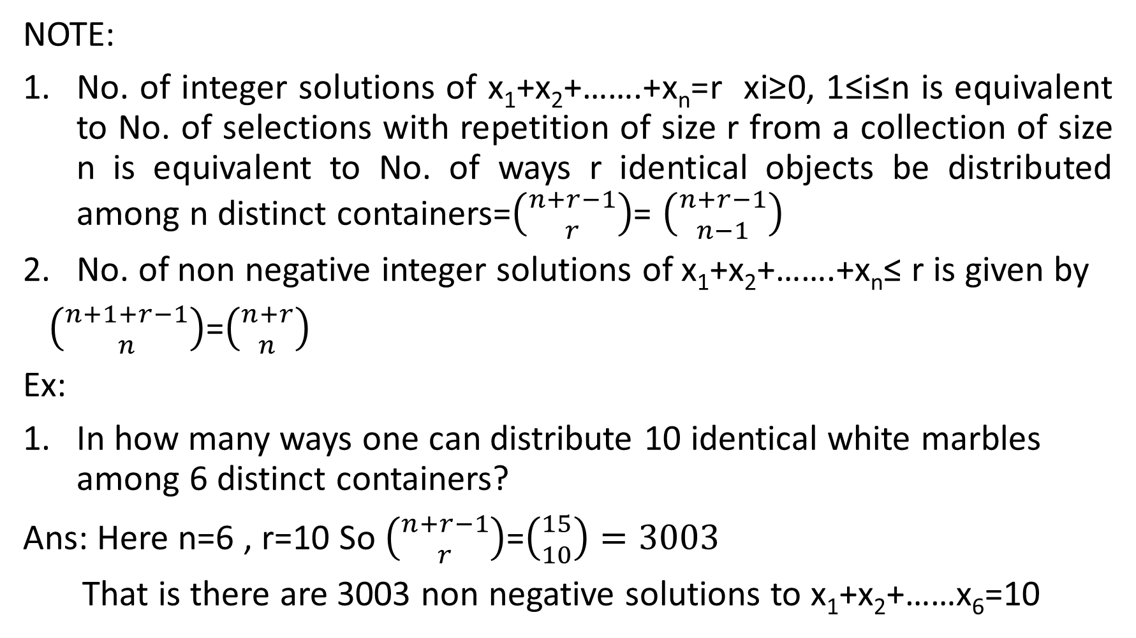
NOTE:
No. of integer solutions of x₁+x₂+…….+x_{n}=r xi≥0, 1≤i≤n is equivalent to No. of selections with repetition of size r from a collection of size n is equivalent to No. of ways r identical objects be distributed among n distinct containers=$\left({n+r−1 \atop r}\right)$= $\left({n+r−1 \atop n−1}\right)$
No. of non negative integer solutions of x₁+x₂+…….+x_{n}≤ r is given by
$\left({n+1+r−1 \atop n}\right)$=$\left({n+r \atop n}\right)$
Ex:
In how many ways one can distribute 10 identical white marbles among 6 distinct containers?
Ans: Here n=6 , r=10 So $\left({n+r−1 \atop r}\right)$=$\left({15 \atop 10}\right)=3003$
That is there are 3003 non negative solutions to x₁+x₂+……x₆=10

Slide 18
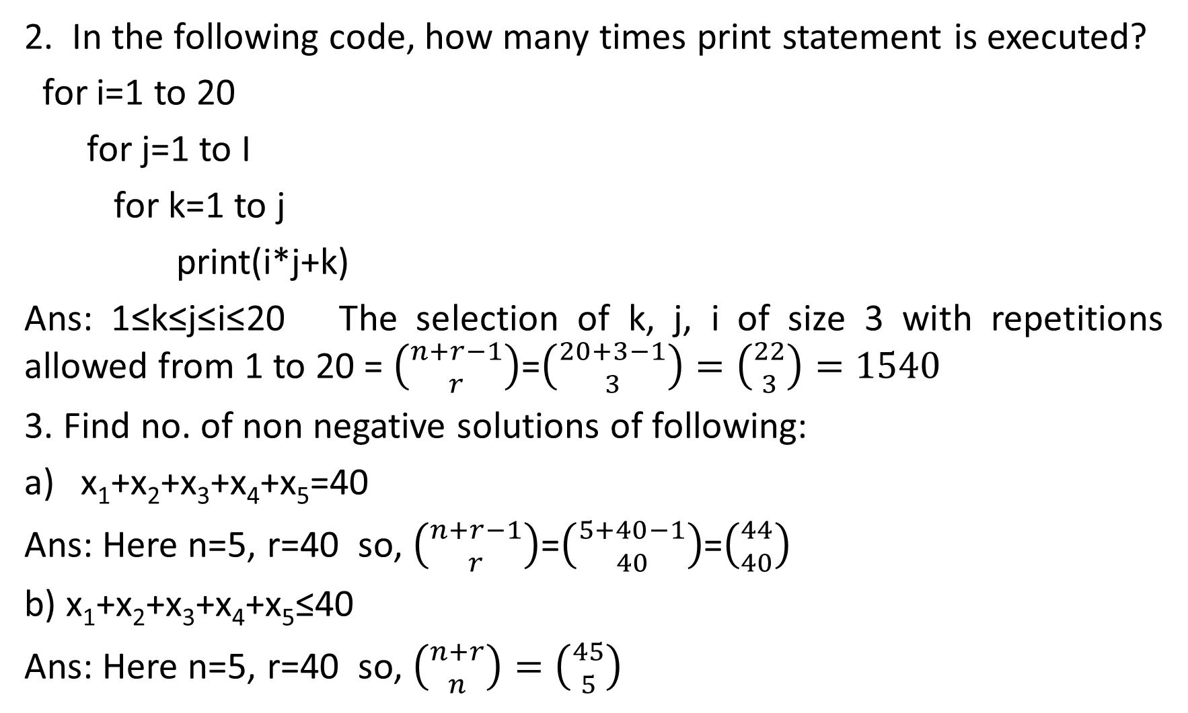
2. In the following code, how many times print statement is executed?
for i=1 to 20
for j=1 to I
for k=1 to j
print(i*j+k)
Ans: 1≤k≤j≤i≤20 The selection of k, j, i of size 3 with repetitions allowed from 1 to 20 = $\left({n+r−1 \atop r}\right)$=$\left({20+3−1 \atop 3}\right)=\left({22 \atop 3}\right)=1540$
3. Find no. of non negative solutions of following:
x₁+x₂+x₃+x₄+x₅=40
Ans: Here n=5, r=40 so,$\left({n+r−1 \atop r}\right)$=$\left({5+40−1 \atop 40}\right)$=$\left({44 \atop 40}\right)$
b)x₁+x₂+x₃+x₄+x₅≤40
Ans: Here n=5, r=40 so, $\left({n+r \atop n}\right)=\left({45 \atop 5}\right)$

Slide 19
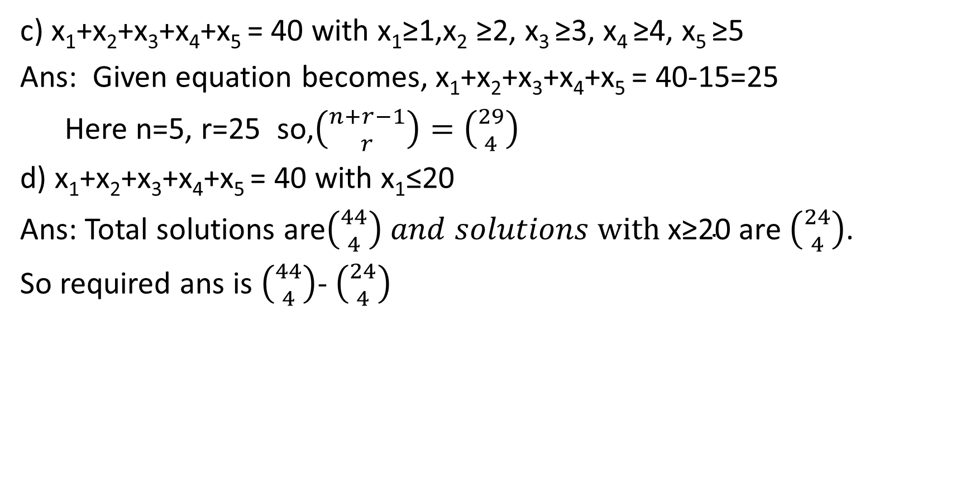
c) x₁+x₂+x₃+x₄+x₅ = 40 with x₁≥1,x₂ ≥2, x₃ ≥3, x₄ ≥4, x₅ ≥5
Ans: Given equation becomes, x₁+x₂+x₃+x₄+x₅ = 40-15=25
Here n=5, r=25 so,$\left({n+r−1 \atop r}\right)=\left({29 \atop 4}\right)$
d) x₁+x₂+x₃+x₄+x₅ = 40 with x₁≤20
Ans: Total solutions are$\left({44 \atop 4}\right) and solutions \text{with} \text{x}\text{≥20 }\text{are} \left({24 \atop 4}\right)$.
So required ans is $\left({44 \atop 4}\right)$- $\left({24 \atop 4}\right)$

Slide 20
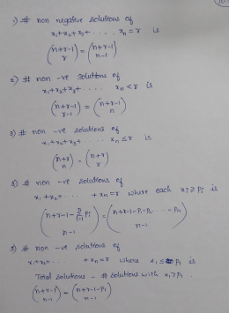
Summary

Slide 21
Exercises:
How many different ways can three people divide 7 pears and 5 apples? ( with repetition - Ans:36x21 = 756)
How many ways can we thread 4 red, 5 blue, and 6 yellow beads onto a thread? (Ans = (4+5+6)!/ (4!⋅ 5!⋅ 6!)​=630630)
The group of 10 girls should be divided into two groups with at least 4 girls in each group. How many ways can this be done? ( Ans: 462)
A florist has roses, tulips, daffodils, and carnations to use in flower arrangements. If she were to make an arrangement using 12 flowers, how many different combinations of these 4 types of flowers would be possible? (Ans: 455)

Slide 22
Recursive definition
A recursive definition, or inductive definition, is used to define the elements in a set in terms of other elements in the set.
Ex:
Fibonacci series: F_{n}=F_{n-1}+F_{n-2} with F₀=0, F₁=1 for all n ϵ Z⁺, n≥2
Lucas nos. : L_{n}=L_{n-1}+L_{n-2} with L₀=2, L₁=1 for all n ϵ Z⁺, n≥2
3. Prove that L_{n}= F_{n-1}+F_{n+1} for all n ϵ Z⁺, n≥2 using mathematical induction

Slide 23
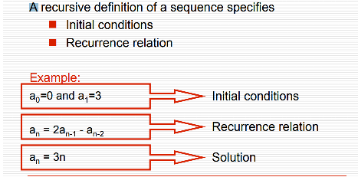
Recursive definition

Slide 24
Recurrence relation
A recurrence relation is an equation that recursively defines a sequence or multidimensional array of values, once one or more initial terms are given.
Linear - Each term of a sequence is a linear function of earlier terms in the sequence(Degree is one) Ex: a₀ = 1 a₁ = 6 a₂ = 10 a_{n} = a_{n-1} + 2a_{n-2} + 3a_{n-3}
General form of linear rr with constant coeffients:
c_{n}a_{n} + c_{n-1}a_{n-1} +c_{n-2} a_{n-2} +c_{n-3}a_{n-3….} =f(n)
Linear recurrences
Linear homogeneous recurrences
Linear non-homogeneous recurrences
Homogeneous - Right hand side is equal to zero i.e, f(n)=0
Non homogeneous –Right hand side is not equal to zero i.e, f(n)≠ 0
First order - each element is dependent only on one previous element.
Second order - each element is dependent on two previous elements.

Slide 25
Linear homogeneous recurrence relation
Linear homogeneous recurrences
A linear homogenous recurrence relation of degree k with constant coefficients is a recurrence relation of the form
a_{n} = c₁a_{n-1} + c₂a_{n-2} + … + c_{k}a_{n-k}, where c₁, c₂, …, c_{k} are real numbers, and c_{k} ≠ 0 an is expressed in terms of the previous k terms of the sequence, so its degree is k.
This recurrence includes k initial conditions. a₀ = C₀ a₁ = C₁ … a_{k} = C_{k}

Slide 26
Ex:
Determine if the following recurrence relations are linear homogeneous recurrence relations with constant coefficients.
P_{n} = (1.11)P_{n-1} - a linear homogeneous recurrence relation of degree 1
a_{n} = a_{n-1} + a²_{n-2} - not linear
f_{n} = f_{n-1} + f_{n-2} - a linear homogeneous recurrence relation of degree 2
H_{n} = 2H_{n-1}+1 - not homogeneous
a_{n} = a_{n-6} - a linear homogeneous recurrence relation of degree 6
B_{n} = nB_{n-1} - does not have constant coefficient

Slide 27
First order linear homogeneous recurrence relations
General form of first order linear homogeneous recurrence relations is a_{n+1} = d a_{n} , n≥0 where d is a constant.
General solution of first order linear homogeneous recurrence relations is a_{n+1} = d a_{n} , n≥0 , a₀=A is unique and is given by a_{n} = A d^{n}
General first order linear recurrence relation with constant coefficient has the form a_{n+1}+ca_{n}=f(n), n≥0 where c is a constant and f(n) is a function on the set N of non negative integers.
When f(n)=0 ∀n ∈N, the relation is called homogeneous; otherwise it is called non homogeneous.

Slide 28
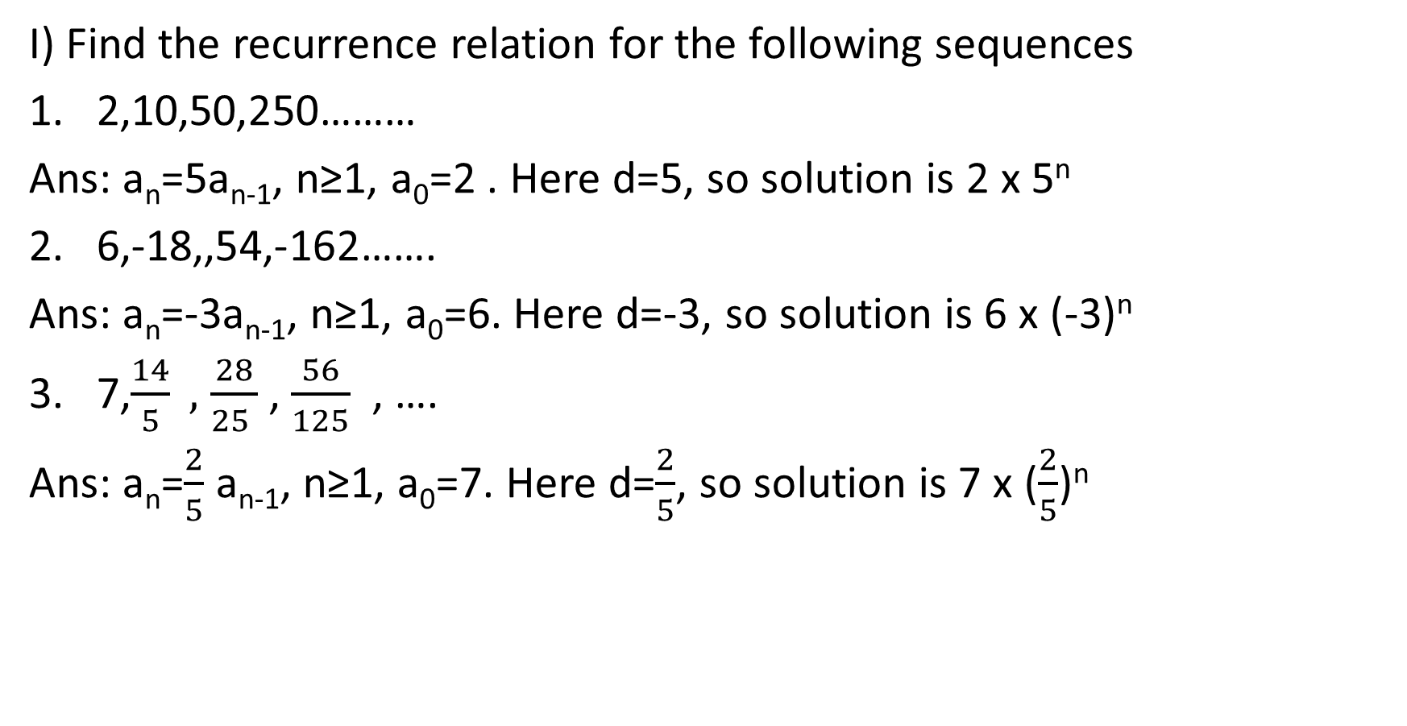
I) Find the recurrence relation for the following sequences
2,10,50,250………
Ans: a_{n}=5a_{n-1}, n≥1, a₀=2 . Here d=5, so solution is 2 x 5^{n}
2. 6,-18,,54,-162…….
Ans: a_{n}=-3a_{n-1}, n≥1, a₀=6. Here d=-3, so solution is 6 x (-3)^{n}
7,$\frac{14}{5} ,$ $\frac{28}{25 }$ , $\frac{56}{125}$ , ….
Ans: a_{n}=$\frac{2}{5}$ a_{n-1}, n≥1, a₀=7. Here d=$\frac{2}{5}$, so solution is 7 x ($\frac{2}{5}$)^{n}

Slide 29
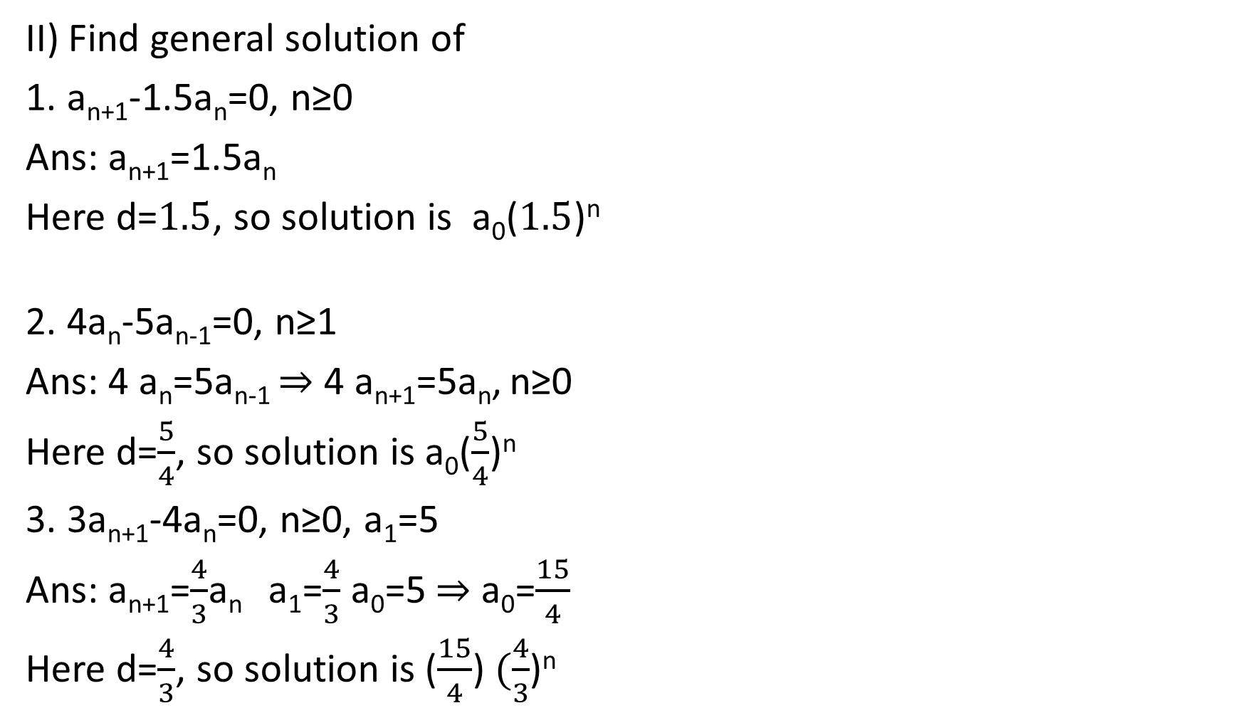
II) Find general solution of
1. a_{n+1}-1.5a_{n}=0, n≥0
Ans: a_{n+1}=1.5a_{n}
Here d=$1.5$, so solution is a₀($1.5$)^{n}
2. 4a_{n}-5a_{n-1}=0, n≥1
Ans: 4 a_{n}=5a_{n-1} ⇒ 4 a_{n+1}=5a_{n}, n≥0
Here d=$\frac{5}{4}$, so solution is a₀($\frac{5}{4}$)^{n}
3. 3a_{n+1}-4a_{n}=0, n≥0, a₁=5
Ans: a_{n+1}=$\frac{4}{3}$a_{n} a₁=$\frac{4}{3}$ a₀=5 ⇒ a₀=$\frac{15}{4}$
Here d=$\frac{4}{3}$, so solution is ($\frac{15}{4}$) $(\frac{4}{3}$)^{n}

Slide 30

4. 2a_{n}-3a_{n-1}=0, n≥1, a₄=81
Ans: a_{n}= $\frac{3}{2}$ a_{n-1,} n≥1 ⇒ a_{n+1}= $\frac{3}{2}$ a_{n,} n≥0
Here d=$\frac{3}{2}$, so solution is a_{n}= a₀$(\frac{3}{2}$)^{n}
If n=4 ⇒ a₄= a₀$(\frac{3}{2}$)⁴ = 81 ⇒ a₀ = 16
So ans is a_{n}= 1$6(\frac{3}{2}$)^{n} and sequence is 16,24,36,…….

Slide 31
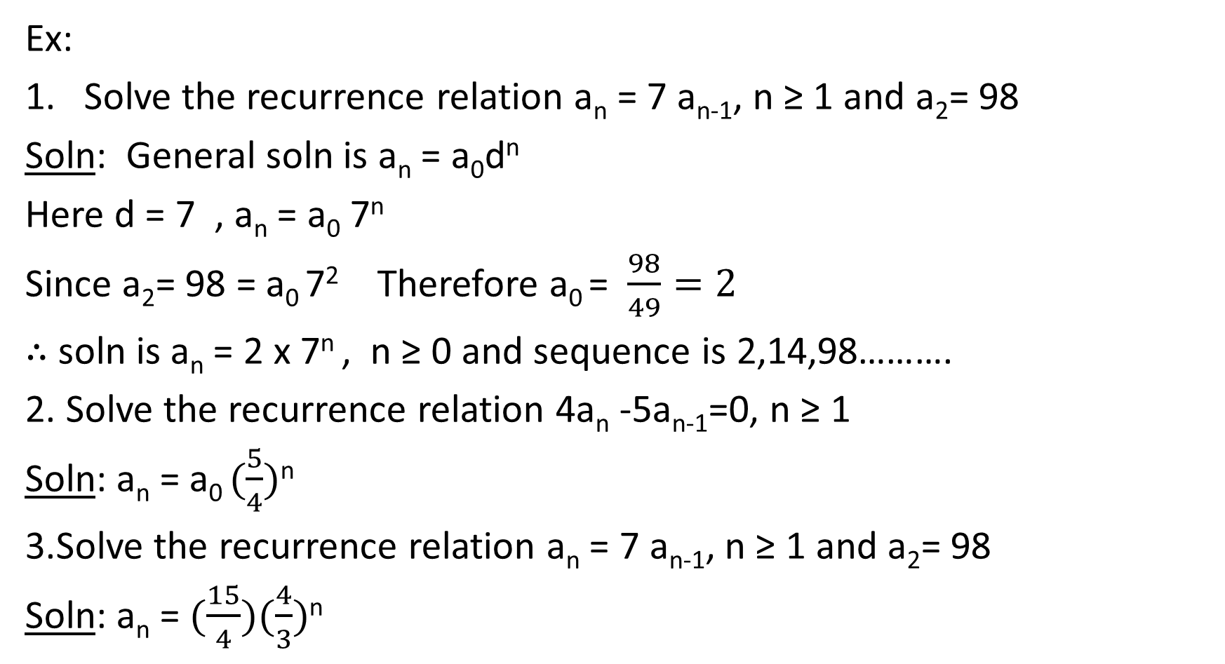
Ex:
Solve the recurrence relation a_{n} = 7 a_{n-1}, n ≥ 1 and a₂= 98
Soln: General soln is a_{n} = a₀d^{n}
Here d = 7 , a_{n} = a₀ 7^{n}
Since a₂= 98 = a₀ 7² Therefore a₀ = $\frac{98}{49}=2$
∴ soln is a_{n} = 2 x 7^{n} , n ≥ 0 and sequence is 2,14,98……….
2. Solve the recurrence relation 4a_{n} -5a_{n-1}=0, n ≥ 1
Soln: a_{n} = a₀ $(\frac{5}{4})$^{n}
3.Solve the recurrence relation a_{n} = 7 a_{n-1}, n ≥ 1 and a₂= 98
Soln: a_{n} = $(\frac{15}{4})(\frac{4}{3})$^{n}

Slide 32
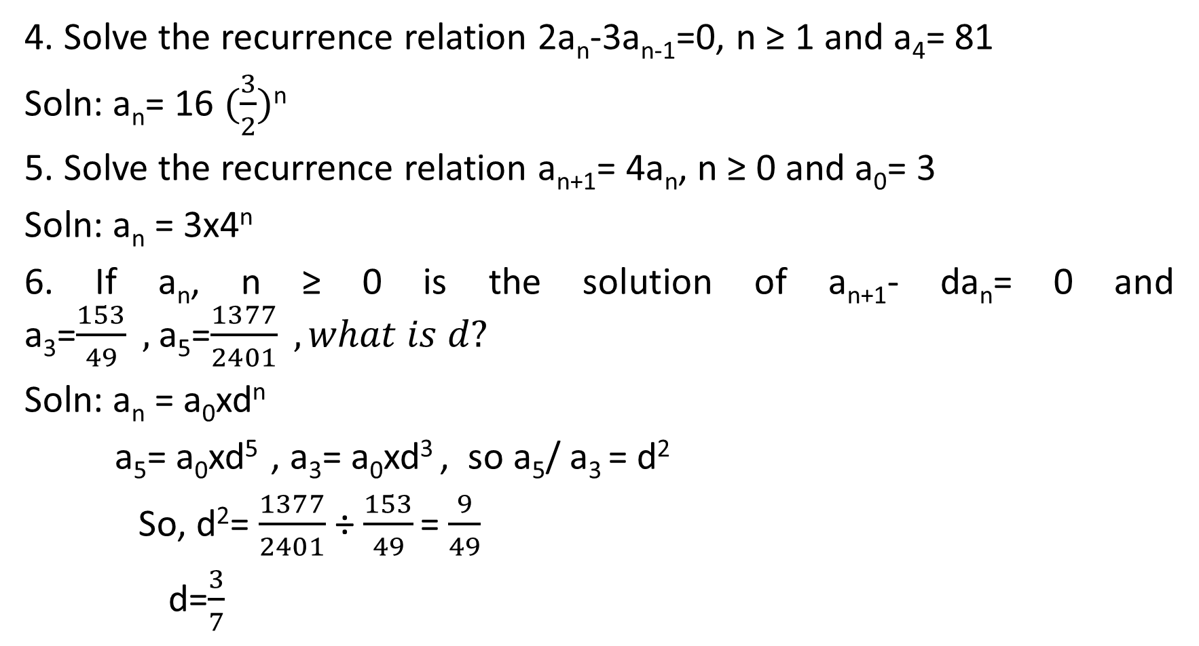
4. Solve the recurrence relation 2a_{n}-3a_{n-1}=0, n ≥ 1 and a₄= 81
Soln: a_{n}= 16 $(\frac{3}{2})$^{n}
5. Solve the recurrence relation a_{n+1}= 4a_{n}, n ≥ 0 and a₀= 3
Soln: a_{n} = 3x4^{n}
6. If a_{n}, n ≥ 0 is the solution of a_{n+1}- da_{n}= 0 and a₃=$\frac{153}{49} ,$a₅=$\frac{1377}{2401} , what is d?$
Soln: a_{n} = a₀xd^{n}
a₅= a₀xd⁵ , a₃= a₀xd³ , so a₅/ a₃ = d²
So, d²= $\frac{1377}{2401}$÷ $\frac{153}{49}$ = $\frac{9}{49}$
d=$\frac{3}{7}$

Slide 33
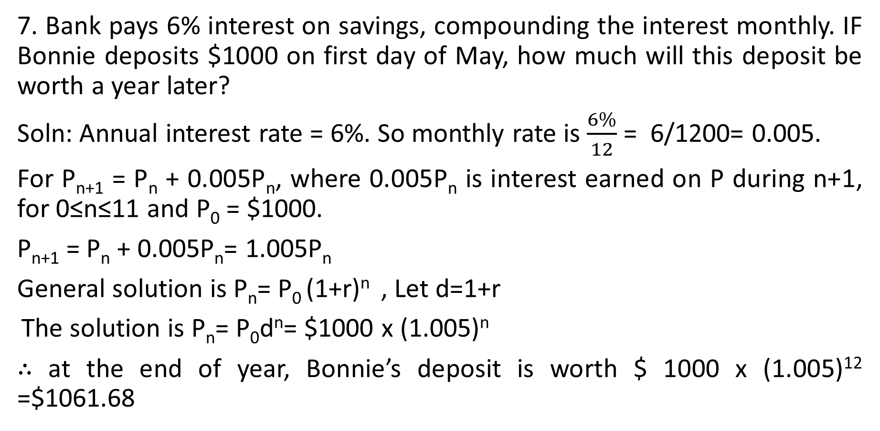
7. Bank pays 6% interest on savings, compounding the interest monthly. IF Bonnie deposits $1000 on first day of May, how much will this deposit be worth a year later?
Soln: Annual interest rate = 6%. So monthly rate is $\frac{6\%}{12}$ = 6/1200= 0.005.
For P_{n+1} = P_{n} + 0.005P_{n}, where 0.005P_{n} is interest earned on P during n+1, for 0≤n≤11 and P₀ = $1000.
P_{n+1} = P_{n} + 0.005P_{n}= 1.005P_{n}
General solution is P_{n}= P₀ (1+r)^{n} , Let d=1+r
The solution is P_{n}= P₀d^{n}= $1000 x (1.005)^{n}
∴ at the end of year, Bonnie’s deposit is worth $ 1000 x (1.005)¹² =$1061.68

Slide 34
8. The number of bacteria in a culture is 1000 and this number increases 250% every two hours. Use recurrence relation to determine number of bacteria present after one day.
Soln: a₁₂= (3.5)¹² x1000
9. If a person invests 10000 at 10% annual interest compounded quarterly, in how many months the money will become 15000?
Soln: Given, P₀=10000, r=10/4=0.025 per quarter, P_{n}=15000
RR is P_{n}=(1+r)^{n}P₀
15000 = 1.025^{n} x10000
1.025^{n} =15000/10000 = 1.5
n log(1.025) = log (1.5) So, n=log(1.5)/log(1.025) =16.4205025541 quarters = 16.4x3=49months approx.

Slide 35
10. 15 years ago, a person invested some amount at 14% annual interest compounded half yearly. Now the amount has become 91341. What was the amount he invested?
Soln: Given, r=14/200=0.07 per half yearly, P_{n}=91341, n=15x2=30, P₀=?
RR is P_{n}=(1+r)^{n}P₀
91341 = 1.07³⁰ xP₀
so, P₀= 91341/ 1.07³⁰= 12000

Slide 36
11. If a person invests 25000 at 9% annual interest, find amount he will get at end of 5 years in each case
Interest compounded annually - soln – 38465.6
Interest compounded half yearly – soln – 3882.4
Interest compounded quarterly – soln – 39012.75
Interest compounded monthly – soln – 39142
12. If Laura invests 100 at 6% interest compounded quarterly, how many months she wait for her money to get doubled?
Soln: 141 months

Slide 37
Second order linear homogeneous recurrence relations with constant coefficients
Definition: A second-order linear homogeneous recurrence relation with constant coefficients is a recurrence relation of the form
c_{n} a_{n}+ c_{n-1} a_{n-1}+c_{n-2} a_{n-2}=0, n≥0.
Solution is a_{n}=c x r^{n} c≠0,r≠0
Substituting a_{n}=c x r^{n} into above equation,
c_{n} c r^{n}+ c_{n-1} c r^{n-1}+c_{n-2} c r^{n-2}=0 with c≠0,r≠0
÷cr^{n-2} , c_{n} r²+ c_{n-1} r+c_{n-2} =0 , a quadratic equation which is called characteristic equation. The roots r₁, r₂ fall into 3 cases.
r₁, r₂ are distinct real
r₁, r₂ are complex
r₁, r₂ are real and equal

Slide 38
Case 1: r₁, r₂ are distinct real
Solve the recurrence relation a_{n} + a_{n-1} – 6a_{n-2} = 0, n ≥ 2, a₀= -1, a₁=8
Soln: characteristic equation is r²+r-6=0 ⇒ (r+3)(r-2)=0 ⇒ r=-3,2
∴ a_{n}= (-3)^{n} and a_{n}=2^{n} are both solutions.
∴ a_{n}= c₁x(-3)^{n}+c₂x(2^{n}) ---------(1) is general solution with a₀= -1, a₁=8
Substituting n=0 in (1) we get, -1=c₁+c₂
Substituting n=1 in (1) we get, 8=-3c₁+2c₂
Solving above two equations, we get c1=-2 and c2=1
∴ a_{n}= -2x(-3)^{n}+(2^{n}) is unique solution.

Slide 39
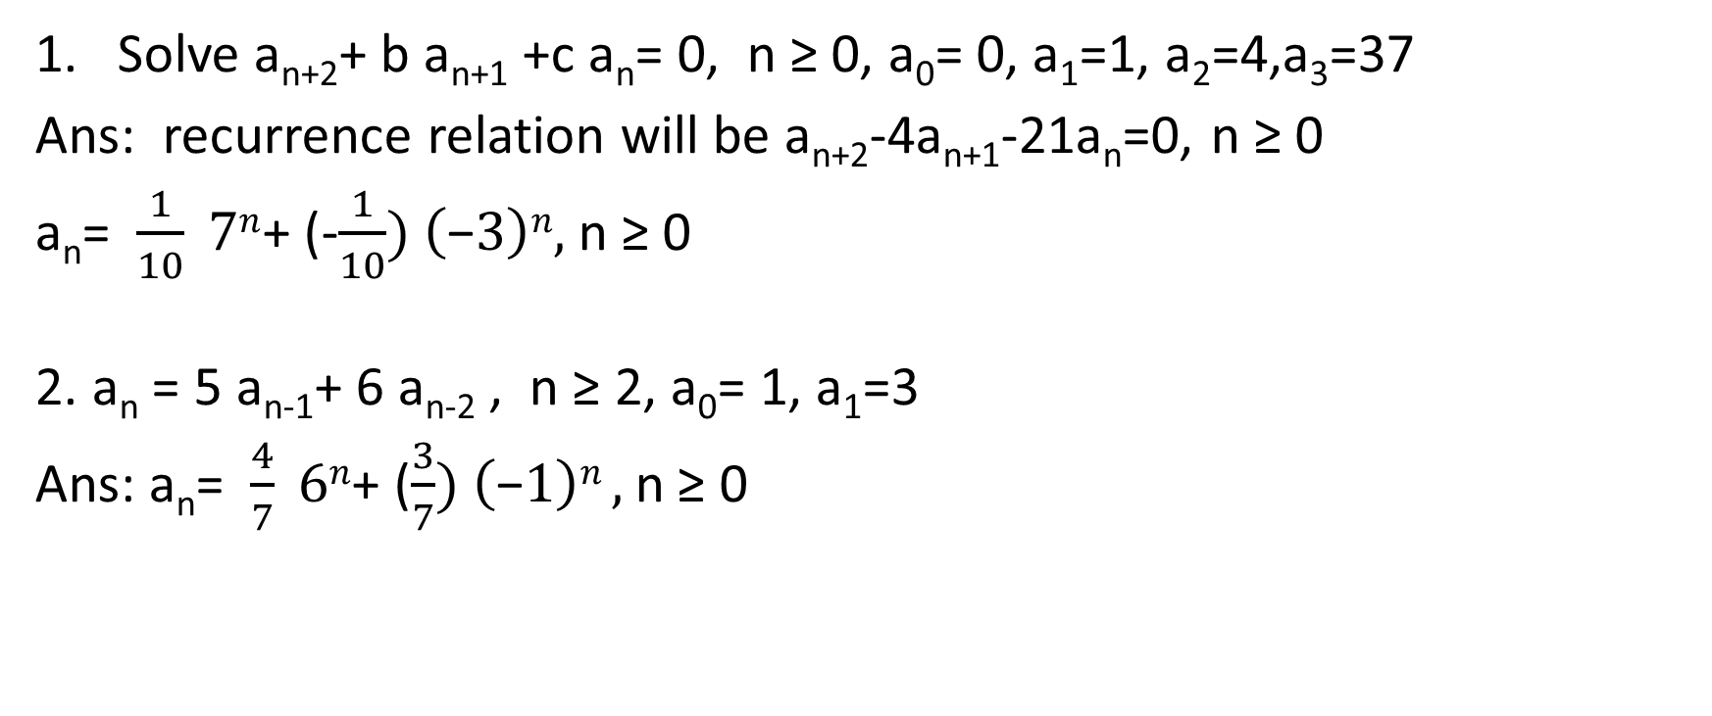
Exercises:
Solve a_{n+2}+ b a_{n+1} +c a_{n}= 0, n ≥ 0, a₀= 0, a₁=1, a₂=4,a₃=37
Ans: recurrence relation will be a_{n+2}-4a_{n+1}-21a_{n}=0, n ≥ 0
a_{n}= $\frac{1}{10} 7n$+ (-$\frac{1}{10}) \left(\text{−}3\right)n,$n ≥ 0
2. a_{n} = 5 a_{n-1}+ 6 a_{n-2} , n ≥ 2, a₀= 1, a₁=3
Ans: a_{n}= $\frac{4}{7} 6n$+ ($\frac{3}{7}) \left(\text{−}1\right)n ,$n ≥ 0

Slide 40
1.Find the recurrence relation for binary sequences of length n that have no consecutive 0’s.
Soln- n≥1, a_{n}-# of sequences of length n
a_{n}⁽⁰⁾ – count of those that end with 0
a_{n}⁽¹⁾ – count of those that end with 1
a₁=2 since sequence length is 1 and string could be either 0 or 1.
a₂=a₁ [0|1] that is a₁ concatenated with either 0 or 1.
If a₁ ends with 0, then only 1 to be concatenated
If a₁ ends with 1, then either 0 or 1 can be concatenated to get valid string.
∴ a_{n}= 2 a_{n-1}⁽¹⁾+ 1 a_{n-1}⁽⁰⁾
⇒a_{n-2} = a_{n-1}⁽¹⁾

Slide 41
a_{n} = a_{n-1}⁽¹⁾ + [ a_{n-1}⁽¹⁾ + a_{n-1}⁽⁰⁾] = a_{n-1} + a_{n-2}
∴ a_{n} =a_{n-1} + a_{n-2} , n≥3, a₁=2, a₂=3 is the recurrence relation.

Slide 42
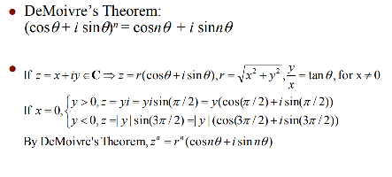
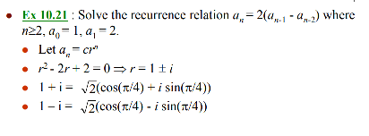
Case 2: r₁, r₂ are complex roots

Slide 43
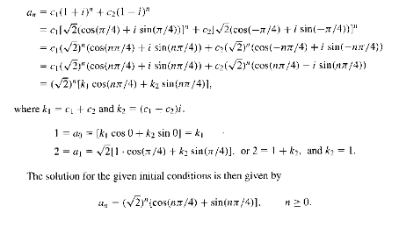

Slide 44
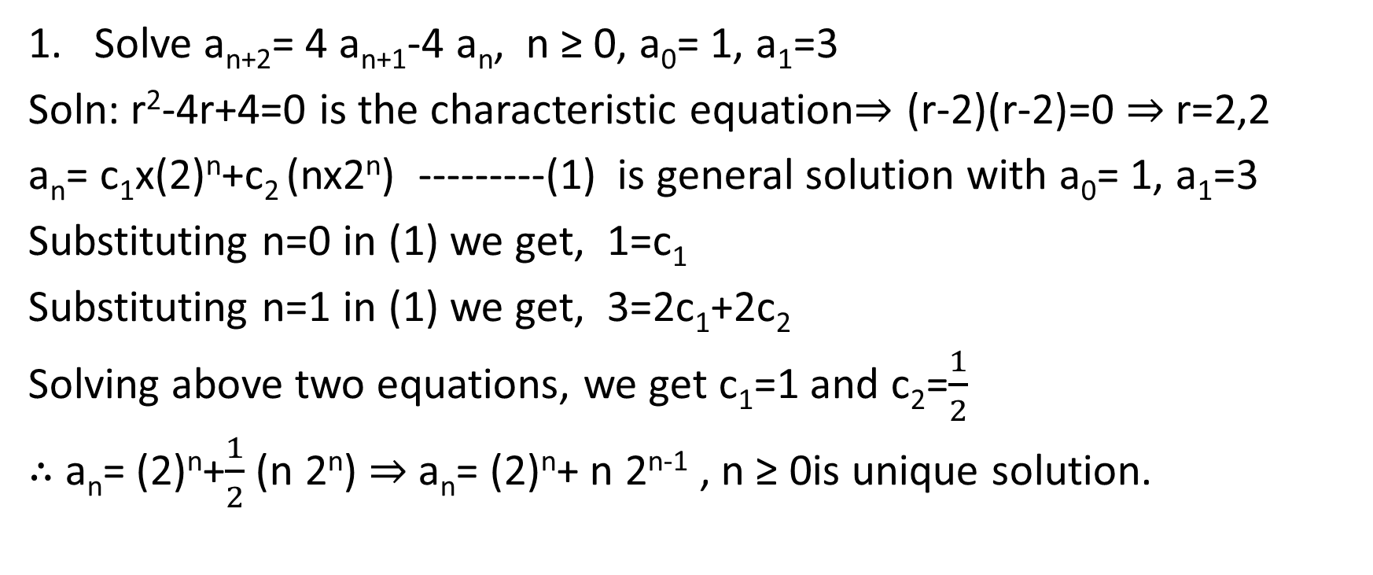
Case 3: r₁, r₂ are repeated real roots
Solve a_{n+2}= 4 a_{n+1}-4 a_{n}, n ≥ 0, a₀= 1, a₁=3
Soln: r²-4r+4=0 is the characteristic equation⇒ (r-2)(r-2)=0 ⇒ r=2,2
a_{n}= c₁x(2)^{n}+c₂ (nx2^{n}) ---------(1) is general solution with a₀= 1, a₁=3
Substituting n=0 in (1) we get, 1=c₁
Substituting n=1 in (1) we get, 3=2c₁+2c₂
Solving above two equations, we get c₁=1 and c₂=$\frac{1}{2}$
∴ a_{n}= (2)^{n}+$\frac{1}{2}$(n 2^{n}) ⇒ a_{n}= (2)^{n}+ n 2^{n-1} , n ≥ 0is unique solution.

Slide 45
First order linear non homogeneous recurrence relations
General form of first order linear non homogeneous recurrence relations is a_{n}+ c₁ a_{n-1} = f(n) , n≥1 where f(n)≠ 0.
We divide these into 2 types:
When c₁=-1
When c₁ ≠ -1

Slide 46
First order linear non homogeneous recurrence relations
When c₁=-1
Here a_{n} - a_{n-1} = f(n)
So, a_{n} - a_{n-1} = f(n)
a_{n-1} - a_{n-2} = f(n-1)
a_{n-2} - a_{n-3} = f(n-2)
……….
a₁-a₀=f(1)
∴ a_{n}-a₀ = f(n)+f(n-1)+…..f(1) = Σf(i) 1≤ i≤n

Slide 47
Examples:
Solve a_{n} - a_{n-1} = 3n² , n≥1, a₀=7
Soln: Here f(n)= 3n²
a_{n} - a_{n-1} = 3n²
a_{n-1} - a_{n-2} = 3(n-1)²
a_{n-2} - a_{n-3} = 3(n-2)²
……….
a₁-a₀= 3(1)²
∴ a_{n}-a₀ = 3n²+ 3(n-1)²+…. 3(1)² = 3Σi² 1≤ i≤n
a_{n} = a₀+3Σi²= 7 + 3(n)(n+1)(2n+1)/6 = 7+¹/₂ n(n+1)(2n+1), n≥0

Slide 48
Examples:
2. Solve a_{n+1} - a_{n} = 2n+3 , n≥0, a₀=1 ⇒ a_{n} – a_{n-1} =2(n-1)+3, n≥1
Soln: Here f(n)= 2(n-1)+3
a_{n} - a_{n-1} = 2(n-1)+3
a_{n-1} - a_{n-2} = 2(n-2)+3
……….
a₁-a₀= 2.0+3
∴ a_{n}-a₀ = 2Σi+3n 0≤ i≤n-1
a_{n} = a₀+2 (n-1)(n)/2 + 3n ,n≥0
a_{n} = 1+ n(n-1) + 3n = 1+n²-n+3n= n²+2n+1= (n+1)² ,n≥0

Slide 49
Examples:
3. Solve a_{n+1} - a_{n} = 3n²-n , n≥0, a₀=3 ⇒ a_{n} – a_{n-1} = 3(n-1)²-(n-1)
Soln: Here f(n)= 3(n-1)² –(n-1) Ans: 3+n(n-1)²
a_{n} - a_{n-1} = 3(n-1)² – (n-1)
a_{n-1} - a_{n-2} = 3(n-2)² – (n-2)
……….
a₁-a₀= 3(0)² – (0)
∴ a_{n}-a₀ = 3Σi²- Σi 0≤ i≤n-1
a_{n} = a₀+3Σi²- Σi = 3 + 3(n-1)(n)(2n-2+1)/6 – (n-1)(n)/2 =3+¹/₂n(n-1)[ 2n-1-1] = 3+¹/₂n(n-1)2(n-1) = 3+(n-1)², n≥0

Slide 50
First order linear non homogeneous recurrence relations
2. When c₁ ≠ -1
Method of Undetermined Coefficients
Here general solution is sum of homogeneous solution and particular solution.
Homogeneous solution is obtained by equating f(n) =0
Particular solution depends on the form of f(n). And there are two cases.
Case 1: If f(n) and homogenous solutions are independent(different form) and
Case 2: If f(n) and homogenous solutions are not independent(same form)

Slide 51
First order linear non homogeneous recurrence relations
2. When c₁ ≠ -1
Case 1: If f(n) and homogenous solutions are independent(different form)
Ex-1: Solve, a_{n}-3a_{n-1} = 5(7^{n}), n ≥1, a₀=2
Here it is first order non homogeneous, f(n)=5(7^{n})
General solution a_{n}=a_{n}^{(h)}+ a_{n}^{(p)} -------- ①
To find a_{n}^{(h)} :
a_{n}-3a_{n-1}=0
a_{n}^{(h)}= A(3^{n})
To find a_{n}^{(p)} :
Here f(n) and a_{n}^{(h)} are independent. So a_{n}^{(p)} is of the form B(7^{n})
Substituting a_{n}^{(p)} in given recurrence relation we get,
B(7^{n}) – 3B(7^{n-1})= 5(7^{n})
÷ 7^{n-1}, 7B-3B=5(7) ⇒B = ³⁵/₄ ∴ a_{n}^{(p)}= ³⁵/₄(7^{n})
Substituting values of a_{n}^{(h)} and a_{n}^{(p)} in ① we get,

Slide 52
First order linear non homogeneous recurrence relations
a_{n} = A(3^{n}) + ³⁵/₄(7^{n}) -------②
Substituting n=0 in ② we get,
A₀= A+ ⁵/₄ ⇒ 2= A+ ³⁵/₄ ⇒ A=2- ³⁵/₄ = ⁻²⁷/₄
∴ a_{n} = ⁻²⁷/₄(3^{n}) + ³⁵/₄(7^{n}) ⇒ a_{n} = ⁻¹/₄(3^{n+3}) + ⁵/₄(7^{n+1}), n≥0

Slide 53
First order linear non homogeneous recurrence relations
2. When c₁ ≠ -1
Case 1: If f(n) and homogenous solutions are independent(different form)
Ex-2: Write the Recurrence relation for Towers of Hanoi and solve it.
Soln: Recurrence relation is a_{n}= 2a_{n-1}+1 , n ≥1, a₀=0
Here it is first order non homogeneous, f(n)=1=(1^{n})
General solution a_{n}=a_{n}^{(h)}+ a_{n}^{(p)} -------- ①
To find a_{n}^{(h)} :
a_{n}-2a_{n-1}=0
a_{n}^{(h)}= A(2^{n})
To find a_{n}^{(p)} :
Here f(n) and a_{n}^{(h)} are independent. So a_{n}^{(p)} is of the form B(1^{n})
Substituting a_{n}^{(p)} in given recurrence relation we get,
B(1^{n}) – 2B(1^{n-1})= 1
⇒B =-1 ∴ a_{n}^{(p)}= -1(1^{n})
Substituting values of a_{n}^{(h)} and a_{n}^{(p)} in ① we get,

Slide 54
First order linear non homogeneous recurrence relations
a_{n} = A(2^{n}) + -1(1^{n}) -------②
Substituting n=0 in ② we get,
A₀= A-1⇒ 0= A-1 ⇒ A=1
∴ a_{n} = (2^{n}) -(1^{n}) ⇒ a_{n} = 2^{n}-1 , n≥0

Slide 55
First order linear non homogeneous recurrence relations
2. When c₁ ≠ -1
Case 1: If f(n) and homogenous solutions are independent(different form)
Ex-3: Solve, a_{n+1}-2a_{n} = 5 , n ≥0, a₀=1
Here it is first order non homogeneous, f(n)=5(1^{n})
General solution a_{n}=a_{n}^{(h)}+ a_{n}^{(p)} -------- ①
To find a_{n}^{(h)} :
a_{n+1}-2a_{n}=0
a_{n}^{(h)}= A(2^{n})
To find a_{n}^{(p)} :
Here f(n) and a_{n}^{(h)} are independent. So a_{n}^{(p)} is of the form B(1^{n})
Substituting a_{n}^{(p)} in given recurrence relation we get,
B(1^{n+1}) – 2B(1^{n})= 5(1^{n})
B-2B=5 ⇒B =- 5 ∴ a_{n}^{(p)}= -5(1^{n}) = -5
Substituting values of a_{n}^{(h)} and a_{n}^{(p)} in ① we get,

Slide 56
First order linear non homogeneous recurrence relations
a_{n} = A(2^{n}) -5 -------②
Substituting n=0 in ② we get,
A₀= A-5⇒ 1= A-5 ⇒ A=6
∴ a_{n} = 6(2^{n}) -5 ⇒ a_{n} = 3(2^{n+1})-5 , n≥0

Slide 57
First order linear non homogeneous recurrence relations
2. When c₁ ≠ -1
Case 2: If f(n) and homogenous solutions are not independent(same form)
Ex-1: Solve, a_{n}-3a_{n-1} = 5(3^{n}), n ≥1, a₀=2
Here it is first order non homogeneous, f(n)=5(3^{n})
General solution a_{n}=a_{n}^{(h)}+ a_{n}^{(p)} -------- ①
To find a_{n}^{(h)} :
a_{n}-3a_{n-1}=0
a_{n}^{(h)}= A(3^{n})
To find a_{n}^{(p)} :
Here f(n) and a_{n}^{(h)} are not independent. So a_{n}^{(p)} is of the form Bn(3^{n})
Substituting a_{n}^{(p)} in given recurrence relation we get,
Bn(3^{n}) – 3B(n-1)(3^{n-1})= 5(3^{n})
÷ 3^{n-1}, 3Bn-3Bn+3B=5(3) ⇒B = 5 ∴ a_{n}^{(p)}= 5n(3^{n})
Substituting values of a_{n}^{(h)} and a_{n}^{(p)} in ① we get,

Slide 58
First order linear non homogeneous recurrence relations
a_{n} = A(3^{n}) + 5n(3^{n}) -------②
Substituting n=0 in ② we get,
A₀= A+ 0⇒ 2= A ⇒ A=2
∴ a_{n} = 2(3^{n}) + 5n(3^{n}) ⇒ a_{n} = (2+5n) (3^{n}) , n≥0

Slide 59
First order linear non homogeneous recurrence relations
2. When c₁ ≠ -1
Case 2: If f(n) and homogenous solutions are not independent(same form)
Ex-2: Solve, a_{n+1}-2a_{n} = (2^{n}), n ≥0, a₀=1 ⇒ a_{n}-2a_{n-1} = (2^{n-1}), n ≥1
Here it is first order non homogeneous, f(n)=(2^{n-1})
General solution a_{n}=a_{n}^{(h)}+ a_{n}^{(p)} -------- ①
To find a_{n}^{(h)} :
a_{n}-2a_{n-1}=0
a_{n}^{(h)}= A(2^{n})
To find a_{n}^{(p)} :
Here f(n) and a_{n}^{(h)} are not independent. So a_{n}^{(p)} is of the form Bn(2^{n-1})
Substituting a_{n}^{(p)} in given recurrence relation we get,
Bn(2^{n-1}) – 2B(n-1)(2^{n-2})= (2^{n-1})
÷ 2^{n-2}, 2Bn-2Bn+2B = 2 ⇒B = 1 ∴ a_{n}^{(p)}= n(2^{n})
Substituting values of a_{n}^{(h)} and a_{n}^{(p)} in ① we get,

Slide 60
First order linear non homogeneous recurrence relations
a_{n} = A(2^{n}) + n(2^{n-1}) -------②
Substituting n=0 in ② we get,
A₀= A+ 0⇒ 1= A ⇒ A=1
∴ a_{n} = (2^{n}) + n(2^{n-1}) ⇒ a_{n} = 2^{n}+n(2^{n-1}), n≥0

