Slide 1


BCSE304L - Theory of Computation
Dr. R. Arumuga Arun,
Cabin : PRP 315(A&B)-19,
Mailid : arumugaarun.r@vit.ac.in.
Winter-Semester 2023-2024
SCOPE
1

Slide 2
Course Outcome
CO1 | Compare and analyse different computational models
CO2 | Apply rigorously formal mathematical methods to prove properties of languages, grammars and automata
CO3 | Identify limitations of some computational models and possible methods of proving them.
CO4 | Represent the abstract concepts mathematically with notations.
Winter-Semester 2023-2024
Dr. R. Arumuga Arun
SCOPE
1

Slide 3
Syllabus
Module:1 | Introduction to Languages and Grammars | 4 hours
Recall on Proof techniques in Mathematics - Overview of a Computational Models - Languages and Grammars - Alphabets - Strings - Operations on Languages, Overview on Automata
Module: 2 | Finite State Automata | 8 hours
Finite Automata (FA) - Deterministic Finite Automata (DFA) - Non-deterministic Finite Automata (NFA) - NFA with epsilon transitions – NFA without epsilon transition, conversion of NFA to DFA, Equivalence of NFA and DFA – minimization of DFA
Module: 3 | Regular Expressions and Languages | 7 hours
Regular Expression - FA and Regular Expressions: FA to regular expression and regular expression to FA - Pattern matching and regular expressions - Regular grammar and FA - Pumping lemma for regular languages - Closure properties of regular languages
2

Slide 4
Syllabus
Module:4 | Context Free Grammars | 7 hours
Context-Free Grammar (CFG) – Derivations - Parse Trees - Ambiguity in CFG - CYK algorithm – Simplification of CFG – Elimination of Useless symbols, Unit productions, Null productions - Normal forms for CFG: CNF and GNF - Pumping Lemma for CFL – Closure Properties of CFL
Module: 5 | Pushdown Automata | 5 hours
Definition of the Pushdown automata - Languages of a Pushdown automata – Power of Non-Deterministic Pushdown Automata and Deterministic pushdown automata
Module: 6 | Turing Machine | 6 hours
Turing Machines as acceptor and transducer - Multi head and Multi tape Turing Machines – Universal Turing Machine - The Halting problem - Turing-Church thesis
3

Slide 5
Syllabus
Module: 7 | Recursive and Recursively Enumerable Languages | 7 hours
Recursive and Recursively Enumerable Languages, Language that is not Recursively Enumerable (RE) – computable functions – Chomsky Hierarchy – Undecidable problems - Post’s Correspondence Problem
Text Book(s) | Text Book(s) | 7 hours
J.E. Hopcroft, R. Motwani and J.D. Ullman, “Introduction to Automata Theory, Languages and Computation”, Third Edition, Pearson Education, India 2008. ISBN: 978-8131720479
Reference Book(s) | Subsystems | 5 hours
Peter Linz, “An Introduction to Formal Languages and Automata”, Sixth Edition, Jones & Bartlett, 2016. ISBN: 978-9384323219 K. Krithivasan and R. Rama, “Introduction to Formal Languages, Automata and Computation”, Pearson Education, 2009. ISBN: 978-8131723562
3

Slide 6

Module I – Introduction to Languages and Grammars
Recall on Proof Techniques in Mathematics
5

Slide 7
Fundamental Proof Techniques
When one wishes to prove the statement P ⇒ Q there are four fundamental approaches.
This document models those four different approaches by proving the same proposition four times over using each fundamental method.
Direct Proof (Proof by Construction)
Proof by Contradiction
Proof by Induction
Proof by Contrapositive
6

Slide 8
Direct Proof (Proof by Construction)
In a constructive proof one attempts to demonstrate P ⇒ Q directly.
This is the simplest and easiest method of proof available to us. There are only two steps to a direct proof.
Assume that P is true.
Use P to show that Q must be true.
6

Slide 9
Direct Proof (Proof by Construction)
Example: If a and b are consecutive integers, then the sum a + b is odd.
Proof: Assume that a and b are consecutive integers. Because a and b are consecutive we know that b = a + 1.
Thus, the sum a + b may be re-written as 2a+1. Thus, there exists a number k such that a+b = 2k +1 so the sum a+b is odd.
6

Slide 10
Proof by Contradiction
The proof by contradiction is grounded in the fact that any proposition must be either true or false, but not both true and false at the same time.
We arrive at a contradiction when we can demonstrate that a statement is both simultaneously true and false, showing that our assumptions are inconsistent.
We can use this to demonstrate P ⇒ Q by assuming both P and ~Q are simultaneously true and deriving a contradiction.
6

Slide 11
Proof by Contradiction
CSI3001- Cloud Computing Methodologies
When we derive this contradiction it means that one of our assumptions was untenable.
Presumably we have either assumed or already proved P to be true so that finding a contradiction implies that ~Q must be false.
The method of proof by contradiction.
Assume that P is true.
Assume that ~Q is true.
Use P and ~Q to demonstrate a contradiction.
6

Slide 12
Proof by Contradiction
Example: Theorem 2: If a and b are consecutive integers, then the sum a + b is odd.
Proof: Assume that a and b are consecutive integers. Assume also that the sum a + b is not odd.
Because the sum a + b is not odd, there exists no number k such that a + b = 2k + 1.
However, the integers a and b are consecutive, so we may write the sum a + b as 2a + 1.
Thus, we have derived that a + b ≠ 2k + 1 for any integer k and also that a + b = 2a + 1. This is a contradiction.
6

Slide 13
Proof by Induction
Proof by induction uses recursion to demonstrate an infinite number of facts in a finite amount of space.
The most basic form of mathematical induction is where we first create a propositional form whose truth is determined by an integer function.
If we can show that the propositional form is true for some integer value then we may argue from that basis that the propositional form must be true for all integers.
6

Slide 14
Proof by Induction
Show that a propositional form P(x) is true for some basis case.
Assume that P(n) is true for some n, and show that this implies that P(n + 1) is true.
Then, by the principle of induction, the propositional form P(x) is true for all n greater or equal to the basis case.
6

Slide 15
Proof by Contradiction
Example: Theorem 2: If a and b are consecutive integers, then the sum a + b is odd.
Proof: Define the propositional form F(x) to be true when the sum of x and its successor is odd.
(Step 1) Consider the proposition F(1). The sum 1 + 2 = 3 is odd because we can demonstrate there exists an integer k such that 2k + 1 = 3.
Namely, 2(1) + 1 = 3. Thus, F(x) is true when x = 1.
(Step 2) Assume that F(x) is true for some x. Thus, for some x we have that x + (x + 1) is odd.
We add one to both x and x + 1 which gives the sum (x+1)+(x+2).
6

Slide 16
Proof by Contradiction
Example: Theorem 2: If a and b are consecutive integers, then the sum a + b is odd.
We claim (x+1)+(x+2) = 2x+3 = 2(x+1)+1 = F(x+1).
(Step 3) By the principle of mathematical induction we thus claim that F(x) is odd for all integers x.
Thus, the sum of any two consecutive numbers is odd.
6

Slide 17
Proof by Contrapositive
From first-order logic we know that the implication P ⇒ Q is equivalent to ~Q ⇒ ~P.
The second proposition is called the contrapositive of the first proposition.
By saying that the two propositions are equivalent we mean that if one can prove P ⇒ Q then they have also proved ~Q ⇒ ~P, and vice versa.
6

Slide 18
Proof by Contrapositive
Example: Theorem 2: If the sum a + b is not odd, then a and b are not consecutive integers.
Proof: Assume that the sum of the integers a and b is not odd. Then, there exists no integer k such that a + b = 2k + 1.
Thus, a + b ≠ k + (k + 1) for all integers k. Because k +1 is the successor of k, this implies that a and b cannot be consecutive integers.
6

Slide 19
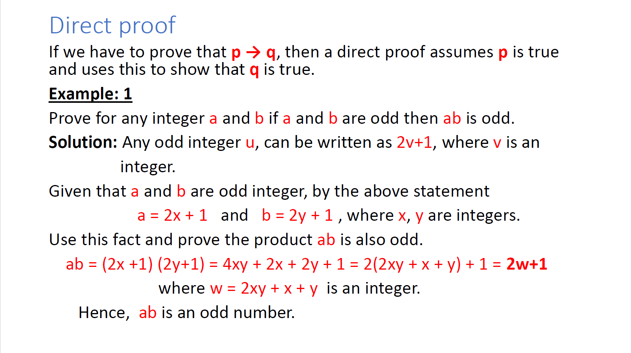
6

Slide 20
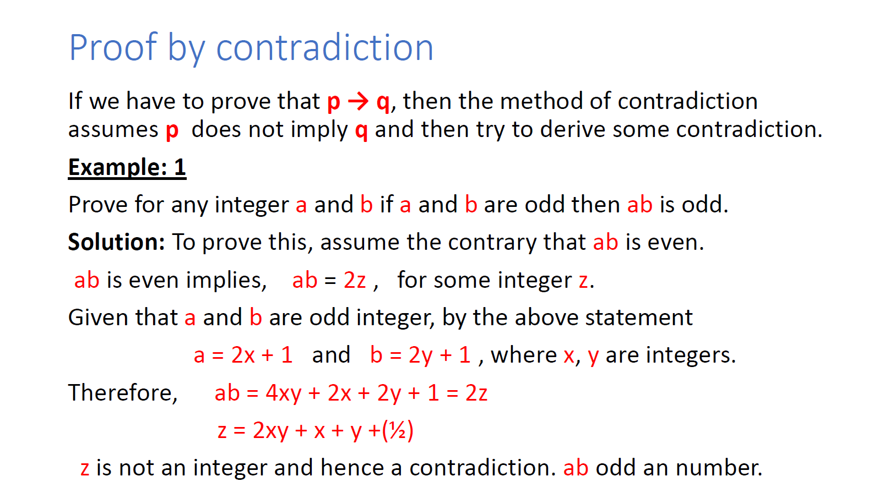
6

Slide 21
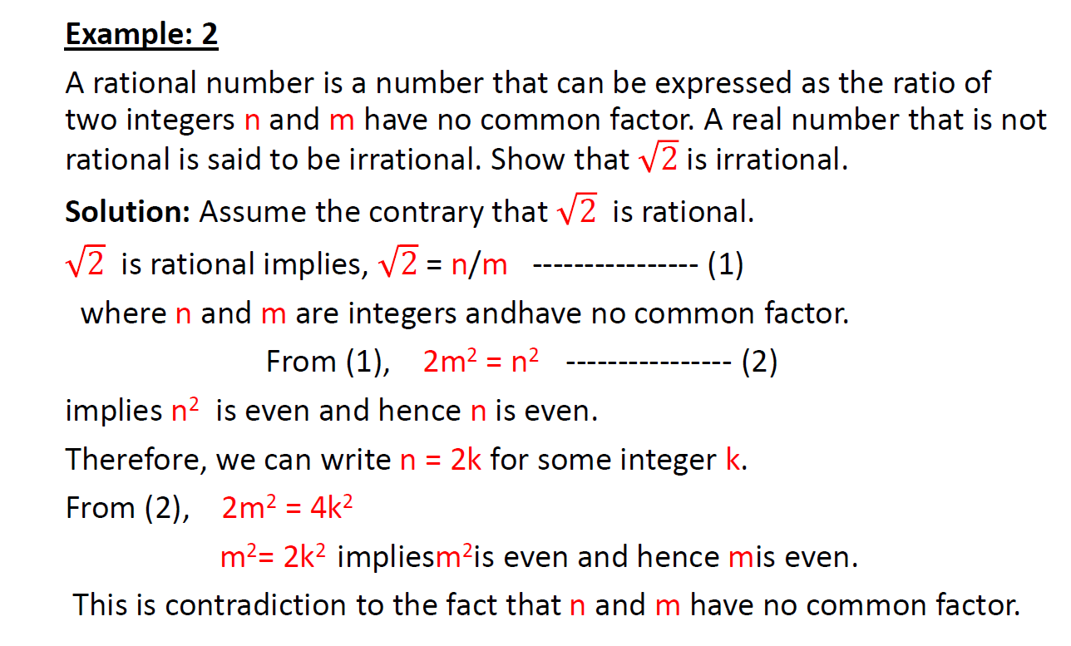
6

Slide 22
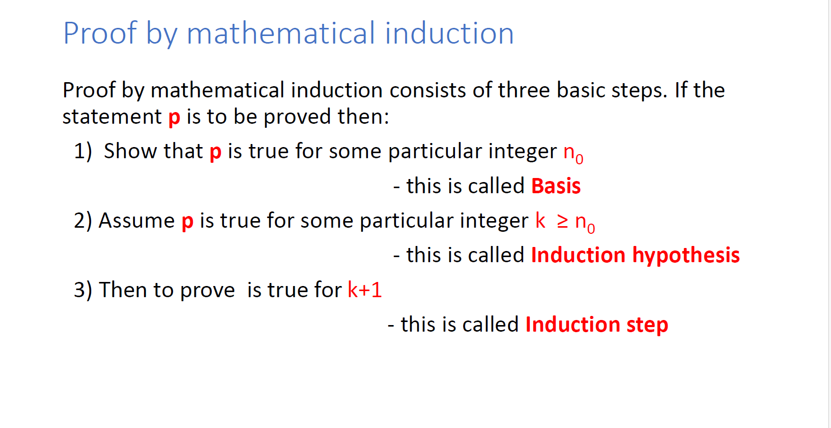
6

Slide 23
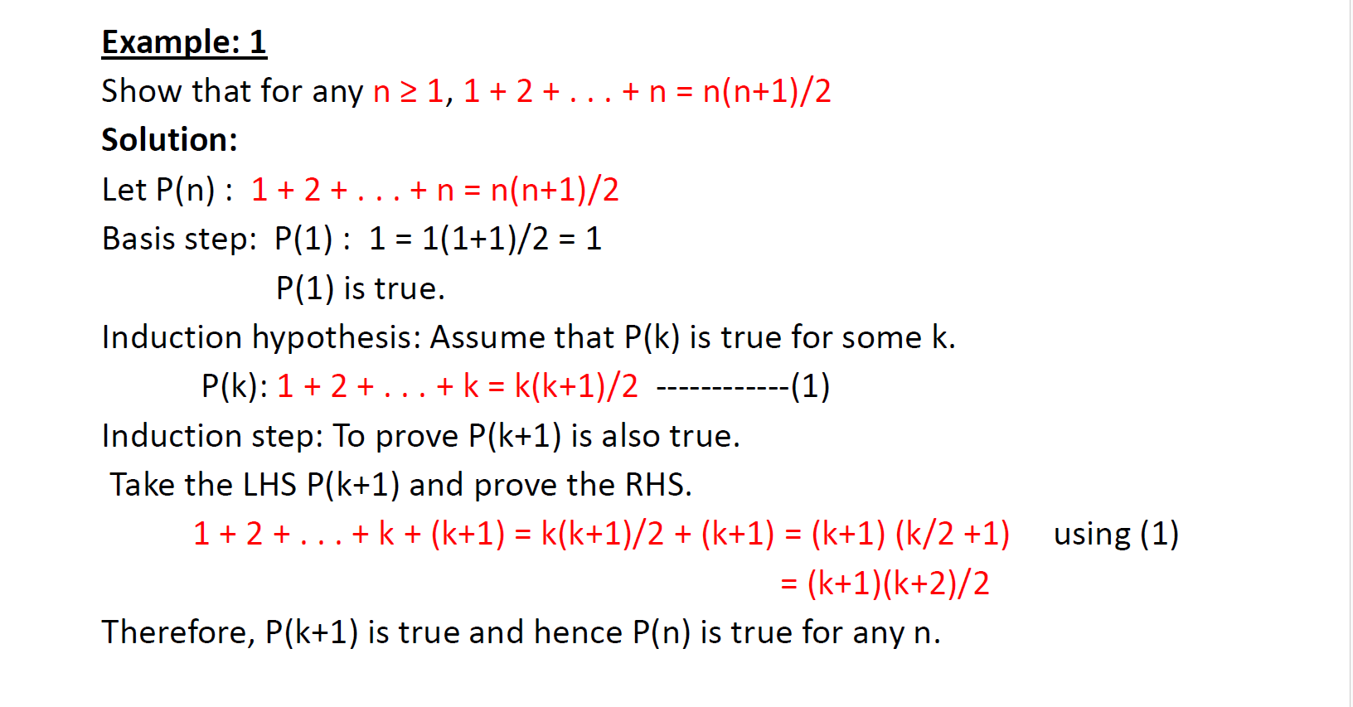
6

Slide 24
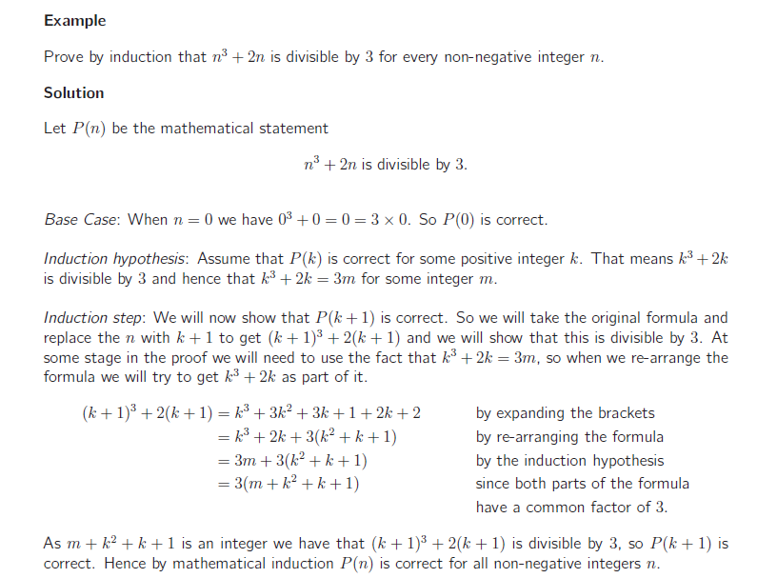
Proof by Induction
6

Slide 25
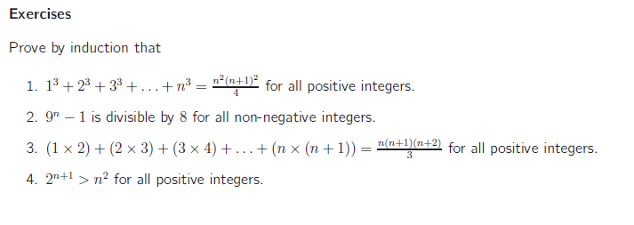
Proof by Induction
6

Slide 26
Thank you
51

