Slide 1


BCSE304L - Theory of Computation
Dr. R. Arumuga Arun,
Cabin : PRP 315(A&B)-19,
Mailid : arumugaarun.r@vit.ac.in.
Winter-Semester 2023-2024
SCOPE
1

Slide 2
Course Outcome
CO1 | Compare and analyse different computational models
CO2 | Apply rigorously formal mathematical methods to prove properties of languages, grammars and automata
CO3 | Identify limitations of some computational models and possible methods of proving them.
CO4 | Represent the abstract concepts mathematically with notations.
Winter-Semester 2023-2024
Dr. R. Arumuga Arun
SCOPE
1

Slide 3
Syllabus
Module:1 | Introduction to Languages and Grammars | 4 hours
Recall on Proof techniques in Mathematics - Overview of a Computational Models - Languages and Grammars - Alphabets - Strings - Operations on Languages, Overview on Automata
Module: 2 | Finite State Automata | 8 hours
Finite Automata (FA) - Deterministic Finite Automata (DFA) - Non-deterministic Finite Automata (NFA) - NFA with epsilon transitions – NFA without epsilon transition, conversion of NFA to DFA, Equivalence of NFA and DFA – minimization of DFA
Module: 3 | Regular Expressions and Languages | 7 hours
Regular Expression - FA and Regular Expressions: FA to regular expression and regular expression to FA - Pattern matching and regular expressions - Regular grammar and FA - Pumping lemma for regular languages - Closure properties of regular languages
2

Slide 4
Syllabus
Module:4 | Context Free Grammars | 7 hours
Context-Free Grammar (CFG) – Derivations - Parse Trees - Ambiguity in CFG - CYK algorithm – Simplification of CFG – Elimination of Useless symbols, Unit productions, Null productions - Normal forms for CFG: CNF and GNF - Pumping Lemma for CFL – Closure Properties of CFL
Module: 5 | Pushdown Automata | 5 hours
Definition of the Pushdown automata - Languages of a Pushdown automata – Power of Non-Deterministic Pushdown Automata and Deterministic pushdown automata
Module: 6 | Turing Machine | 6 hours
Turing Machines as acceptor and transducer - Multi head and Multi tape Turing Machines – Universal Turing Machine - The Halting problem - Turing-Church thesis
3

Slide 5
Syllabus
Module: 7 | Recursive and Recursively Enumerable Languages | 7 hours
Recursive and Recursively Enumerable Languages, Language that is not Recursively Enumerable (RE) – computable functions – Chomsky Hierarchy – Undecidable problems - Post’s Correspondence Problem
Text Book(s) | Text Book(s) | 7 hours
J.E. Hopcroft, R. Motwani and J.D. Ullman, “Introduction to Automata Theory, Languages and Computation”, Third Edition, Pearson Education, India 2008. ISBN: 978-8131720479
Reference Book(s) | Subsystems | 5 hours
Peter Linz, “An Introduction to Formal Languages and Automata”, Sixth Edition, Jones & Bartlett, 2016. ISBN: 978-9384323219 K. Krithivasan and R. Rama, “Introduction to Formal Languages, Automata and Computation”, Pearson Education, 2009. ISBN: 978-8131723562
3

Slide 6

Module I – Introduction to Languages and Grammars
Overview of a Computational Model
5

Slide 7
THEORY OF COMPUTING
Most fundamental course of Computer Science
The foundations and principles of computer science
Helps to develop formal mathematical models of computation that reflect real-world computers.
What is Theory?
A theory explains known facts.
It also allows the scientists to make predictions of what they should observe if a theory is true.
6

Slide 8
THEORY OF COMPUTING
What is computation?
Execution of algorithms.
Computation is simply a sequence of steps that can be performed by a computer.
The “size” of both Input and Output should be finite
The number of steps should also be finite.
6

Slide 9
THEORY OF COMPUTING
Its branches deals with how efficiently problems can be solved on a model of computation, using an algorithm
Branches:
Automata Theory
Computability Theory
Computational Complexity Theory
6

Slide 10
THEORY OF COMPUTING
Automata Theory
Deals with definition and properties of various mathematical models of computers. Ex: FA, CFG, Turing machine
Computability Theory
Deals with what can and cannot be completed by a model.
Computational Complexity Theory
Groups the computable problem based on the hardness
6

Slide 11
Applications
Traffic Lights
Lifts and elevators
Cryptography
Design and Analysis of Algorithm
Quantum Calculation
Logic within Computer Science
Randomness within Calculation
6

Slide 12
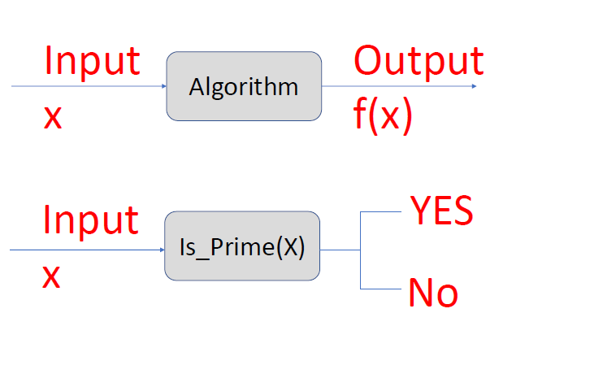
Overview of a computational model
6

Slide 13
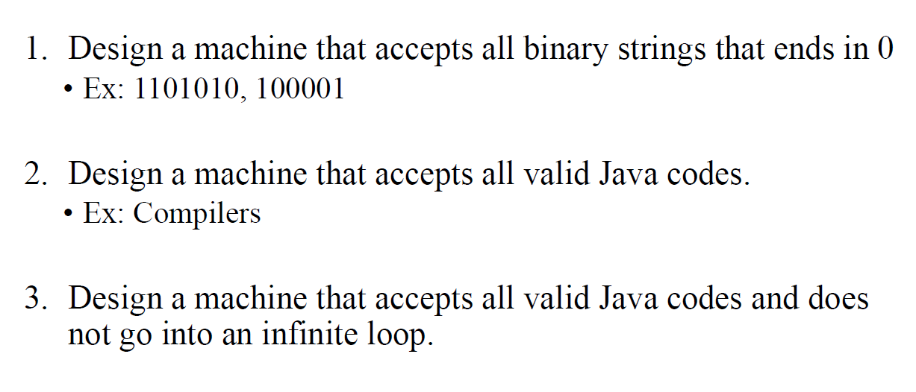
Example
6

Slide 14
Thank you
51

