Slide 1


BCSE304L - Theory of Computation
Dr. R. Arumuga Arun,
Cabin : PRP 315(A&B)-19,
Mailid : arumugaarun.r@vit.ac.in.
Winter-Semester 2023-2024
SCOPE
1

Slide 2
Course Outcomes
On completion of this course, student should be able to:
Compare and analyze different computational models
Apply rigorously formal mathematical methods to prove properties of languages, grammars and automata.
Identify limitations of some computational models and possible methods of proving them.
Represent the abstract concepts mathematically with notations.

Slide 3
Syllabus
Module: 1 Introduction to Languages and Grammars 4 hours
Recall on Proof techniques in Mathematics - Overview of a Computational Models - Languages and Grammars - Alphabets - Strings - Operations on Languages, Overview on Automata
Module: 2 Finite State Automata 8 hours
Finite Automata (FA) - Deterministic Finite Automata (DFA) - Non-deterministic Finite Automata (NFA) - NFA with epsilon transitions – NFA without epsilon transition, conversion of NFA to DFA, Equivalence of NFA and DFA – minimization of DFA
Module: 3 Regular Expressions and Languages 7 hours
Regular Expression - FA and Regular Expressions: FA to regular expression and regular expression to FA - Pattern matching and regular expressions - Regular grammar and FA - Pumping lemma for regular languages - Closure properties of regular languages
Module: 4 Context Free Grammars 7 hours
Context-Free Grammar (CFG) – Derivations - Parse Trees - Ambiguity in CFG - CYK algorithm – Simplification of CFG – Elimination of Useless symbols, Unit productions, Null productions - Normal forms for CFG: CNF and GNF - Pumping Lemma for CFL - Closure Properties of CFL

Slide 4
Cont..
Module: 5 Pushdown Automata 5 hours
Definition of the Pushdown automata - Languages of a Pushdown automata – Power of Non-Deterministic Pushdown Automata and Deterministic pushdown automata
Module: 6 Turing Machine 6 hours
Turing Machines as acceptor and transducer - Multi head and Multi tape Turing Machines – Universal Turing Machine - The Halting problem - Turing-Church thesis
Module: 7 Recursive and Recursively Enumerable Languages 6 hours
Recursive and Recursively Enumerable Languages, Language that is not Recursively Enumerable (RE) – computable functions – Chomsky Hierarchy – Undecidable problems - Post’s Correspondence Problem
Module: 8 Contemporary Issues 2 hours

Slide 5
Text Books & References
Text Book
J.E. Hopcroft, R. Motwani and J.D. Ullman, “Introduction to Automata Theory, Languages and Computation”, Third Edition, Pearson Education, India 2008. ISBN: 978-8131720479
Reference Books
Peter Linz, “An Introduction to Formal Languages and Automata”, Sixth Edition, Jones & Bartlett, 2016. ISBN: 978-9384323219
K. Krithivasan and R. Rama, “Introduction to Formal Languages, Automata and Computation”, Pearson Education, 2009. ISBN: 978-8131723562

Slide 6

Module I – Introduction to Languages and Grammars
Languages and Grammars - Alphabets - Strings - Operations on Languages
5

Slide 7
Automata Theory
Study of abstract computing machine as well as computational problems solved with them
Study of mathematical properties of automata
Ex: FA modeling of on/off switch
Need for Automata Theory
Essential for the study of the limits of computation
Pattern searching in websites
Designing and checking the behaviour of the digital circuits
Push
Start
off
on
Push

Slide 8
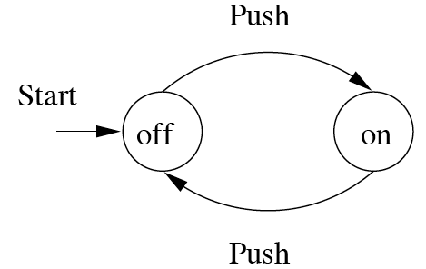
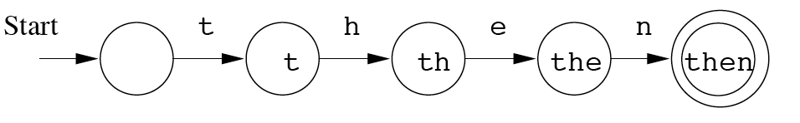
Finite Automata : Examples
action
On/Off switch
Modeling recognition of the word “then”
state
Start state
Transition
Intermediate state
Final state

Slide 9
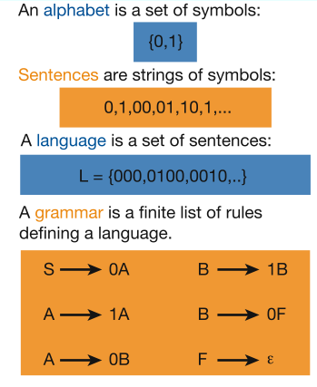
Languages & Grammars
Languages: “A language is a collection of sentences of finite length all constructed from a finite alphabet of symbols”
Grammars: “A grammar can be regarded as a device that enumerates the sentences of a language” - nothing more, nothing less
N. Chomsky, Information and Control, Vol 2, 1959
“words” or
Image source: Nowak et al. Nature, vol 417, 2002

Slide 10
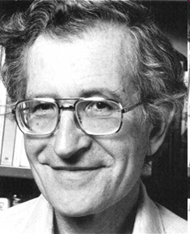
The Chomsky Hierachy
A containment hierarchy of classes of formal languages
Recursively- enumerable (TM)
Context- sensitive (LBA)
Context- free
(PDA)
Regular
(DFA)

Slide 11
Central Concepts of Automata Theory
Alphabets (Σ)
A finite, non-empty set of symbols
Ex:
Σ = {0, 1}, the binary alphabet
Σ = {a, b, … , z}, the set of all lower-case letter
The set of all ASCII characters

Slide 12
Central Concepts of Automata Theory – cont..
Strings
A string (or word) is a finite sequence of symbols chosen from some alphabet
Example
1011 is a string from alphabet S = {0, 1}
Empty string, ε → a string with zero occurrences of symbols
Length |w| of string w → the number of positions for symbols in w
Examples:|0111|= 4, |ε|=0, …

Slide 13
Central Concepts of Automata Theory – cont..
Power of an alphabet, Σ^{k}
A set of all strings of length k
Examples
Given Σ = {0, 1}, we have
Σ⁰ = {ε}, Σ² = {00, 01, 10, 11}
Set of all strings over Σ → denoted as Σ∗
Σ∗ = Σ⁰ ∪ Σ¹ ∪ Σ² ∪ …
Set of nonempty strings from Σ ◊ Σ⁺
Σ⁺ = Σ∗ − {ε}
Σ⁺ = Σ¹ ∪ Σ² ∪ Σ³ ∪ …
Σ∗ = Σ⁺ ∪{ε}
Concatenation of two strings x and y is xy
Example
If x = 01101, y = 110,
then xy = 01101110, and xx = x² = 0110101101, …
ε is the identity for concatenation
since εw = wε = w

Slide 14
Central Concepts of Automata Theory – cont..
Languages
A language is a set of strings all chosen from some Σ*
If Σ is an alphabet, and L⊆Σ*, then L is a language over Σ.
Examples
The set of all legal English words is a language ➔ {a, b, c, …., z}
The set of all strings of n 0’s followed by n 1’s for n≥ 0 ➔ {ε, 01, 0011, 000111, …}
The set of strings of equal no. of 0’s and 1’s ➔ {ε, 01, 10, 0011, 0101,…}
Σ* is an infinite language for any alphabet Σ
φ = the empty language (not the empty string ε) is a language over any alphabet
φ ≠ {ε}

Slide 15
Properties of languages
Concatenation
Substring
Reversal
Kleene Closure and Positive Closure

Slide 16
Concatenation of languages
The concatenation of two languages L₁ and L₂ is given by,
L = L₁ L₂ = {w∈ Σ∗ ; w = xy for some x ∈ L₁ and y ∈ L₂}
Concatenation of two strings w₁ and w₂ is defined as the sequence of symbols in w₁ followed by sequence of symbols in w₂
Let w₁= abcd and w₂ = fgh
Then
w₁w₂ = abcdfgh
w₂w₁ = fghabcd
The concatenation of string x for n times, where n ≥ 0, is denoted by x^{n}
x⁰ = ε
x¹ = x
x² = x x
x³ = x x x
…

Slide 17
Substring
Let x and y be strings over an alphabet Σ
The string x is a substring of y if there exist strings w and z over Σ such that y = w x z.
ε is a substring of every string.
For every string x, x is a substring of x itself.
Example
ε, comp and computation are substrings of computation.

Slide 18
Reversal
The reversal of a string is a string with same symbols in reverse order, denoted by w^{R}
Example
Let w = abcdfgh
Then
w^{R} = hgfdcba

Slide 19
Kleen Star
The Kleen star of a language L is denoted by L* which is the set of all strings obtained by concatenating zero or more strings from L
L* = {w∈ ∑* ; w = w₁…w_{k} for k>=0 and w₁, w₂, …, w_{k} ∈ L}
Let ∑ ={ a, b} i.e. ∑¹ ={ a, b}
∑² = ∑¹ . ∑¹ = { a, b}. { a, b} = {aa, ab, ba, bb}
∑³= ∑¹ . ∑¹ . ∑¹ = { a, b}. { a, b}. { a, b}
= {aa, ab, ba, bb}. { a, b}
= {aaa, aab, aba, abb, baa, bab, bba, bbb}
… etc
∑⁰ ={ε}
The Kleene closure of ∑, denoted by ∑* is defined as follows:
∑* = ∑⁰ U ∑¹ U ∑² U ∑³ …….. = {ε, a, b, aa, ab, ba, bb, aaa,….}
The Positive closure of Σ, denoted by ∑⁺ is defined as follows:
∑⁺ = ∑* - { ε }

Slide 20
Operations on Languages
Σ* denotes the set of all finite strings over Σ
A formal language L over the alphabet Σ is a subset of Σ*
That is L is a subset of Σ*
Let Σ = {0, 1} be the alphabet.
L = {ω∈Σ* | the number of 1’s in ω is even}.
{11,101,11110,10111,101101,1001011,….}

Slide 21
Operations on Languages
Complementation
Union
Intersection
Concatenation
Reversal
Closure

Slide 22
Complementation
Let L be a language over an alphabet Σ.
The complementation of L, denoted by ‾L ( or L’), is Σ*– L.
Example:
Let Σ = {0, 1} be the alphabet.
L = {ω∈Σ* | the number of 1’s in ω is even}.
L’ = {ω∈Σ* | the number of 1’s in ω is not even} [OR]
L’ = {ω∈Σ* | the number of 1’s in ω is odd}.

Slide 23
Union
Let L₁ and L₂ be languages over an alphabet Σ.
The union of L₁ and L₂, denoted by L₁∪L₂, is
L₁∪L₂ = {x | x is in L₁ or L₂}.
Example:
{ x∈ {0,1}* | x begins with 0 } ∪ {x∈{0,1}*|x ends with 0}
= {x ∈ {0,1}*| x begins or ends with 0}

Slide 24
Intersection
Let L₁ and L₂ be languages over an alphabet Σ.
The intersection of L₁ and L₂, denoted by L₁∩L₂, is
{ x | x is in L₁ and L₂}.
Example:
{ x∈{0,1}* | x begins with 0} ∩ { x∈{0,1}*| x ends with 0}
= { x∈{0,1}*| x begins and ends with 0}

Slide 25
Concatenation
Let L₁ and L₂ be languages over an alphabet Σ.
The concatenation of L₁ and L₂, denoted by L₁⋅L₂, is {w₁⋅w₂| w₁ is in L₁ and w₂ is in L₂}.
Example
L₁ = { x ∈ {0,1}*| x begins with 0} L₂ ={x ∈ {0,1}*| x ends with 0}
L₁⋅L₂ = { x ∈ {0,1}*| x begins and ends with 0 and length(x) ≥ 2}

Slide 26
Reversal
Let L be a language over an alphabet Σ.
The reversal of L, denoted by L^{R}, is {w^{R} | w is in L}.
Example
L = {x ∈ {0,1}*| x begins with 0}
L^{R} = {x ∈ {0,1}*| x ends with 0}

Slide 27

Kleene’s closure
Let L be a language over an alphabet Σ.
The Kleene’s closure of L, denoted by L*, is {x | for an integer n ≥ 0 x = x₁ x₂ … x_{n} and x₁, x₂ , …, x_{n} are in L}.
That is, L* = ∪_{i=0}∞L^{i}
Example: Let Σ = {0,1} and
L_{e} = {ω∈Σ* | the number of 1’s in ω is even}
L_{e}* = {ω∈Σ* | the number of 1’s in ω is even}
(‾L_{e})* = {ω∈Σ*| the number of 1’s in ω is odd}*
L* , the Kleene Closure of L: set of strings formed by taking any number of strings (possibly none) from L, possibly with repetitions and concatenating all of them
L* = {w∈ ∑* ; w = w₁…w_{k} for k>=0 and w₁, w₂, …, w_{k} ∈ L}

