Slide 1


BCSE304L - Theory of Computation
Dr. R. Arumuga Arun,
Cabin : PRP 315(A&B)-19,
Mailid : arumugaarun.r@vit.ac.in.
Winter-Semester 2023-2024
SCOPE
1

Slide 2

Module I – Introduction to Languages and Grammars
Languages and Grammars
5

Slide 3
Course Outcomes
On completion of this course, student should be able to:
Compare and analyze different computational models
Apply rigorously formal mathematical methods to prove properties of languages, grammars and automata.
Identify limitations of some computational models and possible methods of proving them.
Represent the abstract concepts mathematically with notations.

Slide 4
Syllabus
Module: 1 Introduction to Languages and Grammars 4 hours
Recall on Proof techniques in Mathematics - Overview of a Computational Models - Languages and Grammars - Alphabets - Strings - Operations on Languages, Overview on Automata
Module: 2 Finite State Automata 8 hours
Finite Automata (FA) - Deterministic Finite Automata (DFA) - Non-deterministic Finite Automata (NFA) - NFA with epsilon transitions – NFA without epsilon transition, conversion of NFA to DFA, Equivalence of NFA and DFA – minimization of DFA
Module: 3 Regular Expressions and Languages 7 hours
Regular Expression - FA and Regular Expressions: FA to regular expression and regular expression to FA - Pattern matching and regular expressions - Regular grammar and FA - Pumping lemma for regular languages - Closure properties of regular languages
Module: 4 Context Free Grammars 7 hours
Context-Free Grammar (CFG) – Derivations - Parse Trees - Ambiguity in CFG - CYK algorithm – Simplification of CFG – Elimination of Useless symbols, Unit productions, Null productions - Normal forms for CFG: CNF and GNF - Pumping Lemma for CFL - Closure Properties of CFL

Slide 5
Cont..
Module: 5 Pushdown Automata 5 hours
Definition of the Pushdown automata - Languages of a Pushdown automata – Power of Non-Deterministic Pushdown Automata and Deterministic pushdown automata
Module: 6 Turing Machine 6 hours
Turing Machines as acceptor and transducer - Multi head and Multi tape Turing Machines – Universal Turing Machine - The Halting problem - Turing-Church thesis
Module: 7 Recursive and Recursively Enumerable Languages 6 hours
Recursive and Recursively Enumerable Languages, Language that is not Recursively Enumerable (RE) – computable functions – Chomsky Hierarchy – Undecidable problems - Post’s Correspondence Problem
Module: 8 Contemporary Issues 2 hours

Slide 6
Text Books & References
Text Book
J.E. Hopcroft, R. Motwani and J.D. Ullman, “Introduction to Automata Theory, Languages and Computation”, Third Edition, Pearson Education, India 2008. ISBN: 978-8131720479
Reference Books
Peter Linz, “An Introduction to Formal Languages and Automata”, Sixth Edition, Jones & Bartlett, 2016. ISBN: 978-9384323219
K. Krithivasan and R. Rama, “Introduction to Formal Languages, Automata and Computation”, Pearson Education, 2009. ISBN: 978-8131723562

Slide 7
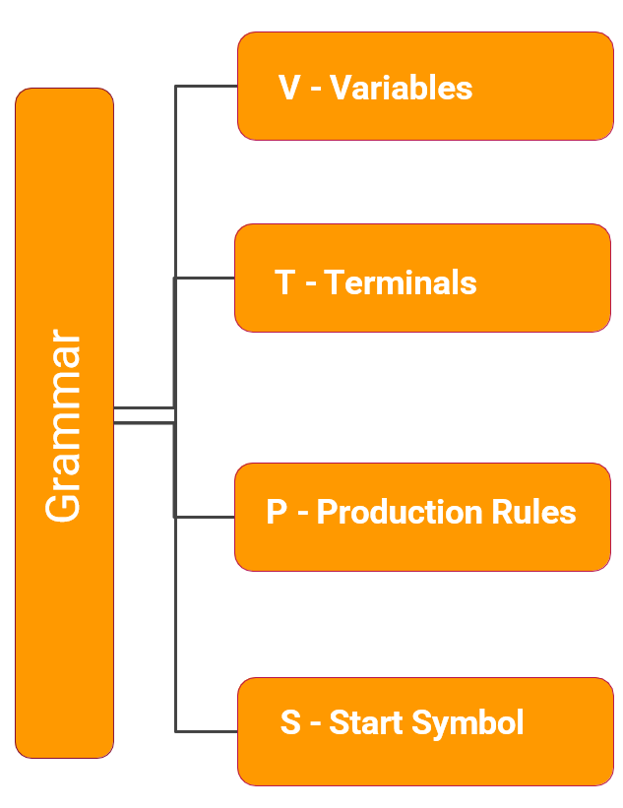
Central Concepts of Automata Theory – cont…
Grammar
A grammar of a language, G is defined as G = (V, T, S, P)
Where,
V or N➔ Finite set of objects called variables/ Non-terminals (Uppercase) (Usually represents a State)
T ➔ Finite set of objects called terminals (lower case) (symbols from ∑)
S∈V ➔ Start Symbol
P ➔ Finite set of productions (rules)
Ex: G = {(S, T), (a, b), S, P}
Note:

Slide 8
Grammar (Examples)
G = ({S, A}, {a, b}, P, S), where
P: S → aA
A → b
S
a
A
b
L(G) = { ab }

Slide 9
Grammar
G = ({S}, {a, b}, P, S), where
P: S → aS
S → b
S
S
S
S
a
a
S
b
a
S
S
a
S
a
S
b
a
S
b
L(G) = { b, ab, a²b, a³b,. . . }
b
L(G) = { a^{n}b / n ≥ 0 }

Slide 10
Problems Based on obtain Grammar Type 1

Slide 11
Grammars and Languages
P1) G= ({S}, {a}, P, S), where
P: S → aS (rule 1) S a
S → a (rule 2) S aS aa
S aS aaS aaa
L(G) = { a^{n} / n ≥ 1 }

Slide 12
Grammars and Languages
P2) G = ({S}, {a, b}, P, S), where
P: S → aS (rule 1) S b
S → b (rule 2) S aS ab
S aS aaS aab
L(G) = { a^{n}b/ n ≥ 0 }

Slide 13
Grammars and Languages
P3) Given a grammar, G = [{A, S}, {a, b}, S, P] where Production, P is given by S → a A, A → bA |ε. Obtain language L(G).
Soln:
S ==> a A
==> a b A
==> a b b A
==> ….
==> a b^{n} A
==> a b^{n}
L(G) = { a b^{n} | where n≥0} or
L(G) = { All strings with exactly one ‘a’ and ‘n’ b’s}

Slide 14
Grammars and Languages
P4) G= ({S}, {a, b }, P, S), where
P: S → aSb (rule 1) S ab
S → ab (rule 2) S aSb aabb
S aSb aaSbb aaabbb
L(G) = { a^{n}b^{n} / n ≥ 1 }

Slide 15
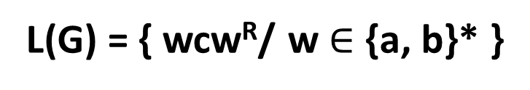
Grammars and Languages
P5) G= ({S}, {a, b, c }, P, S), where
P: S → aSa (rule 1) S c
S → bSb (rule 2) S aSa aca
S → c (rule 3) S bSb bcb
S aSa abSba abcba
S bSb baSab bacab
L(G) = { wcw^{R}/ w $∈$ {a, b}* }

Slide 16
Grammars and Languages
P6) G= ({S, B}, {a, b, c }, P, S), where
P: S → aSBc (rule 1) S abc
S → abc (rule 2) S aSBc aabcBc aabBcc aabbcc
cB → Bc (rule 3)
bB →bb (rule 4) S aSBc aaSBcBc aaabcBcBc
aaabBccB aaabBcBcc aaabBBccc
aaabbBccc aaabbbccc

Slide 17
Grammars and Languages
P6) G= ({S, B}, {a, b, c }, P, S), where
P: S → aSBc (rule 1) S abc
S → abc (rule 2) S aSBc aabcBc aabBcc aabbcc
cB → Bc (rule 3)
bB →bb (rule 4) S aSBc aaSBcBc aaabcBcBc
aaabBccB aaabBcBcc aaabBBccc
aaabbBccc aaabbbccc
L(G) = { a^{n}b^{n}C^{n}/ n ≥ 1 }

Slide 18
Grammars and Languages
P7) G= ({S, A, B}, {a, b}, P, S), where
P: S → AB (rule 1) S AB aAbB aaB aaε = aa
A → aAb (rule 2) S AB aAbB aAbbbB aAbbbεε
bB → bbbB (rule 3) aabb
aAb →aa (rule 4) S AB aAbB aAbbbB aAbbbεε
B →ε ε (rule 5) aaAbbbb
aaabbb

Slide 19
Grammars and Languages
P7) G= ({S, A, B}, {a, b}, P, S), where
P: S → AB (rule 1) S AB aAbB aaB aaε = aa
A → aAb (rule 2) S AB aAbB aAbbbB aAbbbεε
bB → bbbB (rule 3) aabb
aAb →aa (rule 4) S AB aAbB aAbbbB aAbbbεε
B →ε ε (rule 5) aaAbbbb
aaabbb
L(G) = { a^{n+1}b^{n+k}/ n ≥ 1, k = -1, 1, 3, 5, . . .}

Slide 20
Problems Based on checking the words of language Type 2

Slide 21
Examples : Grammars and Languages
Problem 1
Given Σ = {a, b} obtain Σ∗
Give an example of a finite language in Σ
Given L = {a^{n}b^{n} : n>=0}, check if strings aabb, abb are in language, L
Soln:
Σ∗ = {ε, a, b, ab, ba, ….}
{a, aa, aab} → Some example of a language in Σ
String: ‘aabb’
L = {ε, ab, aabb, aaabbb, …}
When n = 2, L = a² b² therefore, it is a string in L
String: ‘abb’
This is not a string in L. Since, there is no equal number of a’s and b’s

Slide 22
Problem 1
Examples : Grammars and Languages
Given u = a²ba³b²; v = ba. Find (i) uv (ii) uv² (iii)|uv|
Soln:
uv = (a²ba³b²).(ba) = a²ba³b³a
uv² = (a²ba³b²).(ba).(ba) = a²ba³b³aba
|uv| = |a²ba³b³a| = |aabaaabbba| = 10

Slide 23
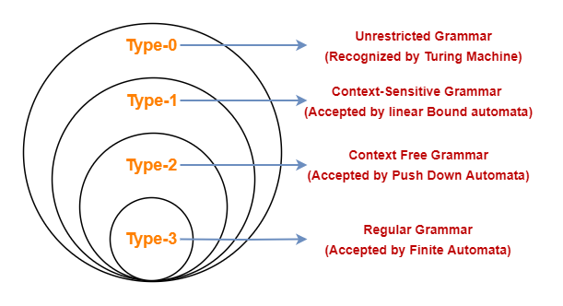
Chomsky Hierarchy

Slide 24
Chomsky Hierarchy
 | Language | Grammar | Machine
Type 3 | Regular languages | Regular grammars • Right-linear grammars • Left-linear grammars | Finite-state automata
Type 2 | Context-free languages | Context-free grammars | Push-down automata
Type 1 | Context-sensitive languages | Context-sensitive grammars | Linear-bound automata
Type 0 | Recursive languages Recursively enumerable languages | Unrestricted grammars | Turing machines

Slide 25
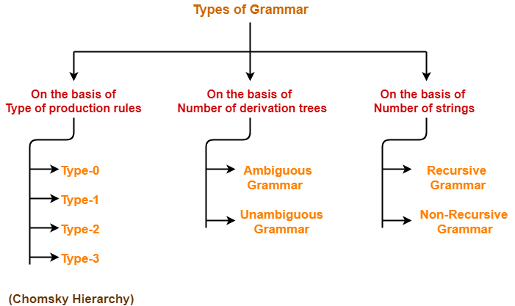
Classification of Grammer

