Slide 1


BCSE304L - Theory of Computation
Dr. R. Arumuga Arun,
Cabin : PRP 315(A&B)-19,
Mailid : arumugaarun.r@vit.ac.in.
Winter-Semester 2023-2024
SCOPE
1

Slide 2

Module I – Introduction to Languages and Grammars
Types of Grammars
5

Slide 3
Course Outcomes
On completion of this course, student should be able to:
Compare and analyze different computational models
Apply rigorously formal mathematical methods to prove properties of languages, grammars and automata.
Identify limitations of some computational models and possible methods of proving them.
Represent the abstract concepts mathematically with notations.

Slide 4
Syllabus
Module: 1 Introduction to Languages and Grammars 4 hours
Recall on Proof techniques in Mathematics - Overview of a Computational Models - Languages and Grammars - Alphabets - Strings - Operations on Languages, Overview on Automata
Module: 2 Finite State Automata 8 hours
Finite Automata (FA) - Deterministic Finite Automata (DFA) - Non-deterministic Finite Automata (NFA) - NFA with epsilon transitions – NFA without epsilon transition, conversion of NFA to DFA, Equivalence of NFA and DFA – minimization of DFA
Module: 3 Regular Expressions and Languages 7 hours
Regular Expression - FA and Regular Expressions: FA to regular expression and regular expression to FA - Pattern matching and regular expressions - Regular grammar and FA - Pumping lemma for regular languages - Closure properties of regular languages
Module: 4 Context Free Grammars 7 hours
Context-Free Grammar (CFG) – Derivations - Parse Trees - Ambiguity in CFG - CYK algorithm – Simplification of CFG – Elimination of Useless symbols, Unit productions, Null productions - Normal forms for CFG: CNF and GNF - Pumping Lemma for CFL - Closure Properties of CFL

Slide 5
Cont..
Module: 5 Pushdown Automata 5 hours
Definition of the Pushdown automata - Languages of a Pushdown automata – Power of Non-Deterministic Pushdown Automata and Deterministic pushdown automata
Module: 6 Turing Machine 6 hours
Turing Machines as acceptor and transducer - Multi head and Multi tape Turing Machines – Universal Turing Machine - The Halting problem - Turing-Church thesis
Module: 7 Recursive and Recursively Enumerable Languages 6 hours
Recursive and Recursively Enumerable Languages, Language that is not Recursively Enumerable (RE) – computable functions – Chomsky Hierarchy – Undecidable problems - Post’s Correspondence Problem
Module: 8 Contemporary Issues 2 hours

Slide 6
Text Books & References
Text Book
J.E. Hopcroft, R. Motwani and J.D. Ullman, “Introduction to Automata Theory, Languages and Computation”, Third Edition, Pearson Education, India 2008. ISBN: 978-8131720479
Reference Books
Peter Linz, “An Introduction to Formal Languages and Automata”, Sixth Edition, Jones & Bartlett, 2016. ISBN: 978-9384323219
K. Krithivasan and R. Rama, “Introduction to Formal Languages, Automata and Computation”, Pearson Education, 2009. ISBN: 978-8131723562

Slide 7
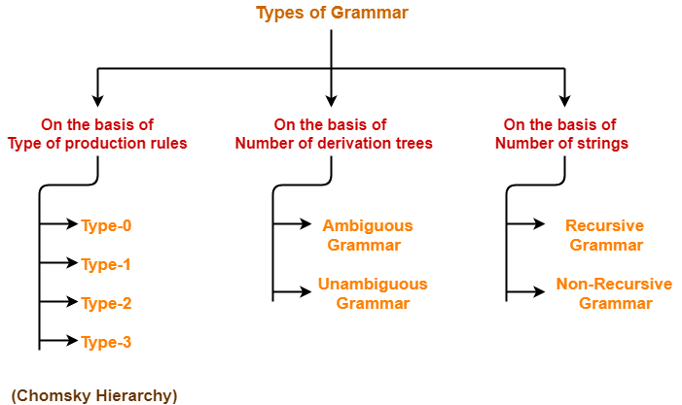
Classification of Grammer

Slide 8
Production Rule - Basis
Type 3: Regular languages
Type 2: Context-free languages
Type 1: Context-sensitive languages
Type 0: Recursively enumerable languages

Slide 9
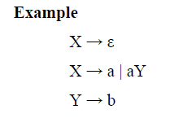


Type 3: Regular languages
Type-3 grammars generate Regular Languages. It must have a single non-terminal on the left-hand side and a right-hand side consisting of a single terminal or single terminal followed by a single non-terminal.
These languages generated by these grammars are be recognized by Finite Automaton (FA)
The productions must be in the form,
The rule S → ε is allowed if S does not appear on the right side of any rule. S is the start symbol.

Slide 10

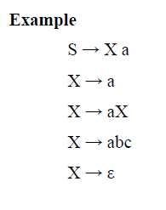


Type 2: Context-free languages
Type-2 grammars generate context-free languages. The productions must be in the form,
These languages generated by these grammars are be recognized by a Non-deterministic Pushdown automaton.

Slide 11
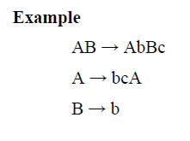
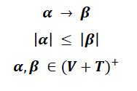
Type 1: Context-sensitive languages
Type-1 grammars generate context-sensitive languages. The productions must be in the form
The rule S → ε is allowed if S does not appear on the right side of any rule. S is the start symbol.
The languages generated by these grammars are recognized by a linear bounded automaton.

Slide 12
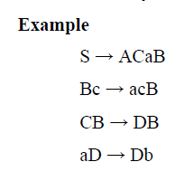
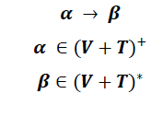
Type 0: Recursively enumerable languages
Type-0 grammars generate recursively enumerable languages. The productions have no restrictions.
They are any phase structure grammar including all formal grammars. They generate the languages that are recognized by a Turing machine.
The productions can be in the form of,
α is a string of terminals and non-terminals with at least one non-terminal and α cannot be null. β is a string of terminals and non-terminals.

Slide 13
Chomsky Hierarchy
 | Language | Grammar | Machine
Type 3 | Regular languages | Regular grammars • Right-linear grammars • Left-linear grammars | Finite-state automata
Type 2 | Context-free languages | Context-free grammars | Push-down automata
Type 1 | Context-sensitive languages | Context-sensitive grammars | Linear-bound automata
Type 0 | Recursive languages Recursively enumerable languages | Unrestricted grammars | Turing machines

Slide 14
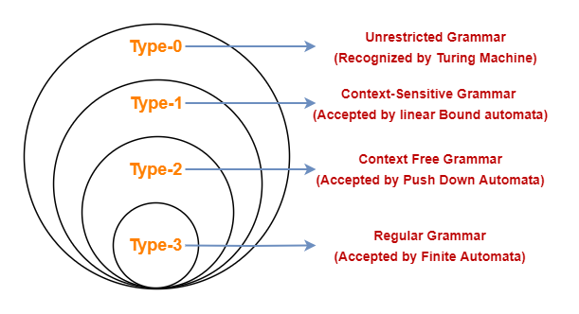
Chomsky Hierarchy

Slide 15
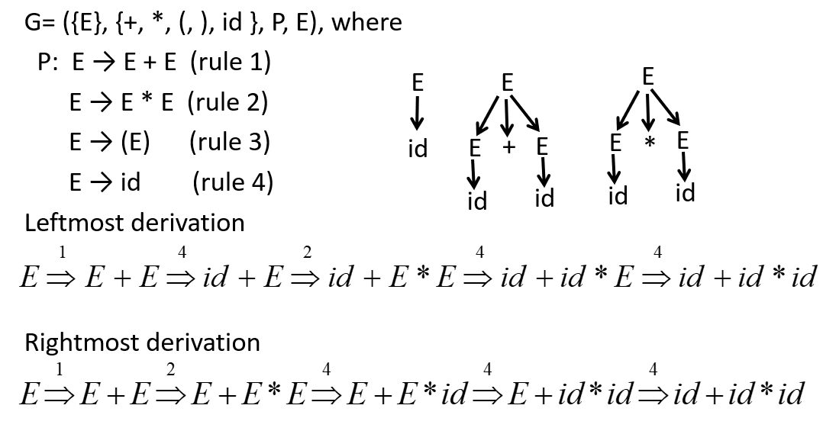
Leftmost Vs Rightmost Derivations

Slide 16
Number of Derivation Trees- Basis
Ambiguous Grammer
Unambiguous Grammer

Slide 17
Ambiguous Grammer
It generates more than one- parse tree ( syntax tree or derivation tree)
In this type of grammar, the leftmost and rightmost derivations represent different parse trees.
Example:
S → S + S |S x S |id

Slide 18
Unambiguous Grammer
It generates exactly one- parse tree (derivation tree or syntax tree)
In this type of grammar, leftmost and rightmost derivations represent the same parse tree.
Example:
S → S + E / E
E → E x F / F
F → id

Slide 19
Number of Strings Basis
Recursive Grammer
Non-recursive Grammer

Slide 20
Recursive Grammer
If the grammar can generate an infinite number of strings then the grammar is said to be Recursive grammar.
Example:
S->SaS
S->b
The strings generated by the above grammar is:{b, bab, babab,…}, which is infinite.

Slide 21
Non-Recursive Grammer
If the grammar can generate a finite number of strings then the grammar is said to be Non-Recursive grammar.
Example:
S->Aa
A->b|c
The language generated by the above grammar is :{ba, ca}, which is finite.

