Slide 1


BCSE304L - Theory of Computation
Dr. R. Arumuga Arun,
Cabin : PRP 315(A&B)-19,
Mailid : arumugaarun.r@vit.ac.in.
Winter-Semester 2023-2024
SCOPE
1

Slide 2

Module 2 – Finite State Automata
Finite Automata (FA) - Deterministic Finite Automata (DFA) - Non-deterministic Finite Automata (NFA) - NFA with epsilon transitions – NFA without epsilon transition, conversion of NFA to DFA, Equivalence of NFA and DFA – minimization of DFA
Topic : Finite Automata (FA)
5

Slide 3
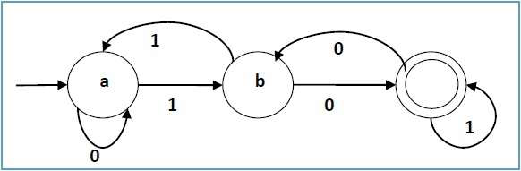
Finite State Automata (FA)
An automaton is an abstract model of a digital computer.
• Mathematical model of a system with discrete inputs and outputs

Slide 4
Working Principle of FA
Inputs are written on a tape, read by automaton but cannot change it
Input tape is divided into cells, each of which can hold one symbol
Finite control, i.e., finite number of states, and
A string is placed on the tape, read head is positioned at the left end.
FA will read the string one symbol at a time until all symbols have been read.
The FA will then either accept or reject the string.
0 | 1 | 1 | 0 | 0
Finite
Control

Slide 5
FSA Applications
Lexical analysis (Compiler) recognition of tokens
Thermostats (fridge)
Elevators
Train Track Switches
Text editing
Image compression
Computer Network

Slide 6
Representation Finite State Automata (FA)
A finite automaton is a 5-tuple M = (Q, Σ, δ, q₀, F), where
Q - is a finite set of states
Σ - is a finite set of input symbols
S or q₀ ∈ Q - is the start state (initial state)
F ⊆ Q - is the set of accept states (final states)
δ : Q × Σ → Q - is the transition function

Slide 7
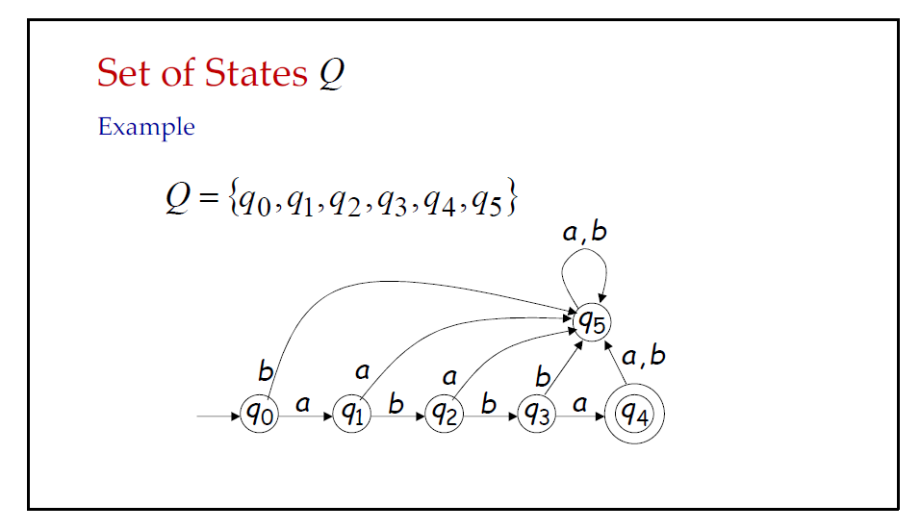
Representation Finite State Automata (FA)

Slide 8
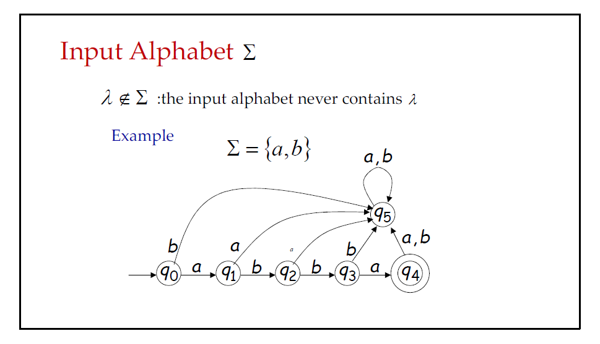
Representation Finite State Automata (FA)

Slide 9
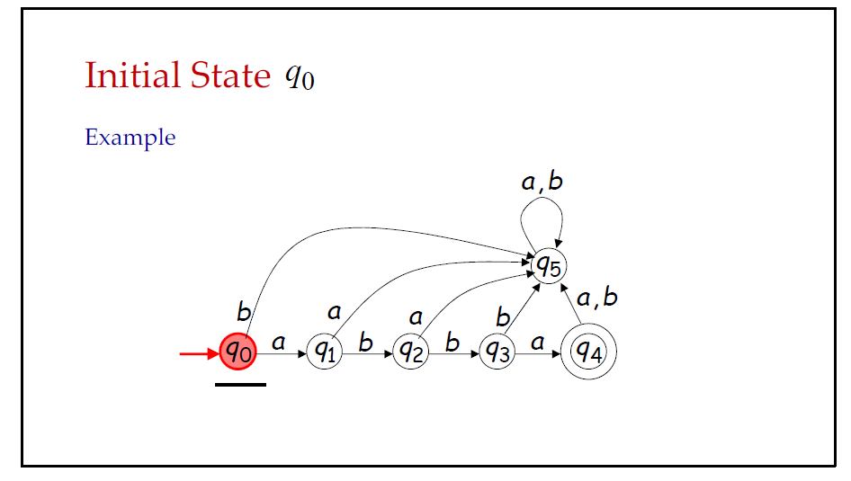
Representation Finite State Automata (FA)

Slide 10
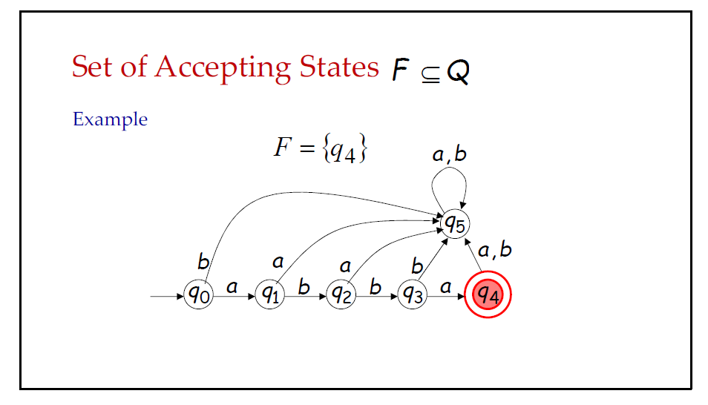
Representation Finite State Automata (FA)

Slide 11
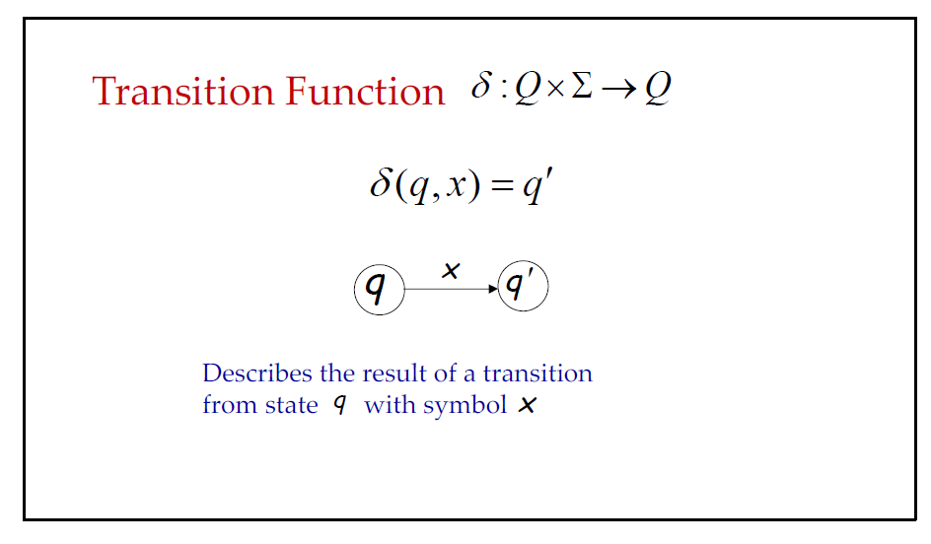
Representation Finite State Automata (FA)

Slide 12
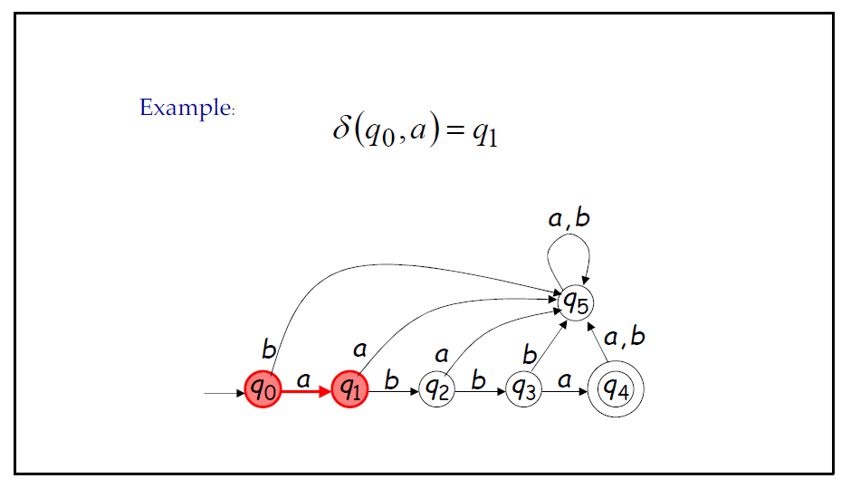
Representation Finite State Automata (FA)

Slide 13
f : A → B
A
B
x₁
f(x₁) = y₁
x₂
f(x₂) = y₂
x₃
f(x₃) = y₃
.
.
.
x
f(x) = y

Slide 14
Q = {q₀ , q₁ } , Σ = { a, b}
n(Q) = 2 , n(Σ) = 2
A x B = { (x, y) / x ∈ A , y ∈ B } - Cartesian Product of A and B
n(A x B) = n(A) . n(B)
Q x Σ = { (q₀, a), (q₀, b), (q₁, a), (q₁, b) }
n(Q x Σ) = n(Q). n(Σ) = 2 . 2 = 4
δ : Q × Σ → Q

Slide 15
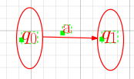
δ : Q × Σ → Q
δ(q₀, a ) = q₁
Q × Σ
Q
(q₀, a)
δ(q₀, a ) = q₁
(q₀, b)
δ(q₁, b ) = q₀
(q₁, a)
(q₁, b)

Slide 16
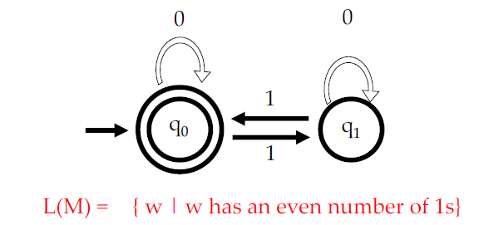
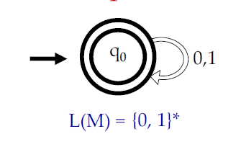
Transition Diagram
A directed graph associated with the vertices of the graph corresponds to the states of Finite Automata.
If there is a transition from state A to state B on input symbol ‘0’, then there is an arc with label ‘0’ is drawn from state A to state B
FA accepts a string, ‘x’, if the sequence of transitions corresponding to the symbols of ‘x’ leads from the start state to an accepting state.
Example

Slide 17
Examples
M = ( {q₀ , q₁ , q₂ , D } , {a, b} , q₀ , δ , {q₂} ) a b
where δ(q₀ , a) = q₁ δ(q₀ , b) = D q₀
δ(q₁ , a) = q₁ δ(q₁ , b) = q₂ q₁
δ(q₂ , a) = D δ(q₂ , b) = q₂ q₂
δ(D , a) = D δ(D , b) = D D
q₁ | D
q₁ | q₂
D | q₂
D | D
a
Transition Table or State Table
q₀
a
b
b
q₁
q₂
Transition diagram or State diagram
b
a
D
a , b

Slide 18
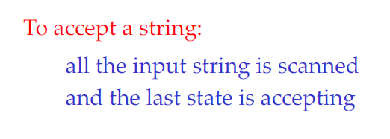
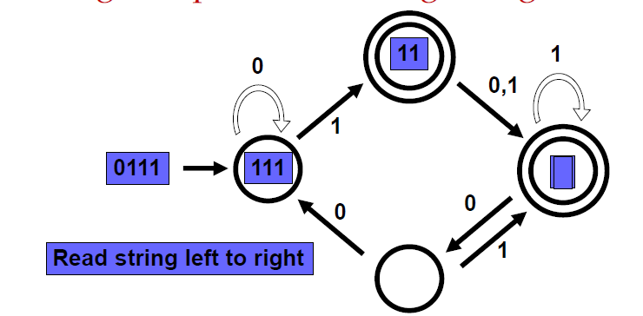
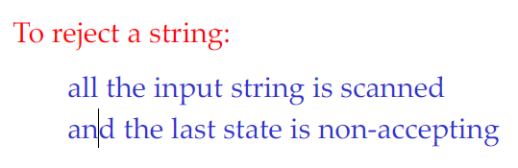
Checking acceptance of string using FA
The machine accepts a string if the process ends in a double circle, i.e., Final State.

Slide 19
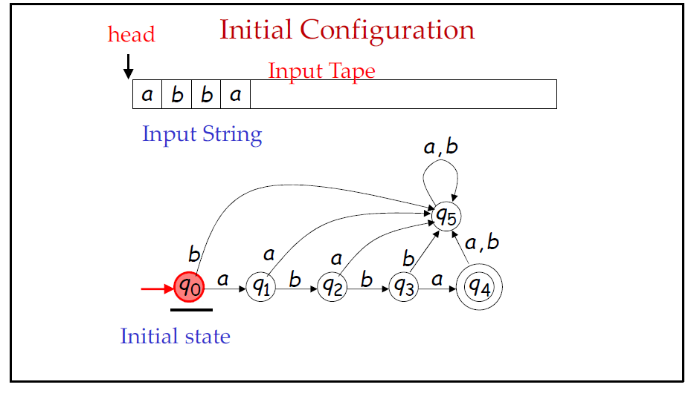
Example 1 - Checking acceptance of string using FA

Slide 20
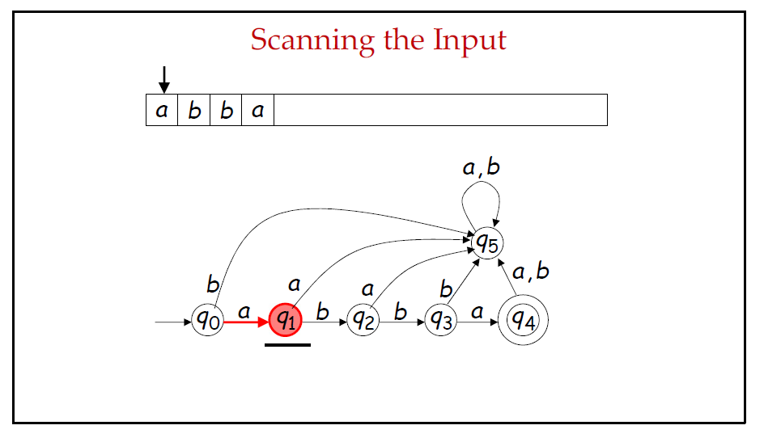
Example 1 - Checking acceptance of string using FA

Slide 21
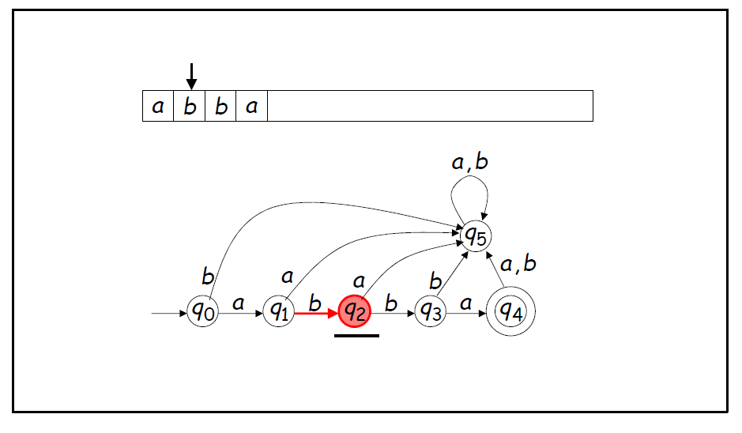
Example 1 - Checking acceptance of string using FA

Slide 22
Example 1 - Checking acceptance of string using FA

Slide 23
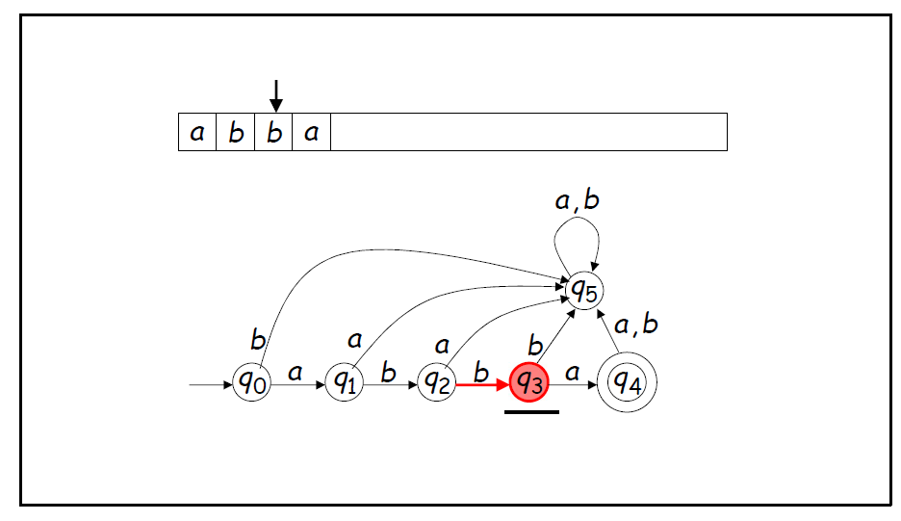
Example - Checking acceptance of string using FA

Slide 24
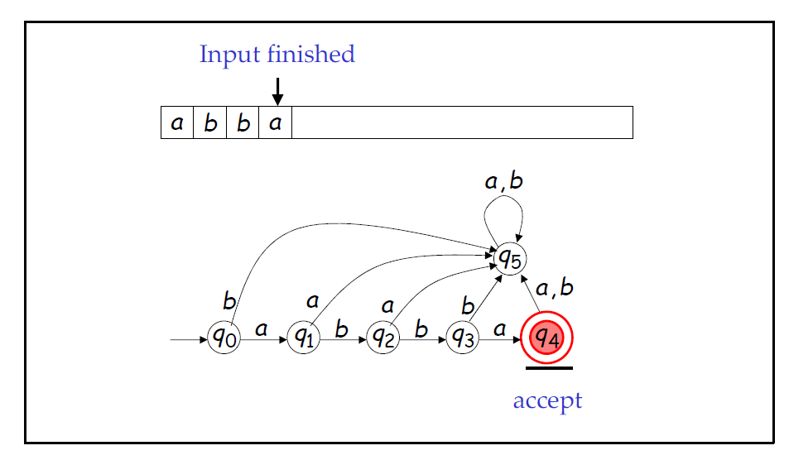
Example 1 - Checking acceptance of string using FA

Slide 25
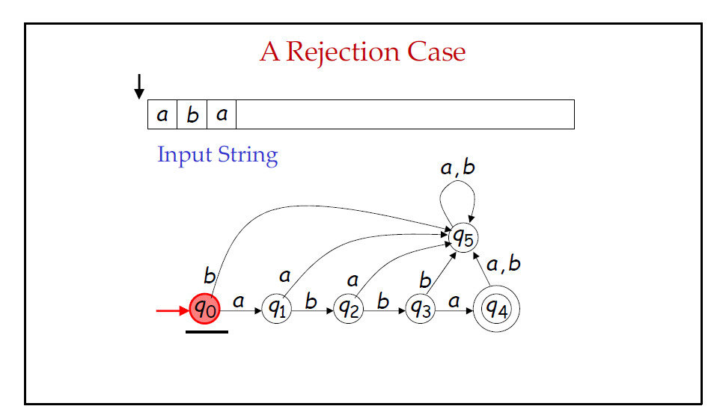
Example 2 - Checking acceptance of string using FA

Slide 26
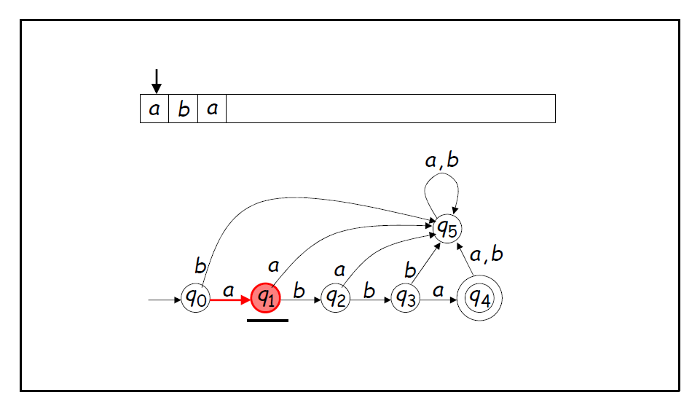
Example 2 - Checking acceptance of string using FA

Slide 27
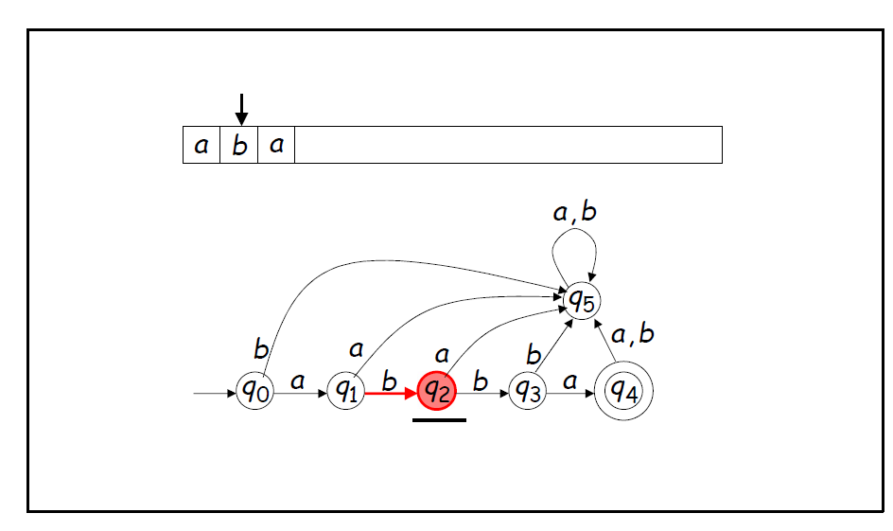
Example 2 - Checking acceptance of string using FA

Slide 28
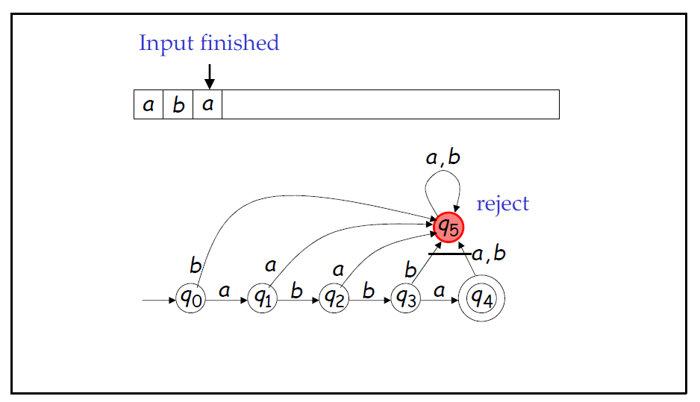
Example 2 - Checking acceptance of string using FA

Slide 29
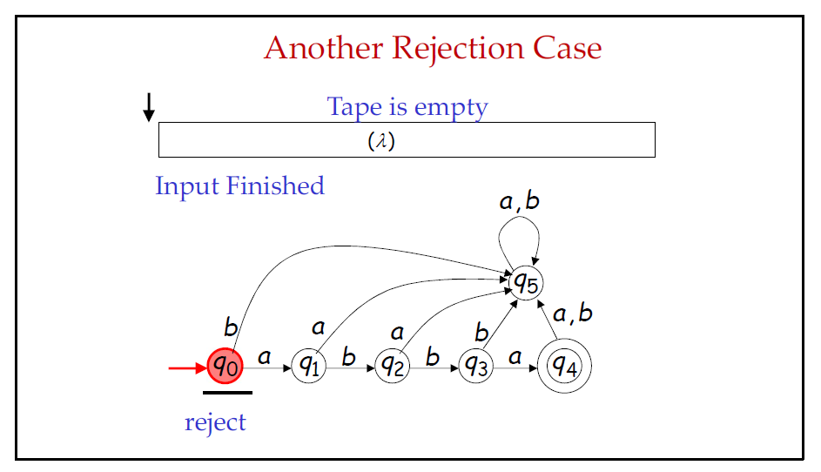
Example 3 - Checking acceptance of string using FA

Slide 30
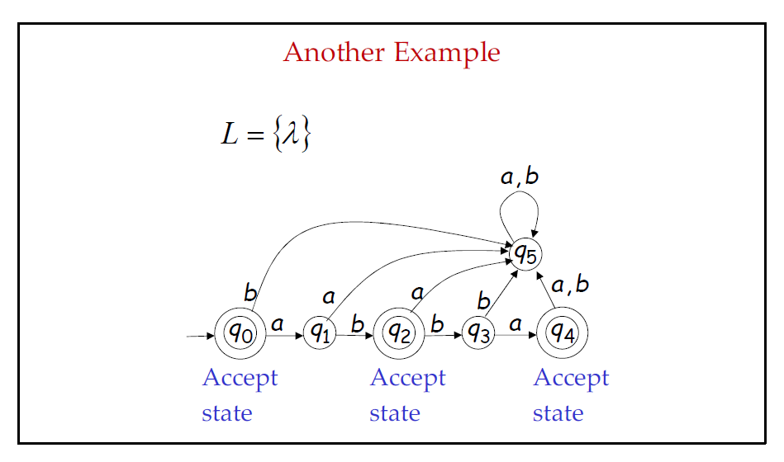
Example 4 - Checking acceptance of string using FA

Slide 31
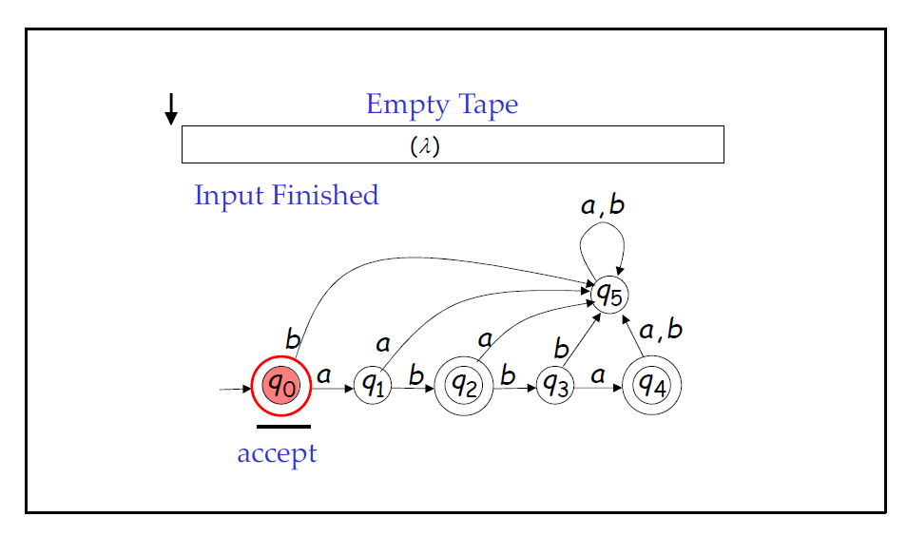
Example 4 - Checking acceptance of string using FA

Slide 32
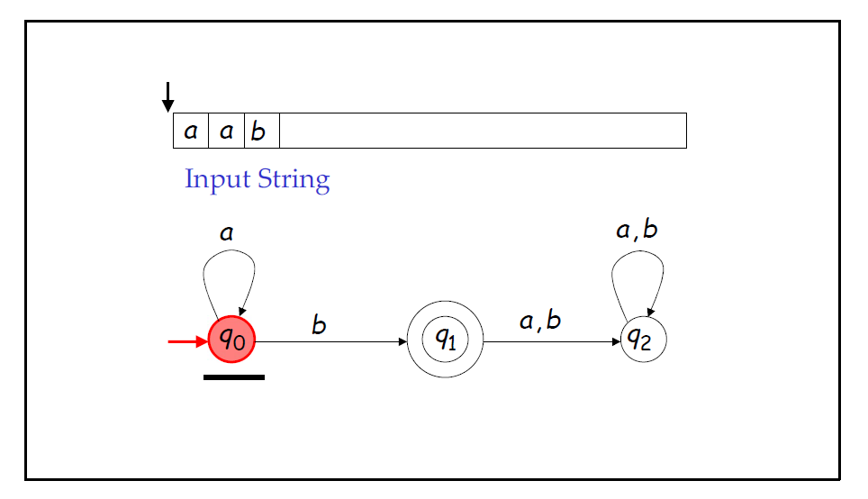
Example 5 - Checking acceptance of string using FA

Slide 33
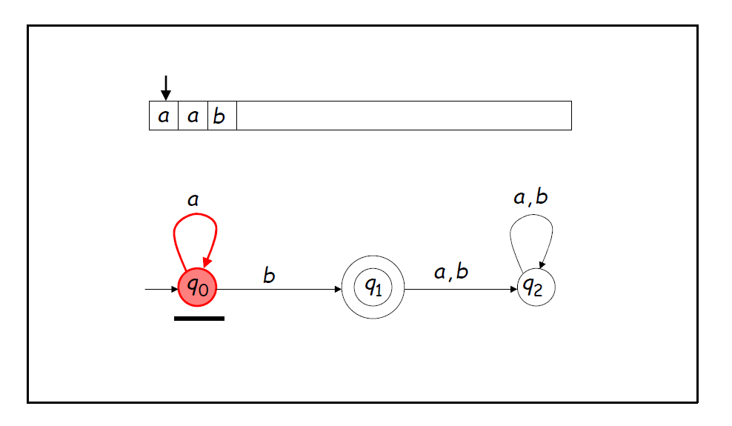
Example 5 - Checking acceptance of string using FA

Slide 34
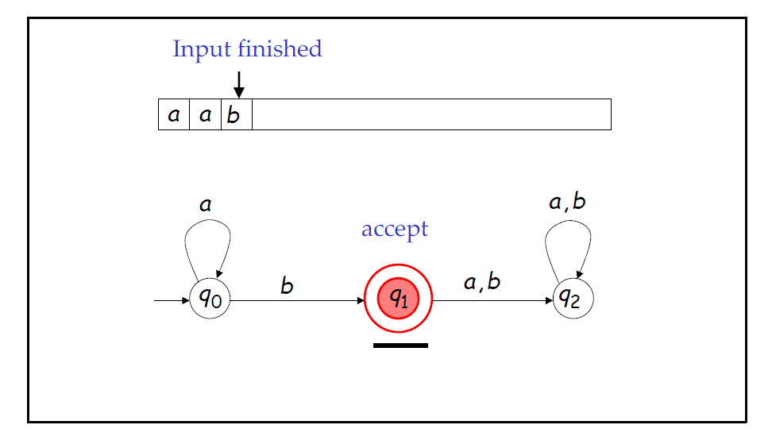
Example 5 - Checking acceptance of string using FA

Slide 35
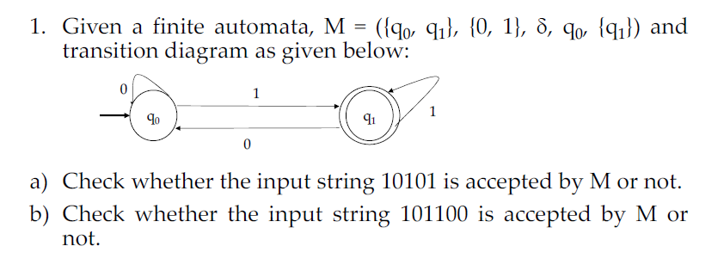
Practice Problem 1

Slide 36
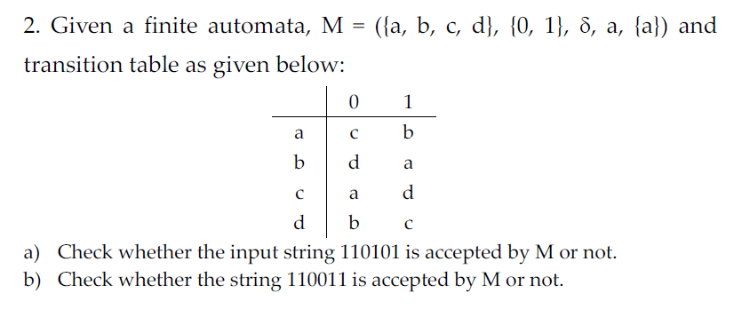
Practice Problem 2

Slide 37
Grammar and Automata
L(M) is the of strings accepted by M
L(G) is the of strings generated by G
M - Automata is an accepting device of the language
G - Grammar is the generating device of the language

Slide 38
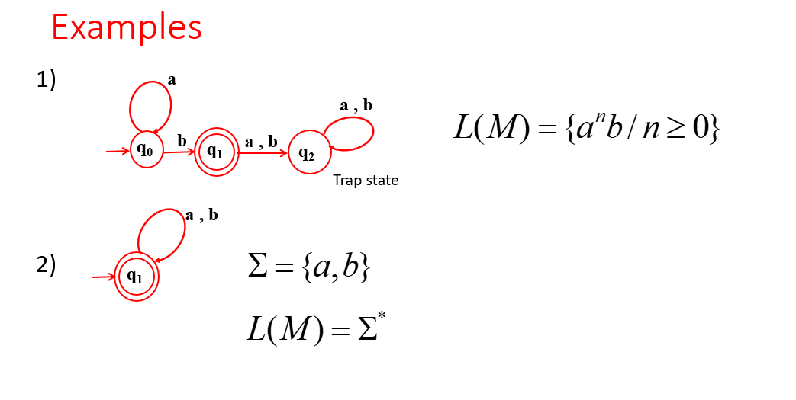
Grammar and Automata

Slide 39

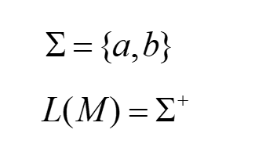
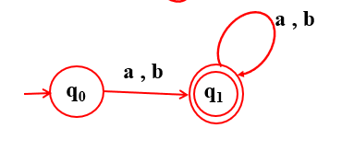

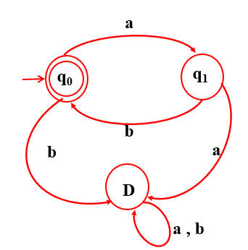
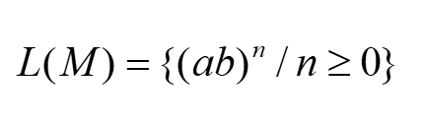
Grammar and Automata

Slide 40
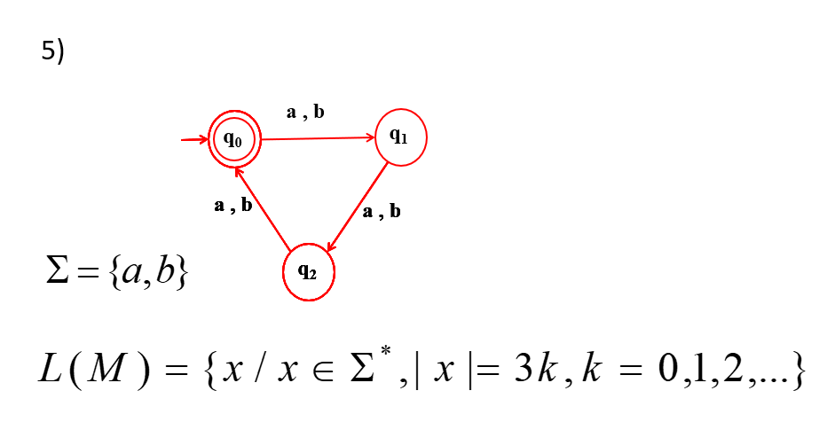
Grammar and Automata

