Slide 1


BCSE304L - Theory of Computation
Dr. R. Arumuga Arun,
Cabin : PRP 315(A&B)-19,
Mailid : arumugaarun.r@vit.ac.in.
Winter-Semester 2023-2024
SCOPE
1

Slide 2

Module 2 – Finite State Automata
Finite Automata (FA) - Deterministic Finite Automata (DFA) - Non-deterministic Finite Automata (NFA) - NFA with epsilon transitions – NFA without epsilon transition, conversion of NFA to DFA, Equivalence of NFA and DFA – minimization of DFA
Topic : Deterministic Finite Automata (DFA) - Non-deterministic Finite Automata (NFA) -
5

Slide 3
Types of Finite Automata
1. Deterministic Finite Automata (DFA)
2. Non-deterministic Finite Automata (NFA / NDFA)

Slide 4
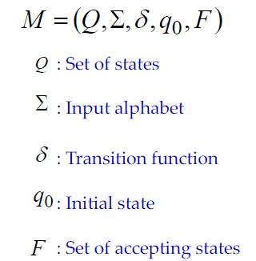
Deterministic Finite Automaton (DFA)
On each input symbol, there is one and only one state to which the automaton can have transition from its current state

Slide 5
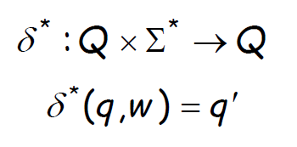
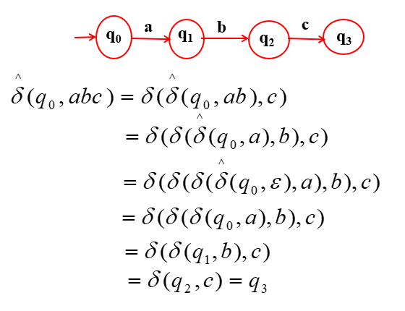
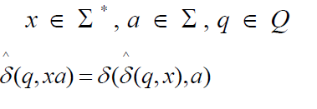
Extended Transition Function
To read zero / more symbols of input string at a time.
Describes the resulting state after scanning string w from state q

Slide 6
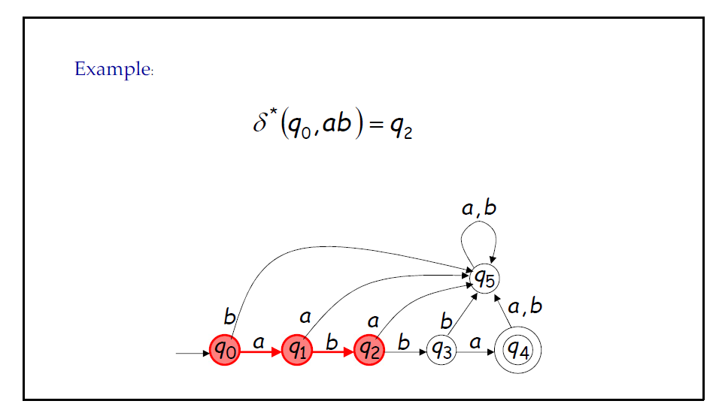
Extended Transition Function - Examples

Slide 7
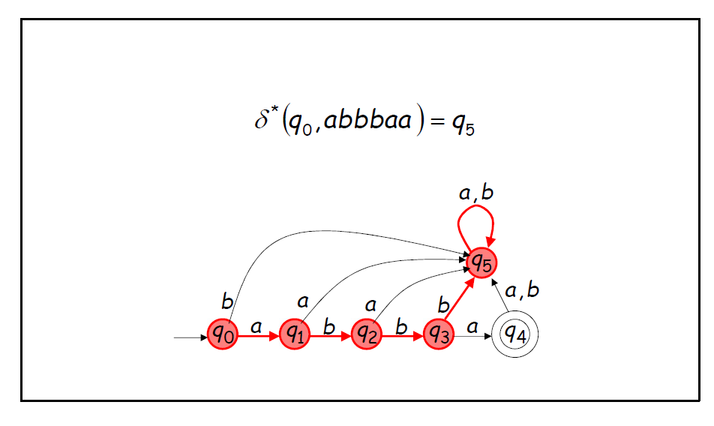
Extended Transition Function - Examples

Slide 8
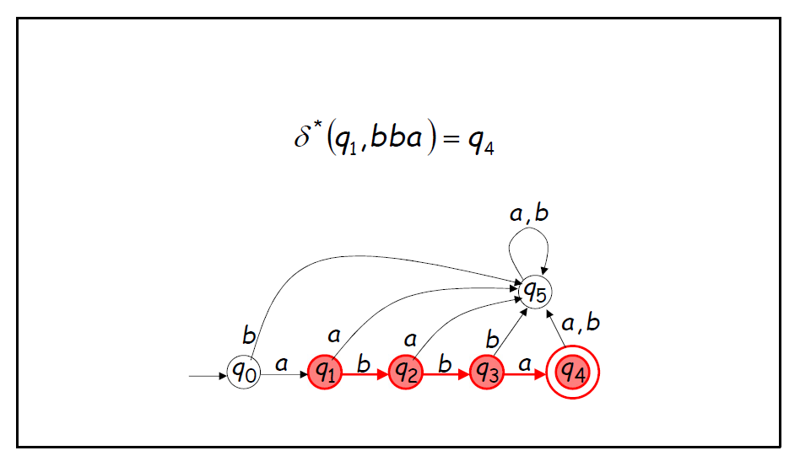
Extended Transition Function - Examples

Slide 9
Problems on DFA
Problem 1:
Construct a DFA that accepts all and only the string of 0’s and 1’s that have the sequence 01 somewhere in the string.

Slide 10
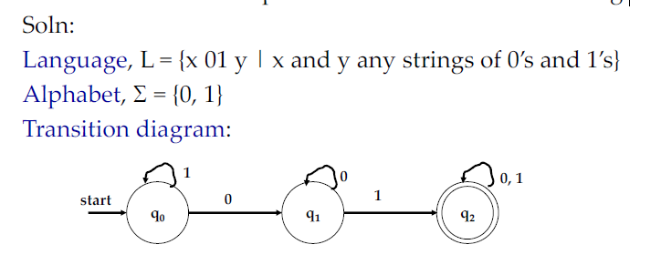
Problems on DFA
Problem 1:
Construct a DFA that accepts all and only the string of 0’s and 1’s that have the sequence 01 somewhere in the string.

Slide 11
Problems on DFA
Problem 2:
Construct the DFA’s accepting the following language over the alphabet {0, 1}.
a) The set of all strings ending with ‘00’
b) The set of strings with three consecutive 0’s

Slide 12
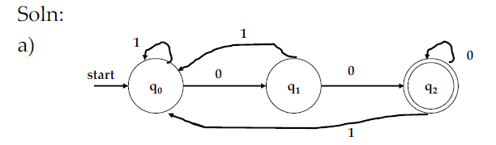
Problems on DFA
Problem 2:
Construct the DFA’s accepting the following language over the alphabet {0, 1}.
a) The set of all strings ending with ‘00’
b) The set of strings with three consecutive 0’s

Slide 13
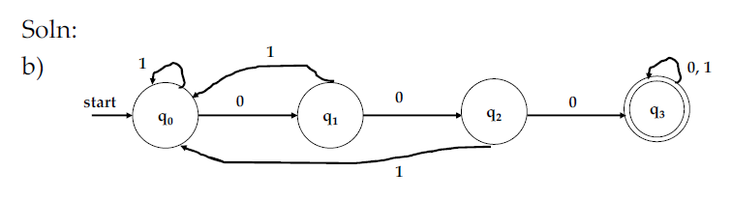
Problems on DFA
Problem 2:
Construct the DFA’s accepting the following language over the alphabet {0, 1}.
a) The set of all strings ending with ‘00’
b) The set of strings with three consecutive 0’s

Slide 14
Problems on DFA
Problem 3:
Construct DFA that accepts input string of 0’s and 1’s that end
with 11.

Slide 15
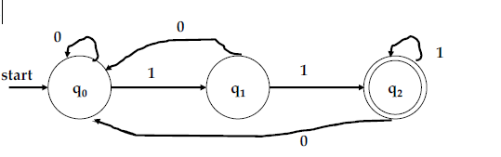
Problems on DFA
Problem 3:
Construct DFA that accepts input string of 0’s and 1’s that end
with 11.

Slide 16
Problems on DFA
Problem 4:
Construct a DFA that accepts all strings with three consecutive
1’s at its end.

Slide 17
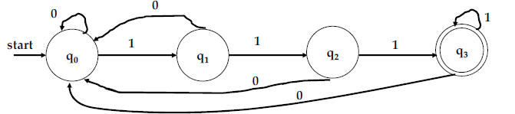
Problems on DFA
Problem 4:
Construct a DFA that accepts all strings with three consecutive
1’s at its end.

Slide 18
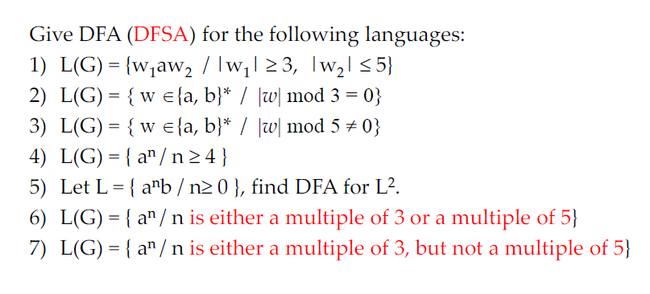
Exercise

Slide 19
Non-Deterministic Finite Automata (NFA)
The transition function that takes a state and input symbol as arguments then returns zero or more states.
Example
0, 1
0, 1
start
q₁
1
q₂

Slide 20
Representation of NFA
A NFA can be represented as,
: Finite set of states
: Finite set of Input symbols
: Transition function, Q X {Σ ∪ {ε}} → 2^{Q}
: Initial / Start state
: Set of accepting states

Slide 21
Power set of any set S is the set of all subsets of S, including the empty set and S itself
S = {a, b, c, d}
P(S) = { Ø,
{a}, {b}, {c}, {d},
{a, b}, {a, c}, {a, d}, {b, c},{b, d}, {c, d},
{a, b, c}, {a, b, d}, {a, c, d}, {b, c, d},
{a, b, c, d}
}
|S| < |P(S)|
|P(S)| = 2⁴ = 16

Slide 22
Q = {q₀ , q₁ } , Σ = { a, b}
n(Q) = 2 , n(Σ) = 2
ρ(Q) = 2^{Q} = { {q₀} , {q₁} , {q₀ , q₁ }, {ϕ} } - Power set of Q
n(2^{Q}) = 2^{n(Q)} = 2² = 4

Slide 23
δ : Q × Σ → 2^{Q}
δ(q_{i}, a ) = {q_{j} , q_{k}}
Q × Σ
2^{Q}
(q₀, a)
δ(q₀, a ) = {q₀ q₁}
(q₀, b)
δ(q₁, b ) = { q₀}
(q₁, a)
(q₁, b)
q_{j}
a
q_{i}
a
q_{k}

Slide 24
Example - 1
a
a
q₃
q₁
q₂
a
q₀
a
a
q₄
q₅
a

Slide 25
Example - 2
a
b
a
b
q₂
q₀
q₁

Slide 26
Problems – Construction of NFA

Slide 27
Problems – Construction of NFA
Construct NFA for set of all strings {0, 1} that end with string 00.
Soln:
Step 1: Language, L = {w | w is set of all strings that end with string 00}
Step 2: Alphabet, Σ = {0, 1}
Step 3: Transition Diagram
Step 4: NFA, N = [{q₀, q₁, q₂}, {0, 1}, δ, q₀, {q₂}]
0, 1
0
start
q₀
0
q₁
0
q₂
1
1

Slide 28
Problems – Construction of NFA
Construct NFA with abb as substring.
Soln:
Step 1: Language, L = {x | x is set of all strings with abb as substring}
Step 2: Alphabet, Σ = {a, b}
Step 3: Transition Diagram
Step 4: NFA, N = [{q₀, q₁, q₂ , q₃}, {a, b}, δ, q₀, {q₃}]
a, b
a, b
start
q₀
a
q₁
b
q₂
b
q₃

Slide 29
Problems – Cont…
Construct NFA with 101 as substring.
1

Slide 30
Problems – Cont…
Construct NFA with 101 as substring.
1, 0
1, 0
start
q₀
1
q₁
0
q₂
1
q₃
0
0

Slide 31
Problems – Checking acceptance of string

Slide 32
Problem 1 – Checking acceptance of string
Construct an NFA for the set of strings with {0, 1} ending with 01 and draw the transition table for the same and check whether the input string 00101 is accepted by NFA.
Soln:
Step 1: Language, L = {x | x is set of all strings ending with 01}
Step 2: Alphabet, Σ = {0, 1}
Step 3: Transition Diagram
Step 4: NFA, N = [{q₀, q₁, q₂}, {a, b}, δ, q₀, {q₂}]
0, 1
0
start
q₀
0
q₁
1
q₂
0, 1

Slide 33
Cont…
0, 1
0
start
q₀
0
q₁
1
q₂
Step 5: Input String = 00101
δ’(q₀, ε) = q₀
δ’(q₀, 0) = δ(q₀, 0) = {q₀, q₁}
δ’(q₀, 00) = δ(δ’(q₀, 0), 0) = δ({q₀, q₁}, 0)
= δ(q₀, 0) ∪ δ(q₁, 0) = {q₀, q₁} ∪ {q₁} = {q₀, q₁}
δ’(q₀, 001) = δ(δ’(q₀, 00), 1) = δ({q₀, q₁}, 1)
= δ(q₀, 1) ∪ δ(q₁, 1) = {q₀, q₂}
δ’(q₀, 0010) = δ(δ’(q₀, 001), 0) = δ({q₀, q₂}, 0)
= δ(q₀, 0) ∪ δ(q₂, 0) = {q₀, q₁}
δ’(q₀, 00101) = δ(δ’(q₀, 0010), 1) = δ({q₀, q₁}, 1)
= δ(q₀, 1) ∪ δ(q₁, 1) = {q₀, q₂}
0, 1

Slide 34
Cont..
Step 6:
To check the acceptance of the string
δ’(q₀, 00101) ∩ F = {q₀, q₂} ∩ {q₂} = {q₂}
Therefore, the string 00101 is accepted.

Slide 35
Problem 2
Consider the given NFA and check whether the input ‘abaab’ is accepted or not.
δ | a | b
→q0 | {q0, q1} | {q0, q3}
q1 | {q2} | φ
*q2 | {q2} | {q2}
q3 | φ | {q4}
*q4 | {q4} | {q4}

