Slide 1


BCSE304L - Theory of Computation
Dr. R. Arumuga Arun,
Cabin : PRP 315(A&B)-19,
Mailid : arumugaarun.r@vit.ac.in.
Winter-Semester 2023-2024
SCOPE
1

Slide 2

Module 2 – Finite State Automata
Finite Automata (FA) - Deterministic Finite Automata (DFA) - Non-deterministic Finite Automata (NFA) - NFA with epsilon transitions – NFA without epsilon transition, conversion of NFA to DFA, Equivalence of NFA and DFA – minimization of DFA
Topic : NFA with epsilon transition
5

Slide 3
NFA with ε - transition
NFA can be extended to NFA-ε transition for an empty string
NFA-ε has 5-tuples, M=(Q, Σ, δ, S, F) [Identical to NFA]
In NFA-ε, there will be a state transition on an input symbol ε
0
start
q₁
ε
q₂

Slide 4
Problems – Construction of NFA-ε
Construct NFA-ε that end with string 11 for the set of all strings {0, 1}
Soln:
Step 1: Language, L = {w | w is set of all strings that end with string 11}
Step 2: Alphabet, Σ = {0, 1}
Step 3: Transition Diagram
Step 4: NFA-ε, NE = [{q₀, q₁, q₂}, {0, 1}, δ, q₀, {q₂}]
0, 1
start
q₀
1
q₁
1
q₂
ε

Slide 5
Problems – cont…
Construct NFA-ε with 011 as substring for set of all strings {0, 1}.
Soln:
Step 1: Language, L = {x | x is set of all strings with 011 as substring}
Step 2: Alphabet, Σ = {a, b}
Step 3: Transition Diagram
Step 4: NFA-ε, NE = [{q₀, q₁, q₂, q₃, q₄}, {0, 1}, δ, q₀, {q₃}]
1, 0
1, 0
start
q₀
0
q₁
1
q₂
1
q₃
ε

Slide 6
Problems – Acceptance of strings
ε-closure: the ε-closure of q₀ [ε-closure(q₀)] denotes the set of all states ‘P’ such that there is a path or transitions from q₀ to P on ε.
Path from current state to set of states that has ‘ε’ transitions
Consider the following NFA-ε and find the ε-closure for each state and check whether the string ‘abb’ is accepted or not.
Soln:
ε-closure(q₀) = {q₀, q₁, q₂} [Path from current state to set of states that has ‘ε’ transitions]
ε-closure(q₁) = {q₁, q₂}
ε-closure(q₂) = {q₂}
a
b
c
start
q₀
ε
q₁
ε
q₂
a
b

Slide 7
Cont (1)
a
b
c
start
q₀
ε
q₁
ε
q₂
Input string: ‘aab’
δ’(q₀, ε) = ε-closure(q₀) = {q₀, q₁, q₂}
δ’(q₀, a) = ε-closure(δ(δ’(q₀, ε), a))
= ε-closure(δ({q₀, q₁, q₂}, a))
= ε-closure(δ(q₀,a) ∪ δ(q₁,a) ∪ δ(q₂,a))
= ε-closure({q₀, q₁} ∪ φ ∪ φ)
= ε-closure({q₀, q₁})
= ε-closure(q₀₎ ∪ ε-closure(q₁)
= {q₀, q₁, q₂} ∪ {q₁, q₂}
= {q₀, q₁, q₂}
a
b

Slide 8
Cont (2)
a
b
c
start
q₀
ε
q₁
ε
q₂
δ’(q₀, ab) = ε-closure(δ’(δ(q₀, a), b))
= ε-closure(δ({q₀, q₁, q₂}, b))
= ε-closure(δ(q₀,b) ∪ δ(q₁,b) ∪ δ(q₂,b))
= ε-closure(φ ∪ {q₁, q₂} ∪ φ)
= ε-closure({q₁, q₂})
= ε-closure(q₁) ∪ ε-closure(q₂)
= {q1, q₂} ∪ {q₂}
= {q₁, q₂}
a
b

Slide 9
Cont (3)
a
b
c
start
q₀
ε
q₁
ε
q₂
δ’(q₀, abb) = ε-closure(δ’(δ(q₀, ab), b))
= ε-closure(δ({q₁, q₂}, b))
= ε-closure(δ(q₁,b) ∪ δ(q₂,b))
= ε-closure({q₁, q₂} ∪ φ)
= ε-closure({q₁, q₂})
= ε-closure(q₁) ∪ ε-closure(q₂)
= {q₁, q₂} ∪ {q₂}
= {q₁, q₂}
Final State, F = {q₂}
Therefore {q₁, q₂} ∩ F = {q₁, q₂} ∩ {q₂} = {q₂} ==> member in final state
So, the string ‘abb’ is accepted by NFA-ε
a
b

Slide 10
Problem 2
Consider the following NFA-ε and find the ε-closure for each state and check whether the string ‘abcc’ is accepted or not.
a
b
c
start
q₀
ε
q₁
ε
q₂
a
b
The string ‘abcc’ is accepted by NFA-ε

Slide 11
Equivalence of NFA and NFA-ε
A language, ‘L’ is accepted by some NFA-ε iff ‘L’ is accepted by NFA without ε transition, i.e., L(M) = L(M’)
Example:
Convert the following NFA- ε to NFA without ε
NFA- ε
NFA
0
1
2
start
q₀
ε
q₁
ε
q₂

Slide 12
Solution – cont…
0
1
2
start
q₀
ε
q₁
ε
q₂
Transition table
δ | 0 | 1 | 2 | ε
→q0 | {q0} | φ | φ | {q1}
q1 | φ | {q1} | φ | {q2}
*q2 | φ | φ | {q2} | φ
ε-closure(q0) = {q0,q1,q2}
ε-closure(q1) = {q1,q2}
ε-closure(q2) = {q2}

Slide 13
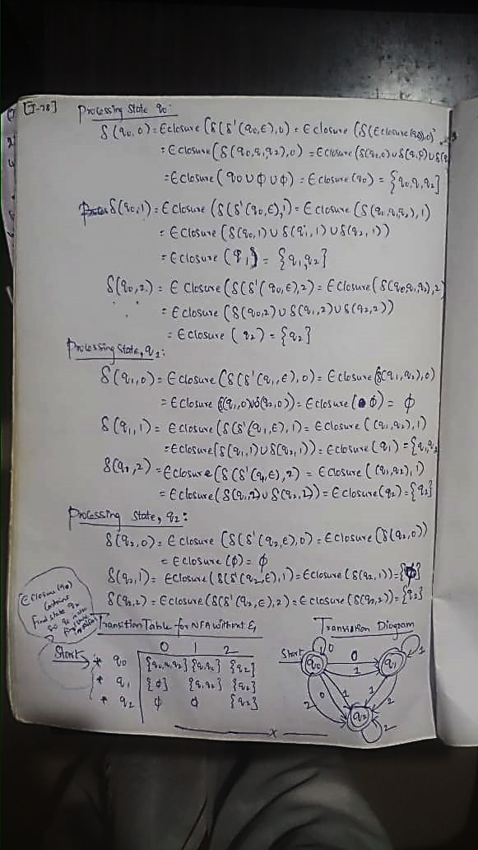
Cont…

Slide 14
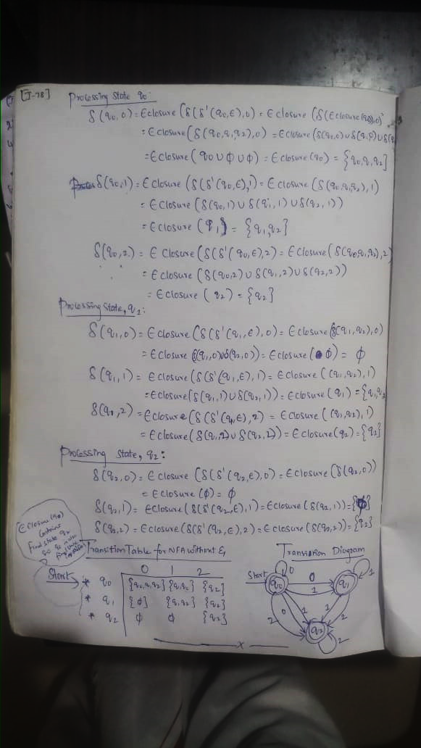
Cont…

Slide 16
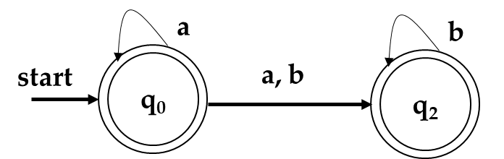
Problem 2:
Convert the following NFA- ε to NFA without ε
Solution:
a
b
start
q₀
ε
q₂

