Slide 1


BCSE304L - Theory of Computation
Dr. R. Arumuga Arun,
Cabin : PRP 315(A&B)-19,
Mailid : arumugaarun.r@vit.ac.in.
Winter-Semester 2023-2024
SCOPE
1

Slide 2

Module 2 – Finite State Automata
Finite Automata (FA) - Deterministic Finite Automata (DFA) - Non-deterministic Finite Automata (NFA) - NFA with epsilon transitions – NFA without epsilon transition, conversion of NFA to DFA, Equivalence of NFA and DFA – minimization of DFA
Topic : Conversion of NFA-ε to NFA without ε
5

Slide 3
Equivalence of NFA and NFA-ε
A language, ‘L’ is accepted by some NFA-ε iff ‘L’ is accepted by NFA without ε transition, i.e., L(M) = L(M’)
Example:
Convert the following NFA- ε to NFA without ε
NFA- ε
NFA
0
1
2
start
q₀
ε
q₁
ε
q₂

Slide 4
Solution – cont…
0
1
2
start
q₀
ε
q₁
ε
q₂
Transition table
δ | 0 | 1 | 2 | ε
→q0 | {q0} | φ | φ | {q1}
q1 | φ | {q1} | φ | {q2}
*q2 | φ | φ | {q2} | φ
ε-closure(q0) = {q0,q1,q2}
ε-closure(q1) = {q1,q2}
ε-closure(q2) = {q2}

Slide 5
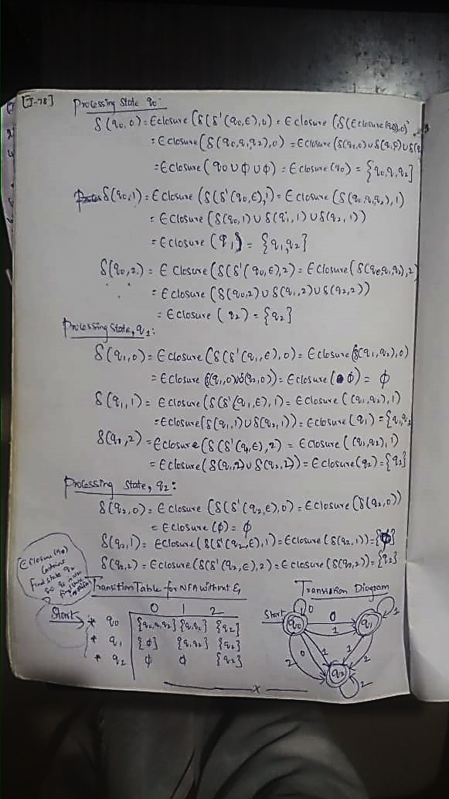
Cont…

Slide 6
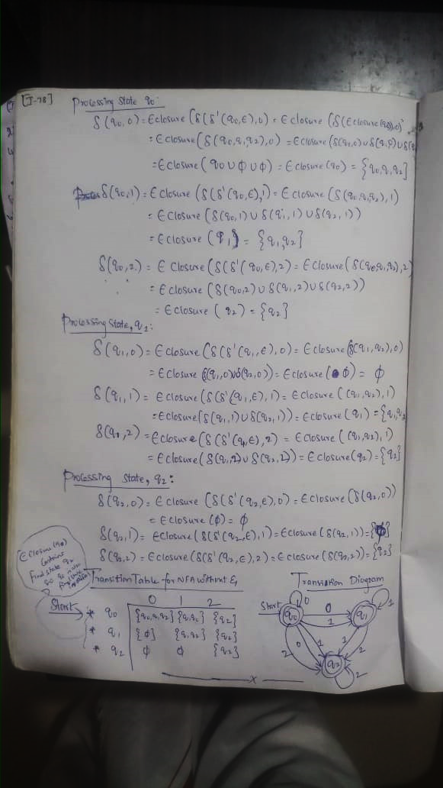
Cont…

Slide 8
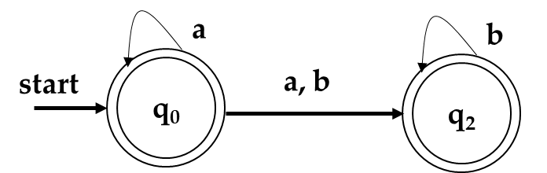
Problem 2:
Convert the following NFA- ε to NFA without ε
Solution:
a
b
start
q₀
ε
q₂

