Slide 1


BCSE304L - Theory of Computation
Dr. R. Arumuga Arun,
Cabin : PRP 315(A&B)-19,
Mailid : arumugaarun.r@vit.ac.in.
Winter-Semester 2023-2024
SCOPE
1

Slide 2

Module 2 – Finite State Automata
Finite Automata (FA) - Deterministic Finite Automata (DFA) - Non-deterministic Finite Automata (NFA) - NFA with epsilon transitions – NFA without epsilon transition, conversion of NFA to DFA, Equivalence of NFA and DFA – minimization of DFA
Topic : Conversion of NFA with ε → DFA
5

Slide 3
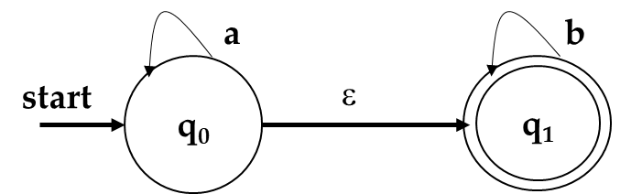
NFA- ε to DFA
Convert the following NFA- ε to DFA

Slide 4
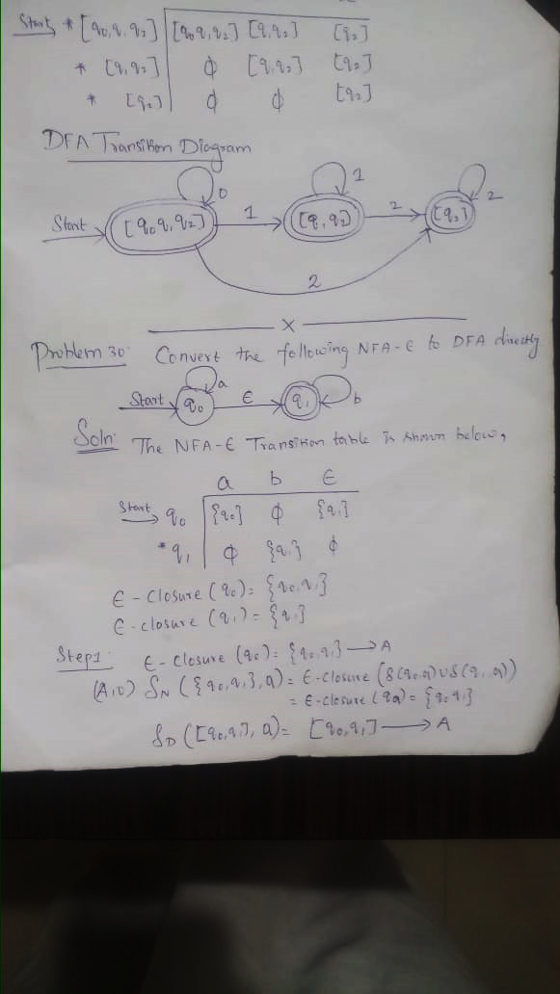
Example - 1

Slide 5
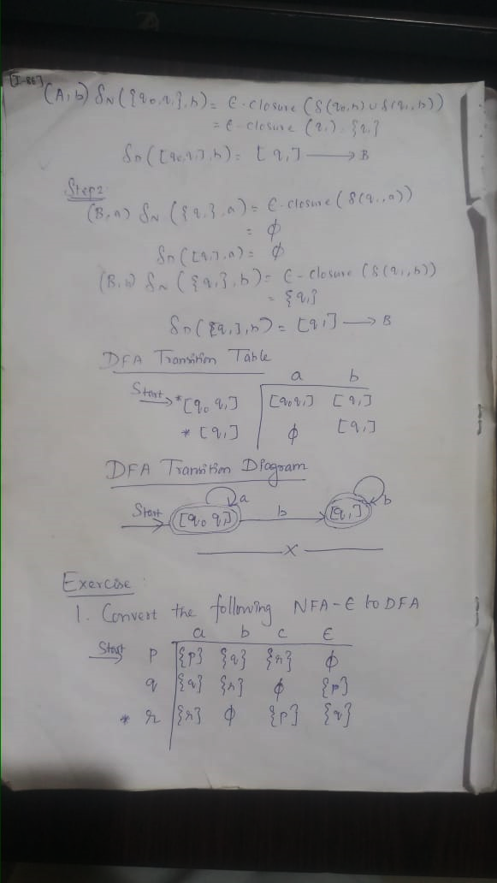
Example - 1

Slide 6
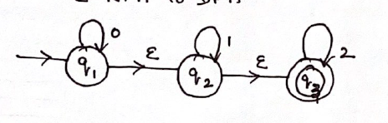

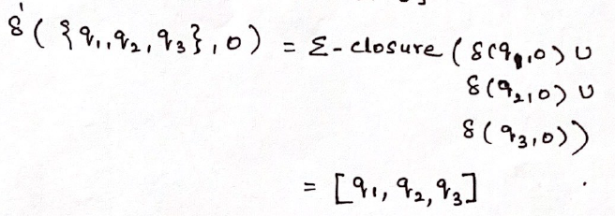
Example - 2
→A
(A, 0)
→A

Slide 7
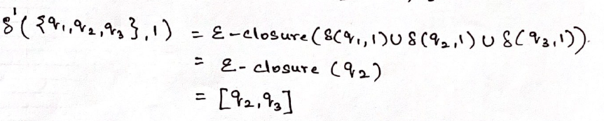

Example - 2
(A, 1)
→B
δ’({q₀, q₀, q₀,}, 2) = ε-closure(δ(q₁,2) ∪ δ(q₂,2) ∪ δ(q3,2))
= ε-closure(φ ∪ φ ∪ {q₃})
= ε-closure({q₃})
= {q₃} → C
(A, 2)
(B, 0)

Slide 8
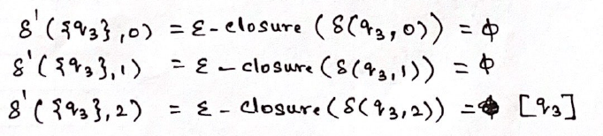
Example - 2
(B, 1)
→B
(B, 2)
(C, 0)
(C, 1)
(C, 2)
→C

Slide 9
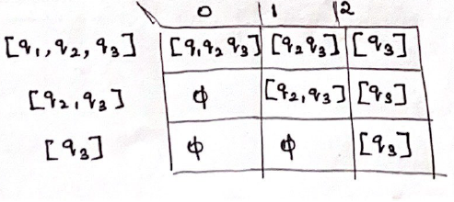
Example - 2
 | 0 | 1 | 2
A | A | B | C
B | φ | B | C
C | φ | φ | C

Slide 10
Example - 3
Convert the following NFA- ε to DFA
δ | 0 | 1 | 2 | ε
→q0 | {q0} | φ | φ | {q1}
q1 | φ | {q1} | φ | {q2}
*q2 | φ | φ | {q2} | φ

Slide 11
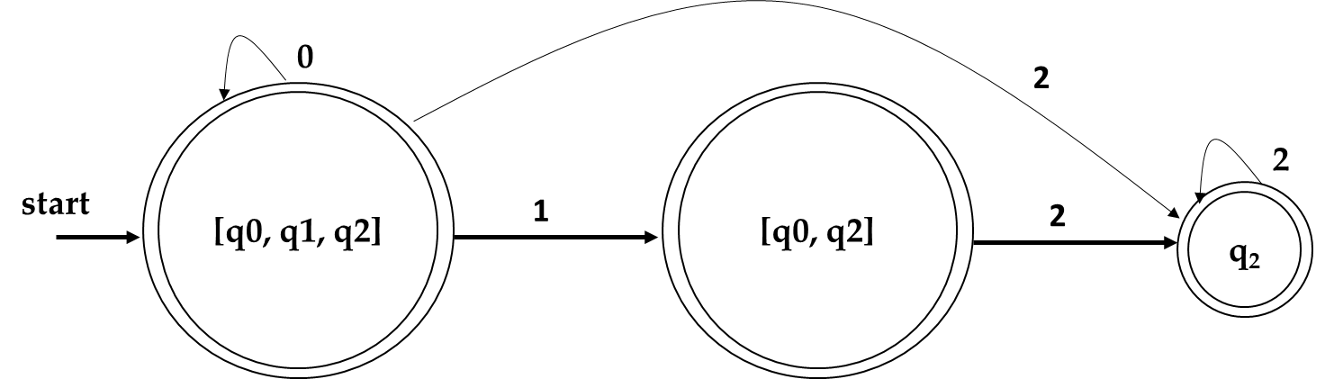
Example - 3
Convert the following NFA- ε to DFA
δ | 0 | 1 | 2 | ε
→q0 | {q0} | φ | φ | {q1}
q1 | φ | {q1} | φ | {q2}
*q2 | φ | φ | {q2} | φ
Soln

Slide 12
Example - 4
Convert the following NFA- ε to DFA
a
b
c
d
ε
ε
ε
q₁
ε
q₂
q₃

Slide 13
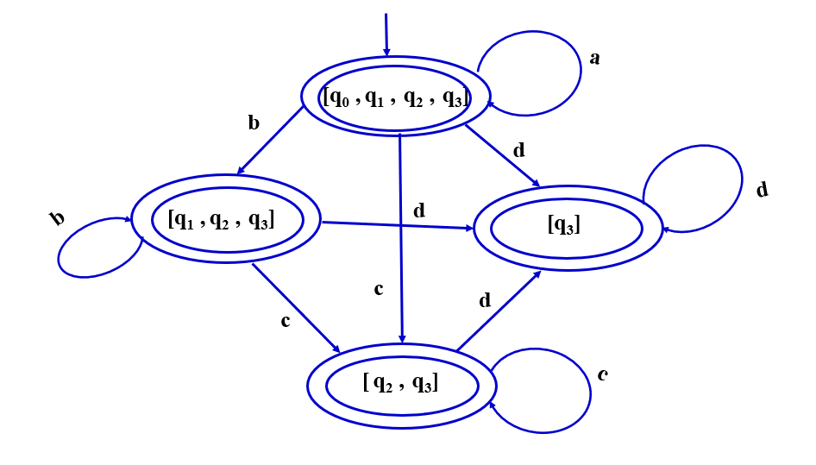
Example - 4
Convert the following NFA- ε to DFA
a
b
c
d
ε
ε
ε
q₁
ε
q₂
q₃
Soln

