Slide 1


BCSE304L - Theory of Computation
Dr. R. Arumuga Arun,
Cabin : PRP 315(A&B)-19,
Mailid : arumugaarun.r@vit.ac.in.
Winter-Semester 2023-2024
SCOPE
1

Slide 2

Module 3 – Regular Expressions and Languages
Regular Expression - FA and Regular Expressions: FA to regular expression and regular expression to FA - Pattern matching and regular expressions - Regular grammar and FA -Pumping lemma for regular languages - Closure properties of regular languages
Topic : Regular Expressions
5

Slide 3
Regular Expressions (REs)
Used to describe about the structure of data
Method to describe languages
REs gives the declarative ways to express / represent the strings
REs serve as the input language for many systems that process strings
Regular Language - Languages defined by the regular
expression
Example:
Search Commands – UNIX grep
Lexical Analyzer generators – breaks the source program into logical units called tokens

Slide 4
Operations on REs
Union (U):
The union of two languages L and M, denoted L U M is the set of strings that are in either L or M or both
Ex: L = {001, 10, 11} and M = {ε, 001} and L U M = {ε, 10, 11, 001}
Concatenation (.):
The concatenation of languages L and M is the set of strings that can be formed by taking in any string in L and concatenating it with any string in M
Ex: L = {001, 10, 11} and M = {ε, 001} and L . M = {001, 10, 11, 001001,
10001, 11001}

Slide 5
Operations on Res – cont…
Closure (*):
Represents the set of those strings that can be formed by taking any number of strings from L, (possibly with repetitions) and concatenating all of them.
Ex1: L = {0, 1}, the L* is all strings of 0’s and 1’s
Ex2: L = {0, 11}, the L* consists of those strings of 0’s and 1’s such that
the 1’s come in pairs {011, 11110, …} but not {01011, 1010}
L = {0, 11} L⁰ = {ε}
L¹ = {0, 11}
L² = L . L = {00, 011, 110, 1111}
L³ = L. L² or L² . L = {000, 0011, 0110, 01111, 1100, 11011, 11110, 111111} L* = L⁰ U L¹ U L² U …….

Slide 6
Building Regular Expressions
The language L(E) is described by Regular Expression, E
REs can be described recursively as follows:
Basis: The basis consists of three parts:
A variable, usually capitalized, such as L, represents any language
The constant ‘ε’ and ‘φ’ are REs, denoting the languages L(ε) and L(φ) respectively. L(ε) = ε & L(φ)= φ
If ‘a’ is any symbol in L, then ‘a’ is a regular expression, L(a) = {a}

Slide 7
Building Regular Expressions – cont…
Induction: Four parts one for each of the operators and one for the parenthesis
If E and F are regular expressions then, E + F is denoting the union of L(E) and
L(F), L(E+F) = L(E) U L(F)
If E and F are regular expressions then, E . F is denoting the concatenating of L(E) and L(F), L(E.F) = L(E) . L(F)
If E is a regular expression then, E* is a RE denoting the closure of L(E), L(E*) = (L(E))*
If E is a regular expression then, (E) is also denoting the same language as E, L((E)) = L(E)

Slide 8
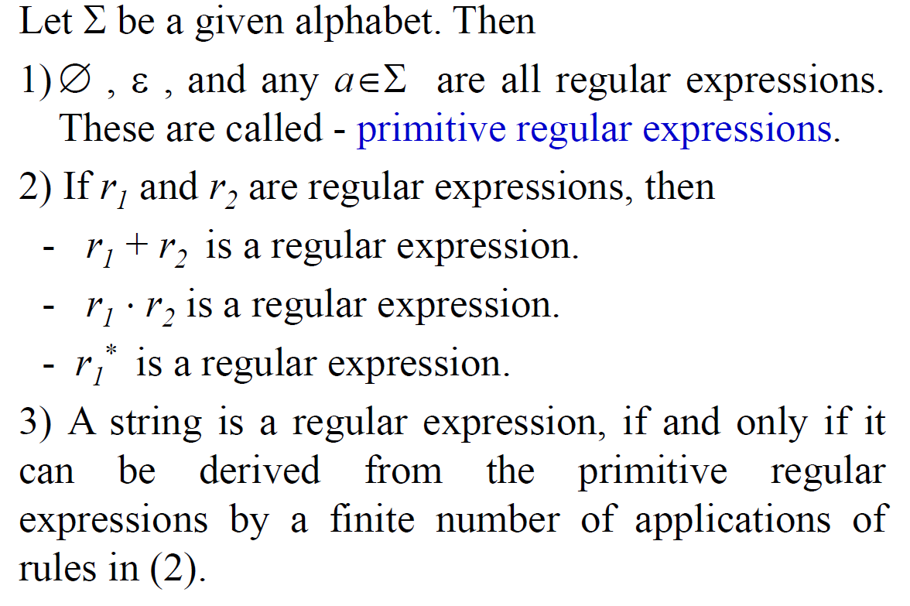
Building Regular Expressions – cont…

Slide 9
Precedence of Regular Expression Operators
Closure operator (*)
Dot Operator (.)
Union operator (+)
Note:
Operator are grouped from left to right
Ex: 012 can be grouped as (01) 2 by default
Use parenthesis to override 0(12)
Ex: The expression 01*+1 is grouped as:
2
1
3

Slide 10
Regular Expression to Language
Regular Expression | Language
1* or 0* | Any number of 1s or any number of 0s
∑* | If ∑={0,1} then, L = {ε, 0, 1, 00, 11, 01, 10, ….}
1 or 0 | One occurrence of 1 (or) 0
01 | No other 0’s and 1’s except the string 01 [i.e., 01 appears only once]
(01)* | All strings that repeat 01 zero or more times
01* | String consists of 0 followed by zero or more occurrence of 1’s
0 + 1 | String consisting of one 0 or string consisting of one 1 [Ex: {0 , 1}]
(a + b)* | Set of strings of a’s and b’s of any length including the null string [Ex: { ε, a, b, aa, ab, aaa, ba, bb, bab, aab, aaaa, …….}]
0 + 1* | String consisting of 0 or any number of 1’s [Ex: {ε, 0, 1, 11, 111, …….}]

Slide 11
Regular Expression to Language – cont…
Regular Expression | Language
0* 1 0* | String with exactly one ‘1’
∑* 1 ∑* | L = {1, 01, 10, 010, 111, ….}
(01*)* | L = {ε, 0, 01, 011, ….., 00, 001, 0011,….}
(∑ ∑)* | L = {ε, 00, 10, 01, 11, 0000, 1111, ….}
(0∑*0) U (1∑*1) U 0 U 1 | L = {0, 1, 00, 11, 010, 000, 0000, 0110, ……, 101, 111, 1001, 1111, ….}
1⁺ [≡ 1.1* (or) 1*.1] | L = {1, 11, 111, ….}
(0 U ε) 1* | L = {ε, 0, 1, 01, 11, ….}
1*.ϕ | L = {ϕ}
Φ* | L = {ε}

Slide 12
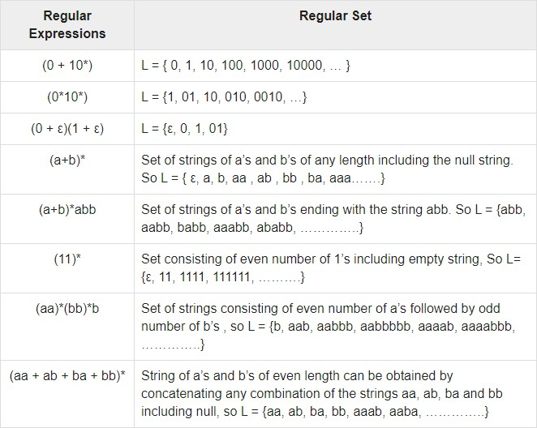
Regular Expression to Language – cont…

Slide 13
Language to Regular Expression
Language | Regular Expression
Set of all strings of Zero or more a’s | a*
Set of all strings of a’s and b’s of length two | (a+b) (a+b)
Set of all strings over {a, b} ending with ‘aba’ | (a+b)* aba
Set of all strings over {0, 1} starting and ending with 0 | 0 (0+1)* 0
Set of all strings over {a, b, c} with any number of a’s followed by any number of b’s followed any number of c’s | a* b* c*

Slide 14
Language to Regular Expression – cont…
Language | Regular Expression
Set of all strings over {a, b, c} with at least one ‘a’ followed by at least one ‘b’ followed at least one ‘c’ | _{a}+ _{b}+ _{c}+
Set of all strings with zero or more instances of a or b | (a + b)* or (a* b*)*
Set containing the string 0 and all strings consisting of zero or more 0’s followed by single 1 | 0 + 0*1
Set of string over {1} having odd length of 1 | 1 (11)*
Set of strings of 0’s and 1’s with atleast one pair of 3 consecutive 1’s | (0+1)* 111 (0+1)*

Slide 15
Problems on Finding Regular Expression

Slide 16
Problems on Finding Regular Expression
Find the regular expression for Languages as the set of all strings containing at least two 0’s over the alphabet {0,1}.
(0+1)*0(0+1)*0(0+1)*
Find the regular expression for the language accepting all the string containing any number of a's and b's is
r.e. = (a + b)*
3. Find the regular expression for the language accepting all the string which are starting with 1 and ending with 0, over ∑ = {0, 1} is
R = 1 (0+1)* 0

Slide 17
Problems on Regular Expression
4. Find RE for the set of all strings with exactly 2 a’s-
b*ab*ab*
5. Find RE for the set of all strings with atleast 2 a’s –
b*a b*a*(a+b)*
6. Find RE for the set of all strings with atmost 2 a’s –
b*(ɛ+a)b*(ɛ+a)b*

Slide 18
Problems on Regular Expression
Languages over the alphabet{0,1}is described by the regular expression (0+1)*0(0+1)*0(0+1)* is the set of all strings containing at least two 0’s.
The regular expression 0*(10*)* denoted by (1*0)*1* are equivalent. Two regular expressions are equivalent if languages generated by them are same.(using the identity)
The regular expression for the language accepting all combinations of a's,
over the set ∑ = {a} is R = a*
4. The regular expression for the language accepting all combinations of a's except the null string, over the set
∑ = {a} is R = a⁺
5. The regular expression for the language accepting all the string containing any number of a's and b's is
r.e. = (a + b)*

Slide 19
The regular expression for the language accepting all the string which are starting with 1 and ending with 0, over ∑ = {0, 1} is R = 1 (0+1)* 0
Set of all strings with exactly 2 a’s- b*ab*ab*
Set of all strings with atleast 2 a’s – b*ab*a*(a+b)*
Set of all strings with atmost 2 a’s – b*(ɛ+a)b*(ɛ+a)b*
Set of all strings with number a’s are even –
(b*ab*ab*)*+b* or (b*ab*ab*)*b*
Set of all strings that contain’s a – (a+b)* a (a+b)*
Set of all strings that starts and ends with same symbol –
a(a+b)*a + b(a+b)*b +(a+b+ɛ)

Slide 20
13. The regular expression for the language starting and ending with a and
b respectively and having any combination of b's in between is
R = a b* b
The regular expression for the language starting with a but not having consecutive b's is R = {a + ab}*
The regular expression for the language accepting all the string in which any number of a's is followed by any number of b's is followed by any number of c's is R = a* b* c*
The regular expression for the language over ∑ = {0} having even length
of the string is R = (00)*
The regular expression for the language having a string which should have atleast one 0 and alteast one 1 is
R = [(0 + 1)* 0 (0 + 1)* 1 (0 + 1)*] + [(0 + 1)* 1 (0 + 1)* 0 (0 + 1)*]

Slide 21
The language consists of the string in which a's appear triples, there is no restriction on the number of b's is r.e. = (b* (aaa)* b*)*
The regular expression for the language L over ∑ = {0, 1} such that all the string do
not contain the substring 01 is R = (1* 0*) (Since L = {ε, 0, 1, 00, 11, 10, 100, .....} )
The regular expression for the language containing the string over {0, 1} in which there are at least two occurrences of 1's between two occurrences of 0's.
Solution: At least two 1's between two occurrences of 0's can
be denoted by (0111*0)*.
Similarly, if there is no occurrence of 0’s(zero occurrenc of ZERO), then any number of 1's are also allowed.
Hence the r.e. for required language is R = (1 + (0111*0))*
The regular expression for the language containing the string in which every 0 is immediately followed by 11 is R = (011 + 1)*

Slide 22
The set of strings that alternate 0’s and 1’s
∗+ 1(01)∗+ (01)∗0+ 1(01)∗0
Set of strings of odd length- ((a+b)(a+b))* (a+b)
Set of strings whose length divisible by 3 –
( (a+b) (a+b) (a+b))*
If it is 2 mod 3=2 -> ( (a+b) (a+b) (a+b))* (a+b) (a+b)

Slide 23
Problems on Finding Languages associated with regular expressions

Slide 24
Languages associated with regular expressions
Exhibit the language L(a* . (a + b)) in set notation
L(a* . (a + b)) = L(a*) . L( (a + b))
= (L(a))*. L(a + b))
= (L(a))*. L(a) U L(b)
= { a }*. { a } U { b }
= {ε, a, aa, aaa,. . . }. { a, b}
= {a, aa, aaa, aaaa,. . . ,b, ab, aab, aaab,. . . }

Slide 25
Languages associated with regular expressions
2. r = (a + b)*. (a + bb), find L(r)
L(r) = L((a + b)*. (a + bb))
= L((a + b)*). L(a + bb)
= (L(a + b))*. L(a + bb)
= (L(a) U L(b))* . L(a) U L(bb)
= {a, b}* . {a} U {b}.{b}
= {a, b}* . {a} U {bb}
= {a, b}* . {a, bb}
= {ε, a, b, aa, ab, ba, bb,. . .} . {a, bb}
= {a, aa, ba, aaa, aba, baa, bba,. . .,bb, abb, bbb, aabb, abbb, . . .}

Slide 26
Examples
Describe the following sets by regular expressions
L₁ = the set of all strings of 0’s and 1’s ending with 00- (0 + 1)*00
L₂ = the set of all strings of 0’s and 1’s and beginning with 0 and ending with 1 - 0(0 + 1)*1
L₃ = {ε, aa, aaaa, . . . } - (aa)*
The set of all strings of 0’s and 1’s with at least two consecutive zeros - (0 + 1)*00(0 + 1)*
The set of all strings of a’s and b’s whose length is divisible by 6 - [(a + b)⁶]*
The set of all strings of a’s and b’s whose 5th last symbol is b - (a + b)⁴ b (a + b)*
The expression r = (aa)* (bb)*b denotes the set of strings with an even number of a’s
followed by an odd number of b’s - L(r) = {a^{2n} b^{2m+1} / n ≥ 0 , m ≥ 0 }
L₄ = {a^{n} b^{m} / n ≥ 4 , m ≤ 3} - aaaaa*(b + bb + bbb)

