Slide 1


BCSE304L - Theory of Computation
Dr. R. Arumuga Arun,
Cabin : PRP 315(A&B)-19,
Mailid : arumugaarun.r@vit.ac.in.
Winter-Semester 2023-2024
SCOPE
1

Slide 2

Module 3 – Regular Expressions and Languages
Regular Expression - FA and Regular Expressions: FA to regular expression and regular expression to FA - Pattern matching and regular expressions - Regular grammar and FA -Pumping lemma for regular languages - Closure properties of regular languages
Topic : Regular Expressions to FA
5

Slide 3
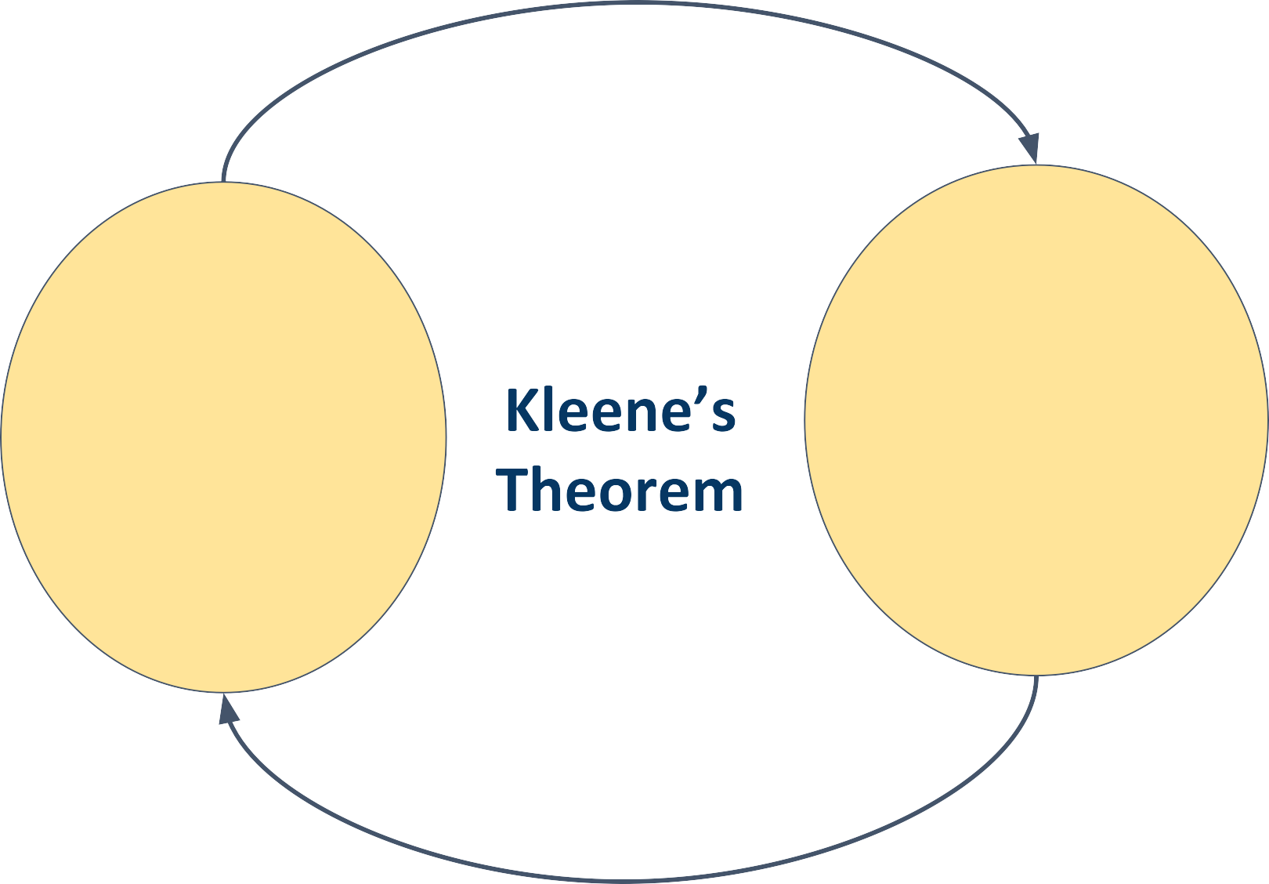
Regular Expression R
Finite Automata M

Slide 4
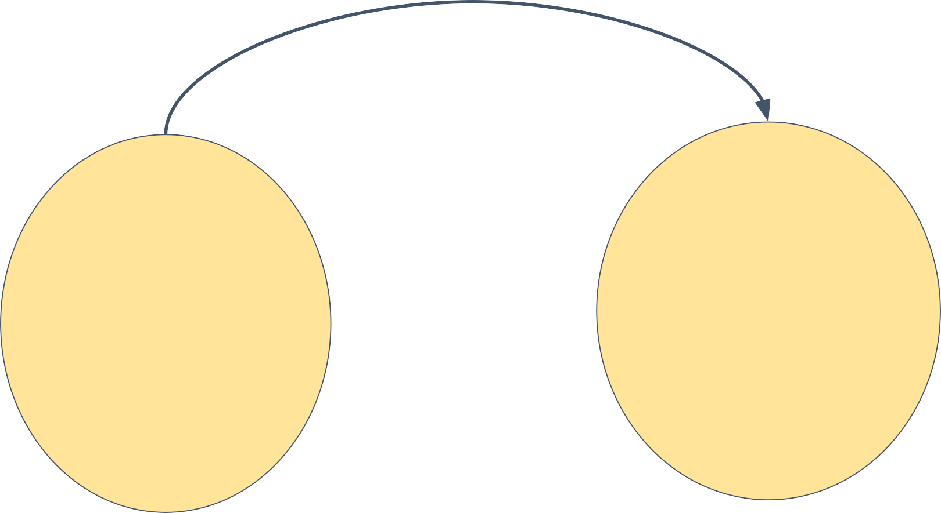
Regular Expression R
Finite Automata M

Slide 5


https://en.wikipedia.org/wiki/Thompson%27s_construction#:~:text=In%20computer%20science%2C%20Thompson's%20co nstruction,strings%20against%20the%20regular%20expression.

Slide 6

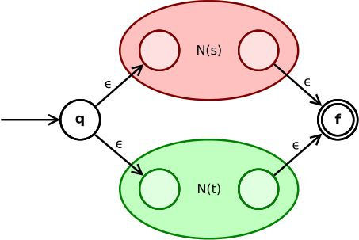
https://en.wikipedia.org/wiki/Thompson%27s_construction#:~:text=In%20computer%20science%2C%20Thompson's%20co nstruction,strings%20against%20the%20regular%20expression.

Slide 7
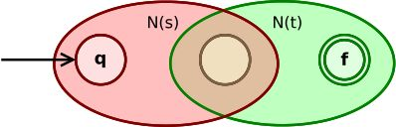
https://en.wikipedia.org/wiki/Thompson%27s_construction#:~:text=In%20computer%20science%2C%20Thompson's%20co nstruction,strings%20against%20the%20regular%20expression.

Slide 8
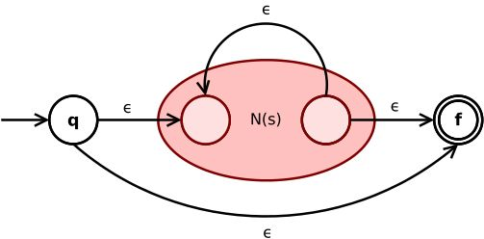

https://en.wikipedia.org/wiki/Thompson%27s_construction#:~:text=In%20computer%20science%2C%20Thompson's%20co nstruction,strings%20against%20the%20regular%20expression.

Slide 9

https://www.cs.york.ac.uk/fp/lsa/lectures/REToC.pdf

Slide 10

q0
q1
https://www.cs.york.ac.uk/fp/lsa/lectures/REToC.pdf

Slide 11
q0
q1
q2
q3
https://www.cs.york.ac.uk/fp/lsa/lectures/REToC.pdf

Slide 12
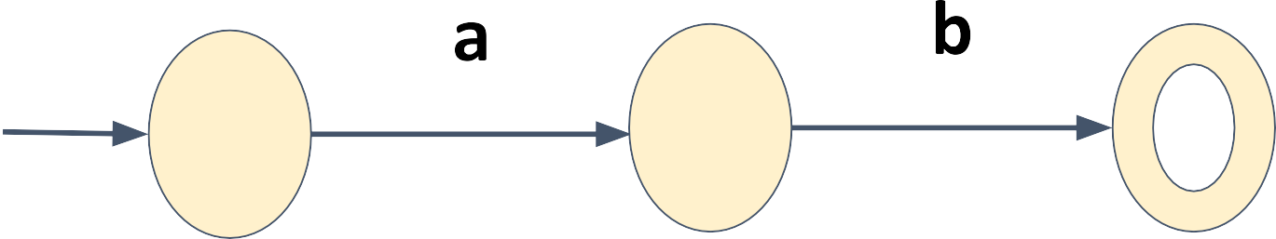
q0
q2
q3
https://www.cs.york.ac.uk/fp/lsa/lectures/REToC.pdf

Slide 13
q0
q2
q3
q4
q5
https://www.cs.york.ac.uk/fp/lsa/lectures/REToC.pdf

Slide 14
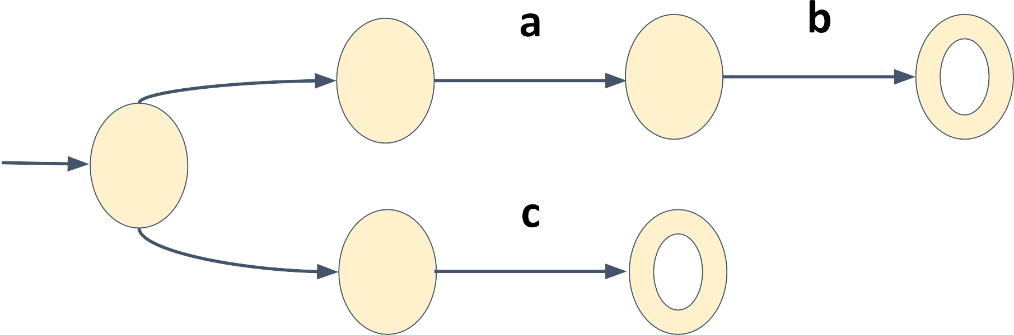
𝜖
q0
q2
q3
qs
𝜖
q4
q5
https://www.cs.york.ac.uk/fp/lsa/lectures/REToC.pdf

Slide 15
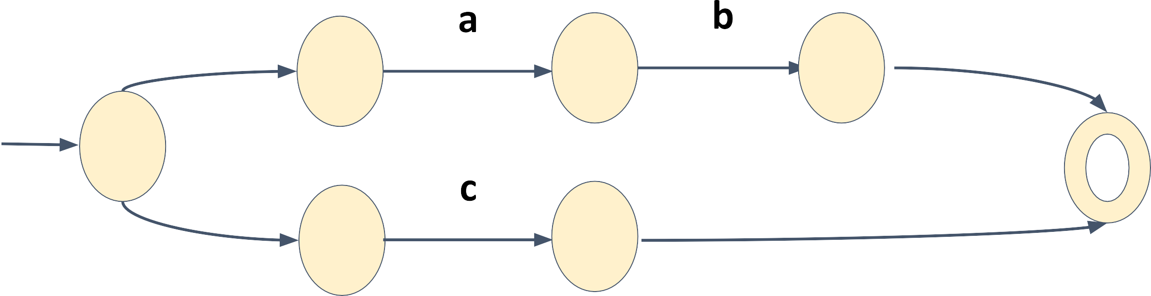
𝜖
𝜖
q0
q2
q3
qs
qf
𝜖
q4
q5
𝜖
https://www.cs.york.ac.uk/fp/lsa/lectures/REToC.pdf

Slide 16
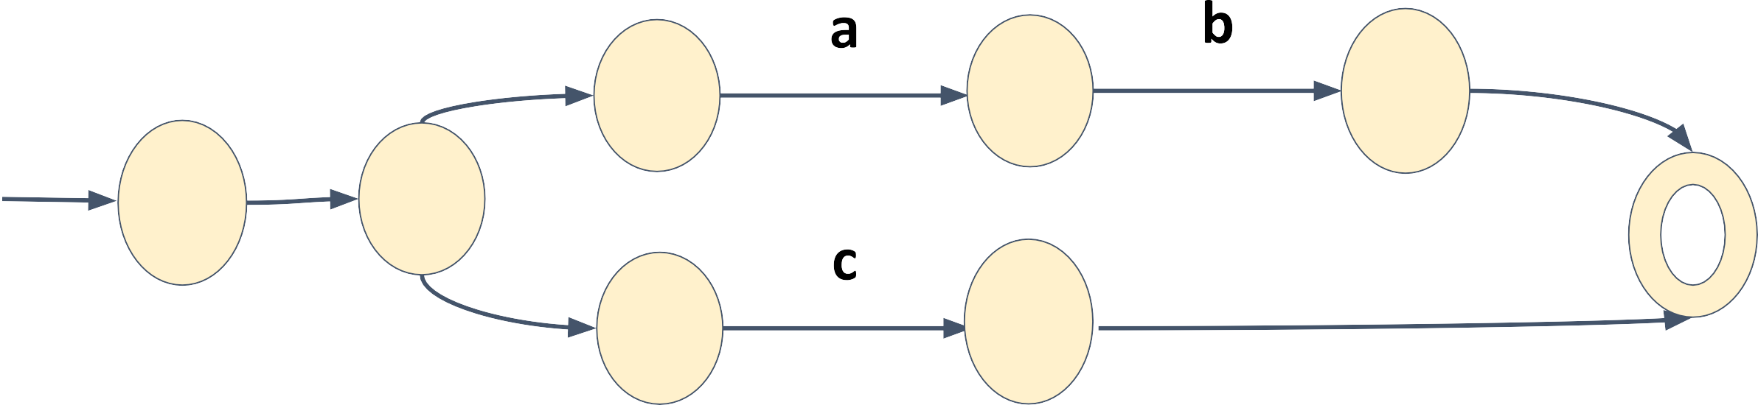
𝜖
𝜖
q 0
q 2
𝜖
q3
q s
S
qf
q 4
q5
𝜖
𝜖
https://www.cs.york.ac.uk/fp/lsa/lectures/REToC.pdf

Slide 17
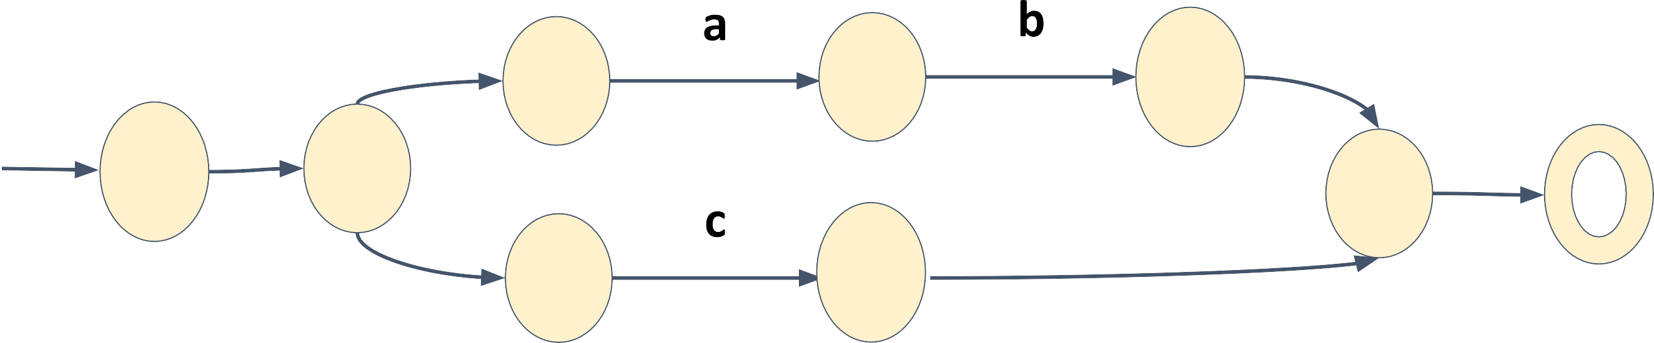
𝜖
𝜖
q 0
q 2
𝜖
q3
q s
𝜖
S
qf
F
q 4
q5
𝜖
𝜖
https://www.cs.york.ac.uk/fp/lsa/lectures/REToC.pdf

Slide 18
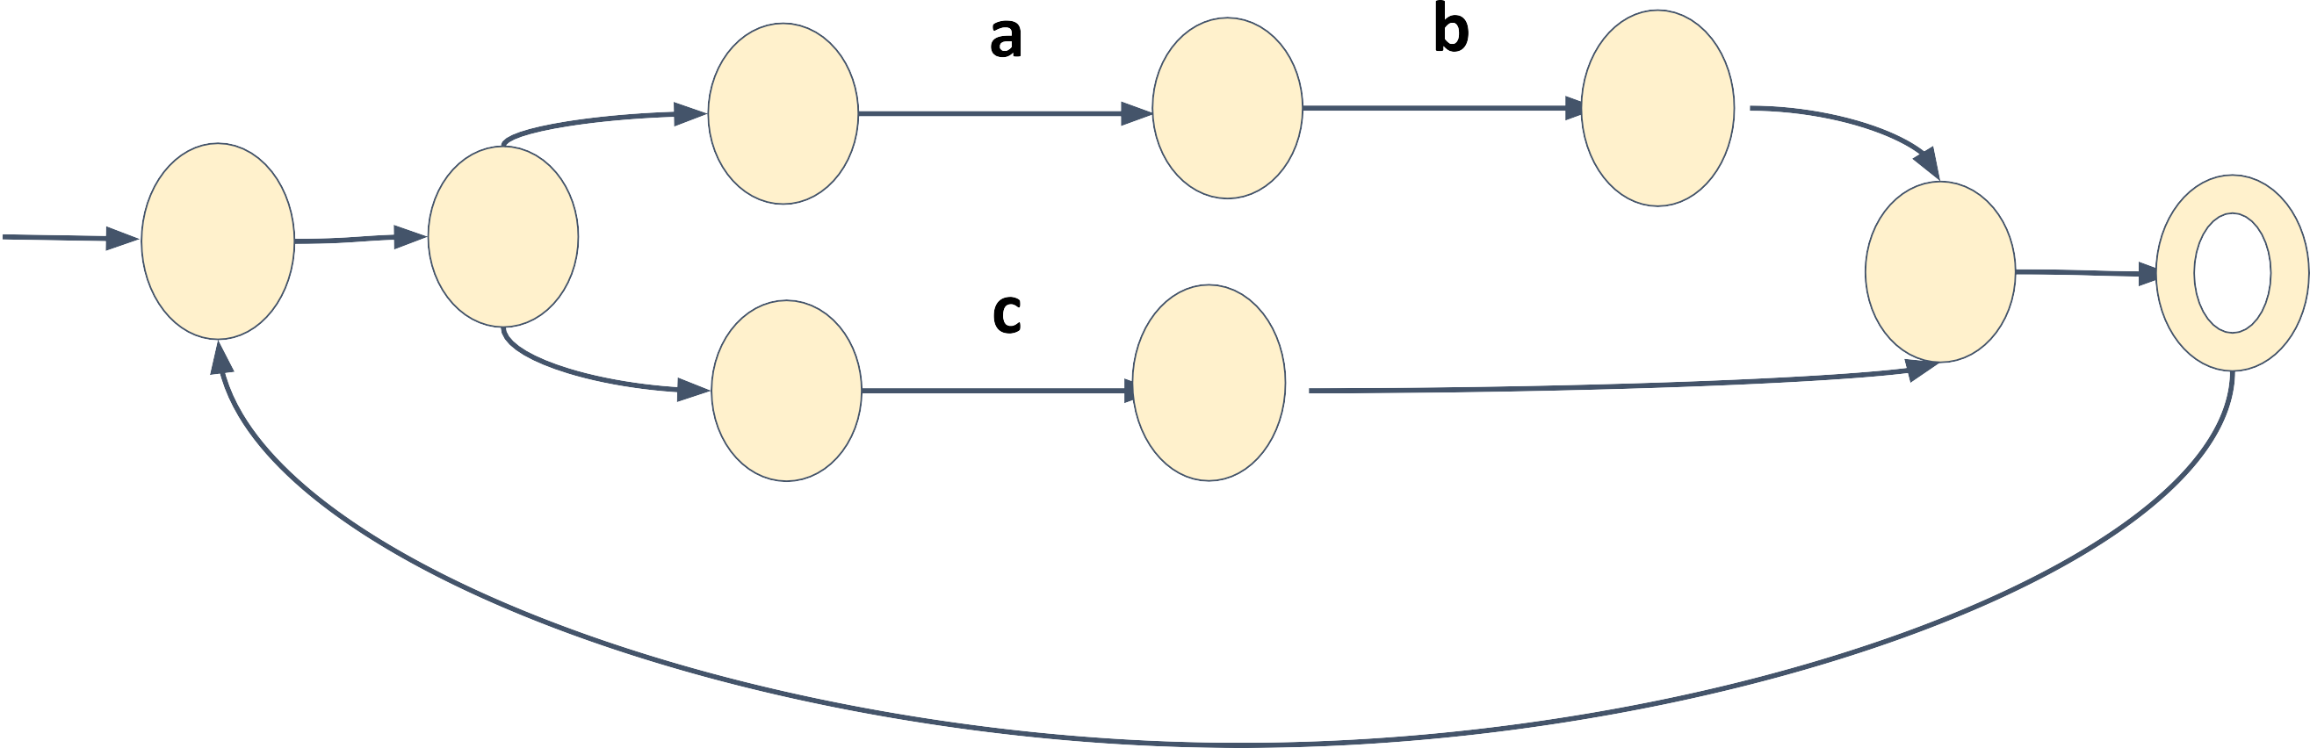
𝜖
𝜖
q 0
q 2
𝜖
q3
q s
𝜖
S
qf
F
q 4
q5
𝜖
𝜖
𝜖
https://www.cs.york.ac.uk/fp/lsa/lectures/REToC.pdf

Slide 19
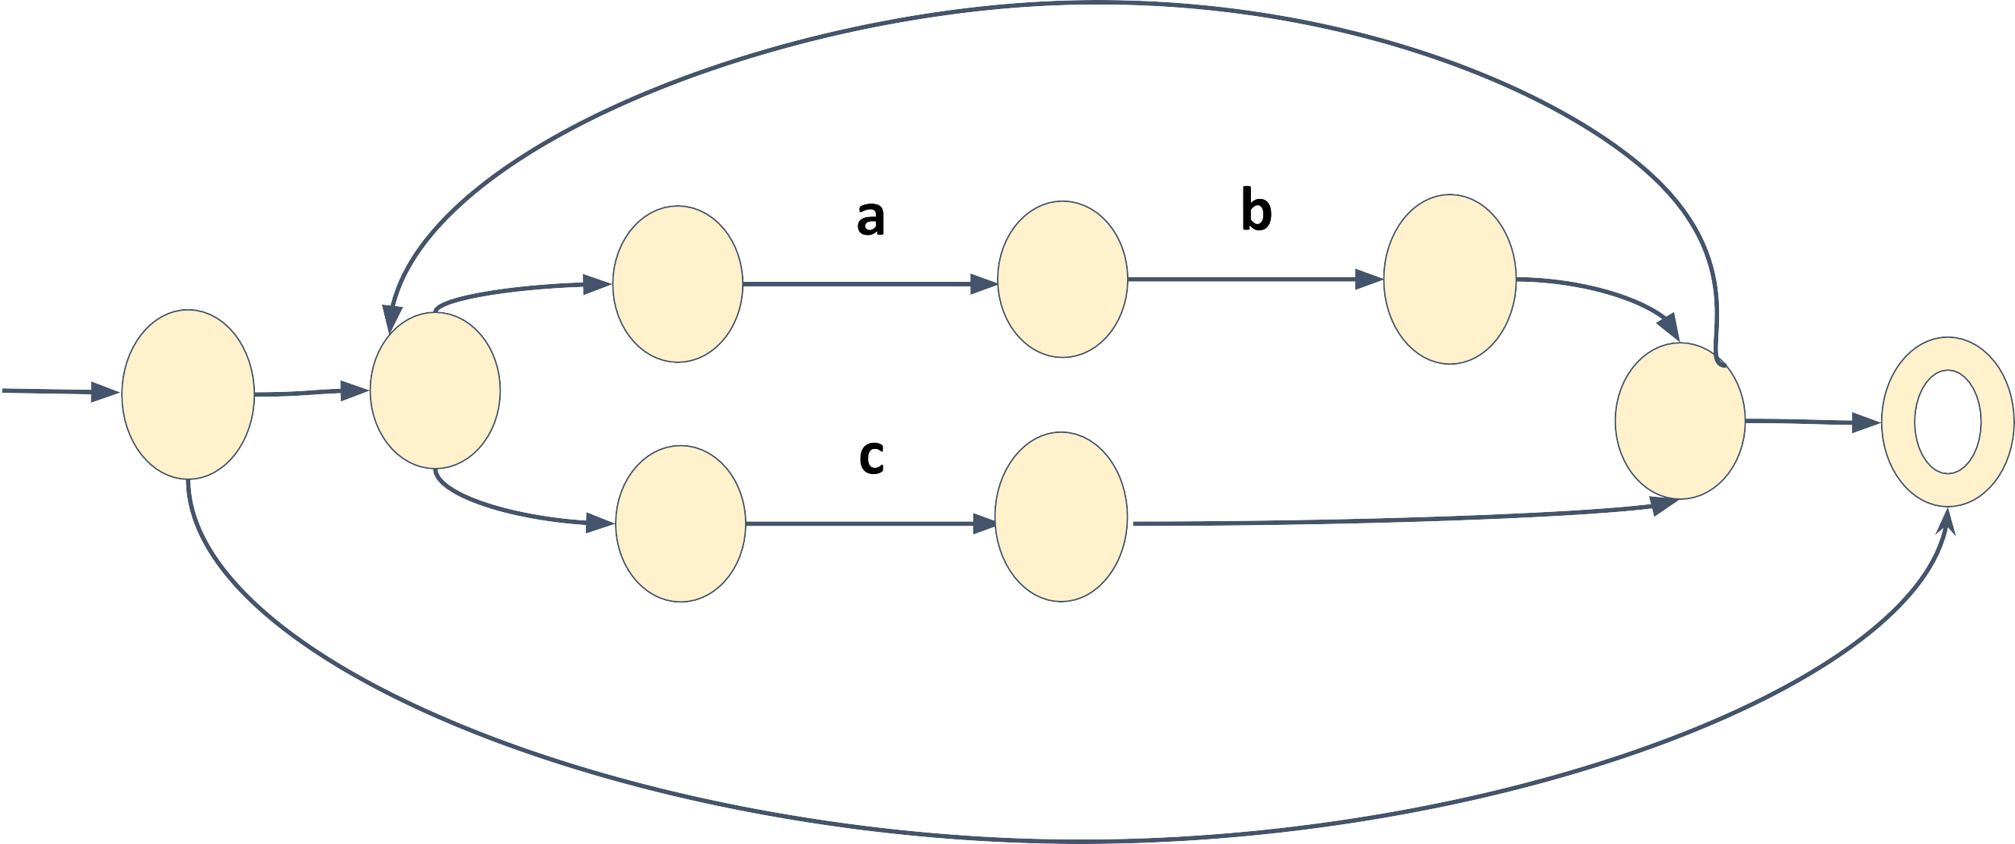
𝜖
𝜖
𝜖
q 0
q 2
𝜖
q3
q s
𝜖
S
qf
F
q 4
q5
𝜖
𝜖
𝜖
https://www.cs.york.ac.uk/fp/lsa/lectures/REToC.pdf

Slide 20
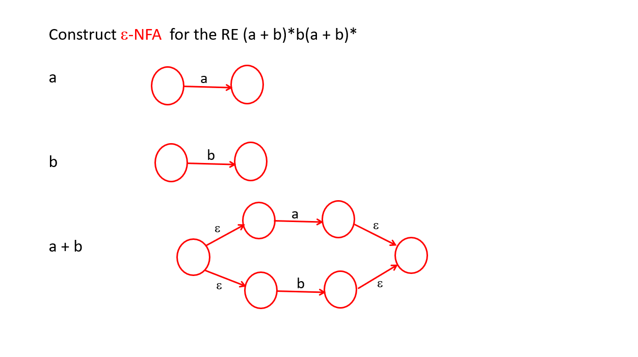
Example 2

Slide 21
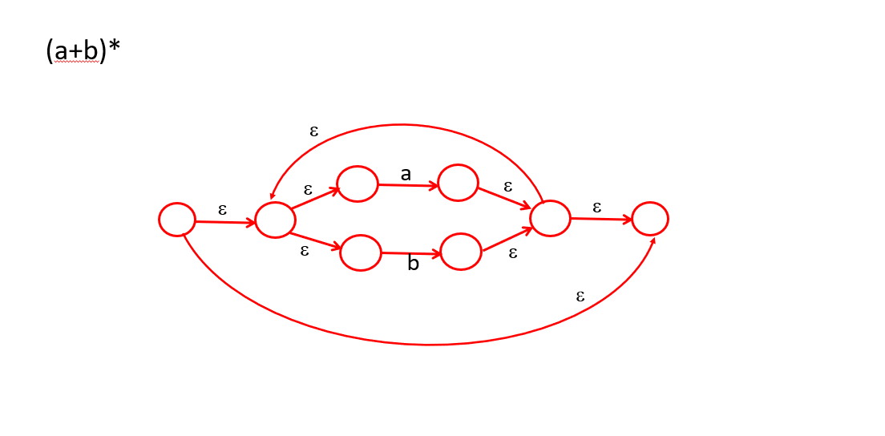
Example 2

Slide 22
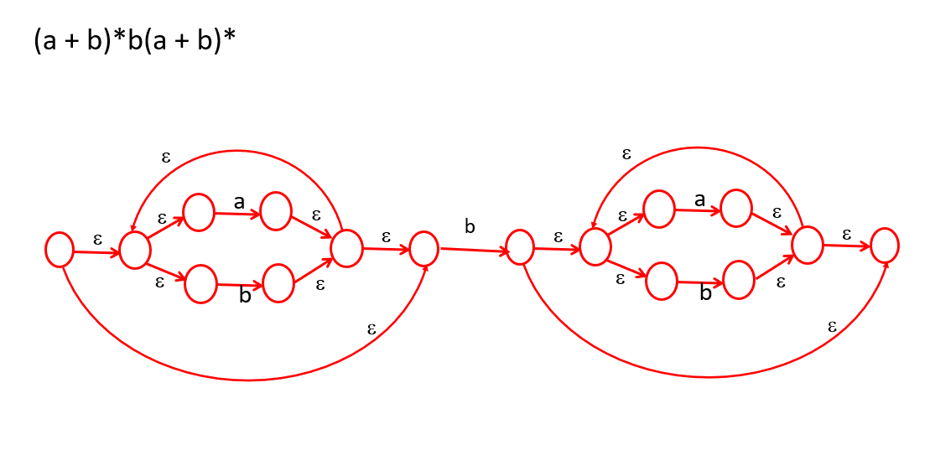
Example 2

