Slide 1


BCSE304L - Theory of Computation
Dr. R. Arumuga Arun,
Cabin : PRP 315(A&B)-19,
Mailid : arumugaarun.r@vit.ac.in.
Winter-Semester 2023-2024
SCOPE
1

Slide 2

Module 3 – Regular Expressions and Languages
Regular Expression - FA and Regular Expressions: FA to regular expression and regular expression to FA - Pattern matching and regular expressions - Regular grammar and FA -Pumping lemma for regular languages - Closure properties of regular languages
Topic : FA to Regular Expressions State Elimination Method
5

Slide 3
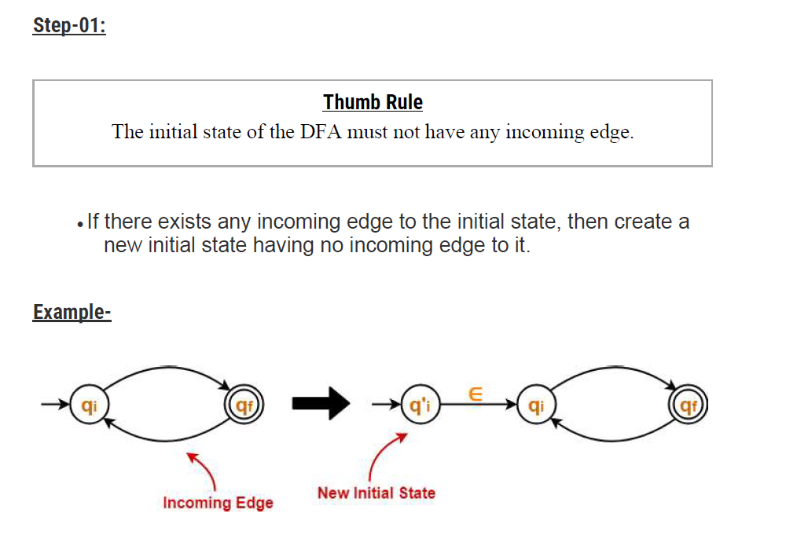
State Elimination Method - Rules

Slide 4
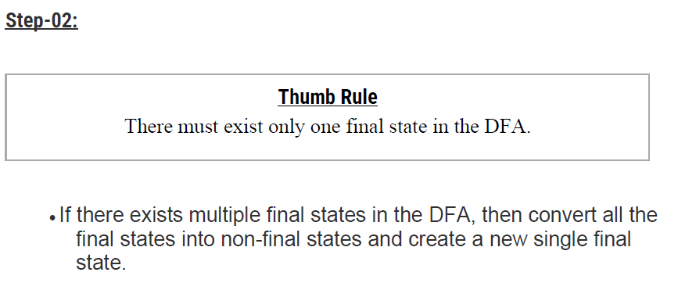
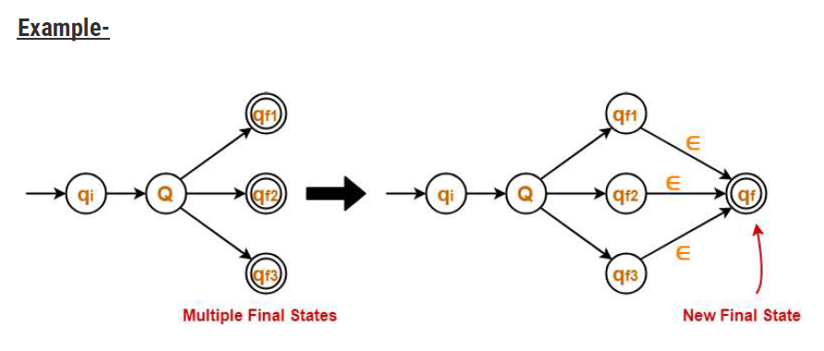
State Elimination Method - Rules

Slide 5
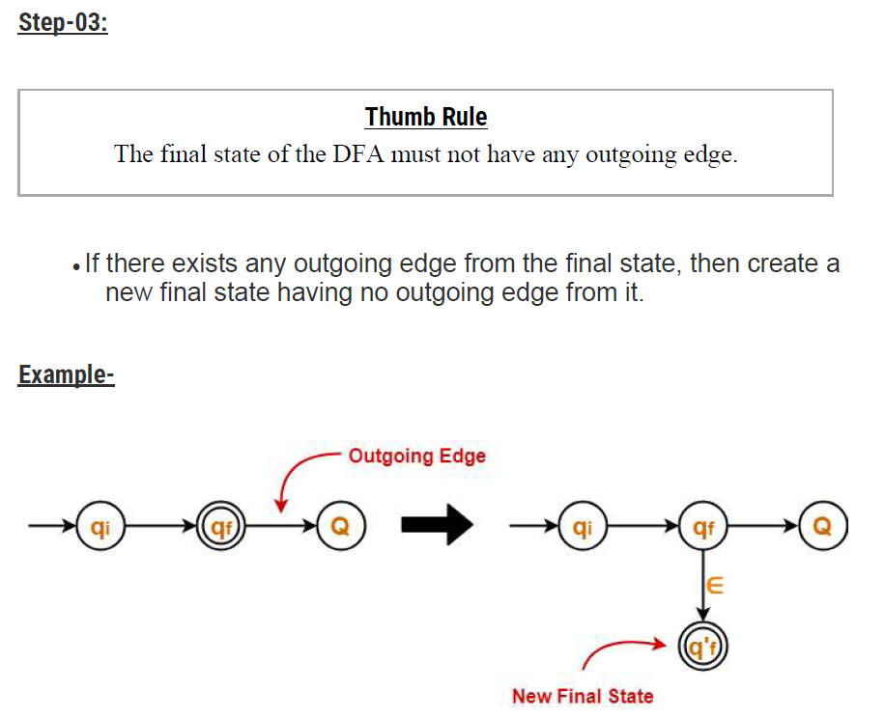
State Elimination Method - Rules

Slide 6
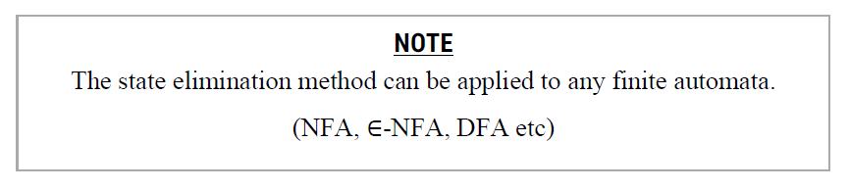
State Elimination Method - Rules
Step-04:
Eliminate all the intermediate states one by one.
These states may be eliminated in any order.
In the end,
Only an initial state going to the final state will be left.
The cost of this transition is the required regular expression.

Slide 7
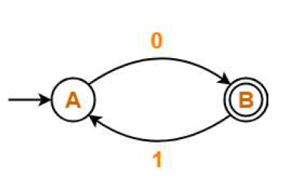
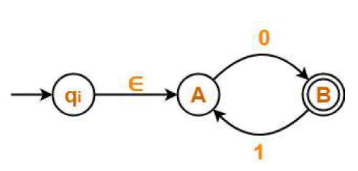
Example 1
Find regular expressions for the following DFA
Solution
Step-01:
Initial state A has an incoming edge.
So, we create a new initial state qi. The resulting DFA is-

Slide 8

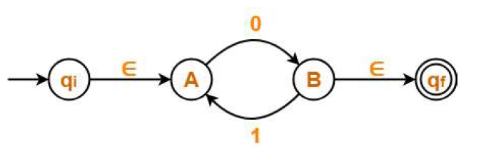
Example 1
Step-02:
Final state B has an outgoing edge.
So, we create a new final state qf. The resulting DFA is-

Slide 9
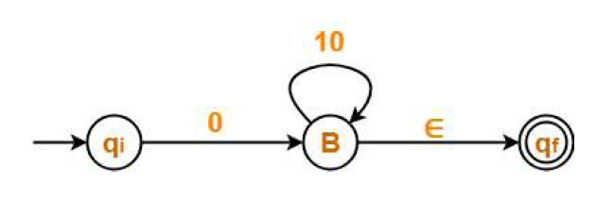
Example 1
Step-03:
Now, we start eliminating the intermediate states.
First, let us eliminate state A.
There is a path going from state qi to state B via state A.
So, after eliminating state A, we put a direct path from state qi to state B having cost ∈.0 = 0
There is a loop on state B using state A.
So, after eliminating state A, we put a direct loop on state B having cost 1.0 = 10.
Eliminating state A, we get-

Slide 10
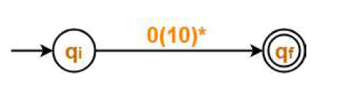


Example 1
Step-04:
Now, let us eliminate state B.
There is a path going from state qi to state qf via state B.
o, after eliminating state B, we put a direct path from state qi to state qf having cost 0.(10)*.∈ = 0(10)*
Eliminating state B, we get-

Slide 11
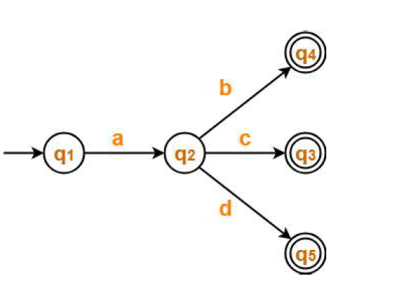
Example 2
Find regular expression for the following DFA

Slide 12
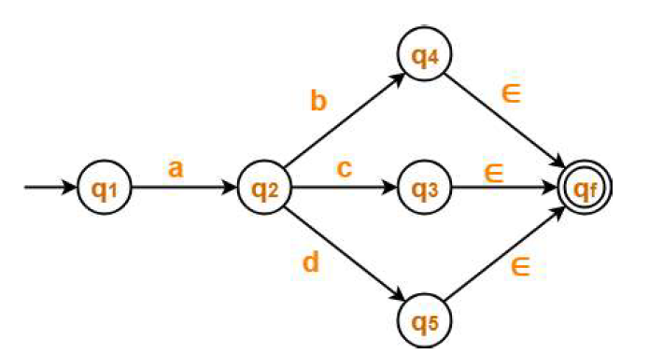
Example 2
Step-01:
There exist multiple final states.
So, we convert them into a single final state.
The resulting DFA is

Slide 13
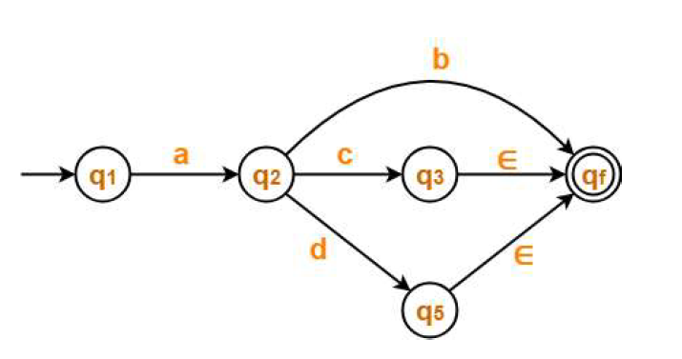
Example 2
Step-02:
First, let us eliminate state q4.
There is a path going from state q2 to state qf via state q4.
So, after eliminating state q4 , we put a direct path from state q2 to
state qf having cost b.∈ = b.

Slide 14
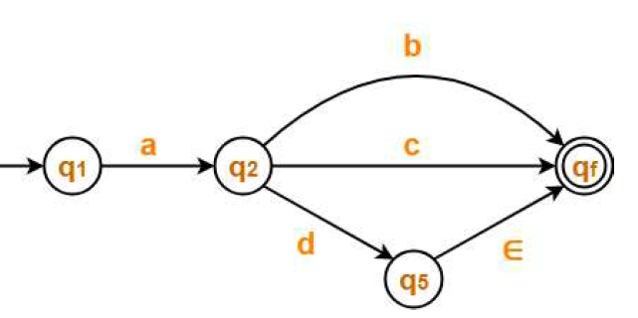
Example 2
Step-03:
Next, let us eliminate state q3
There is a path going from state q2 to state qf via state q3.
So, after eliminating state q3 , we put a direct path from state q2 to state qf having cost c.∈ = c.

Slide 15
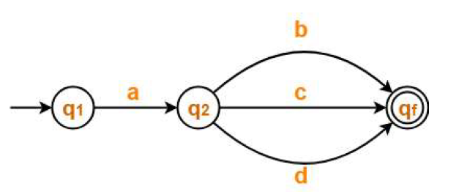
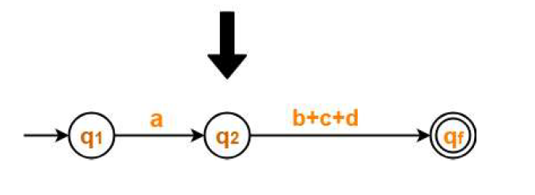
Example 2
Step-04:
Let us eliminate state q5
There is a path going from state q2 to state qf via state q5.
So, after eliminating state q5 , we put a direct path from state q2 to state qf having cost d.∈ = d.

Slide 16
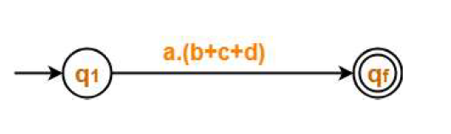


Example 2
Step-05:
Now, let us eliminate state q2
There is a path going from state q1 to state qf via state q2.
So, after eliminating state q2 , we put a direct path from state q1 to state qf having cost a.(b+c+d).

Slide 17
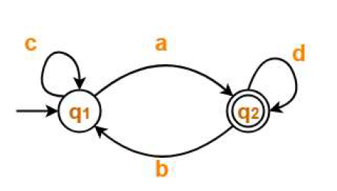
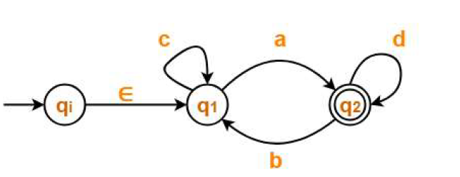
Example 3
Find regular expressions for the following DFA
Solution
Step-01:
Initial state q1 has an incoming edge.
So, we create a new initial state qi.
The resulting DFA is-

Slide 18
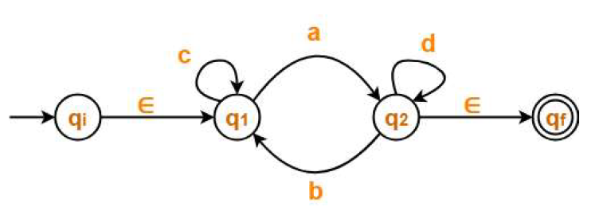
Example 3
Step-02:
Final state q2 has an outgoing edge.
So, we create a new final state qf.
The resulting DFA is

Slide 19
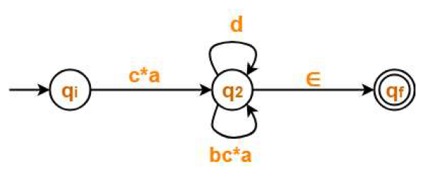
Example 3
Step-03:
Now, we start eliminating the intermediate states.
First, let us eliminate state q1.
There is a path going from state qi to state q2 via state q1 .
So, after eliminating state q1, we put a direct path from state qi to state q2 having cost ∈.c*.a = c*a
There is a loop on state q2 using state q1.
So, after eliminating state q1 , we put a direct loop on state q2 having cost b.c*.a = bc*a
Eliminating state q1, we get-

Slide 20
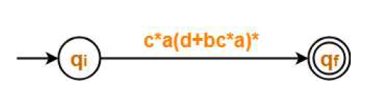

Example 3
Step-04:
Now, let us eliminate state q2.
There is a path going from state qi to state qf via state q2 .
So, after eliminating state q2, we put a direct path from state qi to state qf having cost c*a(d+bc*a)*∈ = c*a(d+bc*a)*
Eliminating state q2, we get-

Slide 21
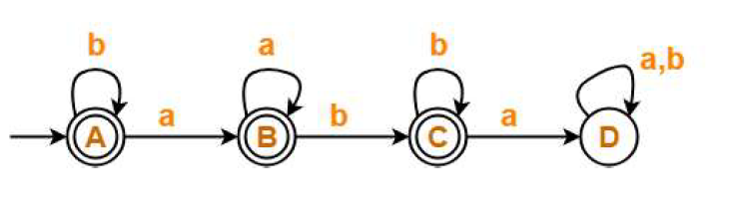
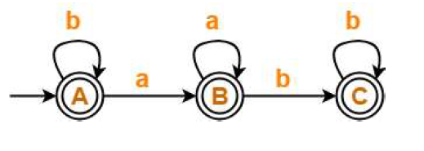
Example 4
Find regular expressions for the following DFA
Solution
Step-01:
State D is a dead state as it does not reach to any final state.
So, we eliminate state D and its associated edges.

Slide 22
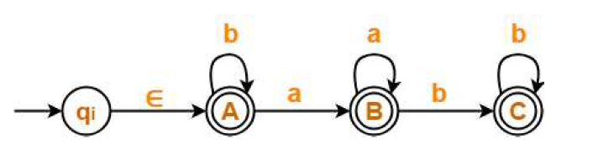
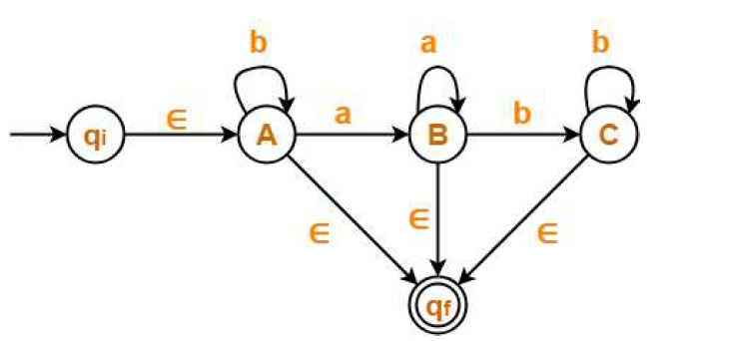
Example 4
Step-02:
Initial state A has an incoming edge (self loop).
So, we create a new initial state qi.
Step-03:
There exist multiple final states.
So, we convert them into a single final state.

Slide 23
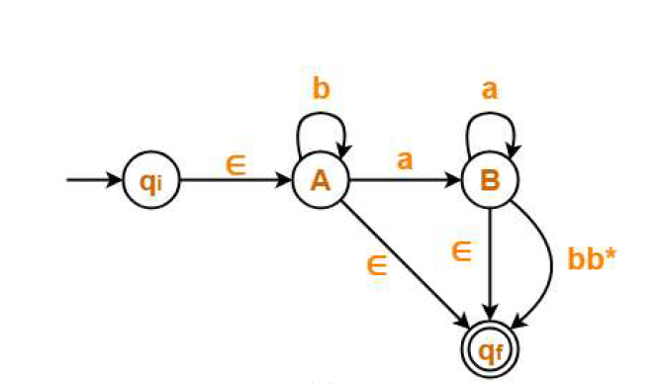
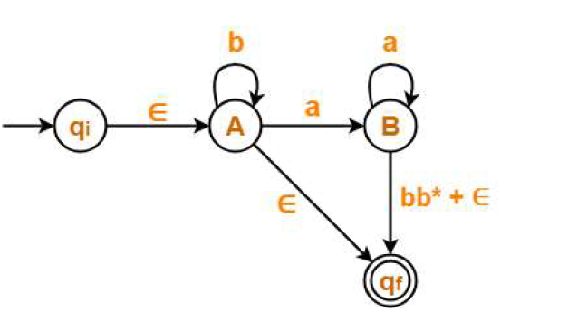
Example 4
Step-04:
First, let us eliminate state C.
There is a path going from state B to state qf via state C.
So, after eliminating state C, we put a direct path from state B to state qf having cost b.b*.∈ = bb*

Slide 24
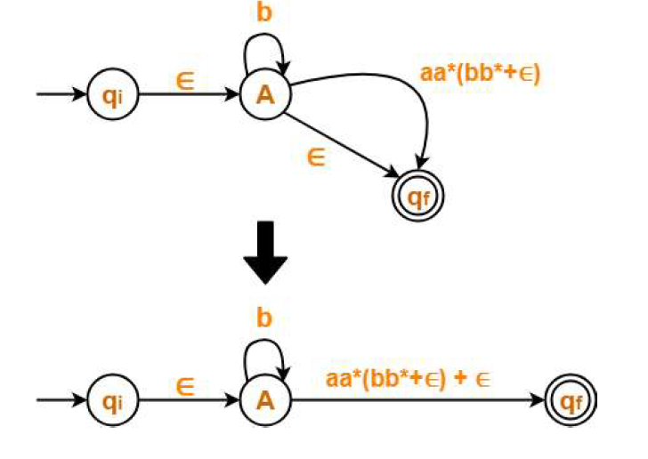
Example 4
Step-05:
Now, let us eliminate state B.
There is a path going from state A to state qf via state B.
So, after eliminating state B, we put a direct path from state A to state qf having cost a.a*.(bb*+∈) = aa*(bb*+∈)

Slide 25
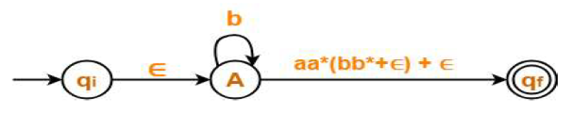
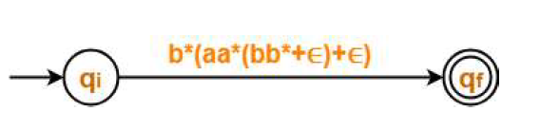

Example 4
Step-06:
Now, let us eliminate state A.
There is a path going from state qi to state qf via state A.
So, after eliminating state A, we put a direct path from state qi to state qf having cost ∈.b*.(aa*(bb*+∈)+∈) = b*(aa*(bb*+∈)+∈)

Slide 26
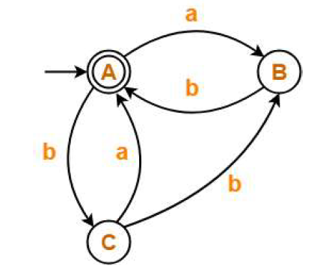
Example 5
Find regular expressions for the following DFA

Slide 27
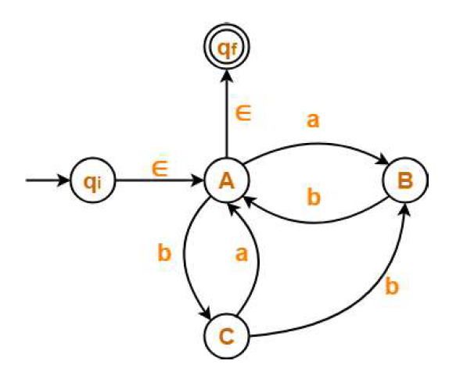
Example 5
Step-01:
Since initial state A has an incoming edge, so we create a new initial state qi.
Since final state A has an outgoing edge, so we create a new final state qf.
The resulting DFA is

Slide 28
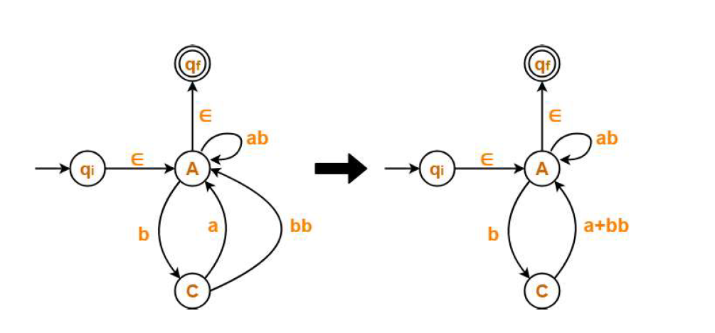
Example 5
Step-02:
Now, we start eliminating the intermediate states.
First, let us eliminate state B.
There is a path going from state C to state A via state B.
So, after eliminating state B, we put a direct path from state C to state A having cost b.b = bb.
There is a loop on state A using state B.
So, after eliminating state B, we put a direct loop on state A having cost a.b = ab.

Slide 29
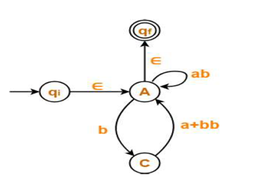
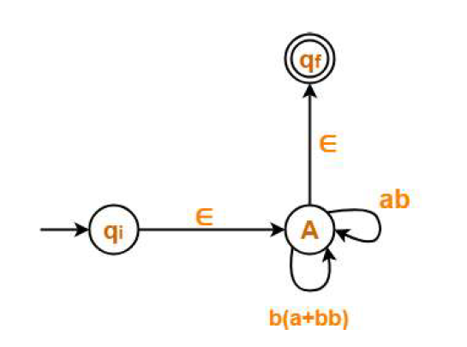
Example 5
Step-03:
Now, let us eliminate state C.
There is a loop on state A using state C.
So, after eliminating state C, we put a direct loop on state A having cost b.(a+bb) = b(a+bb)
Eliminating state C, we get

Slide 30
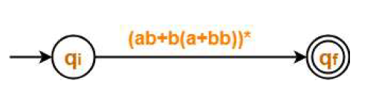

Example 5
Step-04:
Now, let us eliminate state A.
There is a path going from state qi to state qf via state A.
So, after eliminating state A, we put a direct path from state qi to
state qf having cost ∈.(ab + b(a+bb))*∈ = (ab + b(a+bb))*

Slide 31
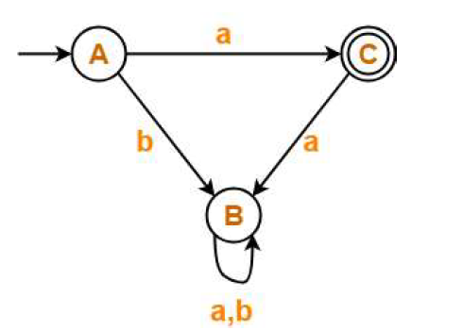
Example 6
Find regular expressions for the following DFA

Slide 32
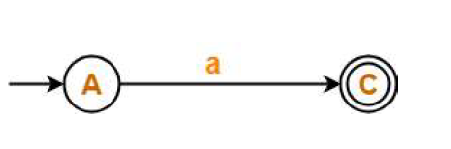

Example 6
State B is a dead state as it does not reach to the final state.
So, we eliminate state B and its associated edges.

Slide 33
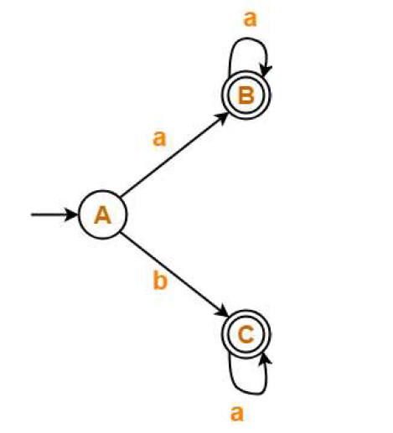
Example 7
Find regular expressions for the following DFA

Slide 34
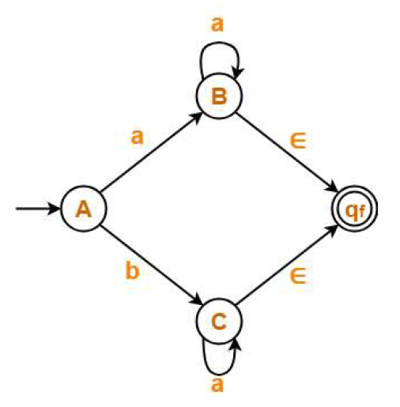
Example 7
Step: 01
There exist multiple final states.
So, we create a new single final state

Slide 35
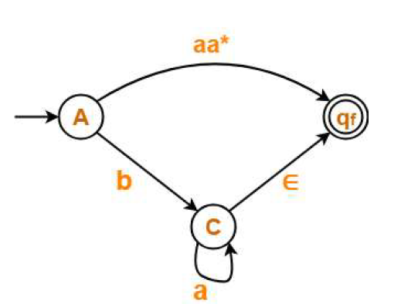
Example 7
Step: 02
First, let us eliminate state B.
There is a path going from state A to state qf via state B.
So, after eliminating state B, we put a direct path from state A to
state qf having cost a.a*.∈ = aa*.

Slide 36
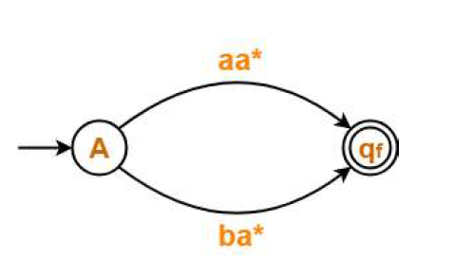
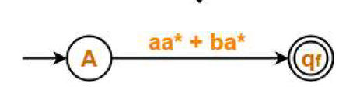

Example 7
Step: 03
Now, let us eliminate state C.
There is a path going from state A to state qf via state C.
So, after eliminating state C, we put a direct path from state A to state qf having cost b.a*.∈ = ba*.

