Slide 1


BCSE304L - Theory of Computation
Dr. R. Arumuga Arun,
Cabin : PRP 315(A&B)-19,
Mailid : arumugaarun.r@vit.ac.in.
Winter-Semester 2023-2024
SCOPE
1

Slide 2

Module 3 – Regular Expressions and Languages
Regular Expression - FA and Regular Expressions: FA to regular expression and regular expression to FA - Pattern matching and regular expressions - Regular grammar and FA -Pumping lemma for regular languages - Closure properties of regular languages
Topic : Regular Grammar and FA
5

Slide 3
Constructing Regular Grammar from DFA

Slide 4
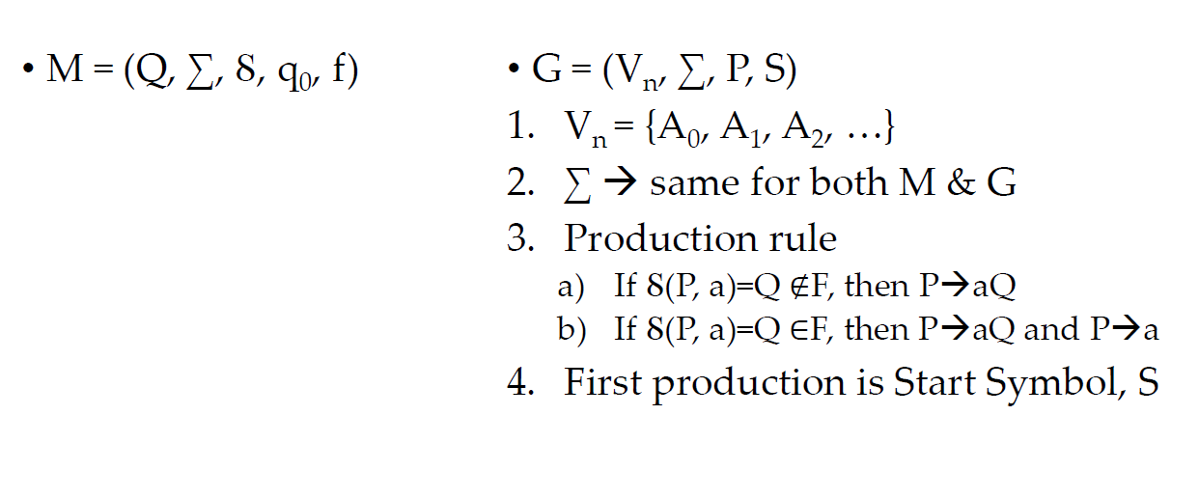
Constructing Regular Grammar from DFA

Slide 5
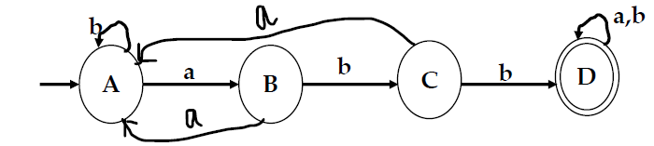

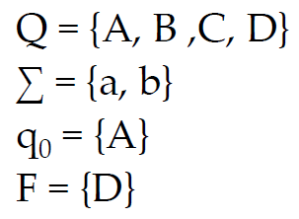
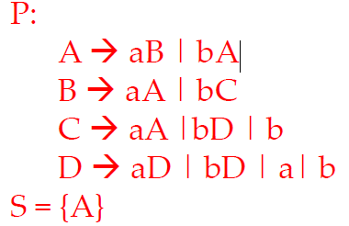
Example 1
Construct a Regular grammar for the following DFA

Slide 6
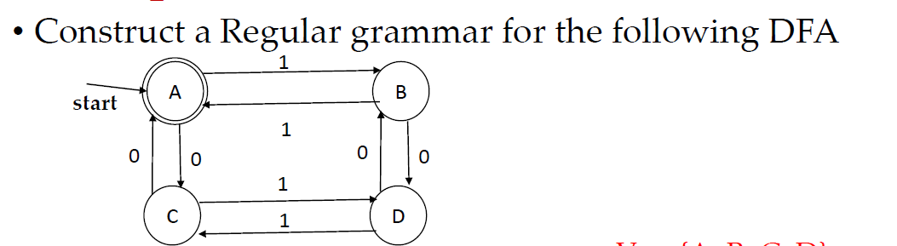
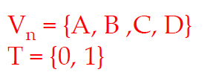
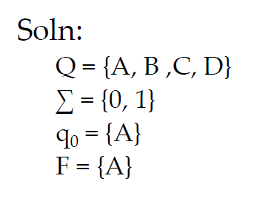
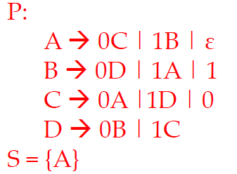
Example 2

Slide 7
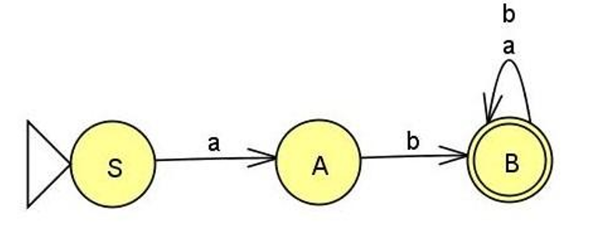
Example 3
Construct a Regular grammar for the following DFA
V = {S, A, B}
T = {a, b}
Soln:
Q = {S, A, B}
Σ = {a,b}
q0 = {S}
F = {B}
S→ aA
A→ bB|b
B→ aB|bB|a|b

Slide 8
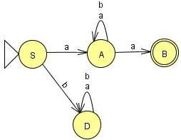
Example 4
Construct a Regular grammar for the following FA
V = {S, A, B}
T = {a, b}
Soln:
Q = {S, A, B, D}
Σ = {a,b}
q0 = {S}
F = {B}
S→ aA
A→ aA|bA|aB|a

Slide 9
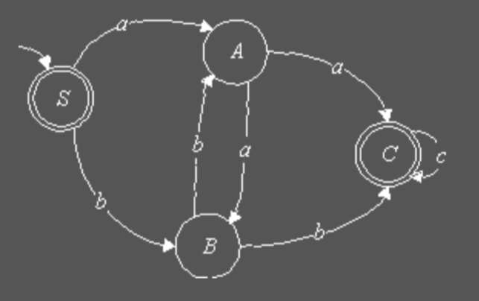
Example 5
Construct a Regular grammar for the following FA

Slide 10
Constructing DFA from Regular Grammar

Slide 11
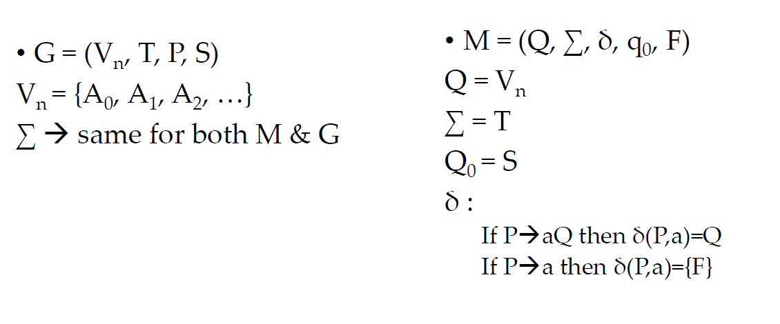
Constructing DFA from Regular Grammar

Slide 12
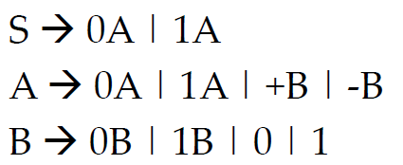
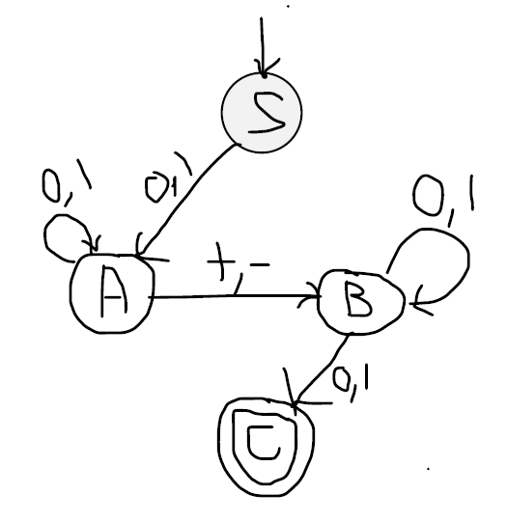
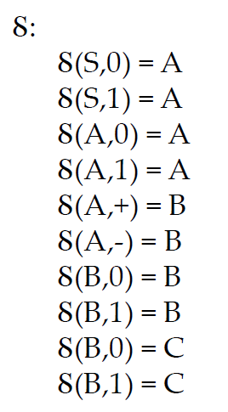
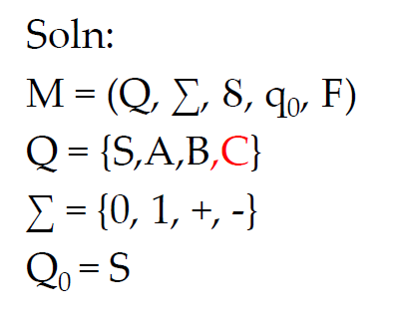
Example 1
Construct a FA from the following regular grammar:

Slide 13
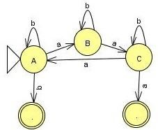
Example 2
Construct a FA from the following regular grammar:
Example 1 :
A→aB|bA|b B→aC|bB C→aA|bC|a
Ꟙ(A,a) = B
Ꟙ(A,b) = A
Ꟙ(A,b) = F1
Ꟙ(B,a) = C
Ꟙ(B,b) = B
Ꟙ(C,a) = A
Ꟙ(C,b) = C
Ꟙ(C,a) = F2

Slide 14
Example 3
S→01A A→10B B→0A|11

Slide 15
Example 3
S→01A A→10B B→0A|11
0
1
S
A

Slide 16
Example 3
S→01A A→10B B→0A|11
0
1
1
0
S
A
B

Slide 17
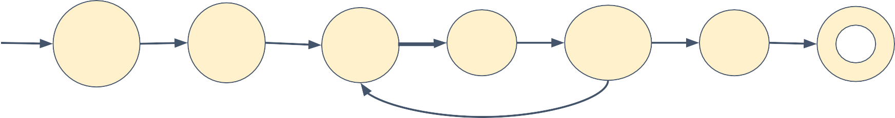
Example 3
S→01A A→10B B→0A|11
B→11 indicates on state B on consuming the input 11 we reach final state
1
0
1
1
0 1
S
A
B
0

Slide 18
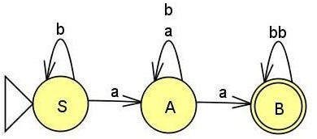
Example 4
Construct a FA from the following regular grammar:
S→bS|aA A→aA|bA A→aB B→bbB B→𝜆
Ꟙ(S,b) = S
Ꟙ(S,a) = A
Ꟙ(A,a) = A
Ꟙ(A,b) = A
Ꟙ(A,b) = B
Ꟙ(B,bb) = B
Ꟙ(B, 𝜆) = B

Slide 19
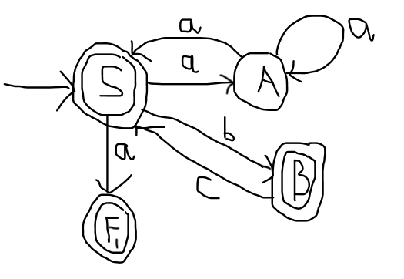
Example 5
Construct a FA from the following regular grammar:
S → a | aA | bB | ε
A → aA | aS
B → cS | ε

Slide 20
Construct a regular grammar for a given language description

Slide 21
Construct a regular grammar for the given language
Language | RE | RG
L = {a} | a | S -> a

Slide 22
Construct a regular grammar for the given language
Language | RE | RG
L = {a, b} | a+b | S -> a | b or S -> a S -> b

Slide 23
Construct a regular grammar for the given language
Language | RE | RG
L = {ab} | ab | S -> ab

Slide 24
Construct a regular grammar for the language L={a^{n}|n>=0}
Language | RE | RG
L = {ε,a,aa,aaa,...} | a* | S -> aS|ε

Slide 25
Construct a regular grammar for the language L={a^{n}|n>=1}
Language | RE | RG
L = {a,aa,aaa,...} | _{a}+ | S -> aS | a

Slide 26
Construct a regular grammar for the regular expression (a+b)*
Language | RE | RG
L = {ε,a,b,abb,baaaab,. .....} L={any number of ‘as and b’s} | (a+b)* | S -> aS | bS | ε

Slide 27
Construct a regular grammar for the regular expression (a+b)⁺
Language | RE | RG
L = {𝛌,a,b,abb,baaaab,. .....} L={any number of ‘as and b’s} | (a+b)⁺ | S -> aS | bS | a | b

Slide 28
Construct a regular grammar for the regular expression (ab)*
Language | RE | RG
L = {ε,a,b,ab,ababab,... ...} L={any number of ab’s} | (ab)* | S -> abS | ε

Slide 29
Construct a regular grammar for the language L={a^{m} b^{n}
|n,m>=0}
Language | RE | RG
L={,a,b,bb,abb,..... .} L={any number of a’s followed by any number of b’s} | a*b* | S -> aS|bB|ε B->bB|ε

Slide 30
Construct a regular grammar for the given language with even number of a’s. L={a^{2n} |n>=0}
Language | RE | RG
L={ε, aa, aaaa,aaaaaa…. | (aa)* | S -> aaS | ε

Slide 31
Construct a regular grammar for the given language with
odd number of a’s. L={a^{2n+1} |n>=0}
Language | RE | RG
L={a, aaa, aaaaa, aaaaaaa …. | (aa)*a | S -> aaS | a

Slide 32
Construct a regular grammar for the given language with number of a’s as multiples of 4. L={a^{4n} |n>=0}
Language | RE | RG
L={ε, aaaa, aaaaaaaa, aaaaaaaaaaaa, …. | (aaaa)* | S -> aaaaS | ε

Slide 33
Convert finite automata to regular grammar for the language to accept at least one ‘a’ over the alphabet 𝝨={a,b}
Language | RE | RG
L={a, bb... a, ba any # of a’s & b’s | b* a (a+b)* | S -> bS | aA A -> aA | bA | ε

Slide 34
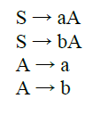
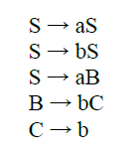
1. Find the grammar for the regex (a+b) (a+b)
2. Find the Grammar for (a+b)*abb

Slide 35
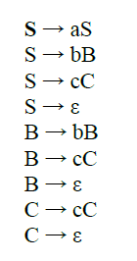
3. Find the grammar for the regex a*b*c*

Slide 36
4. Find the grammar for the regex (a+b)*aa(a+b)*
S → aS | bS | aA
A → aB
B → aB | bB | ε
5. Find the grammar for the regex (a+b)*(a+bb)
S → aS | bS | a | bB
B → b

