Slide 1


BCSE304L - Theory of Computation
Dr. R. Arumuga Arun,
Cabin : PRP 315(A&B)-19,
Mailid : arumugaarun.r@vit.ac.in.
Winter-Semester 2023-2024
SCOPE
1

Slide 2

Module 3 – Regular Expressions and Languages
Regular Expression - FA and Regular Expressions: FA to regular expression and regular expression to FA - Pattern matching and regular expressions - Regular grammar and FA -Pumping lemma for regular languages - Closure properties of regular languages
Topic : Pumping lemma for regular languages
5

Slide 3
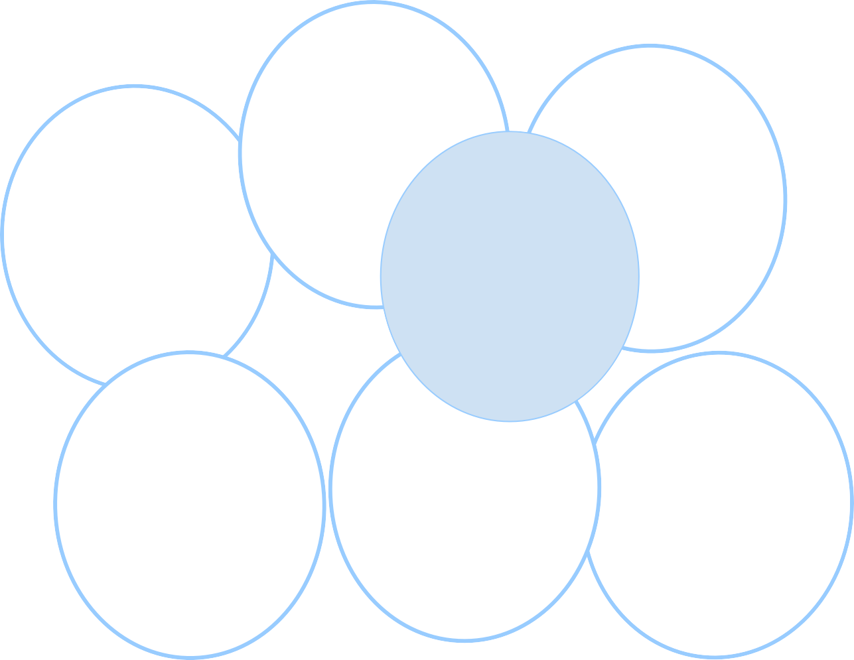
Unit 3- Pumping Lemma for Regular Languages
𝜮*
𝜮 = {a,b}
n
(w) >
a
(w)
n
n
n
b
a
b
|w| = 2
a*b*
|w|
awa
mod 5
ww
R
=2

Slide 4
Unit 3- Pumping Lemma for Regular Languages
𝜮 = {a,b}
𝜮*
Language
Finite

Slide 5
Unit 3- Pumping Lemma for Regular Languages
𝜮 = {a,b}
𝜮*
Language
Finite
|w| <= 2
or
|w| = 2

Slide 6
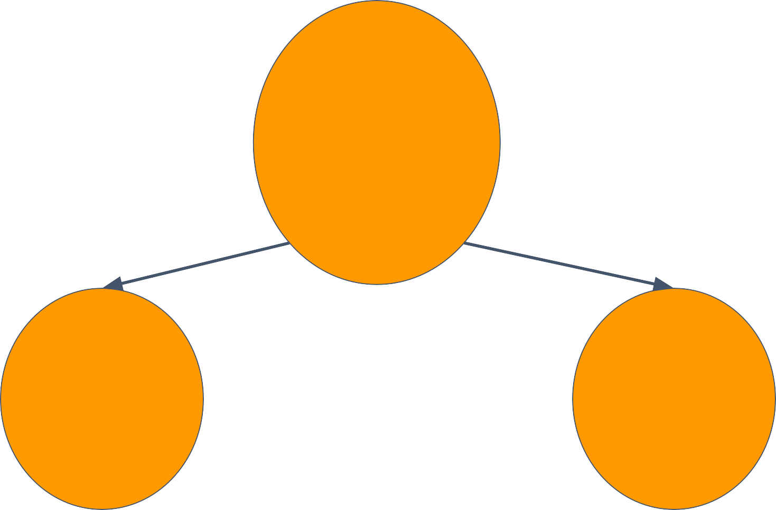
Unit 3- Pumping Lemma for Regular Languages
𝜮 = {a,b}
𝜮*
Language
Finite
Infinite
|w| <= 2
or
|w| = 2

Slide 7
Unit 3- Pumping Lemma for Regular Languages
𝜮 = {a,b}
𝜮*
Language
Finite
Infinite
|w| <= 2 or
|w| = 2
n_{a}(w) >= 2 or
n_{a}(w) = n_{b}(w)

Slide 8
Unit 3- Pumping Lemma for Regular Languages
Is there any infinite language for which we cannot construct a Finite Automata?
That means, a language which is not regular?

Slide 9
Unit 3- Pumping Lemma for Regular Languages
Let's look at an example :
a*b*

Slide 10
Unit 3- Pumping Lemma for Regular Languages
Let's look at an example :
a
b
a*b*
𝝀
S
F

Slide 11
Unit 3- Pumping Lemma for Regular Languages
Let's look at an example :
a
b
a*b*
𝝀
S
F
S -> aS | F
F -> bF | 𝝀

Slide 12



Unit 3- Pumping Lemma for Regular Languages
Regex
Let's look at an example :
a
FA
b
a*b*
𝝀
S
F
S -> aS | F
F -> bF | 𝝀
Regular
Grammar

Slide 13
Unit 3- Pumping Lemma for Regular Languages
Regex
Let's look at an example :
a
FA
b
a*b*
𝝀
S
F
Deﬁnitely Regular !
S -> aS | F
F -> bF | 𝝀
Regular
Grammar

Slide 14
Unit 3- Pumping Lemma for Regular Languages
For the language a^{n}b^{n} Can we construct either of :
a*b*
_{a}n_{b}n
n>0
Finite Acceptor or
Regular Grammar or
Regular Expression
????????????

Slide 15
Unit 3- Pumping Lemma for Regular Languages
a*b*
_{a}n_{b}n
n>0
aaaaaaaaaaaaaaaaaaaaaaaa bbbbbbbbbbbbbbbbbbbbbb
state q

Slide 16
Unit 3- Pumping Lemma for Regular Languages
Basically,
a*b*
_{a}n_{b}n
n>0
There is no way to remember how many a’s you have seen to compare with the upcoming b’s !
The value of n could be anything!
We cannot come up with a FA that takes care of all n!

Slide 17
Unit 3- Pumping Lemma for Regular Languages
Basically,
a*b*
_{a}n_{b}n
n>0
There is no way to remember how many a’s you have seen to compare with the upcoming b’s !
Deﬁnitely Non-Regular !
The value of n could be anything!
We cannot come up with a FA that takes care of all n!

Slide 18
Unit 3- Pumping Lemma for Regular Languages
Basically,
a*b*
_{a}n_{b}n
n>0
There is no way to remember how many a’s you have seen to compare with the upcoming b’s !
Finite
Automata
Deﬁnitely Non-Regular !
has limits !
The value of n could be anything!
We cannot come up with a FA that takes care of all n!

Slide 19
Unit 3- Pumping Lemma for Regular Languages
Limits of Finite Automata :
a*b*
_{a}n_{b}n
n>0
Finite Memory !
String comparison not possible - A finite automata can only "count" ; that is, It can maintain a counter, where different states correspond to different values of the counter.
Linear Power :
an n>0 is possible but a^{n^2}, a^{2^n}, a^{i} where i is prime is not

Slide 20


Unit 3- Pumping Lemma for Regular Languages
𝜮*
Language
Finite
Infinite
Definitely Regular
Regular
a*b*
Non-Regular
_{a}n_{b}n

Slide 21
Unit 3- Pumping Lemma for Regular Languages
𝜮*
Infinite Lang
Test for Regularity
Regular
Non-Regular

Slide 22
Unit 3- Pumping Lemma for Regular Languages
𝜮*
Infinite Lang
Regular Language
Pumping Property

Slide 23
Unit 3- Pumping Lemma for Regular Languages
𝜮*
Infinite Lang
DFA
NFA
Regular Language
Pumping Property

Slide 24
Unit 3- Pumping Lemma for Regular Languages
Let’s take an example of infinite regular language ab*c
b
a
c
q₀
q₁
q₂

Slide 25
Unit 3- Pumping Lemma for Regular Languages
Let’s take an example of infinite regular language ab*c
b
a
c
q₀
q₁
q₂
a
b
b b c
q₀

Slide 26
Unit 3- Pumping Lemma for Regular Languages
Let’s take an example of infinite regular language ab*c
b
a
c
q₀
q₁
q₂
a
b
b b c
q₀
q₁

Slide 27
Unit 3- Pumping Lemma for Regular Languages
Let’s take an example of infinite regular language ab*c
b
a
c
q₀
q₁
q₂
a
b
b b c
q₀
q₁
q₁

Slide 28
Unit 3- Pumping Lemma for Regular Languages
Let’s take an example of infinite regular language ab*c
b
a
c
q₀
q₁
q₂
a
b
b
b c
q₀
q₁
q₁
q₁

Slide 29
Unit 3- Pumping Lemma for Regular Languages
Let’s take an example of infinite regular language ab*c
b
a
c
q₀
q₁
q₂
a
b
b
b c
q₀
q₁
q₁
q₁
q₁

Slide 30
Unit 3- Pumping Lemma for Regular Languages
Let’s take an example of infinite regular language ab*c
if |w| >= n
we visit a set of states more than once
b
a
c
q₀
q₁
q₂
a
b
b
b c
q₀
q₁
q₁
q₁
q₁
q₂

Slide 31

Unit 3- Pumping Lemma for Regular Languages
if |w| >= n
we visit a set of states more than once
The Pigeonhole Principle

Slide 32
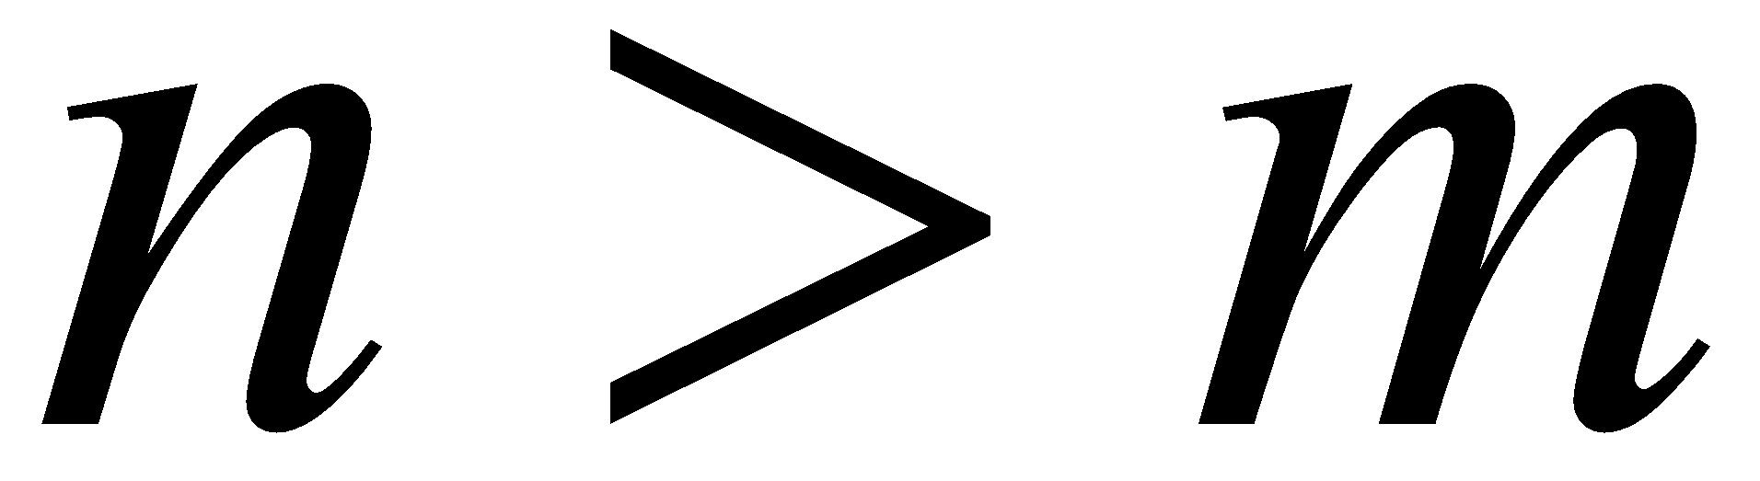

Unit 3- Properties of Regular Languages
The Pigeonhole Principle
pigeons
pigeonholes
There is a pigeonhole with more than 1 pigeon
……..

Slide 33
Unit 3- Properties of Regular Languages
The Pigeonhole Principle
if |w| > n
A set of states will be visited more than once
pigeons
pigeonholes
String
# States n
There is a pigeonhole with more than 1 pigeon
……..

Slide 34
Unit 3- Pumping Lemma for Regular Languages
Let’s take an example of infinite regular language ab*c
if |w| >= n
we visit a set of states more than once which means,
b
a
c
there exists a loop in our Automata (within these n states)
if we pump that loop 0 or more no. of times,
the resultant string will always be in the language
q₀
q₁
q₂
a
b
b
b c
q₀
q₁
q₁
q₁
q₁
q₂

Slide 35
Unit 3- Pumping Lemma for Regular Languages
Let’s take an example of infinite regular language ab*c
There exists 3 parts to a string w:
b
w = x y z
a
c
q₀
q₁
q₂
Part before the loop
The loop
Part after the loop
a
b
b
b
c
q₀
q₁
q₁
q₁
q₁
q₂

Slide 36
Unit 3- Pumping Lemma for Regular Languages
Let’s take an example of infinite regular language ab*c
There exists 3 parts to a string w:
b
w = x y z
a
c
q₀
q₁
q₂
Part before the loop
The loop
Part after the loop
b
a
c
a
b
b
b
c
q₀
q₁
q₁
q₁
q₁
q₂

Slide 37
Unit 3- Pumping Lemma for Regular Languages
Let’s take an example of infinite regular language ab*c
There exists 3 parts to a string w:
b
w = x y z
a
c
q₀
q₁
q₂
Part before the loop
The loop
Part after the loop
b
a
c
a
b
b
b
c
q₀
q₁
q₁
q₁
q₁
q₂
y ≠ 𝜖 that is|y| >=1

Slide 38
Unit 3- Pumping Lemma for Regular Languages
The Pumping property States,
For every Regular language L, (infinite)
there exists n where n is the # states in Finite Automata for L

Slide 39
Unit 3- Pumping Lemma for Regular Languages
The Pumping property States,
For every Regular language L, (infinite)
there exists n where n is the # states in Finite Automata for L
In our example of infinite regular language ab*c

Slide 40

Unit 3- Pumping Lemma for Regular Languages
The Pumping property States,
For every Regular language L, (infinite)
there exists n where n is the # states in Finite Automata for L
n =3
In our example of infinite regular language ab*c
b
a
c
q₀
q₁
q₂

Slide 41
Unit 3- Pumping Lemma for Regular Languages
The Pumping property States,
For every Regular language L, (infinite)
there exists n where n is the # states in Finite Automata for L
n is also called Pumping Constant
n =3
In our example of infinite regular language ab*c
b
a
c
q₀
q₁
q₂

Slide 42
Unit 3- Pumping Lemma for Regular Languages
The Pumping property States,
For every Regular language L, (infinite)
there exists n where n is the # states in Finite Automata for L For every string w that belongs to L such that,
|w| >= n
n =3
In our example of infinite regular language ab*c
b
a
c
q₀
q₁
q₂

Slide 43
Unit 3- Pumping Lemma for Regular Languages
The Pumping property States,
For every Regular language L, (infinite)
there exists n where n is the # states in Finite Automata for L For every string w that belongs to L such that,
|w| >= n
w = abbbc
|w| = 5 > n
n =3
In our example of infinite regular language ab*c
b
a
c
q₀
q₁
q₂

Slide 44
Unit 3- Pumping Lemma for Regular Languages
The Pumping property States,
For every Regular language L, (infinite)
there exists n where n is the # states in Finite Automata for L For every string w that belongs to L such that,
|w| >= n
There exists a break up of the string in three parts w = xyz such that |y| >=1 and |xy| <= n
w = abbbc
|w| = 5 > n
n =3
In our example of infinite regular language ab*c
b
a
c
q₀
q₁
q₂

Slide 45
Unit 3- Pumping Lemma for Regular Languages
The Pumping property States,
For every Regular language L, (infinite)
there exists n where n is the # states in Finite Automata for L For every string w that belongs to L such that,
|w| >= n
There exists a break up of the string in three parts w = xyz such that |y| >=1 and |xy| <= n
w = abbbc
|w| = 5 > n
w = abc x = a y = b z = c
n =3
In our example of infinite regular language ab*c
b
a
c
q₀
q₁
q₂

Slide 46
Unit 3- Pumping Lemma for Regular Languages
The Pumping property States,
For every Regular language L, (infinite)
there exists n where n is the # states in Finite Automata for L For every string w that belongs to L such that,
|w| >= n
There exists a break up of the string in three parts w = xyz such that |y| >=1 and |xy|<=n,
for every i >= 0,
xy^{i}z belongs to L
w = abbbc
|w| = 5 > n
w = abc x = a y = b z = c
n =3
In our example of infinite regular language ab*c
b
a
c
q₀
q₁
q₂

Slide 47
Unit 3- Pumping Lemma for Regular Languages
The Pumping property States,
For every Regular language L, (infinite)
there exists n where n is the # states in Finite Automata for L For every string w that belongs to L such that,
|w| >= n
There exists a break up of the string in three parts w = xyz s uch that |y| >=1 and |xy|<=n,
for every i >= 0,
xy^{i}z belongs to L
w = abbbc
|w| = 5 > n
w = abc x = a y = b z = c
n =3
for i>=0,
ab^{i}c is in lang ab*c
In our example of infinite regular language ab*c
b
a
c
q₀
q₁
q₂

Slide 48
Unit 3- Pumping Lemma for Regular Languages
For Regular Languages (infinite)
Pumping Property
For every Regular language L,
there exists n where n is the # states in Finite Automata for L For every string w that belongs to L such that,
|w| >= n
There exists a break up of the string in three parts w = xyz such that |y| >= 1 and |xy|<=n,
for every i >= 0,
xy^{i}z belongs to L

Slide 49
Unit 3- Pumping Lemma for Regular Languages
For Regular Languages (infinite)
Replace
For every ----> ∀
There exists ---->
∃
belongs to ----> ∈
Pumping Property
For every
Regular language L,
there exists
n where n is the # states in Finite Automata for L
For every
string w that L such that,
belongs to
|w| >= n
a break up of the string in three parts w = xyz such that |y| >= 1 and |xy|<=n,
There exists
for every i >= 0,
xy^{i}z belongs to L

Slide 50
Unit 3- Pumping Lemma for Regular Languages
For Regular Languages
(infinite)
Replace
For every ----> ∀
There exists ---->
∃
belongs to ----> ∈
Pumping Property
∀ Regular language L,
∃n where n is the # states in Finite Automata for L
∀ string w ∈ L such that,
|w| >= n
∃w = xyz such that |y| >= 1 and |xy|<=n,
∀ i >= 0,
xy^{i}z ∈ L

Slide 51
Unit 3- Pumping Lemma for Regular Languages
For Regular Languages (infinite)
To Prove a lang is Non-Regular
Pumping Property
~Pumping Property
∀ Regular language L,
∃n where n is the # states in Finite Automata for L
∀ string w ∈ L such that,
|w| >= n
∃w = xyz such that |y| >= 1 and |xy|<=n,
∀ i >= 0,
xy^{i}z ∈ L

Slide 52
Unit 3- Pumping Lemma for Regular Languages
For Regular Languages (infinite)
To Prove a lang is Non-Regular
Pumping Property
~Pumping Property
∀ Regular language L,
∃n where n is the # states in Finite Automata for L
~ ∀ =
∃
~ ∃ =
∀
∀ string w ∈ L such that,
|w| >= n
∃w = xyz such that |y| >=1 and |xy|<=n,
∀ i >= 0,
xy^{i}z ∈ L

Slide 53
Unit 3- Pumping Lemma for Regular Languages
For Regular Languages (infinite)
To Prove a lang is Non-Regular
Pumping Property
~Pumping Property
∀ Regular language L,
∃ a language L which is claimed to be regular,
∀n where n is the # states in Finite Automata for L
∃ string w ∈ L such that,
|w| >= n
∀w = xyz such that |y| >= 1 and |xy|<=n,
∃n where n is the # states in Finite Automata for L
~ ∀ =
∃
~ ∃ =
∀
∀ string w ∈ L such that,
|w| >= n
∃w = xyz such that |y| >= 1 and |xy|<=n,
∀ i >= 0,
∃ i >= 0,
xy^{i}z ∈ L
xy^{i}z ∉ L
This contradicts the claim made, hence proving that the language is not regular

Slide 54
Unit 3- Pumping Lemma for Regular Languages
For Regular Languages (infinite)
To Prove a lang is Non-Regular
Pumping Property
~Pumping Property
∀ Regular language L,
∃ a language L which is claimed to be regular,
∃n where n is the # states in Finite Automata for L
∀n where n is the # states in Finite Automata for L
~ ∀ =
∃
~ ∃ =
∀
∃ string w ∈ L such that,
Proof by
∀ string w ∈ L such that,
|w| >= n
∃w = xyz such that |y| >= 1 and |xy|<=n,
|w| >= n
∀w = xyz such^{C}thºat^{n}|y^{t}|^{ra}>=^{d}1^{i}a^{c}n^{t}d^{io}|x^{n}y|<=n,,
∀ i >= 0,
∃ i >= 0,
xy^{i}z ∈ L
xy^{i}z ∉ L
This contradicts the claim made, hence proving that the language is not regular

Slide 55
Unit 3- Pumping Lemma for Regular Languages
For Regular Languages (infinite)
To Prove a lang is Non-Regular
Pumping Property
~Pumping Property
∀ Regular language L,
∃ a language L which is claimed to be regular,
∃n where n is the # states in Finite Automata for L
∀n where n is the # states in Finite Automata for L
Pumping
~ ∀ =
∃
~ ∃ =
∀
Lemma
∃ string w ∈ L such that,
Proof by
∀ string w ∈ L such that,
|w| >= n
∃w = xyz such that |y| >= 1 and |xy|<=n,
|w| >= n
∀w = xyz such^{C}thºat^{n}|y^{t}|^{ra}>=^{d}1^{i}a^{c}n^{t}d^{io}|x^{n}y|<=n,,
∀ i >= 0,
∃ i >= 0,
xy^{i}z ∈ L
xy^{i}z ∉ L
This contradicts the claim made, hence proving that the language is not regular

Slide 56
Unit 3- Pumping Lemma for Regular Languages
Procedure to prove a language is Not regular :
Assume the opposite: L is regular
Use Pumping Lemma to obtain a contradiction
It suffices to show that only one string gives a contradiction
Thereby proving L is not regular

Slide 57

Unit 3- Pumping Lemma for Regular Languages
Procedure to prove a language is Not regular :
! String must be chosen
1. Assume the opposite: L is regular
appropriately
Use Pumping Lemma to obtain a contradiction
It suffices to show that only one string gives a contradiction
Thereby proving L is not regular

Slide 58
Unit 3- Pumping Lemma for Regular Languages
For Regular Languages
Pumping Property
Always Pass

Slide 59
Unit 3- Pumping Lemma for Regular Languages
For Regular Languages Non-Regular Languages
Pumping Property
Pumping Property
Always Pass
Fails
Pass
Definitely
Non-Regular
Can you
construct a FA??

Slide 60
Unit 3- Pumping Lemma for Regular Languages
For Regular Languages Non-Regular Languages
Pumping lemma is
Pumping Propaenrteycessary buPt nuomt ping Property
sufficient condition for a language to be regular
Always Pass
Fails
Pass
Definitely
Non-Regular
Can you
construct a FA??

Slide 61

Unit 3- Pumping Lemma for Regular Languages
Using Pumping lemma prove that the language a^{n}b^{n} is not regular

Slide 62

Unit 3- Pumping Lemma for Regular Languages
The role
You
Adversary
Claims L = a^{n}b^{n} is regular

Slide 63
Unit 3- Pumping Lemma for Regular Languages
The role
You
Okay! Gimme the no. of states in your machine for L
Adversary
Claims L = a^{n}b^{n} is regular

Slide 64
Unit 3- Pumping Lemma for Regular Languages
The role
You
Okay! Gimme the no. of states in your machine for L
Adversary
Claims L = a^{n}b^{n} is regular
There are 10 states in my automata for L

Slide 65
Unit 3- Pumping Lemma for Regular Languages
The role
You
Okay! Gimme the no. of states in your machine for L
Adversary
Claims L = a^{n}b^{n} is regular
There are 10 states in my automata for L
okay! I’ll choose the string _{a}6_{b}6
|w| >= 10
Now tell me where is the loop in your automata?

Slide 66
Unit 3- Pumping Lemma for Regular Languages
Where is the loop ?
aaaaaabbbbbb

Slide 67
Unit 3- Pumping Lemma for Regular Languages
Where is the loop ?
aaaaaabbbbbb
Loop must be within first 10 symbols

Slide 68
Unit 3- Pumping Lemma for Regular Languages
Where is the loop ?
aaaaaabbbbbb
a⁵(a)^{i}b⁶

Slide 69
Unit 3- Pumping Lemma for Regular Languages
Where is the loop ?
aaaaaabbbbbb
Pump down, i=0 → a⁵b⁶ ∉ L
a⁵(a)⁰b⁶

Slide 70
Unit 3- Pumping Lemma for Regular Languages
Where is the loop ?
aaaaaabbbbbb
Pump down, i=0 → a⁵b⁶ ∉ L
a⁵(a)²b⁶
Pump up, i=2 → a⁷b⁶ ∉ L

Slide 71
Unit 3- Pumping Lemma for Regular Languages
Where is the loop ?
aaaaaabbbbbb
Pump down, i=0 → a⁵b⁶ ∉ L
i = 1 doesn’t help !!
a⁵(a)^{i}b⁶
Pump up, i=2 → a⁷b⁶ ∉ L

Slide 72
Unit 3- Pumping Lemma for Regular Languages
Where is the loop ?
aaaaaabbbbbb
Pump up, i=2 → a⁵ababb⁵ ∉ L
a⁵(ab)^{i}b⁵

Slide 73
Unit 3- Pumping Lemma for Regular Languages
Where is the loop ?
aaaaaabbbbbb
Pump up, i=2 → a⁵ababb⁵ ∉ L
a⁵(ab)^{i}b⁵
i = 0 or i = 1 doesn’t help !!

Slide 74
Unit 3- Pumping Lemma for Regular Languages
Where is the loop ?
aaaaaabbbbbb
Pump down, i=0 → a⁶b⁵ ∉ L
Pump up, i=2 → a⁶b⁷ ∉ L
a⁶(b)^{i}b⁵

Slide 75
Unit 3- Pumping Lemma for Regular Languages
Where is the loop ?
aaaaaabbbbbb
Pump down, i=0 → a⁶b⁵ ∉ L
i = 1 doesn’t help !!
Pump up, i=2 → a⁶b⁷ ∉ L
a⁶(b)^{i}b⁵

Slide 76
Unit 3- Pumping Lemma for Regular Languages
Where is the loop ?
aaaaaabbbbbb
For every break up
possible we got
some i that will result
in a string ∉ to L

Slide 77
Unit 3- Pumping Lemma for Regular Languages
The role
You
Okay! Gimme the no. of states in your machine for L
Adversary
Claims L = a^{n}b^{n} is regular
There are 10 states in my automata for L
okay! I’ll choose the string _{a}6_{b}6
|w| >= 10
Now tell me where is the loop in your automata?
We saw and explored different possibilities where the loop could be

Slide 78
Unit 3- Pumping Lemma for Regular Languages
The role
You
Okay! Gimme the no. of states in your machine for L
Adversary
Claims L = a^{n}b^{n} is regular
There are 10 states in my automata for L
okay! I’ll choose the string _{a}6_{b}6
|w| >= 10
Now tell me where is the loop in your automata?
We saw and explored different possibilities where the loop could be
Okay! but for some i, nothing worked out!

Slide 79

Unit 3- Pumping Lemma for Regular Languages
The role
You
Okay! Gimme the no. of states in your machine for L
Adversary
Claims L = a^{n}b^{n} is regular
There are 10 states in my automata for L
okay! I’ll choose the string _{a}6_{b}6
|w| >= 10
Now tell me where is the loop in your automata?
We saw and explored different possibilities where the loop could be
Okay! but for some i, nothing
worked out!
Oh no! I lost!!!!
L is not regular

Slide 80
Unit 3- Pumping Lemma for Regular Languages
Using Pumping lemma prove that the language of the form ww over {a,b}* is not regular

Slide 81
Unit 3- Pumping Lemma for Regular Languages
The role
You
Adversary
Claims L = ww is regular

Slide 82
Unit 3- Pumping Lemma for Regular Languages
The role
You
Okay! Gimme the no. of states in your machine for L
Adversary
Claims L = ww is regular

Slide 83
Unit 3- Pumping Lemma for Regular Languages
The role
You
Okay! Gimme the no. of states in your machine for L
Adversary
Claims L = ww is regular
There are n states in my automata for L

Slide 84
Unit 3- Pumping Lemma for Regular Languages
The role
You
Okay! Gimme the no. of states in your machine for L
Adversary
Claims L = ww is regular
There are n states in my automata for L
okay! I’ll choose the string _{a}n_{a}n
|w| >= n
Now tell me where is the loop in your automata?

Slide 85
Unit 3- Pumping Lemma for Regular Languages
Where is the loop ?
a…a..aa..aa…a..aa..a

Slide 86
Unit 3- Pumping Lemma for Regular Languages
Where is the loop ?
a…a.aa..aa…a.aa..a
Loop must exist within first n symbols

Slide 87
Unit 3- Pumping Lemma for Regular Languages
Where is the loop ?
a…a..aa..aa…a..aa..a
a^{n-2}(aa)^{i}a^{n}

Slide 88
Unit 3- Pumping Lemma for Regular Languages
Where is the loop ?
a…a..aa..aa…a..aa..a a^{n-2}(aa)^{i}a^{n}
Let’s Pump down, i=0
_{= a}n-2_{a}n
_{= a}n-2_{a}2_{a}n-2
_{= a}n-1_{a}n-1

Slide 89
Unit 3- Pumping Lemma for Regular Languages
Where is the loop ?
a…a..aa..aa…a..aa..a a^{n-2}(aa)^{i}a^{n}
Let’s Pump up, i=3
= a^{n-2}(aa)³a^{n}
_{= a}n-2_{(a}2₎3_{a}n
_{= a}n-2_{a}6_{a}n
_{= a}n-2_{a}4_{a}2_{a}n
_{= a}n-2+4_{a}n+2
_{= a}n+2_{a}n+2

Slide 90
Unit 3- Pumping Lemma for Regular Languages
Where is the loop ?
a…a..aa..aa…a..aa..a a^{n-2}(aa)^{i}a^{n}
Pump up or Pump down,
resultant string will always belong to L

Slide 91

Unit 3- Pumping Lemma for Regular Languages
Where is the loop ?
a…a..aa..aa…a..aa..a a^{n-2}(aa)^{i}a^{n}
Pump up or Pump down,
resultant string will always belong to L

Slide 92

Unit 3- Pumping Lemma for Regular Languages
Where is the loop ?
a… a^{n-2}(aa)^{i}a^{n}
a..aa..aa…a..a
a..a
You chose
Pump up or Pump down,
resultant string will always belong to L
a wrong
string

Slide 93
Unit 3- Pumping Lemma for Regular Languages
Check the same grammar with the following
a…a..aa..aba…a..aa..ab
^{For example: aaaaabaaaaab}

Slide 94
Steps – Prove by contradiction
Consider a language as a regular
Assume a constant ‘n’ which depend on the regular language, L for every string ‘w’ in L such that |w| ≥ n
Break ‘w’ into three strings (i.e.) w=xyz such that
|xy| ≤ n
|y| > 0
For all k ≥ 0, every string w = xy^{k}z is also in L for k = 0, 1, 2, . . . ∈ L
Prove by contradiction that every string w = xy^{k}z is not in L

Slide 95
Problems
Show that the following languages are not regular
is prime}

