Slide 1


BCSE304L - Theory of Computation
Dr. R. Arumuga Arun,
Cabin : PRP 315(A&B)-19,
Mailid : arumugaarun.r@vit.ac.in.
Winter-Semester 2023-2024
SCOPE
1

Slide 2

Module 3 – Regular Expressions and Languages
Regular Expression - FA and Regular Expressions: FA to regular expression and regular expression to FA - Pattern matching and regular expressions - Regular grammar and FA -Pumping lemma for regular languages - Closure properties of regular languages
Topic : Closure properties of regular languages
5

Slide 3
Closure Properties of Regular Languages
To prove the given language L is regular, we can apply one of the following methods:
1) Construct a regular grammar G such that L(G) = L
A → aB
A → a
A → ε A, B ∈ N , a ∈ T
2) Construct a Finite Automata M such that L(M) = L
3) Represent by a regular expression r such that L(r) = L

Slide 4
Closure Properties of Regular Languages
If L₁ and L₂ are regular languages, then so are
a) L₁UL₂
b) L₁∩L₂
c) L₁L₂
d) L₁^{c}
e) L₁*
2) If L₁ and L₂ are regular languages, then L₁ - L₂ is also regular.
3) If L is regular language, then the reversal L^{R} is also regular.
4) Let h be a homomorphism. If L is a regular language, then its
homomorphic image h(L) is also regular.

Slide 5
L₁UL₂
_{Proof:}
L₁ is a regular language there exist a regular expression r₁ such that L(r₁) = L₁
L₂ is a regular language there exist a regular expression r₂ such that L(r₂) = L₂
r₁ and r₂ are regular expressions r₁ + r₂ is also regular
expression.
The language corresponding to the regular expression r₁ + r₂ is
L( r₁ + r₂) = L(r₁) U L(r₂) = L₁U L₂ is regular.

Slide 6
c) L₁L₂
_{Proof:}
L₁ is a regular language there exist a regular expression r₁ such that L(r₁) = L₁
L₂ is a regular language there exist a regular expression r₂ such that L(r₂) = L₂
r₁ and r₂ are regular expressions r₁ . r₂ is also regular expression.
The language corresponding to the regular expression r₁ . r₂ is L( r₁ . r₂) = L(r₁).L(r₂) = L₁ . L₂ is regular.

Slide 7
L₁*
_{Proof:}
L₁ is a regular language there exist a regular expression r₁ such that L(r₁) = L₁
r₁ is a regular expression r₁* is also regular expression.
The language corresponding to the regular expression r₁* is L(r₁*) = (L(r₁))* = L₁* is regular.

Slide 8
L₁^{c}
Proof: L₁^{c} = Σ* - L₁ the complement of L₁
L₁ is a regular language there exist a DFA
M = (Q, Σ, δ, q₀, F) such that L(M) = L₁
Construct a DFA M’ from M by interchange final and non final states, then M’ accepts all the strings not in L1 .
That is M’ accepts all the strings in Σ* - L1

Slide 9
Example:
a
a
q₀
a
b
b
q₁
q₂
a
b
b
q₀
q₁
q₂
b
a
b
a
D
a , b
D
a , b

Slide 10
L₁∩L₂
Proof: L₁ is a regular language there exist a DFA
M₁ = (Q₁, Σ, δ₁, q₀₁, F₁) such that L(M₁) = L₁
L₂ is a regular language there exist a DFA
M₂ = (Q₂, Σ, δ₂, q₀₂, F₂) such that L(M2) = L₂
Then L₁∩L₂ is accepted by
M= (Q₁xQ₂, Σ, δ, [q₀₁, q₀₂], F₁xF₂)
δ([q, p] , a) = [r, s] if δ₁(q, a) = r and δ₂(p, a) = s

Slide 11


Regular Languages are closed under Intersection
M₁
M₂
Intersection L₁ ∩ L₂
Two ways to find Intersection of two Regular Languages :
Take Cartesian production of the states of the two FA:
#of States in new FA will be m x n where, m - # states in M₁ and n - # states in M₂
Start state of new FA will be the pair :
{Start State of M₁ , Start State of M₂)}
Final state of new FA will be the pair :
{Final State of M₁ , Final State of M₂)}
Use De Morgan’s Law

Slide 12
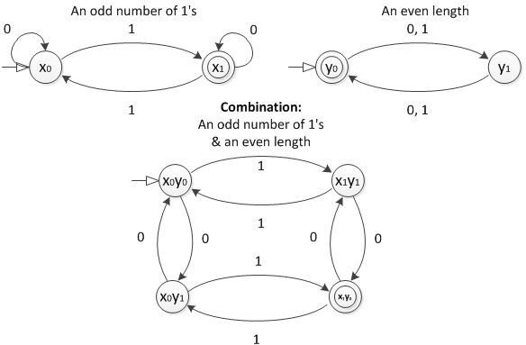
Unit 3 - Regular Languages are closed under Intersection

Slide 13
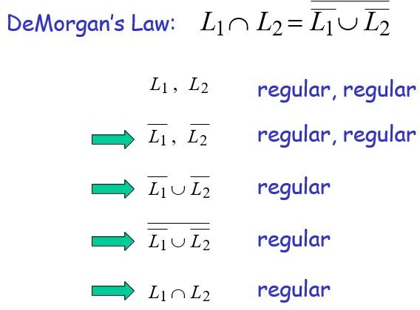
Unit 3 - Properties of Regular Languages

Slide 14
If L₁ and L₂ are regular languages, then L₁ - L₂ is also regular.
Proof:
As per the Demorgan’s law L₁ - L₂ = L₁∩L₂^{c}
L₂ is a regular language L₂^{c} is also regular.
L₁ and L₂^{c} are a regular L₁∩L₂^{c} is also regular.
Therefore, L₁∩L₂^{c} = L₁ - L₂ is regular.

Slide 15
3) If L is regular language, then the reversal L^{R} is also regular.
Proof:
1) Interchange initial and final states.
2) Reverse the edges
The resulting DFA will accept L^{R} and hence it is regular.

Slide 16
Example:
a
a
b
q₀
a
b
b
q₁
q₂
q₀
a
q₁
b
q₂
b
a
D
b
a
a , b
D
a , b

Slide 17
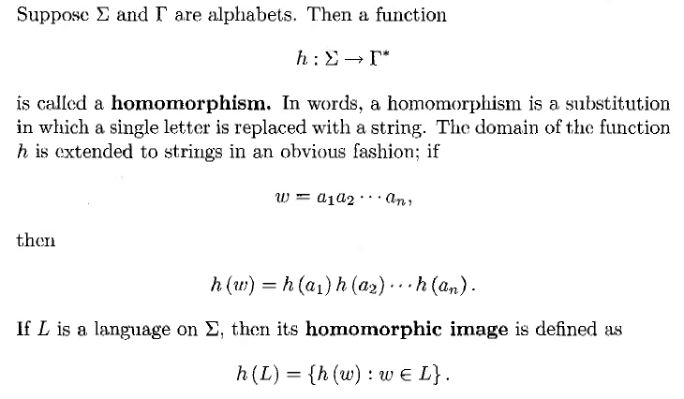
4) Homomorphism

Slide 18
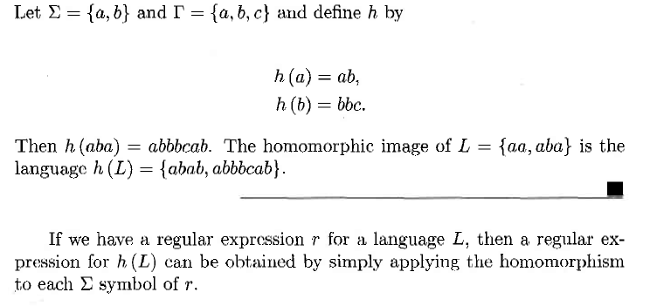

Slide 19
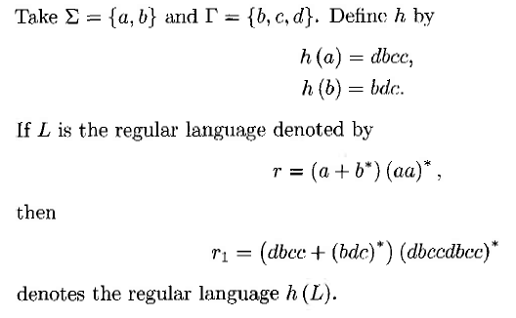

Slide 20
5)Inverse Homomorphism
Let ‘h’ be a homomorphism and ‘L’ is a language whose alphabet is the output language of ‘h’
h⁻¹(L) = {w | h(w) is in L}
Ex: Let h(0) = ab; h(1) = ε
Let L= {ababab}
h⁻¹(L) = (01010)

