Slide 1


BCSE304L - Theory of Computation
Dr. R. Arumuga Arun,
Cabin : PRP 315(A&B)-19,
Mailid : arumugaarun.r@vit.ac.in.
Winter-Semester 2023-2024
SCOPE
1

Slide 2

Module 4 – Context Free Grammar
Context-Free Grammar (CFG) – Derivations - Parse Trees - Ambiguity in CFG – CYK algorithm – Simplification of CFG – Elimination of Useless symbols, Unit productions, Null productions - Normal forms for CFG: CNF and GNF - Pumping Lemma for CFL – Closure Properties of CFL
Topic: Context-Free Grammar (CFG) – Derivations - Parse Trees - Ambiguity in CFG
5

Slide 3
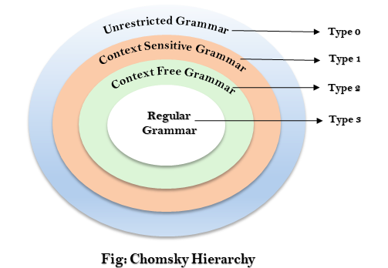
Grammar
Set of rules used to define the language
Types:
Type 0: Unrestricted Grammar / Recursively Enumerable Grammar
Type 1: Context Sensitive Grammar
Type 2: Context Free Grammar
Type 3: Regular Grammar

Slide 4
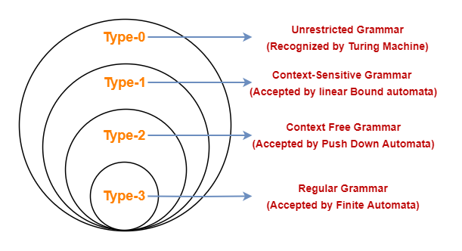
Chomsky Hierarchy of Grammars

Slide 5
Difference between types
 | Restriction | Production [Rules of form α → β] | Example | Language
TYPE 0 Grammar [UG] | NO | α and β can contain any number of terminals and non-terminals | Aac → bDBE aBD → abcDE | Type – 0 language
TYPE 1 Grammar [CSG] | YES | |α| ≤ |β| β should contain terminal followed by any number of non-terminals and terminals | S → bAB A→ c B → ab | Type – 1 language
TYPE 2 Grammar [CFG] | YES | |α| ≤ |β| α should contain only one non-terminal β No restriction | S → α A A → b B → AC | Type – 2 language
TYPE 3 Grammar [RG] | YES | |α| ≤ |β| α can contain only one non-terminal β can contain only a terminal or a terminal followed by a single NT | S → a A → bC | Type – 3 language

Slide 6
Context Free Grammar (CFG)
CFG contains tuples, G = (V, T, P, S)
Where,
V ➔ Variable or Non-terminal (A, B, … , Z)
T ➔ Terminals
P➔ Productions [|α| ≤ |β|, α should contain only one non-terminal, β No restriction]
S ➔ Starting symbols

Slide 7
Generating CFG from Language
Generate CFG from Language, L = {0^{n} | n = 1}
Soln:
S → A
A → 0
2. Generate CFG from Language, L = {0^{n} | n ≥ 1}
Soln:
S → 0A
A → 0A | ε
S → 0A
A → ε
OR

Slide 8
Generating CFG from Language
3. Generate CFG from Language, L = {0*}
Soln:
S → 0A | ε
A → 0A | ε
4. Generate CFG from Language, L = {0^{n}1^{n} | n ≥ 0}
Soln:
S → AB
A → 0A | 0 | ε
B → 1B | 1 | ε

Slide 9
Generating CFG from Language
5. Generate CFG from Language, L = {0^{n}10^{n} | n = 1}
Soln:
6. Generate CFG from Language, L = {0^{n}10^{n} | n ≥ 0}
Soln:
S → A1A
A → 0A | 0 | ε
S → A1A
A → 0
OR

Slide 10
Derivations using grammar
Apply the productions of CFG to find the set of strings that can be formed from that grammar
Methods:
Recursive Inference
Derivation Method

Slide 11
Derivation Method
Use the production from head to body of the grammar
Start by expanding the start symbol using one of its production
Replace one of the non-terminals by body of one of its production until we derive a string containing all terminals
Types:
Left Most Derivation (LMD)
Right Most Derivation (RMD)

Slide 12
Left Most Derivation Vs Right Most Derivation
Left Most Derivation | Right Most Derivation
Replace the left most non-terminal by one of its production in the grammar | Replace the right most non-terminal by one of its production in the grammar
Represented by ==>_{lm} | Represented by ==>_{rm}
To represent one or more steps ==>_{lm}* | To represent one or more steps ==>_{rm}*

Slide 13
Example 1
Derive the string (a + (a * a)) using Left Most derivation and Right most derivation for the following productions:
E → E + E | E * E | (E) | a
Soln: String = (a + (a * a))
RMD: E ==>_{rm} (E)
==>_{rm} (E + E)
==>_{rm} (E + (E))
==>_{rm} (E + (E * E))
==>_{rm} (E + (E * a))
==>_{rm} (E + (a * a))
==>_{rm} (a + (a * a))
E ==>_{rm} * (a + (a * a))
LMD: E ==>_{lm} (E)
==>_{lm} (E + E)
==>_{lm} (a + E)
==>_{lm} (a + (E))
==>_{lm} (a + (E * E))
==>_{lm} (a + (a * E))
==>_{lm} (a + (a * a))
E ==>_{lm} * (a + (a * a))

Slide 14
Example 2
Derive the string b * (b + a11) using LMD and RMD for the following production:
E → I | E + E | E * E | (E)
I → a | b | Ia | Ib | I0 | I1
Soln: String = b * (b + a11)
LMD: E ==>_{lm} E * E
==>_{lm} I * E
==>_{lm} b * E
==>_{lm} b * (E)
==>_{lm} b * (E + E)
==>_{lm} b * (I + E)
==>_{lm} b * (b + E)
==>_{lm} b * (b + I)
==>_{lm} b * (b + I1)
==>_{lm} b * (b + I11)
==>_{lm} b * (b + a11)
E ==>_{lm}* b * (b + a11)
RMD: E ==>_{rm} E * E
==>_{rm} E * (E)
==>_{rm} E * (E + E)
==>_{rm} E * (E + I)
==>_{rm} E * (E + I1)
==>_{rm} E * (E + I11)
==>_{rm} E * (E + a11)
==>_{rm} E * (I + a11)
==>_{rm} E * (b + a11)
==>_{rm} I * (b + a11)
==>_{rm} b * (b + a11)
E ==>_{rm}* b * (b + a11)

Slide 15
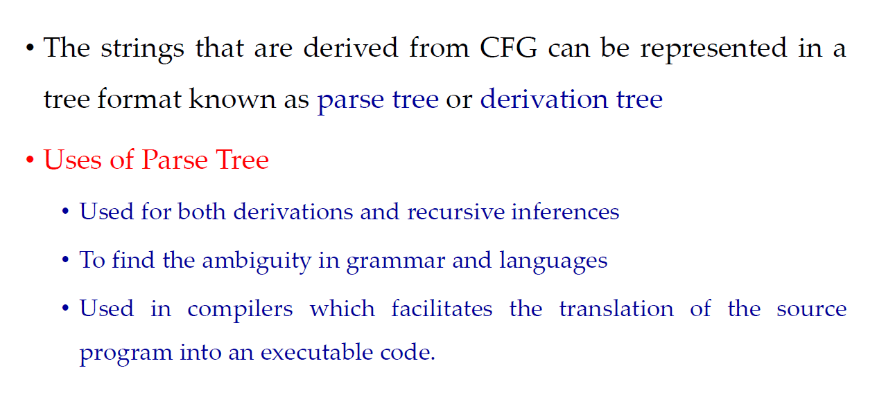
Parse Trees

Slide 16
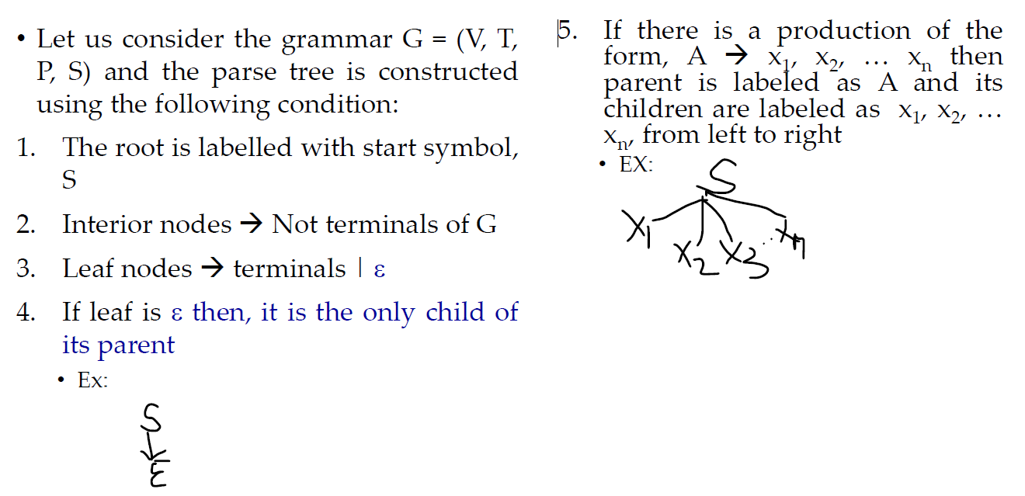
Methods of constructing Parse Trees

Slide 17
Methods of constructing Parse Trees

Slide 18
Problems – Parse Trees
Construct parse tree for the string a * (a + a) for the following CFG using LMD and RMD:
E → E + E | E * E | (E) | a
Soln:
LMD
RMD

Slide 19
Problems – Parse Trees
Construct parse tree for the string a * (a + b00) for the following CFG using LMD and RMD.
E → I | E + E | E * E | (E)
I → a | b | Ia | Ib | I0 | I1
Soln:
LMD
RMD

Slide 20
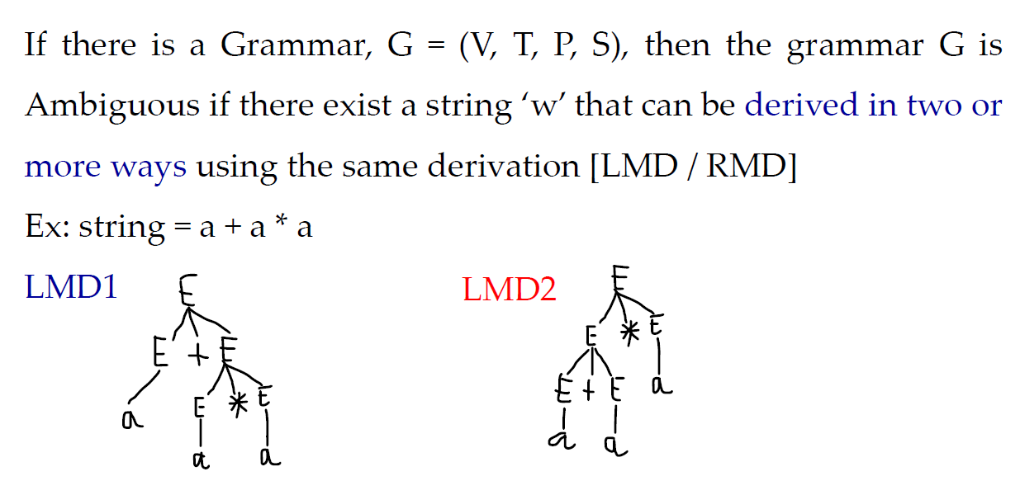
Ambiguity in Grammars and Languages

Slide 21
Example 1
Check whether the following grammar is ambiguous or not for the string, w = a * a + a. E → E + E | E * E | a
The string, w = a * a + a can be derived using two LMDs. So the given grammar is ambiguous

Slide 22
Example 2
Check whether the following grammar is ambiguous or not for the string, w = aab S → aS | aSbS | ε
The string, w = aab can be derived using two LMDs. So the given grammar is ambiguous

Slide 23
Example 3
Consider grammar G with productions
S → aSb
S → SS
S → ε
G is ambiguous, since w = aabb has two derivation trees.

Slide 24
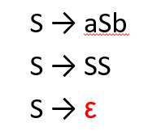

Example 3
S
S
S
S
S
S
ε
ε
ε
ε
a
S
b
a
S
b
a
S
b
a
S
b
ε
ε
ε
ε

Slide 25
Example 4
S
3) Consider the grammar G,
G = ({S}, {a, b}, P, S), where
P: S → aSb
S → ab
G is unambiguous grammar.
a
S
b
a
S
b
a
b

Slide 26
Example 5
Consider grammar G with productions
S → SaSbS (rule 1)
S → SbSaS (rule 2)
S → ε (rule 3)
G is ambiguous, since w = aabbab has two derivation trees.
S SaSbS aSbS aSaSbSbS aaSbSbS aabSbS
aabbS aabbSaSbS aabbaSbS aabbabS
aabbab=aabbab

Slide 27

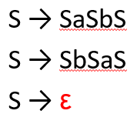
S
S
S
a
S
b
S
S
a
S
b
S
ε
ε
ε
S
a
S
b
S
S
a
S
b
S
S
a
S
b
S
ε
ε
ε
ε
ε
ε
ε
ε
S
b
S
a
S
ε
ε
ε

Slide 28
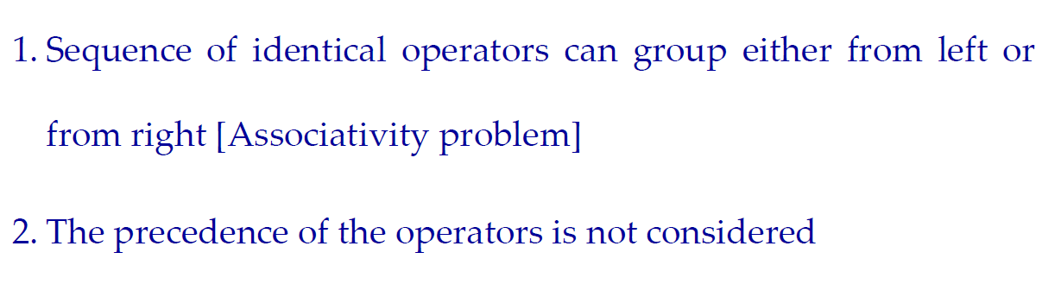
Reasons for Ambiguity in Grammars

Slide 30
There is no particular algorithm for removing the ambiguity of grammar.
But we can remove ambiguity by Disambiguate the grammar i.e., rewriting the grammar such that there is only one derivation or parse tree possible for a string of the language which the grammar represents.

Slide 31
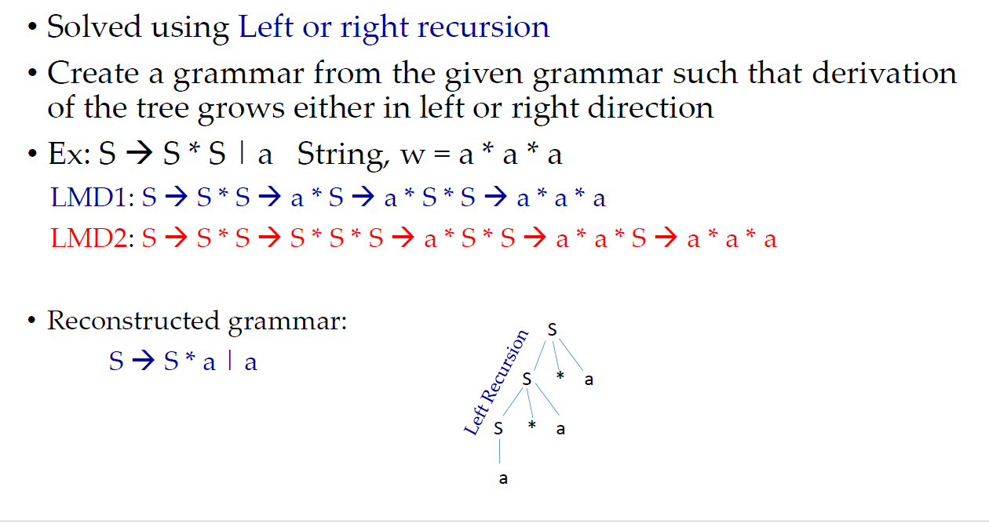
1. Associative problem

Slide 32
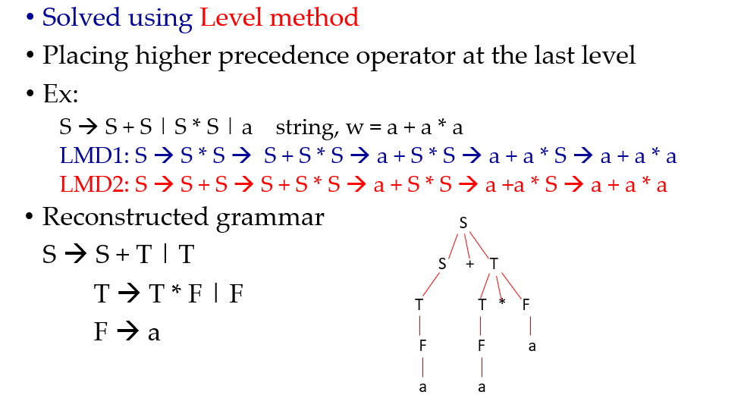
2. Precedence Problem

Slide 33
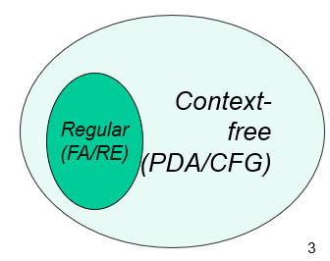
Context Free Language (CFL)
A language class larger than the class of regular languages
Supports natural, recursive notation called “context-free grammar”
A CFL L can be generated by many grammars G₁ , G₂ , G₃ , . . .
L is said to be unambiguous if there is an unambiguous grammar generating L.
If all the grammars that generate L are ambiguous, i.e. there is no unambiguous grammar generating L, then L is said to be inherently ambiguous.
Ambiguity is a property of grammar, not languages.

Slide 34
Example:
S → aS
S → a
unambiguous grammar.
L(G) = { a^{n} / n ≥ 1 }
S
S
S
S
a
a
S
a
a
S
S
a
S
a
S
a
a
S
a
a

Slide 35
L(G) = { a^{n} / n ≥ 1 }
S → SS
S → a
ambiguous grammar
S
S
S
S
S
S
S
S
a
S
S
S
S
a
a
S
a
a
S
a
a
a
a

Slide 36
Example: (Inherently ambiguous)
L(G) = { a^{n}b^{n} c^{m} / n, m ≥ 1 } ∩ { a^{n}b^{m} c^{m} / n, m ≥ 1 } = L₁ ∩ L₂
G= ({S, S₁, S₂ , A, B, C, D}, {a, b, c}, P, S), where
P: S → S₁ / S₂
S₁ → AB S₂ → CD
A → aAb / ab C → aC / a
B → cB / c D → bDc / bc
L₁∩L₂ = { a^{n}b^{n} c^{n} / n ≥ 1 }

Slide 37
L₁ = { a^{n}b^{n} c^{m} / n, m ≥ 1 }
abc , abc² , abc³ , abc⁴ , abc⁵ , abc⁶ , . . . .
a²b²c , a²b²c² , a²b²c³ , a²b²c⁴ , a²b²c⁵ , a²b²c⁶ , . . . .
a³b³c , a³b³c² , a³b³c³ , a³b³c⁴ , a³b³c⁵ , a³b³c⁶ , . . . .
. . . . . . . . . . . . . . . . . . . . . . . . . . . . . . . . . . . . . . . . . . . . . . . .
L₂ = { a^{n}b^{m} c^{m} / n, m ≥ 1 }
abc , ab²c² , ab³c³ , ab⁴c⁴ , ab⁵c⁵ , ab⁶c⁶ , . . . .
a²bc , a²b²c² , a²b³ c³ , a²b⁴c⁴ , a²b⁵c⁵ , a²b⁶c⁶ , . . . .
a³bc , a³b²c² , a³b³ c³ , a³b⁴c⁴ , a³b⁵c⁵ , a³b⁶c⁶ , . . . .
. . . . . . . . . . . . . . . . . . . . . . . . . . . . . . . . . . . . . . . . . . . . . . . .
L₁∩L₂ = { a^{n}b^{n} c^{n} / n ≥ 1 }

Slide 38
S
S
S₂
S₁
C
D
A
B
a
b
c
a
b
c

