Slide 1


BCSE304L - Theory of Computation
Dr. R. Arumuga Arun,
Cabin : PRP 315(A&B)-19,
Mailid : arumugaarun.r@vit.ac.in.
Winter-Semester 2023-2024
SCOPE
1

Slide 2

Module 4 – Context Free Grammar
Context-Free Grammar (CFG) – Derivations - Parse Trees - Ambiguity in CFG – CYK algorithm – Simplification of CFG – Elimination of Useless symbols, Unit productions, Null productions - Normal forms for CFG: CNF and GNF - Pumping Lemma for CFL – Closure Properties of CFL
Topic:
CYK algorithm
5

Slide 3
CYK Algorithm
CYK is a membership algorithm.
It is used to decide whether a string belongs to the language grammar or not. Is w in L(G)?
It is developed by J. Cocke, D. Younger, and T. Kasami.
CNF form used to derive a string which takes exponential in |x| or even less.
The CYK algorithm is based on the idea of Dynamic Programming which is also known as the table filling algorithm.

Slide 4
CYK Algorithm
To apply the CYK algorithm convert the given Grammar into CNF form.
The input to the algorithm is w.
Time taken to construct the table is O(n³)
CNF is a Binary tree where if the length of W is n then there will be exactly 2n-1 nodes labelled by variables in the tree.
Thus no. of possible trees and node–labelling is thus “only exponential in n.

Slide 5
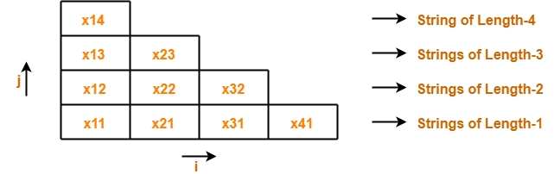
Construct a Triangular Table
In a Table Each row corresponds to one length of substrings
Bottom Row – Strings of length 1
Second from Bottom Row – Strings of length 2
…………………………….
Top Row – string ‘w’

Slide 6
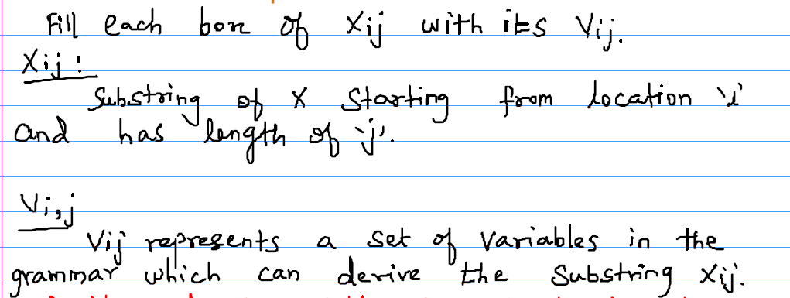
Construct a Triangular Table

Slide 7
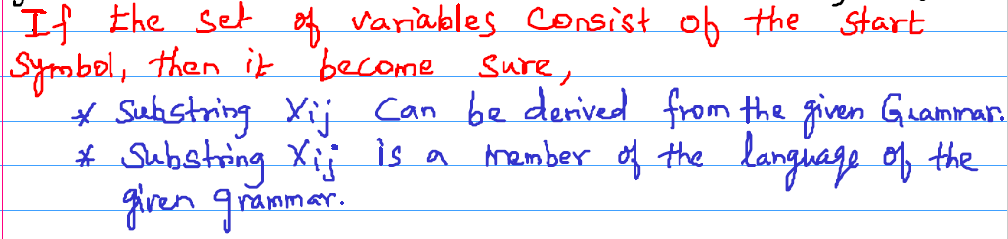
Construct a Triangular Table

Slide 8
Construct a Triangular Table

Slide 9
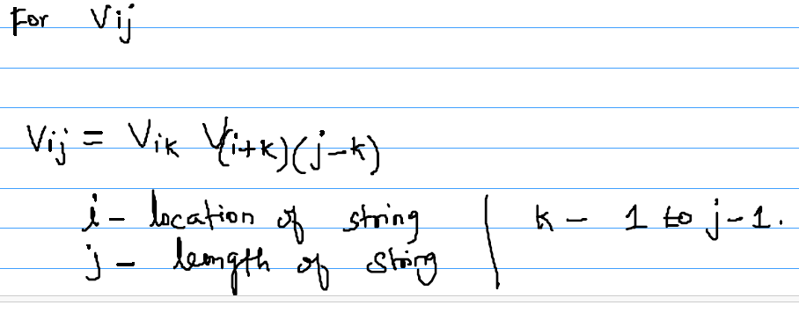
Rules for filling the Table

Slide 10
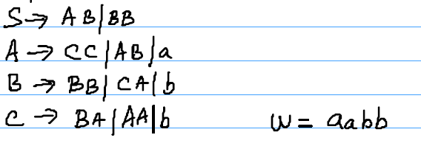
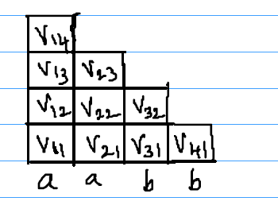
Example
Check the string w = aabb is belongs to the following grammar using following algorithm
Solution:
Initial Table

Slide 11
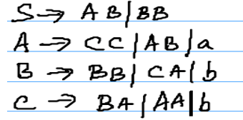
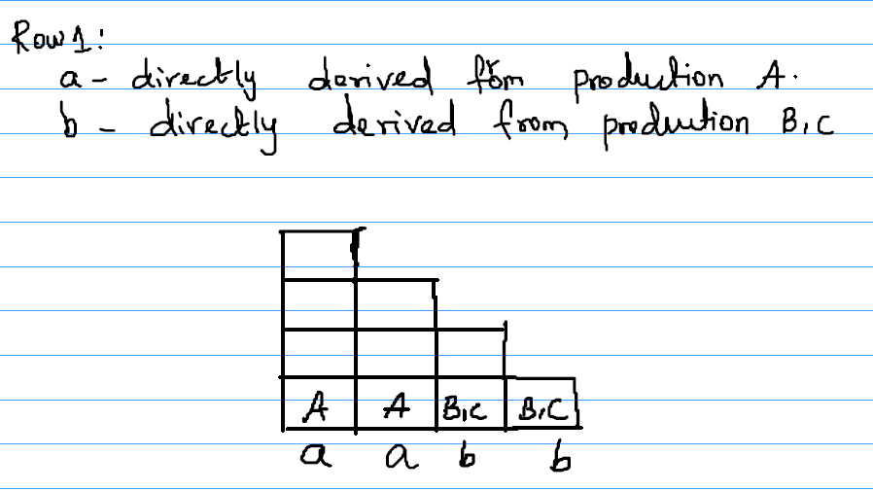
Example
ROW 1:

Slide 12
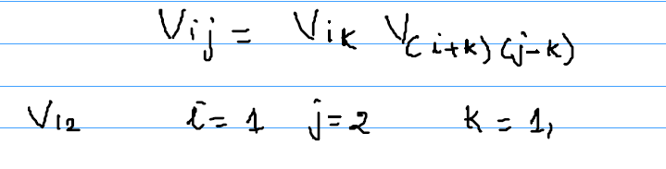
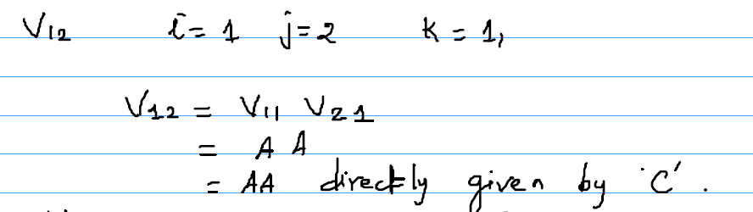
Example
ROW 2:

Slide 13
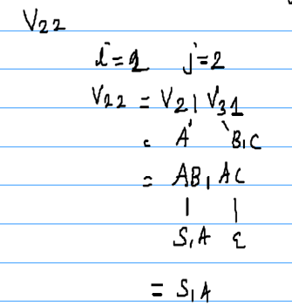
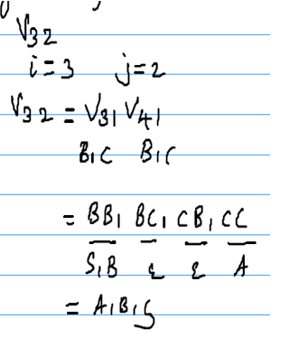
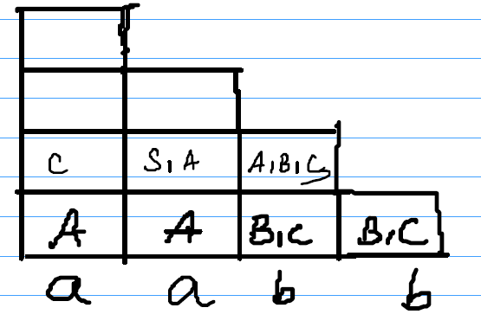
Example
ROW 2:

Slide 14
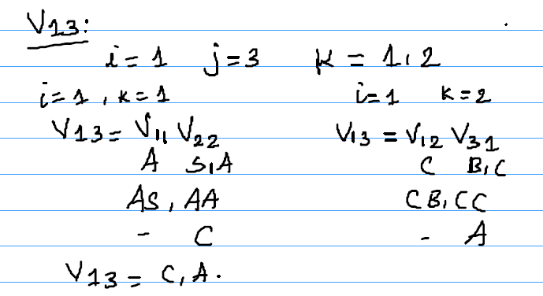
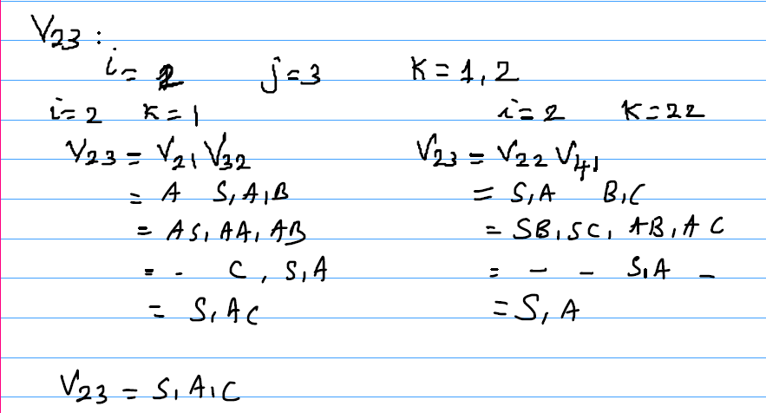
Example
ROW 3:

Slide 15
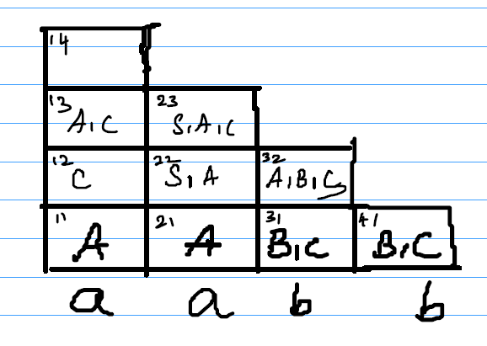
Example
ROW 3:

Slide 16
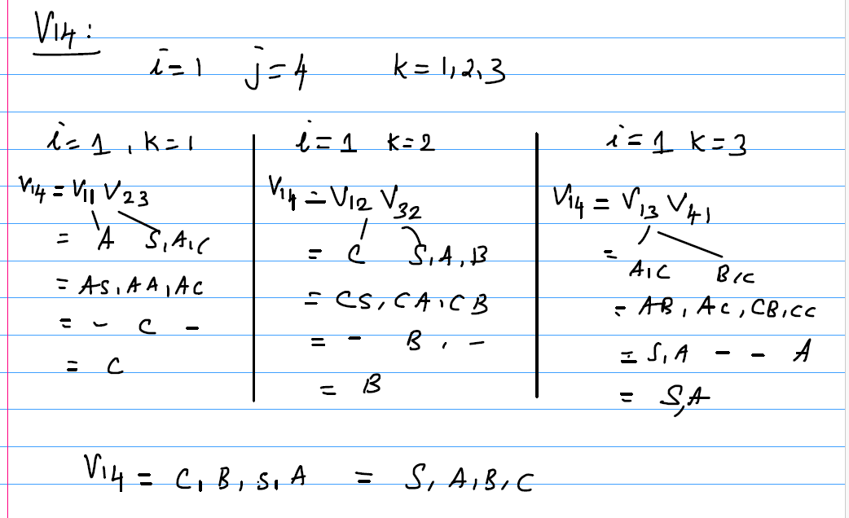
Example
ROW 4:

Slide 17
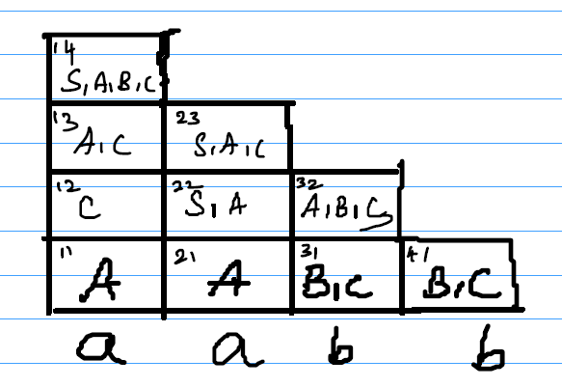
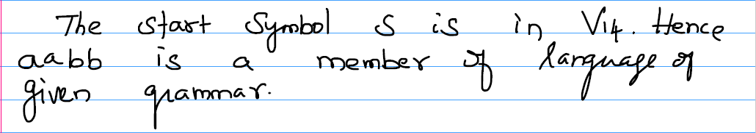
Example
ROW 4:

Slide 18
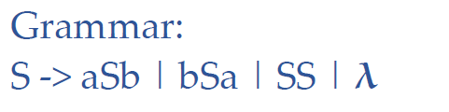
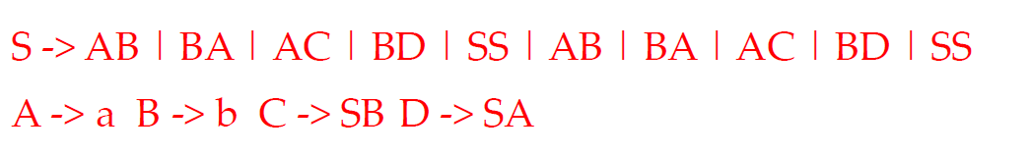
Additional Problem 1
Parse the string abba using the CYK algorithm
Solution:
The above grammar is not in CNF form.
Convert into CNF form.
The resultant converted grammar in CNF form.

Slide 19
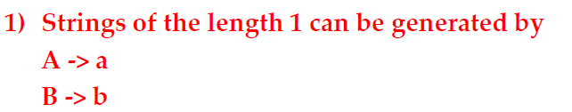
Additional Problem 1
J = 4
J = 3
J = 2
J = 1 | A | B | B | A
 | a | b | b | a

Slide 20
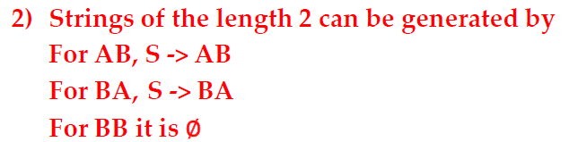
Additional Problem 1
J = 4
J = 3
J = 2 | S | ∅ | S
J = 1 | A | B | B | A
 | a | b | b | a

Slide 21
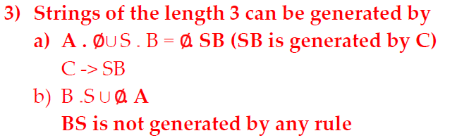
Additional Problem 1
J = 4
J = 3 | C | ∅
J = 2 | S | ∅ | S
J = 1 | A | B | B | A
 | a | b | b | a

Slide 22
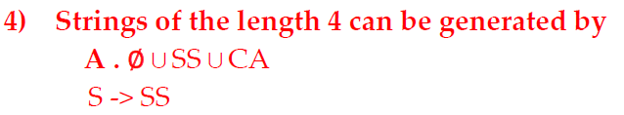
Additional Problem 1
J = 4 | S
J = 3 | C | ∅
J = 2 | S | ∅ | S
J = 1 | A | B | B | A
 | a | b | b | a
The given string abba belongs to the above grammar G

