Slide 1


BCSE304L - Theory of Computation
Dr. R. Arumuga Arun,
Cabin : PRP 315(A&B)-19,
Mailid : arumugaarun.r@vit.ac.in.
Winter-Semester 2023-2024
SCOPE
1

Slide 2

Module 5 – Pushdown Automata
Definition of the Pushdown automata - Languages of a Pushdown automata – Power of
Non-Deterministic Pushdown Automata and Deterministic pushdown automata
Topic: Definition of the Pushdown automata, Languages of a Pushdown automata, Acceptance Problem
5

Slide 3
PUSHDOWN AUTOMATA (Introduction)
Pushdown automata is a way to implement a CFG in the same way we design DFA for a regular grammar.
A DFA can remember a finite amount of information, but a PDA can remember an infinite amount of information.
Pushdown automata is simply an NFA augmented with an "external stack memory".
The addition of stack is used to provide a last-in-first-out memory management capability to Pushdown automata.
A PDA can push an element onto the top of the stack and pop off an element from the top of the stack.

Slide 4
PUSHDOWN AUTOMATA (Introduction)
A PDA is more powerful than an FA. Any language which can be acceptable by FA can also be acceptable by PDA.
PDA also accepts a class of language which even cannot be accepted by FA.
Thus PDA is much more superior to FA.

Slide 5
PDA Components
Input Tape: The input tape is divided into many cells or symbols. The input head is read-only and may only move from left to right, one symbol at a time.
Finite State Control: The finite control has some pointer that points to the current symbol which is to be read.
Stack: The stack is a structure in which we can push and remove the items from one end only. It has an infinite size. In PDA, the stack is used to store the items temporarily.

Slide 6
PDA Components
FINITE STATE CONTROL
INPUT
STACK
(Last in,
first out)

Slide 7
Formal definition of PDA
A (non-deterministic) PDA is defined by the 7-tuple
M = (Q, Σ, Γ, δ, q₀, Z₀ , F),
where
Q - is a finite set of states
Σ - is a finite set of input symbols
Γ - stack symbol which can be pushed and popped from the stack
q₀ ∈ Q - is the start state (initial state)
Z₀ ∈ Γ - a start symbol of stack which is in Γ
F ⊆ Q - is the set of accept states (final states)
δ - mapping function which is used for moving from the current state to the next state.

Slide 8
PDA Types
PDA can be classified as
Deterministic PDA
Non-Deterministic PDA
Let M = (Q, ∑, Γ, q0, Z, F, δ) be a PDA. The PDA is deterministic if and only if
δ(q, a, Z) has one element.
If δ(q, ∈, Z) is non-empty, then δ(q, c, Z) should be empty for every c ∈ ∑ .
Both conditions should be satisfied for the PDA to be deterministic.
If one of the conditions fails, the PDA is non-deterministic.

Slide 9
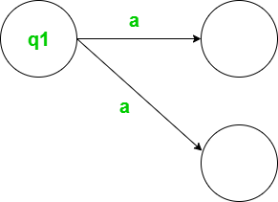

PDA Types
Non- Deterministic path
Deterministic path

Slide 10
DPDA vs NDPDA Definition
In PDA of M = (Q,∑, Γ, q0, Z, F, δ), all the representations are similar for DPDA and NDPDA except the Transition function(δ), which are
Transition function of DPDA : δ: (Q ×∑ × Γ)→ Q × Γ *
Transition function of NDPDA : δ: (Q × {∑∪∈} × Γ) → 2^{Q ×Γ*}

Slide 11
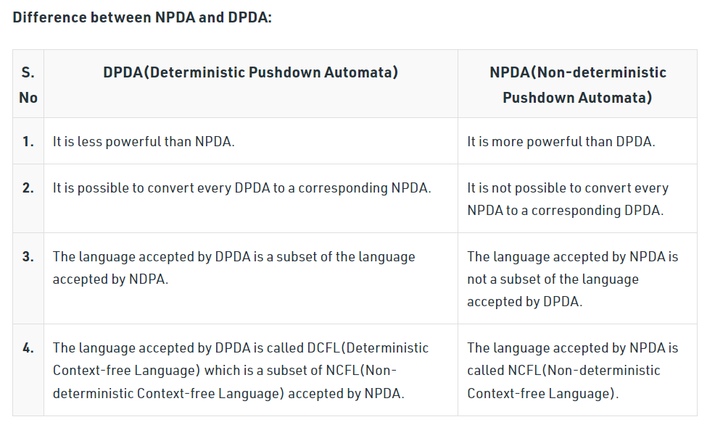
DPDA vs NDPDA

Slide 12
Diagrammatic representation of PDA

Slide 13
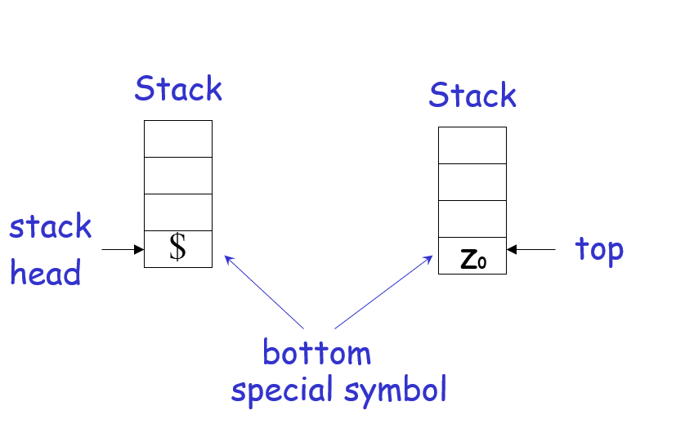
Initial Stack Symbol

Slide 14
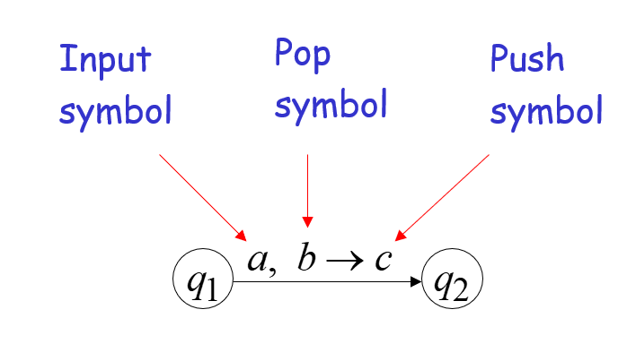
The States

Slide 15
The States

Slide 16
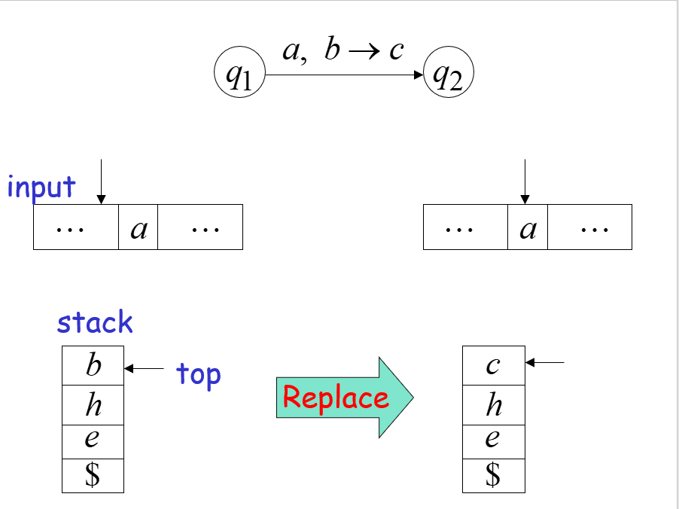
Replace

Slide 17
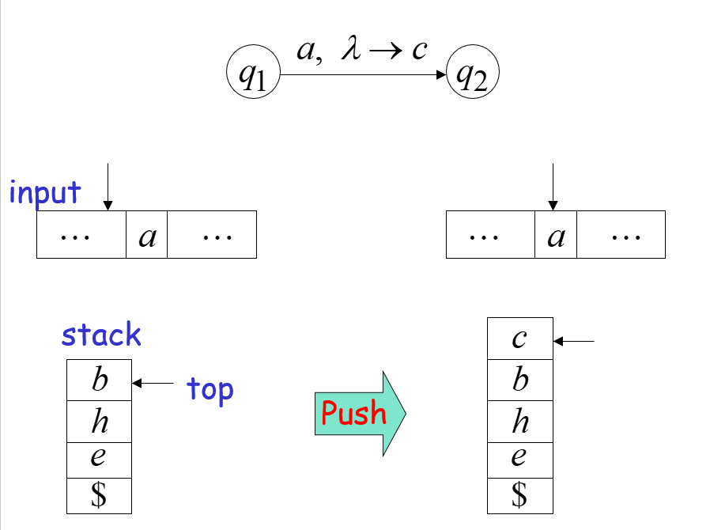
Push

Slide 18
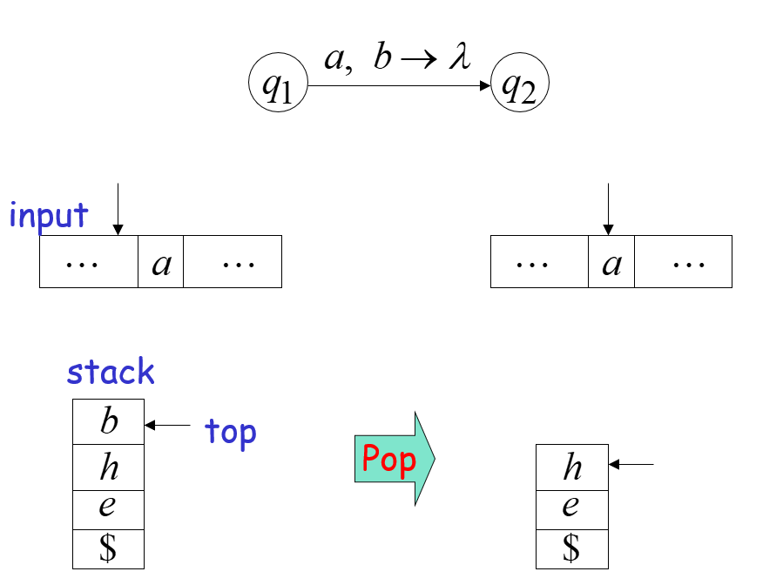
Pop

Slide 19
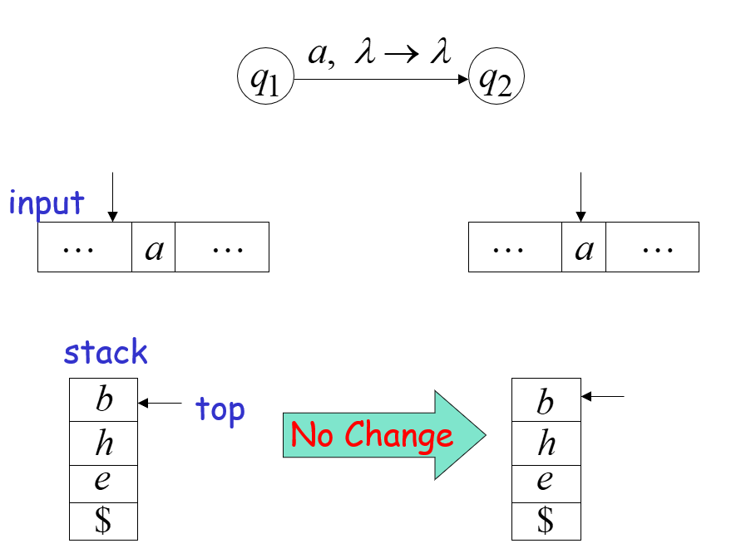
No Change

Slide 20
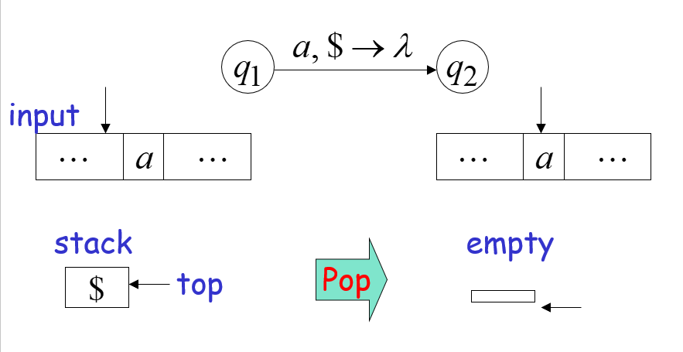
Possible Transition

Slide 21
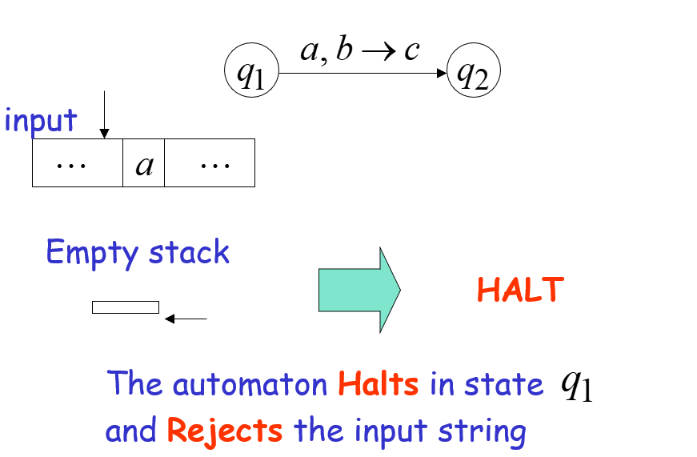
Bad Transition

Slide 22
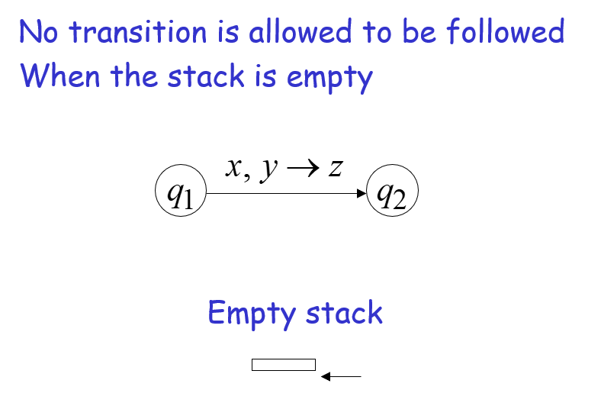
Bad Transition

Slide 23
Instantaneous Description (ID)
ID is an informal notation of how a PDA computes an input string and make a decision that the string is accepted or rejected.
An instantaneous description is a triple (q, w, α) where:
q describes the current state.
w describes the remaining input.
α describes the stack contents, top at the left.

Slide 24
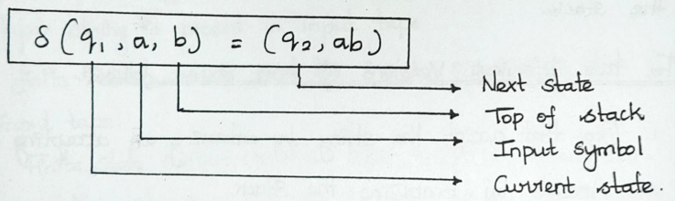
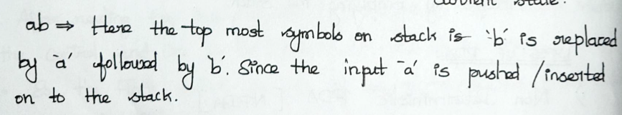
PUSH

Slide 25
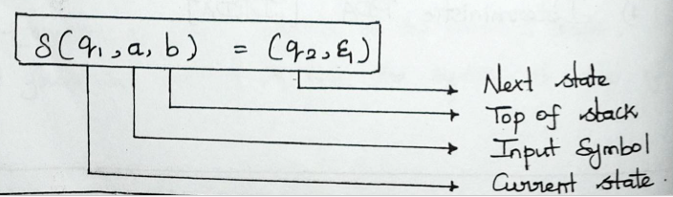
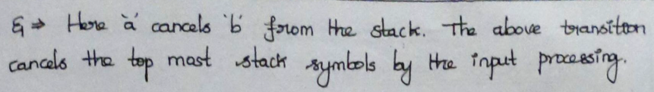
POP

Slide 26
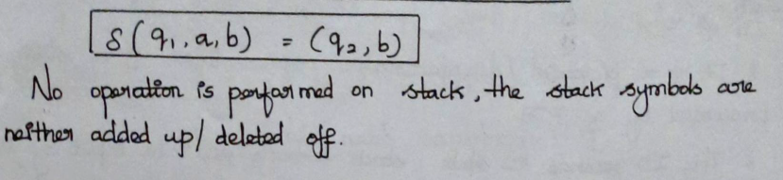
No Operation

Slide 27
Turnstile Notation
⊢ sign describes the turnstile notation and represents one move.
⊢* sign describes a sequence of moves.
For example: (p, b, T) ⊢ (q, w, α)
In the above example, while taking a transition from state p to q, the input symbol 'b' is consumed, and the top of the stack 'T' is represented by a new string α.

Slide 28
Acceptance in PDA
A language can be accepted by Pushdown automata using two approaches:
Acceptance by Final State
Acceptance by Empty Stack

Slide 29
Acceptance in PDA
Acceptance by Final State :
The PDA is said to accept its input by the final state if it enters any final state in zero or more moves after reading the entire input.
Let M =(Q, ∑, Γ, δ, q0, Z, F) be a PDA. The language acceptable by the final state can be defined as:
L(M) = { w / w ∈ Σ* , (q₀, w, Z₀) Ⱶ* (q_{f} , ε , γ ), for some q_{f} ∈ F , γ ∈ Γ* }

Slide 30
Acceptance in PDA
Acceptance by Empty Stack:
On reading the input string from the initial configuration for some PDA, the stack of PDA gets empty.
Let M =(Q, ∑, Γ, δ, q0, Z, F) be a PDA. The language acceptable by empty stack can be defined as:
N(M) = { w / w ∈ Σ*, (q₀, w, Z₀) Ⱶ* (q, ε , ε ), for some q ∈ Q}

Slide 31
Acceptance in PDA
Equivalence of Acceptance by Final State and Empty Stack
If L = N(P1) for some PDA P1, then there is a PDA P2 such that L = L(P2). That means the language accepted by the empty stack PDA will also be accepted by the final state PDA.
If there is a language L = L (P1) for some PDA P1 then there is a PDA P2 such that L = N(P2). That means language accepted by final state PDA is also acceptable by empty stack PDA.

Slide 32
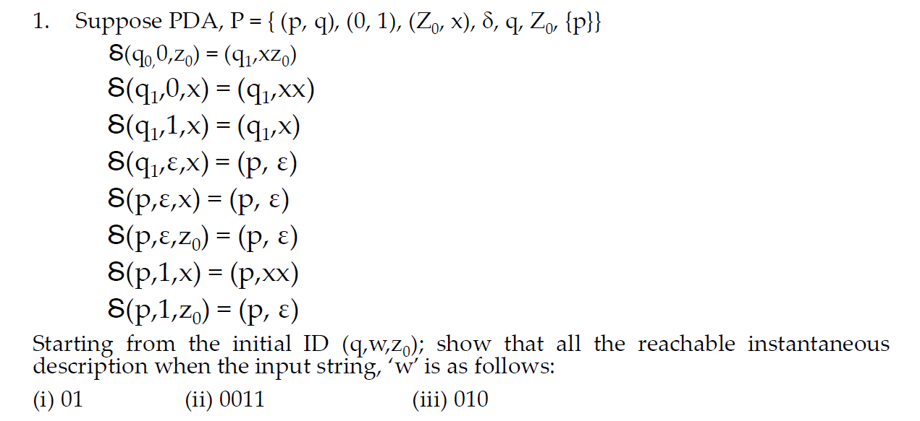
Checking acceptance of the string using ID
Example 1

Slide 33
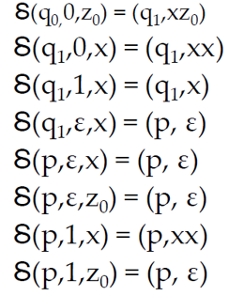
Checking acceptance of the string using ID
Example 1
i) string, w=01 Initial ID = (q,w,z0)
(q0,01,z0)
⊢(q1,1,xz0)
⊢(q1,ε,xz0)
⊢(p,ε,z0)
⊢(p,ε, ε)
The string, w=01 by reaching the final state and also empty stack

Slide 34
Checking acceptance of the string using ID
Example 1
ii) string, w= 0011 Initial ID ==(q,w,z0)
(q0,0011,z0)
⊢(q1,011,xz0)
⊢(q1,11,xxz0)
⊢(q1,1,xxz0)
⊢(q1,ε,xxz0)
⊢(p,ε,xz0)
⊢(p,ε,z0) ⊢(p, ε, ε)
The string, w=0011 by reaching the final state and also empty stack

Slide 35
Checking acceptance of the string using ID
Example 1
iii) string,w=010 InitialID=(q,w,z0)
(q0,010,z0)
⊢(q1,10,xz0)
⊢(q1,0,xz0)
⊢(q1,ε,xxz0)
⊢(p,ε,xz0)
⊢(p,ε,z0)
⊢(p, ε, ε )
The string, w=010 by reaching the final state and also empty stack

Slide 36
Checking acceptance of the string using ID
Example 2
L = { wcw^{R} / w ∈ { 0, 1}* }
M = (Q, Σ, Γ, δ, q₀, Z₀ , ɸ), where
Q = {q₀ , q₁} , Σ = {0, 1, c} , Γ ={X, Y, Z₀}
δ(q₀ , 0 , Z₀ ) = { (q₀ , X Z₀ ) } δ(q₀ , 1 , Z₀ ) = { (q₀ , Y Z₀ ) }
δ(q₀ , 0 , X ) = { (q₀ , X X ) } δ(q₀ , 1 , Y ) = { (q₀ , YY ) }
δ(q₀ , 0 , Y ) = { (q₀ , X Y ) } δ(q₀ , 1 , X ) = { (q₀ , YX ) }
δ(q₀ , c , X ) = { (q₁ , X ) } δ(q₀ , c , Y ) = { (q₁ , Y) }
δ(q₀ , c , Z₀ ) = { (q₁ , Z₀ ) }
δ(q₁ , 0 , X ) = { (q₁ , ε) }
δ(q₁ , 1 , Y ) = { (q₁ , ε) }
δ(q₁ , ε, Z₀ ) = { (q₁ , ε) }

Slide 37
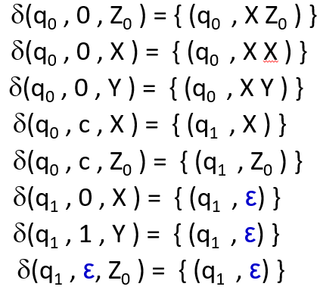
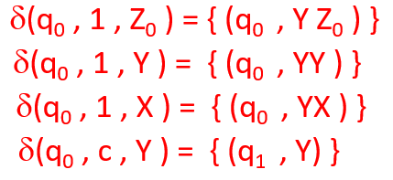
w = 001 , w^{R} = 100 wcw^{R} = 001c100
(q₀ , 001c100 , Z₀ )
Ⱶ (q₀ , 01c100 , XZ₀ )
Ⱶ (q₀ , 1c100 , XXZ₀ )
Ⱶ (q₀ , c100 , YXXZ₀ )
Ⱶ (q₁ , 100 , YXXZ₀ )
Ⱶ (q₁ , 00 , XXZ₀ )
Ⱶ (q₁ , 0 , XZ₀ )
Ⱶ (q₁ , ε , Z₀ )
Ⱶ (q₁ , ε , ε )

Slide 38
0 , Y / XY
εε , Z₀ / ε ε
0 , X / XX
1 , Y / εε
1 , X / YX
0 , Z₀ / XZ₀
0 , X / ε
1 , Y / YY
1 , Z₀ / YZ₀
c , Z₀ / Z₀
c , Y / Y
c , X / X
q₀
q₁

Slide 39
Checking acceptance of the string using ID
Example 3
L = { a^{n}b^{n} / n ≥ 1}
M = (Q, Σ, Γ, δ, q₀, Z₀ , ɸ), where
Q = {q₀ , q₁} , Σ = {a , b} , Γ ={X , Z₀}
δ(q₀ , a , Z₀ ) = { (q₀ , X Z₀ ) } δ(q₀ , b, X ) = { (q₁ , ε) }
δ(q₀ , a, X ) = { (q₀ , X X ) } δ(q₁ , b , X ) = { (q₁ , ε) }
δ(q₁ , ε, Z₀ ) = { (q₁ , ε) }
w = aabb
(q₀ , aabb , Z₀ ) Ⱶ (q₀ , abb , XZ₀ ) Ⱶ (q₀ , bb , XXZ₀ )
Ⱶ (q₁ , b , XZ₀ ) Ⱶ (q₁ , ε , Z₀ ) Ⱶ (q₁ , ε , ε )

Slide 40
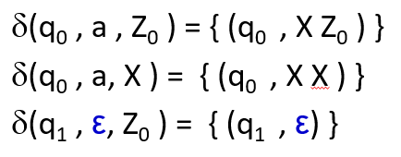
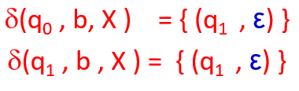
Checking acceptance of the string using ID
Example 3
w = aabb
(q₀ , aabb , Z₀ )
Ⱶ (q₀ , abb , XZ₀ )
Ⱶ (q₀ , bb , XXZ₀ )
Ⱶ (q₁ , b , XZ₀ )
Ⱶ (q₁ , ε , Z₀ )
Ⱶ (q₁ , ε , ε )

Slide 41
a , X / XX
ε , Z₀ / εε
a , Z₀ / XZ₀
b , X / εε
b , x / εε
q₀
q₁

Slide 42
Checking acceptance of the string using ID
Exercise 1
L = { a^{n}b^{m}c^{n} / m, n ≥ 1}
M = (Q, Σ, Γ, δ, q₀, Z₀ , ɸ), where
Q = {q₀ , q₁ , q₂} , Σ = {a , b, c} , Γ ={X , Z₀}
δ(q₀ , a , Z₀ ) = { (q₀ , X Z₀ ) }
δ(q₀ , a, X ) = { (q₀ , X X ) }
δ(q₀ , b, X ) = { (q₁ , X) }
δ(q₁ , b , X ) = { (q₁ , X) }
δ(q₁ , c , X ) = { (q₂ , ε) }
δ(q₂ , c , X ) = { (q₂ , ε) }
δ(q₂ , ε, Z₀ ) = { (q₂ ,ε) }

Slide 43
a , X / XX
ε , Z₀ /ε ε
a , Z₀ / XZ₀
b , X / X
c , X / εε
b , X / X
c , X / εε
q₀
q₁
q₂

Slide 44
Checking acceptance of the string using ID
Exercise 2
L = { ww^{R} / w ∈ { 0, 1}* }
M = (Q, Σ, Γ, δ, q₀, Z₀ , ɸ), where Q = {q₀ , q₁} , Σ = {0, 1} , Γ ={X, Y, Z₀}
δ(q₀ , 0 , Z₀ ) = { (q₀ , X Z₀ ) } δ(q₁ , 0 , X ) = { (q₁ , ε) }
δ(q₀ , 1 , Z₀ ) = { (q₀ , Y Z₀ ) } δ(q₁ , 1 , Y ) = { (q₁ , ε) }
δ(q₀ , 0 , X ) = { (q₀ , X X ) , (q₁ , ε)} δ(q₁ , ε, Z₀ ) = { (q₁ , ε) }
δ(q₀ , 1 , X ) = { (q₀ , YX ) }
δ(q₀ , 0 , Y ) = { (q₀ , XY ) }
δ(q₀ , 1 , Y ) = { (q₀ , YY ) , (q₁ , ε)}

Slide 45
0 , Y / XY
ε, Z₀ / εε
0 , X / XX
1 , Y / ε ε
0 , Z₀ / XZ₀
0 , X /ε ε
1 , X / YX
1 , Y / YY
1 , Z₀ / YZ₀
1 , Y /ε ε
0 , X /ε ε
q₀
q₁

