Slide 1


BCSE304L - Theory of Computation
Dr. R. Arumuga Arun,
Cabin : PRP 315(A&B)-19,
Mailid : arumugaarun.r@vit.ac.in.
Winter-Semester 2023-2024
SCOPE
1

Slide 2

Module 5 – Pushdown Automata
Definition of the Pushdown automata - Languages of a Pushdown automata – Power of
Non-Deterministic Pushdown Automata and Deterministic pushdown automata
Topic: Construction of PDA
5

Slide 3
Transition in PDA

Slide 4
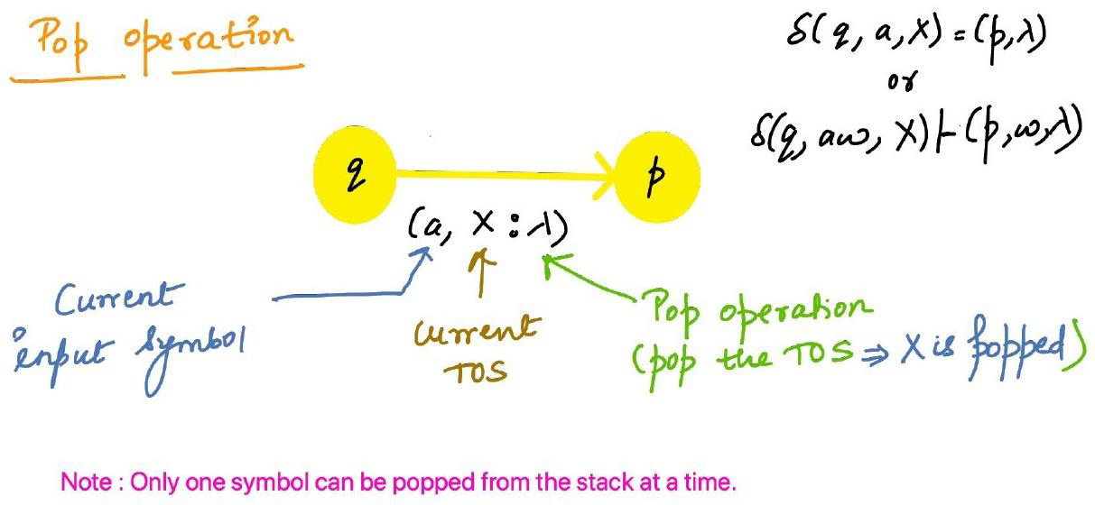
Transition in PDA

Slide 5
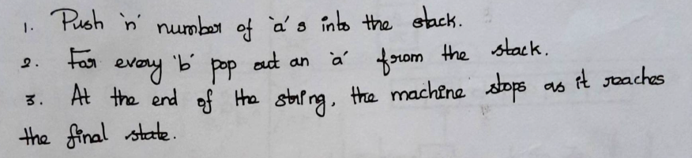
Example 1:
Design a PDA to accept a language {a^{n}b^{n} |n>=1} by accepting by final state/empty stack.
Solution:
L = {a^{n}b^{n} |n>=1}
L = {ε, ab, aabb, aaabbb…….}
Consider n = 3, L = aaabbb

Slide 6
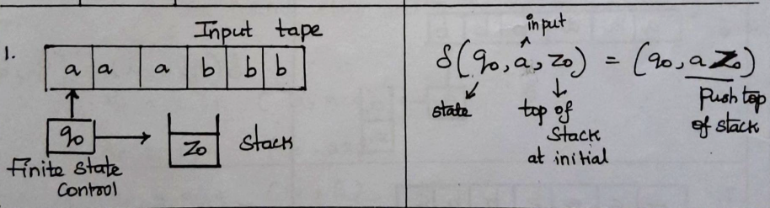
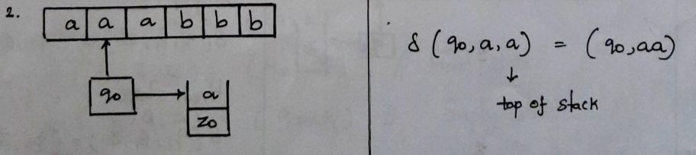
Example 1:
L = aaabbb
Step 1:
Step 2:

Slide 7
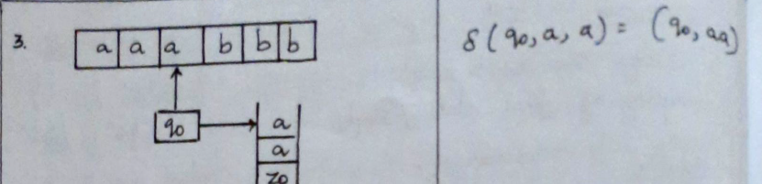
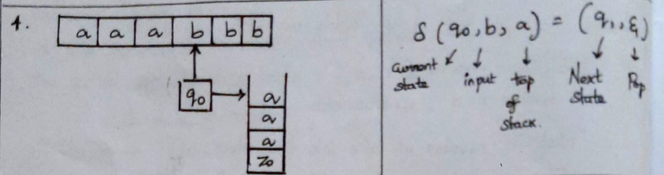
Example 1:
L = aaabbb
Step 3:
Step 4:

Slide 8
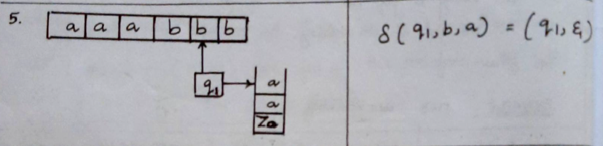
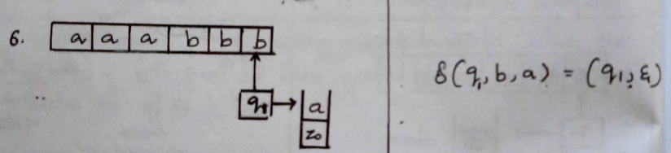
Example 1:
L = aaabbb
Step 5:
Step 6:

Slide 9
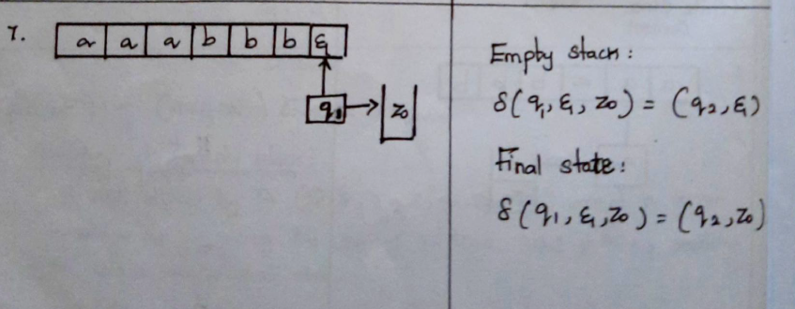
Example 1:
L = aaabbb
Step 7:

Slide 10





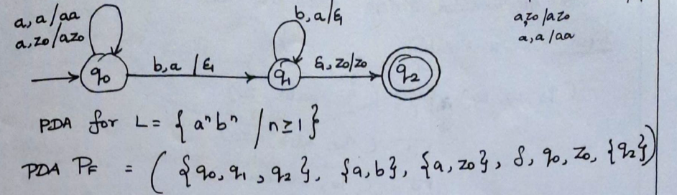
Example 1:
PDA Diagram – Acceptance by final state

Slide 11

Example 1:
PDA Diagram – Acceptance by empty stack

Slide 12
Example 2:
Design a PDA for accepting a language {0^{n}1^{m}0^{n} | m, n>=1}.
Solution:
L = {0^{n}1^{m}0^{n} | m, n>=1}
L = {ε, 010, 0110, 0011100, 000111000…….}
Consider n = 2, m =3, L = 0011100
Steps
Push all 0's onto the stack from encountering first 0’s till first encountering 1.
Then if we read 1, do nothing.
Then read 0, and on each read of 0, pop one 0 from the stack.

Slide 13
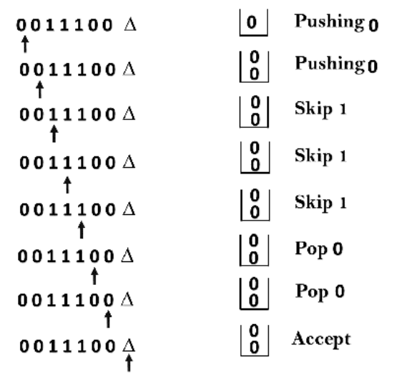
Example 2:
δ(q0, 0, Z) = (q0, 0Z)
δ(q0, 0, 0) = (q0, 00)
δ(q0, 1, 0) = (q1, 0)
δ(q1, 1, 0) = (q1, 0)
δ(q1, 0, 0) = (q1, ε)
δ(q1, ε, Z) = (q2, Z)

Slide 14
Example 2:
δ(q0, 0, Z) = (q0, 0Z)
δ(q0, 0, 0) = (q0, 00)
δ(q0, 1, 0) = (q1, 0)
δ(q1, 1, 0) = (q1, 0)
δ(q1, 0, 0) = (q1, ε)
δ(q1, ε, Z) = (q2, Z)

Slide 15
PDA – Transition Diagram
δ(q0, 0, Z) = (q0, 0Z)
δ(q0, 0, 0) = (q0, 00)
δ(q0, 1, 0) = (q1, 0)
δ(q1, 1, 0) = (q1, 0)
δ(q1, 0, 0) = (q1, ε)
δ(q1, ε, Z) = (q2, Z)
0, 0 / 00
ε , Z₀ / ε
0, Z₀ / 0Z₀
0 , 0 / ε
1, 0 / 0
q₀
q₁
Acceptance by empty stack

Slide 16
Example 3:
Design a PDA for accepting a language {a^{n}b^{2n} | n>=1}..
Solution:
L = {a^{n}b^{2n} | n>=1}
Steps
In this language, n number of a's should be followed by 2n number of b’s.
Hence, we will apply a very simple logic, and that is if we read single 'a', we will push two a's onto the stack.
As soon as we read 'b' then for every single 'b' only one 'a' should get popped from the stack.

Slide 17
Example 3:
The ID can be constructed as follows:
δ(q0, a, Z) = (q0, aaZ)
δ(q0, a, a) = (q0, aaa)
Now when we read b, we will change the state from q0 to q1 and start popping the corresponding 'a'. Hence,
δ(q0, b, a) = (q1, ε)
Thus this process of popping 'b' will be repeated unless all the symbols are read. Note that popping action occurs in state q1 only.
δ(q1, b, a) = (q1, ε)

Slide 18
Example 3:
After reading all b's, all the corresponding a's should get popped. Hence when we read ε as input symbol then there should be nothing in the stack. Hence the move will be:
δ(q1, ε, Z) = (q2, ε)
We can summarize the ID as:
δ(q0, a, Z) = (q0, aaZ)
δ(q0, a, a) = (q0, aaa)
δ(q0, b, a) = (q1, ε)
δ(q1, b, a) = (q1, ε)
δ(q1, ε, Z) = (q2, ε)

Slide 19
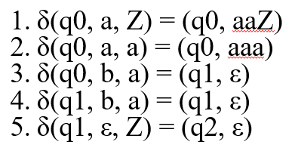
Example 3:
Now we will simulate this PDA for the input string "aaabbbbbb".
δ(q0, aaabbbbbb, Z) ⊢ δ(q0, aabbbbbb, aaZ)
⊢ δ(q0, abbbbbb, aaaaZ)
⊢ δ(q0, bbbbbb, aaaaaaZ)
⊢ δ(q1, bbbbb, aaaaaZ)
⊢ δ(q1, bbbb, aaaaZ)
⊢ δ(q1, bbb, aaaZ)
⊢ δ(q1, bb, aaZ)
⊢ δ(q1, b, aZ)
⊢ δ(q1, ε, Z)
⊢ δ(q2, ε, ε)
ACCEPT

Slide 20
PDA – Transition Diagram
a , a / aaZ
a , Z /aaZ
b , a / ε
b , a / ε
ε , z / ε
q₀
q₁
q₂
Acceptance by final state

