Slide 1
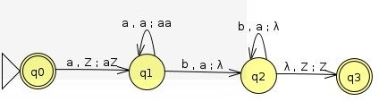
Deterministic Pushdown Automata
1.Construct a PDA for language L = {a^{n}b^{n} | n≥0}
Solution :

Slide 2
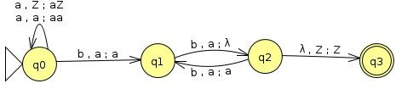
Deterministic Pushdown Automata
2.Construct a PDA for language L = {a^{n}b^{2n} | n≥1}
Solution : Two ways of solving the above language
For every 2 b’s pop one a

Slide 3
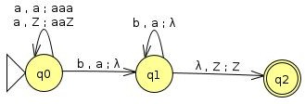
Deterministic Pushdown Automata
Solution:
Push 2 a’s by encountering one a

Slide 4

Deterministic Pushdown Automata
3.Construct a PDA for language L = {a^{n}b^{2n+1}| n≥1}
Solution :

Slide 5
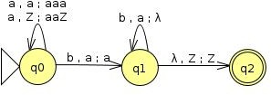
Deterministic Pushdown Automata
4.Construct a PDA for language L = {a^{n}bb^{n} | n≥1}
Solution :

Slide 6
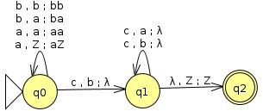
Deterministic Pushdown Automata
5.Construct a PDA for language L = {a^{n}b^{m}c^{m+n} | m,n≥1}
Solution :

Slide 7
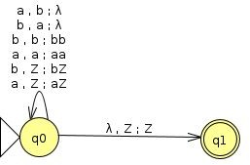
Deterministic Pushdown Automata
6.Construct a PDA for language L={n_{a}(w)=n_{b}(w)) where w ∈ {a,b}}
Solution :

Slide 8
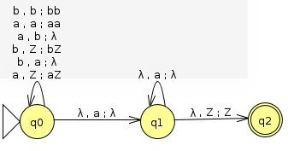
Deterministic Pushdown Automata
7.Construct a PDA for language L={n_{a}(w)>n_{b}(w)) where w ∈ {a,b}}
Solution :

Slide 9
Deterministic Pushdown Automata
7.Construct a PDA for language L={n_{a}(w)>n_{b}(w)) where w ∈ {a,b}}
Solution :

Slide 10
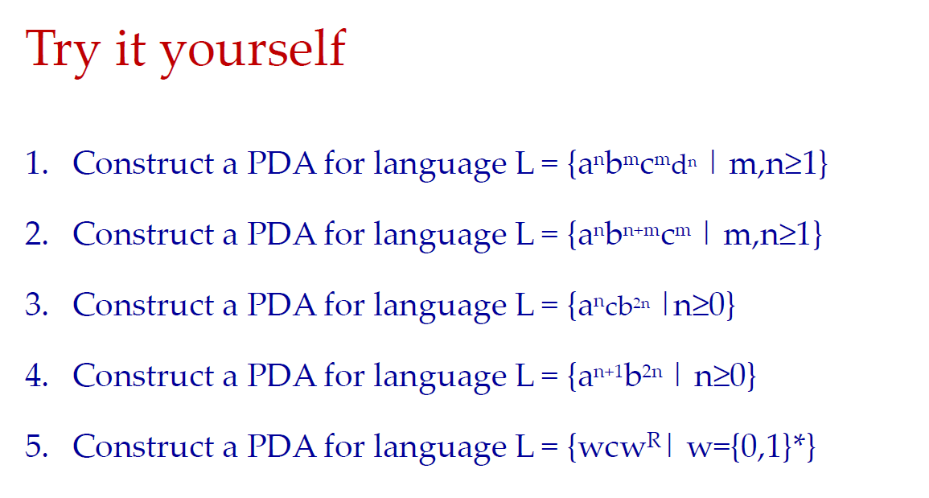
Deterministic Pushdown Automata

